Slide 1

LNG Trade Prospects in the Atlantic Basin
US EIA
National Energy Modeling System
Annual Energy Outlook 2003 Conference
Washington, DC, March 18, 2003
David Nissen
Center for Energy Policy
Columbia University dn2022@columbia.edu
&
Poten & Partners, Inc. www.poten.com

Slide 2

Punchlines
Atlantic LNG -- volume and facilities
  Trade volume will triple by 2010
  Supply – flood of new projects
  Europe import capacity to triple
  Big question – No. American import capacity
Trading and commerce – new markets, new models
LNG significance – supply, liquidity, competition, arbitrage

Slide 3
Volumes and facilities

Slide 4
Atlantic LNG trade -- from 30 Mtpa (1.5 Tcf/y) today to 100+ Mtpa (5+ Tcf/y) by 2010
Atlantic LNG Imports Projected to 2010
100
Europe to 60 MMtpa
  Big growth in Iberia
  Coming growth in France and Italy
  Import facilities and supply
  mostly committed
North America – 40+ MMtpa
  US/Caribbean existing
  terminals at 28MMtpa
  US, Canada, Mexico
  terminals big uncertainty
Brazil
Mexico
New Markets
Caribbean
80
USA
Turkey
Greece
Italy
60
Spain
Portugal
France
Belgium
40
UK
20
0
1965
1980
1995
2010
Source: Atlantic Basin LNG Outlook to 2010, Poten & Partners

Slide 5
New supply
Nigeria (NLNG)and Trinidad
  new grassroots in 1999
  expansions now
  more coming
Committed
  Norway (Snohvit)
  Egypt (Dammieta and Idku)
  RasGas (to Italy), Qatargas (to UK)
Developing
  Algeria
  Africa – Nigeria Brass, Angola LNG, Eq. Guinea
  Venezuela – Mariscal/Sucre
Supply is not resource limited -- for inland market prices above
$3-$3.50/MMBtu, long-run supply curve is flat for a long way

Slide 6
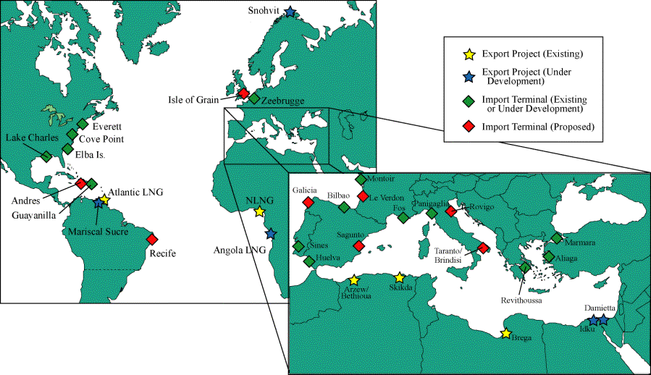
Flood of new European import projects and export projects
Qatar

Slide 7
Big question
-- No. American import terminals
US existing, 4 terminals at 26 MMtpa
New Brunswick (Canada) Chevron/Irving, 4 MMtpa
Bahamas, 3 competing, Tractabel probably ahead, 6+ MMtpa
Florida (BP) ?
LA (Hackberry), Sempra, 10 MMtpa
El Paso offshore “energy bridge”?
Offshore Gulf gravity-based, ChevronTexaco 7-14 MMtpa
Texas coast (Cheniere),3 sites each 4 – 14 MMtpa
Altamira (Mexico) Shell, 4 MMtpa
Could be 70 MMtpa (3.5 Tcf/y) or more by 2010
Big pause – departure of “energy merchants” – Enron, EL Paso, CMS, Dynegy
Big help – Deepwater Act, FERC relax open access/open season

Slide 8
Trading and commerce

Slide 9
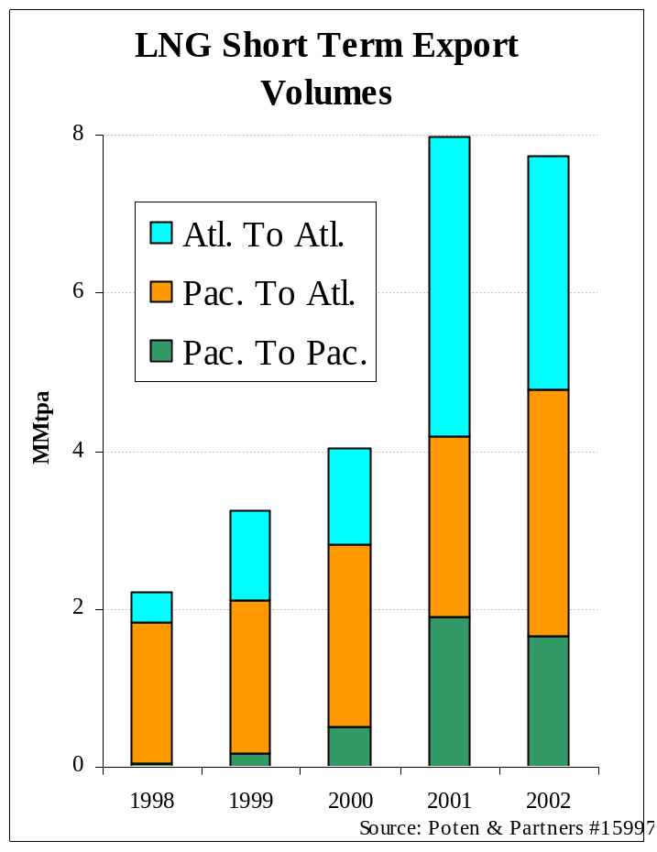
Growing Short-term Supplies
From 2 to 8 MMtpa in 4 years
Asia/Pacific supply largely to Atlantic
Growing Atlantic short-term supply, from new projects in Nigeria and Trinidad

Slide 10
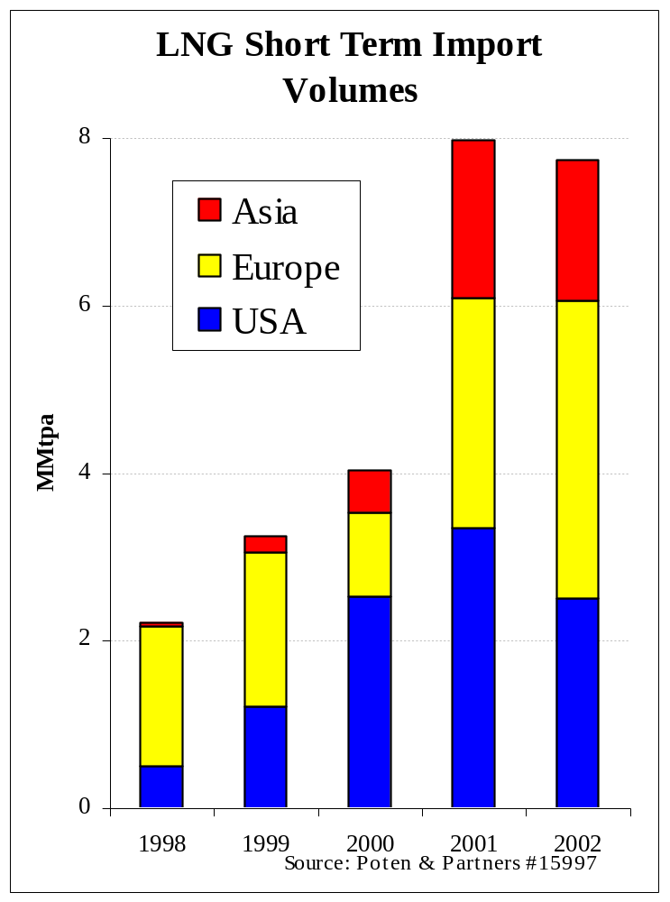
Growing short-term markets
Growing US liquidity offers markets for global spare supply capacity
Shift to Europe in 2002 reflects opportunistic exploitation of oil-based prices
Asia import mostly Korea reflecting winter shortfall and stalled long-term contracting

Slide 11
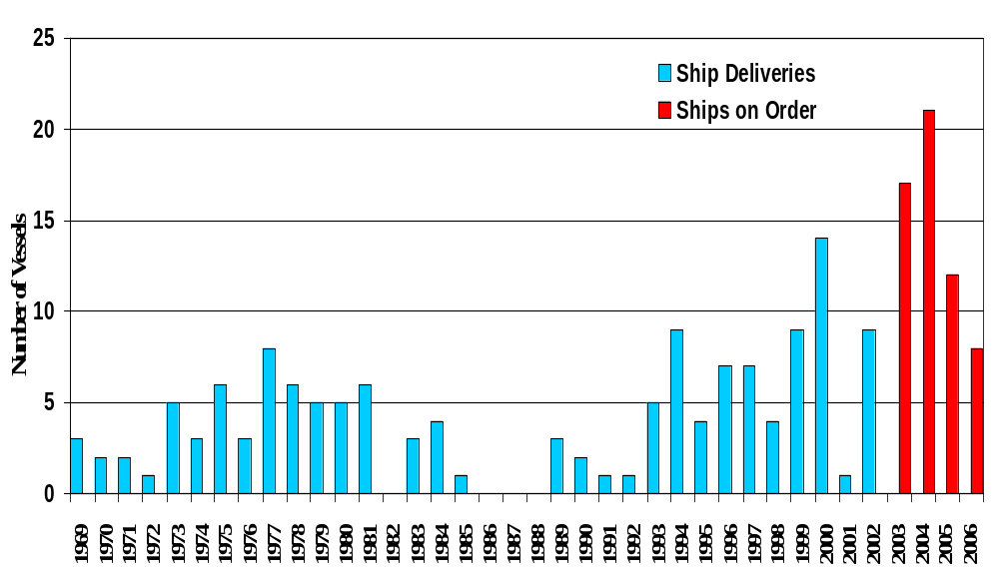
Aggressive expansion of the LNG Fleet…
74,000m3 and above (end 2002)
Of 58 orders (+ 22 options), at least 15 are not employed in LT trades

Slide 12
Significance

Slide 13
Why now?
LNG supply business changed
  Project costs down by 50% due to scale and design efficiency
  Since 1996, supply projects commit with part of capacity unsold
  Flood of shipping with – with some for trading
Deepening Atlantic gas markets
  Transparent, liquid US market
  Europe -- deregulation/open access, demand-side dash to gas
Broadened scope of LNG market
  Proliferations of supplies and uncommitted capacity
  Proliferation of import markets

Slide 14
Implications
LNG supply, at 5+Tcf/y by 2010 becomes significant
LNG competition will affect continental gas pricing
  In Europe where long-term contracts are now indexed to oil
  In USA, where adequate P/L supply is uncertain
LNG arbitrage is the only physical mode for continental gas/electricity value – embedded “real option” value in trading chain
LNG merchant traders emerge with supply, import capacity, and shipping for trading – Shell, BP, BG, and Tractabel
Atlantic LNG – the emerging “nexus” energy market

