Slide 1
Airport Capacity Benchmarks
Trends and Issues in Airport Utilization
William J. Swedish
Thomas P. Berry, Jr.
18 March 2003
Presentation to the
Annual Energy Outlook 2003 Conference

Slide 2
Objectives of Benchmarks
“We need a set of capacity benchmarks to understand the impact of airline scheduling and what relief can realistically be provided by the ATC modernization effort, new controller procedures and new ground infrastructure in the near and longer term.”
  Kenneth Mead, DOT Inspector General
  Hearing of the Senate Commerce, Science and Transportation Committee, 14 September 2000

Slide 3
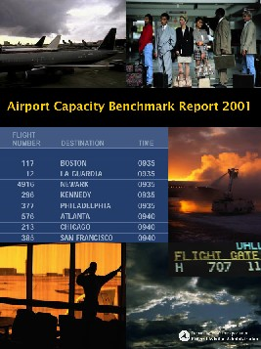
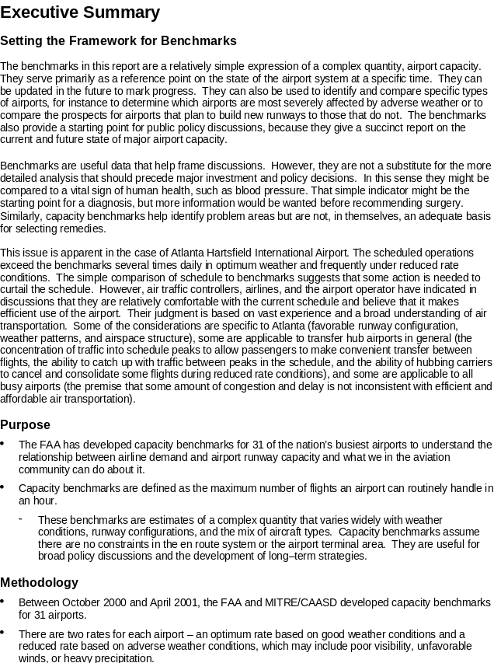
Capacity Benchmark Report
Methodology
• Between October 2000 and April 2001, the FAA
and MITRE/CAASD developed capacity benchmarks
for 31 airports.

Slide 4
Description of Benchmarks
Benchmarks are a starting point for public policy discussions
Benchmarks are a sustainable level of operations for the given conditions
  Can be exceeded occasionally
  Lower rates can be expected if conditions are worse
Two Benchmark rates per airport
  Optimum Rate – best weather and runway configuration
  Reduced Rate – most commonly used configuration in adverse weather
Capacity benchmarks combined actual data and computer models

Slide 5
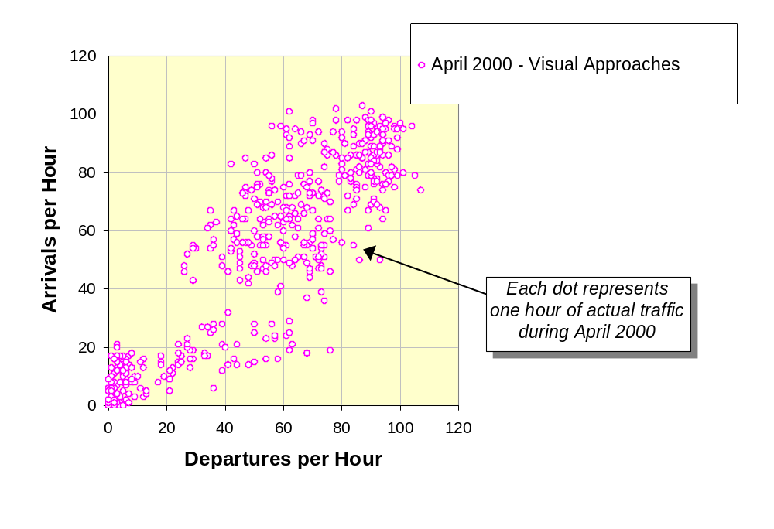
Example of Methodology – Atlanta (ATL)
Step 1. Use operational counts (FAA data) to determine actual hourly throughputs

Slide 6
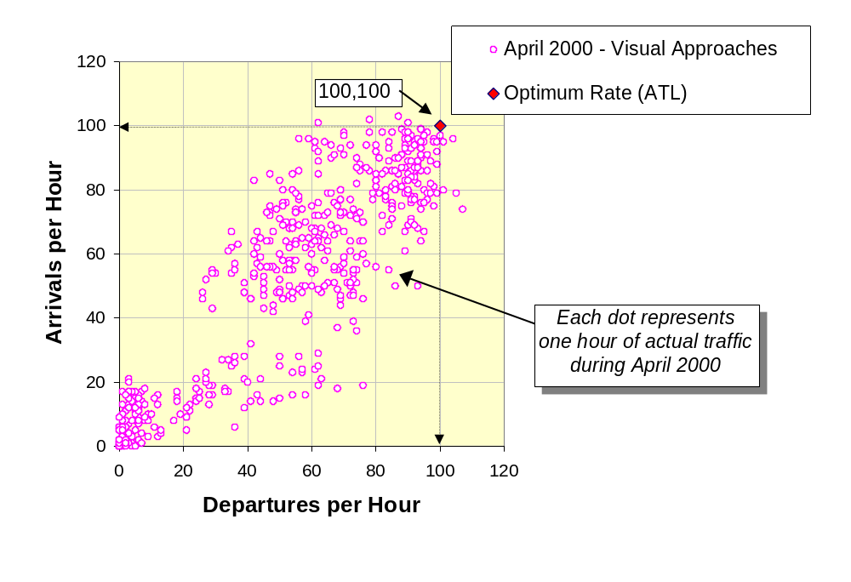
Example of Methodology – Atlanta (ATL)
Step 2. Compare to rates reported by facility

Slide 7
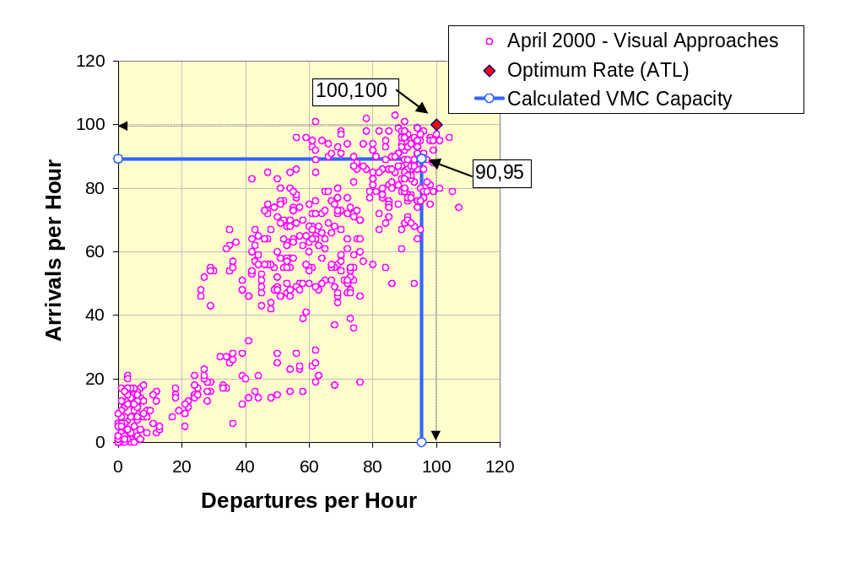
Example of Methodology – Atlanta (ATL)
Step 3. Calculate capacity for the reported operations
Estimated using Enhanced Airfield Capacity Model
(E-ACM)

Slide 8
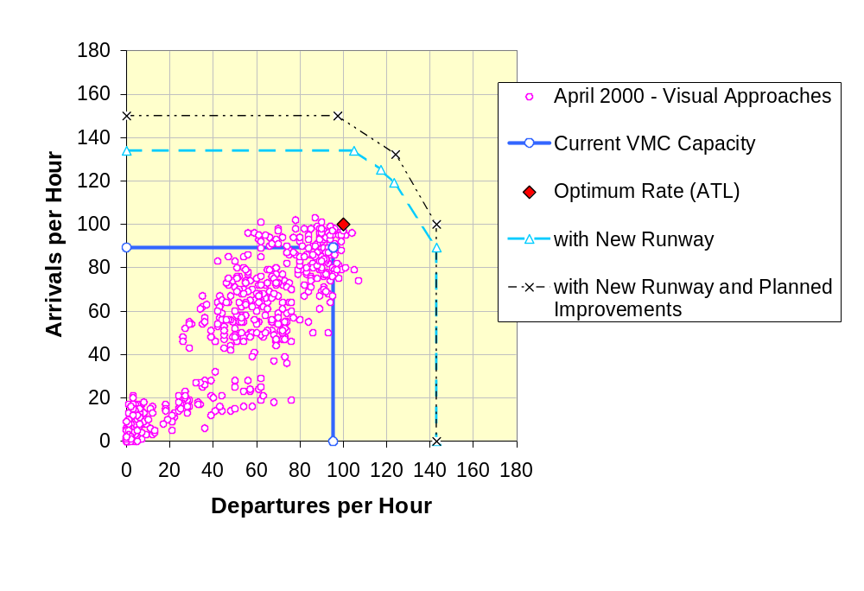
Example of Methodology – Atlanta (ATL)
Step 4. Use calibrated model to develop future capacities for new runways, procedures, technology

Slide 9
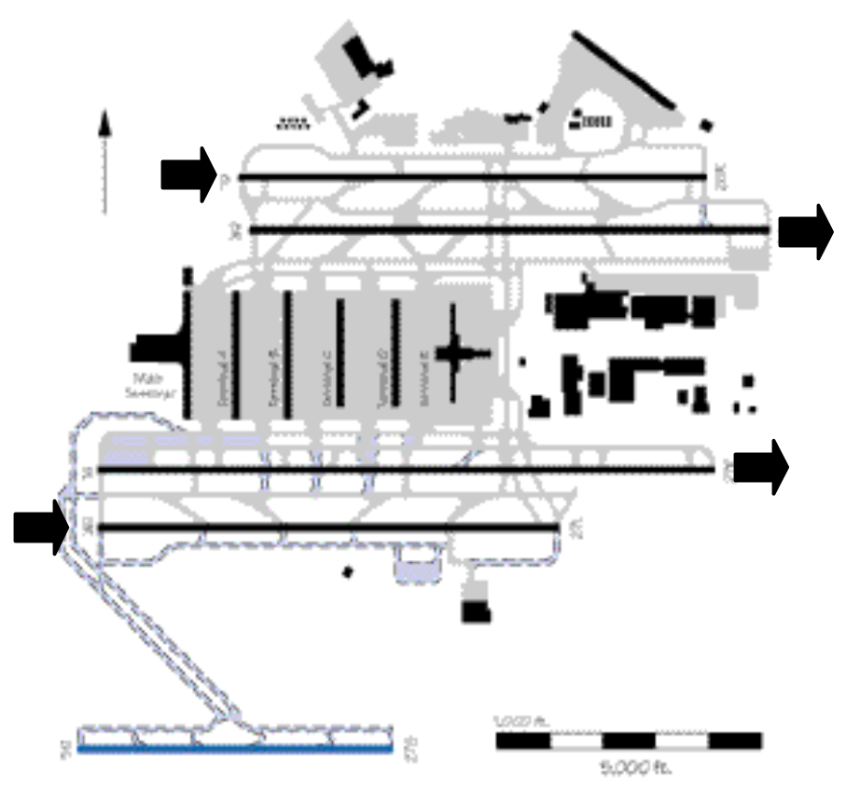
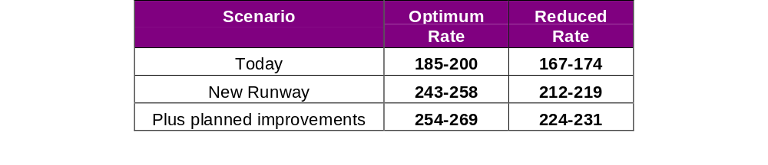
ATL Benchmark Summary
New runways and other improvements will increase capacity

Slide 10
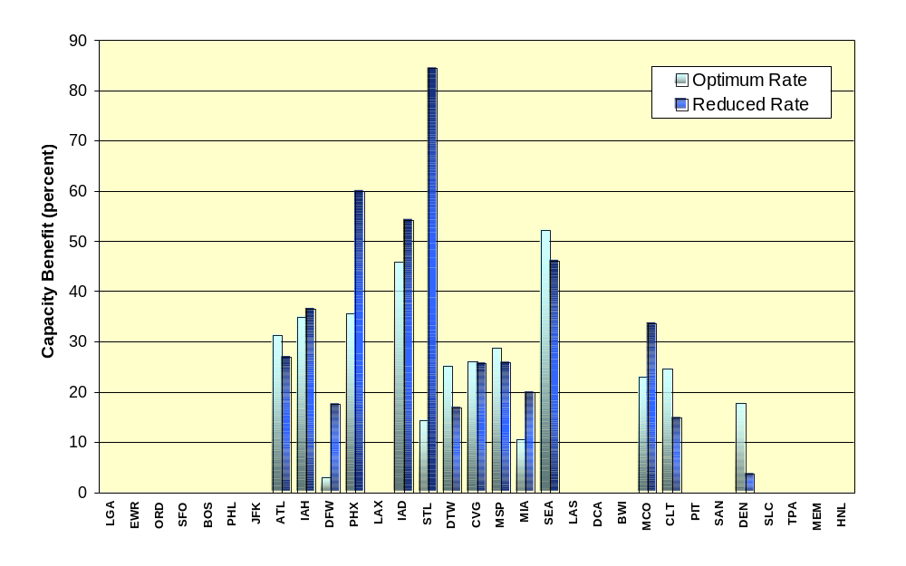
Benefit of a New Runway Depends on Current Configuration, Use of New Runway
Airports ordered by average delay (CY2000)

Slide 11
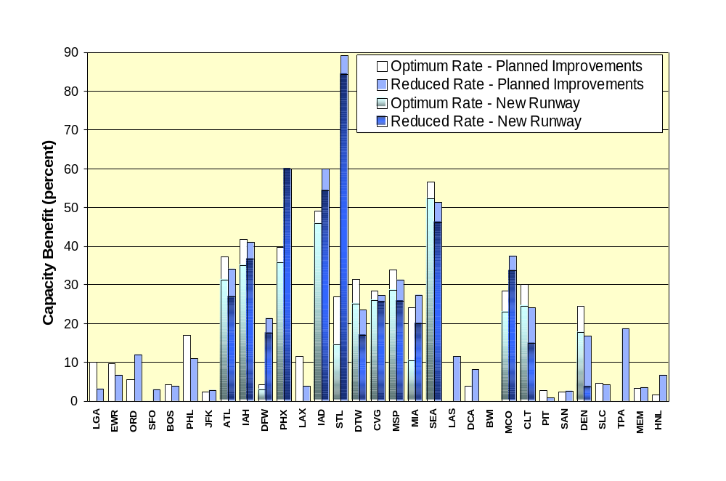
Technology and Procedural Improvements Provide Benefit of 0–17 Percent
Airports ordered by average delay (CY2000)

Slide 12
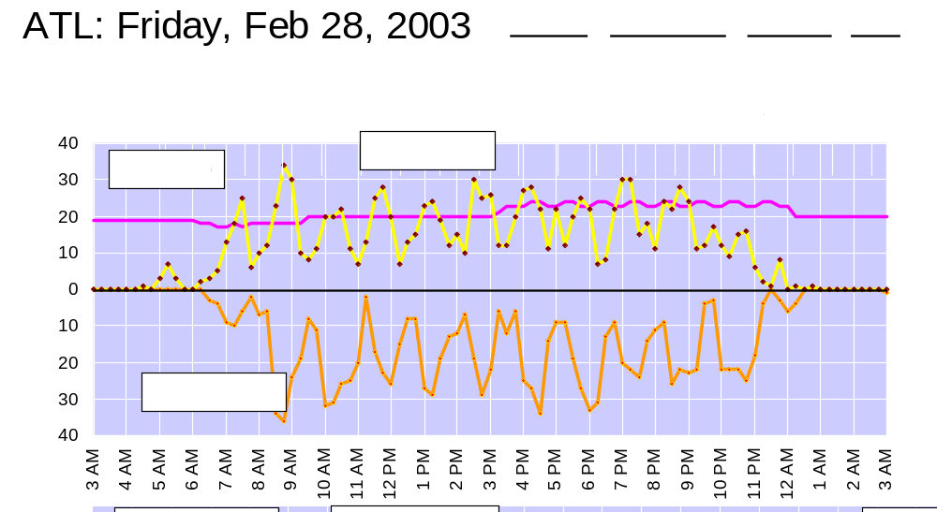
Actual operations are limited by airport capacity

Slide 13
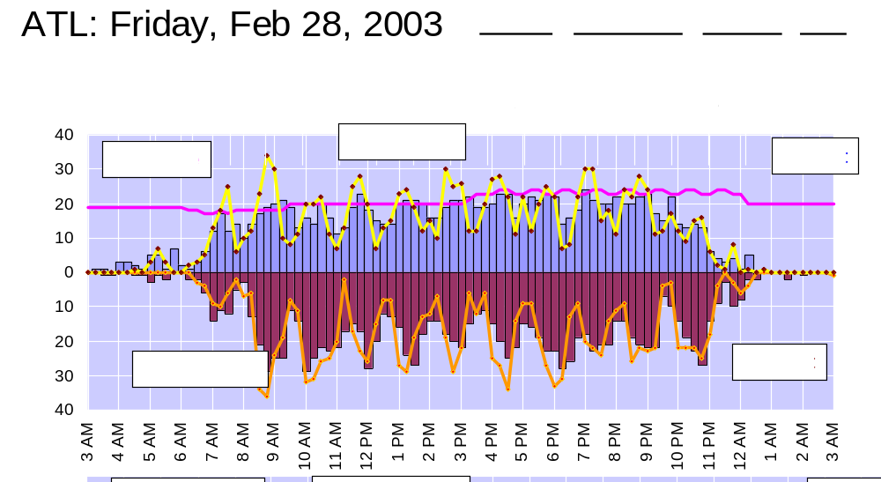
Actual operations are limited by airport capacity

Slide 14
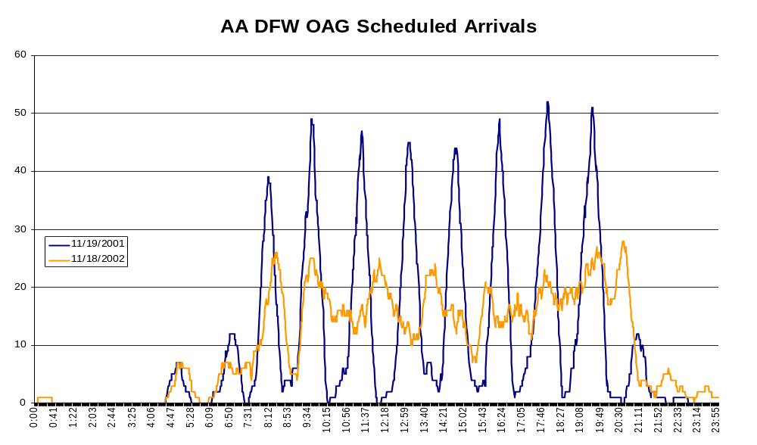
Airlines are Adjusting Schedules in Response
American’s DFW Rolling Hub
Notes:
Understanding external factors that affect airline service providers is part of evaluating any capacity strategy.

Slide 15
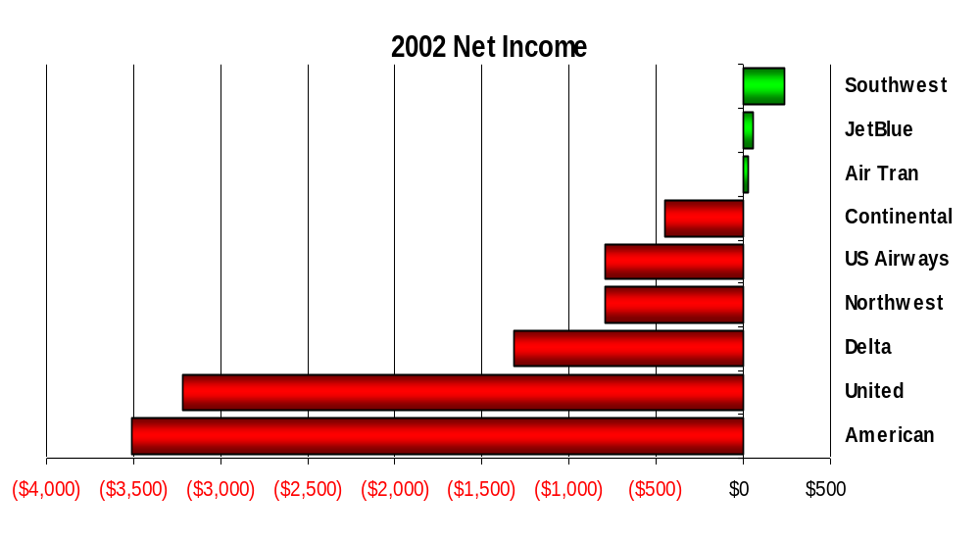
Changes in Demand
Network carriers have lost a record $15 billion in the past 24 months, while the low cost carriers remained profitable

Slide 16
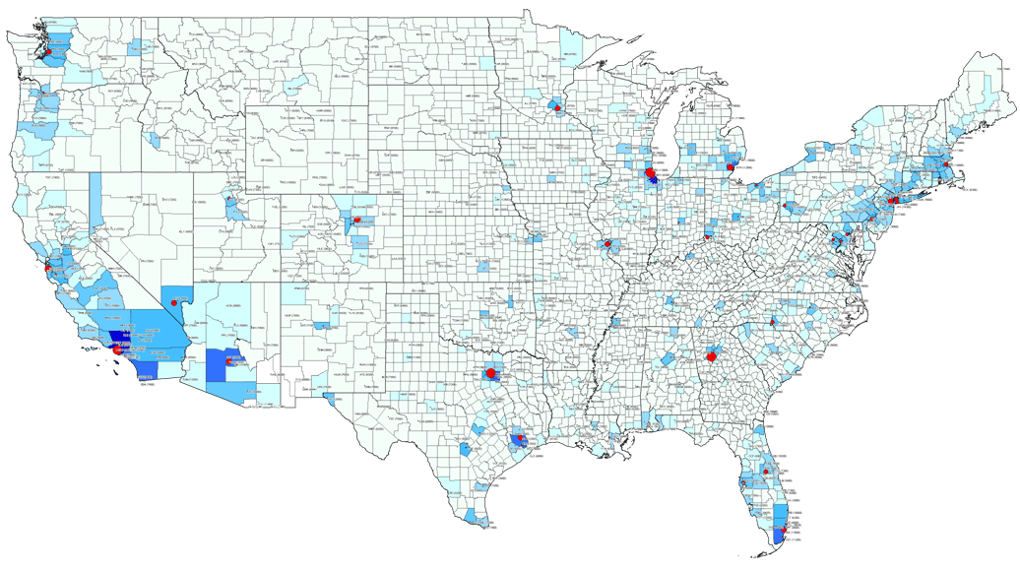




Low Cost Carriers Frequently Use Secondary Airports in Major Markets
MHT
MDW
PVD
OAK
ISP
BWI
SJC
BUR
ONT
LGB
DAL
SNA
HOU
1980
1985
1990
1995
2000
2002
PBI
FLL

Slide 17




Metropolitan Areas Continue to Grow
Increased Secondary Traffic
HPN
ISP
MMU
TEB
LGA
FRG
More RJ’s, less peaky hubs
JFK
EWR
Some Bizjets

Slide 18
Expect Traffic to Change in the Following Ways
More flights by low cost carriers as they leverage their cost advantages
More flights by regional jets operated by regional airlines as network carrier transfer routes
Some business jets and fractional or on-demand traffic increases
A more diverse set of users with more evenly distributed influence

Slide 19
Volume Will Return but with Changes in its Distribution
Airports
  Major airports may reach capacity limits
    Even though planned improvements will increase capacity
    New runways, where possible, provide largest increase
  Secondary airport growth in major metropolitan areas
  Fewer hubs as airlines restructure
  Rolling, less peaky hubs will become standard practice

