Slide 1

Facilitating Infrastructure Development: A Critical Role for Electric Restructuring
Russell J. Tucker
Manager, Public Policy and Analysis
Edison Electric Institute
National Energy Modeling System/Annual Energy Outlook Conference
March 18, 2003

Slide 2

The Real Questions?
What does it take to provide low cost, reliable electricity?
Can we finance the next round of generation and transmission.
Can we harmonize the goals of the Federal Energy Regulatory Commission (FERC) with State Commissions in support of new infrastructure investment?

Slide 3
Low Cost, Reliable Electricity Requires:
Adequate generating and demand side resources.
    Viable spot market.
    Long-term contracting.
    Trading to manage risk.
Market rules and regulations that allow markets to function efficiently.
A strong energy delivery system.

Slide 4
Stable Demand, Cyclical Supply
1,000,000
45%
Reserve Margin
Installed Capacity
900,000
40%
800,000
35%
700,000
30%
600,000
25%
500,000
Reserve
Margin
MW
20%
400,000
Peak
15%
300,000
200,000
10%
100,000
5%
0
0%
1970
1975
1980
1985
1990
1995
2000
2005
Source: NERC, RDI NewGen, NEG analysis

Slide 5
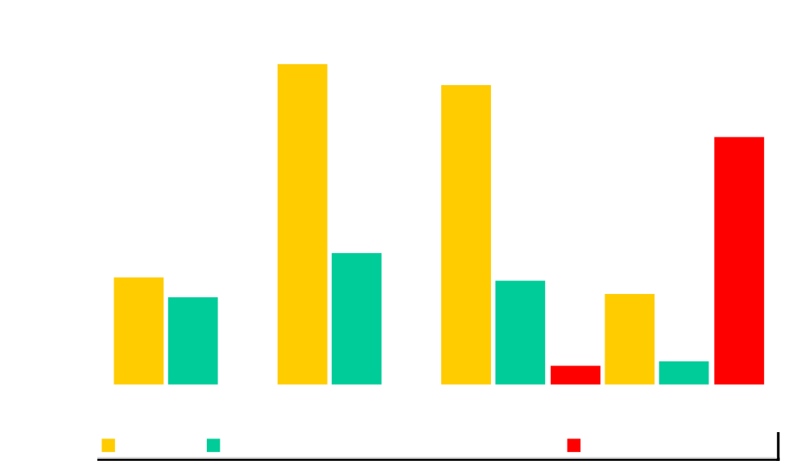
New Generating Capacity
Increased Cancellations
*Through November 2002.
Source: Energy Info Source New Plant Construction Report . November 15, 2002.

Slide 6
The Viability of Trading Business
Severe reduction in energy trading activity (down 70+%).
Major parties exiting the trading business.
Enron model – investigations.
Market credibility.
Counter-party credit risk.
Role of financial institutions.

Slide 7
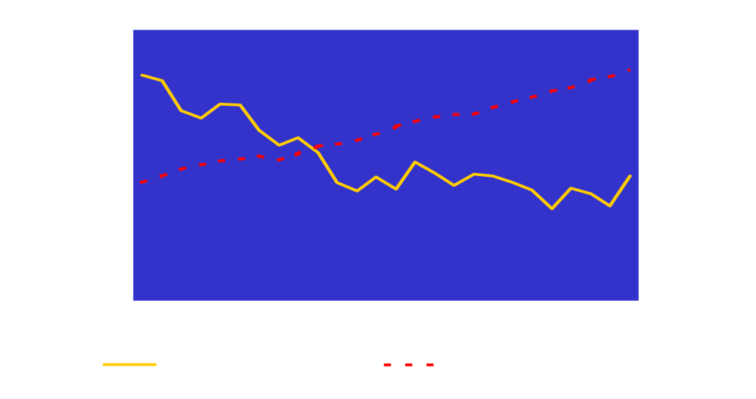
Transmission Investment Has Not Kept Pace With Electricity Demand
+67 billion kWh/year
2001 million $
Billion kilowatt-hours
-$103 million/year
Sources: 2001 EEI Construction Survey (Note: Data represents Shareholder-owned electric utilities.)
Table 8.5 Electricity End Use, (1949-2001). EIA Annual Energy Review.

Slide 8
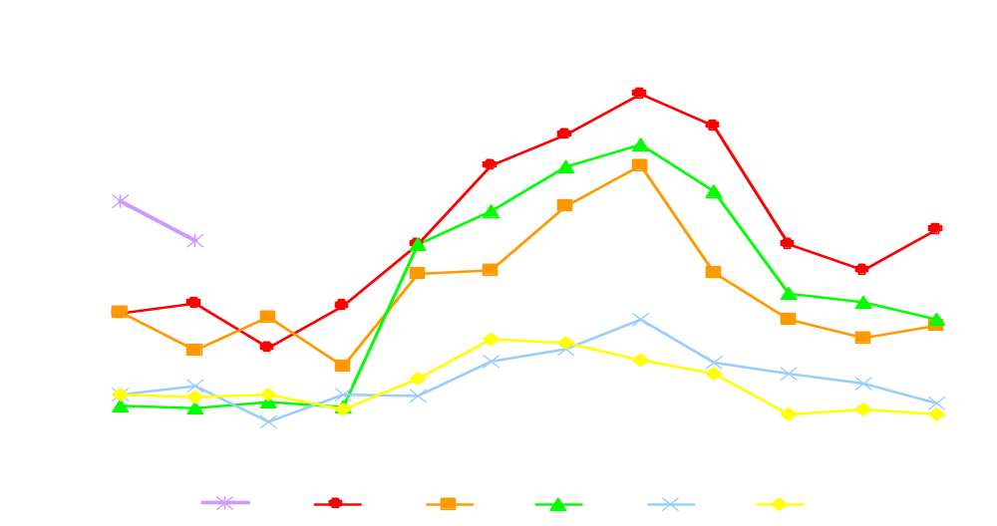
Congestion on Transmission Lines
Has Increased
Level 2 or higher TLRs
Source: NERC Transmission Loading Relief Procedure Logs

Slide 9

Can We Finance the Next Round of
Generation and Transmission?

Slide 10
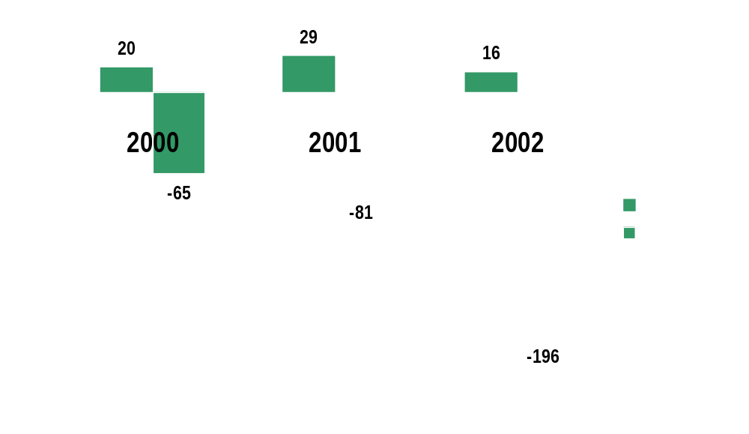
The Industry –
Doing the “Electric Slide”
Credit Rating Actions 2000-2002
2002 Downgrade to Upgrade Ratio of 12+:1

Slide 11
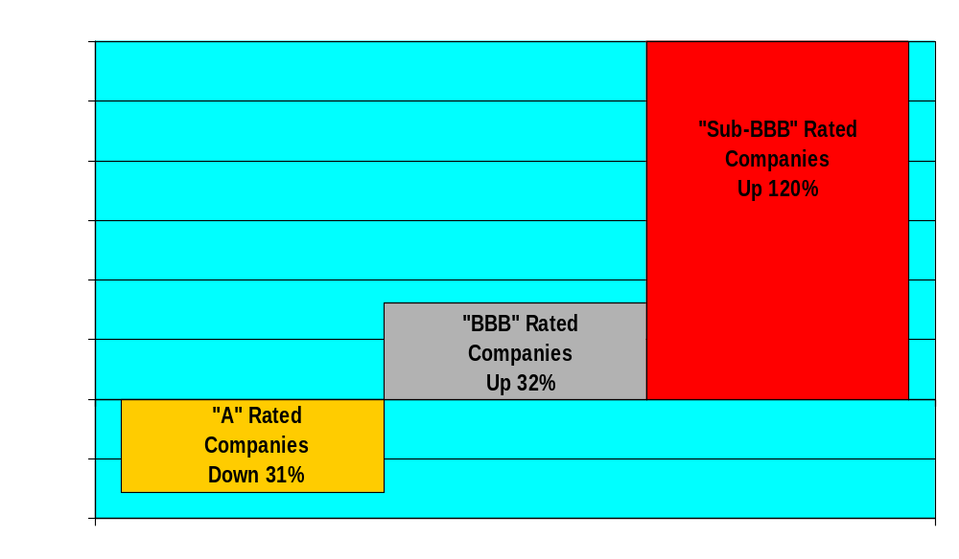
Credit Rating Changes
2000-2002

Slide 12
Companies are Responding
Making more comprehensive financial disclosures.
A Guide To Improving Financial Information and Energy Trading Disclosure for the Electric Industry
Restating financial statements.
Raising equity capital / announcing assets for sale.
Negotiating terms with banks.
Canceling acquisitions and new construction.
Curtailing or exiting energy trading and marketing.
Changing senior management and evaluating the Board.

Slide 13
Will SMD Improve
Infrastructure Investment?
SMD proposal seeks to “regionalize” transmission planning and resource adequacy.
Enormous Independent Transmission Provider (ITP) role: transmission planning + resource planning on a regional basis.
Regional State Advisory Committee (RSAC) provides formal advisory role for state representatives.

Slide 14
Resource Adequacy Requirement
The SMD Proposal
  Spot market prices that are subject to mitigation measures may not produce an adequate level of infrastructure investment.
  ITP forecasts regional demand, helps determine adequate level of resources with RSAC and assigns each LSE a share of resource requirement.
  ITP assesses monetary penalties and curtailment penalties if LSEs don’t meet resource requirements.
Issues
  Curtailment not technically feasible.
  Not clear that proposed financial penalties sufficient to eliminate incentives to “free-ride”.
  No basis to translate LSE’s obligation into transparent economic signals.
  Need to address retail load migration.
  Provide regions with broad latitude to develop workable resource adequacy programs.

Slide 15
Transmission Planning
The SMD Proposal
  SMD proposes RFP driven regional planning process for competition among generation, transmission and demand response.
  Integrated transmission utilities are builders of last resort.
  FERC recently indicated this proposal would not be in final rule.
  States provide non-binding input into ITP planning process through Regional State Advisory Committee (RSAC).
Issues
  Top down, ITP-driven, all-source bidding approach risks continued under-investment in transmission.
  Transmission owners should not be last resort option. Use all options to get transmission built: Integrated utilities, ITCs, and Merchant Transmission.
  FERC needs to recognize states’ decisional role and states need to recognize evolution to regional markets.

Slide 16
Transmission Pricing Policy Proposal
Relies on “carrot” mechanisms rather than prescriptive “stick” mechanisms to achieve transmission independence.
  FERC Transmission Pricing Initiative (issued January 15th)
    Additional equity percentage points for –
      Transfer operational control to RTO – 50 basis points.
      ITCs that are part of an RTO – 150 basis points.
      Efficient grid expansion and operation – 100 basis points.
EEI’s concern --
  Policy narrowly focuses on complete divestiture as the primary vehicle for getting higher returns and has not adequately recognized utilities that are turning operational control but not ownership over to regional transmission organizations.

Slide 17
Common Regional Views on SMD
Everyone likes some elements - no one supports SMD as released.
No support favoring opening state retail markets that are not already opened.
Regional differences require regional approaches.
Erosion of state role in resource adequacy, transmission planning, pricing.
Regions should accept responsibility for regional market design, using their own processes or regional institutions.
FERC should set flexible, regional implementation schedule.

Slide 18
Unique Regional SMD Concerns
Mid-Atlantic
  Don’t use PJM as a “living laboratory” for untested market design.
Western
  Majority transmission system owned by non-jurisdictional entities.
  Primarily hydro based system.
  Conflict with existing regional entities.
Southeastern
  Lack of confidence in cost effectiveness of FERC NOPR.
  Funding - “Rolled in” versus “Participant” funding , Regional cost shifting.
  Native load priority.

Slide 19
Unique Regional SMD Concerns
Mid-America
  Regional mechanism desirable, but not additional layer of regulation.
  Favor regional certificate of need for use in state action.
New England
  Flexibility needed – don’t disrupt current progress.

Slide 20
Summary
We must restore investor confidence among investors and the investment community – so they will want to invest again.
We must ensure that the rules of competition still being written are done so and applied in ways that provide the flexibility and incentives needed to ensure a strong, reliable system.
We must move FERC and the states to a regional process for transmission planning and resource adequacy that both recognizes a decisional role for states and supports FERC’s efforts to improve wholesale markets.

