Slide 1

Energy and Technology Perspectives:
Insights from IEA modelling
Fridtjof Unander
Carmen Difiglio
Energy Technology Policy Division
International Energy Agency
INTERNATIONAL ENERGY AGENCY
AGENCE INTERNATIONALE DE L’ENERGIE

Slide 2
Overview of Presentation
Highlights from IEA World Energy Outlook 2002.
IEA Energy Technology Perspectives Project: Investigating the role of technologies in future energy markets.
INTERNATIONAL ENERGY AGENCY
AGENCE INTERNATIONALE DE L’ENERGIE

Slide 3
World Energy Outlook 2002
Two Scenarios analysed
Reference Scenario:
A baseline vision of how global energy markets might evolve up to 2030 if governments do nothing more than what they have already committed themselves to do.
Alternative Policy Scenario:
Analyses impact of new policies & measures being considered by OECD countries on energy use & CO₂ emissions.

Slide 4
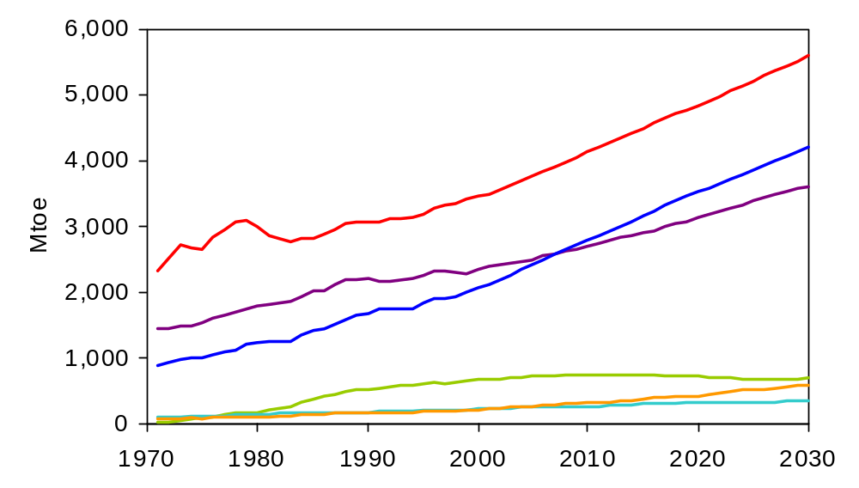
World Primary Energy Demand
Reference Scenario
Oil
Natural gas
Coal
Hydro power
Nuclear power
Non-hydro renewables
Gas grows fastest in absolute terms & non-hydro renewables
fastest in % terms, but oil remains the dominant fuel in 2030

Slide 5
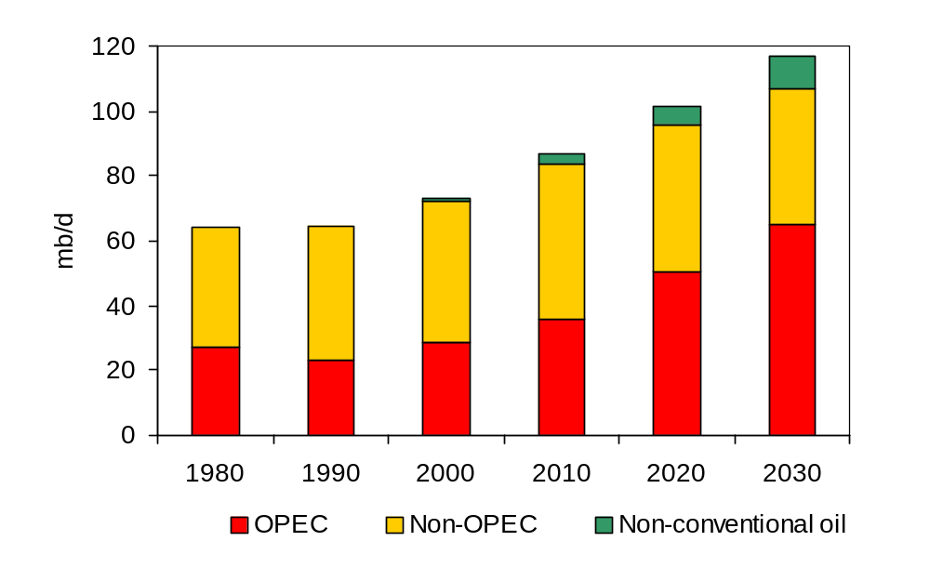
World-Oil Production
Non-conventional oil emerges as a major new source

Slide 6
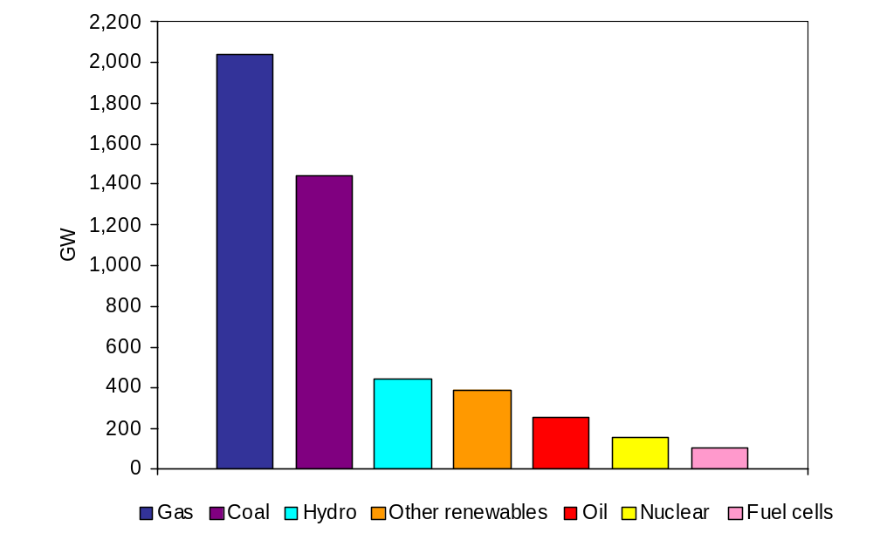
World Power-Generation Capacity Additions, 2000-2030
More than 40% of new capacity worldwide is gas-fired

Slide 7
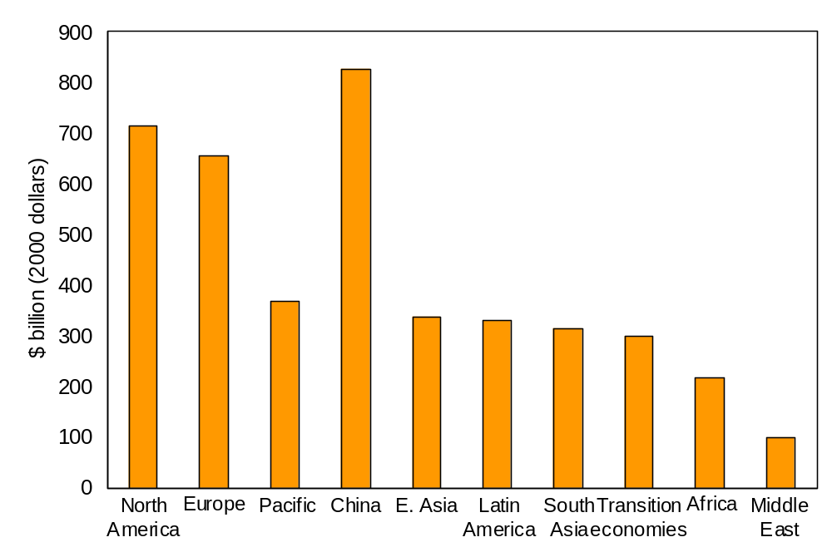
World Power-Generation Investment, 2000-2030
Cumulative worldwide investment in new power plants amounts
to $ 4.2 trillion, more than half in developing countries

Slide 8
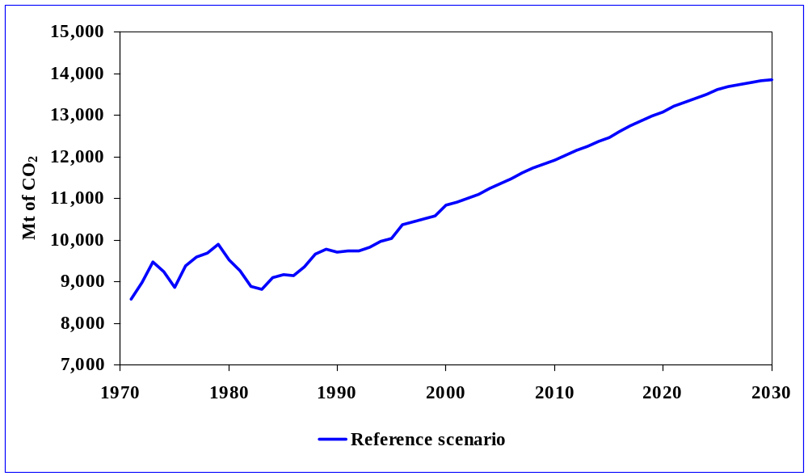
OECD CO₂ Emissions
Reference Scenario
OECD Reference Scenario emissions increase by
almost 1% per year between 2000 and 2030
Notes:
Emissions fall more than energy use, because of the
added impact of fuel switching to less carbon-intensive fuels

Slide 9
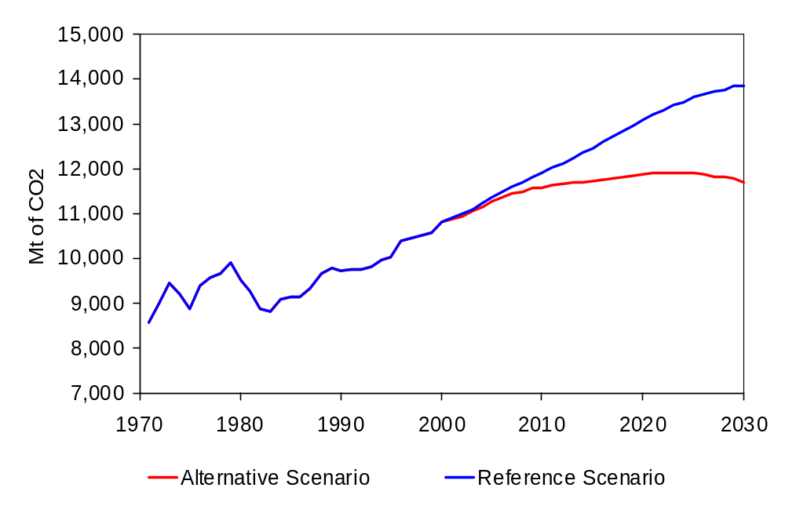
OECD CO₂ Emissions
Reference and Alternative Scenarios
Notes:
Emissions fall more than energy use, because of the
added impact of fuel switching to less carbon-intensive fuels

Slide 10
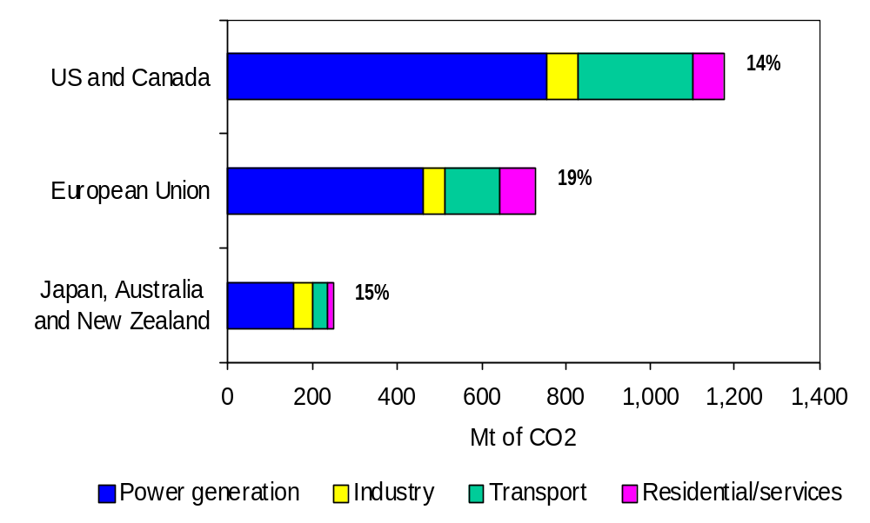
CO₂-Emission Reductions in Alternative Scenario (2030)
Reduction in Emissions Compared to Reference Scenario

Slide 11
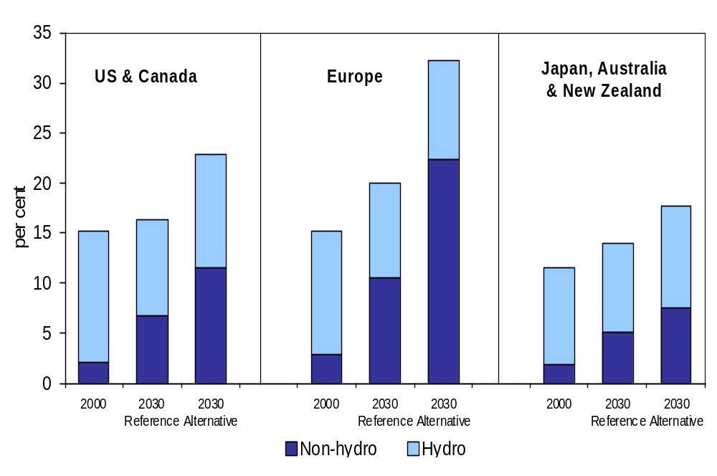
Share of Renewables in Electricity Generation

Slide 12
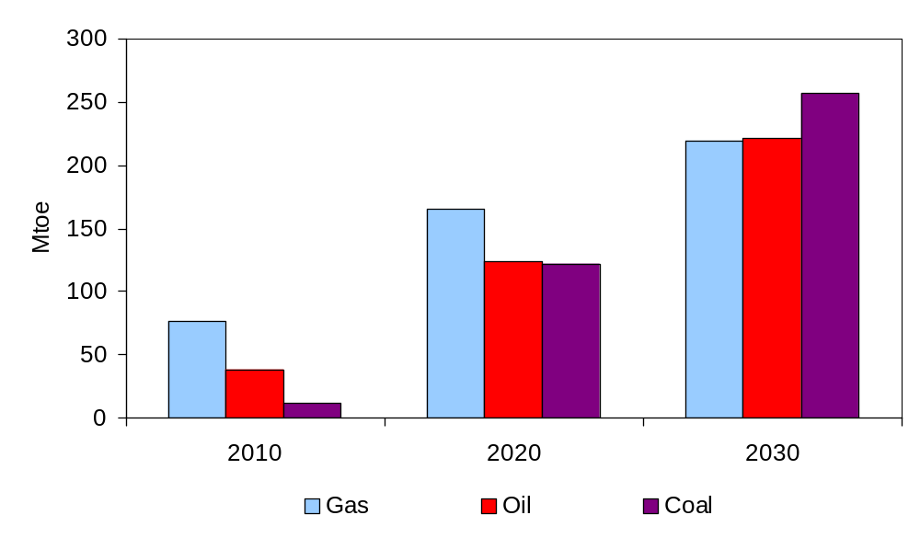
Fossil-Fuel Savings in the Alternative Scenario
Reduction in Primary Energy Use Compared to Reference Scenario
Energy savings would be 9% of projected demand
in the Reference Scenario in 2030

Slide 13
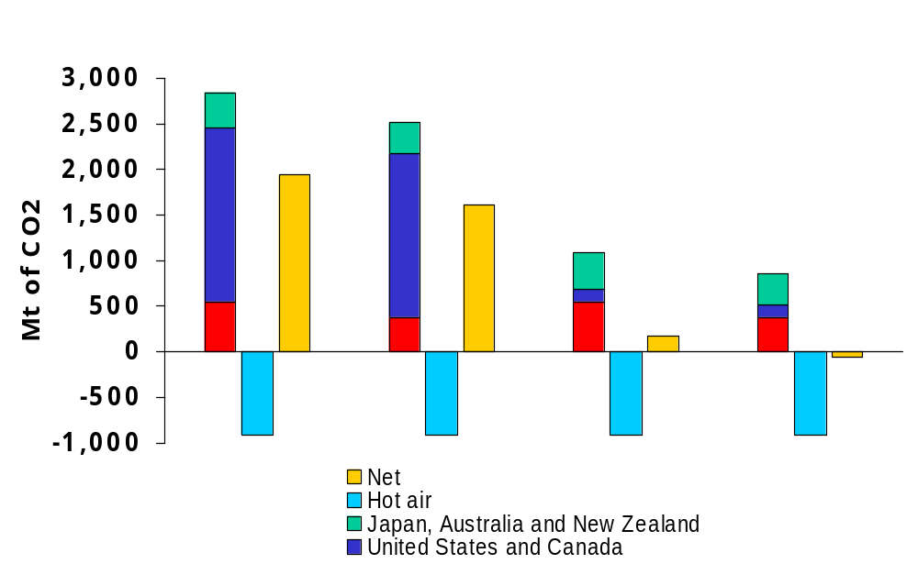
Bridging the Kyoto Gap
Reference with US
Alternative with US
Reference without US
Alternative without US
Emissions in each OECD region would still be above target,
but “hot air” would fill the gap if the US is excluded

Slide 14
Central Findings of WEO 2002
Unless policies change, energy demand will continue to grow steadily.
Most of the growth in demand will come from developing countries.
Fossil fuels will continue to dominate the energy mix.
Policy challenges:
  Security of energy supply
  Uneven access to commercial energy
  Increasing emission levels
  Infrastructure investment

Slide 15
Policy Challenges
Technology the solution?
Technology development poses both uncertainties and opportunities for long-term energy markets.
Examples;
  oil recovery
  non-conventional oil
  carbon capture and storage
  hydrogen
  fuel cells
Driving factors;
  R&D
  Deployment - learning effects
Opportunities for government actions.
INTERNATIONAL ENERGY AGENCY
AGENCE INTERNATIONALE DE L’ENERGIE

Slide 16
IEA Project:
Energy Technology Perspectives
Studies how governmental actions can bring about changes needed to meet energy policy goals.
Main tools are a global energy technology model (MARKAL) and a technology database.
Provides IEA with analytical capacity to better address how technology can impact energy markets.
Provides input to several IEA projects and the World Energy Outlook.
Co-ordinated with IEA Economic Analysis Division.
INTERNATIONAL ENERGY AGENCY
AGENCE INTERNATIONALE DE L’ENERGIE

Slide 17
Total Energy System Coverage
Primary
energy
Conversion
sectors/processes
Final
energy
Demand
sectors/processes
Useful
energy
Electricity
production
Fossil fuels
Gasoline
Natural gas
Electricity
Coke
Hydrogen
Heat
etc.
Industry
Refineries
Heating
Cooling
Power
Moving
etc.
Coke ovens
Transport
Renewables
Heat
production
Residential/
commercial
Nuclear
Hydrogen
production
INTERNATIONAL ENERGY AGENCY
AGENCE INTERNATIONALE DE L’ENERGIE

Slide 18
Plan for Scenario Analysis
Scenarios reflecting different market conditions will be developed to explore alternate policy paths.
Scenarios will build on WEO-2002 and focus on long-term technology impacts (beyond 2030).
Results of first set of scenarios expected ready fall 2003.
INTERNATIONAL ENERGY AGENCY
AGENCE INTERNATIONALE DE L’ENERGIE

Slide 19
Input to IEA technology studies
The role of carbon sequestration and renewables to reduce emissions from electricity generation.
The impact of technology development in oil and gas exploration and production.
Strategies to meet global transport needs with minimal environmental impacts.
Road map for the development of a H₂ economy.
INTERNATIONAL ENERGY AGENCY
AGENCE INTERNATIONALE DE L’ENERGIE

Slide 20
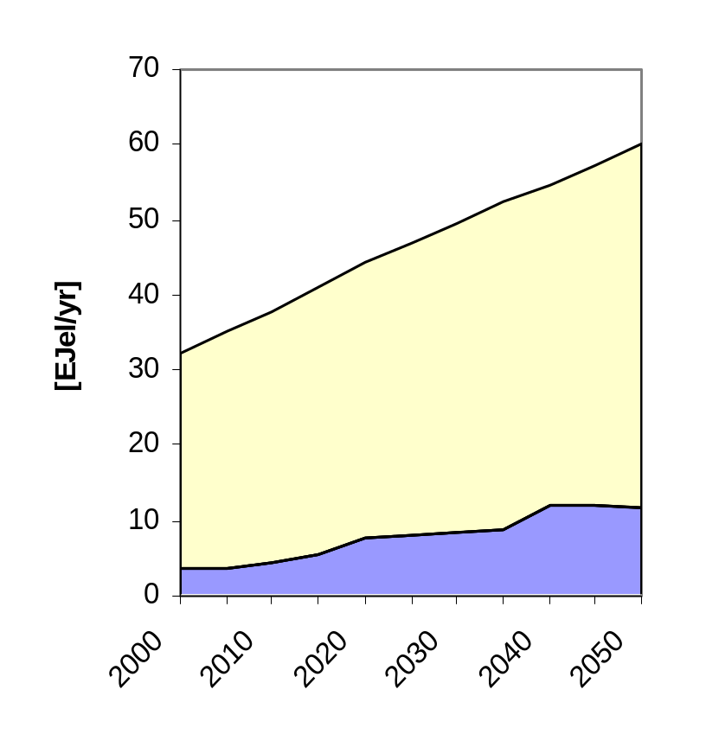
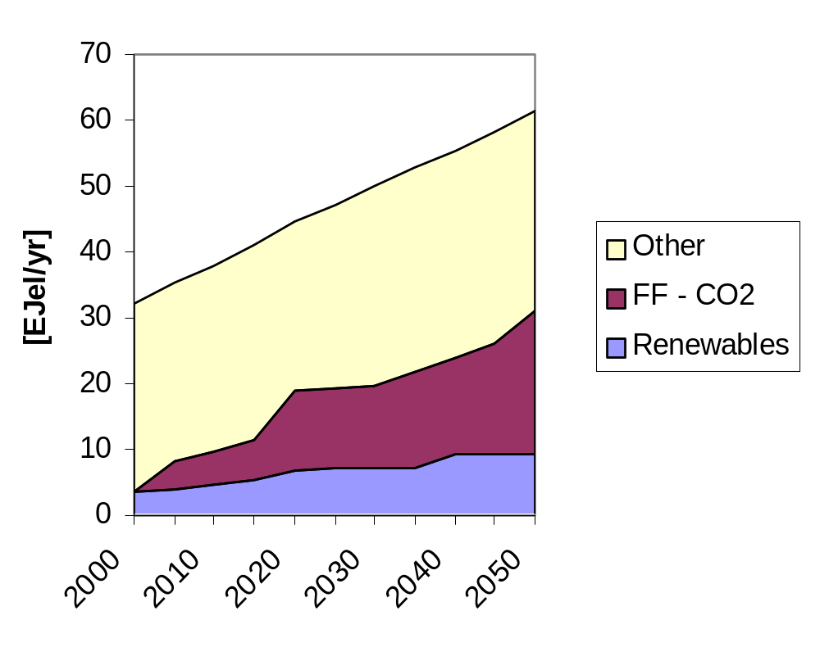
Preliminary ETP results
Example: OECD Electricity output
Role of Renewables and CO2 Capture
INTERNATIONAL ENERGY AGENCY
AGENCE INTERNATIONALE DE L’ENERGIE

