Slide 1
Peaks, Shortages, and Other
Oil Market Myths
Dan Butler
Energy Information Administration
Department of Energy
2005 EIA Midterm Energy Outlook and Modeling Conference
April 12, 2005
Washington, DC

Slide 2
Oil Market Insights?
“The diagnosis of the U.S. energy crisis is quite simple: demand for energy is increasing, while supplies of oil and natural gas are diminishing. Unless the U.S. makes a timely adjustment before world oil becomes very scarce and very expensive in the 1980’s, the nation’s economic security and the American way of life will be gravely endangered.”
1977

Slide 3
Oil Market Insights?
“…there is the common misconception that the world is running out of oil, that it will become more valuable over time and that one should take steps now to preserve it for future generations. [In fact,] oil is being discovered in large quantities and reserves continue to increase faster than consumption…Over the next three to four decades…supply will not be an issue…nor are we likely to see any upward trend in the prices of energy.”
1993

Slide 4
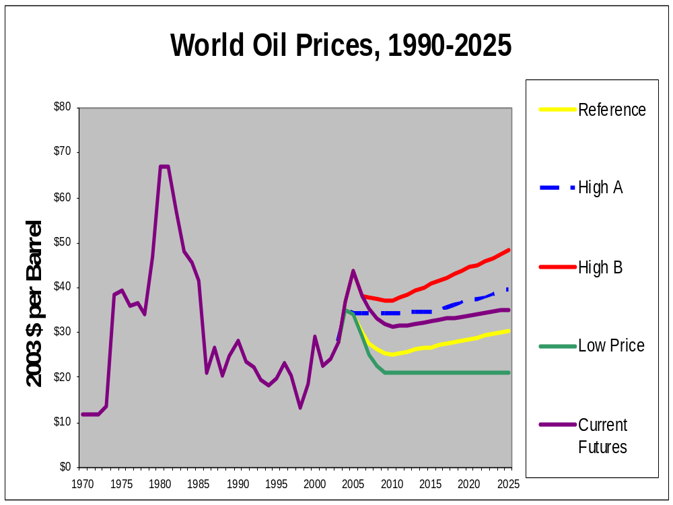

Slide 5
Oil Market Insights?
“…it is unsafe to rest in the assurance that plenty of petroleum will be found in the future merely because it has been in the past.” 1936

Slide 6
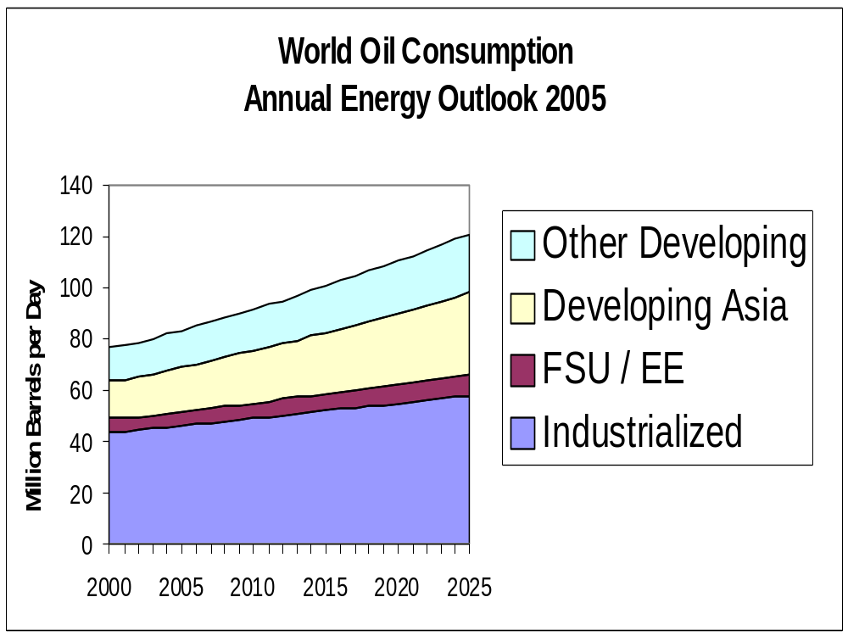

Slide 7
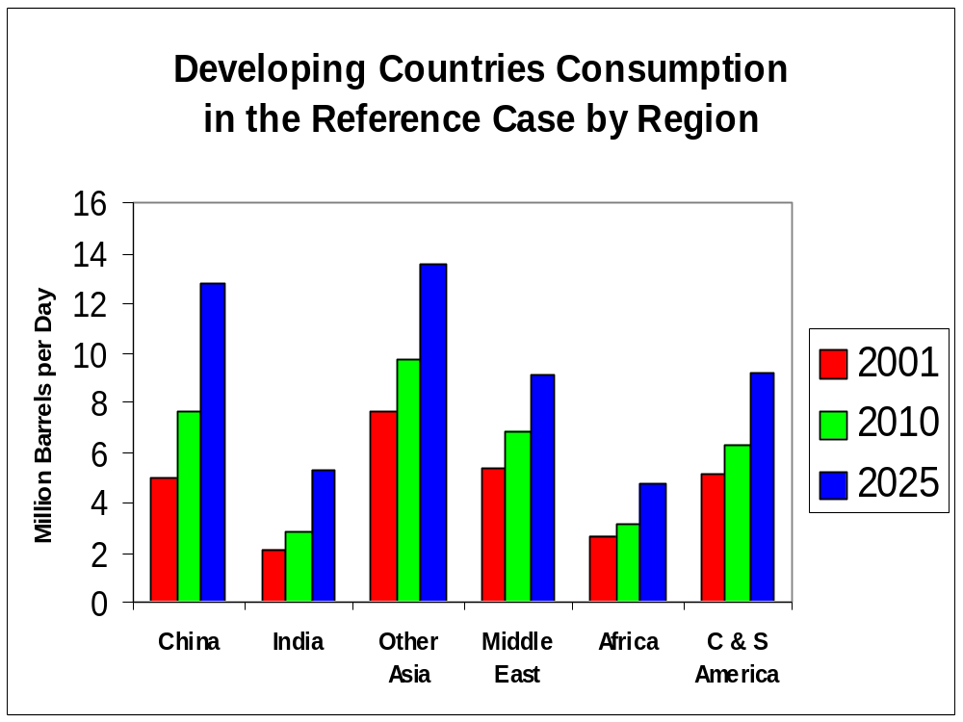

Slide 8
Oil Market Insights?
“…the peak of [U.S.} production will soon be passed – possibly
within three years.”
1919

Slide 9
Oil Market Insights?
“ … Non-OPEC production in the longer term will at best remain stagnant and is more likely to fall gradually due to resource constraints.”
1990

Slide 10
Oil Market Insights?
“ … Higher [resource] numbers are
likely to be quoted and used by
economists and others lacking
insight into the matter…”
1994

Slide 11
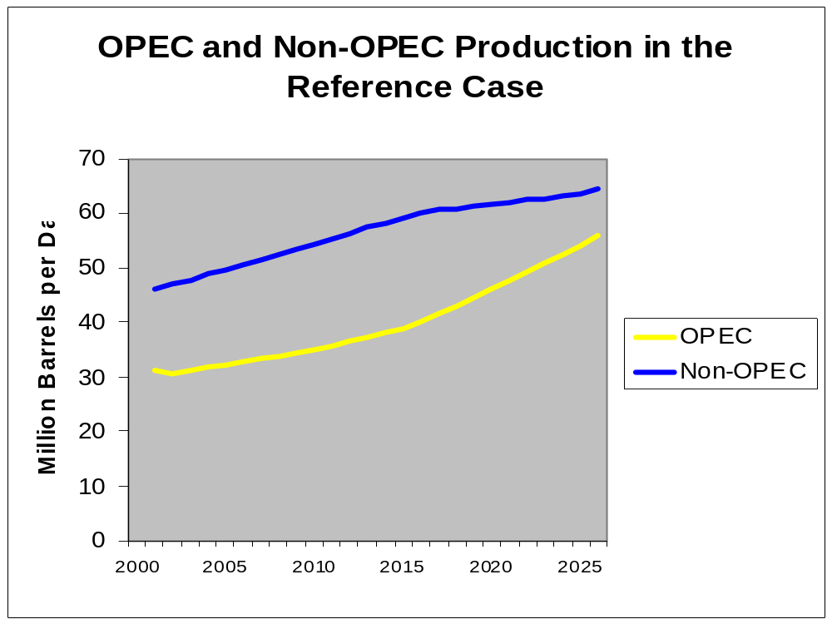

Slide 12
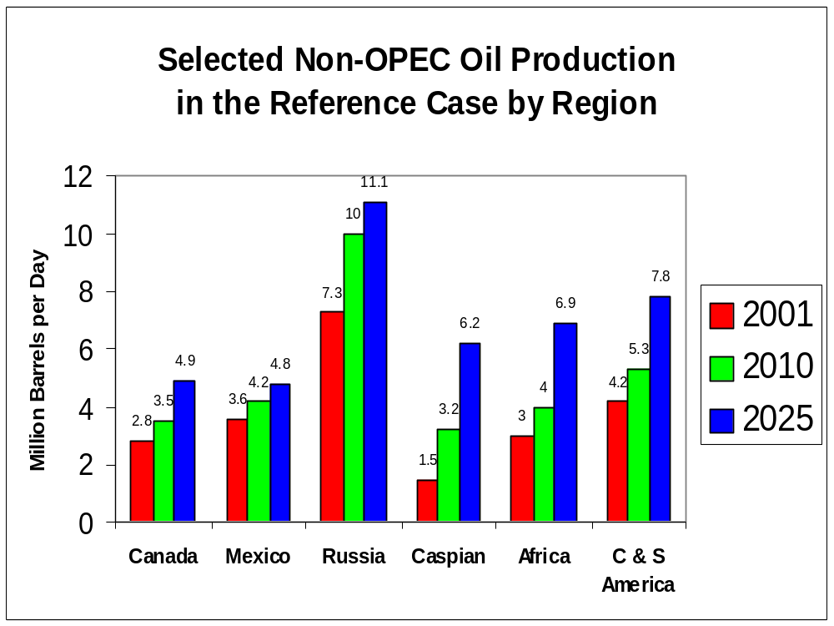

Slide 13
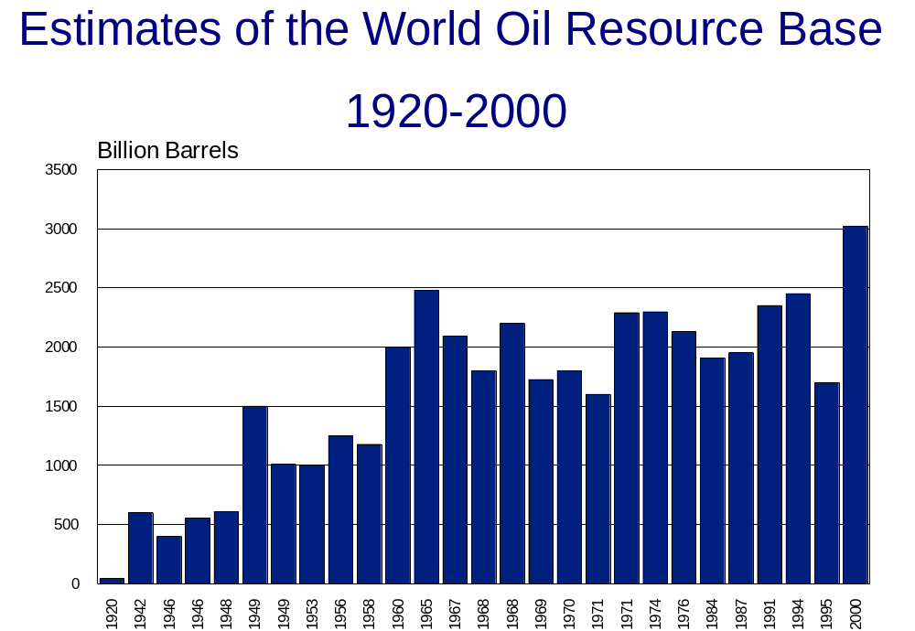

Slide 14
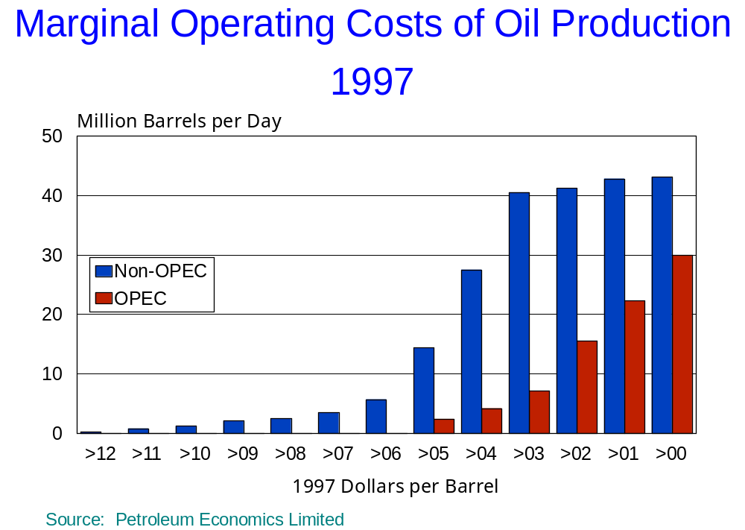

Slide 15
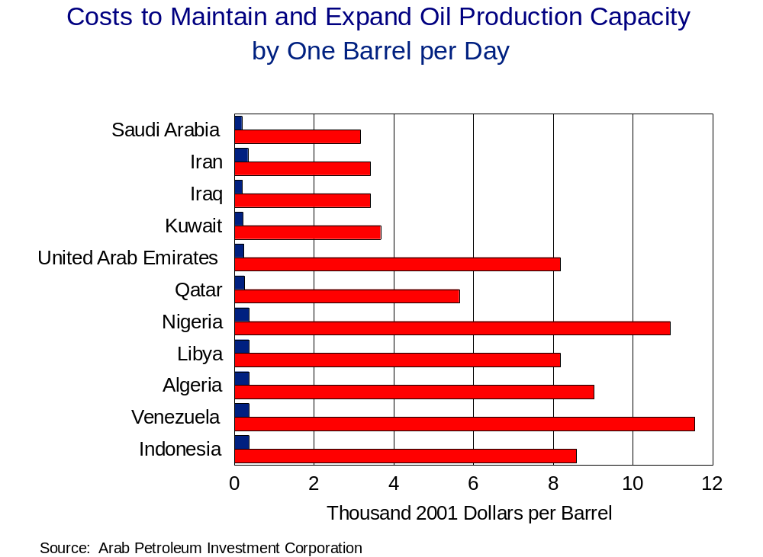

Slide 16
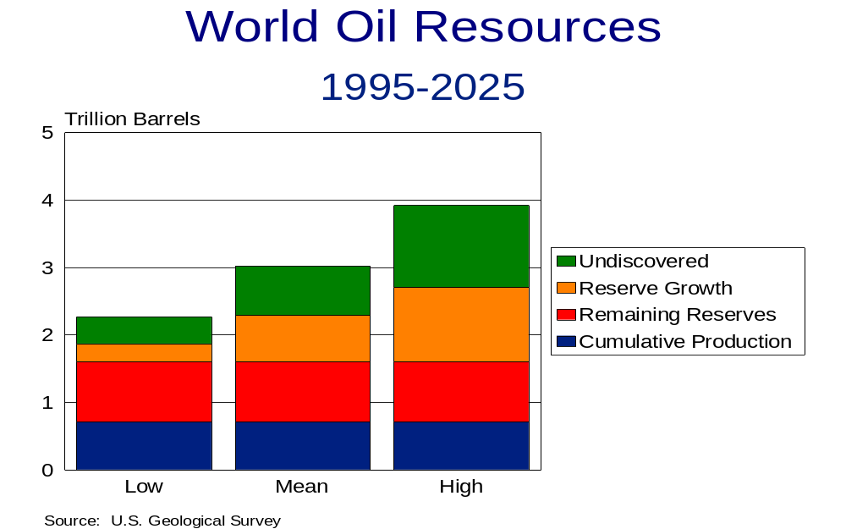

Slide 17
