Slide 1

2005 EIA Midterm Energy Outlook
and Modeling Conference
Energy Information Administration
April 12, 2005
Renaissance Hotel
Washington, D.C.
www.eia.doe.gov
Notes:
Hello, my name is Guy Caruso. I am the Administrator of the Energy Information Administration. On behalf of everyone at EIA, I would like to welcome you to the 13th EIA Midterm Energy Outlook and Modeling Conference.
The Annual Energy Outlook is the premier forecasting product produced by EIA. The AEO is produced using the National Energy Modeling System or NEMS. NEMS is a computer-based, energy-economy modeling system of U.S. energy markets. NEMS was designed and implemented by EIA and is maintained by EIA’s Office of Integrated Analysis and Forecasting.

Slide 2
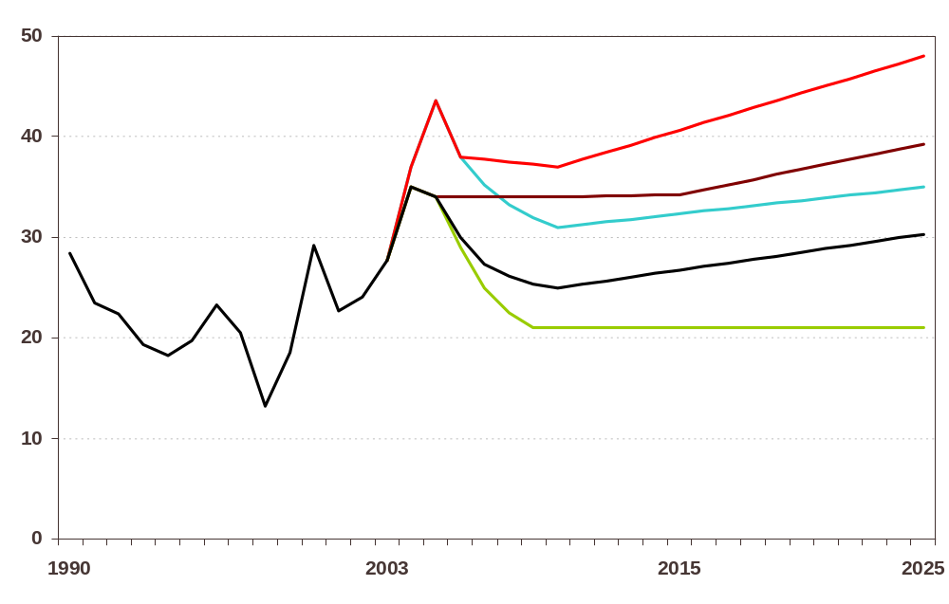
World Oil Prices Cases in the AEO, 1990-2025 (2003 dollars per barrel)
High B
High A
October Futures
Reference
Low
History
Projections
Notes:
The AEO2005 reference case is frequently cited in the press and in presentations. However, EIA recognizes that projections of energy markets are highly uncertain. The AEO2005 includes alternative cases intended to examine uncertainty. For example, crude oil prices have been very volatile over the last few decades. AEO2005 examines other cases based on alternative world crude oil price paths. In total, five oil prices cases were examined in the AEO.

Slide 3
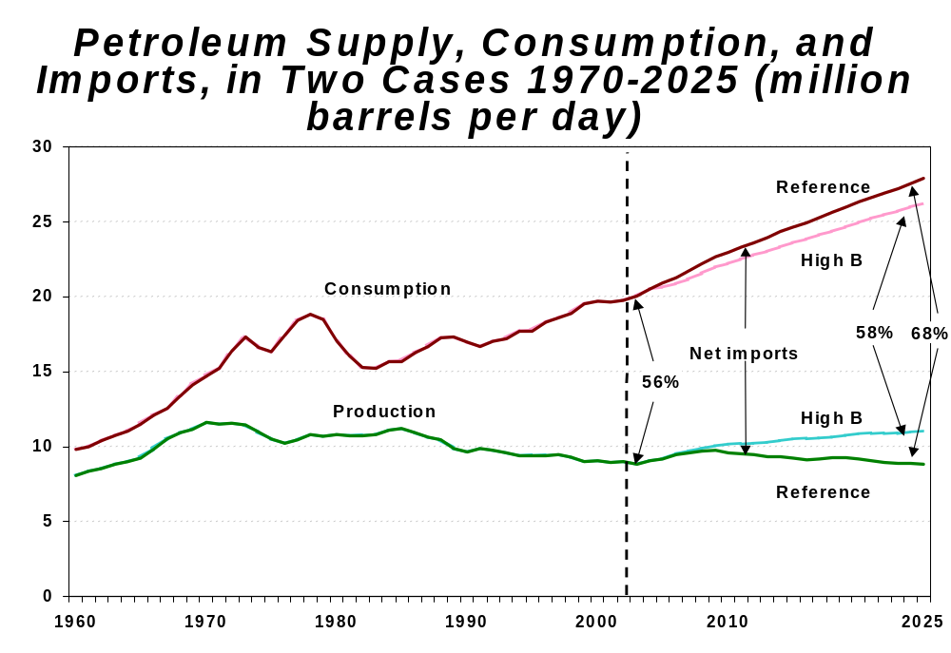
Notes:
These side cases and the ensuing analysis can reveal important implications for energy markets. In the reference case, the import share of total petroleum supply increases from 56 percent in 2003 to 68 percent in 2025. In the high B world oil price case, higher prices spur greater exploration and development of domestic oil supplies, reduce demand for petroleum, and slow the growth of oil imports. As a result, the projected import share of total U.S. petroleum demand in 2025 is 58 percent in the high B world oil price case, only slightly higher then the current share.
However, in the other oil price cases with somewhat lower price scenarios, the import share in 2025 is much closer to the reference case level. With limited opportunities for fuel switching in the transportation and industrial sectors, large price-induced changes in U.S. petroleum consumption are unlikely, unless changes in petroleum prices are very large or there are significant changes in the efficiencies of petroleum-using equipment.

Slide 4
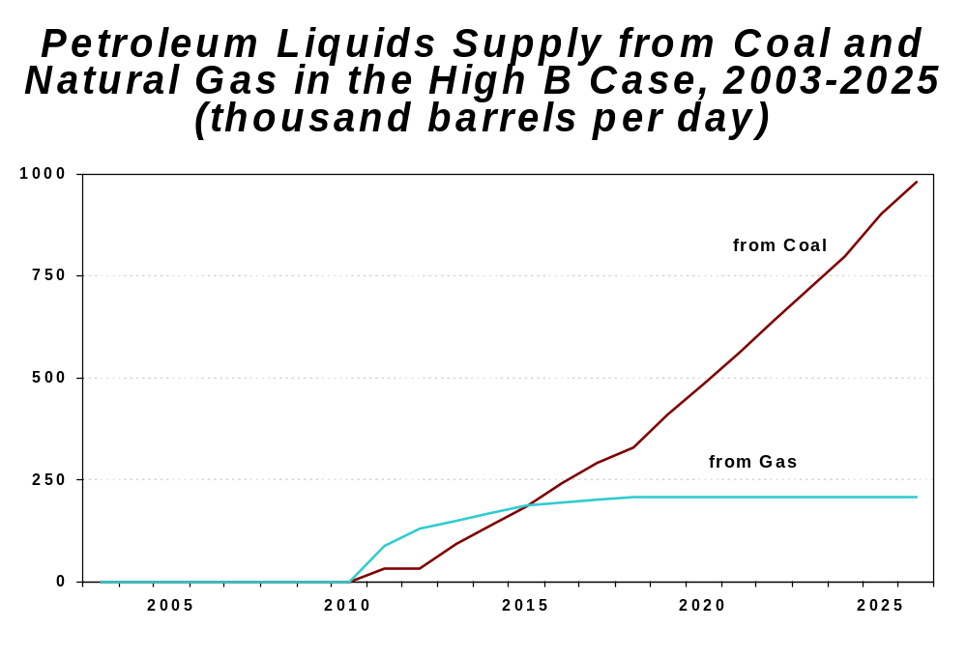
Notes:
The alternative cases also reveal unexpected implications that suggest a need for further analysis. For example, the high B world oil price includes 1.2 million barrels per day of synthetic petroleum fuel produced from coal and natural gas in 2025. These synthetic petroleum fuels simply do not penetrate the market in the projection timeframe with lower oil prices.
One of the values of the AEO is identifying those implications for energy markets that only become apparent in the side cases employing alternative assumptions.

Slide 5
Forecast Publications and Documentation
Annual Energy Outlook 2005, DOE/EIA-0383(2005)
Assumptions for the AEO 2005, DOE/EIA-0554(2005)
Supplemental Tables to the AEO 2005
National Energy Modeling System: An Overview 2003, DOE/EIA-0581(2003)
Detailed documentation by module
AEO Web Page:
www.eia.doe.gov/oiaf/forecasting.html
www.eia.doe.gov
Notes:
A major purpose of this conference is to discuss the many points of view relating to energy markets in the context of the AEO. Perspectives on the potential for improvement in energy efficiency, electric reliability, and the role of liquefied natural gas and renewables, among many topics. These help us identify those issues that we need to consider in the reference case and those issues that we need to test through alternative cases.
The conference also helps to make EIA’s efforts on the AEO as transparent as possible. No matter how transparent EIA is about the assumptions and methodology, as we all know, a forecast is only as good as the data available. Given the extensive regulatory and structural changes that energy markets have undergone over the last decade, EIA has experienced difficulties in data collection. These problems can affect the quality of the forecasts. We acknowledge these problems and I want to make it clear that EIA is working hard to fix them. The goal is to provide the best data possible for all users.

Slide 6
Outreach and Quality Control
Midterm Energy Outlook and Modeling Conference
  Focus on model structure, AEO2005 Forecast, and identifying key energy issues
  Need participation by attendees to help us identify important issues and trends that need to be considered
Working group meetings for Government users
Focus groups on selected topics
Independent Expert Reviews
www.eia.doe.gov
Notes:
The focus of this conference is on the National Energy Modeling System methodology, the AEO2005 forecast, and on identifying and discussing the many energy issues that EIA needs to consider in developing future Annual Energy Outlooks. Today, we are looking for “your” participation in helping us to identify those issues and trends that need to be considered as we develop future AEOs and make enhancements to the NEMS.
Your comments and those we receive during the year from users in the Department of Energy, focus groups, other non-DOE users, industry, and consumers act as quality control for both NEMS and the AEO. EIA also regularly uses panels of independent expert reviewers to more closely examine aspects of the NEMS model. For example, this year we conducted independent expert reviews on the cost and performance characteristics of electric generating technologies and EIA’s characterization of offshore oil and gas supply.

Slide 7
Conference Overview
Overview AEO2005: John Conti, Director, Office of Integrated Analysis and Forecasting
Keynote Address: “The Economic and Financial Outlook: An Energetic Economy” by Dr. David A. Wyss, Chief Economist, Standard and Poor’s
3 concurrent sessions
www.eia.doe.gov
Notes:
Following my remarks, John Conti, Director of the Office of Integrated Analysis and Forecasting, will present an overview of the recently released 2005 Annual Energy Outlook. The complete publication summarizing AEO2005 was released in March. We will close the opening session with a keynote presentation by Dr. David A. Wyss, Chief Economist of Standard and Poor’s. The keynote address is entitled, “The Economic and Financial Outlook: An Energetic Economy.”
The balance of the day will be broken up into three concurrent sessions, one this morning and two in the afternoon. The topics are listed in your packet in the final agenda. Each session is one and one-half hours, which should provide plenty of time for follow-up discussion.

Slide 8
Concurrent Sessions
Midterm Outlook for Conventional International Oil Supply, Demand, and Prices
Siting Issues in the Development of U.S. LNG Receiving Terminals
Power Sector Emissions Issues
Is There a Future for Nuclear Power in the United States?
Adaptation of U.S. Refineries to Market Challenges
Unconventional Gas Production: Challenges, Successes, and Future Outlook
State Incentives for Renewable Energy: Successes and Challenges
World Outlook for Unconventional Oil Production
When Should We Expect to See Hydrogen Vehicles?
www.eia.doe.gov
Notes:
The concurrent sessions are intended to review the AEO2005 forecast results, discuss issues related to the topic area, and analyze and compare the NEMS methodology with that used by other forecasters. For example, topics addressed in the sessions include the outlook for conventional and unconventional oil supply and the challenges facing U.S. refineries. The natural gas topics include expectations for unconventional gas production and siting issues in the development of U.S. LNG receiving terminals. The electric power discussions cover emissions issues and discuss the role of nuclear power in the United States. We also have sessions examining the impact of State incentives on renewable energy use and expectations for hydrogen vehicles.
These and other topics covered in the concurrent sessions should provide for a lively discussion of the National Energy Modeling System and the Annual Energy Outlook. I hope everyone is willing to participate and discuss the issues. We are looking forward to your input to the AEO process.

Slide 9
Notes:
As one final word, your packets include an evaluation form. This includes questions on the conference as a whole and on the individual speakers in each session. It also asks you to suggest session topics for future conferences. These are used to help us plan the agenda for next year’s conference. This approach has its pluses and minuses. By asking you for your preferences we are responding to your interests. However, by setting the agenda so far in advance, which is necessary to get speakers and make arrangements, we may not include the most current topics on energy markets. Despite this tradeoff we believe asking for your preferences has value. Could you please complete the evaluation form and return them at the registration desk in the hallway or by fax after the conference?
Again, thank you for attending.

