Slide 1
Analyzing Transitions to Hydrogen Powered Vehicles with HyTrans
Progress Report & Preliminary Results
Paul N. Leiby David Bowman
ORNL Econotech
David L. Greene Elzbieta Tworek
ORNL Strata-G
April 12, 2005
EIA Midterm Energy Outlook
& Modeling Conference
Washington, DC

Slide 2
HyTrans works!
But it also needs work.
From: “Don’t believe this!”
To: “This is dependent on key data, key assumptions, and model limitations.”
Agenda
Brief overview of HyTrans
Key Issues
Preliminary Results from 3 Scenarios
  Vehicle Technology Case 1:
    DOE Freedom Car Program Goals Met
  Vehicle Tech. Case 2:
    Alternative Technology Evolution
  Carbon Emissions Limits
Lessons
Future Development

Slide 3
The results I will present today are preliminary and should not be interpreted as conclusions about the hydrogen transition.
HyTrans is still under development.
Have not yet incorporated HFCIT program goals via H2A models but will do so soon.
NAS production technologies used; results presented below based on restricted sets of production options.
Geographical regions, several major improvements to come.
Results illustrate feasibility of optimization methodology, kinds of analyses that will be possible.

Slide 4
HyTrans Design Approach:
Simulate a Market Solution
Successor to successful TAFV model
National model, with high, medium & low (intercity) fuel-demand-density-regions
Integrates all main H₂ market components
  from fuel and vehicle production
  to distribution pathways
  through final consumer choice and demand
Determines a market equilibrium solution
  Maximizes total consumption benefit minus production, distribution, and other costs
  Assumes consumers & producers have perfect information and perfect foresight.
Currently benchmarked to AEO2004 Reference Case oil and gasoline price forecasts. AEO2005 markedly higher.

Slide 5
A H2 Supply Pathway (Supply Chain)
is comprised of three parts.
Delivery
Includes: Compression/Liquefaction+Storage+Dispensing+
Transporting+Storage+Compression/Vaporization
Production
Forecourt
Pipeline
(Store + Dispense)
Centralized SMR
Coal Gasification
Biomass, etc.
Truck Compressed Gas
Retailing of
Compressed
Gas
Truck Liquefied
Forecourt SMR
Forecourt Electrolysis
Many Others…
Notes:
Our prod date still from NAS
Delivery still our own delivery model, H2A un-available

Slide 6
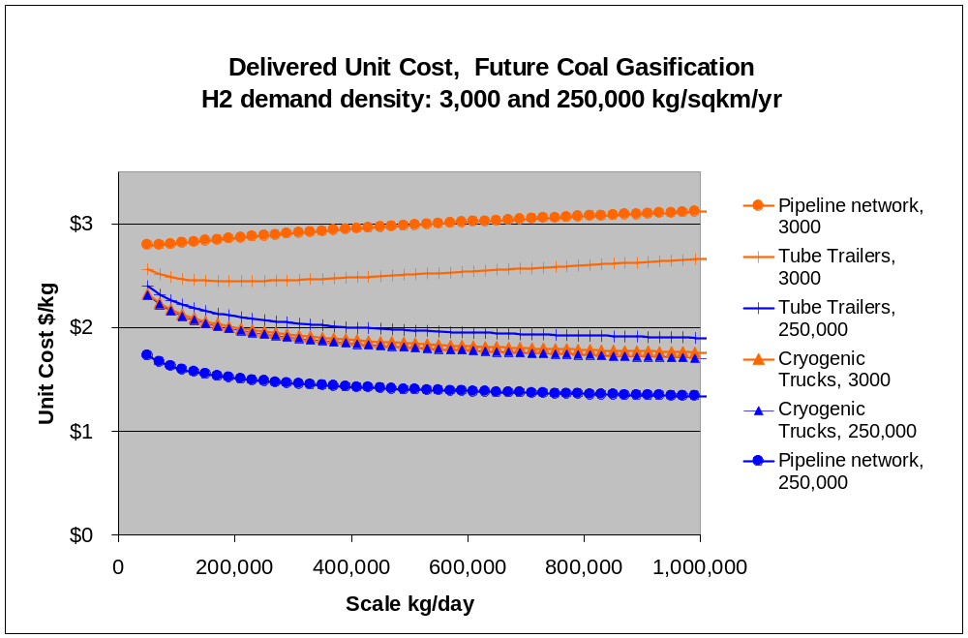
Demand density affects the competitive positions of production/delivery pathways.
(H2 delivered to vehicle excl. taxes)
Notes:
At higher density now pipelines

Slide 7
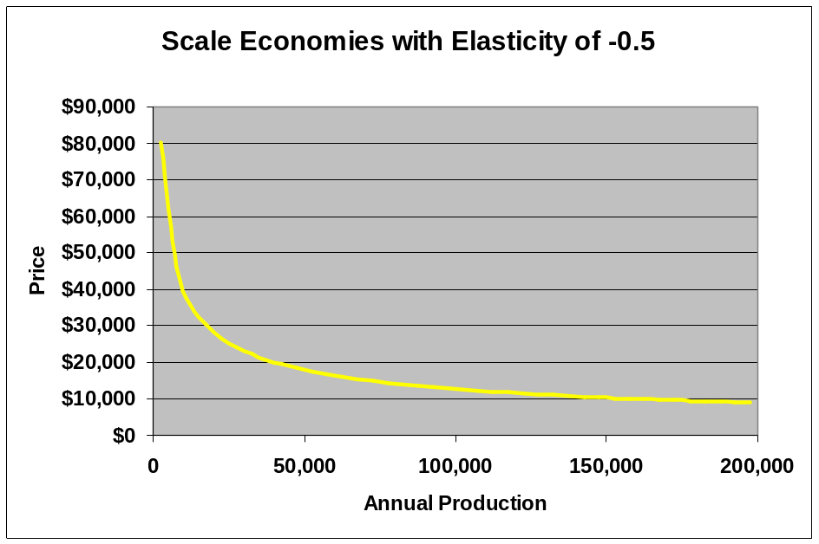
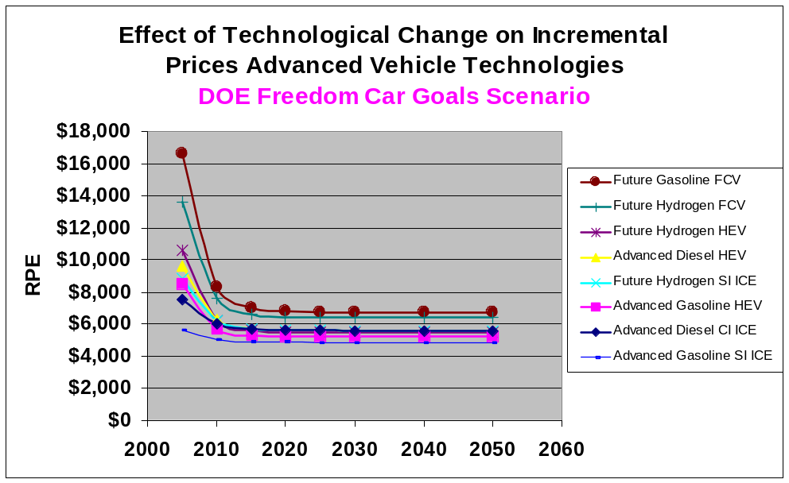
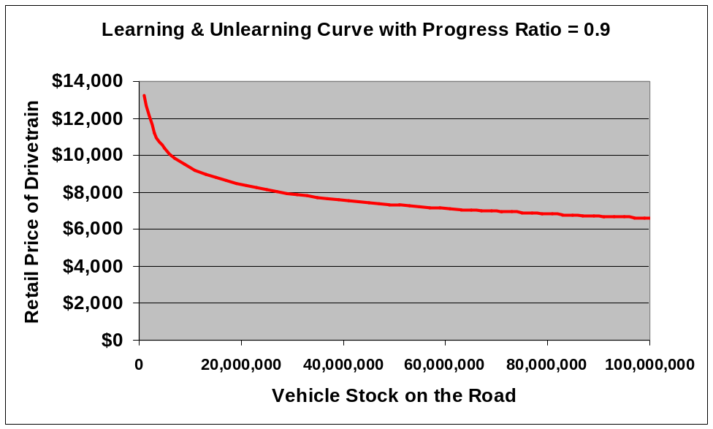
Vehicle technologies improve through 3 distinct mechanisms.
Retail Price =
Scale × Learning × Tech Change
× Scenario Price
Scale w/ Annual Production/Plant
Tech Change w/ Passage of Time (Yr)
Learning & Unlearning w/ Stock on Road
Notes:
Tech progress occurs strictly as a function of time.
Tech change curves are for large scale advance level of learning.
Cheaper to produce later, all else equal.
Learning and unlearning curve.
Done as a function of stock on the road.
Q: What are elasticities related to?
Q: [Santini] Can you mark where you are on Scale and Learning curves with X’s

Slide 8
I will show some preliminary results from three scenarios.
Based on AEO 2004 Reference Case & extrapolated.
Two policy drivers
  Vehicle subsidies
  Fuel subsidies
1: DOE Freedom Car Goals Met
2: Alternative Technology Evolution
3: Carbon Emissions Limitations
ALL scenarios here rely on NAS (2004) production cost estimates – H2A models will be incorporated in the near future.

Slide 9
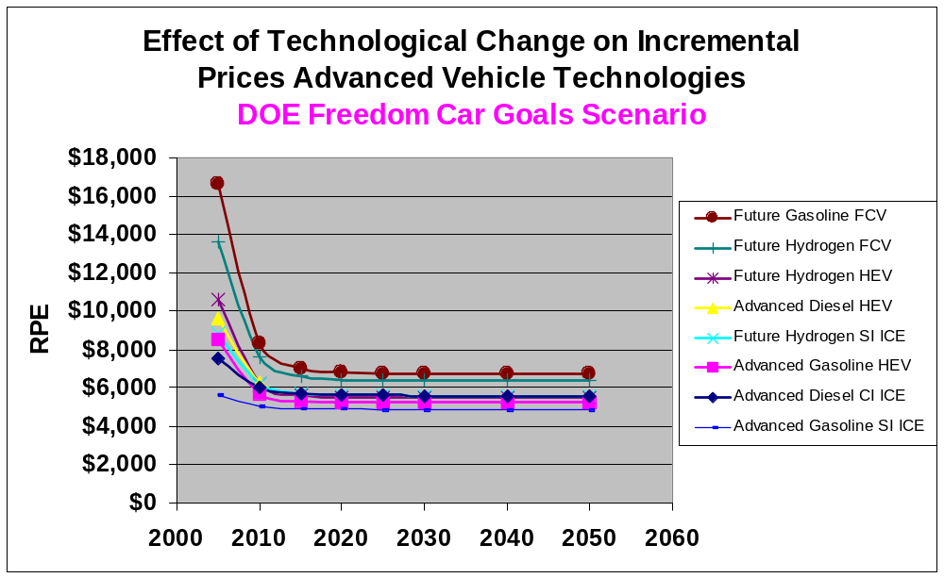
SCENARIO 1
The DOE Vehicle Technology Program Goals scenario anticipates rapid progress for all technologies.
Future FCV
Gasoline SI ICE

Slide 10
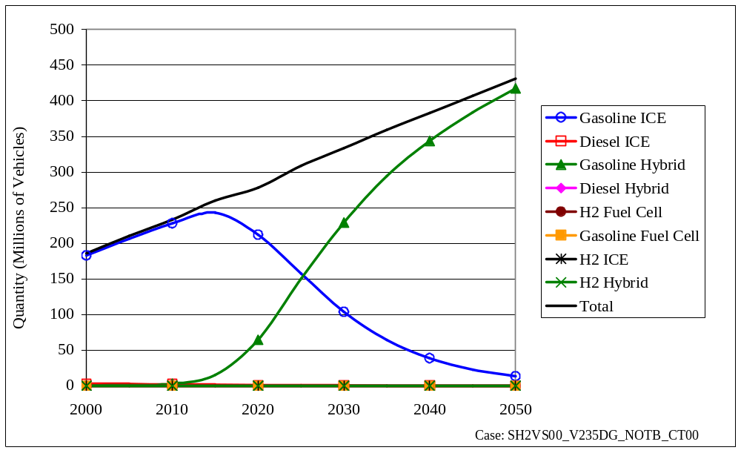
Given no new policies, HyTrans sees a shift to gasoline hybrids in scenario 1.
(Scenario 1: DOE Freedom Car Goals)
Total Vehicle Stock
Total Vehicles
Gasoline HEV
Gasoline ICE
PRELIMINARY
Notes:
No new policy, veh stock goes to HEVs.
Q: [Jeff Dowd] In GPRA analysis, we see some small (FCV) activity even with no new policy.
A: Perhaps because analysis does not include scale, learning, etc.

Slide 11
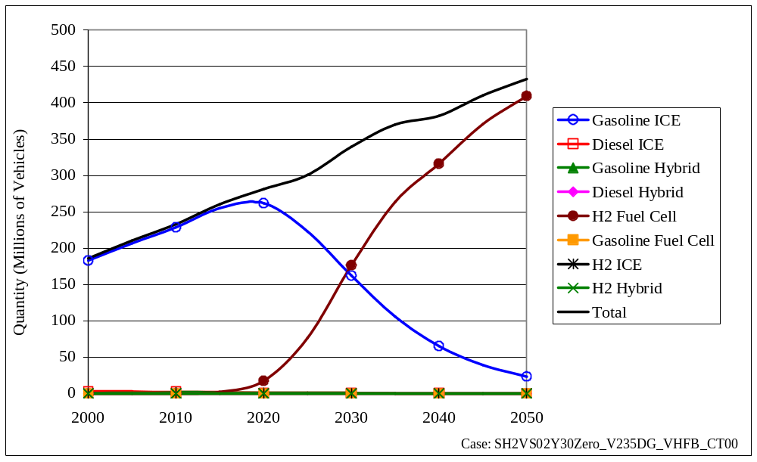
Given a temporary H2-vehicle subsidy in Scenario 1 ($2,000 until 2030, $0 afterwards), HyTrans finds a sustainable transition to hydrogen-powered light-duty vehicles.
Total Vehicle Stock
PRELIMINARY
All Vehicles
H2 FCV
Gasoline ICE
Notes:
Q: [Phil Patterson] Should say “Tried lower number ($1500) but did not get transition.”
Q: [Fred] are you saying that FCVs are comparable in attributes.
A: Included benefits for FCV, and for electricity.
Q: [Fred] Need to point this out. (we did)
Q: [Santini] Include key assumptions list on every slide. Replace legend with details.
Q: [Patterson] This is a bit of a rosy scenario. Putting all good/positive stuff first.

Slide 12
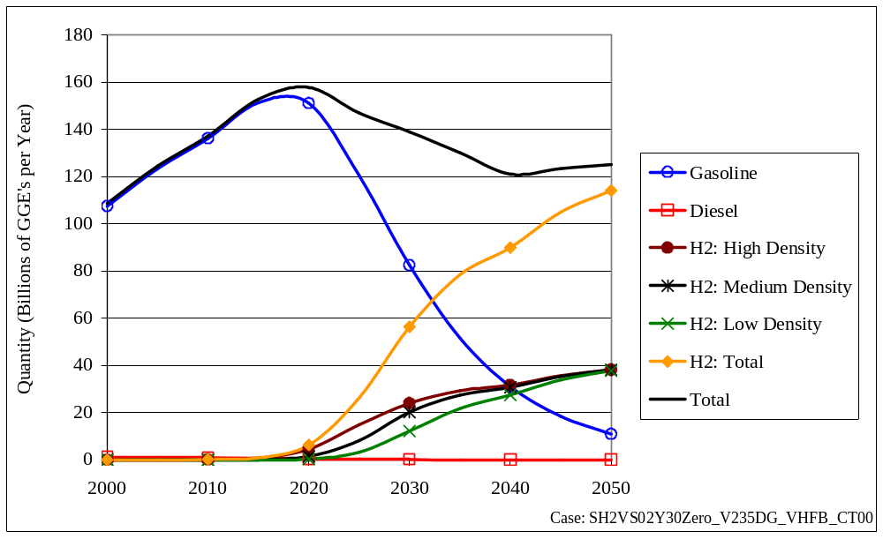
The transition to H₂ reduces vehicle fuel use in the face of steadily growing travel demand.
(Scenario 1: $2,000 H2 Vehicle Subsidy, $0 After 2030)
Light-Duty Vehicle Fuel Use
Total Fuel
Gasoline
PRELIMINARY
H2 fuel total
Notes:
Add slide showing vehicle travel.
Fuel use comes down because H2 vehicles more efficient.

Slide 13
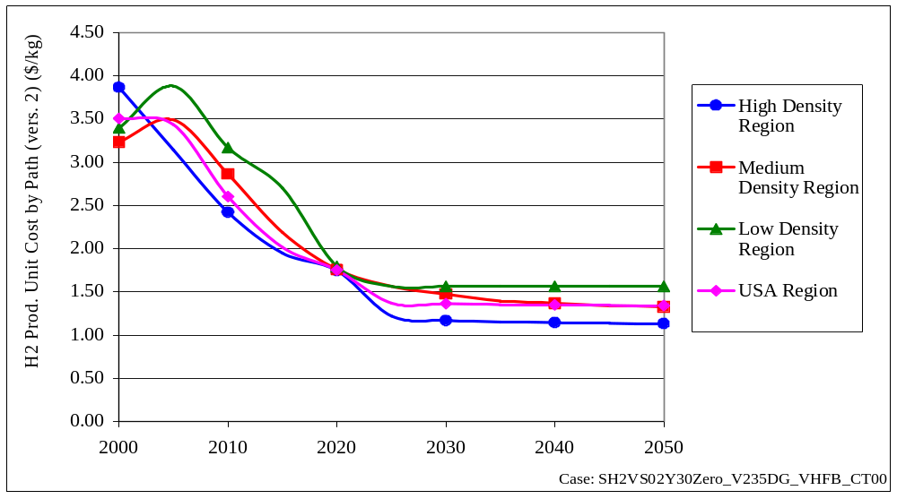
Delivered H₂ costs for central coal gasification fall over time with technological progress, scale economies and market share.
(Scenario 1: $2,000/H2-Veh Subsidy, $0 After 2030)
H2 Average Unit Cost ($/kg) (excl. tax)
Low Density Region
Medium Density
High Density Region
PRELIMINARY
Notes:
Q: Even getting $1.50 for low density region.
A: Yes, cryo truck have considerable scale intensities (due to liquefaction).

Slide 14
With H supplied by coal gasification, high and medium density regions start with truck and shift to pipeline as hydrogen’s market share grows.
(Scenario 1: $2,000/H2-Veh Subsidy, $0 After 2030)
H2 Delivery Modes: High Density Region
120,000
100,000
Coal Gasification.
by Pipelines
Tube Trucks
80,000
Cryogenic trucks
Total H2 Production (1000 Kg H2/day)
60,000
PRELIMINARY
40,000
20,000
0
2000
2010
2020
2030
2040
2050
Case: SH2VS02Y30Zero_V235DG_VHFB_CT00

Slide 15
The low density (intercity) region relies on cryogenic-trucking throughout.
(Scenario 1: $2,000/H2-Veh Subsidy, $0 After 2030)
H2 Production by Path: Low Density Region
120,000
100,000
80,000
Central Coal Gasification
by Pipelines
Total H2 Production (1000 Kg H2/day)
Tube Trucks
60,000
Cryogenic trucks
PRELIMINARY
40,000
20,000
0
2000
2010
2020
2030
2040
2050
Case: SH2VS02Y30Zero_V235DG_VHFB_CT00

Slide 16
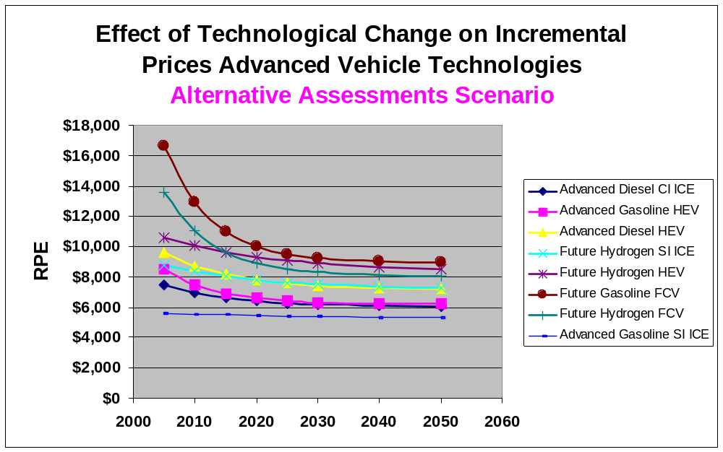
SCENARIO 2
We derived the Alternative Vehicle Technology Case from published studies. It is less favorable for some technologies, certainly for FCVs.
Future FCV
Alternative scenarios may provide a basis for estimating the benefits of accelerating technological progress.
Gaso SI ICE
Notes:
For Alt went to literature [MIT on the Road in 2020, Ricardo study, Joan Ogden study.

Slide 17
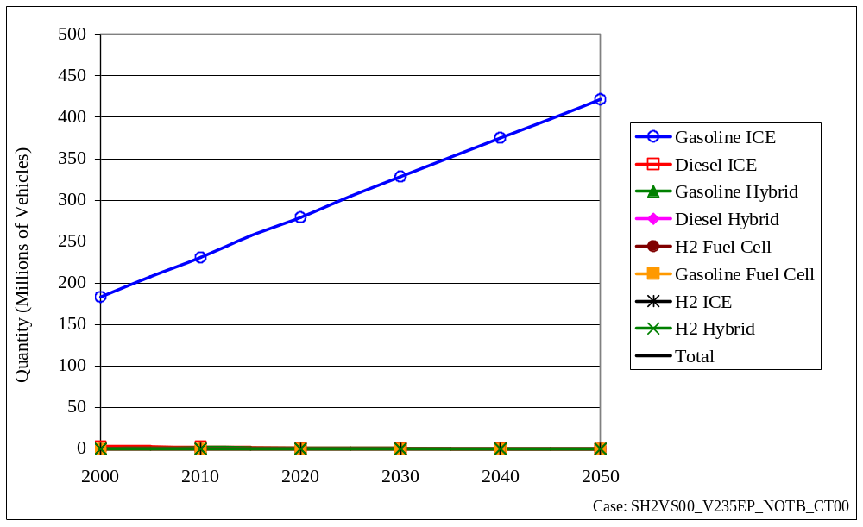
The Alternative Vehicle Technology Assumptions imply continued dominance of (advanced) gasoline-ICEs.
(Scenario 2: No New Policy)
Total Vehicle Stock
PRELIMINARY
Notes:
One of the assumptions is that gasoline CVs improve fairly rapidly in this case.
Q: Are fuel economy measures for FCVs subject to density. FCVs (and hybrids)
A: No.
Note AEO 2004 prices for gasoline are being used.

Slide 18
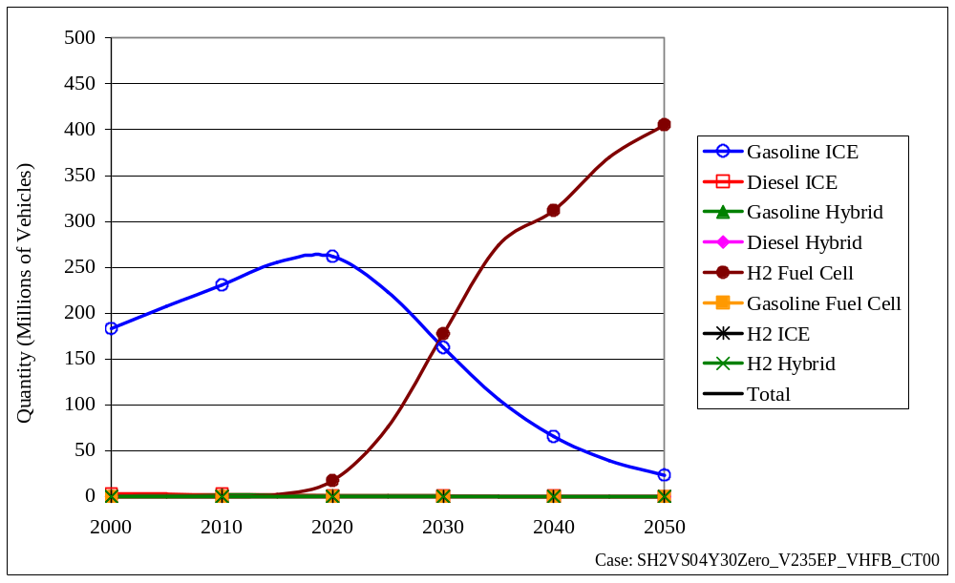
Scenario 2 requires twice the removable-subsidy to produce a sustainable transition.
(Scenario 2: $4,000 H2-Veh Subsidy, $0 After 2030)
Total Vehicle Stock
PRELIMINARY
Notes:
Continue to see FCVs going up, not ICEs.

Slide 19
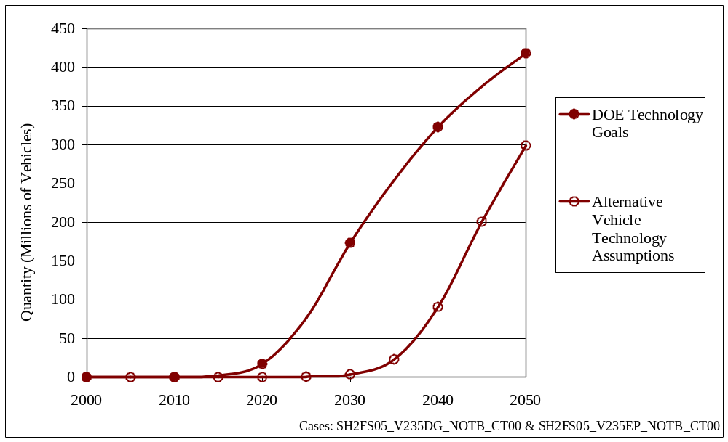
Given the same fuel subsidy policy, the hydrogen transition occurs later in scenario 2.
(Scenarios 1 & 2: $0.90/GGE H2 Fuel Subsidy)
Total H2 FCV Vehicle Stock
Scenario 1
Freedom Car Goals
PRELIMINARY
Scenario 2
Alternative Technology Evolution
Notes:
Greater rate of tech progress in DOE Tech Goals.
Q: [Fred] What is “Alt Vehicle Technology Assumption”
A: One set of prices from EERE office (Patterson) and work by S> Das.
[Phil says we should just call Scenarios 1 & 2]
This is interesting, indicating what might be gained by achieving tech goals.
Q: [Fred] Can you say what this is equivalent to (in terms of fuel subsidy)
Q: [Phil] Do you have a case with a removable fuel subsidy? Would it behave similarly.
Discussion about why no HEVs in the interim. Why not? What are we missing? Could it be shared components or learning?
Q

Slide 20
SCENARIO 3: Carbon emission Limits
How do the vehicle technology program goals change the ability to reduce CO₂ emissions from light-duty vehicles?
GREET 1.6 Supplemented by other sources (GREET update in Spring)
Represent carbon limits in the form of carbon taxes (cap and trade)
Add vehicle subsidies, as well
DOE Vehicle Technology Program Goals

Slide 21
Sequestering C from H₂ production yields major reductions in C emissions.
(Scenarios 1 & 3 w/ and w/o CO₂ Charge)
CO2 Emissions from LDVs
2500
2000
Base Case
1500
Bill kg/year
H Vehicle Subsidy
No CO₂ Charge
1000
PRELIMINARY
H Vehicle Subsidy
$40/t CO₂
500
0
2000
2010
2020
2030
2040
2050
Notes:
Phil: Label axis “bill KG CO2/year”
Frances: Good to show $40/t CO2 _w/o_ FCVs (no FCV subsidy. What would other techs do in response to CO2 charges.

Slide 22
HyTrans is making significant progress.
Plausible answers to:
  Is a stable transition achievable?
  When?
  How long will it take?
Can begin to test key policies
Will be able to produce potentially useful cost and benefit measures
Close to useful visions of the transition
Beginning to generate insights about R&D goals
  Good enough?
  Effects of competing technologies
Notes:
Fred: My recommendation, given NAS production, is to focus on vehicle.
Given that distributed doesn’t come in.
Don’t want to show this in the context that it is a DOE program.
If do not incorporate MYPP (Model Year Prpgram Plan) goals. If just say “coal,” we will have a problem.
[See ”Hydrogen, Fuel Cells & Infrastructure Techn Program, Multiyear Research, Dev. And Demo Program,” 2005. Also see MYPP FreedomCar and Vehicle Technologies,” Aug. 2004.
A: Noted we do not yet have delivery representation from H2A.
Also do not have H2A assumptions on what key
Also there is no scaling factor for different size plants.

Slide 23
Several important deficiencies remain to be addressed.
Market has multiple equilibria: Challenging model search
Lack of geographic regions makes it difficult for renewable H sources.
Fixed station size assumption appears to be excluding distributed production.
Still reflects NAS rather than H2A production and delivery.
Representation of learning & unlearning still not satisfactory.
  Should be asymmetric
  Technologies should be linked by shared components
Need to improve representation of fuel availability
  Intercity (Melaina methodology)
  Variable station sizes
Notes:
Phil: Note sure that NHA people will care about modeling issue of mult equilibria.
Fixed station size also
Q: [Phil] If not going to show sources of H2, then do not need this point.

Slide 24
THANK YOU.

