Slide 1
The Role of Technology Development in Accelerating U.S. Mercury and Carbon Dioxide Emission Reductions
Ned Helme
President, Center for Clean Air Policy
2005 EIA Midterm Energy Outlook and Modeling Conference Program
April 12, 2005

Slide 2
Center for Clean Air Policy
Non-profit environmental think tank founded in 1985 by state governors to find a market-based solution to acid rain
Applying similar approaches to ozone, greenhouse gases, and air toxics at state, regional, national, international levels
Leader in OTAG process, EU GHG trading system design, and international climate change negotiations
Sponsor power sector and economy-wide modeling to support policy design

Slide 3
CCAP Air Quality Dialogue
A stakeholder policy dialogue on alternative designs of power sector three-pollutant (3P) and four-pollutant (4P) legislative programs
ICF conducted an IPM modeling analysis of 3P and 4P incentive and/or cap and trade programs
Stakeholders agreed on model assumptions and options for analysis
Goal was to understand possible middle-ground, second-best solutions

Slide 4
Some Caveats
Not speaking for the environmental community
Recommendations based on analysis conducted within multi-stakeholder Air Quality Dialogue
Not commenting on the legality of EPA’s Mercury Rule
Technology ideas expressed in this presentation were discussed in the context of a larger policy package and may not be supported independently by some groups

Slide 5
Technology Key to Industry Acceptance of Emissions Caps
Perceived availability of technologies with cost and performance certainty reduces resistance to new emissions caps
Less resistance to NO_{x}, SO₂ caps at “efficient” levels of control b/c high degree of certainty on control technology performance and cost
More experience w/advanced Hg and CO₂ control technologies (or low-emitting generating technologies) is expected to build confidence in, reduce costs of technology, and lower resistance to new requirements

Slide 6
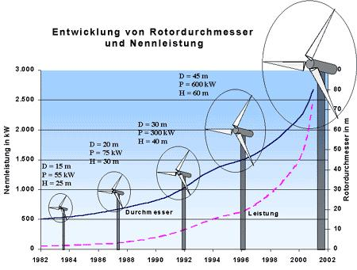
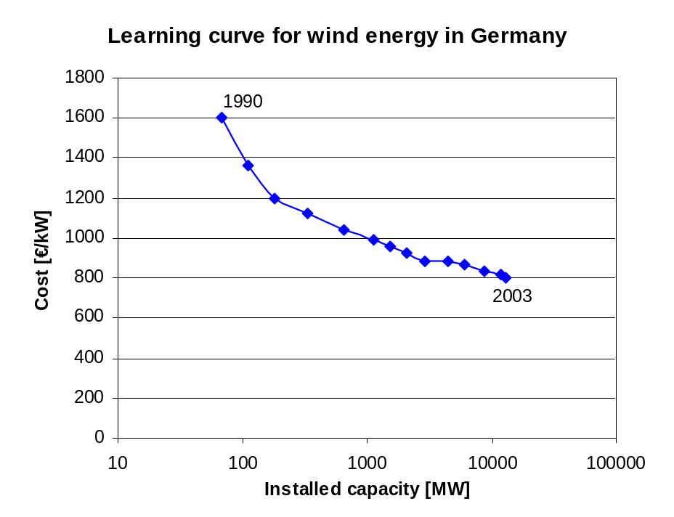
Development of wind technology
Development of wind turbines

Slide 7
CCAP Recommendation #1
Legislative or regulatory approaches should include a technology incentive pool to spread the risks of technology development and help build confidence in the performance and cost of advanced mercury control technologies

Slide 8
“Technology Incentive Pool” for Mercury
Dialogue evaluated “Technology Incentive Pool” to encourage early experience with advanced Hg control technology
  Allocates 10% of the allowances from Phase I target to early adopters of advanced Hg technologies (ACI) pre-Phase I
Modeling shows 31 GW of ACI in 2010 w/Technology Incentive Pool in contrast to 21 GW in 2010 without the incentive pool option*
Increase in the system costs is minimal (1%, or $400 million over 2005-2030)
* Comparison case assumes Hg is capped at 10 tons in 2015.

Slide 9
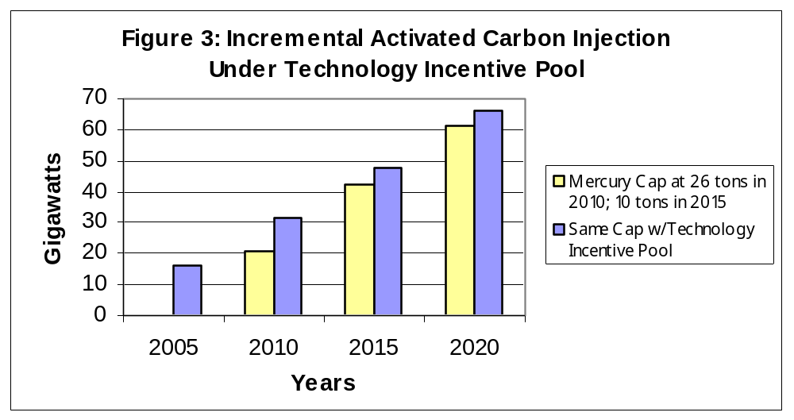
“Technology Incentive Pool” Achieves Early Mercury Technology

Slide 10
Design and Implementation of a Mercury “Technology Incentive Pool”
Tons could be awarded by:
  reverse auction – lowest bidders win
  First come, first served
  Pro rata sharing of 2.6 ton pool
Portion of tons could be set aside for particular plant characteristics and coals (e.g. PC burning subbituminous coals) to insure demos on all configurations
Incentive pool could be added to multi-pollutant bill
  Hg Early Action Reduction Credits were included in S.131, the Clear Skies Act of 2005

Slide 11
Comparison of CCAP Tech Incentive Pool and Senate version
Senate version did not set aside share of original allocation pool for techs – leakage from cap
Allowances given to all reductions carried out early via tech – no limits, no process for selecting winners
Senate incentive level may not have been high enough to cover cost differential – might only reward “free riders”
Reverse auction method preferable

Slide 12
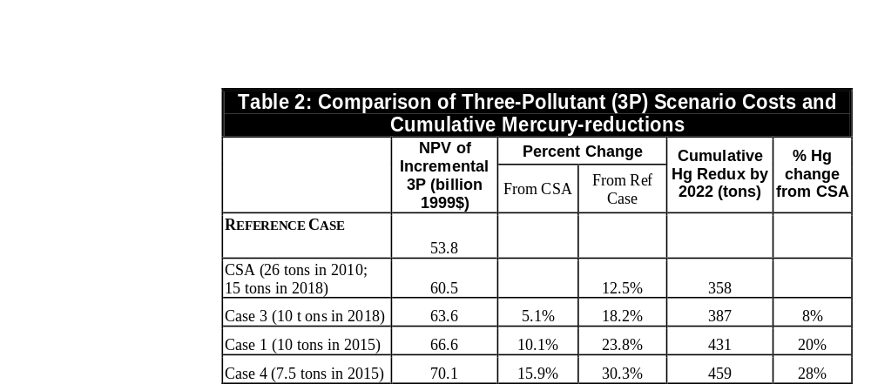
Small Increases in 3P Compliance Costs Under Tougher Hg Caps

Slide 13
Effects of Tighter Phase 2 Hg Cap Levels & Timing
Costs of incrementally more stringent cap levels and timing about 5% of incremental 3P cost for each tightening evaluated
Cumulative Hg benefits increase 8-12% with each incremental change evaluated
Tightening the timing and size of cap has very limited impact on wholesale electricity prices (-1.5% to +2.1% depending on the scenario)
If measured against mercury only costs, the percentage increases would be considerably higher

Slide 14
Effect on Coal Markets of Tighter Hg Caps and Timing
Tightening the mercury cap has marginal impacts on regional coal markets
  Interior coal production rises slightly (1-3%)
  Appalachian and western coal production declines slightly (2-4% and within 1%, respectively)
National coal production is higher than 2000 levels in all cases and varies only slightly between cases

Slide 15
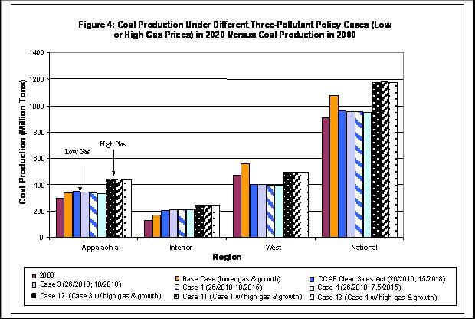

Slide 16
Hg/3P Conclusions
Technology incentive pool before Phase I could encourage ACI early at low add’l cost, potentially reducing Phase 2 costs
Significant portion of Tech pool probably needs to be targeted to subbituminous/lignite
Costs of incrementally more stringent cap levels and timing about 5% of incremental 3P cost for each tightening

Slide 17
Policy Implications of Hg/3P Modeling (CCAP View)
Possible win-win areas on multi-pollutant design:
  Phase I cap w/ some portion allocated to “technology incentive pool” would encourage experience w/advanced technology, reducing current disagreements on ACI feasibility
  Trade off easy (e.g., 34 ton) Phase 1 cap for tougher and earlier Phase 2 cap – cost of moving to a 10 ton cap in 2015 is roughly equal to the savings from moving from 26 to 34 ton phase I target, going to 7.5 ton cap adds another 6%

Slide 18
CCAP Recommendation #2
Legislative approaches should include incentives for IGCC with carbon capture and sequestration, whether with or without a cap. Such incentives can help reduce carbon dioxide emissions while preserving coal-fired power generation.

Slide 19
Need both Mid-Term and long-term solutions for climate
Reduction in carbon intensity
(environmental incentives)
Emissions
Creation of material new energy sectors
(economic growth incentives)
Target
(60% reduction)
1990
2015
2040
2100
Medium-term
economic development
and competitiveness
Long-term
Policy interventions to support technology breakthrough
Shot-term
emission constraints

Slide 20
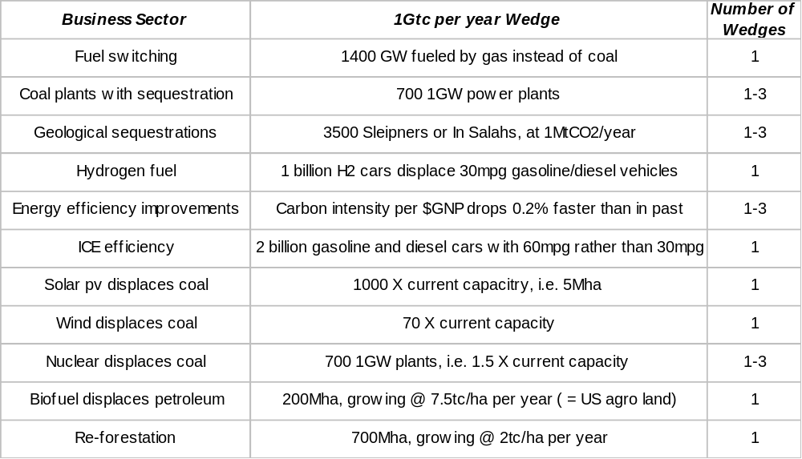
What is the scale of one 1Gtc wedge?
Source: Rob Socolow, Princeton

Slide 21
Chicken and Egg Problem
Without technology solutions, hard to get strong reduction requirements; however, without strong reduction requirements, there is little incentive to develop technology solutions.
Solution: Use incentives and a carbon cap together

Slide 22
Key 4P Modeling Assumptions
3P Reference Case assumes:
  Phase 1 Hg control is 26 tons in 2010, Phase 2 Hg control is 10 tons in 2015
  EIA AEO 2003 assumptions on gas price and electricity demand
Capital cost of IGCC = $1,248/kW
Enhanced Oil Recovery (EOR) lowers sequestration costs by ~$10/ton CO2
EOR is available in TX, CA, NM, LA & WY

Slide 23
Selected 4P Scenarios Modeled
IGCC w/CCS Incentive Package
  Incentives for 17.5 GW IGCC+CCS, half w/credits for enhanced oil recovery, half without
  Modeled by forcing desired level of IGCC+CCS generation; incentive was output
Cap at 2000 Levels in 2010 with IGCC Incentive Package
  Offsets used to meet 15% of compliance
  17.5 GW of IGCC+CCS, half with EOR credits
  EOR availability capped

Slide 24
Effect of IGCC Incentive Package
IGCC + CCS package reduces emissions by 2 to 3% below projected levels at an incremental cost of $8.2 billion and an annual cost in 2010 of $750 – 870 M*
If incentive program were added to the 3P bill modeled here, cost would increase by 11%
IGCC + CCS package maintains coal consumption at levels > or = to 3P Reference Case and lowers wholesale electricity prices
Incentives needed to encourage IGCC+CCS are low ($1.20-$4.30/MWH) where EOR is available, higher ($15.30-$28.30/MWH) where it is not**
*Costs reflect NPV from 2005 to 2030. 3P Reference Case = $71.3 billion. **For comparison, the federal tax credit for renewable energy is $17/MWh.

Slide 25
Comparison of IGCC/CCS Incentives (Phase I) with Existing RE Incentives
 | Cost per Year in 2010 ($millions) | Price per MWH | Capacity (GW)
RE | $328 | $17 | 2.75
IGCC+CCS no EOR | $750-870 | $15-28 | 4.75

Slide 26
Effect of CO₂ Cap w/IGCC Incentives
Results in an increase in emissions over current levels due to use of offsets but reduces emissions by 4 to 10% from what they would otherwise be in the absence of the cap.
Costs $29.0 billion* and results in allowance costs of $3 to 5 per ton CO₂
Results in higher coal consumption than 2000 levels, but less than 3P Reference Case
Raises wholesale electricity prices by 5 to 8% from 3P Reference Case
* Costs reflect NPV from 2005 to 2030; 3P Reference Case = $71.3 billion.

Slide 27
Effect of CO₂ Cap w/IGCC Incentives, cont.
IGCC incentives come to $0.9 to 1.3 billion per year as modeled (with ½ EOR) in 2010 and 2015
  This is less than 10% of CO2 allowance value under modeled power sector scenario at the revised McCain-Lieberman Cap levels
  This comes to more than double the proposed value of tax incentives and direct subsidies for coal in the Energy Bill
S. 131 NOx/Sox allowance incentives for IGCC would total approximately $80 million per year
* This is the cost of the incentive with a cap at 2000 levels in 2010. The cost varies depending on the level of the carbon cap.

Slide 28
Design of CO₂ Control Measure:
Including IGCC in a CO₂ Cap
Adding IGCC incentives to a cap program* results in:
Slightly higher system costs (1-2%)
Lower electricity prices
Slightly more coal generation (4%)
*Note: These results are based on CO₂ cap runs that were
not previously described. Runs capped CO₂ at 1990 levels
by 2016 but allowed unlimited penetration of EOR.

Slide 29
Conclusions (CCAP View)
Affordable incentives can achieve real penetration of mercury and advanced coal technologies.
Expected advantages include:
  Greater certainty on technology performance
  Lower costs for Hg control technologies and advanced coal generation technologies
  Enhanced fuel diversity
New legislative authority is needed to advance these issues – ideas were in play with S. 131, albeit at lower incentive levels.

Slide 30
Conclusions (cont)
Growing consensus that need to have both IGCC demos and sequestration demos – can be separate
State CO2 cap & trade programs could provide first tests of IGCC/sequestration techs – Cal cap on load-serving entitities
Proposed Frontier Line from Wyoming to Cal could be 6,000 MW sequesteration-ready IGCC w/ 6,000 MW wind

Slide 31
For More Information
See “Design of a Multipollutant Control Program: Stakeholder Analysis of Potential Policy Options,” available at www.ccap.org/pdf/2004-May--multipollutant-report.pdf
Contact Ned Helme, Center for Clean Air Policy, at 202-408-9260 or nhelme@ccap.org

