Slide 1

NOx & Mercury Control Technology DOE’s R&D Program
2005 EIA Midterm Energy Outlook and Modeling Conference
Washington, DC
April 12, 2005
Bruce Lani, Project Manager
National Energy Technology Laboratory

Slide 2
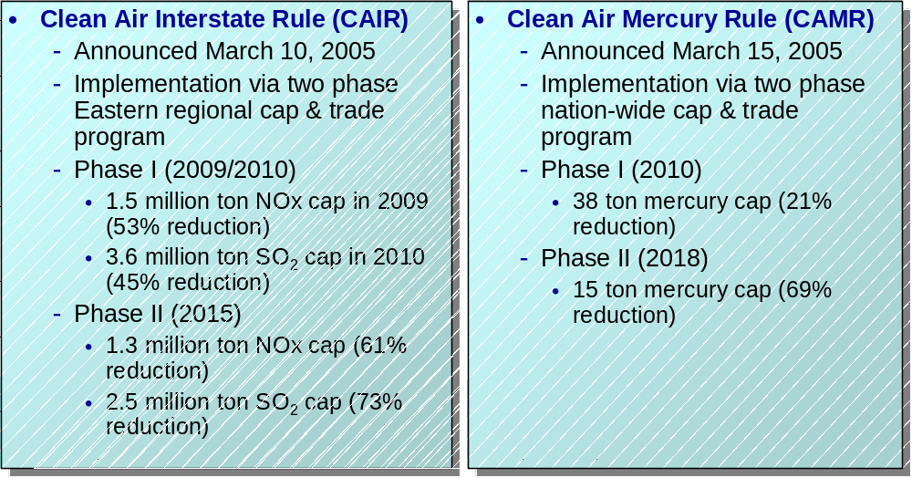
New Regulatory Drivers for Coal-Fired Power Plant Emissions
Note: Percentage reductions from 2003 baseline emission levels.

Slide 3
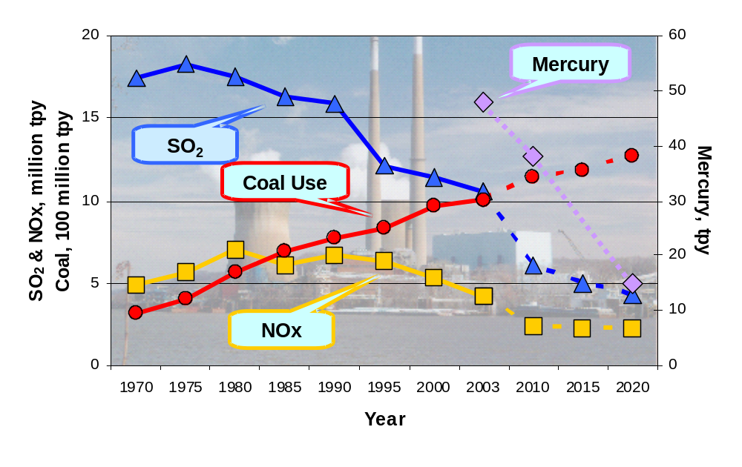
Trends and Projections
National electric power sector coal use and emissions per EIA & EPA databases.

Slide 4

Innovations for Existing Plants Program
Mercury & NOx Goals
2000
2005
2010
2015
2020
Achieve NOx emission rate of 0.01 lb/MMBtu
Achieve 90% Hg capture
Achieve NOx emission rate of 0.10 lb/MMBtu
50-70% Hg capture for low rank coals
Achieve NOx emission rate of 0.15 lb/MMBtu
Achieve 50-70% Hg capture
for bituminous coal
Phase 1
NOx cap
Phase 1
Hg Cap
Phase 2 NOx cap;
Phase 2 Hg cap
Caps under Clear Skies Act
Phase 1 NOx cap;
Phase 1 Hg cap
Phase 2
NOx cap
Phase 2
Hg cap
Caps under CAIR and Hg Rule

Slide 5
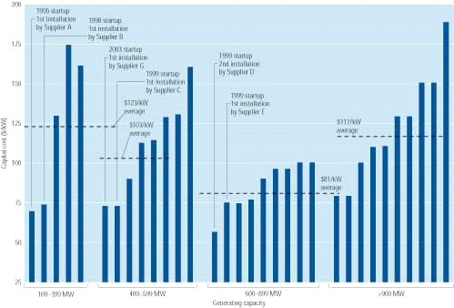
Current NOx Performance Standard - SCR
Advantages
  90% reduction
  Adaptive to most boilers
Disadvantages
  Expensive
  NH₃ storage and slip
  Parasitic load
  SO₃ generation

Slide 6
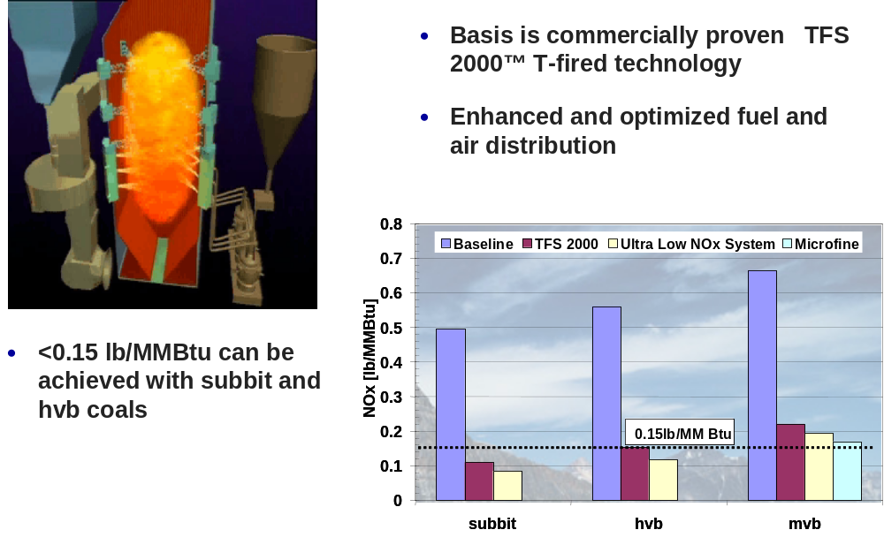
Alstom – Tangential Fired Technology

Slide 7
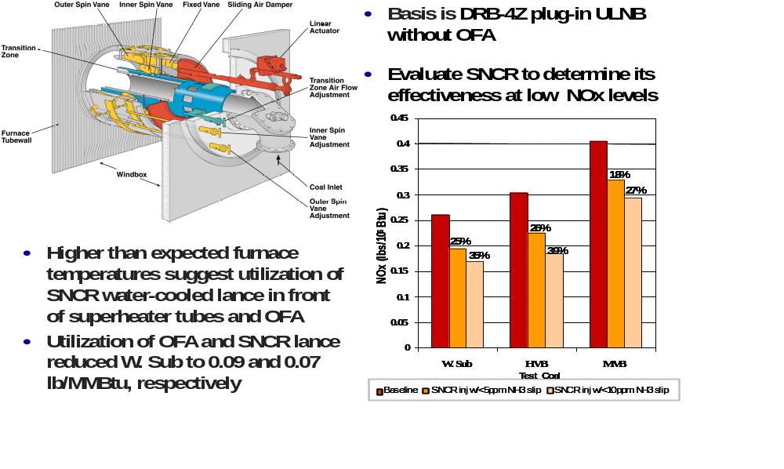
B&W – Wall Fired Technology

Slide 8
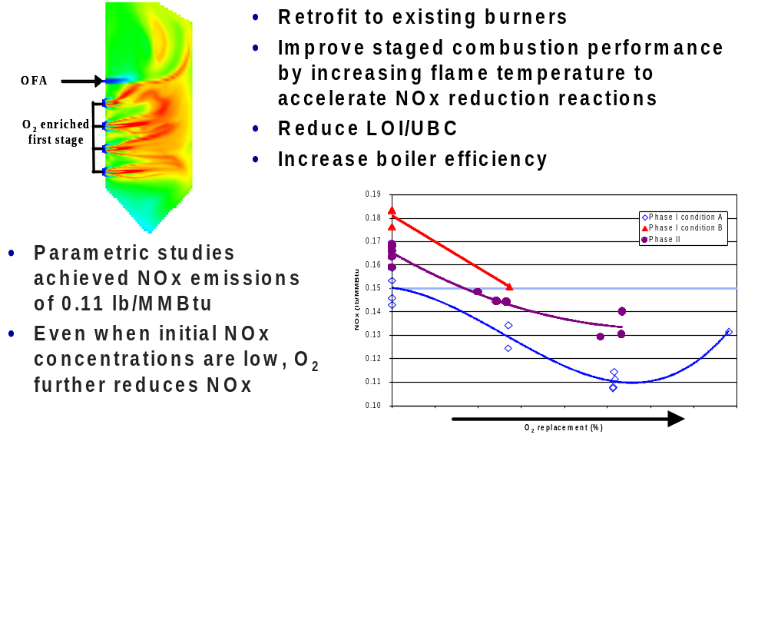
Praxair – Oxygen Enhanced Combustion

Slide 9
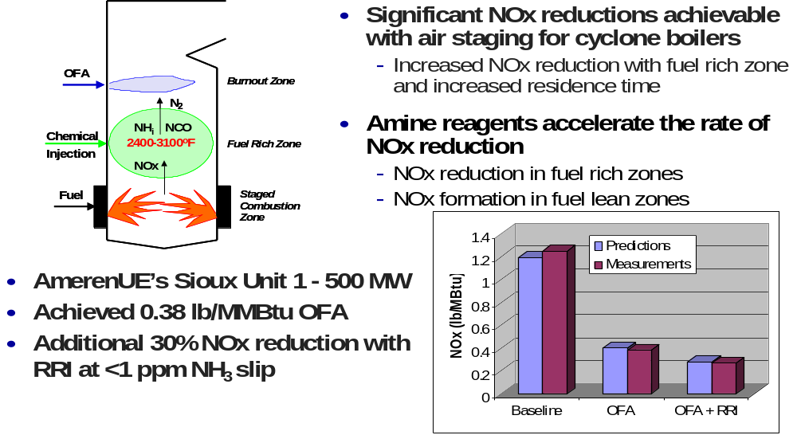
Reaction Engineering International
RRI - Cyclone Technology

Slide 10
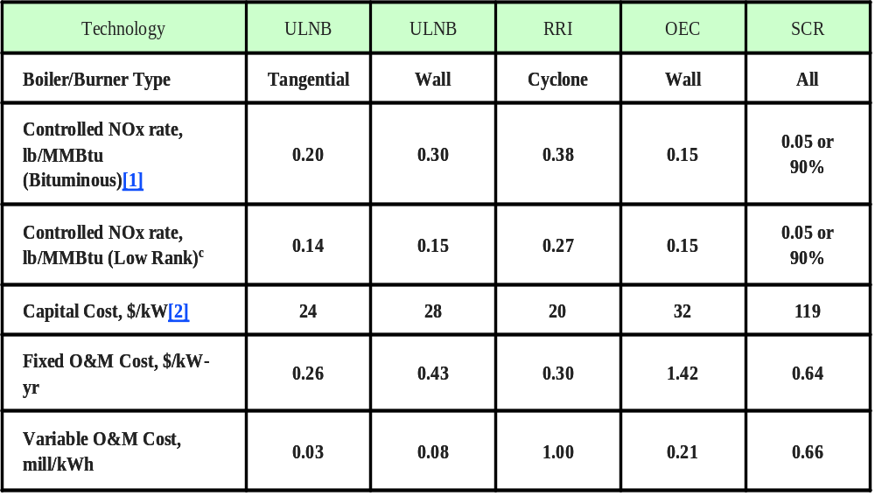
Cost and Performance Assumptions for Advanced NOx Combustion Control Technologies
Note: All costs in 2005$

Slide 11
How good is the methodology?
If new technologies not available –
Methodology projects 93 GW for SCR control versus 102 GW by IPM for compliance with Clear Skies Act

Slide 12
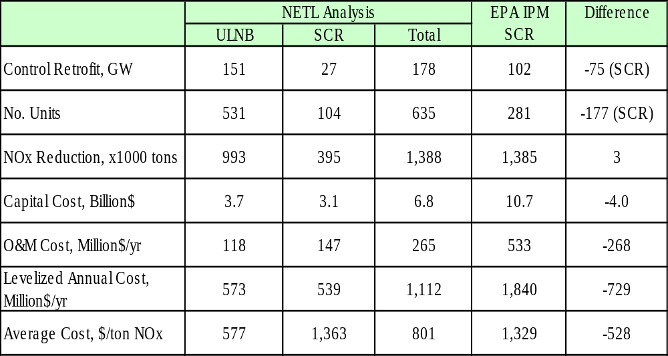
Advanced NOx Combustion Control vs. SCR for Compliance with the Clear Skies Act (preliminary)
Note: All costs in 2005$

Slide 13
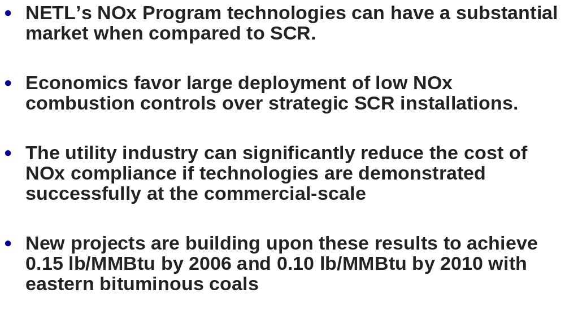
NOx Summary

Slide 14


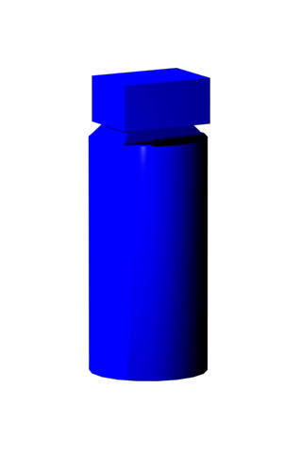
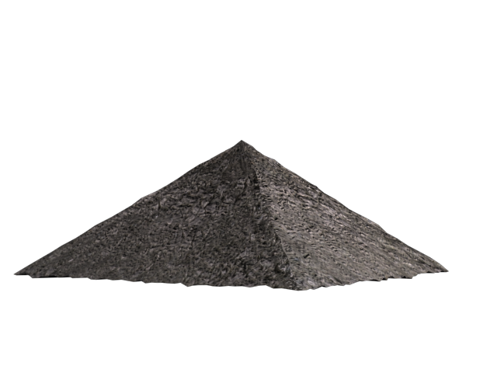
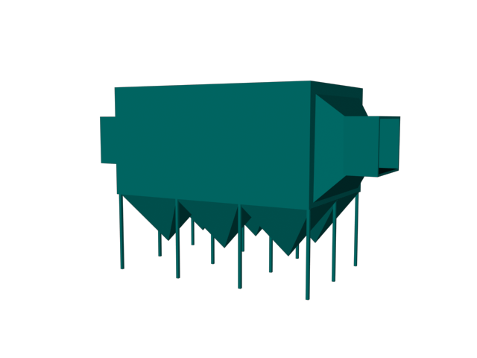
DOE/NETL Mercury Control Technology R&D
Plume
Chemistry
Combustion/
Chemistry
Modification
Polishing
Technology
Sorbent
Injection
Scrubber
Enhancement/
Oxidation
Cl-based additives
Combustion
modifications
Baghouse
or ESP
Boiler
Scrubber
ACI
Amended silicates
Halogenated AC
Ca-based sorbents
Chemically treated
sorbents
COHPAC/Toxecon™
Thief sorbents
Oxidation catalysts
Reagent addition
Ultraviolet radiation
(GP-254)
Electrocatalytic
oxidation
SCR oxidation
MerCAP™
Transport/
speciation
Coal combustion
byproducts
characterization

Slide 15
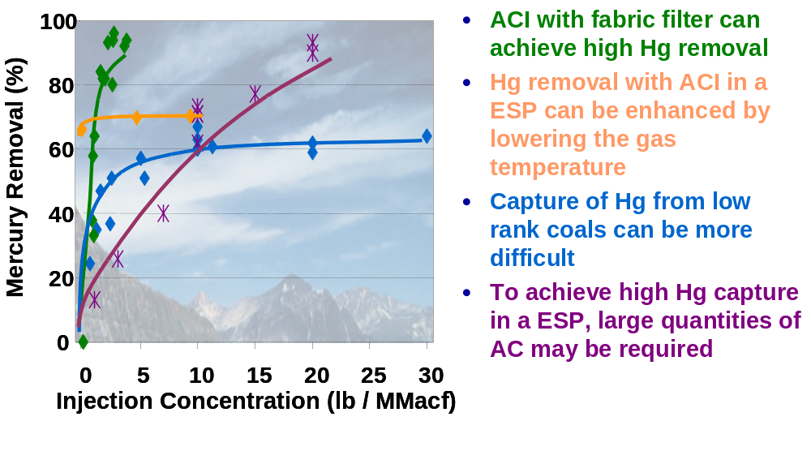
ADA-ES Phase I Field Test Results
Activated Carbon Injection

Slide 16
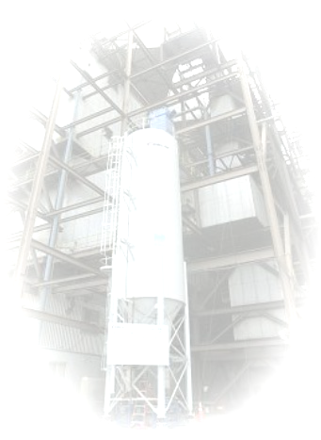
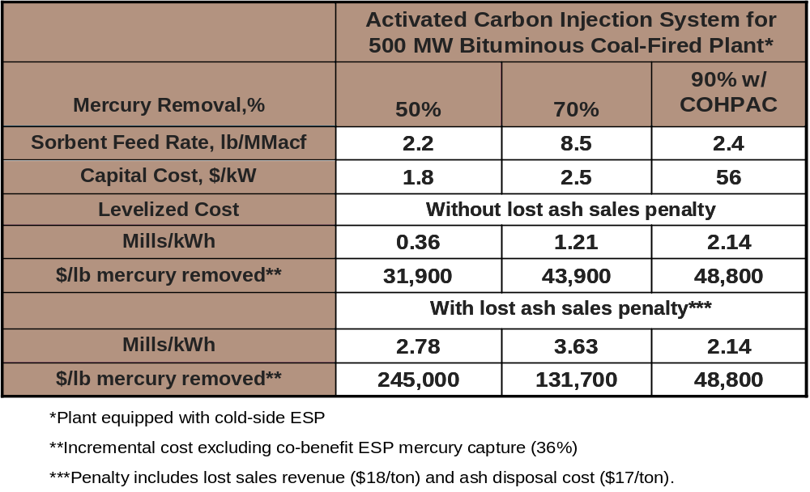
Mercury Control Using ACI
Preliminary Bituminous Cost Estimate

Slide 17
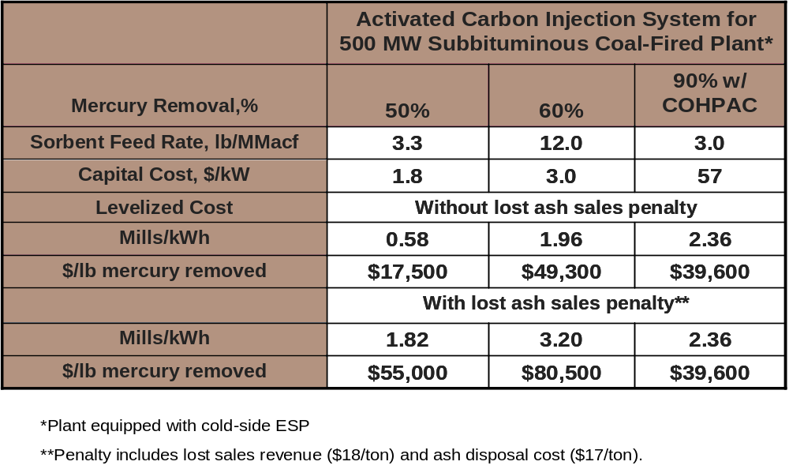
Mercury Control Using ACI
Preliminary Subbituminous Cost Estimate

Slide 18
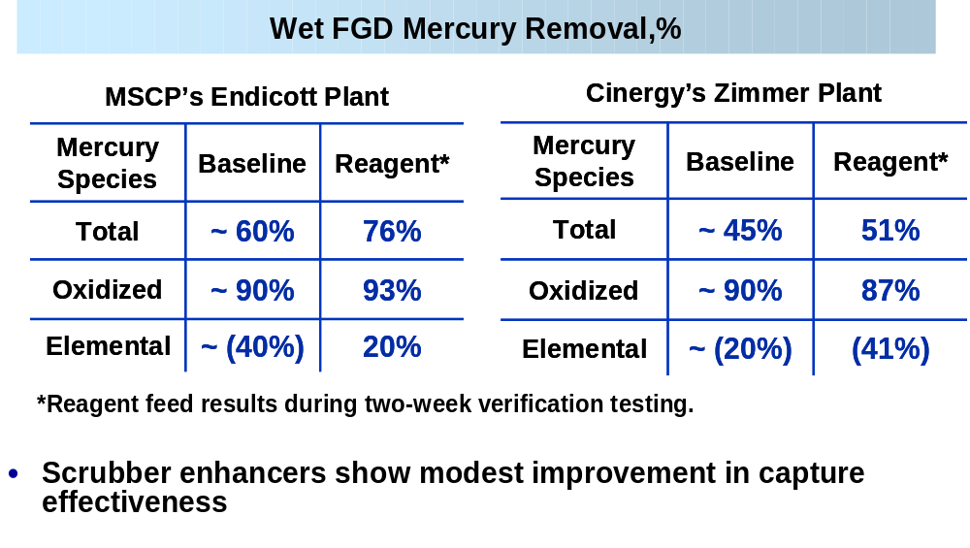
B&W Phase I Field Test Results
Enhanced Mercury Control in Wet FGD

Slide 19
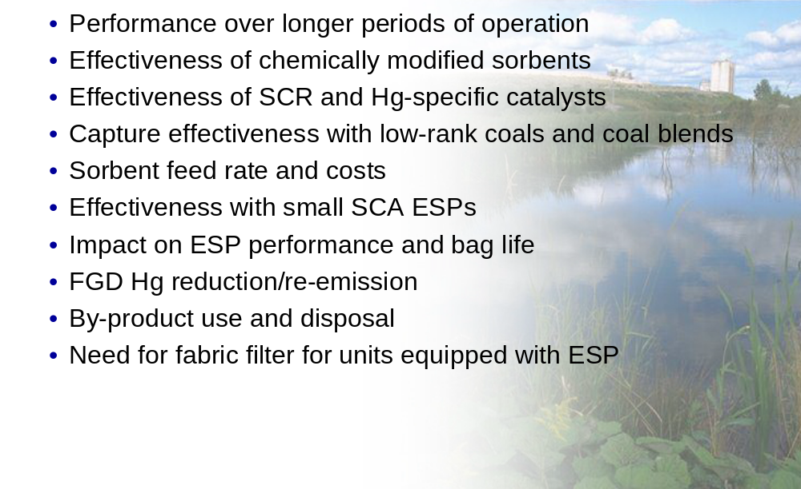
Uncertainties From Phase I Field Tests

Slide 20
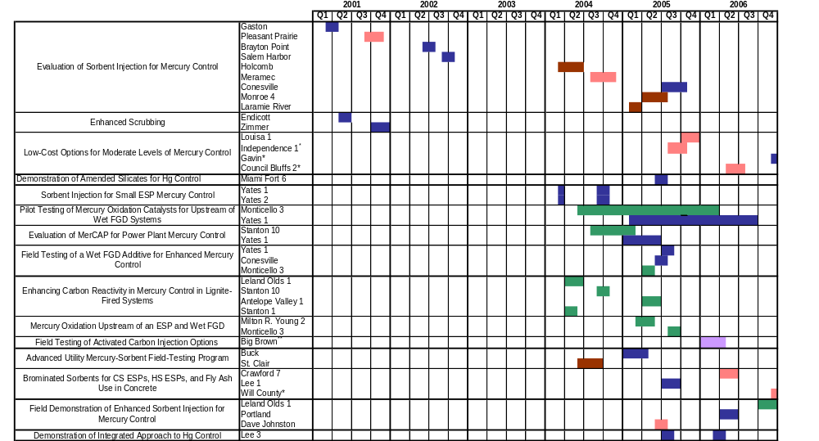
NETL’s Mercury Field Testing
Phase II 2004-2006
Sites 35
Fuel Types 5
Technologies 11
Cost $45.5 million
Phase I 2002-2003
Sites 6
Fuel Types 2
Technologies 3
Cost $8.8 million

Slide 21
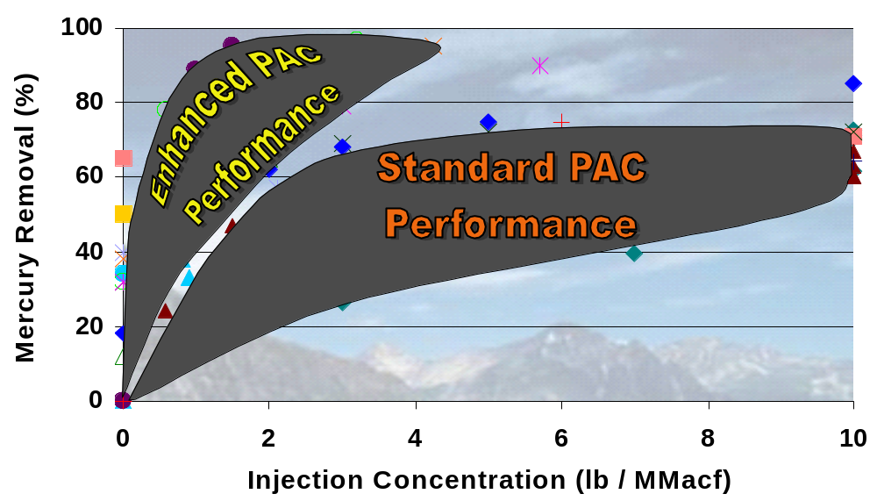
Phase I and II Field Testing Results
Comparison of Standard & Enhanced PAC

Slide 22
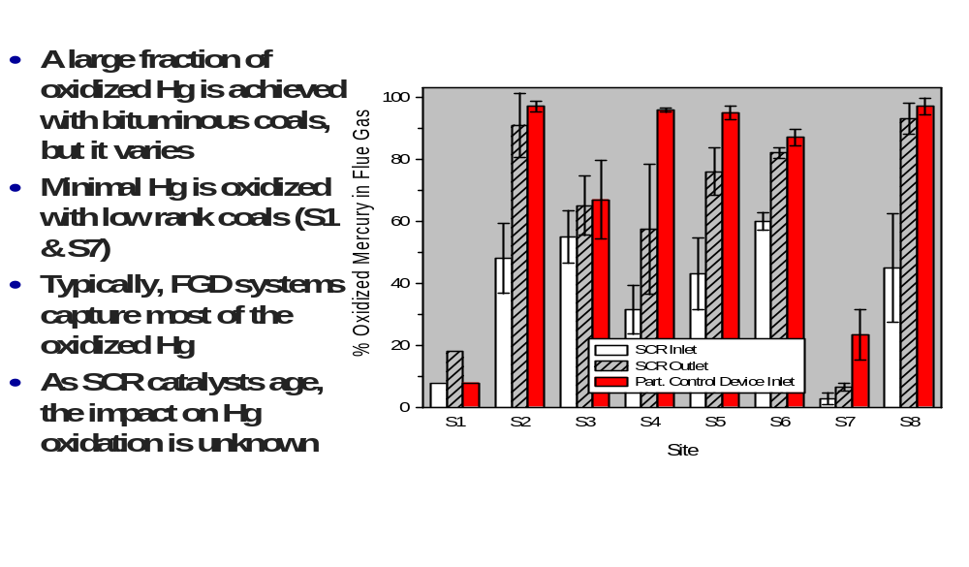
Co-Benefits From SCR and FGD

Slide 23
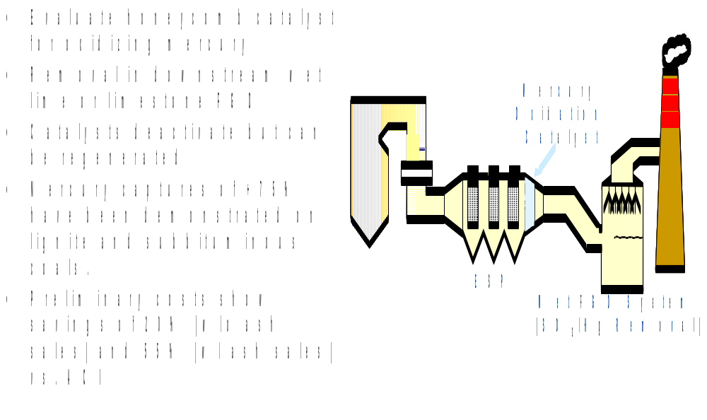
Mercury Oxidation Catalysts

Slide 24
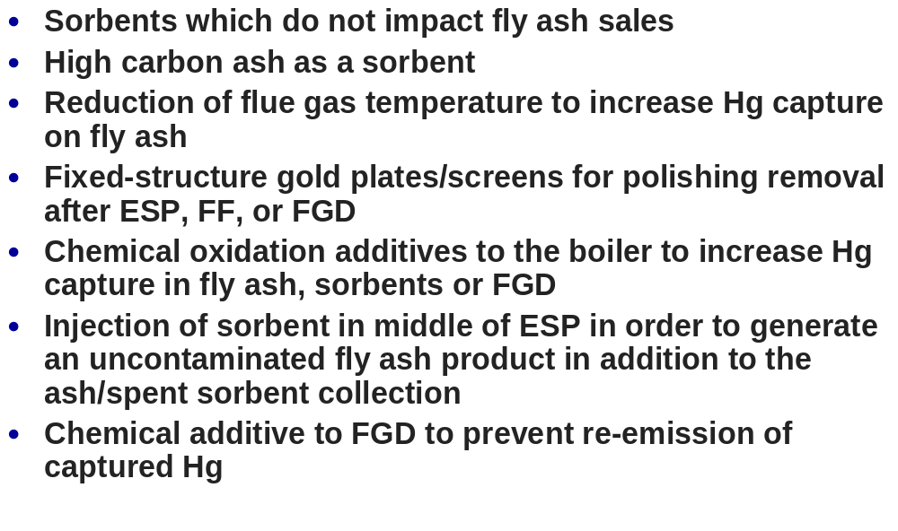
Additional Mercury Control Options

Slide 25
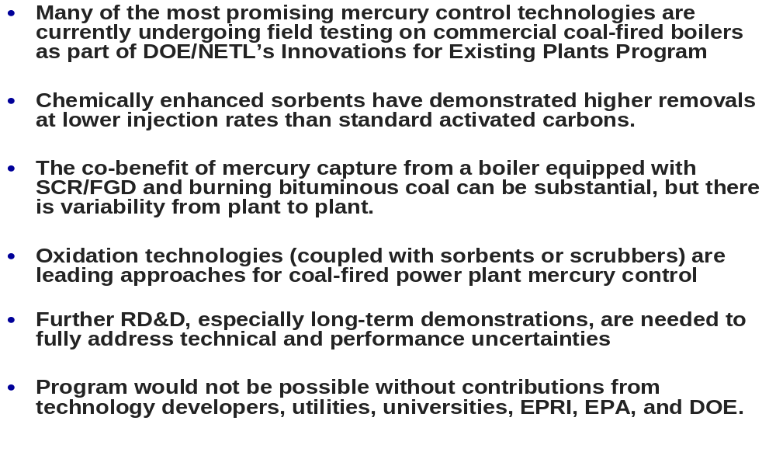

Mercury Summary

Slide 26
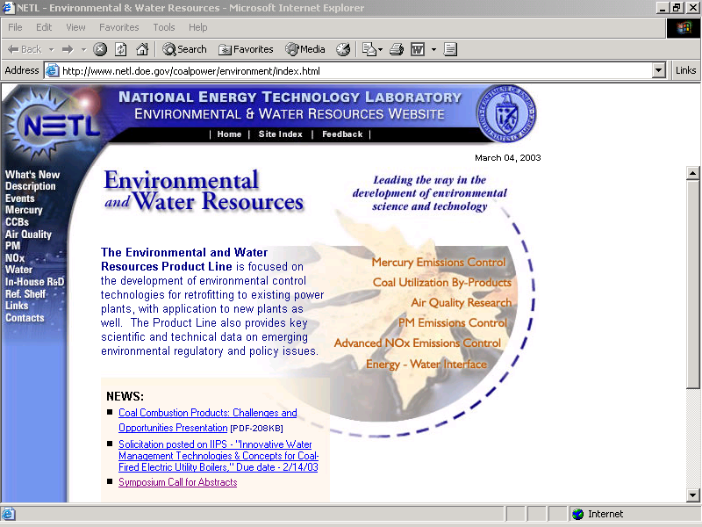
DOE/NETL Environmental and Water Resources
(Innovations for Existing Plants Program)
To find out more about DOE-NETL’s Hg R&D activities visit us at:
http://www.netl.doe.gov/coal/E&WR/index.html

