Slide 1
Construct, Creep, or Caribbean: How Will The US Meet The Need For New Refinery Capacity?
Michael Leister
Fuels Technology Manager
Marathon Ashland Petroleum LLC
APRIL 12, 2005

Slide 2
Recent Headlines
US Product Imports Growing at Alarming Rates
US Product Imports Fall Below Expectations
The US Refining Industry Will Never Build A New Grassroots Refinery
EPA Approves Permits For New Arizona Refinery
US Refining Industry Records Record Profits But Is Unwilling to Expand Capacity
US Refining Industry Invests Record Sums To Meet Clean Fuels Regulation

Slide 3
Gasoline Trends

Slide 4
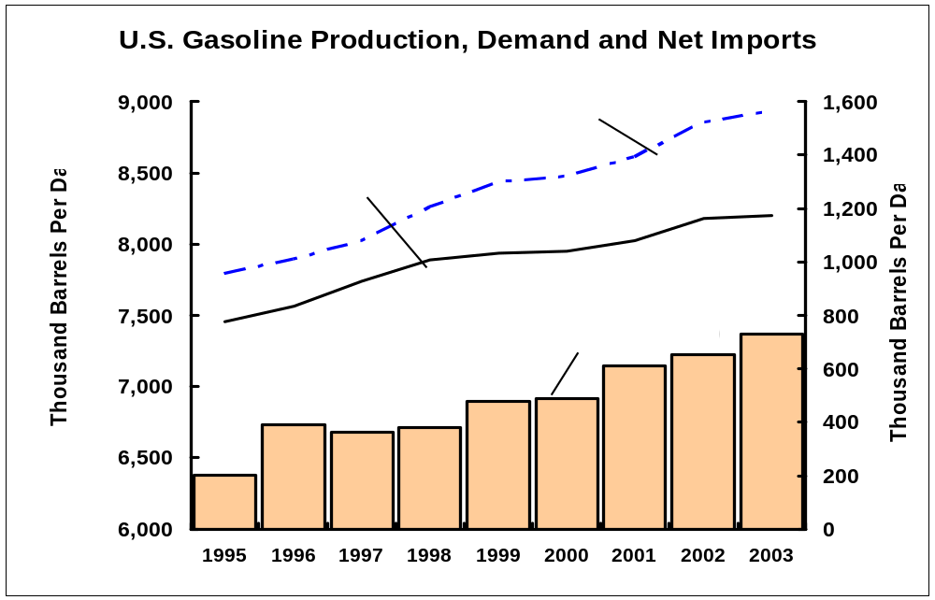
US Gasoline Production, Demand and Net Imports

Slide 5
Gasoline Trends
US demand increasing ~1.5-2% per year
Net imports increasing faster than demand
Imports from Europe are increasing
Product quality requirements are becoming more restrictive
Ethanol production is increasing
MTBE bans are increasing

Slide 6
Distillate Trends

Slide 7
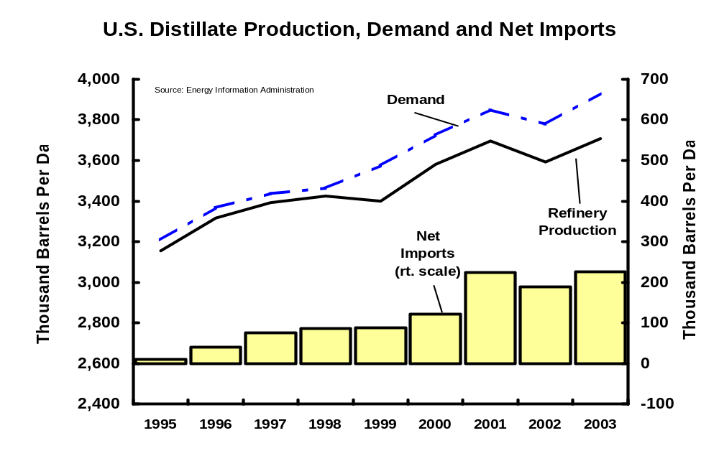
US Distillate Production, Demand and Net Imports

Slide 8
Distillate Trends
Demand increasing ~2% per year
Increased distillate imports are tied to Canadian refinery expansion
Distillate imports into Europe are increasing
Product quality requirements are becoming more restrictive

Slide 9
Import Trends
US has historically imported gasoline from Caribbean, plus recently Europe
US has historically imported only small volumes of highway diesel fuel
Caribbean and European refineries will be capable of producing US Tier 2 gasoline
Europe will import, not export, USLD
It is uncertain if Caribbean refineries will make ULSD investments

Slide 10
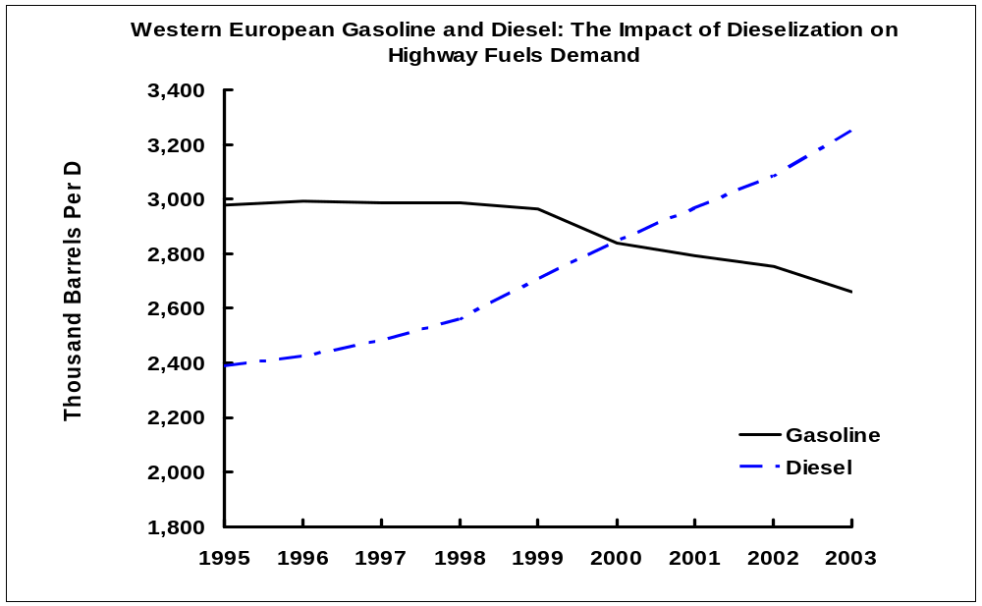
European Gasoline and Diesel Demand
Source: International Energy Agency

Slide 11
Decisions on
Building New Refineries, Expanding Existing Refineries and Importing Products
Are Based On
Economic Expectations

Slide 12
Import Characteristics
Import/Export decisions are driven by profit motives
Flexible transportation allows shipments to be redirected in transit
US Imports Come Into East Coast, Gulf Coast and West Coast
The US distribution system allows PADD’s 1, 2, & 3 to adapt to import impacts of supply and economics.

Slide 13
Import Impacts
Import availability/price impact the incremental cost of supply to US markets East of the Rockies and West Coast
Long term import availability/price provides an alternative to US refinery expansion projects and US grassroots refinery projects, except in areas with limited distribution capabilities
Even if US production capacity is increased, import economics will determine if this capacity is used or not.

Slide 14
Refinery Expansions Cost Less Than Grassroots Refinery Construction
Grassroots Refinery Construction is 3-4 Times more Expensive than Capacity Expansion
  Existing site vs new
  Existing utilities and support units
  Shorter implementation and permitting times
  Limited fixed operating costs vs full
  Investment can be targeted to specific products

Slide 15
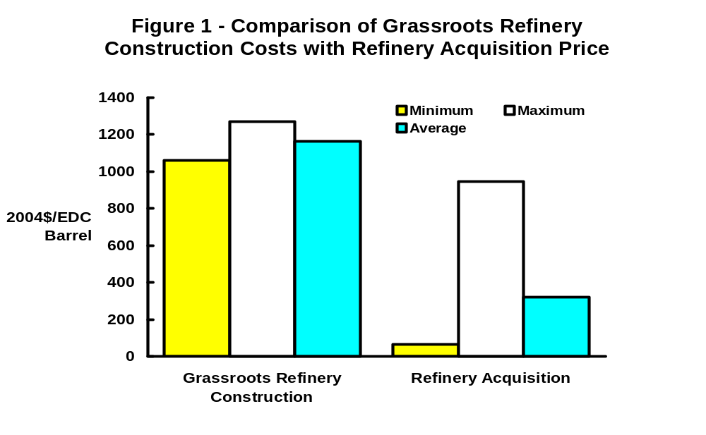
Refinery Construction
Grassroots vs Expansions
Source: NPC Report, ”Observations on Petroleum Product Supply”, 2004

Slide 16
CONCLUSIONS
Import increases have reflected short-term economic opportunity as well as longer term supply choices, which is partially reflected in US refinery utilization variations
Import economics will be reflected in US refinery capacity expansion project decisions.
Recent limited US capacity expansion has been driven by imported product availability and cost
For most of the US, new refineries will only be built when import costs and expansion costs are high enough to justify the higher incremental costs

