Slide 1
Unconventional Oil: Filling in the Gap or Flooding the Market?
DOE NEMS APRIL 12, 2005
Michael C. Lynch
lynch@energyseer.com

Slide 2
URBAN LEGENDS (OIL DIVISION)
CONVENTIONAL OIL NEAR A PEAK
  DISCOVERIES ARE INADEQUATE
TAR SANDS TOO DIRTY TO BE PRODUCED
EROEI ON ETHANOL IS NEGATIVE
SHALE OIL ALWAYS MORE EXPENSIVE THAN CONVENTIONAL OIL
EASY OIL IS GONE, COSTS ARE RISING
OIL MARKET ANALYSTS ARE YOUNG AND HANDSOME

Slide 3
PERTINENT ISSUES
VOLUMES ARE HUGE
COSTS MODERATE—COMPARED TO PRICES, NOT CONVENTIONAL OIL
  VERY CAPITAL INTENSIVE
  FUEL INTENSIVE
RECOVERY RATES LOW
CONTAMINANTS/EMISSIONS SIGNFICANT
WHAT RATE OF CHANGE POSSIBLE?

Slide 4
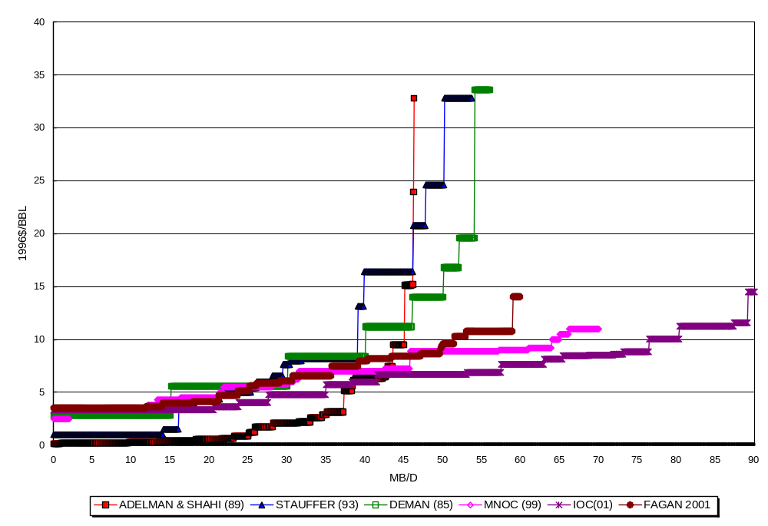
CONVENTIONAL OIL SUPPLY CURVES

Slide 5
HURDLES
NIMBY/GHG AND OTHER ENVIRONMENTAL PROBLEMS
  BUSH CAN OPEN IRAQ, BUT CAN HE OPEN COLORADO?
RELATIVELY HIGH COSTS
  ARE HIGH PRICES PERMANENT?
WILL GOVERNMENTS ACCEPT LOW RETURNS IF PRICES DROP?

Slide 6
ADVANTAGES
NO EXPLORATION RISK, MODERATE POLITICAL RISK
INCREMENTAL VOLUMES MEANS LOWER PRICE RISK
CONTINUING TECHNOLOGICAL IMPROVEMENTS
  NON-VIABLE RESOURCES MOVE INTO VIABLE CATEGORY
  LESS PRICE RISK AS COSTS DROP

Slide 7
MAIN SOURCES
CANADIAN TAR SANDS
VENEZUELAN HEAVY OIL
  ORIMULSION
ETHANOL, MTBE, ETC.
GTL
US SHALE OIL

Slide 8
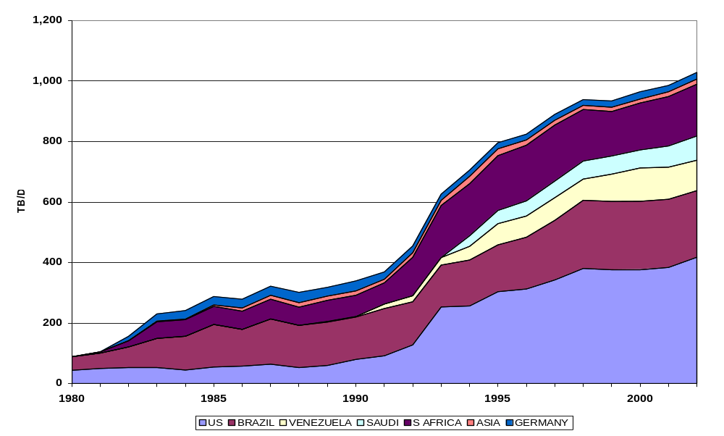
“OTHER” LIQUIDS
(ETHANOL, MTBE, ORIMULISION, ETC.)

Slide 9
HEAVY OIL/TAR SANDS
RESOURCES 5 TRILLION, 10-15% RECOVERABLE
PRODUCTION BOOMING
COSTS ARE APPROXIMATELY $8-12/BBL, $15-18 IF ADJUSTED FOR QUALITY
  EXCHANGE RATE SENSITIVE
CANADA/VENEZUELA MAIN ARENAS
HIGH FUEL USE

Slide 10
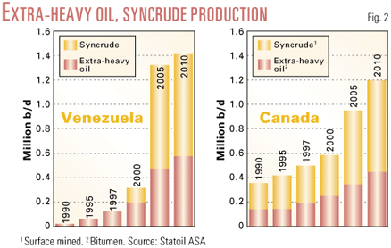
OGJ 7/28/03

Slide 11
SHALE OIL
ENORMOUS RESOURCE, MUCH IN US
  3 TO 10 TRILLION BARRELS
COSTS REMAIN HIGH, RESEARCH ONGOING
WHAT COST MODEL?
  “CRUDE OIL +$5/BBL” (i.e., Manana)
  OR TAR SANDS DECLINE?

Slide 12
GAS-TO-LIQUIDS
LARGE POTENTIAL RESOURCE
  STRANDED GAS OF >1 TRILLION BBLS
  ULTIMATE GAS MUCH MORE
TECHNOLOGY ‘PROVEN’ BUT EVOLVING
500 TB/D IN 5 YEARS
CAPITAL COSTS ARE DROPPING: $50K/BBL TO $25K/BBL (c. $10/BBL)
SENSITIVE TO OIL PRICES, TAXES

Slide 13
INVESTMENT APPROACH
HIGH-COST MEGA-PROJECT
  HOPE PRICES STAY UP
  TAR SANDS/SHALE OIL 1970S
GO FOR SWEET SPOTS
  CBM, ORINOCO, TAR SANDS
DRIVE COSTS DOWN
NEW TECHNOLOGIES
  SAGD

Slide 14
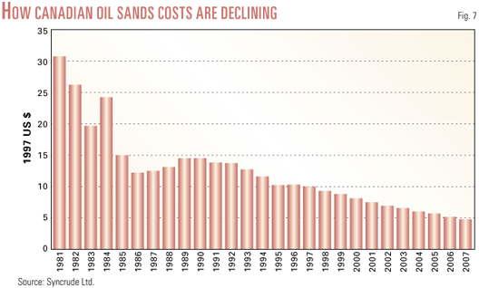
SAMPLE COST TRENDS
Revolutionary
Evolutionary
Oil & Gas Journal 7/28/2003.

Slide 15
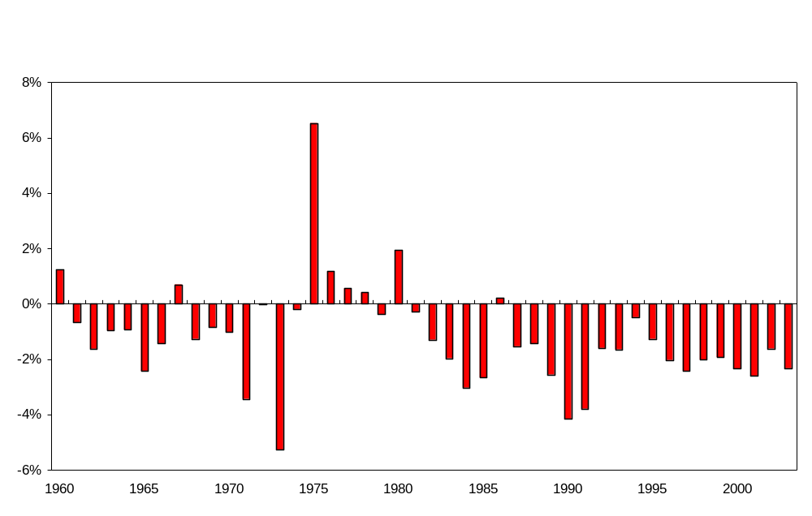
EQUIPMENT COST TRENDS

Slide 16
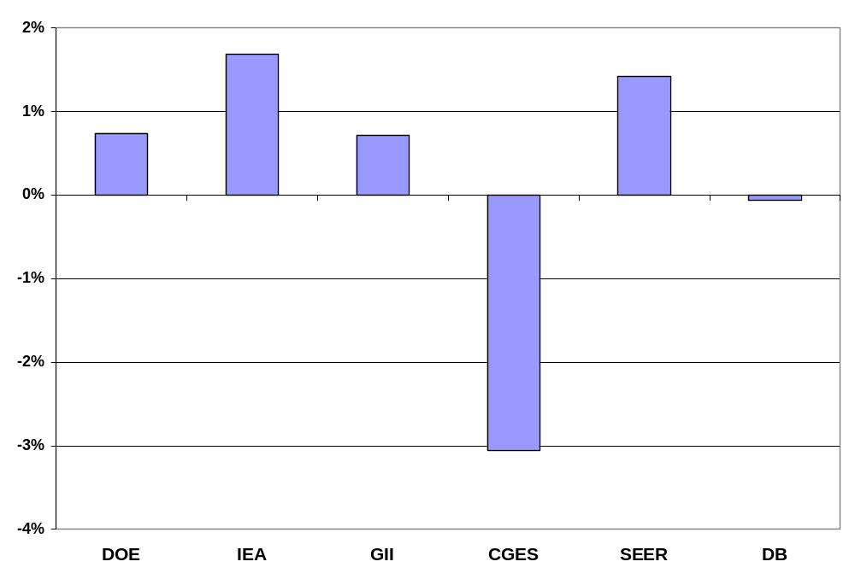
EXPECTED OIL PRICE TREND
(ANNUAL REAL CHANGE 2010-2025)
DOE IEO 2004, expect increase next year.

Slide 17
LESSONS
SHORT-TERM PROBLEMS ARE LONG-TERM OPPORTUNITIES
  ENGINEERS ARE SMART
  HIGH PRICES MOTIVATE THEM
RESOURCES ARE CONTINUOUS
  CONVENTIONAL OIL
  UNCONVENTIONAL OIL
    QUALITY, DENSITY, EASE OF EXTRACTION

Slide 18


Slide 19


Slide 20
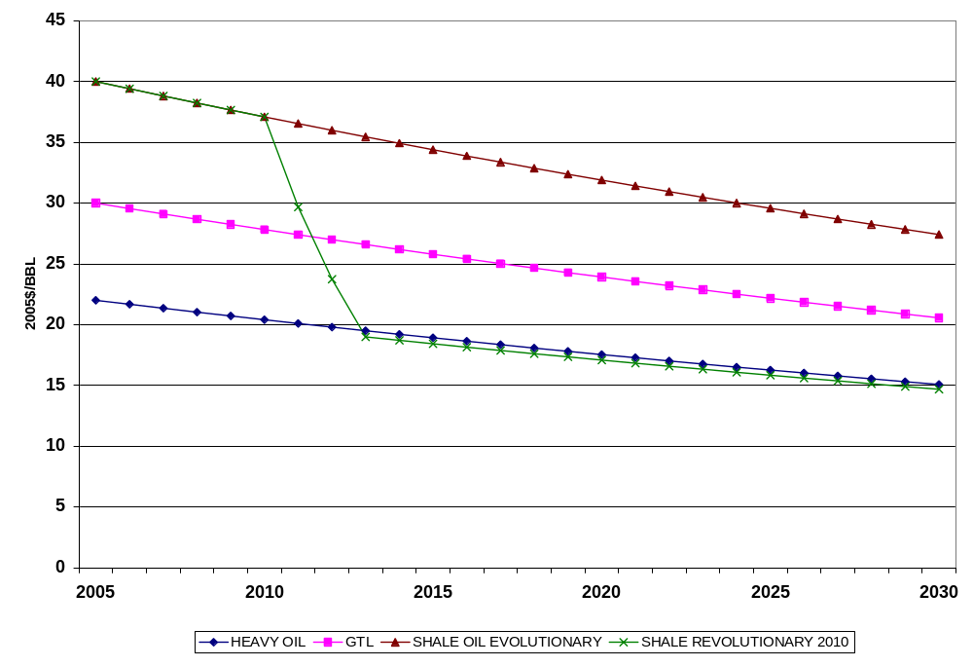
POTENTIAL COST TRENDS

Slide 21
FUTURE TRENDS
WILL HIGH PRICES SEE HEAVY INVESTMENT, THEN COST-CUTTING AS IN TAR SANDS IN 1970S?
WILL LOWER PRICES CAUSE ABANDONMENT OF GTL AS IN 1980S?
HOW WOULD GOVERNMENTS RESPOND TO LOWER PRICES?
  PUSH VOLUMES OR REACH INDIFFERENCE TO INCOME?

Slide 22
EXPECTATIONS
HEAVY OIL/TAR SANDS TO ADD 200-350 TB/D PER YEAR
GTL TO ADD 75-150 TB/D/YR
“OTHER” TO ADD 50-100 TB/D/YR
SHALE OIL NOT BY 2010
PRICE PRIMARY FACTOR DETERMINING LEVEL
  TECHNOLOGY, POLICY SECONDARY

Slide 23
THEREFORE…
MAINLY GAP FILL, BECAUSE OF ‘INERTIA’
  CAN’T ADD CAPACITY FAST ENOUGH TO SWAMP MARKET UNLESS DEMAND WEAK
PRIMARY UNCERTAINTY TO 2010 IS PRICE
  FOLLOWED BY GTL
SHALE OIL COULD BECOME IMPORTANT BY 2015
HIGH INVESTMENT NOW IS THE SEED FOR LOWER COSTS, HIGHER VOLUMES IN NEXT DECADE
  HIGH PRICES FOR 2 MORE YEARS COULD BE BIG TROUBLE FOR OPEC LATER

