Slide 1
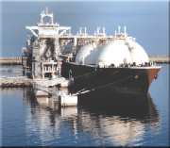
The Rapidly Expanding Role of LNG
in North America
Phyllis Martin
Energy Information Administration
Phyllis.Martin@eia.doe.gov
202-586-9592
EIA Midterm Energy Outlook
and Modeling Conference
Washington, DC
April 12, 2005
Siting Issues
in the Development of U.S. LNG Receiving Terminals

Slide 2
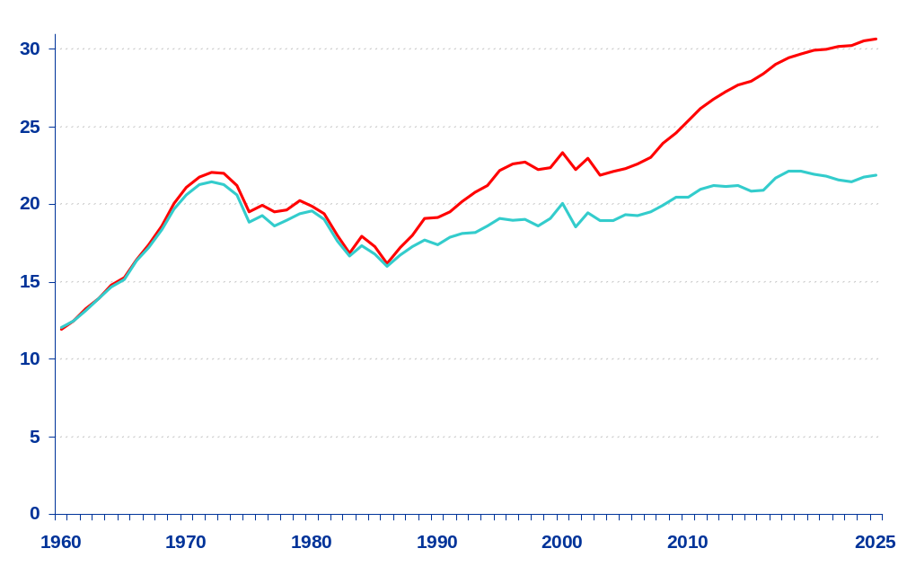
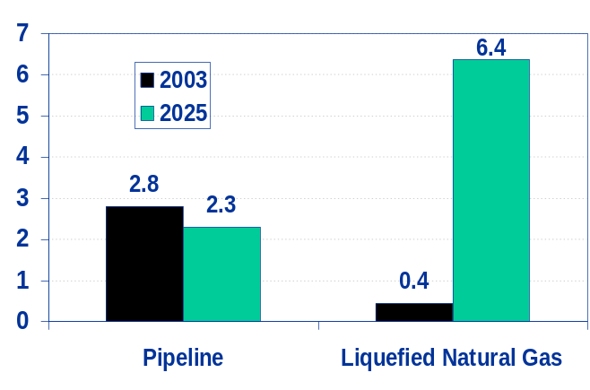
Natural Gas Production, Consumption, and Imports,
1960-2025 (trillion cubic feet)
30.7 Tcf
28%
Consumption
Net imports
15%
21.8 Tcf
Production
Natural Gas Net Imports, 2003 and 2025
(trillion cubic feet)
Source: Annual Energy Outlook 2005

Slide 3
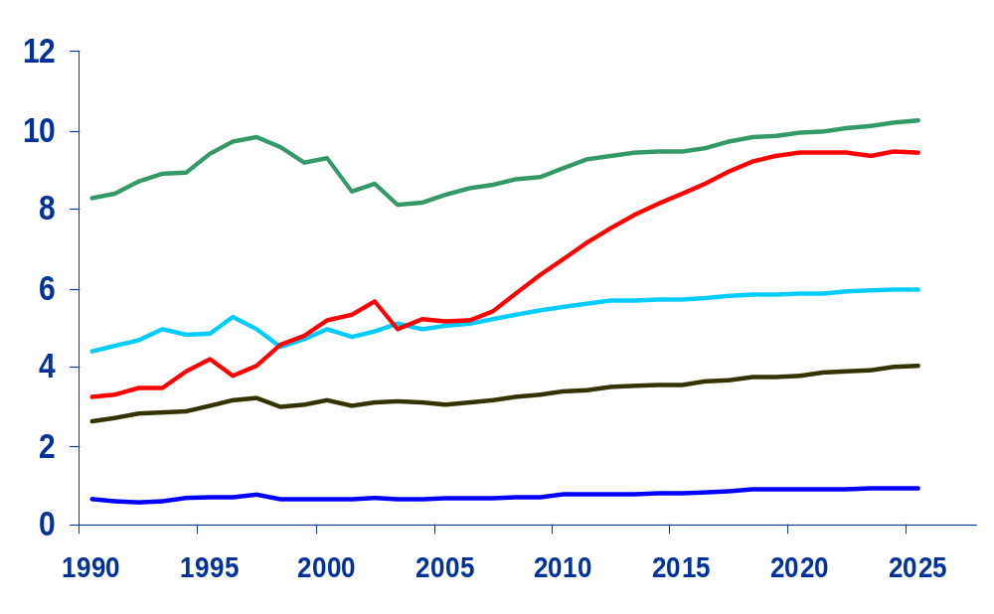
U.S. Natural Gas Consumption by Sector, 1990-2025
(trillion cubic feet)
History
Projections
Industrial*
Electric Generators
Residential
Commercial
Transportation**
* Includes lease and plant fuel
** Includes pipeline fuel
Source: Annual Energy Outlook 2005

Slide 4
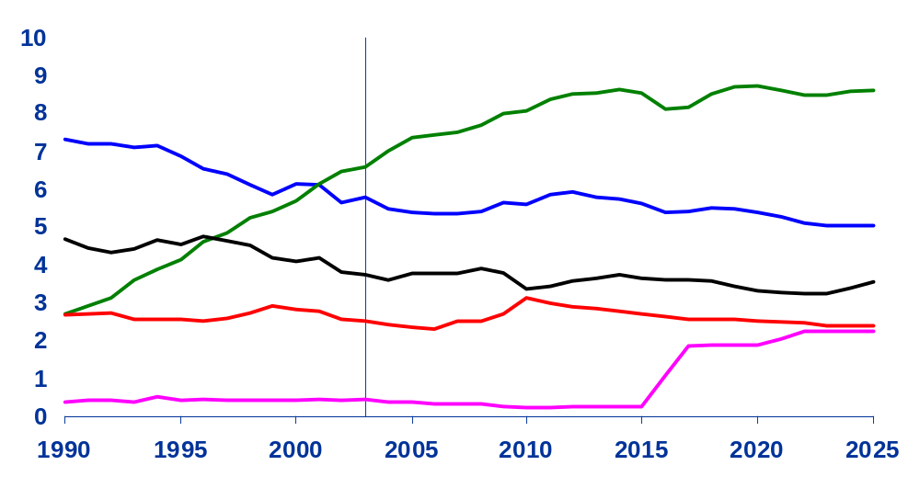
U.S. Dry Natural Gas Production,
1990-2025 (trillion cubic feet)
History
Projections
Onshore Unconventional
Nonassociated
Onshore Conventional
Non-associated Offshore
Associated/Dissolved
Alaska
Source: Annual Energy Outlook 2005

Slide 5
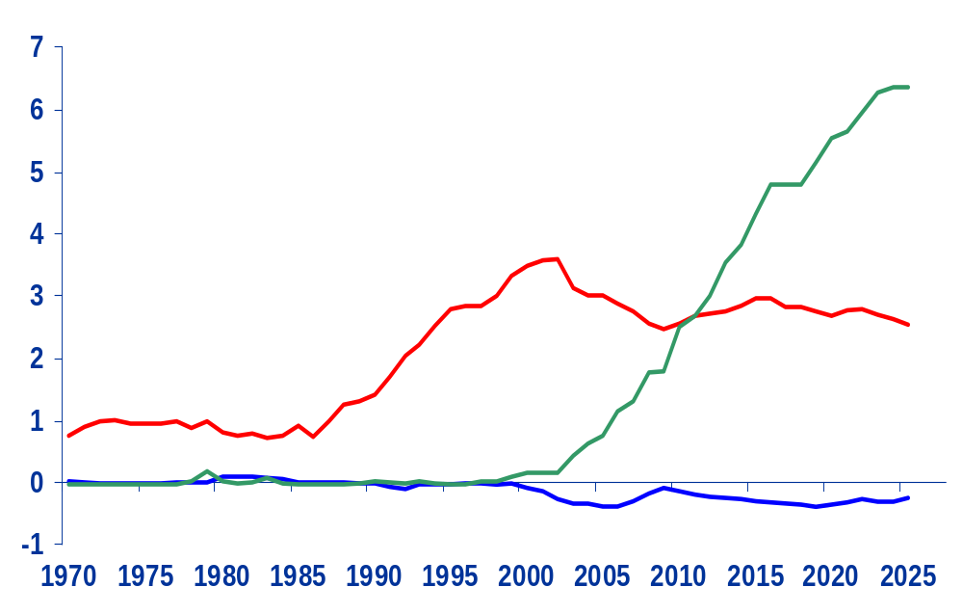
Net U.S. Imports of Natural Gas, 1970-2025
(trillion cubic feet)
History
Projections
Liquefied Natural Gas
Canada
Mexico
Source: Annual Energy Outlook 2005

Slide 6
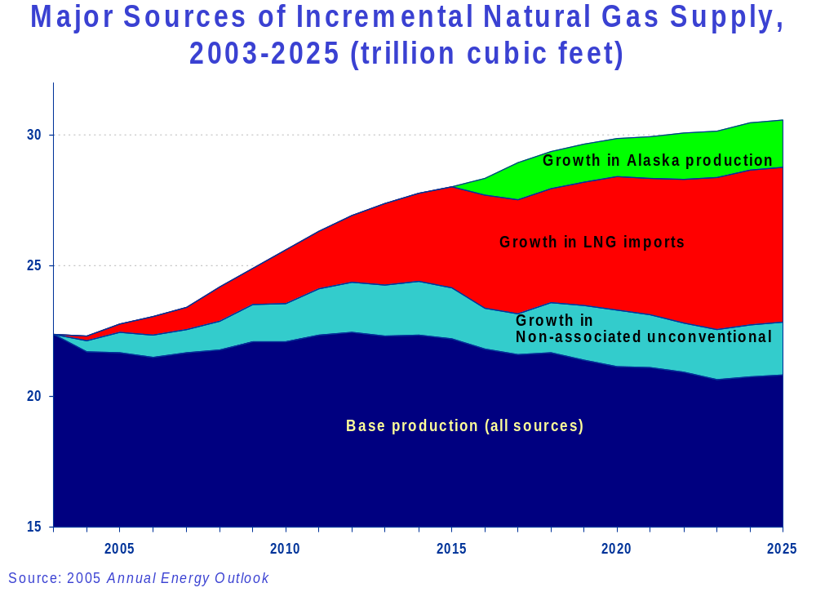

Slide 7
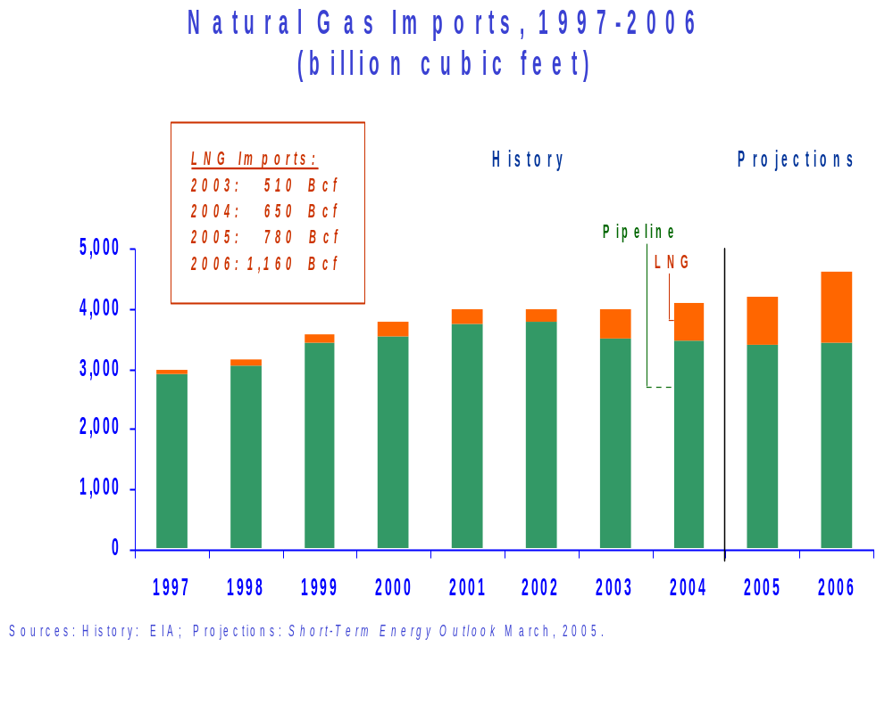

Slide 8
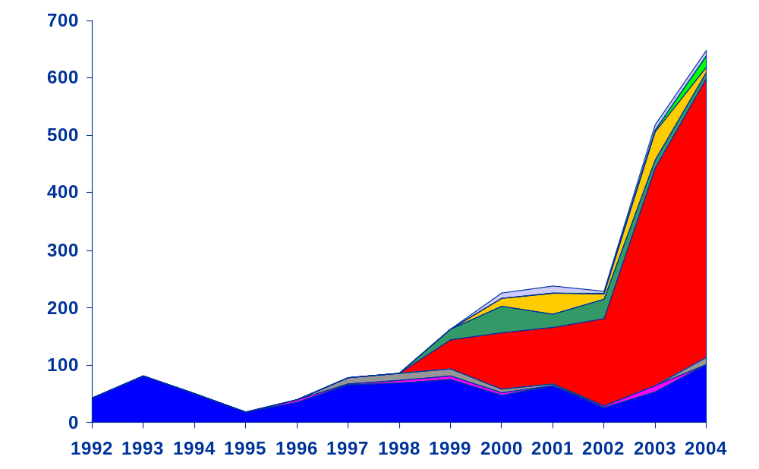
U.S. LNG Imports by Country, 1992-2004
(billion cubic feet)
Malaysia
Trinidad and Tobago
Nigeria
Oman
Qatar
Australia
Algeria
Other
Source: EIA

Slide 9
Current U.S. LNG Import Terminals
Everett, Massachusetts
3.5 Bcf Storage Capacity
Regasification Capacity:
Peak: 885 MMcf per day
Baseload: 710 MMcf per day
Cove Point, Maryland
7.8 Bcf Storage Capacity
Regasification Capacity:
Peak: 1 Bcf per day
Baseload: 750 MMcf per day
Elba Island, Georgia
4.1 Bcf Storage Capacity
Regasification Capacity:
Peak: 675 MMcf per day
Baseload: 460 MMcf per day
Lake Charles, Louisiana
6.3 Bcf Storage Capacity
Regasification Capacity:
Peak: 1.2 Bcf per day
Baseload: 630 MMcf per day
Gulf of Mexico, Offshore
Shipboard
Regasification Capacity:
Peak: 500 MMcf per day
Baseload: 500 MMcf per day
Source: Energy Information Administration

Slide 10
FERC
CONSTRUCTED
A. Everett, MA : 1.035 Bcfd (Tractebel - DOMAC)
B. Cove Point, MD : 1.0 Bcfd (Dominion - Cove Point LNG)
C. Elba Island, GA : 0.68 Bcfd (El Paso - Southern LNG)
D. Lake Charles, LA : 1.0 Bcfd (Southern Union - Trunkline LNG)
E. Gulf of Mexico: 0.5 Bcfd, (Gulf Gateway Energy Bridge - Excelerate Energy)
APPROVED BY FERC
1. Lake Charles, LA: 1.1 Bcfd (Southern Union - Trunkline LNG)
2. Hackberry, LA : 1.5 Bcfd, (Sempra Energy)
3. Bahamas : 0.84 Bcfd, (AES Ocean Express)*
4. Bahamas : 0.83 Bcfd, (Calypso Tractebel)*
5. Freeport, TX : 1.5 Bcfd, (Cheniere/Freeport LNG Dev.)
6. Sabine, LA : 2.6 Bcfd (Cheniere LNG)
7. Elba Island, GA: 0.54 Bcfd (El Paso - Southern LNG)
APPROVED BY MARAD/COAST GUARD
8. Port Pelican: 1.6 Bcfd, (Chevron Texaco)
9. Louisiana Offshore : 1.0 Bcfd (Gulf Landing - Shell)
PROPOSED TO FERC
10. Fall River, MA : 0.8 Bcfd, (Weaver's Cove Energy/Hess LNG)
11. Long Beach, CA : 0.7 Bcfd, (Mitsubishi/ConocoPhillips - Sound Energy Solutions)
12. Corpus Christi, TX : 2.6 Bcfd, (Cheniere LNG)
13. Corpus Christi, TX : 1.0 Bcfd (Vista Del Sol - ExxonMobil)
14. Sabine, TX : 1.0 Bcfd (Golden Pass - ExxonMobil)
15. Logan Township, NJ : 1.2 Bcfd (Crown Landing LNG - BP)
16. Bahamas : 0.5 Bcfd, (Seafarer - El Paso/FPL )
17. Corpus Christi, TX: 1.0 Bcfd (Ingleside Energy - Occidental Energy Ventures)
18. Providence, RI : 0.5 Bcfd (Keyspan & BG LNG)
19. Port Arthur, TX: 1.5 Bcfd (Sempra)
20. Cove Point, MD : 0.8 Bcfd (Dominion)
21. LI Sound, NY: 1.0 Bcfd (Broadwater Energy - TransCanada/Shell)
22. Pascagoula, MS: 1.0 Bcfd (Gulf LNG Energy LLC)
23. Bradwood, OR: 1.0 Bcfd (Northern Star LNG - Northern Star Natural Gas LLC)
24. Pascagoula, MS: 1.3 Bcfd (Casotte Landing - ChevronTexaco)
25. Cameron, LA: 3.3 Bcfd (Creole Trail LNG - Cheniere LNG)
26. Port Lavaca, TX: 1.0 Bcfd (Calhoun LNG - Gulf Coast LNG Partners)
PROPOSED TO MARAD/COAST GUARD
27. California Offshore: 1.5 Bcfd (Cabrillo Port - BHP Billiton)
28. So. California Offshore : 0.5 Bcfd, (Crystal Energy)
29. Louisiana Offshore : 1.0 Bcfd (Main Pass McMoRan Exp.)
30. Gulf of Mexico: 1.0 Bcfd (Compass Port - ConocoPhillips)
31. Gulf of Mexico: 2.8 Bcfd (Pearl Crossing - ExxonMobil)
32. Gulf of Mexico: 1.5 Bcfd (Beacon Port Clean Energy Terminal - ConocoPhillips)
POTENTIAL SITES IDENTIFIED BY PROJECT SPONSORS
33. Coos Bay, OR: 0.13 Bcfd, (Energy Projects Development)
34. Somerset, MA: 0.65 Bcfd (Somerset LNG)
35. California - Offshore: 0.75 Bcfd, (Chevron Texaco)
36. Pleasant Point, ME : 0.5 Bcf/d (Quoddy Bay, LLC)
37. St. Helens, OR: 0.7 Bcfd (Port Westward LNG LLC)
38. Offshore Boston, MA: 0.8 Bcfd (Northeast Gateway - Excelerate Energy)
39. Galveston, TX: 1.2 Bcfd (Pelican Island - BP)
40. Philadelphia, PA: 0.6 Bcfd (Freedom Energy Center - PGW)
41. Astoria, OR: 1.0 Bcfd (Skipanon LNG - Calpine)
42. Freeport, TX: 1.5 Bcfd, (Cheniere/Freeport LNG Dev. - Expansion)
43. Offshore Boston, MA: 0.4 Bcfd (Neptune LNG - Tractebel)
CANADIAN APPROVED AND POTENTIAL TERMINALS
44. St. John, NB : 1.0 Bcfd, (Canaport - Irving Oil)
45. Point Tupper, NS 1.0 Bcf/d (Bear Head LNG - Anadarko)
46. Quebec City, QC : 0.5 Bcfd (Project Rabaska - Enbridge/Gaz Met/Gaz de France)
47. Rivière-du- Loup, QC: 0.5 Bcfd (Cacouna Energy - TransCanada/PetroCanada)
48. Kitimat, BC: 0.61 Bcfd (Galveston LNG)
49. Prince Rupert, BC: 0.30 Bcfd (WestPac Terminals)
50. Goldboro, NS 1.0 Bcfd (Keltic Petrochemicals)
MEXICAN APPROVED AND POTENTIAL TERMINALS
51. Altamira, Tamulipas : 0.7 Bcfd, (Shell/Total/Mitsui)**
52. Baja California, MX : 1.0 Bcfd, (Sempra & Shell)**
53. Baja California - Offshore : 1.4 Bcfd, (Chevron Texaco)
54. Lázaro Cárdenas, MX : 0.5 Bcfd (Tractebel/Repsol)
55. Puerto Libertad, MX: 1.3 Bcfd (Sonora Pacific LNG)
Existing, Proposed and Potential North American
LNG Terminals
49
48
46
47
45
36
44
50
41
23
A
43
33
37
18
10
38
21
34
15
40
B
20
27
11
28
35
52
C
7
53
6
D,1
2
22
16
55
5,42
25
24
3
4
12
14
31
1
30
17
13
19
E
29
39
26
32
9
51
8
US Jurisdiction
FERC
US Coast Guard
54
As of March 25, 2005
* US pipeline approved; LNG terminal pending in Bahamas
** These projects have been approved by the Mexican and Canadian authorities
Office of Energy Projects

Slide 11
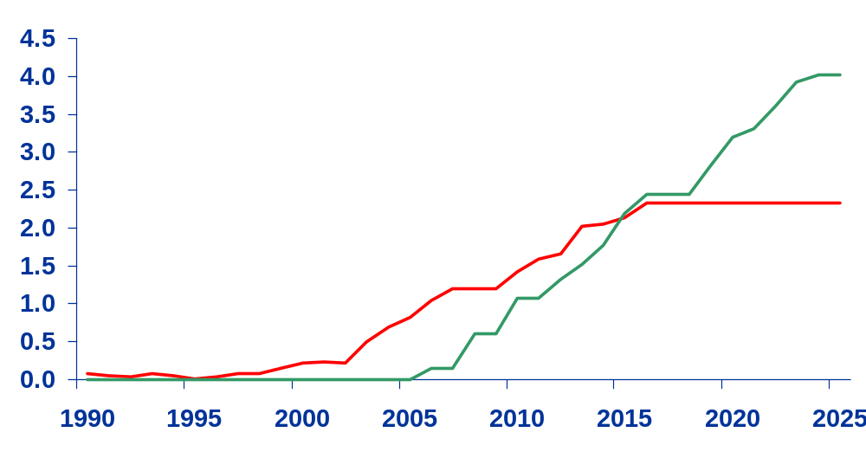
U.S. LNG Imports, 1990-2025
(trillion cubic feet)
History
Projections
New terminals
Existing terminals
Source: 2005 Annual Energy Outlook

Slide 12
Regional LNG Imports at New Terminals,
2010, 2015, 2020, and 2025 (billion cubic feet)
114
128
2010
New
0
0
2015
England
(2020)
2020
WA/OR
West
New England
2025
Mountain
North
Mid
256
Central
Atlantic
128
East
0
0
North
(2020)
Central
Middle Atlantic
2008
413
CA
East
South
West
1551
South
Atlantic
188
AZ/NM
South
Central
0
0
Central
(2016)
1086
930
930
South Atlantic
183
183
183
244
807
293
293
293
(2007)
615
FL
146
Mexico into US
310
(2010)
Florida
(20xx) – Start year of first new terminal
(2010)
(2006)
East South Central
West South Central
Source: EIA Annual Energy Outlook 2005

Slide 13
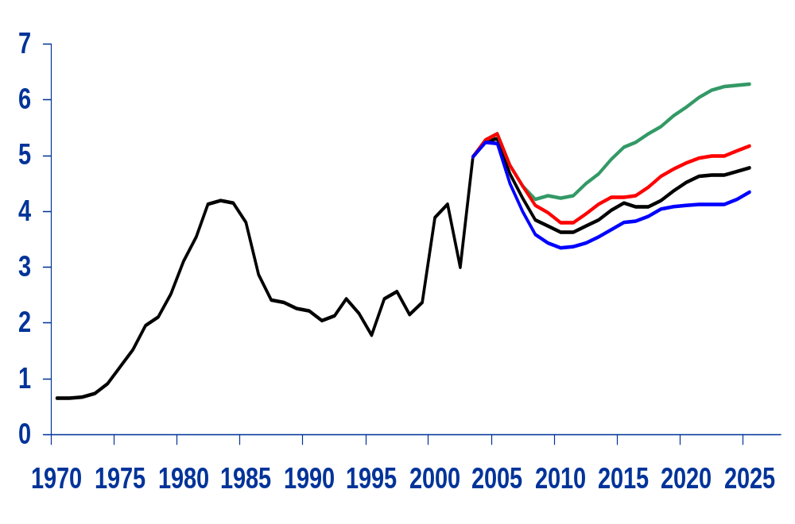
Lower 48 Natural Gas Wellhead Prices,
1970-2025 (2003 dollars per thousand cubic feet)
History
Projections
Restricted Supply $6.29
Slow technology $5.18
Reference case $4.79
Rapid Technology $4.35
Source: EIA Annual Energy Outlook 2005

Slide 14
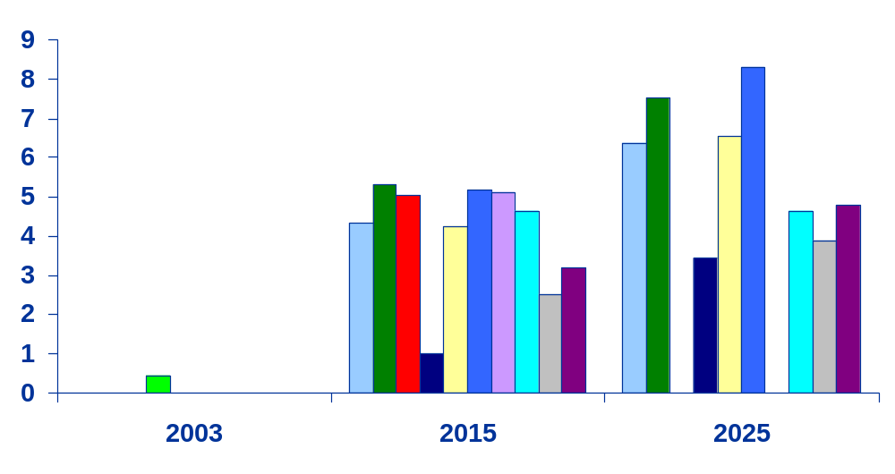
Comparison of Net LNG Import Forecasts
(trillion cubic feet)
History
Projections
EEA
EVA
GII
SEER
PIRA
EIA
DB
NARG
NPC/
RP
NPC/
BF
Source: 2005 Annual Energy Outlook

Slide 15
Summary
More than 8 tcf of new U.S. gas supply will be needed by 2025, with more than 60 percent coming from imports.
By 2025, almost 75 percent of net U.S. imports is expected to come from LNG, as Canadian imports decline.
    Siting issues are a key component in determining the rate of penetration of new LNG facilities into the marketplace.
    NIMBY issues and safety concerns must be addressed if LNG is to become a viable source of supplemental supply for North American markets.
Phyllis Martin
Energy Information Administration
Phyllis.Martin@eia.doe.gov

