Slide 1
Unconventional Gas: Challenges, Successes, and Future Outlook
Unconventional Gas Production Projections in
the Annual Energy Outlook 2005: An Overview
Ted McCallister
Energy Information Administration
ted.mccallister@eia.doe.gov
202-586-4820
EIA Midterm Energy Outlook
and Modeling Conference
Washington, DC
April 12, 2005

Slide 2
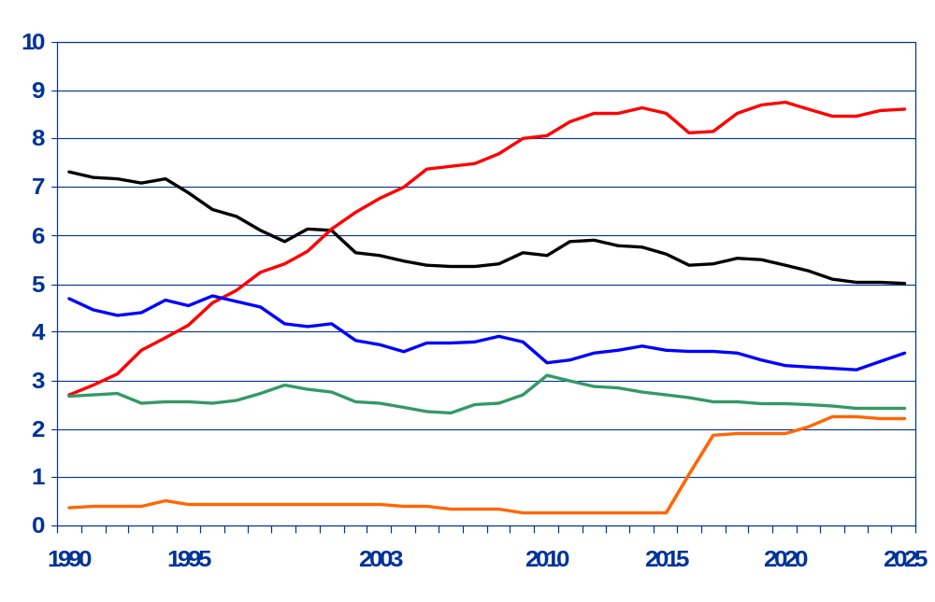
Natural Gas Production by Source 1990-2025
(Trillion Cubic Feet)
History
Projections
Lower 48 Non-Associated Unconventional
Lower 48 Non-Associated Conventional Onshore
Lower 48 Non-Associated Offshore
Lower 48 Associated-Dissolved
Alaska

Slide 3
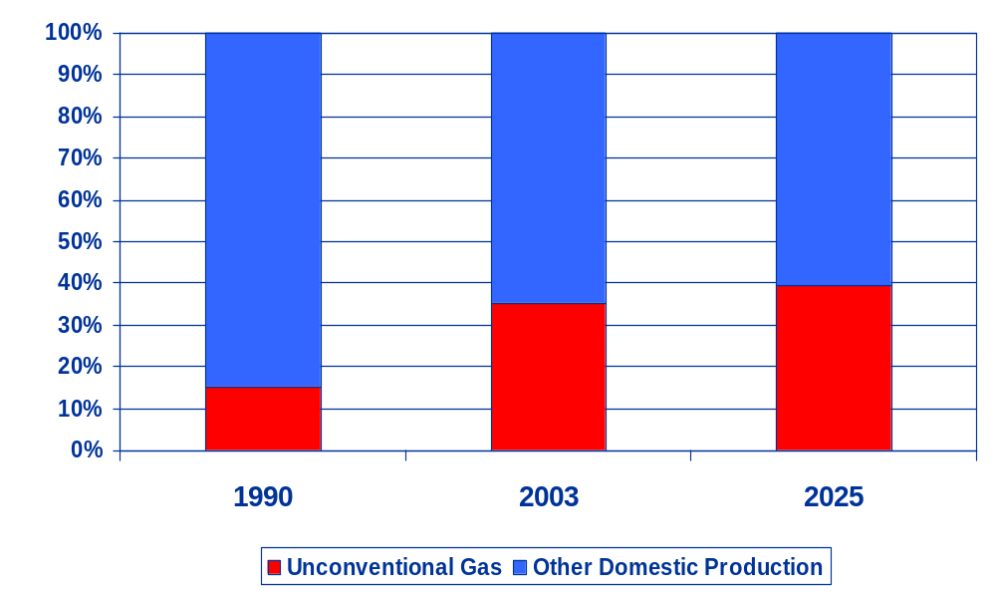
Unconventional Gas Share of Production

Slide 4
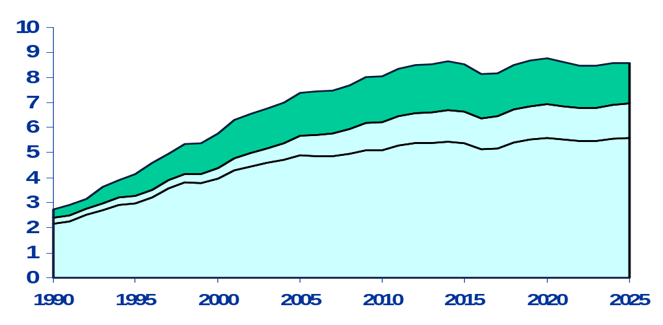
U.S. Unconventional Natural Gas Production,
1990-2025 (trillion cubic feet)
History
Projections
Coalbed methane
Gas shales
Tight sands

Slide 5
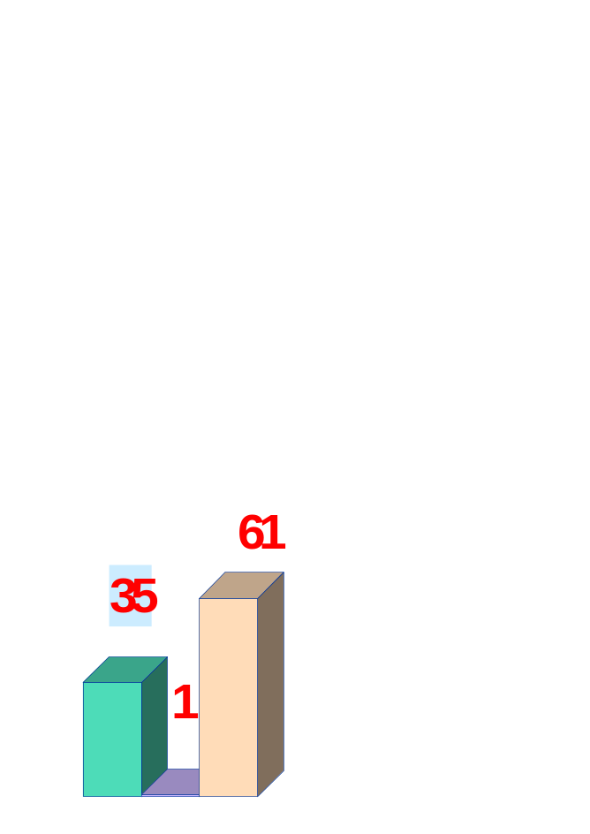


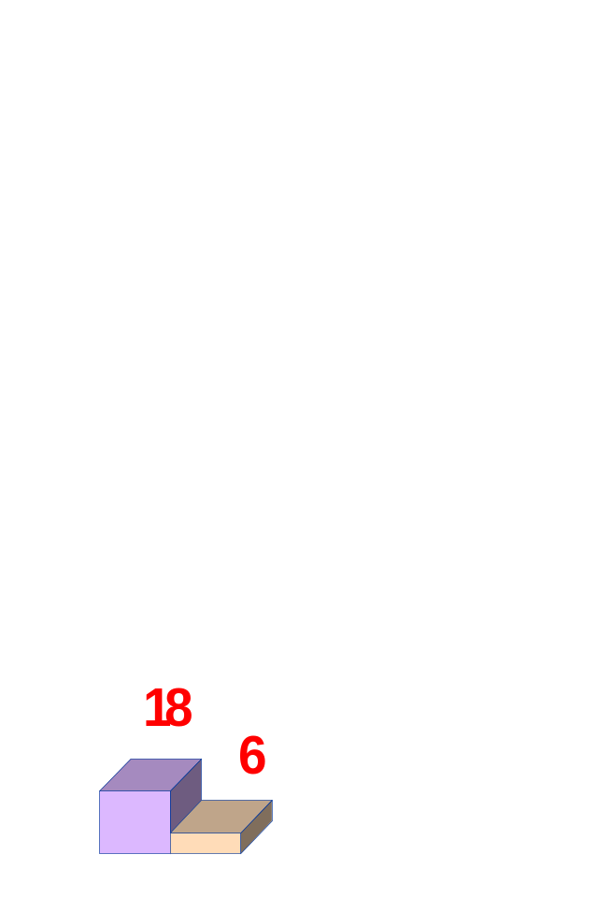
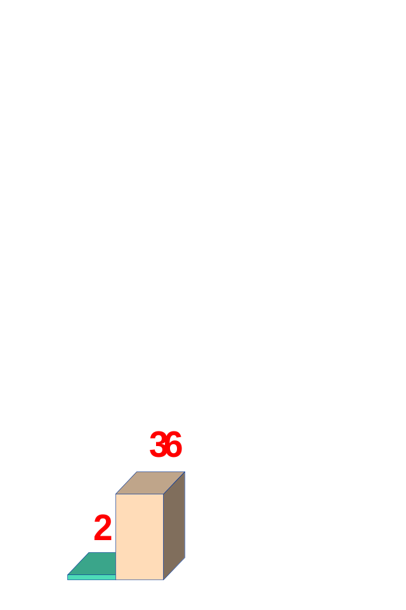
Cumulative Unconventional Gas Production by Region, 2003-2025 (Trillion Cubic Feet)
Rocky Mountain
West Coast
Midcontinent
Northeast
DC
Southwest
Gulf Coast
Coalbed Methane
Gas Shales
Tight Sands

Slide 6
-
Coalbed Methane Basins (and Resources) - Northeast Region
ME
VT
WI
NH
NY
MA
MI
CT
RI
PA
Appalachia
(10 Tcf)
Illinois
(1 Tcf)
NJ
IN
OH
DE
DC
MD
IL
WV
VA
KY
TN
NC
SC
GA

Slide 7
Coalbed Methane Basins (and Resources) - Gulf Coast Region
Black Warrior
(2 Tcf)
Cahaba
(1 Tcf)
MS
AL
LA
TX
FL

Slide 8
Coalbed Methane Basins (and Resources) – Midcontinent Region
MN
Midcontinent
(8 Tcf)
IA
NE
KS
MO
TX
RR10
OK
AR

Slide 9
Coalbed Methane Basins (and Resources) - Rocky Mountain Region
Powder River
(24 Tcf)
MT
ND
ID
SD
WY
Uinta
(6 Tcf)
Greater Green River
(2 Tcf)
NV
UT
CO
Piceance
(8 Tcf)
San Juan
(33 Tcf)
AZ
Raton
(6 Tcf)
NM
WEST

Slide 10
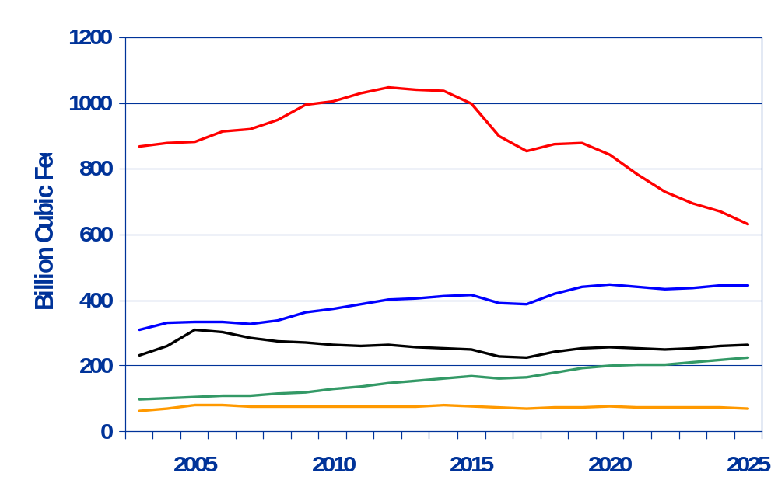
Coalbed Methane Production by Basin
San Juan
(-1.4%)
Powder River
(+1.7%)
Non-Rocky Mountain
(0.6%)
Uinta-Piceance
(3.9%)
Other Rocky Mountain
(0.5%)

Slide 11
-
Gas Shales Basins (and Resources) - Northeast Region
Michigan Antrim
(13 Tcf)
ME
VT
WI
NH
NY
MA
MI
CT
RI
Appalachia
(19 Tcf)
PA
NJ
IN
OH
DE
New Albany
(2 Tcf)
DC
MD
IL
WV
VA
KY
TN
NC
SC
GA

Slide 12
Gas Shales Basins (and Resources) - Southwest Region
Fort Worth Barnett
(45 Tcf)
NM
EAST
TX

Slide 13
Gas Shales Basins (and Resources) - Rocky Mountain Region
Williston
(4 Tcf)
MT
ND
ID
SD
WY
NV
UT
CO
San Juan
(11 Tcf)
AZ
NM
WEST

Slide 14
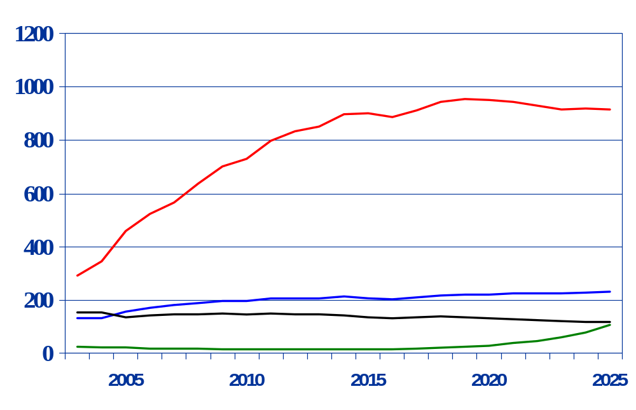
Gas Shales Production by Basin
Fort Worth Barnett
(5.3%)
Appalachia
(2.6%)
Michigan Antrim
(-1.3%)
San Juan
(7.0%)

Slide 15
Tight Sands Basins (and Resources) - Northeast Region
ME
VT
WI
NH
NY
MA
MI
CT
RI
PA
Appalachia
(64 Tcf)
NJ
IN
OH
DE
DC
MD
IL
WV
VA
KY
TN
NC
SC
GA

Slide 16
Tight Sands Basins (and Resources) - Gulf Coast Region
East Texas
(50 Tcf)
MS
AL
LA
TX
FL
Gulf Coast
(30 Tcf)

Slide 17
Tight Sands Basins (and Resources) - Midcontinent Region
MN
IA
NE
KS
Anadarko
(11 Tcf)
MO
Arkoma
(6 Tcf)
TX
RR10
OK
AR

Slide 18
Tight Sands Basins (and Resources) - Southwest Region
NM
EAST
Permian
(13 Tcf)
TX

Slide 19
Tight Sands Basins (and Resources) - Rocky Mountain Region
Williston
(6 Tcf)
MT
ND
Wind River
(27 Tcf)
ID
SD
WY
Greater Green River
(99 Tcf)
Uinta
(10 Tcf)
NV
UT
Denver
(8 Tcf)
CO
San Juan
(22 Tcf)
Piceance
(31 Tcf)
AZ
NM
WEST

Slide 20
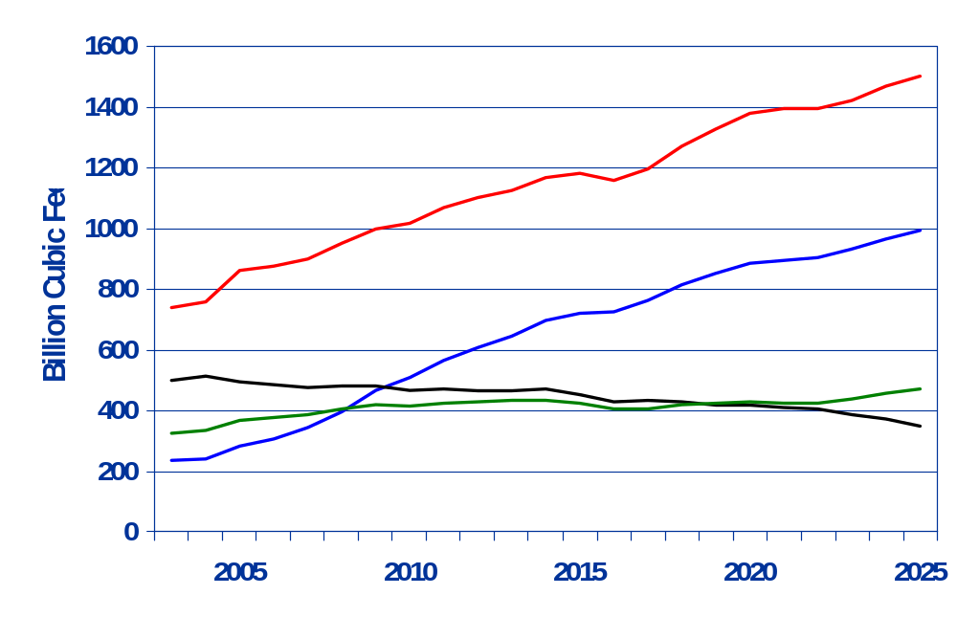
Tight Sands Production by Basin:
Rocky Mountain Basins
Greater Green River
(3.3%)
Uinta-Piceance
(6.8%)
San Juan
(-1.6%)
Other Rocky Mountain
(1.7%)

Slide 21
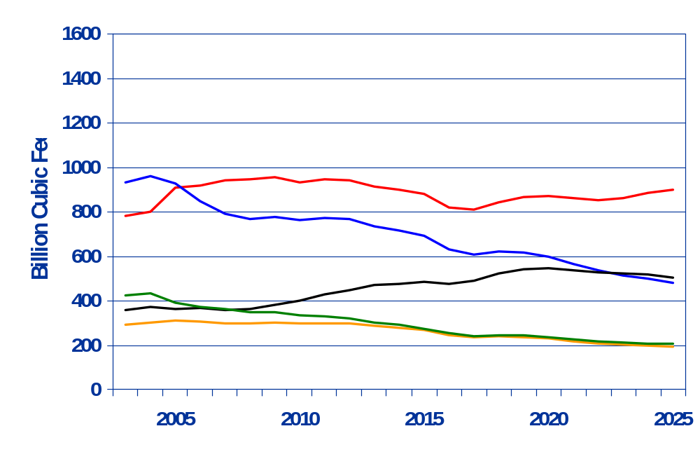
Tight Sands Production by Basin:
Non-Rocky Mountain Basins
Texas Gulf
(-3.0%)
East Texas
(0.6%)
Midcontinent
(-3.2%)
Appalachia
(1.7%)
Permian
(-1.9%)

Slide 22
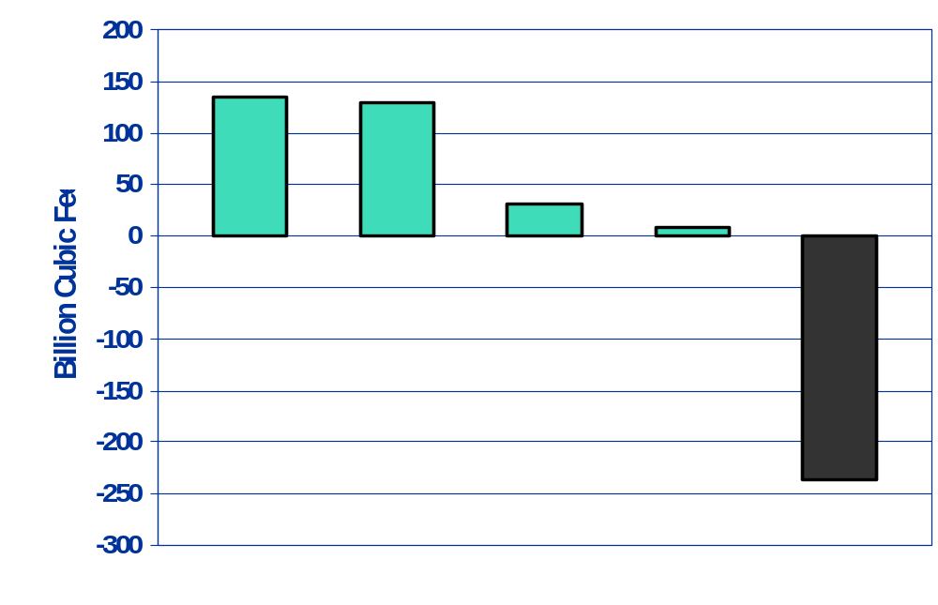
Coalbed Methane Production Growth by Basin,
2025 vs 2003
Powder River
(135 Bcf)
Uinta-Piceance
(129 Bcf)
Non-Rocky Mountain
(32 Bcf)
Other Rocky Mountain
(8 Bcf)
San Juan
(-236 Bcf)

Slide 23
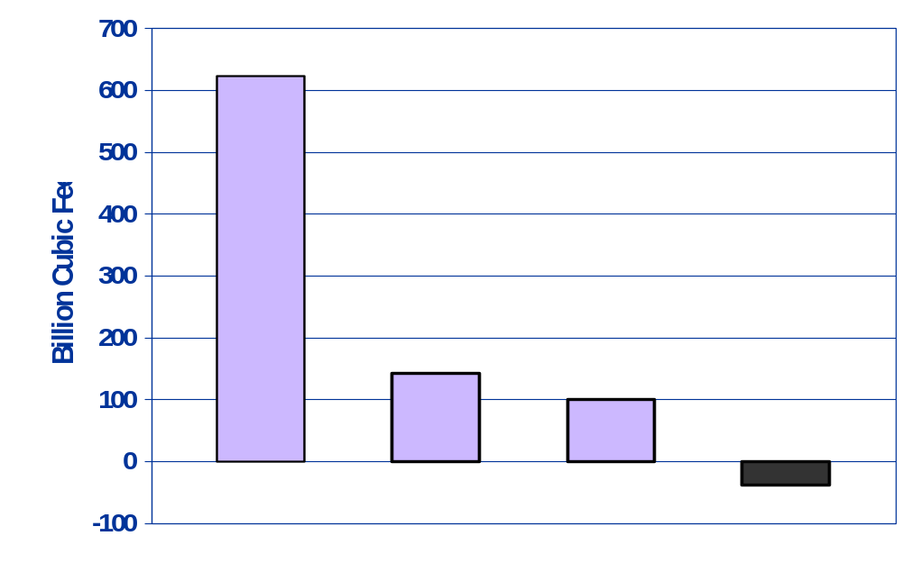
Gas Shales Production Growth by Basin, 2025 vs 2003
Fort Worth Barnett
(623 Bcf)
San Juan
(144 Bcf)
Appalachia
(101 Bcf)
Michigan Antrim
(-38 Bcf)

Slide 24
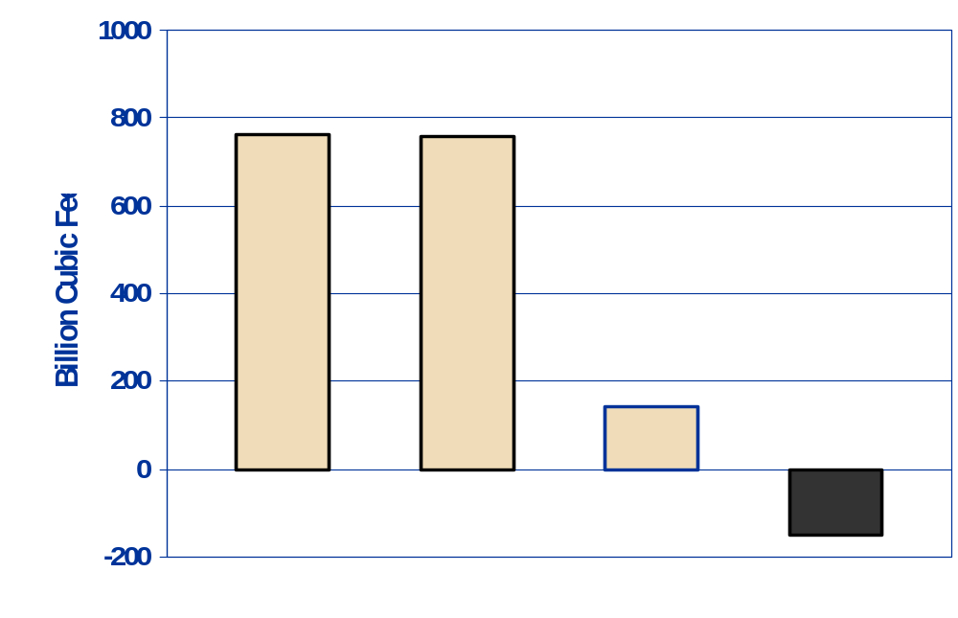
Tight Sands Production Growth by Basin, 2025 vs 2003:
Rocky Mountain Basins
Greater Green River
(761 Bcf)
Uinta-Piceance
(760 Bcf)
Other Rocky Mountain
(144 Bcf)
San Juan
(-152 Bcf)

Slide 25
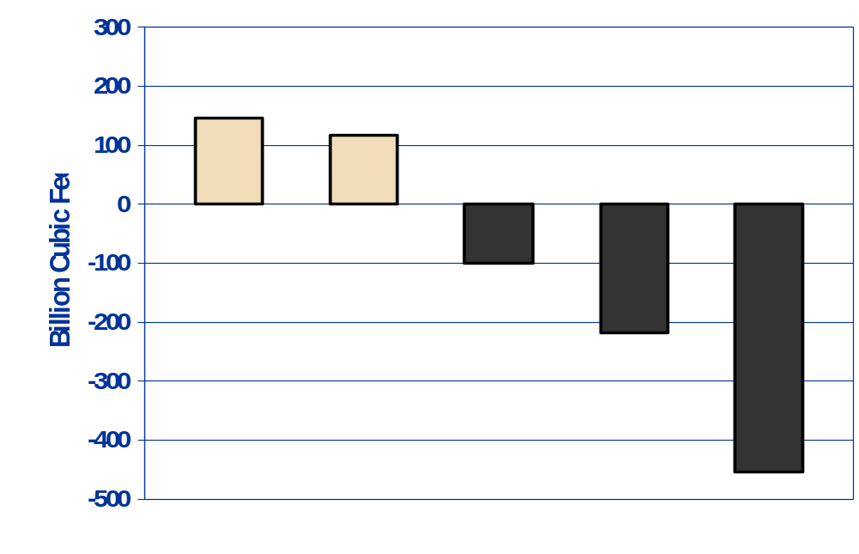
Tight Sands Production Growth by Basin:
Non-Rocky Mountain Basins
Appalachia
(146 Bcf)
East Texas
(117 Bcf)
Permian
(-99 Bcf)
Midcontinent
(-217 Bcf)
Gulf Coast
(-455 Bcf)

