Slide 1
State Renewable Energy Requirements and Goals:
Status Through 2003
Thomas Petersik
Chris Namovicz

Slide 2
End of 2003
15 States, 17 Programs
9 Renewable Portfolio Standards (RPS)
4 Mandates
4 Voluntary Goals

Slide 3
In this presentation -
Define RPS, Mandates, Goals
Identify States With Each
Briefly Describe Key Characteristics
Show Amount of Capacity Built in Each
Introduce Changes Since 2003
Discuss Expectations for Future

Slide 4
Renewable Portfolio Standards
9 States
RPS Set Increasing Percentages Over Time
RPS Set Shares of Generation or Sales
Do Not Specify or Project New Capacity
Supplier Can Choose From a Menu (Portfolio) of Renewable Energy Choices
Most Just Beginning, Peaking Around 2010
Arizona, California, Connecticut, Maine, Massachusetts, Nevada, New Jersey, New Mexico, and Wisconsin

Slide 5
RPS
5 of 9 Established as Part of Deregulation
7 of 9 Accept Existing Capacity
All 9 Accept Out-of-State Supply
8 Accept Credit Trading
All Accept Landfill Gas, Solar, and Wind
Acceptance of Biomass, Hydro Varies
3 Favor Some Renewables (usually solar)

Slide 6
RPS
Financing, Alternatives
6 States Allow Costs Passed to Ratepayers
Only 3 Allow Systems Benefits Charges
Only 4 Explicitly Allow Green Power Contributions to RPS
8 of 9 Excuse if Costs are Excessive
7 of 9 Feature non-Cost Alternatives/Delays
8 of 9 Have Penalties, None Used

Slide 7
Mandates
4 States
Set Specific Amounts of Capacity
  Sometimes targets are by technology
  Target may be set based on fraction of expected generation, but remains fixed once established
Must be New Capacity
Sets Deadlines (Many Already Met)
Fewer Cost/non-Cost Outs than RPS
Iowa (105 MW), Minnesota (1,250 MW), Texas (2000 MW), Wisconsin (50 MW)

Slide 8
Voluntary Goals
4 States
Resemble RPS, but
  Lack Penalties
  Set Percentage Goals
Hawaii, Illinois, Minnesota (except Xcel), Pennsylvania

Slide 9
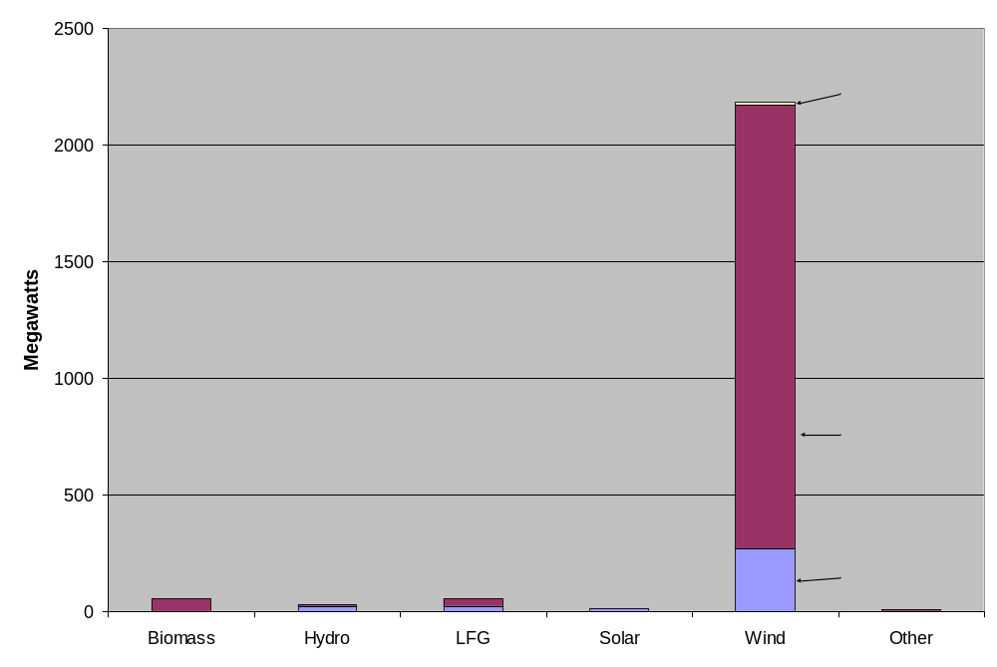
State Programs Through 2003
Added 2,335 Megawatts

Slide 10
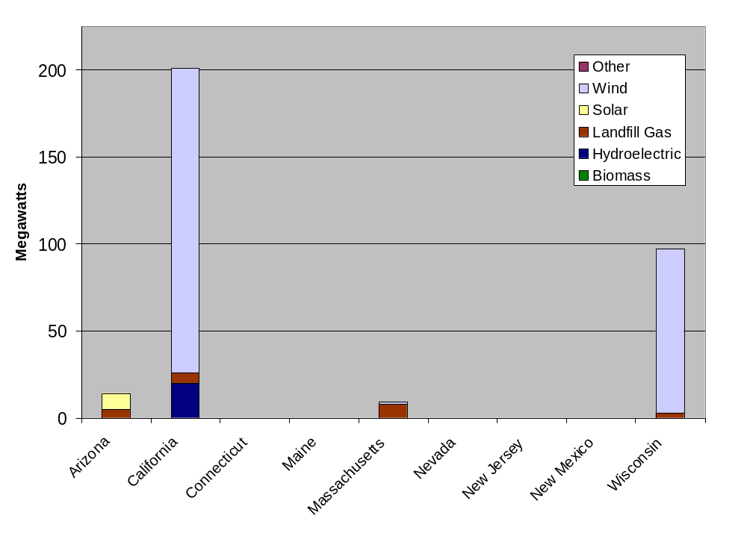
State Breakout of RPS Additions
Not all RPS-qualified capacity was necessarily “caused” by the RPS

Slide 11
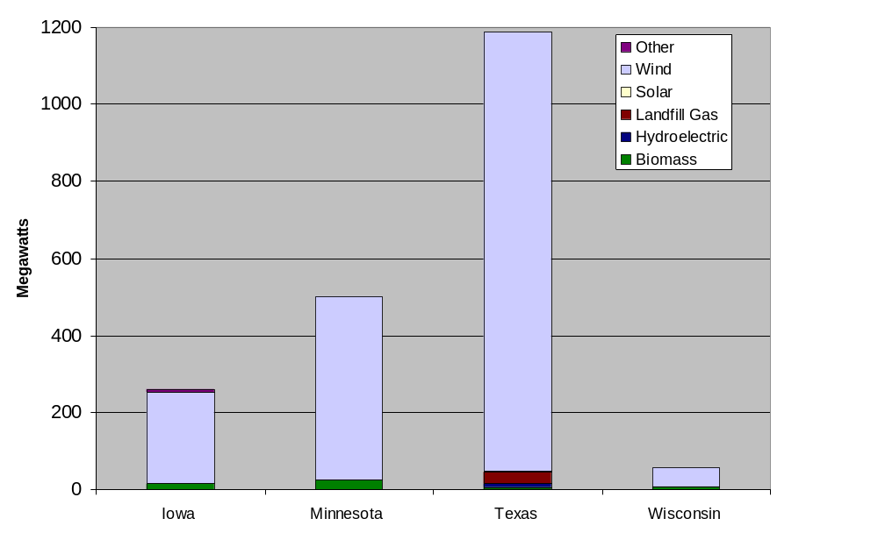
State Breakout of Mandates
Solar (PV) accounts for a few hundred kilowatts

Slide 12
Tentative Conclusions Through 2003
Mandates (Texas, Minnesota, Iowa, Wisconsin) have been the state-level primary drivers of new renewable energy capacity
So Far, state RPS have not unambiguously resulted in much new capacity
  Most RPS programs are relatively new
  Most have compliance options without renewable generation
Little new capacity observed in 2004 – PTC lapsed but anticipated.

Slide 13
New Requirements Since 2003
Colorado
  Ballot initiative, 10% by 2015
  Includes solar set-asides, credit trading, limits on electricity price impacts
  Awards “bonus” credits, which may effectively reduce target amount
District of Columbia
  11% by 2022
  Credit trading, penalty payments
  Awards “bonus” credits, which may effectively reduce target amount
Maryland
  7.5% by 2019 for “Tier I” resources, 2.5% for “Tier II”
  Has credit trading, alternative compliance payments
  Awards “bonus” credits, which may effectively reduce target amount
New York
  Regulatory action, 25% by 2013 (up from current 19%)
  Portion of target to come from “voluntary” market
  Includes distributed resource set-asides
Rhode Island
  16% by 2020
  Has credit trading, alternative compliance payments

Slide 14
Revised Requirements or Goals
Changed target
  Minnesota: from 425 MW of wind to 1125 MW
  New Jersey: from 2% to 4%
  New Mexico: reduces target for large electricity consumers
Goal replaced with RPS
  Pennsylvania: 8% “Tier I”, 10% “Tier II” by 2020
  Hawaii: 20% by 2020 (up from current 8%)
Added credit trading
  Maine
  Nevada
Other
  New Mexico: regulatory action recognized by statute; established maximum cost threshold
  Connecticut: RPS now applies to larger share of generation, new resources added

Slide 15
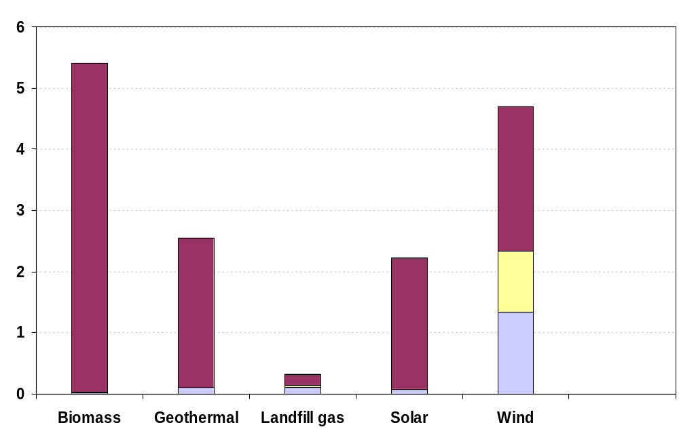
Additions of Renewable Generating Capacity, 2003-2025
(gigawatts)
Unplanned
Other Planned
State Mandates
AEO2005 projects 1,600 MW of additional state-mandated capacity through 2025
  Based on consultations with state officials
  13,300 MW of new commercial builds through 2025 (not mandated)
  Union of Concerned Scientists estimates about 25,500 MW if all RPS/mandate targets are met with capacity additions

Slide 16
Expectations
New states continue to propose, pass, and modify existing renewable target programs
  Specific programs match local needs and resources
  While some features seem to be popular, no common, comprehensive model has emerged
Compliance with renewable capacity additions may hinge on Federal policy
  PTC has been seen as critical in wind market compliance
  FERC policy will play a role in both ability to comply and cost of compliance

Slide 17
Massachusetts Compliance Report
In 2003, MA estimates 45% of RPS compliance was from prior-year banked credits
Outlook for 2004 suggests about 40% compliance from alternative compliance payments @ 51 $/MWh
  About 20 $/MWh is available from PTC
  Implies approx. 70-100 $/MWh in value available, including electricity value
  Wind costs estimated between 40 and 60 $/MWh
  New England has wind resource available
  What’s wrong with this picture?

Slide 18
Questions?
Report at http://www.eia.doe.gov/oiaf/analysis.htm
Contact:
  Tom Petersik
    tpetersi@eia.doe.gov
    202-586-6582
  Chris Namovicz
    cnamovicz@eia.doe.gov
    202-586-7120

