Slide 1

World Oil Markets:
A Comparison of Forecasts
John J. Conti, Director
Office of Integrated Analysis & Forecasting
Energy Information Administration
2005 EIA Midterm Analysis and Forecasting Conference
Washington, DC
April 12, 2005

Slide 2
The Midterm Outlook for Conventional International Oil Supply, Demand, and Prices: Have the Fundamentals Changed?
Peaks, Shortages, and Other Oil Market Myths
Speaker: G. Daniel Butler, EIA
Recent Trends in Exploration Results and The Implications for Future Liquids Supply
Speaker: Michael Rodgers, PFC Energy
The Outlook for Oil
Speaker: Todd W. Onderdonk, ExxonMobil Corporation

Slide 3
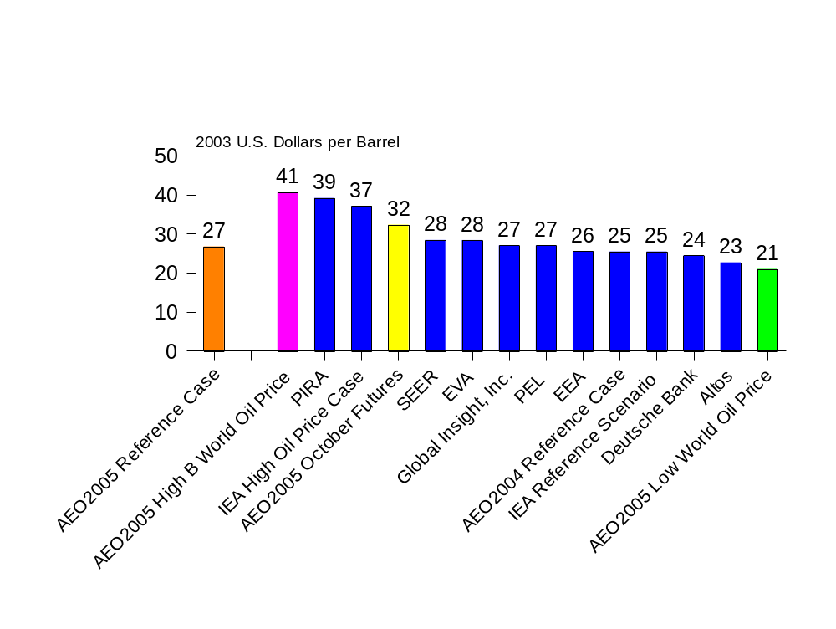
World Oil Prices by Forecaster, 2015
Source: EIA, Annual Energy Outlook 2005
Notes:
The AEO2005 reference case assumes world oil prices in 2015 will reach $27 per barrel (in constant 2003 U.S. dollars). All of the other forecasts fall within the range defined by the low world oil price and the high B world oil price cases.
Nine forecasters outside of EIA provide forecasts for world oil prices out to 2015. In 2015, the forecasts span a $16 per barrel range of prices in 2015, from $23 (Altos, October 2004) to $39 (PIRA, October 2004).

Slide 4
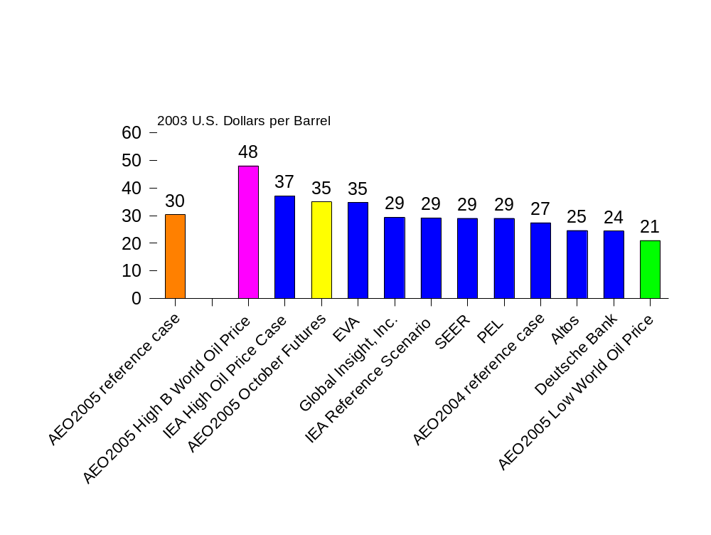
World Oil Prices by Forecaster, 2025
Source: EIA, Annual Energy Outlook 2005
Notes:
The AEO2005 reference case assumes world oil prices in 2025 will reach $30 per barrel (in constant 2003 U.S. dollars)
In addition to EIA, seven forecasters provide world price outlooks to 2025. In 2025, the range in prices varies from $24 per barrel (March 2005, Deutsche Bank) to $37 (October 2004, International Energy Agency High Oil Price Case), a span of $13 per barrel. All of the forecasts fall within the range defined by the AEO2005 low world oil price case and the high B world oil price case.

Slide 5
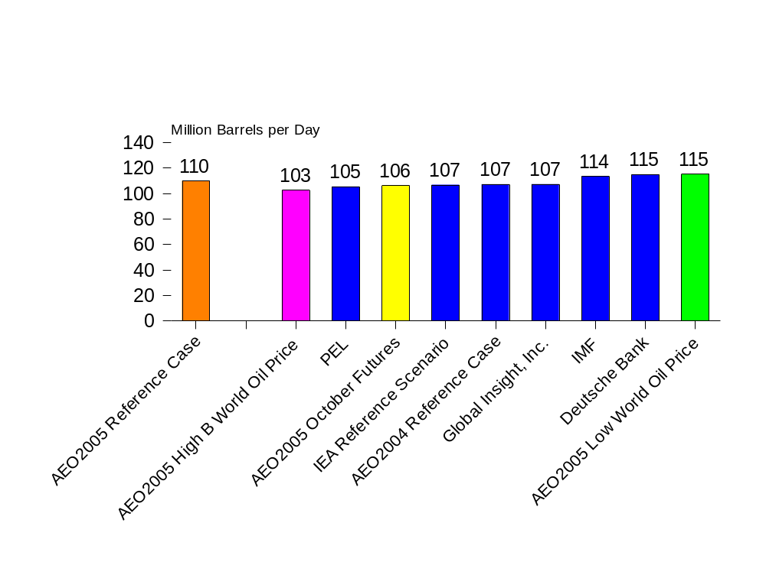
World Oil Production by Forecaster, 2020
Source: EIA, Annual Energy Outlook 2005
Notes:
Four forecasters other than EIA provide world oil supply forecasts to 2020. The AEO2005 reference case has the highest projected prices among these forecasts in 2020, at $28.50 per barrel, but it also has the second highest production among the forecasts at 110.0 million b/d.
In contrast, Deutsche Bank (March 2005) forecasts the lowest price projection of the series in 2020 at $24.43 per barrel, but the highest projected production at 114.9 million b/d.
The IMF released their estimate of world oil production/consumption in April 2005, with a price path of between $39 and $56 per barrel by 2030.

Slide 6
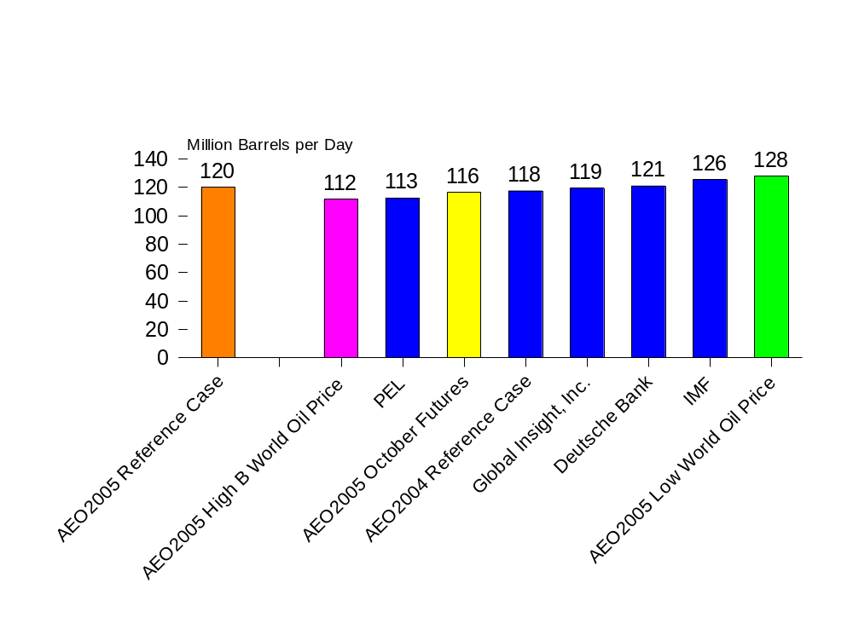
World Oil Production by Forecaster, 2025
Source: EIA, Annual Energy Outlook 2005
Notes:
There are only three forecasters in addition to EIA who provide forecasts for the year 2025.
In 2025, the AEO2005 reference case projects a world oil price of $30.31 (in real 2003 U.S. dollars) per barrel, the highest among the other three forecasters. However, it also projects the second largest world oil production levels, at 120.2 million b/d. Deutsche Bank (March 2005) forecasts the lowest price in the series ($24.43 per barrel), but the largest production levels at 121.0 million b/d.
PEL forecasts the second lowest price for 2025 at $29.00 per barrel (March 2004, Brent), and –by far—the lowest production levels of the forecasts at 112.5 million b/d.
The IMF expects world oil production to reach 125.5 million b/d by 2025.

Slide 7
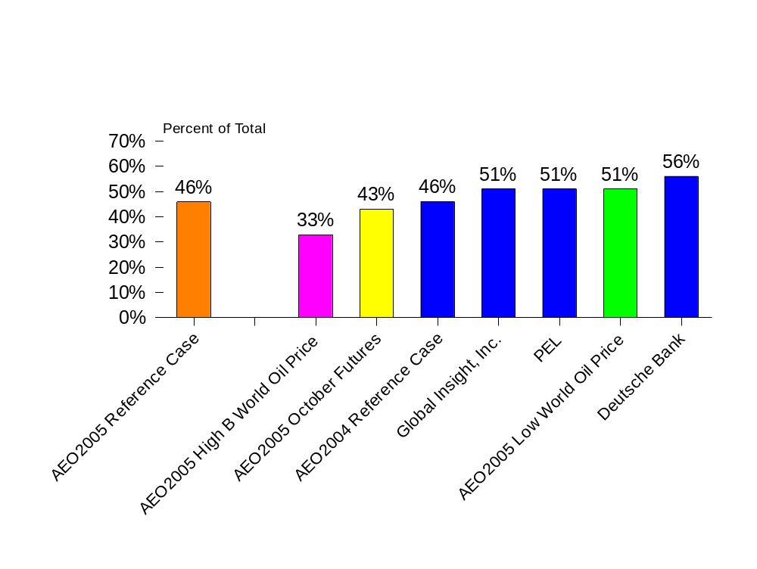
OPEC’s Share of Production by Forecast, 2025
Source: EIA, Annual Energy Outlook 2005
Notes:
Expectations for world reliance on OPEC supplies vary among the forecasts. The AEO2005 reference case believes that OPEC will account for 46 percent of world oil supply by 2025, but the other three forecasters who provide production forecasts for 2025, expect OPEC share to range between 51 percent (Global Insight, January 2005, and PEL, March 2004) to 56 percent (Deutsche Bank, March 2005).
The IMF forecast (April 2005) proffers a range of potential supplies from OPEC. In 2025, OPEC supply accounts for between 51.6 million barrels per day (41 percent of total world oil production) to 61.0 million barrels per day (49 percent).

Slide 8
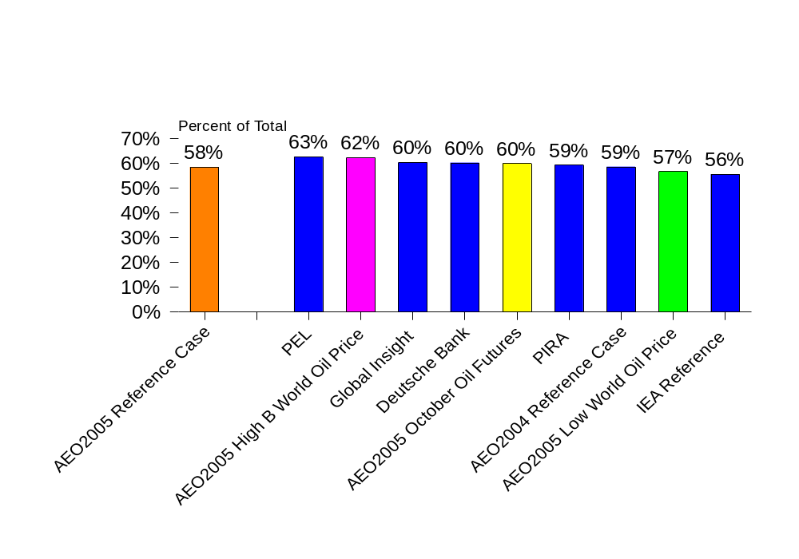
Percent of Growth Attributed to the United States and Developing Asia, 2002-2025*
* Note that IEA Reference is from 2002-2020; PIRA from 2002-2015
Notes:
For IEA Reference, increment includes the United States and Canada, but excludes South Korea from Developing Asia. PIRA increment includes Australia/New Zealand.
While there may be a wide range of opinions about the oil price and production levels into the future, there is little doubt among the forecasts that the United States and Developing Asia (including China and India) will account for a substantial portion of the world’s increment in oil use. All of the forecasts expect these two regions to account for around 60 percent of the world oil increment over the duration of the forecasts (56 percent, IEA, October 2004 to 63 percent, PEL, March 2004).

Slide 9
A Comparison of World Oil Market Forecasts
AEO2005 reference case prices lie in the middle of the forecasts in the mid- to long-term; however, the scenarios included in the AEO2005 cover the spectrum of world oil price forecasts.
World oil production forecasts for 2025 range from 113 mb/d to 126 mb/d (the AEO2005 reference case expects 120 mb/d).
There is wide variation in expectations for OPEC’s share of world oil production in the mid-term.
Most forecasts expect the United States and developing Asia to account for the largest share of the world’s increase in oil demand over the forecast period.
Notes:
The developing world = world – industrialized –EE/FSU. The developing regions include developing Asia (including China, India, and South Korea, but excluding Japan, Australia, and New Zealand), Middle East (including Turkey), Africa, and Central and South America (including Brazil, but excluding Mexico).
We attempted to obtain the latest available forecasts for our comparison. The forecasts included here were released in the March 2004 (PEL) to March 2005 (Deutsche Bank) time period. The AEO2005 reference case price forecast was formulated in June 2004 and, in October 2004, the AEO2005 October futures and high B world oil price cases were derived.

