Slide 1
Recent Trends in Exploration Results and the Implication for Future Petroleum Liquids Supply
Michael Rodgers, Senior Director
Upstream Group
April, 2005

Slide 2
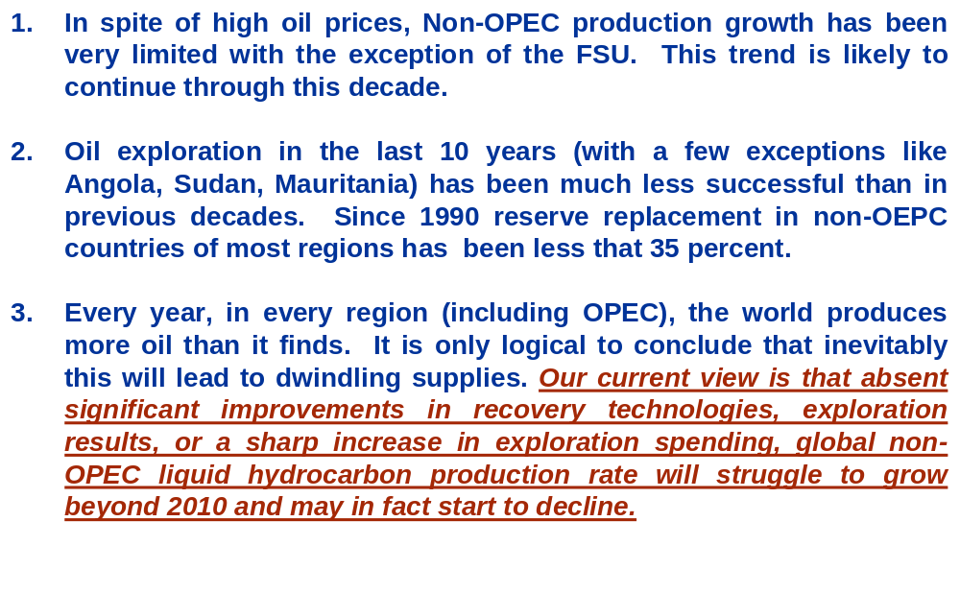
Key Messages
Given a continuation of recent trends in exploration results (field sizes, success rates, etc. and recovery factors):

Slide 3
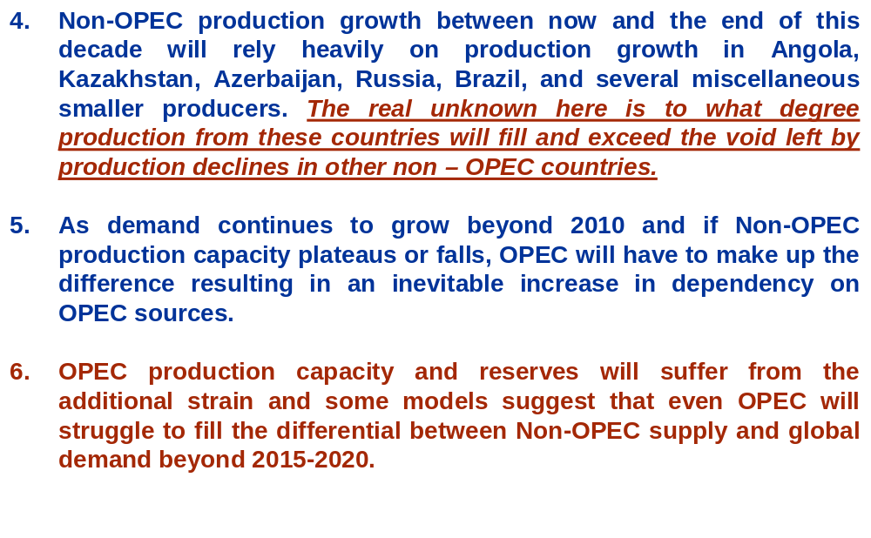
Key Messages

Slide 4
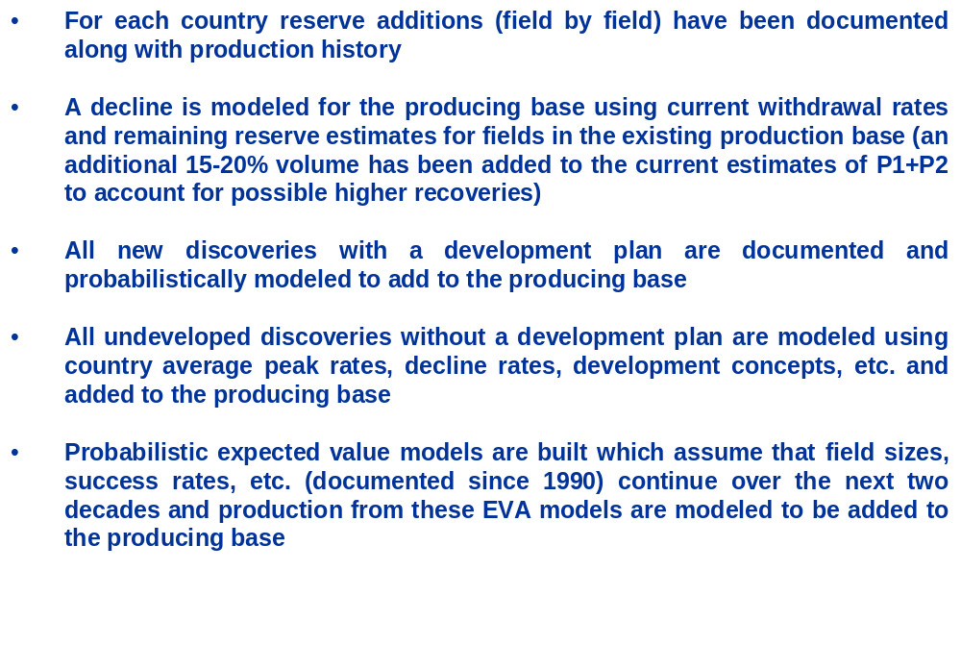
Methodology

Slide 5
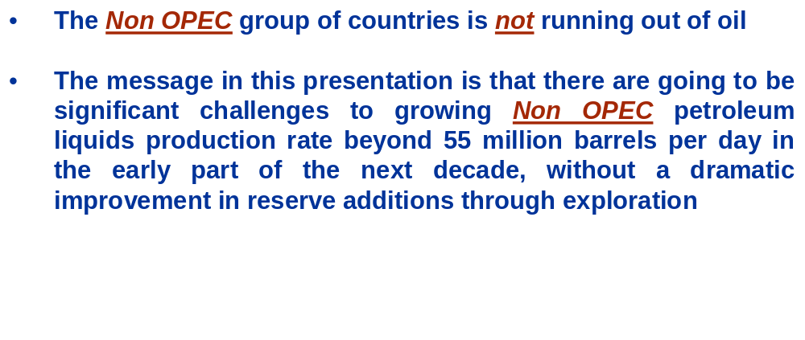
The Message

Slide 6
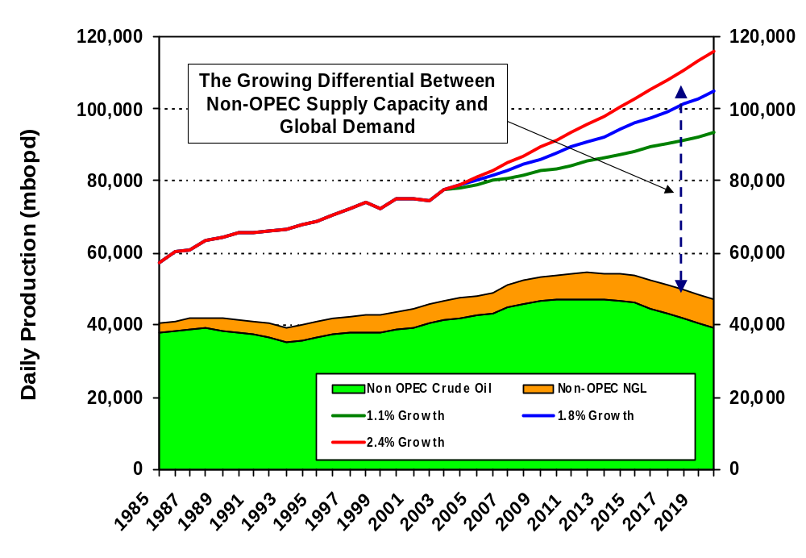
The Problem - The Expected Growing Gap Between Global Demand and Global Non-OPEC Supply in the Next Decade

Slide 7
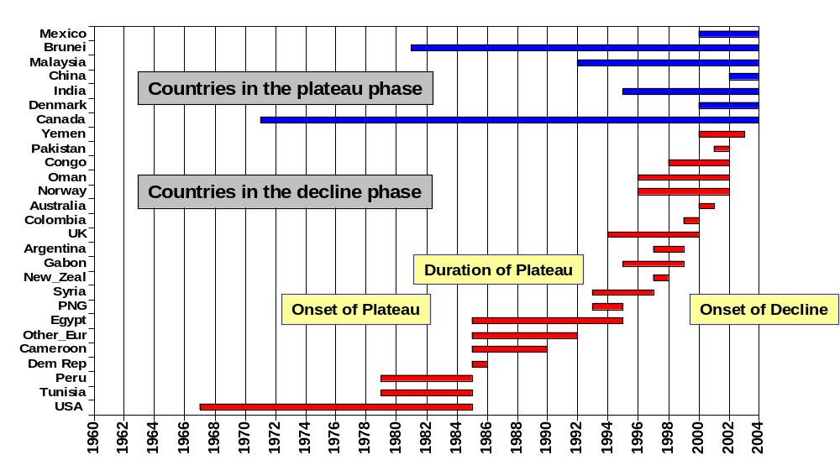
Non-OPEC Countries that are Either in Decline or Currently in a Plateau
The above bars show the onset and duration of documented production peaks or plateaus – tracking country life cycle shows an acceleration of the number of countries passing from peak to decline

Slide 8
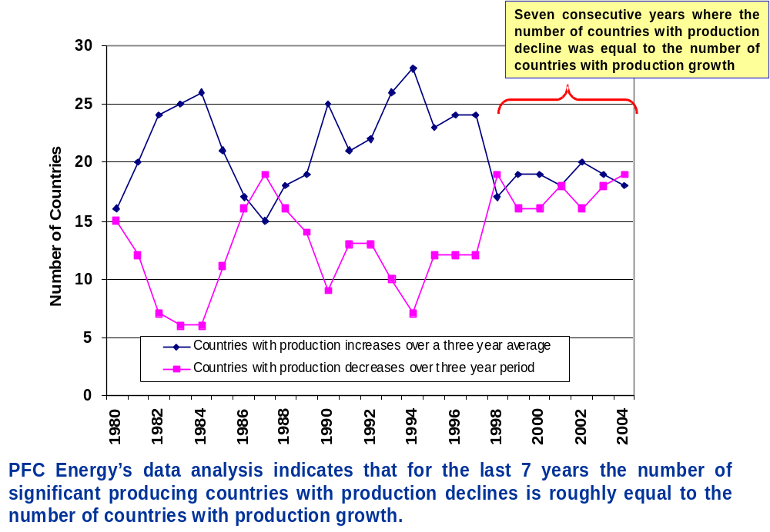
Countries Growing Production Versus Countries Declining

Slide 9
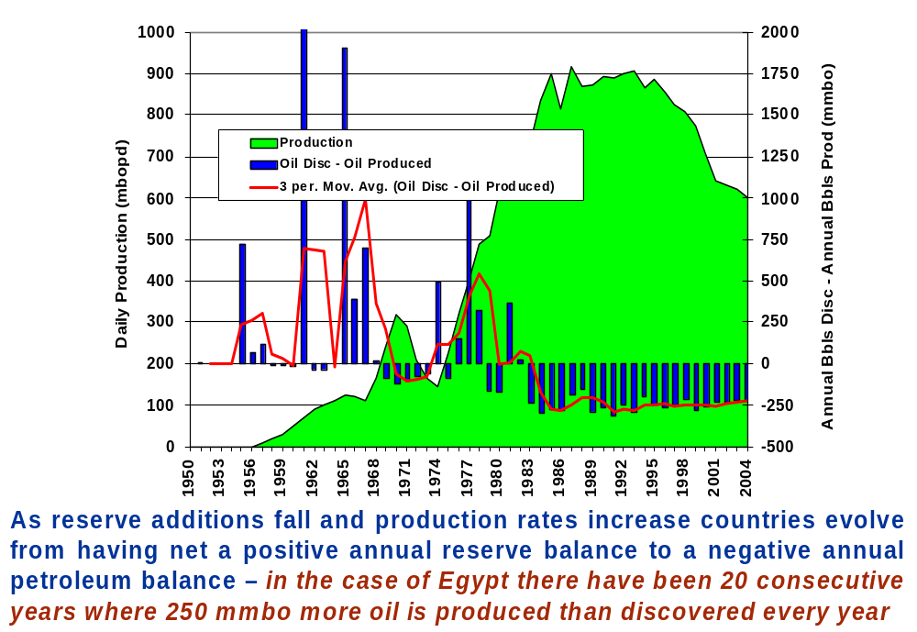
Egypt – A Typical Life Cycle for an Oil Producing Country

Slide 10
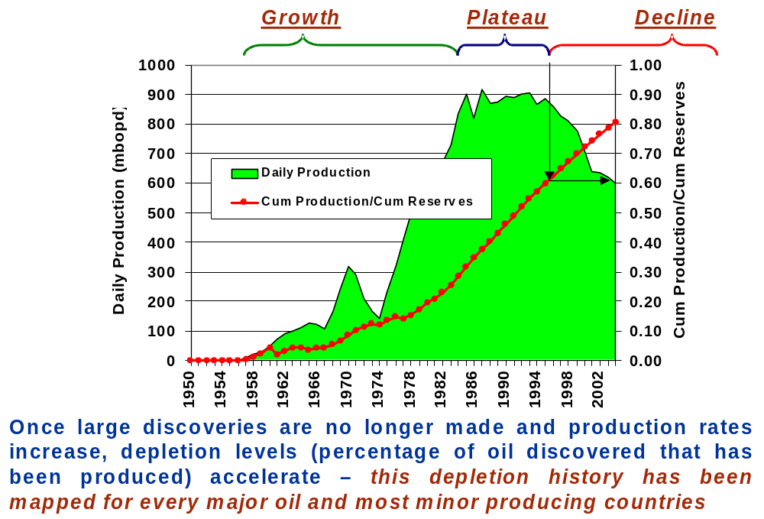
Egypt – A Typical Life Cycle for an Oil Producing Country

Slide 11
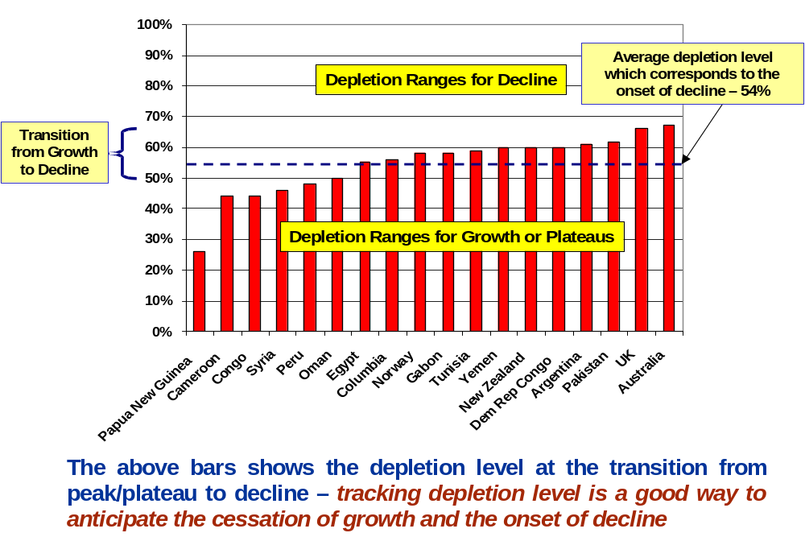
Non-OPEC Countries that are in Decline

Slide 12
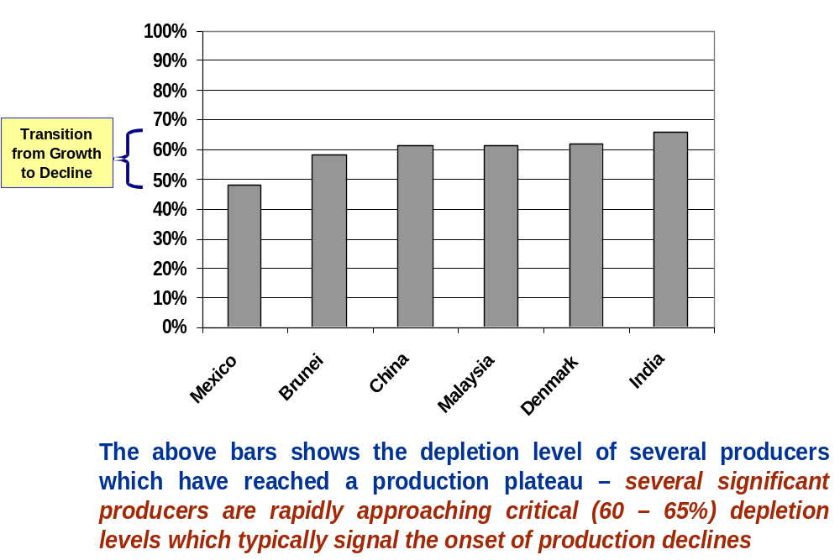
Non-OPEC Countries that are in Plateau

Slide 13
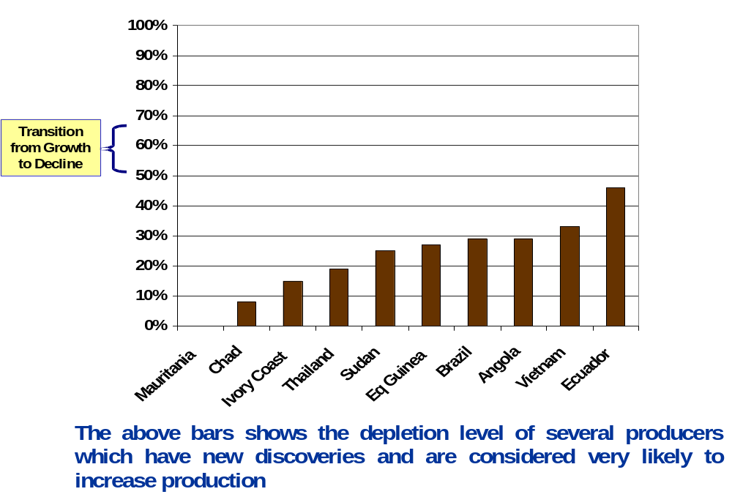
Non-OPEC Non-FSU
Countries with Production Growth Profiles

Slide 14
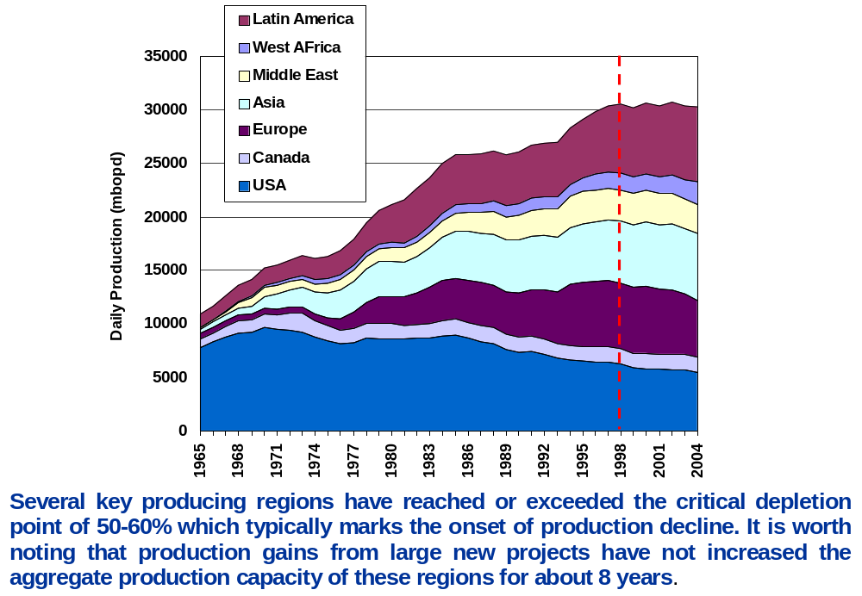
Historical Non OPEC Crude Production (Excluding FSU, Natural Gas Liquids and Canadian Oil Sands)

Slide 15
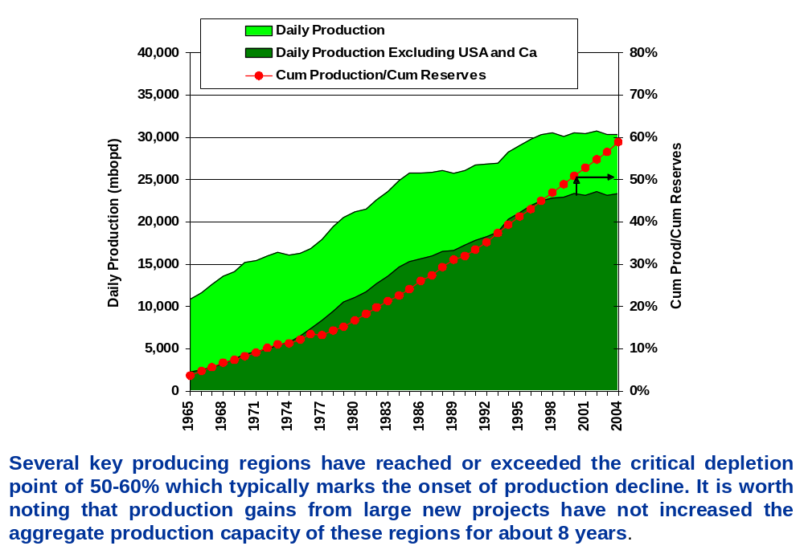
Historical Non OPEC Crude Production (Excluding FSU, Natural Gas Liquids and Canadian Oil Sands)

Slide 16
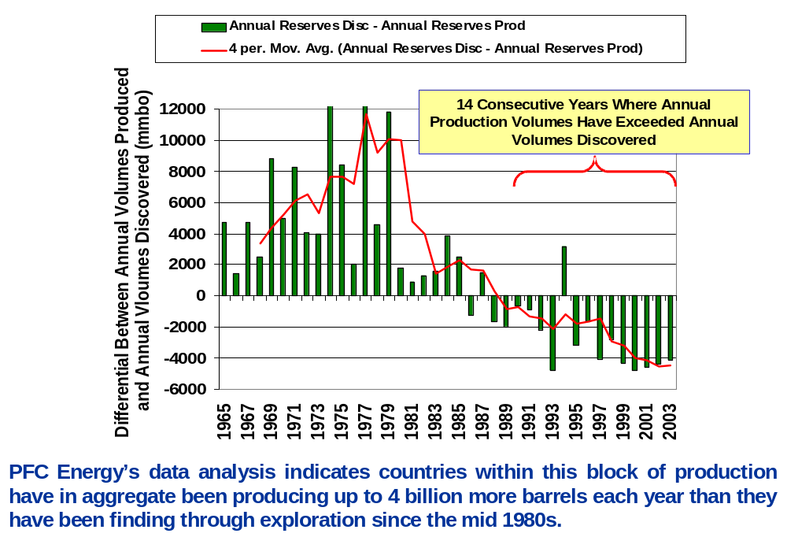
Annual Non OPEC Crude Production Balance (Excluding FSU, USA, and Canada)

Slide 17
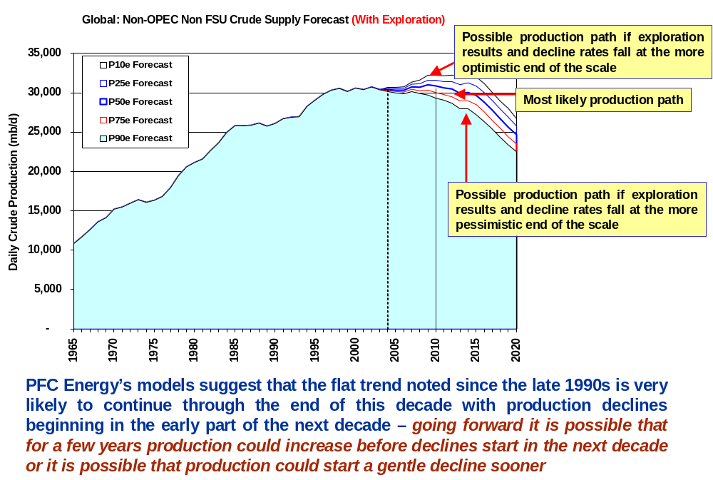
Non OPEC Crude Oil Forecast with an Exploration Component (Excluding Natural Gas Liquids, FSU, and Canadian Oil Sands)

Slide 18
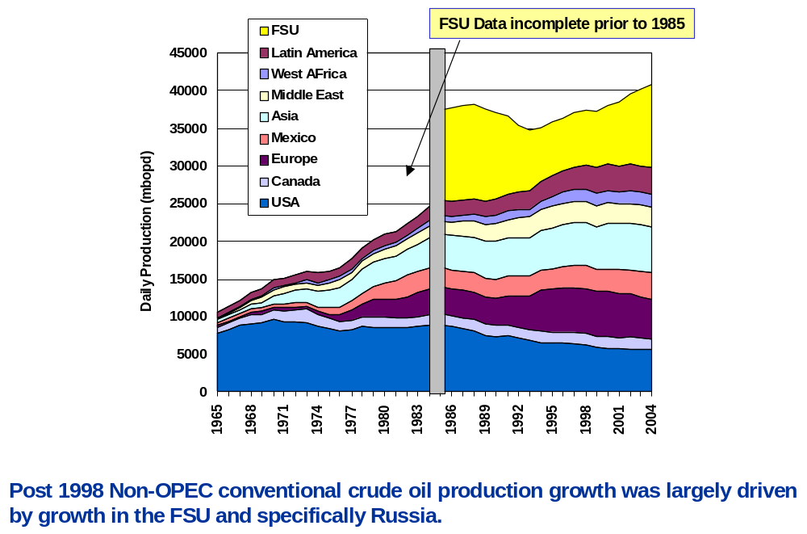
Historical Crude Production (Excluding Natural Gas Liquids and Canadian Oil Sands)

Slide 19
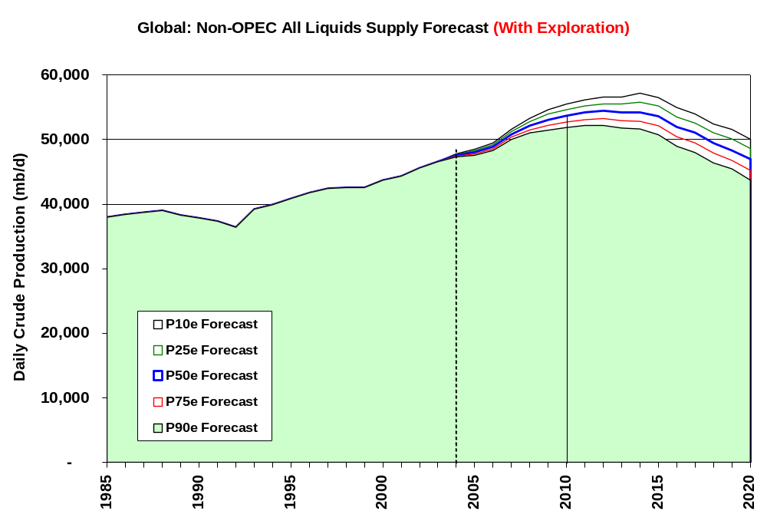
Non OPEC Crude Oil and NGL Production Forecast with an Exploration Component (includes Canadian Oil Sands)

Slide 20
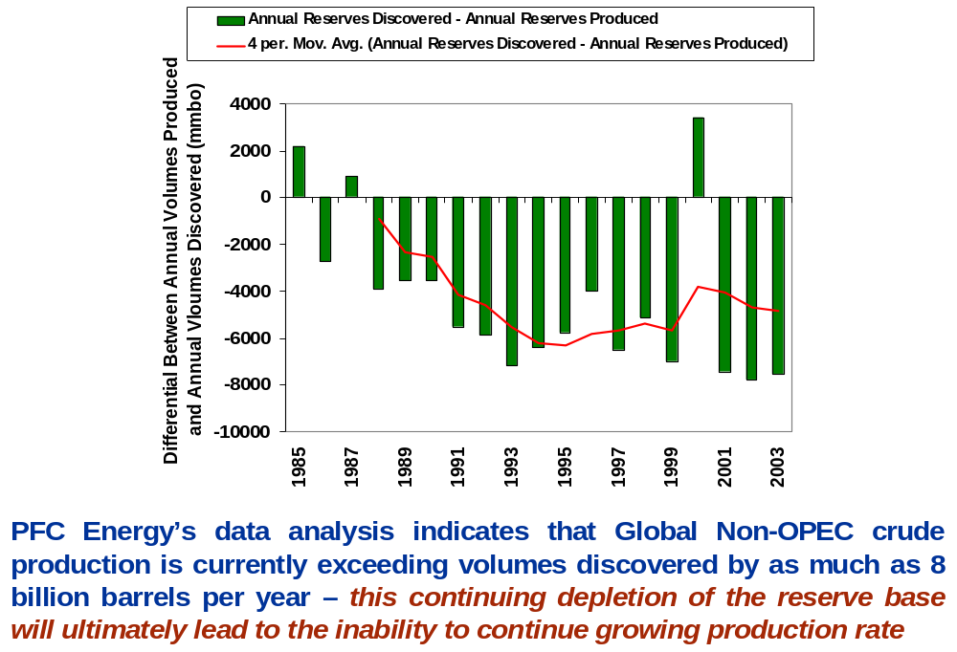
Non OPEC Annual Crude Oil Production Balance (Excluding USA, Canada, and Canadian Oil Sands)

Slide 21
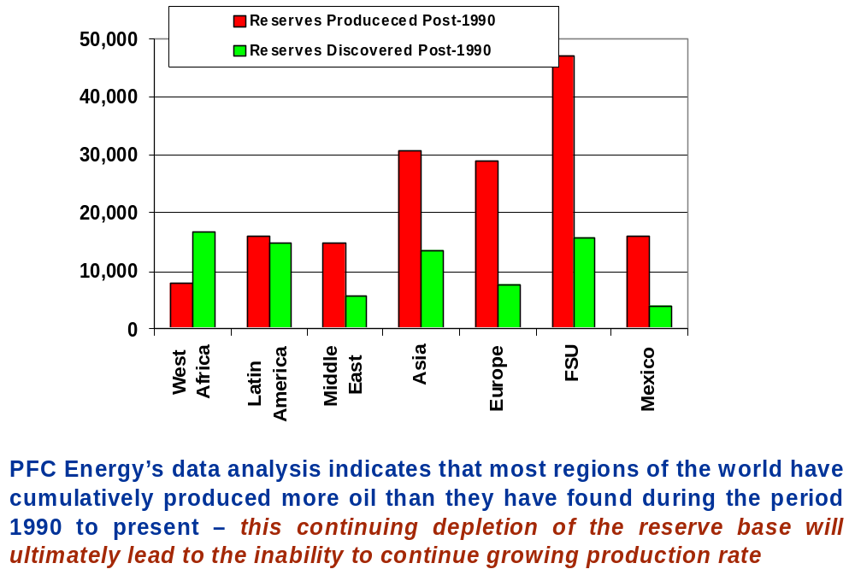
A Comparison of Reserves Discovered Versus Reserves Produced Since 1990

Slide 22
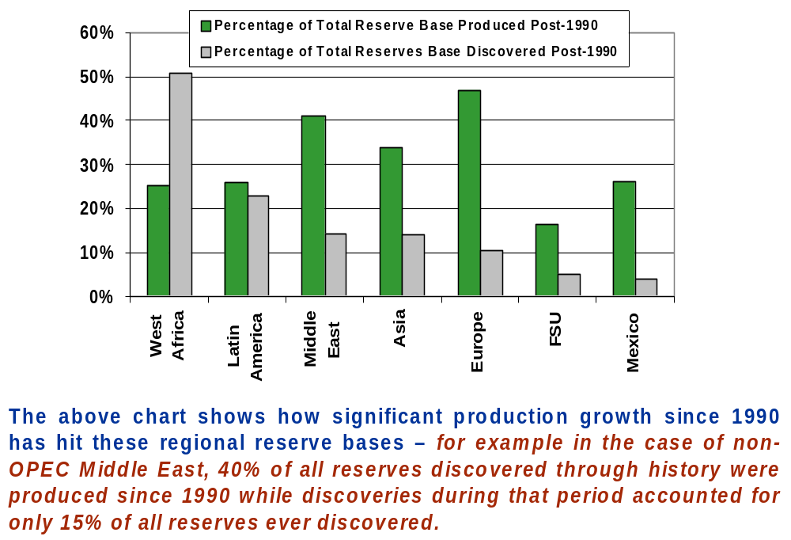
Significant Percentages of Regional Reserve Bases Were Produced Post 1990

Slide 23

The Problem - The Expected Growing Gap Between Global Demand and Global Non-OPEC Supply in the Next Decade

Slide 24
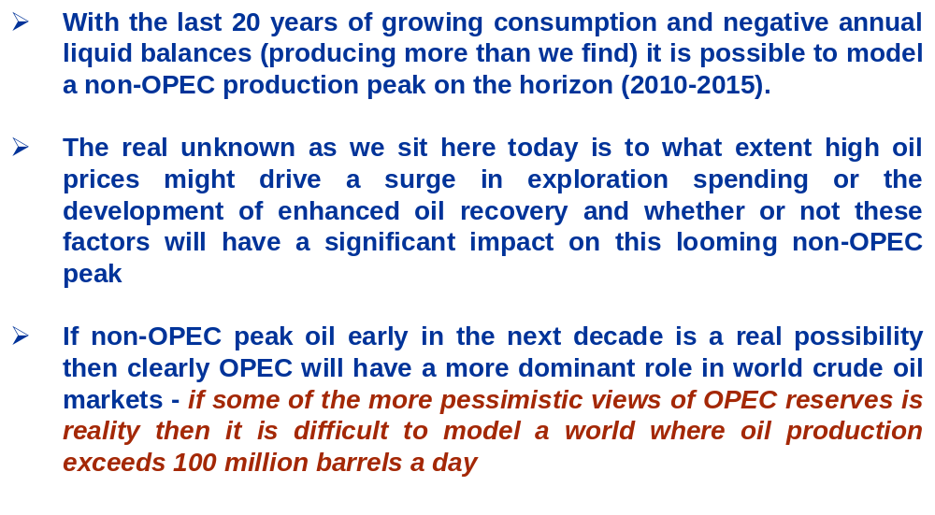
Concluding Comments

Slide 25
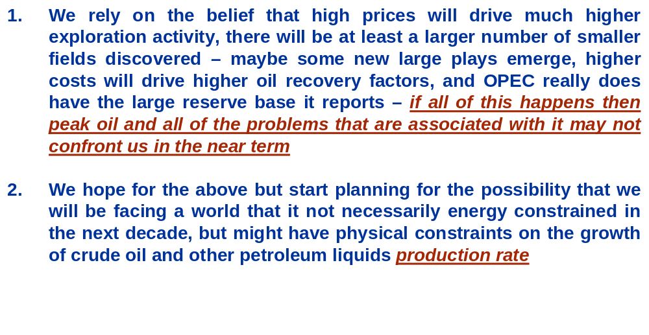
The Choices

Slide 26
Offices
1300 Connecticut Avenue, N.W.
Suite 800
Washington, DC 20036 USA
Tel: (1 202) 872 1199
Fax: (1 202) 872 1219
3, cité Paradis
75010 Paris, France
Tel: (33 1) 47 70 29 00
Fax: (33 1) 47 70 27 37
Houston, Texas
Tel: (1 281) 599 7099
Fax: (1 281) 599 9891
London, United Kingdom
Tel: 44 (0)1256 760678
Fax: 44 (0)1256 760678
info@pfcenergy.com www.pfcenergy.com

