Slide 1

If Not Gas Then …………..?
2006 Energy Outlook and Modeling Conference
Energy Information Administration
March 27, 2006
Notes:
Thank you for the opportunity to speak here today.
As you can see by the title of my talk, I plan to speak about the forces that influence electricity generation plant investment and fuel use decisions and where we see them going today.
Some of my talk may be a little old hat for some of the experienced utility planners, but I think some background could be useful to others.

Slide 2
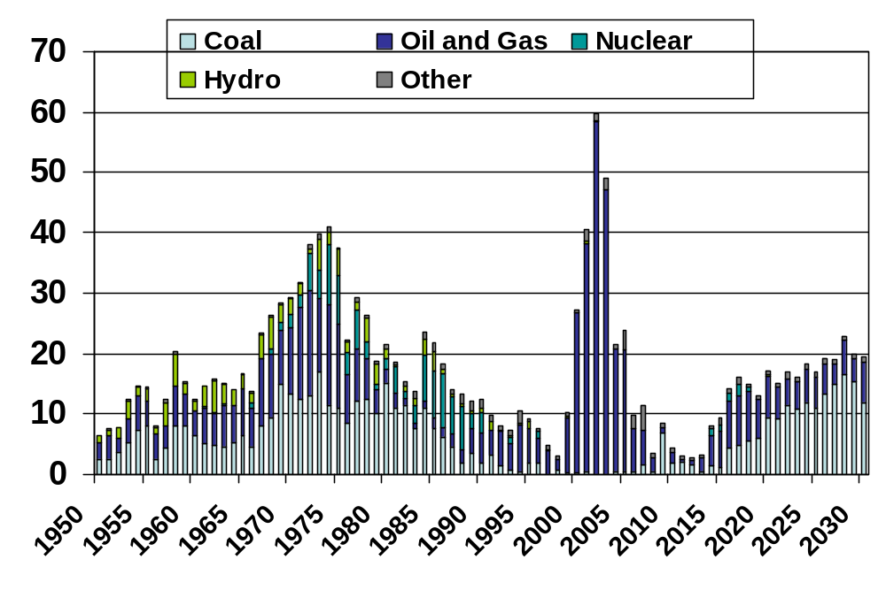

Electricity Capacity Additions by Year
Notes:
This figure illustrates annual capacity additions by type for 1950 through 2005 and projections through 2030.
Unless you have been out of the country for the last 5 years or so, you are probably aware that there has been a massive building boom, and almost all the capacity built recently is natural gas fired.
Between 1999 and 2005 almost 232 gigwatts of new capacity was added and about 95 percent of it was natural gas fired.
We do not expect this rate of construction to continue. Instead we expect a slowdown such as what was seen in the 1990s.
When building does pick up again, after a lull, similar to what happened in the 1990s, we expect it to be increasingly coal dominated. Gas will continue to be built, but not for baseload use.

Slide 3
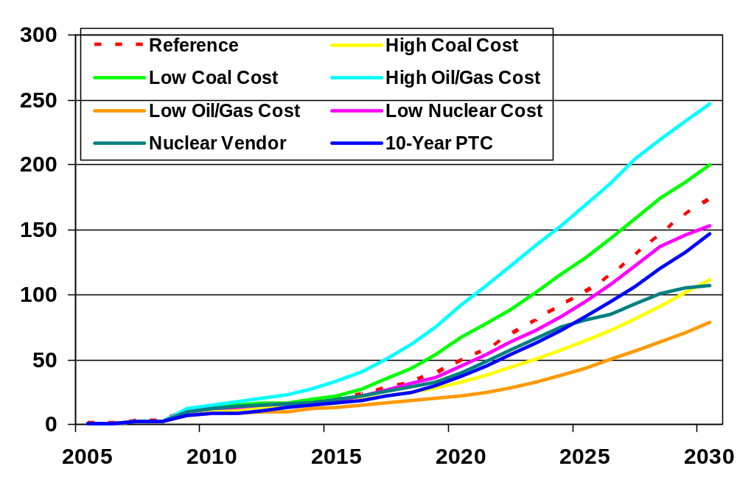
Coal Capacity Additions in Alternative Cases
(Gigawatts)

Slide 4
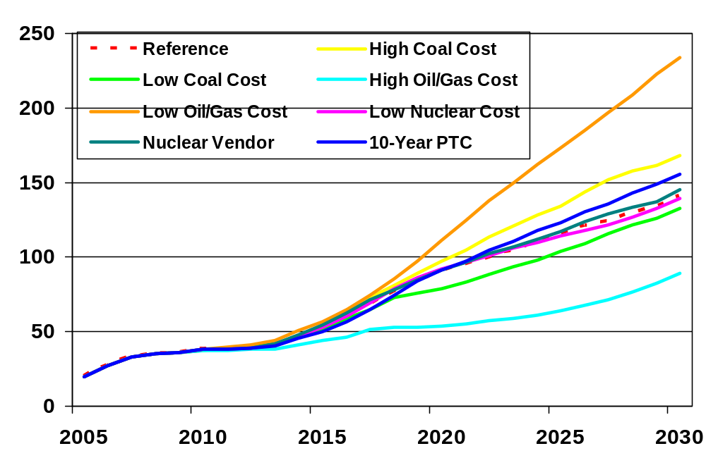
Natural Gas and Oil Capacity Additions in Alternative Cases
(Gigawatts)

Slide 5
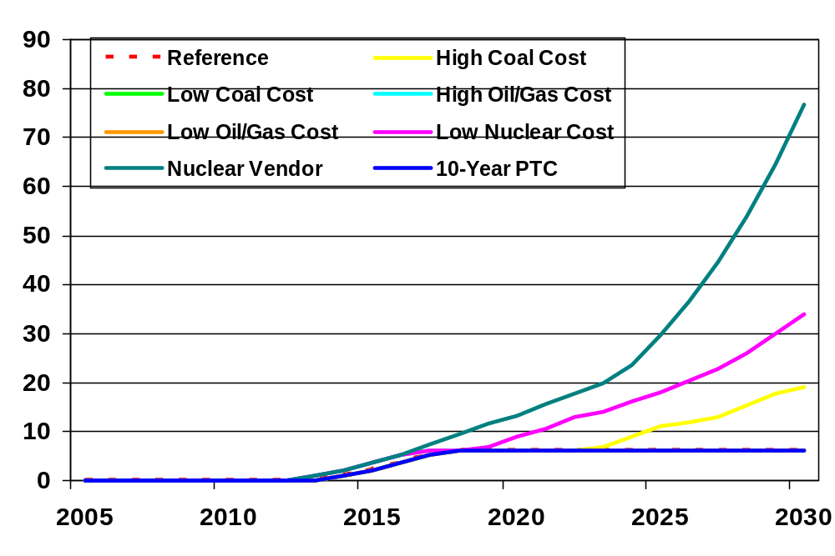
Nuclear Capacity Additions in Alternative Cases
(Gigawatts)

Slide 6
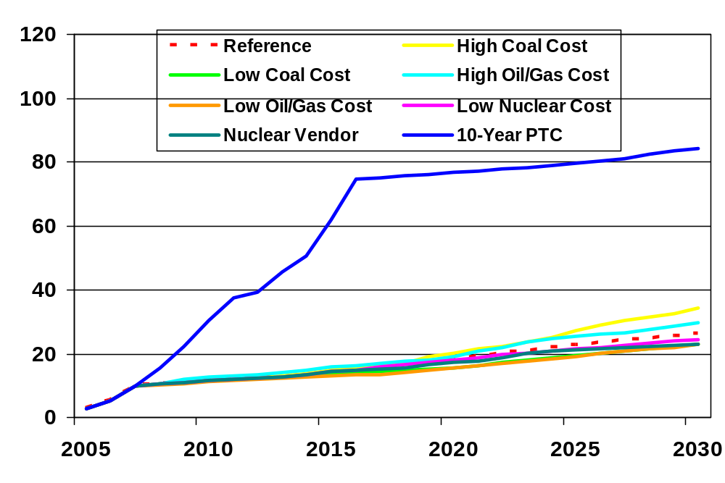
Renewable Capacity Additions in Alternative Cases
(Gigawatts)

Slide 7
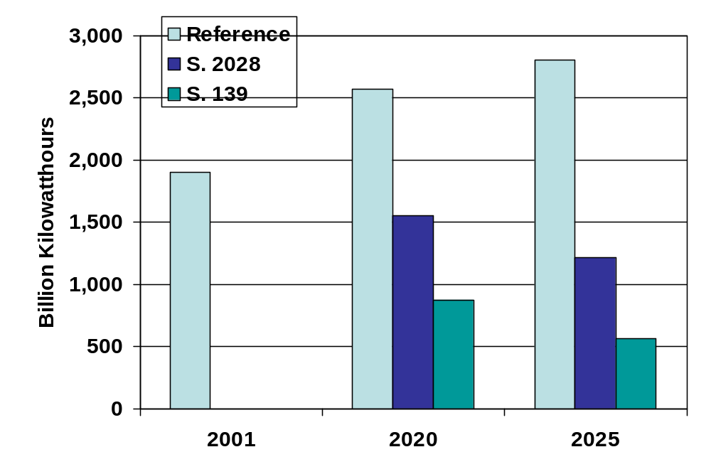
Coal Generation With Greenhouse Gas Emission Limits
Source: Analysis of Senate Amendment SA 2028, the Climate Stewardship Act of 2003
Notes:
Points to make:
One key uncertainty for coal is any policies aimed at reducing GHG.
We analyzed the bill proposed by Senators McCain and Lieberman to reduce power sector CO2 emissions to their 1990 level and coal use dropped dramatically.

Slide 8
J. Alan Beamon
Director, Coal and Electric Power Division
Office of Integrated Analysis and Forecasting
Energy Information Administration
Joseph.Beamon@eia.doe.gov
(202) 586-2025

