Slide 1
EIA Energy Outlook and Modeling Conference
Impediments to Developing Unconventional Natural Gas Resource Plays
March 27, 2006
Laramie Energy

Slide 2
Agenda
Laramie Energy Background
Unconventional Natural Gas Resource Plays
  Emerging Resource
  Financial Attributes
Model for Development
Impediments
  Price Volatility
  Market Access/Pipelines
  Land Access
    Regulations & Permitting
    Obstructionists
  Oilfield Services
Solutions
Implications

Slide 3
Laramie Energy Background
Laramie Energy, LLC. was formed to invest in primarily unconventional natural gas plays in the Rocky Mountain region. The Company was started in June 2004 and is headquartered in Denver, Colorado.
Private Equity Capital commitments in the amount of $150 million dollars were obtained from EnCap Investments and Credit Suisse.
Laramie Energy’s operations are focused in the Piceance Basin of northwestern Colorado where it has accumulated interests in approximately 60,000 acres of Federal and fee mineral leases.
The Piceance Basin is primarily a basin centered tight gas sand play in the Williams Fork section of the Mesa Verde formation.
Since starting, the company has drilled 63 wells, grown reserves to 165 Bcfe and production to 15 MMcfd.
In 2006 Laramie will operate a 5 rig drilling program to drill 100 wells and will participate in the construction of a 20 mile pipeline and central processing facility to move 60 mmcfd beginning in August of this year.

Slide 4
Drilling Unconventional Indigenous Natural Gas Resources offers the Greatest Short Term Potential for Meeting the U.S. Goals of
Safe, Affordable and Clean Energy
Laramie Energy’s focus is on finding and developing gas reserves from unconventional gas reservoirs in the Rockies
  Rockies represent the largest onshore resource potential for natural gas in the lower 48.
  Advancing technology, potential pipeline expansions, improving Federal land access, and the Lower 48’s highest reserve potential provides the Country with the greatest opportunity to increase longer term supplies of natural gas.
80% of the Rockies Natural Gas Resource Potential Comes from Unconventional Natural Gas Resources:
  Tight Gas Sands
  Coalbed Methane
  Shale Gas

Slide 5
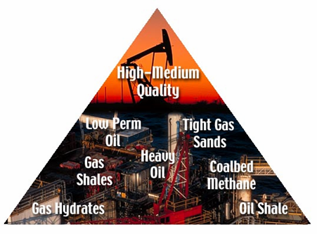
Business Rationale
E&P Business is Being Revolutionized
Unconventional reservoirs (“UCRs”) to be largest U.S. gas source within 10 years
  Production from UCRs has increased to 41% of natural gas output,
  from 15% in 1990
  Production from conventional reservoirs has declined 15% since 1995
Technological advances are shifting the E&P industry to UCRs to fill U.S. gas supply gap
Reservoir Knowledge
Hydrofracing
Stimulation
Horizontal Drilling
Drilling Fluids
3D Seismic
Conventional Reservoirs:
Small volumes, difficult to find,
easy to develop
Technological
Advances
Unconventional Reservoirs:
Large volumes, easy to find,
previously less economic
to develop
2004 U.S. Gas Production
28% Tight Gas Sands
9% Coal Bed Methane
4% Gas Shales
41% Total
Oil
Shales
Gas Shales

Slide 6
UCR Gas – Lower Production Rates
Longer Life Reserves
UCR’s have the following characteristics:
  Lower drilling, completion, and operating risk (+98% drilling success rate with UCR)
  Lower finding costs per Mcfe of reserves added
  Lower reserve decline rates with tight sands and gas shale reservoirs
  More predictable cash flow and capital expenditure programs
Yet requires a different corporate mindset than conventionally focused companies
  Operations built around large scale development drilling (i.e. gas manufacturing projects)
    Individual plays cover a wide aerial extent
    Engineering project management, acreage inventory, and UCR technological expertise are key value drivers, not wildcat geologic prospecting

Slide 7
Unconventional Natural Gas Resources
Project Development Model
Basin / Play Analysis
Identification of Play Types
G&G/Engineering Evaluation
Reservoir Analysis
Review of Acreage Availability
  Federal/State/Private
  Farm-in
  Acquisition
Market Access
  Pipeline
  Road
  Field Infrastructure
  Environmental
Commerciality Assessment
  Technology Applications
  Seismic
  Drilling
  Logging
  Completion
  Production
  Economic Model
  Risk Assessment
  Number of Wells Needed
  to Evaluate
  Field Development Model
  Return Expectations
Project Evaluation
Acreage Procurement
Well / Prospect Generation
Location Identification
Permitting / EIS
Proof of Concept
  Field Study
  Testing
  Project Economic Evaluation
  Development Model
  Technology Alternatives
  Multi-well Drilling Program
  Assessments / Testing
Project Execution
Multi-Rig Drilling Program
Construction of Infrastructure for
Processing & Market Access
Service Contractor Alignment /
Negotiations
Sales / Marketing Agreements
Field Operations

Slide 8
Largest U.S. Gas Resource Opportunities
UCR Gas from Rockies – Our Principal Focus
Undiscovered Gas Resources
Pacific
49 Tcf
Rockies
41% of proved and probable
Lower 48 gas reserves
Over 80% Unconventional
Rocky
Mtn. Basins
318 Tcf
N. Central
31 Tcf
Appalachia
89 Tcf
Mid-Con
41 Tcf
Permian
38 Tcf
Gulf Coast
166 Tcf
Source: United States Geological Survey (2000), Undiscovered Resources

Slide 9
Impediments – Price Volatility
Natural Gas is a commodity
Natural Gas has demonstrated the highest volatility of any commodity traded -62%
  Demand is dependent upon weather
  Market access/pipeline availability creates large regional differences in prices
  Crude oil and fuel oil prices impact natural gas prices
Price volatility makes it difficult to budget and plan drilling programs
  Hedging can help stabilize cash flows but accounting regulations are difficult to understand and cause significant variability in earnings
  Combination of exploration risk and price volatility creates need to keep debt levels low and fund capital expenditures from cash flow
  Large changes in capital spending make it difficult to make long term commitments for infrastructure and oil field services.
While natural gas prices have increased significantly recently, so have oilfield service costs.
  In today’s market the average unconventional resource play breaks even at $4/Mmbtu and requires in excess of $7/Mmbtu to achieve a 20% rate of return at the wellhead.

Slide 10
Natural Gas Price Environment
Current Paradigm Shift
Gas Prices
Marginal
Coal/Oil
Displaces
Gas
Industrial
Consumption
Decreases
E&P
Increases
Supply
$4.50
E & P Services Cost
New
Paradigm
Storage
Weather
$3.50
Gas
Displaces
Marginal
Coal/Oil
Industrial
Demand
Increases
E&P
Reduces
Supply
$2.50
Prior
Decades
Supply
Bubble
$2.00
2000
2010
Sources: Dominion Resources

Slide 11
Impediments – Market Access/Pipelines
The largest source of unconventional natural gas is the Rocky Mountains
Most pipelines in the Rockies flow gas to the west into lower priced markets than the eastern markets.
  Basis differentials or price differentials for Rockies gas are significantly higher than the differentials for gas flowing from the Midcontinent and Gulf Coast areas.
    Rockies differentials average $1
    Midcontinent differentials average $.25
    Gulf Coast differentials average $.10 to $.15
  New pipeline construction will be necessary to move gas from the Rockies to the major consuming markets.

Slide 12
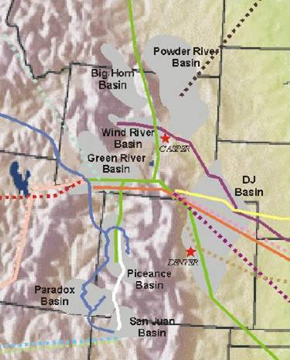
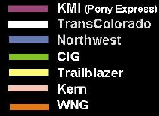
Rockies Pipeline Infrastructure
Map of Existing Pipelines and Capacity Expansion Projects
Bison (NBP)
540 MMcf/d
Existing pipelines
Northwest expansion (WMB)
175 MMcf/d
Ruby (EP)
750 MMcf/d
Kern expansion
900 MMcf/d
Advantage (KMI)
320 MMcf/d
Transwestern
150 MMcf/d
Western Frontier (WMB)
500 MMcf/d
Cheyenne Plains (EP)
560 MMcf/d
Southern Trails (STR)
90 MMcf/d
Source: Recent industry research reports
Note: Dotted lines refer to ongoing expansion projects

Slide 13
Rockies Pipeline Infrastructure
Rocky Mountain region has suffered in the past from depressed natural gas prices due to relatively immature pipeline infrastructure
Expansion of the Kern River pipeline system in Q2 2003 dramatically improved the basis differential for Rockies gas
  Transports gas from southwestern Wyoming to markets in central California, Nevada, Arizona, and New Mexico
Basis differentials are projected to decrease through end of 2005, through additional capacity from planned projects
Existing Pipelines | Capacity (MMcf/d)
KMI (Pony Express) | 450
TransColorado | 180
Northwest¹ | 1,015
CIG | 520
Trailblazer | 725
Kern² | 1,825
WNG | 190
Southern Trails² | 90
Total | 4,995
New Projects | Capacity (MMcf/d)
East
Ruby | 750
Entegra/RM Express | 1500
West
Advantage | 320
Cheyenne Plains | 560
Western Frontier | 500
Bison | 540
Total | 4170
Source: Recent equity research reports
Pro forma for recently completed expansion projects

Slide 14
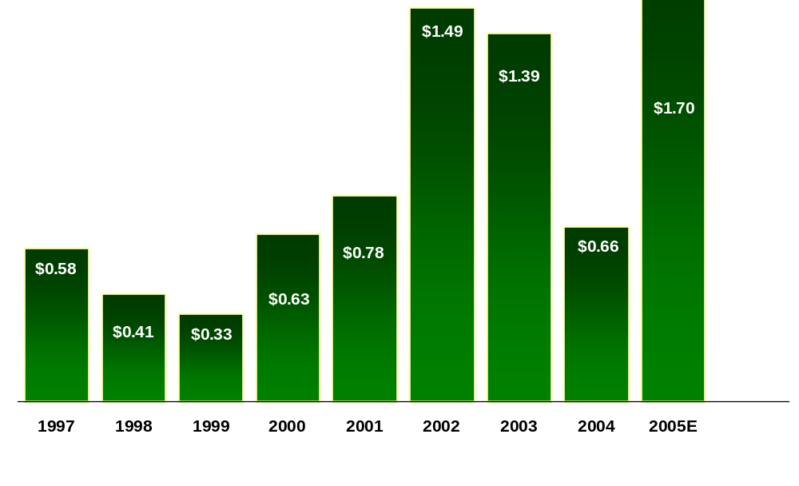
Rocky Mountain Gas Price Differentials
CIG discount to NYMEX
Supply / export capacity inequality
Hurricane Effects
Source: Bloomberg and recent industry research reports

Slide 15
Impediments – Land Access
Roughly 50% of the land in the west is owned by Federal and state governments
  These lands have extensive permitting and regulatory requirements
    Multiple agencies have regulatory and permitting requirements
      10 Agencies and over 100 regulations have to met to drill one well
        Department of Energy
        Department of Interior
        Bureau of Land Management
        National Forest Service
        National Wildlife and Fisheries
        Environmental Protection Agency
        Department of Transportation
        State Oil and Gas Commissions
        County Planning Commissions
        State Wildlife Agencies
        USGS

Slide 16
Impediments – Land Use
  Permitting requirements are extensive on Federal and State lands
    Environmental Impact Statements
    Environmental Assessment Statements
    Plans of Development
    Drilling Permits
    Air Quality Permits
    Surface Use Agreements
    Wildlife Stipulations
    Endangered Species
    Etc.

Slide 17
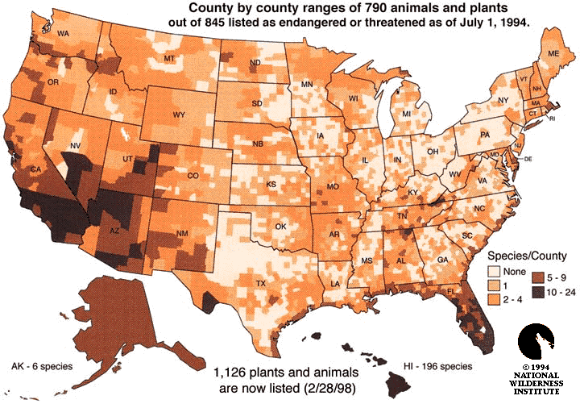
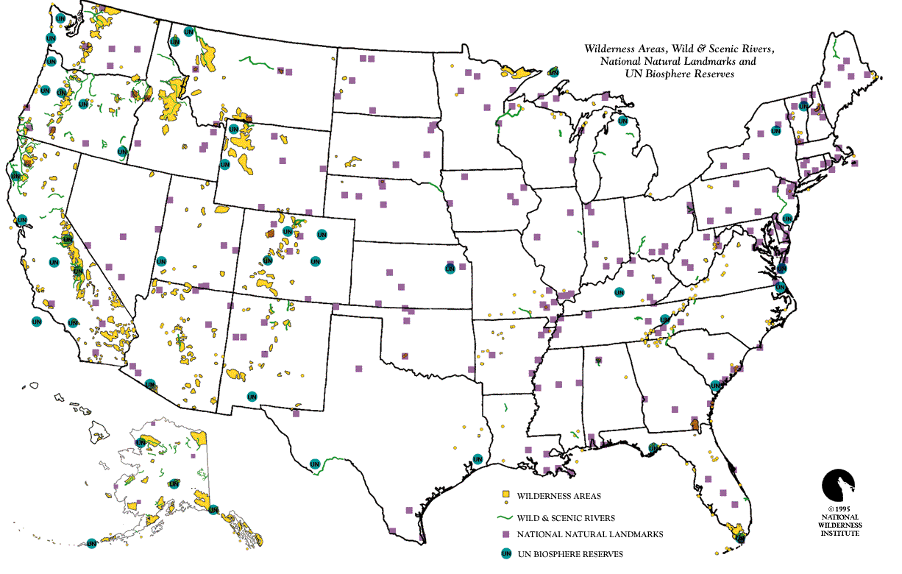
Endangered Species, Wilderness and other Land Use Restrictions

Slide 18
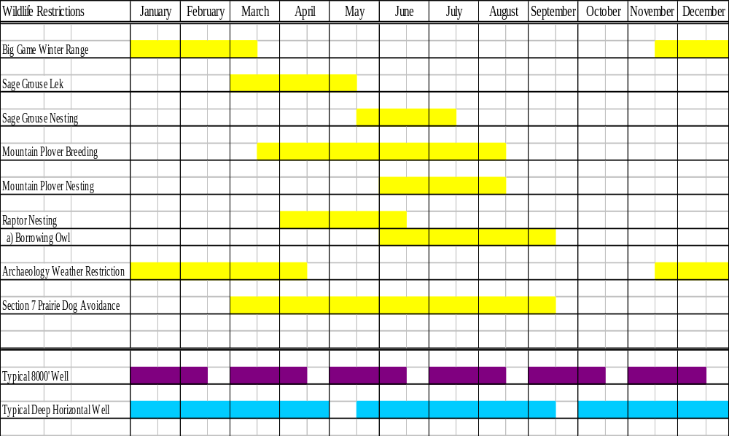
Surface Use/Restrictions

Slide 19
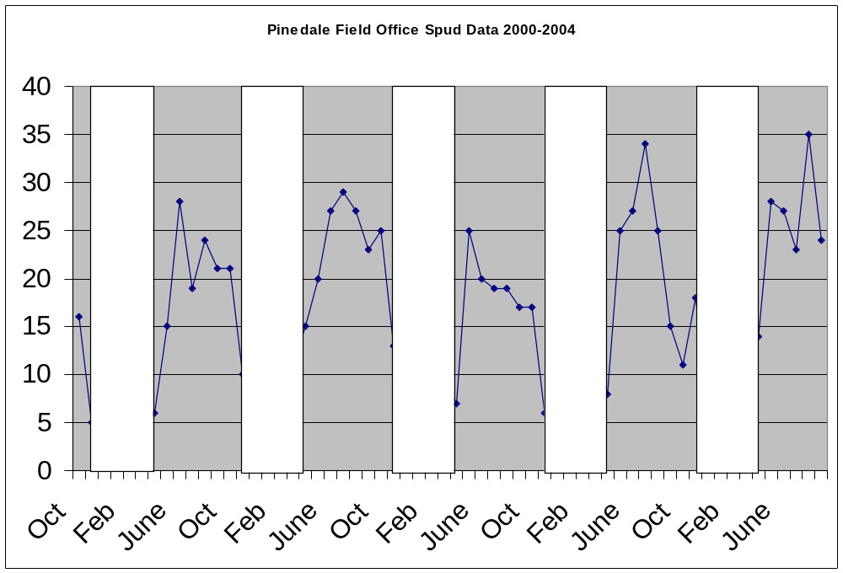
Winter Wildlife Stipulations Effects on Drilling

Slide 20
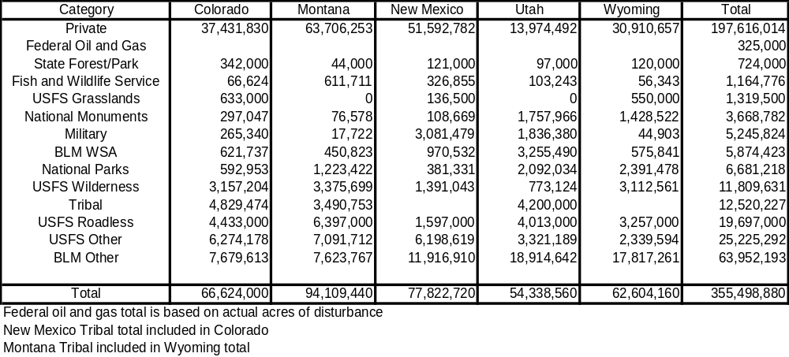
Rockies Surface Use

Slide 21
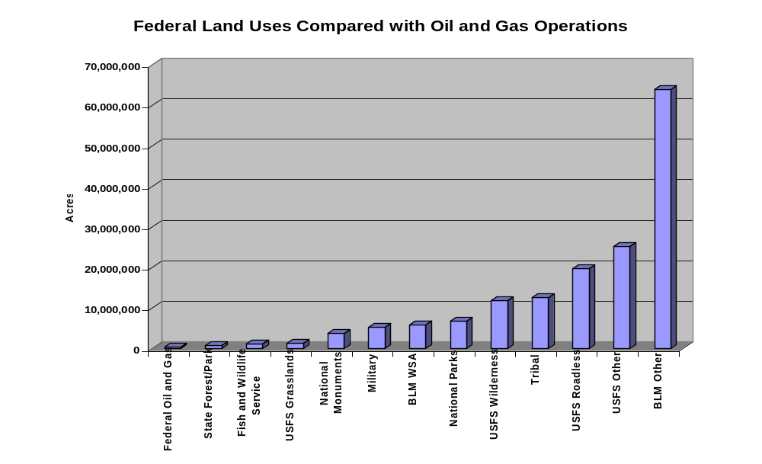
Federal Land Uses In the Rockies

Slide 22
Leasing of Federal Lands
Federal practices for the leasing of government lands need to be updated.
  Current practices:
    Open bids
    10 year leases
    12.5% royalties
    Leases held by production even if wells are shut-in if royalties are paid
    Large areas can be unitized to hold lands and avoid Federal limitations of 250,000 acres per state
    No commitment to drill or develop
  Lands bought by speculators with no intention of development
  Large companies amass huge acreage positions

Slide 23
Obstructionists
environMENTALists
“Man is always and everywhere a blight on the landscape” –John Muir, founder of the Sierra Club
“Human beings as a species have no more value than slugs” –John Davis, Editor of Earth First
I do not believe that a human being has a right to life…I would rather have medical experiments done on our children than on animals.” –PETA (People for the Ethical Treatment of Animals)
“Giving society cheap, abundant energy would be the equivalent of giving an idiot child a machine gun.” -Dr. Paul Ehrlich, Stanford Professor of Biology
“Complex technology of any sort is an assault on human dignity. It would be a little short of disastrous for us to discover the source of clean, cheap, abundant energy, because of what we might do with it.”-Amory Lovins, Rocky Mountain Institue
“Isn’t the only hope for the planet that the industrialized civilizations collapse? Isn’t it our responsibility to bring that about?”- Maurice Strong, head of 1992 Earth Summit and Executive Officer for Reform in the office of the Secretary General of the United Nations.
Etc.
Source: The Environmentalists’ Little Green Book –Compiled by the US Chamber of Commerce

Slide 24
Impediments – Oilfield Services
The Oil and Gas Industry employs approximately 1.5 million people in the U.S.
The downturn in the 1980’s reduced employment by over 700,000 people
“Green hands and worn out iron are syndromes from the downturn”
  In the late 70’s and early 80’s in excess of 4000 drilling rigs were operating
  Today the rig count is approximately 1500
  The biggest constraint is finding skilled workers to man the rigs
Oilfield service prices have roughly doubled over the past two years but the biggest costs increases are generally due to human errors related to a work force in training and to pushing older equipment to its limits.

Slide 25
Solutions
Price Volatility – put in place tax incentives that offset marginal economic returns when prices dip below certain levels or variable royalties on Federal lands.
Market Access –encourage the development of pipeline infrastructure and consolidate the regulatory processes for permitting under a single agency.
Land access – the number one constraint on new supply:
  Revise Federal leasing policies
  Identify regions for development and streamline the regulatory requirements for development
  Lease the lands under five year work programs with the that requirement that capital be spent on the evaluation and development of lands (Canadian frontier model)
Oilfield Services – work with industry to establish job training programs.

Slide 26
Implications
Failure to act will result in:
Higher energy prices
Increased imports
Potential economic disruptions for unreliable foreign sources
Less efficient development of indigenous resources

