Slide 1

2006 EIA Energy Outlook
and Modeling Conference
Energy Information Administration
March 27, 2006
Renaissance Hotel
Washington, D.C.
www.eia.doe.gov
Notes:
Hello, I am Guy Caruso, the Administrator of the Energy Information Administration. On behalf of everyone at EIA, I welcome you to the 14th EIA Energy Outlook and Modeling Conference.
This conference has traditionally focused on EIA’s Annual Energy Outlook. The AEO looks out at the energy markets over the long term, the next 20 to 25 years. The AEO is produced using the National Energy Modeling System or NEMS, a computer-based, energy-economy modeling system of U.S. energy markets.
This year’s conference also includes a session that examines short term energy issues over the next 1 to 2 years. These issues are addressed by EIA’s other forecasting product, the Short Term Energy Outlook.

Slide 2
EIA Reassessed Its Long-term Oil Price Projection
The pace of investment by major oil producing countries is more consistent with a higher oil price path
Investment impediments persist, even after several years of relatively higher oil prices
Cost of doing business increasing
Not due to “Peak Oil” considerations, although EIA is following this issue closely
Notes:
A key change in EIA’s long term outlook, the AEO2006, was made in our expectations about oil prices. While I don’t intend to go into the details, I wanted to address this important change.
EIA does not try to “predict” long-term oil prices; rather it considers a number of alternative oil price scenarios and examines their implications. The world oil market is simply too complex for anyone to consistently and accurately predict future long-term oil prices.
However, EIA reassessed its long-term oil price outlook for the AEO2006 reference case. Our expectations on the upstream investment climate have changed for several reasons.
EIA has reexamined the willingness of oil-rich countries to expand production capacity as aggressively as had been envisioned previously. Historically, oil producers have worried that high world oil prices would reduce economic activity as evidenced by the recessions accompanying previous price hikes. Recently, high world oil prices do not appear to have significantly impacted world economic growth.
Investment impediments are perceived to be more persistent, even after several years of relatively high crude oil prices.
(Next Page)

Slide 3
Notes:
International major energy companies lack access to resources in some key oil-rich countries. There has been an increasing recognition that the situation is not expected to change over the projection period.
There is a lack of clear, consistent, and trustworthy investment operating conditions in major producing countries such as in Russia, Venezuela, and Iran.
Experience has shown that sovereign governments controlling many lower-cost oil reserves often change contract terms to capture all or nearly all of the additional return available when oil prices are high, but leave investors to earn subpar returns when prices are low, creating a situation of asymmetric market risk for potential investors.
Revenues from national oil companies in several key oil exporting countries flow to governments that face increasing demands for social, welfare, and physical infrastructure projects to service rapidly growing, restive populations. The diversion of revenues for use outside the oil sector constrains internal resources available for investment.
In the longer term, lack of access leads to movement to higher cost development prospects, e.g., deepwater and oil sands.
The cost of bringing more oil to market in many producing areas also appears to be rising. This situation may improve over time, but it does appear to be impacting opportunities to expand production in the near term.
Infrastructure costs for some commodities have increased, e.g., steel and concrete.
There is a near-term shortage of skilled personnel.
Major contractors for large infrastructure projects are stretched.
The AEO2006 reference case does not reflect any change in our view of the physical availability of world oil resources. EIA’s assessment of international resources is based on the traditional U. S. Geological Survey and non-governmental sources.

Slide 4
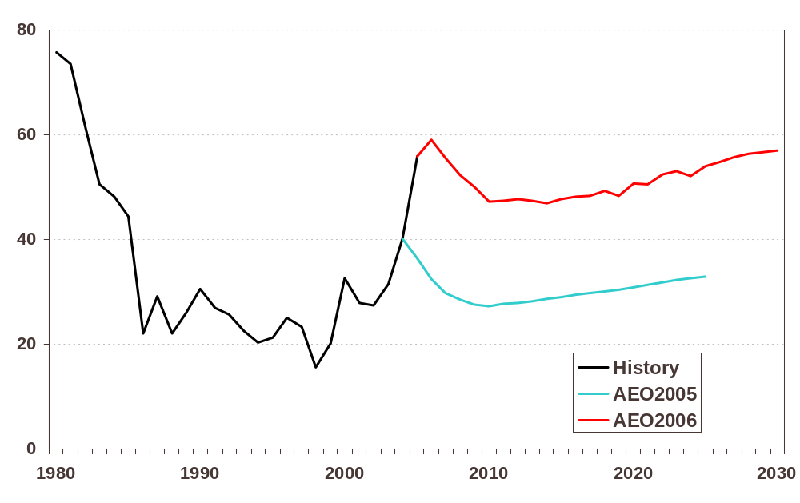
World Oil Price*, 1980-2030
(2004 dollars per barrel)
*World oil price is the weighted average price of imported low sulfur light crude oil.
Notes:
The AEO2006 reference case includes much higher world oil prices than previous AEOs. In AEO2006, world crude oil prices, which are now expressed in terms of the average price of imported low-sulfur crude oil to U.S. refiners, are projected to fall from current levels to about $47 per barrel in (2004 dollars) in 2014, then rise to $54 per barrel in 2025 and $57 per barrel in 2030. The projected price in 2025 is about $21 per barrel higher than projected in last year’s reference case.
In previous AEOs, the world crude oil price was defined on the basis of the average imported refiner acquisition cost of crude oil or IRAC. Historically, IRAC price has tended to be a few dollars less then the premium crudes, such as West Texas Intermediate and Brent. In an effort to provide a crude oil price that is more consistent with those generally reported in the media, AEO2006 uses the average price of imported low-sulfur crude oil to U.S. refiners, which is closer to WTI.
It should be noted that the reference case is only one of many scenarios considered. Energy market projections are subject to considerable uncertainty. Price projections are particularly uncertain, because small shifts in either supply or demand, which are both relatively insensitive to price changes, can necessitate large price movements to restore balance between supply and demand.

Slide 5
Forecast Publications and Documentation
Annual Energy Outlook (AEO) 2006
Assumptions for the AEO 2006
Supplemental Tables to the AEO 2006
National Energy Modeling System (NEMS): An Overview 2003
Detailed NEMS documentation by module
AEO Web Page:
www.eia.doe.gov/oiaf/forecasting.html
Short-Term Energy Outlook Web Page:
http://www.eia.doe.gov/emeu/steo/pub/contents.html
www.eia.doe.gov
Notes:
A major purpose of this conference is to discuss the many points of view relating to energy markets. That helps us identify those issues that EIA needs to test through alternative cases.
The conference also helps to make EIA’s modeling efforts more transparent. No matter how transparent EIA is about the assumptions and methodology, as we all know, a forecast is only as good as the underlying data. Given the extensive regulatory and structural changes that energy markets have undergone over the last decade, EIA faces new challenges in collecting data and ensuring its quality. Our goal is to provide the best data, analyses, and forecasts for our users.

Slide 6
Outreach and Quality Control
Energy Outlook and Modeling Conference
  Focus on model structure, AEO2006 and Short-Term Energy Outlook Forecasts, and identifying key energy issues
  Need participation by attendees to help us identify important issues and trends that should be considered
Working group meetings for Government users
Focus groups on selected topics
Independent Expert Reviews
www.eia.doe.gov
Notes:
A primary focus of this conference is EIA’s National Energy Modeling System methodology, the AEO2006 forecast, and the many energy issues that EIA needs to consider in developing future Annual Energy Outlooks. As mentioned earlier, we have also included a session on EIA’s short term energy modeling efforts. Today, we are looking for “your” participation in helping us to identify those issues and trends that need to be considered as we develop future Outlooks.
Your comments today along with those we receive during the year from users in the Department of Energy, focus groups, other non-DOE users, industry, and consumers are instrumental in helping EIA to ensure the on-going quality of our efforts.

Slide 7
Conference Overview
Overview AEO2006: John Conti, Director, EIA’s Office of Integrated Analysis and Forecasting
Keynote Address - “Energy for a Sustainable World: The Oil Challenge” by Joseph A. Stanislaw (JAStanislaw Group, LLC; Independent Senior Advisor to the Energy & Resources Practice of Deloitte & Touche USA LLP; and former President, Cambridge Energy Research Associates)
3 concurrent sessions
www.eia.doe.gov
Notes:
Following my remarks, John Conti, Director of EIA’s Office of Integrated Analysis and Forecasting, will present an overview of the recently released 2006 Annual Energy Outlook. The complete publication summarizing AEO2006 was released in early March. We will close the opening session with a keynote presentation by Joseph A. Stanislaw of the JAStanislaw Group, LLC and Independent Senior Advisor to the Energy & Resources Practice of Deloitte & Touche USA LLP; as well as former President, Cambridge Energy Research Associates. The keynote address is entitled, “Energy for a Sustainable World: The Oil Challenge.”
The balance of the day will be broken up into three concurrent sessions, one this morning and two in the afternoon. The topics are listed in your packet in the final agenda. Each session is one and one-half hours, which should provide time for interesting follow-up discussions.

Slide 8
Concurrent Session Topics
The Future Relationship of Oil and Natural Gas Prices in the United States
Global Oil Market Outlook: Short-Term Issues
Nuclear—Is EPACT Enough?
Return to Coal—From Where and at What Price?
World Outlook for Unconventional Oil Production
Globalization of the Natural Gas Market
If Not Gas Then…?
How Far Ethanol?
Unconventional Natural Gas: Industry Savior Or Bridge?
www.eia.doe.gov
Notes:
The concurrent sessions are intended to review the AEO2006 forecast results, discuss issues related to the topic area, and compare the NEMS methodology with that used by other forecasters. For example, topics addressed in the sessions include the relationship between natural gas and oil prices, the potential for globalization of natural gas markets, the role of ethanol, and the potential of unconventional oil, among many topics.
These and other topics covered in the concurrent sessions should provide for a lively discussion. I hope everyone is willing to participate and discuss the issues. We look forward to your input on EIA’s modeling processes.

Slide 9
Notes:
A final word. Your packets include an evaluation form. This includes questions on the conference as a whole and on the individual speakers. It also asks you to suggest topics for future conferences. These are used to help us plan the agenda for next year’s conference. Please complete the evaluation form and return them at the registration desk in the hallway or by fax after the conference.
Again, thank you for attending.

