Slide 1
The Outlook for Unconventional
Liquids in AEO2006
John Cochener
Energy Information Administration
John.Cochener@eia.doe.gov
2006 EIA Energy Outlook and Modeling Conference
March 27, 2006

Slide 2
How’s Business?
Over 100 billion burgers sold since 1948.
- McDonalds
Over 63 billion CTL gallons produced since 1955.
- Sasol
Over 1.5 billion syncrude barrels produced since 1978.
- Syncrude Canada
www.eia.doe.gov

Slide 3
Unconventional Often Evolves Into
Conventional Production
Technology allows yesterday’s “exotic” production to become today’s
“ordinary” production. Recent examples include:
      Coalbed Methane
      Enhanced Oil Recovery (EOR)
      Deepwater Gulf of Mexico
Today, unconventional frequently includes:
      Shale Oil
      Heavy Oil
      Oil Sands
      Gas-to-liquids (GTL)
      Coal-to-liquids (CTL)
      Energy Crops
        Biomass-to-liquids (BTL)
        Ethanol
        Biodiesel

Slide 4
Representative Unconventional Production in 2005
OS [0.99]
SO [0.00]
E
[0.1]
E
[0.25]
E
[0.04]
H
[0.55]
E
[0.1]
G
[0.05]
G
[0.01]
Legend
B- BTL
C- CTL
E- Ethanol
G- GTL
H- Extra-Heavy Oil
OS- Oil Sands
SO- Shale Oil
[0.00] - Million BPD
E
[0.28]
C [0.13]

Slide 5
Unconventional Production in Reference Case, 2030
C
[0.2]
OS
[3.6]
G
[0.2]
SO [<0.1]
E
[0.7]
C
[0.6]
E
[0.3]
G
[<0.1]
B
[<0.1]
G
[<0.1]
C [0.6]
G
[<0.1]
G
[<0.1]
G
[<0.1]
G
[1.1]
H
[0.1]
H
[1.6]
C
[<0.1]
E
[0.3]
G
[0.2]
G
[0.3]
Legend
B- BTL
C- CTL
E- Ethanol
G- GTL
H- Extra-Heavy Oil
OS- Oil Sands
SO- Shale Oil
[0.0] - Million BPD
G
[<.1]
E
[0.7]
C
[0.6]
C [<0.1]
SO
[<0.1]

Slide 6
Unconventional Production in High Price Case, 2030
G
[0.2]
C
[0.4]
OS
[4.8]
G
[0.4]
SO
[0.1]
E
[0.6]
E
[0.9]
G
[<0.1]
C
[1.8]
SO
[0.4]
C [1.6]
B
[<0.1]
G
[0.2]
G
[<0.1]
G
[0.1]
G
[<0.1]
G
[1.5]
H
[0.1]
H
[3.1]
C
[0.2]
E
[0.9]
G
[0.3]
G
[0.4]
Legend
B- BTL
C- CTL
E- Ethanol
G- GTL
H- Extra-Heavy Oil
OS- Oil Sands
SO- Shale Oil
[0.0] - Million BPD
G
[0.3]
E
[0.8]
C
[1.8]
C
[0.1]
SO
[<0.1]

Slide 7
Unconventional Petroleum Production, 2030
(million barrels per day)
Synthetic Crudes Synthetic Fuels Renewable Fuels
Extra-
Oil Heavy Shale
Sands Oil Oil CTL GTL BTL Biodiesel Ethanol Total
Reference Case
United States 0.8 N/A 0.02 0.7 1.5
World 3.6 1.7 0.05 1.8 1.1 N/A N/A 1.7ª 10.0
High Price Case
United States 0.4 1.7 0.2 N/A 0.03 0.9 3.2
World 4.9 3.1 0.5 2.3 2.6 N/A N/A 3.0ª 16.4
Notes
N/A- Not forecast
a- Includes Biodiesel

Slide 8
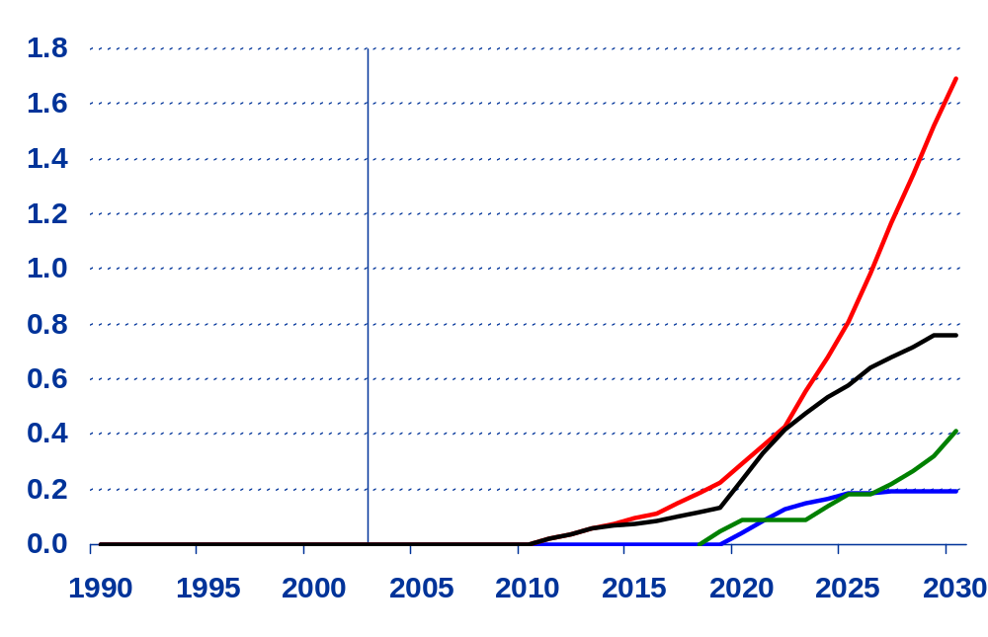
Gas-to-Liquids, Coal-to-Liquids, and Oil Shale Production in the Price Cases,
1990-2030 (million barrels per day)
History
Projections
Coal to Liquids/
High price
Coal to Liquids/
Reference
Oil Shale/High price
Gas to Liquids/
High price

Slide 9
Simplified Synfuels Flow Diagram
Biomass
Front End
Feedstock
Handling
&
Syngas
Production
Naphtha
Fischer-
Tropsch
Synthesis
Product
Separation
&
Work-up
Section
Diesel
Natural Gas
Syngas
Syncrude
Kerosene
Lubes/Waxes
Coal
Steam/Heat
By Products
&
Co-production
Capability
Electricity
Water
CO₂/H₂

Slide 10
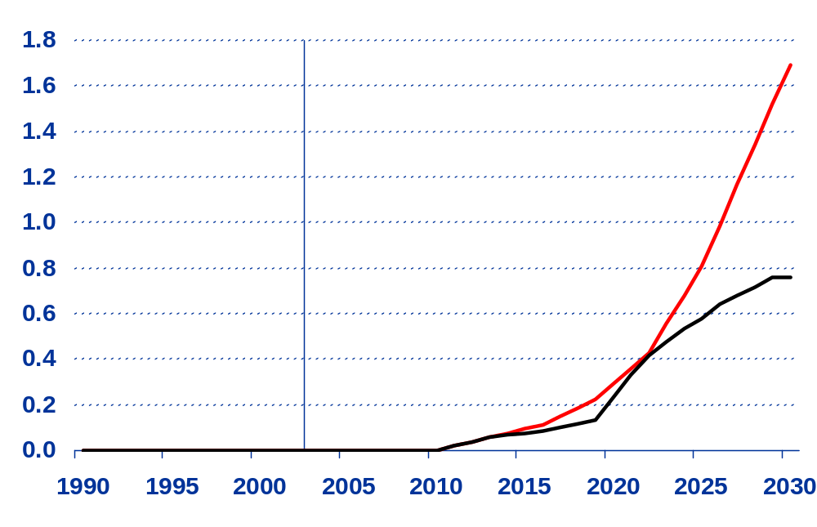
Coal-to-Liquids Production in the Price Cases,
1990-2030 (million barrels per day)
History
Projections
Coal to Liquids/
High price
Coal to Liquids/
Reference

Slide 11
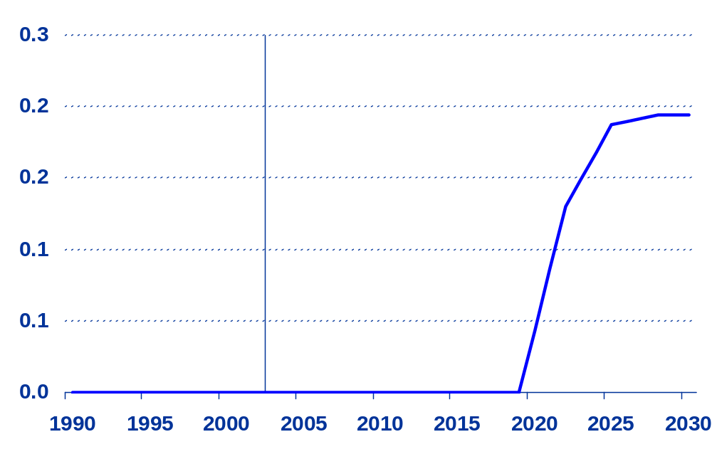
Gas-to-Liquids Production in the
High Price Case,
1990-2030 (million barrels per day)
History
Projections
Gas to Liquids/
High price

Slide 12
Simplified Oil Shale Process Diagram
Mining Process
Surface
or Underground
Mining
Kerogen
Surface
Retorting
Cracking/
Hydrotreating
Syncrude
Marlstone
Bitumen
Drilling
Wells
Heating
Marlstone
Production
Petroleum
Products
In Situ Process

Slide 13
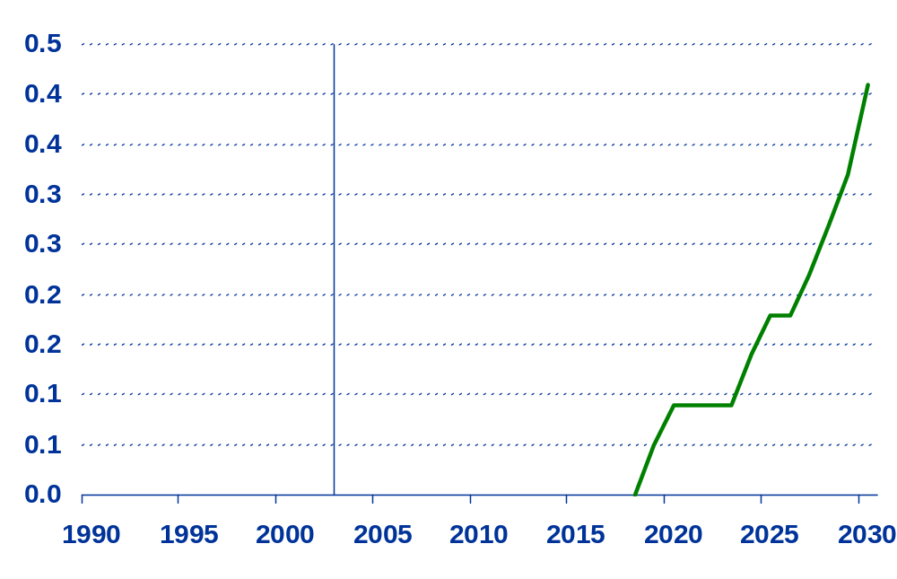
Oil Shale Production in the High Price Case,
1990-2030 (million barrels per day)
History
Projections
Oil Shale/High price

Slide 14
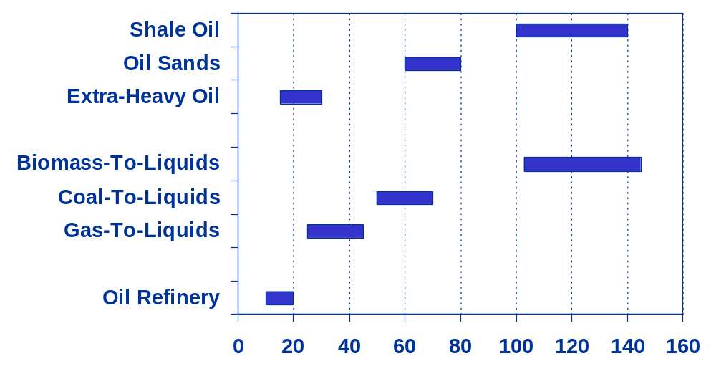
Unconventional Petroleum Liquids
Capital Investment Costs
(Thousand 2004 dollars per daily barrel of capacity)
Source: Energy Information Administration

Slide 15
Production Challenges
Biomass-to-Liquids- Material handling; large catchment areas required
Coal-to-Liquids- Material handling; gasifier reliability
Gas-to-Liquids- Efficiency; capital costs; stranded gas supplies
Extra-Heavy Oil- Future investment for expansion
Oil Sands- Fuel costs; diluents
Shale Oil- Capital costs; open pit vs in-situ process
www.eia.doe.gov

Slide 16

Summary
United States (2030)
Unconventionals represent 5 to 13 percent of national supply
across the price cases.
CTL is the largest contributor at 7 percent of national supply in the
high price case.
World (2030)
Unconventionals represent 8 to 16 percent of total world supply
across the price cases.
Oil sands and extra-heavy oil are the largest global supply
contributors at 5 and 3 percent, respectively, in the high price case.
www.eia.doe.gov

