Slide 1
Non-OPEC Oil Supply:
Outlook for 2006 and 2007
2006 EIA Energy Outlook and Modeling Conference
Global Oil Market Outlook: Short-Term Issues
Michael Cohen
Energy Markets & Contingency Information Division
Notes:
GOOD MORNING, name, EMEU
I was asked to focus more specifically on the contribution of non-OPEC countries to world oil supply in 2006 and 2007.
As you know, non-OPEC supply is a key variable in how global balances end up this year, and represents over half of the world’s current oil supply.

Slide 2
Outline
Worldwide trends
Regional focus on fundamentals
Conclusions
Notes:
Will begin with worldwide trends in the oil industry
Speak specifically about EIA’s forecast for the major producing regions

Slide 3
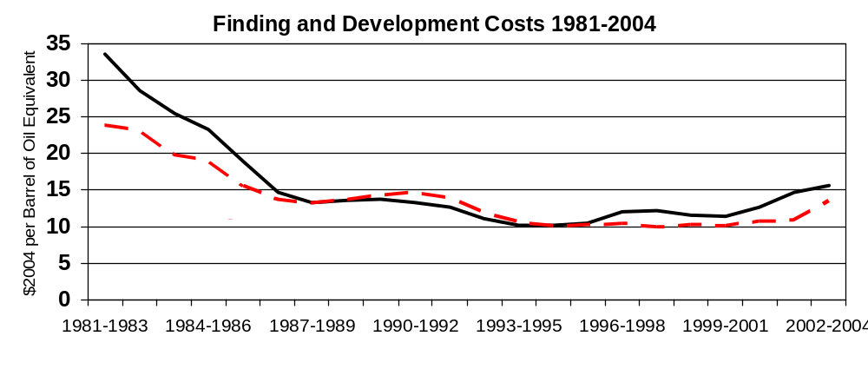
A company’s financial strength enables new field development and mature field upkeep.
RISING F&D COSTS
2000-2004: expenditures for exploration and development increasing.
Higher rates of decline at mature fields means production becomes more capital intensive.
Rig accessibility can derail project schedules and rates remain high after Gulf hurricane impact.
Companies benefit from current high prices, but in some areas the company does not fully collect economic rents.
Notes:
Talk about two upstream barometers before I discuss EIA’s prod. forecasts:
FIRST, 2000-2004: Company expenditures for exploration and development increased 34 percent over the previous 5-year period
Chart uses data from FRS companies : primarily US-based companies but also include foreign companies invested in the US oil and gas sector (ie BP America and Shell)
As you can see, foreign costs have also risen, but more slowly.
In 2004: cost increase came as a result of large negative revisions of reserves
Even though costs remain well below that of the early 1980s, rising F&D costs have been a contributor to the higher price of 5 year deferred WTI contract.
Trend is also significant because higher rates of decline at mature fields means marginal production is becoming more capital intensive.
SECOND barometer is rising rig rates: a company’s access to rigs for exploration and drilling are necessary in order to keep projects on schedule –
As rig rates have increased after the impacts of the Hurricanes last year, some companies have had to change their projects’ timelines
Since gov’ts and companies are rarely eager to report poor field performance, let alone forecast it, rosy outlooks need to be offset by an understanding of a company’s bottom line
Finally, although companies benefit from current high prices, in some places high levels of government taxation lessen a company’s economic rents.

Slide 4
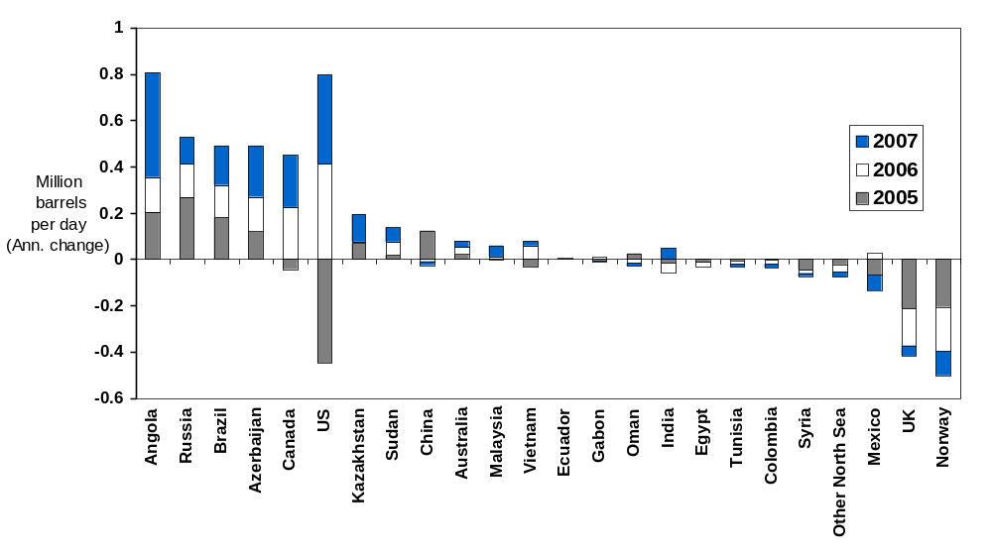
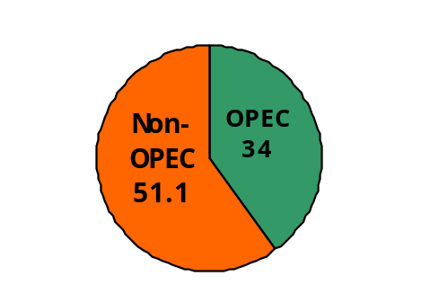
EIA expects Non-OPEC supply growth of 900,000 bbl/d in 2006 and 1.6 million bbl/d in 2007.
World Liquids Production 2006
← Hurricane recovery
← Hurricane damage
March 2005 forecast for Non-OPEC output in 2005 did not predict hurricane effects but was within 100,000 bbl/d of actual.
Majority of Non-OPEC oil supply growth in 2006 and 2007 will come from the FSU and West Africa.
Notes:
It is with these barometers in mind that EIA develops its forecast for non-OPEC supply, which represents over half of world oil production
The accompanying chart provides a breakdown by country of EIA’s forecast, and is published each month on the EIA STEO homepage
EIA, traditionally conservative fcsts
E.g. in March 2005 we forecast that non-OPEC supply for the year would average 50.7, which at that time was considered very low/conservative.
Oil supply averaged 50.2 million bbl/d, because of the hurricanes, so basically our fcsts were on target.
THIS YEAR, EIA expects non-OPEC, total liquids supply growth of roughly 900,000 bbl/d and we expect 1.6 million bbl/d in 2007.
Outside the US, the majority of non-OPEC supply growth will come from the FSU and from deepwater fields off the shore of W. Africa
Since I have not devoted a slide to Angola I’d like to speak about it briefly here, and answer any further questions about it at the end:
- Major projects are US-led Bengeula Belize (200,000) and Kizomba B and C (250,00 and 240,000) fields
- By the time these projects are all producing at their maximum rate in 2007 and 2008, they will have added almost 700,000 bbl/d

Slide 5
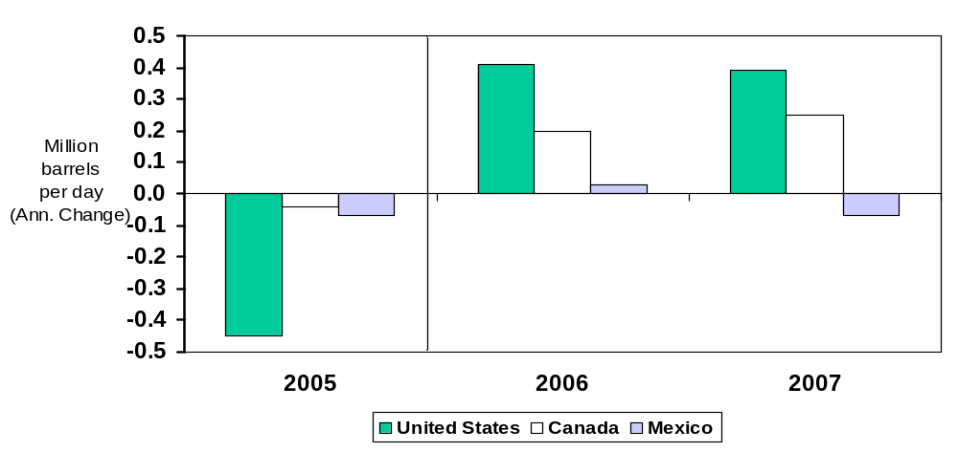
North American growth dependent on hurricane recovery and on development of Canadian oil sands.
US production recovery from GOM Hurricanes, field development in North Slope of AK add to growth.
Despite declining conventional production in the W. Canada Sedimentary Basin, total Canadian oil production will increase due to:
  Rising oil sands production and new offshore projects (White Rose, 100,000 bbl/d).
Mexican production growth, if any, depends on level of Cantarell decline (6% in 2006).
Notes:
A major portion of additions in non-OPEC supply in 2006 is simply production recovery from GOM Hurricanes
Some field development in North Slope of AK add to growth. – expect some downwards revision in the April STEO outlook
Canadian conventional production in the W. Canada Sedimentary Basin will continue to decline, estimated at around 3 percent a year –
But taking into account non-conventional growth from oil sands, EIA still expects 200,000 bbl/d additional growth.
White Rose field will provide 100,000 bbl/d additional conventional production
There is currently a moratorium on Pacific offshore developments,
Mexican production growth, if any, depends on level of mature field decline The Cantarell field comprises over half of Mexico’s 3.8 million bbl/d
current expectations for decline at the field are for 6% (2006), 12% (2007), 15% (2008).
Even with the recent announcement of the discovery of a new field, medium-term growth depends on significant amounts of investment to turn these newly added probable reserves into economically proven reserves
We forecast a slight increase in Mexican 2006 production, despite Cantarrel declines, because there is some new production from Ku-Maloop-Zaap expected to come online and Mexican production was reduced in 2005 due to direct and indirect hurricane effects.

Slide 6
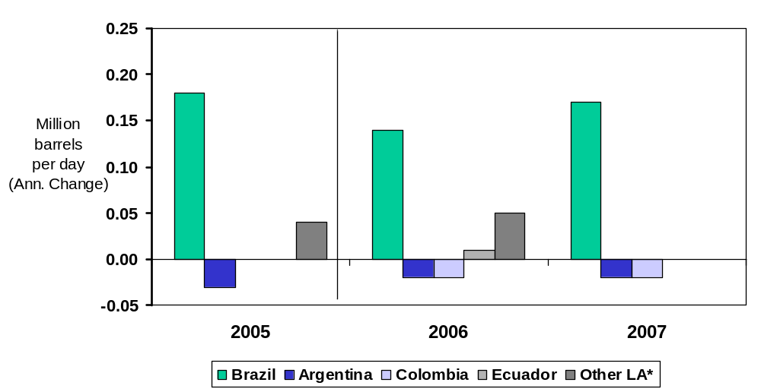
Brazil leads Non-OPEC oil supply growth in Latin America.
0 0
0 0
*Does not include Venezuela
Production in Brazil will increase as new projects come onstream.
Delays at Albacore Leste (P-50) push start date to April 2006. In addition, prospective start dates for new fields have been pushed later into the STEO outlook.
Mature field declines in Argentina and Colombia will offset increased production from Trinidad and Tobago.
Notes:
Large amounts of production from brazil
STILL, recently announced delays at the 180,000 bbl/d Albacore Leste or (P-50) field push start date to April 2006.
Due to similar design structure and the fact that other prospective fields are being developed by the same company,
START dates for new fields have been pushed later into the STEO outlook.
These have altered our supply outlook for Latin America very slightly since it was first published in the January STEO.

Slide 7
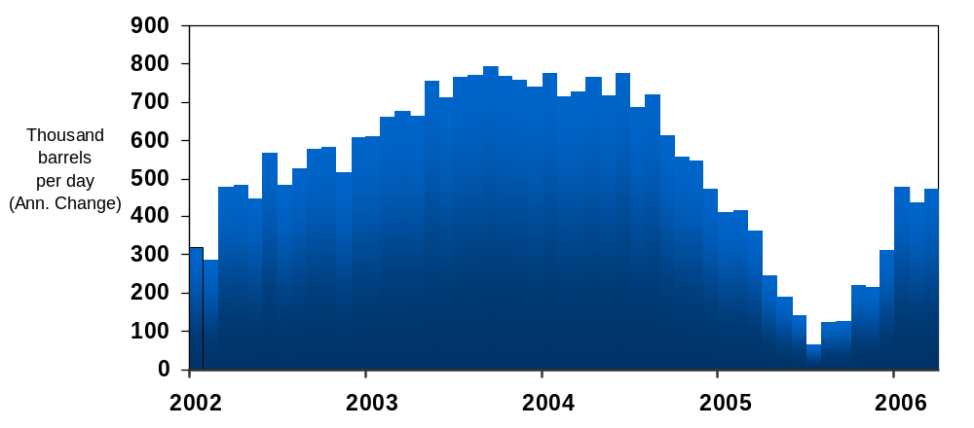
Oil supply growth in Russia depends on mature field decline, financial strength of major producers.
Mar-06, 475,000 bbl/d y/y growth
EIA expects slower but steady oil production growth of 1.5% in Russia in 2006.
Cold temperatures in Siberia shut in 250,000 bbl/d of production in January and early February. Roughly 100,000 bbl/d of production has rebounded during Feb. and Mar.
Export taxation hindering maintenance on existing fields and new field development.
2007 growth is smaller (1.2%) and may depend on when mature field declines begin.
Notes:
Russia is the largest component of current Non-OPEC supply. From 2002 to 2005, Russian oil supply growth comprised over 40% of non-OPEC supply growth during that time period.
This graph shows year to year change in monthly oil production from 2002 to the present.
As you can see oil production growth reached its peak in late 2004 and has been affected since then in part by the Yukos affair, which soured the investment climate.
A major reason for the slowing of growth in the past year and a half is the level of export taxation.
In April 2004, Russian companies gave the gov’t around 15% of their oil revenues in the form of an export duty. By November 2005, that share had grown to almost 50%.
This places Russian companies in a difficult financial situation to maintain current production and develop new fields.
There are few signs that the Russian government can lessen its reliance on oil export revenues, especially leading up to a presidential election in 08.
We expect slower but steady oil production growth of 1.5% (140,000) in Russia in 2006
Also, unusually cold weather this quarter could have implications for the 2006 outlook by (1) causing permanent damage to oilfield equipment and (2) raising the company’s operating costs.
This makes them even more unlikely to spend money on further exploration and development.
The key component to the Russian production outlook beyond 2006 is when mature field decline begins.
Sakhalin 1 growth, other small field development by Lukoil and TNK- BP will be unable to compensate for these declines, which have already begun at major fields.

Slide 8
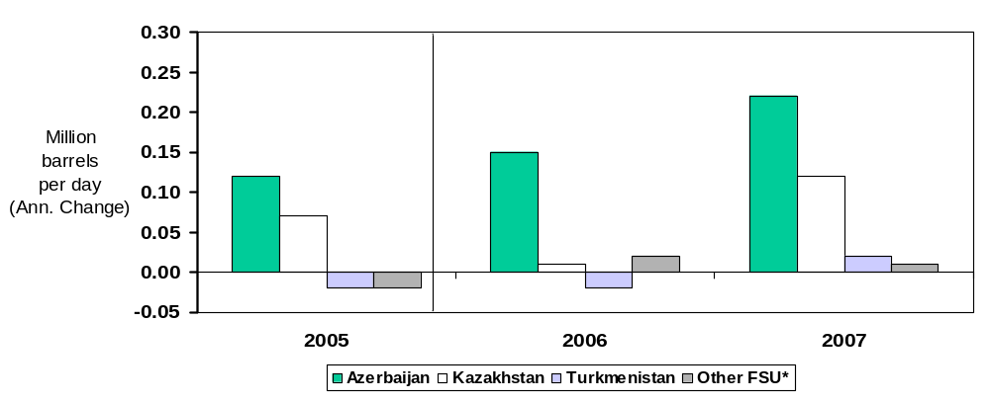
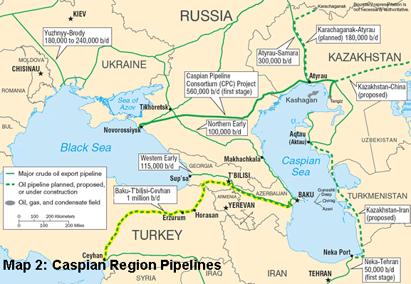
Caspian region growth from ACG in Azerbaijan and from expansion of existing projects in Kazakhstan.
Tengiz
*Ukraine, Uzbekistan, Tajikistan and Kyrgyzstan
Contingent on infrastructure (pipeline) availability.
Due to construction problems in Turkey, the Baku-T’bilisi-Ceyhan pipeline is expected to load its first tanker in early summer 2006.
Part of ACG came online in late December 2005, expected to add an average of 70,000 bbl/d during 2006.
CPC
ACG
BTC
Notes:
In the nearby Caspian region
CLICK
Project startups at the Azeri-Chirag-Guneshli field (ACG) in February and December of last year will add to growth during 2006
BUT: contingent on the scheduled commercial operation of BTC in early summer 2006.
Kaz. has also expressed interest in sending oil to BTC but agt has not been signed yet.
Production gains from Kazakhstan (and in particular Tengiz) are largely dependent on infrastructure availability and CPC expansion
Russia has agreed on almost all demands of consortium members but has not signed an agreement
EIA forecasts small growth from Turkmen. And Uzbek over the course of the outlook –
Despite large oil and gas reserves in these countries, political regimes and a lack of available transport infrastructure hinder access to resource potential.
Why (if time)?
fundamental changes to shareholder governance structure, Bosporus bi-passes, direct involvement of Transneft in CPC management, allocation of management positions
Lack of leadership- unclear who in Russian gov’t will have final say.

Slide 9
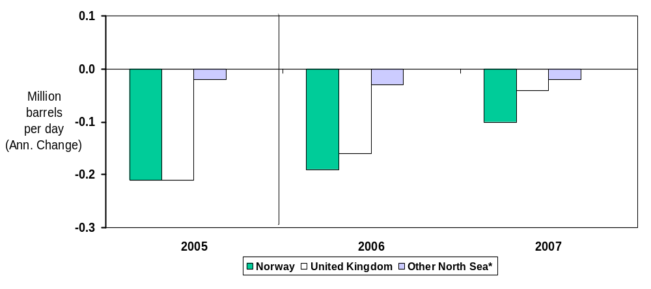
North Sea infrastructure development helps stem decline rates of 6-12 percent at mature fields.
*Denmark, Netherlands, Germany (offshore)
North Sea liquids production continues to decline, but at a slower rate due to added capacity in 2006 and 2007.
Early maintenance (scheduled and unscheduled) in Norway could lower production in 2006.
In the UK, several fields totalling up to 120,000 bbl/d throughout 2006 will likely stem the rate of decline in 2006. Buzzard, the largest of these is expected to come online at 85,000 bbl/d in late 2006 and ramp to 150,000 bbl/d by mid 2007.
Notes:
North Sea liquids production continues to decline, but at a slower rate due to added capacity in 2006 and 2007.
Early maintenance (scheduled and unscheduled) in Norway could lower production in 2006.
Norway
For 4 days in March 730,000 bbl/d of output was offline at Ekofisk and the Troll fields.
This year’s maintenance schedule averages to an equiv. of 110,000 bbl/d, which is roughly 40,000 bbl/d larger than last year.
Partly offset by 140 kb/d of new and ramping up fields (Grane, Kristin, Oseberg, Snorre) and development at existing fields.
In the UK
Canadian company Nexen expects production from the Buzzard field during the fourth quarter of this year. The field will peak in 2007 at around 150,000 bbl/d.
Other new projects in the UK include Oilexco’s Brenda and Maersk Oil’s Dumbarton projects in the central North Sea. Combined, these could produce about 100,000 bbl/d next year at peak levels.
But government policy changes on taxation could hurt investment climate and have long term implications

Slide 10
Conclusions
Relationship between oil prices and non-OPEC supply: goes both ways.
Largest growth on a per barrel basis will come from US, Russia, W. Africa, Caspian, and Latin America.
Offset by large declines from the North Sea, Mexico, and the Middle East.
AEO forecasts non-conventional growth of 2 million bbl/d from 2005-2010, but not until late in short term outlook.
Non-OPEC supply growth of 2.5 million bbl/d between 2005 and 2007 (including Canadian oil sands).
Demand will rise over 3.5 million bbl/d between 2005 and 2007.
1 million bbl/d growth in “Call on OPEC”.
Notes:
To the extent possible, EIA uses a bottom-up approach for its forecasting methodology.
maintain a list of upcoming projects and conduct extensive research on mature fields to estimate project, country, and region-specific decline rates.
In addition to all issues I’ve discussed in the previous slides the oil price itself can have a large effect on the production outlook for a given country or region.
On one hand, changes in expectations of non-OPEC supply effect oil prices
But on the other hand, oil companies are subject to pressures to bring projects online on time because of high prices - increasing oil supply.
And companies are being pressured by higher capital costs that came about as a result of prolonged high oil prices.
All of these simultaneous pressure make forecasting beyond a couple months subject to particular uncertainty
Overly optimistic or pessimistic forecasts have had implications for OPEC behavior, which makes accurate forecasting of non-OPEC supply even more important .
SO…
Largest growth on a per barrel basis will come from US, Russia, W. Africa, Caspian, and Latin America.
Offset by large declines from the North Sea, Mexico, and the Middle East.
AEO forecasts non-conventional growth of 2 million bbl/d from 2005-2010 but not until late in short term outlook - SEE APPENDIX FOR REGIONAL BREAKDOWN
EIA’s STEO: Non-OPEC conventional supply growth of 2.5 million bbl/d between 2005 and 2007.
Demand will rise over 3.5 million bbl/d between 2005 and 2007 – ERIK and ED WILL DISCUSS THIS FURTHER.
1 million bbl/d growth in “Call on OPEC”. –
Other members of our panel will discuss the OPEC dynamic in more depth – so that concludes my presentation
THANK YOU.

Slide 11
Appendix

Slide 12
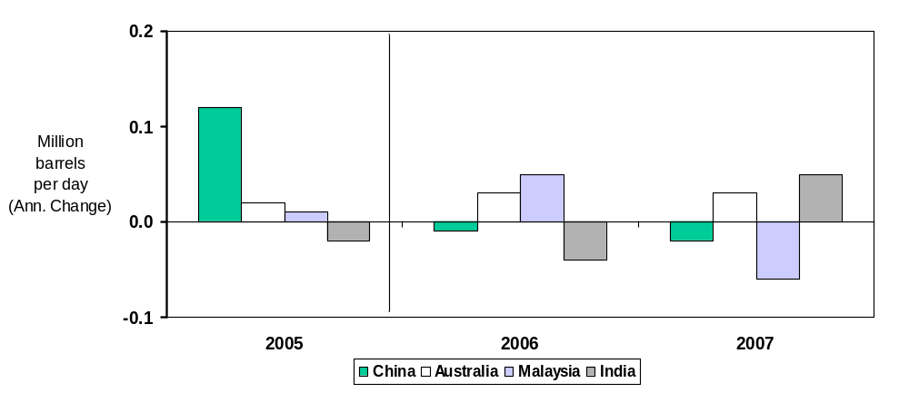
Maturing fields in Asia dampen expected growth from small new projects.
In China, Daqing field workovers have been more successful than in previous years
India’s Mangala field not expected until 2007, but Bombay High back online by Summer 2006
FPSO usage in Australia dampening outlook for new production: Enfield and Mutineer-Exeter.
Notes:
China: Daqing field comprises large portion of Chinese oil output,
BUT - field is in decline and remains to be seen whether
India: Bombay high – fire destroyed 500 kb/d platform last july - new platform on schedule for delivery in July
Australia: Enfield production moved forward to Q3 2006
Mutineer Exeter never reached target peak – output has halved since it came online 11 months ago – Target of 100,000 bbl/d and 70-90 kb/d during development phase, has averaged only 50-60 kb/d during this year
Other fields in offshore Australia have had similar performance problems
FPSO usage is more capital intensive motivating operator to try to maximize production early and recover more of the costs.

Slide 13
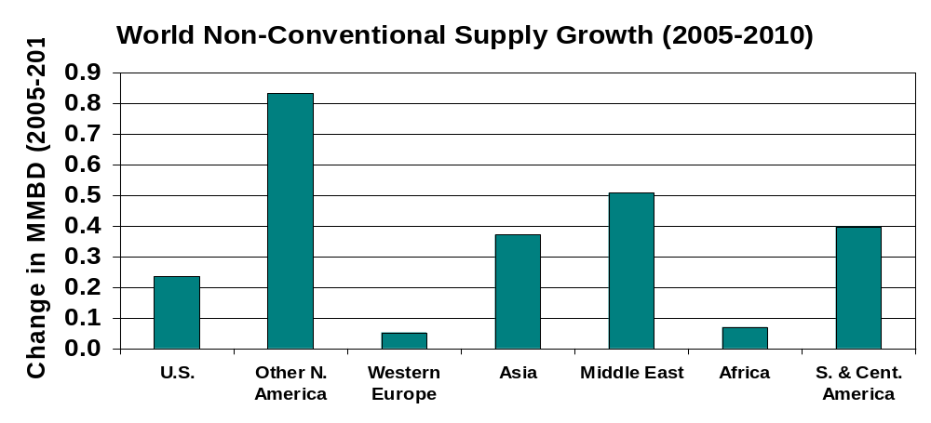
World non-conventional oil supply may grow over 2 MMBD by 2010 but mostly not until after 2007.
Note: Includes OPEC non-conventional supply
Source: EIA. Annual Energy Outlook, 2006
Canadian oil sands production growth adds over 800,000 bbl/d by 2010 but are largely dependent on adequate infrastructure and fuel supply.
In Qatar, Oryx GTL (35,000 bbl/d during 2006) and Pearl GTL (70,000 bbl/d by 2009) comprise largest part of Middle East non-conventional growth.
Notes:
Non-conventional oil supplies will grow, but will remain relatively small in the short term outlook to 2007.
Canadian oil sands production and Venezuelan extra-heavy oil and bitumen production are largest components of current non-conventional supply.
We expect supply additions and expansions in Canada to add non-conventional supply of 110 kb/d in 2006 and 260 kb/d in 2007
Non-conventionals currently compose 3% of world oil supply and their share will grow by only a percentage point by 2007 (or
Non-conventional oil production will account for 5 percent of world oil output in 2010, up from 3 percent in 2006.

