Slide 1

Annual Energy Outlook 2006
John J. Conti
Office of Integrated Analysis and Forecasting
Energy Information Administration
March 27, 2006
Notes:
Good morning and thank you for attending this year’s conference. We find this conference invaluable in providing us both technical feedback as well as insight into the information that you would like to see in the future.
We have broadened the scope of this year’s conference to include a session on short term energy issues and hence change the name change to the EIA Energy Outlook and Modeling Conference.
I would like to take this opportunity to thank all the EIA staff that helped to make this conference possible.
I will discuss energy projections contained in the Annual Energy Outlook 2006. As most of you know the AEO contains a number of scenarios that address a number of possible future outcomes for U.S. energy markets. This year, I hope to give a greater flavor for some of the other scenarios that are contained in the AEO.
The projections in the AEO2006 are not statements of what will happen, but what might happen given the specific assumptions and methodologies used. They provide an objective, policy-neutral basis that can be used to analyze energy markets under alternative assumptions. The AEO results are based on the National Energy Modeling System, which is an abstraction of energy markets, including the representation of regulations and producer and consumer behavior.
The AEO’s projections are based generally on current laws and regulations. It does not include the potential impacts of pending or proposed legislation, regulations, or standards.

Slide 2
Presentation Overview
AEO2006 reference case
Oil market results in the context of low, reference, high price cases
Natural gas market results in the context low, reference, and high LNG cases
Coal market results in the context of low, reference, high coal cost cases.
Electricity market results in the context of the reference, advanced, and vendor estimate nuclear cases
Carbon dioxide emissions in the context of the low, reference and high growth cases.
Notes:
First, I will present some general information about the AEO2006 reference case to provide some context for the comparisons and additional detail that follow.
The following sections will contrast the reference case to two alternative sets of scenario projections found for each fuel.
I will present results for the oil markets in the context of the low, reference and high price cases.
Then, I will present information about the natural gas markets in the context of the low, reference, and high LNG import cases.
That will be followed with information about the coal markets in the context of the low, reference, and high coal cost cases.
This will followed with information about electricity markets in the context of the reference, advanced, and vendor nuclear cases.
Finally, I will present information about carbon dioxide emissions in the context of the low, reference, and high growth cases.

Slide 3
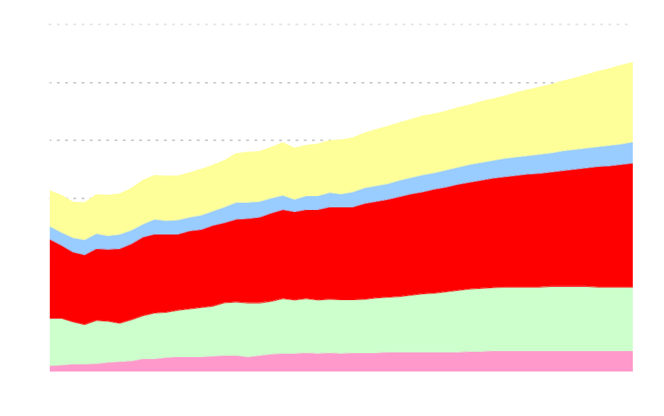
Primary Energy Consumption by Fuel
(quadrillion Btu)
Coal
Renewables
Petroleum
Natural Gas
Nuclear
Notes:
Total primary energy consumption in the AEO2006 reference case is projected to increase at an average rate of 1.1 percent per year, from about 100 quadrillion Btu in 2004 to 134 quadrillion Btu in 2030.
Coal is the fastest growing fuel followed in decreasing order by renewables, petroleum, natural gas, and nuclear.
The projected rate of growth in primary fuel consumption through 2030 is comparable to the historical period of 1980 through 2004 for some fuels and different for others.
For example, the rate of primary energy consumption for coal and natural gas are similar to history, whereas it is different for renewables, petroleum and nuclear.
Renewables are projected to grow at 1.5 percent per year in the AEO2006 reference case, faster than the 0.4 percent rate of growth in history.
Petroleum is also projected to grow faster at 1.1 percent per year compared to 0.6 percent per year experienced in the historical period.
Nuclear power is projected to grow at 0.4 percent per year between 2004 and 2030, much slower than the 4.3 percent per year historical growth rate.

Slide 4
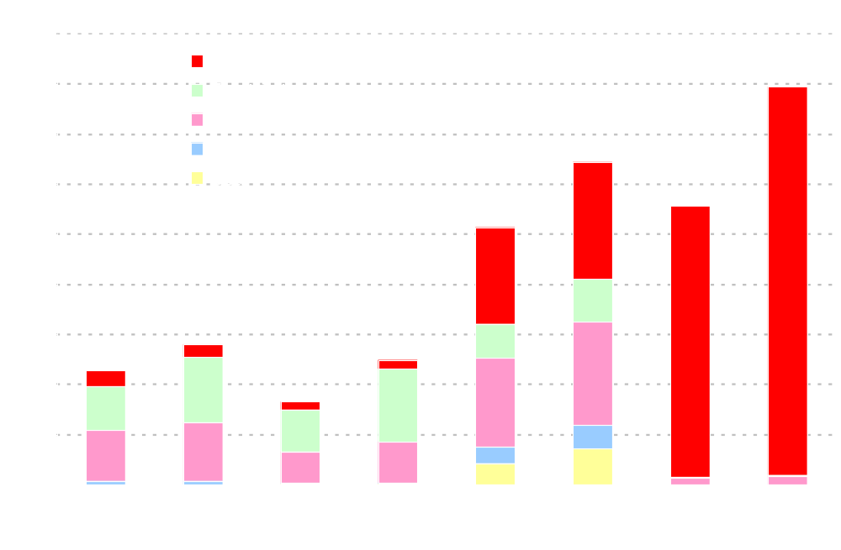
Delivered Energy Consumption by Sector and Fuel
(quadrillion Btu)
39.7
32.2
27.8
25.7
14.0
11.4
12.4
8.2
Residential
Commercial
Industrial
Transportation
Notes:
Total delivered energy consumption in the reference case grows at 1.1% per year, about one-third the 3.0% rate projected for GDP. The fastest growth rates are in commercial, at 1.6% per year, and transportation, at 1.4% per year. Industrial grows at 0.9% and residential grows at 0.8%.
Rapid growth in Commercial energy use, from 8.2 quads in 2004 to 12.4 quads in 2030, occurs with increases in commercial floor space, as services expand with higher population and higher incomes.
Transportation energy use increases from 27.8 quads in 2004 to 39.7 quads in 2030. Most of that growth occurs in light-duty vehicles (57% of total growth), followed by heavy truck travel (24% of growth) and air travel (11% of growth).
Industrial energy increases from 25.7 quads in 2004 to 32.2 quads in 2030 as a result of 2.0% per year growth in industrial output. Efficiency improvements and structural shifts in the economy away from energy-intensive manufacturing moderate energy growth.
Residential energy grows moderately, from 11.4 quads in 2004 to 14.0 quads in 2030. Population is expected to migrate south and west, where electricity for air conditioning becomes more important than natural gas and oil for space heating. The sizes, types, and locations of homes influence the trends in per-household energy use, as does efficiency of new appliances.

Slide 5
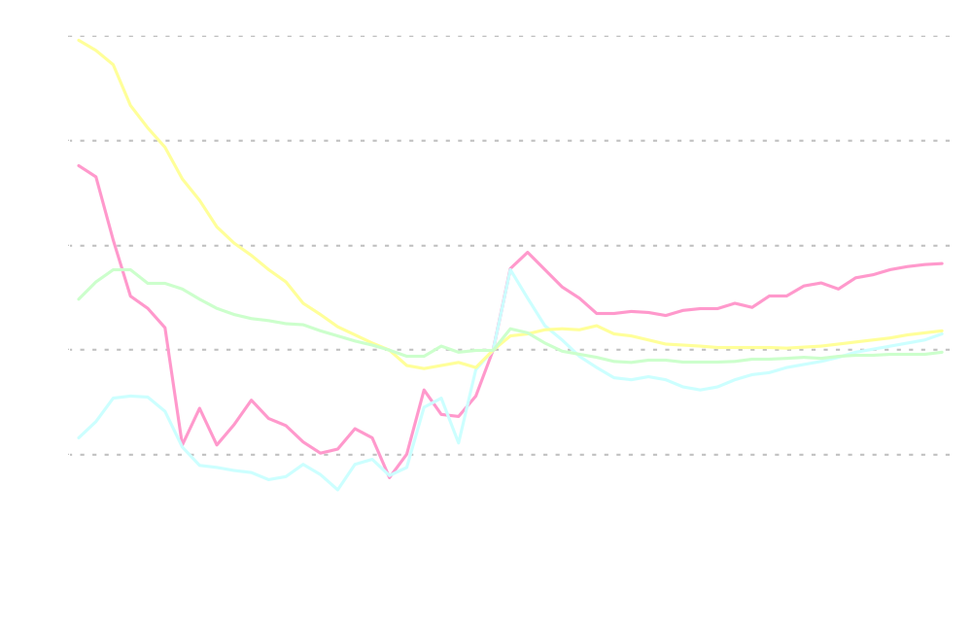
Energy Prices
(index, 2004 = 1.0)
History
Projections
Crude Oil
Electricity
Coal
Natural gas
Notes:
The chart illustrates relative energy prices indexed to 2004.
Coal prices show the largest change over the years displayed. Between 1980 and 2004, coal mine mouth prices decreased dramatically from about $50/ton to $20/ton. In the AEO2006 reference case, they are projected to remain relatively flat.
While crude oil prices have been very high during the past two years, average prices in real dollar terms are lower than they were in the early 1980’s, but significantly higher than the late 1980’s through the early part of this decade. World crude oil prices are projected to decrease through about 2015 before rising again.
Between 1980 and 2004 natural gas prices were less than half of what they are today. The natural gas wellhead price is projected to decline from today’s highs as recovery from supply disruptions caused by hurricanes Katrina and Rita occur, new import sources become available (in the Gulf), and increased drilling brought about by high prices expands available supply. After 2016, wellhead prices are projected to increase gradually. The growth in liquefied natural gas (LNG) imports, Alaskan production, and Lower-48 production from unconventional sources are not expected to increase sufficiently to offset the impacts of resource depletion and increased demand in towards the end of the projections.
Electricity prices have been relatively constant over the period displayed, decreasing slightly from the early 1980’s and remaining relatively flat throughout the forecast period.

Slide 6
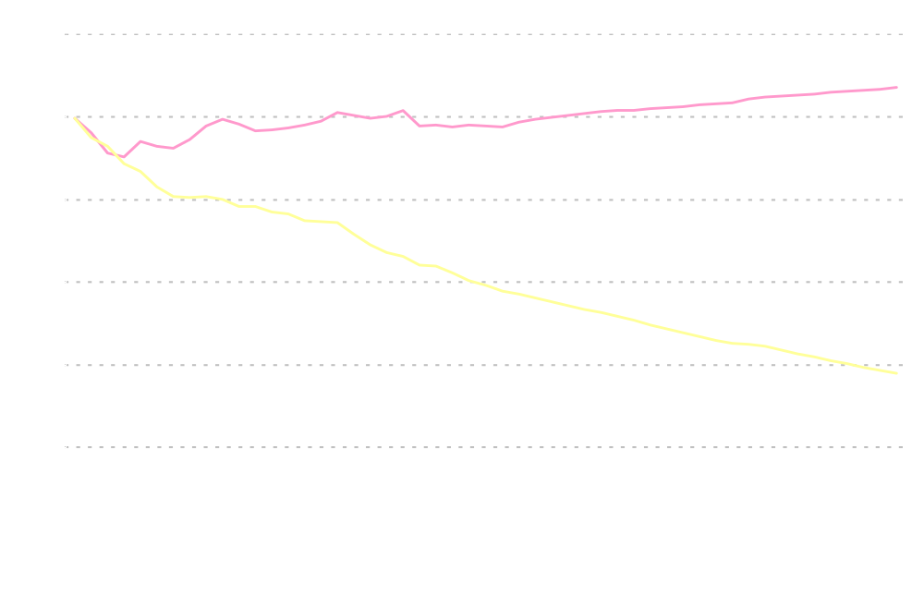
Energy Use per Capita and per Dollar of Real Gross
Domestic Product (index, 1980 = 1)
Energy use per capita
Energy use per dollar GDP
History
Projections
Notes:
Energy efficiency can be measured in many different ways. The chart illustrates two different measures of energy efficiency: Energy Intensity and Per Capita Energy Use.
In the Reference case, the economy is expected to continue to become less energy-intensive as GDP grows faster (3.0%/yr) than energy use (1.1%/yr). We project energy intensity (primary energy use per dollar of GDP) to decline at an average rate of 1.8 percent per year between 2004 and 2030.
Efficiency gains and structural shifts in the economy offset some of the growth in demand for energy services.
The energy intensity decline in the projections approximately matches the decline rate between 1992 and 2004 (1.9%/yr). Energy-intensive industries’ share in overall industrial output is projected to fall at an average rate of 0.8%/yr, which is slower then the decline rate of 1.3%/yr experienced from 1992 to 2004.
Starting in the late 1980s and lasting through the mid-1990s, energy consumption per capita increased with declining energy prices and strong economic growth.
Per capita energy use is projected to increase by an average of 0.3%/yr in the projections, despite relatively high energy prices and efficiency improvements in buildings, transportation, and electricity generation sectors.

Slide 7
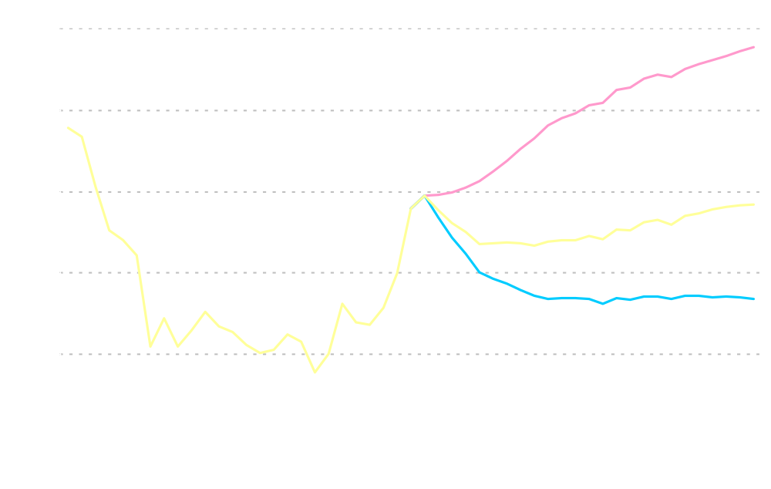
World Oil Prices in Three Cases
(2004 dollars per barrel)
High Price
Reference
Low Price
History
Projections
Notes:
Administrator Caruso explained earlier this morning the rationale for the upward revision to the reference case world oil price path.
In AEO2006, world crude oil prices are projected to fall from current levels to about $47 per barrel in (2004 dollars) in 2014, then rise to $57 per barrel in 2030. World oil production reaches 118 million barrels per day by 2030 and OPEC’s market share grows from 37 percent in 2004 to 39 percent in 2030.
The AEO2006 also includes alternative price cases designed to address the uncertainty about OPEC market behavior and the world conventional crude oil resource base.
In the low price case, the conventional world resource base is 15% larger than the USGS mean estimate. World crude oil prices decline gradually from today’s level to $34/bbl in 2020 and remain at that level through 2030. In this case world oil production reaches 128 million barrels per day in 2030, with OPEC’s share rising to 40 percent.
In the high price case, the conventional world resource base is 15% smaller than the USGS mean estimate. In this case, world crude oil prices grow throughout the projection horizon, reaching more than $96/bbl in 2030. World oil production reaches 102 million barrels per day in 2030, with OPEC’s share falling to 31 percent..

Slide 8
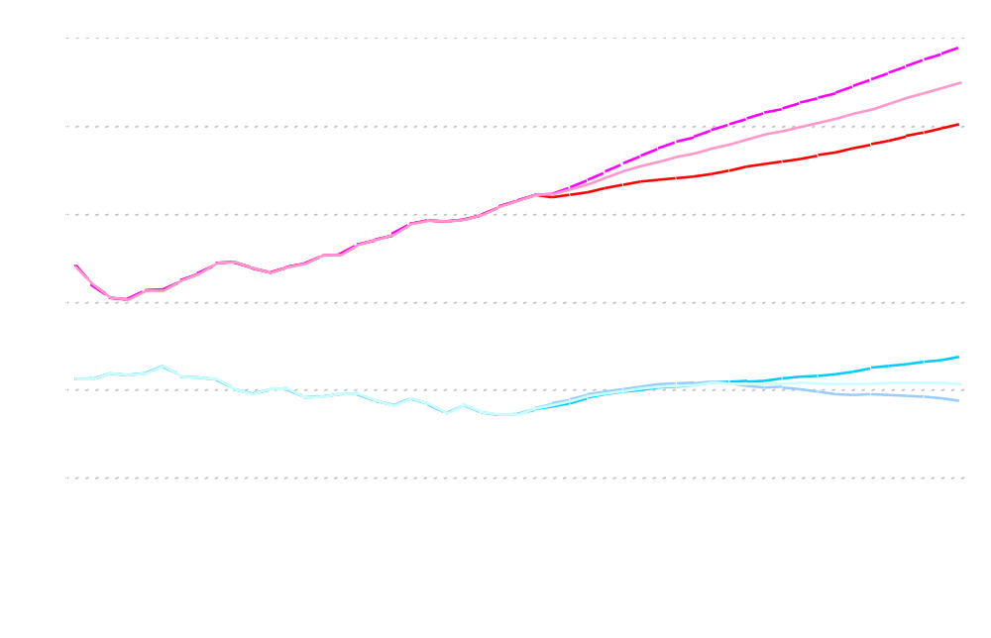
Petroleum Supply, Consumption, and Imports in Three
Cases (million barrels per day)
Low Price
High Price
68%
53%
Consumption
Net imports
58%
High Price
Production
Low Price
History
Projections
Notes:
In the reference case in 2030, imports of crude oil and refined products are 17.2 mbd. Import dependency increases from 58% in 2004 to 62% in 2030. Under alternative oil price projections, import fraction ranges from 68% in the low price case to 53% in the high price case.
In the High Price case, higher crude oil prices spur greater exploration and development of domestic oil supplies, reduce demand for petroleum, and slow the growth of oil imports compared to the reference case.
Total domestic petroleum supply in 2030 is 1.5 mbd (15%) higher in the high price case than in the reference. Total net imports in 2030, including crude oil and refined products, are reduced to 13.3 mbd, 3.9 mbd less than in the reference case.
The converse is true for the low price case. Total domestic petroleum supply in 2030 is 0.9 mbd (9%) lower in the low price case than in the reference.
Total net imports in 2030, including crude oil and refined products, are increased to 20.2 mbd in the low price case, 3 mbd more than in the reference case.

Slide 9
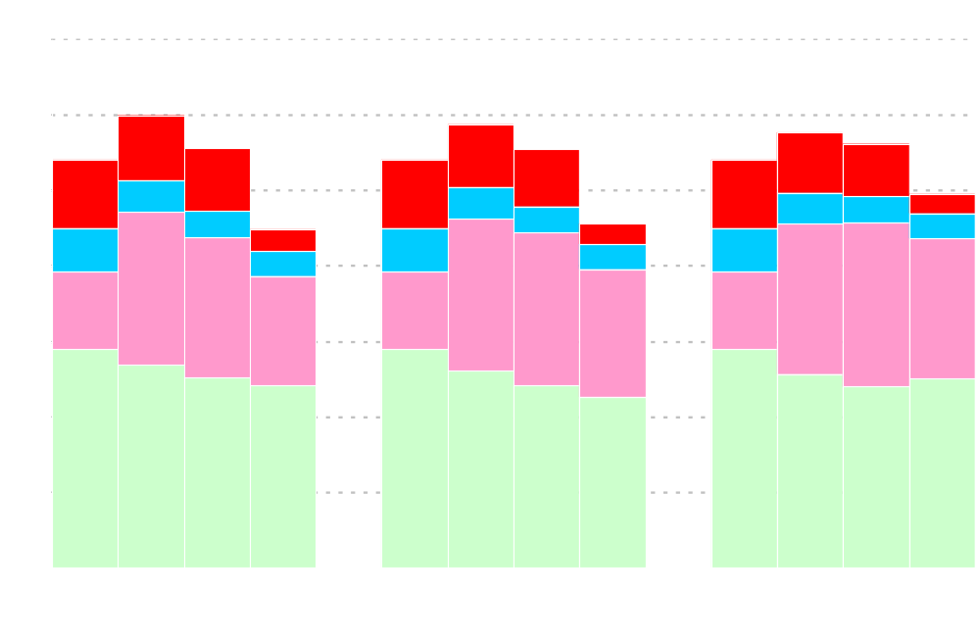
Domestic Crude Oil Production by Source
(million barrels per day)
Alaska
6.0
Lower 48 Offshore Shallow
5.9
5.8
5.4
5.6
5.5
5.6
5.4
5.4
5.0
4.5
4.6
Lower 48 Offshore Deep
Lower 48 Onshore
Low Price
Reference
High Price
Notes:
New onshore conventional oil reservoir discoveries are likely to be smaller, more remote, and increasingly costly to exploit. While higher oil prices make it economical to produce resources at higher cost, lower 48 onshore oil production will decline in the reference case by 0.6 mbd (2.9 mbd in 2004; 2.3 mbd in 2030).
Oil production in Alaska gets a boost in 2007 when production from the National Petroleum Reserve begins, peaking at half a million barrels per day (0.5 mbd) in 2016, after which it declines.
Considerable oil resources remain in the offshore, especially in the deep waters of the Gulf of Mexico, where production is expected to reach a peak of 2.2 mbd in 2016 before declining. World oil prices are especially important to development of the deepwater gulf.
The increase in Alaska and deepwater Gulf of Mexico production results in an increase in total domestic oil production through 2016. (5.4 mbd in 2004; 5.86 mbd in 2016).
In the alternative scenarios, the larger resource base assumptions in the low price case cause relatively higher production in the near term, but the lower crude world oil prices depress production by the end of the forecast. The converse is true in the high price case.

Slide 10

Petroleum Liquids from Coal, Natural Gas, and Shale
(million barrels per day)
2020
2030
Notes:
Unconventional liquids production from coal, natural gas, and shale begins in earnest towards the end of the projection period. This chart illustrates unconventional petroleum liquids production in the reference and high price cases.
By 2030, unconventional petroleum liquids production accounts for 7 percent of total liquids production in the reference case and 22 percent of total liquids production in the high price case.
In 2030, U.S. coal-to-liquids production is 0.8 mbd in the Reference case and 1.7 mbd in the high price scenario.
There are no domestic gas-to-liquids production In the reference case. In the high price case gas-to-liquids production is about 0.2 mbd in 2030.
The U.S. has vast resources of oil shales; however, based on currently documented technologies, there is no shale oil production in the Reference case. In the High Price Case production is about 0.4 mbd in 2030.

Slide 11
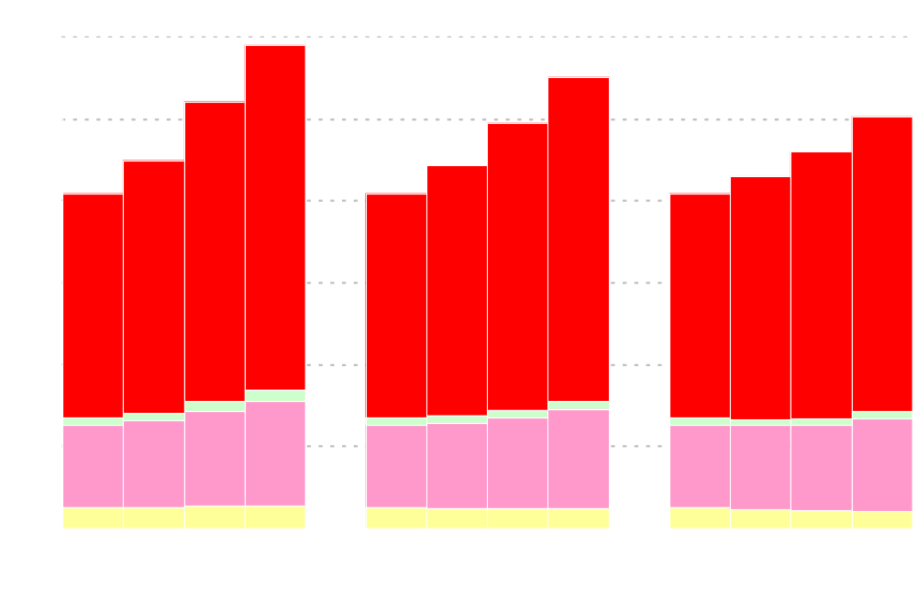
Petroleum Consumption by Sector
(million barrels per day)
29.6
27.6
Residential and Commercial
26.1
24.8
25.2
22.5
23.1
22.2
21.5
20.8
20.8
20.8
Transportation
Industrial
Electric Power
Low Price
Reference
High Price
Notes:
Despite relatively high petroleum product prices, total petroleum consumption is projected to grow from 20.8 million barrels per day in 2004 to 27.6 million barrels per day in 2030 in the AEO2006 reference case.
The transportation sector consumes about two-thirds of all petroleum products and the industrial sector about one-quarter. The remaining 10% is divided among the residential, commercial, and electric power sectors.
Light duty vehicles are responsible for more than half of all energy use in the transportation sector. Despite the significant increase in petroleum consumption in the transportation sector in the projections, light duty vehicles efficiency increase 17 percent.
Much of the increase in new light-duty vehicle fuel economy reflects greater penetration of hybrid and diesel vehicles. Hybrids (11.5%) and diesel vehicles (8.2%) are together expected to account for about 20 percent of new vehicle sales in 2030.
Across the price cases, petroleum consumption varies by about 4.4 mbd.
The transportation sector is responsible for about 70 percent of the change.
The industrial sector is responsible for another 17 percent.
The remainder is spread among the electric power and building sectors.
The penetration of advanced technology and alternatively fueled vehicles across scenarios is a key factor in the change in transportation sector petroleum consumption.

Slide 12

Net Imports of Liquefied Natural Gas in Three Cases
(trillion cubic feet)
History
Projections
High LNG
Reference
Low LNG
Notes:
Moving to natural gas, in the AEO2006 reference case, LNG grows from 0.6 trillion cubic feet in 2004 to 4.4 tcf in 2030.
In order to evaluate the potential impact of higher or lower LNG imports two additional cases were constructed to investigate the impact on domestic production, consumption, and prices. The range of values found in these scenarios were based upon the LNG imports found in the high and low price cases.
LNG imports are assumed to be 30 percent higher than in the High LNG case than in the Low Price case. LNG imports grow faster to 9.6 tcf by 2030
LNG imports are assumed to be 30 percent lower in the Low LNG case than in the High Price case. LNG imports only grow to 1.3 tcf by 2030.
The LNG import cases assume reference case oil prices and domestic resource levels.

Slide 13
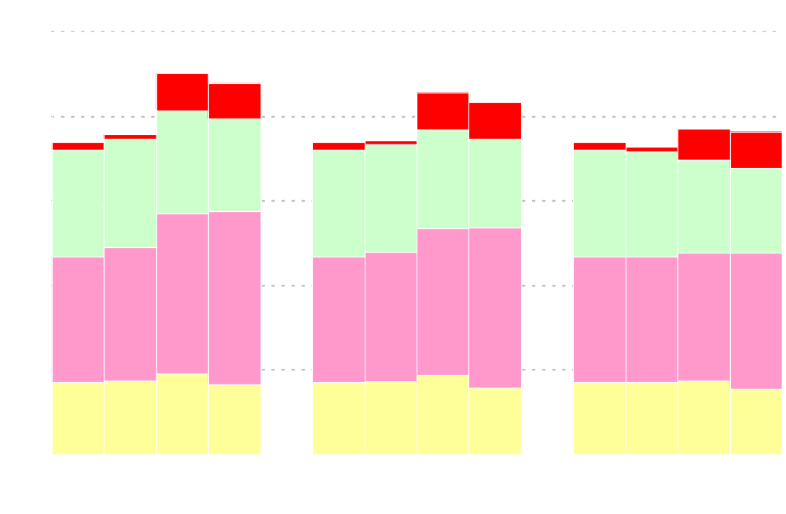
Natural Gas Production by Source
(trillion cubic feet)
22.5
22.0
Alaska
21.4
20.8
19.3
19.1
18.5
18.9
18.5
18.6
18.5
18.2
Lower 48 Conventional
Onshore
Lower 48
Unconventional
Lower 48 Offshore
Low LNG
Reference
High LNG
Notes:
Domestic dry natural gas production in the reference case is projected to increase from 18.5 tcf in 2004 to 21.6 tcf in 2019, before declining to 20.8 tcf in 2030.
Unconventional natural gas production (i.e., Coal bed methane, tight sands, and gas shale) is projected to grow throughout the period from 7.5 tcf in 2004 to 9.5 tcf in 2030 and account for 45 percent of domestic U.S. gas production in 2030.
Lower-48 offshore production is projected to increase from the 2004 level of 4.3 tcf to 5.1 tcf in 2015 as new resources come on line in the Gulf of Mexico. After 2015, lower-48 offshore production declines to 4.0 tcf in 2030.
With the projected completion of an Alaskan natural gas pipeline in 2015, total Alaskan production increases from 0.4 tcf in 2004 to 2.2 tcf in 2018 and remains at about that level through 2030.
Lower-48 onshore conventional production decreases throughout the forecast although still supplying 25 percent of all supplies in 2030.
Domestic dry natural gas production only moderately compensates for the variance in LNG imports across scenarios. By 2030, domestic dry natural gas production is about 3 tcf higher in the low LNG import case than in the high LNG import case
About three-fourths of the difference in supply is due to increased unconventional natural gas production. The remainder is split evenly between offshore and conventional production.

Slide 14
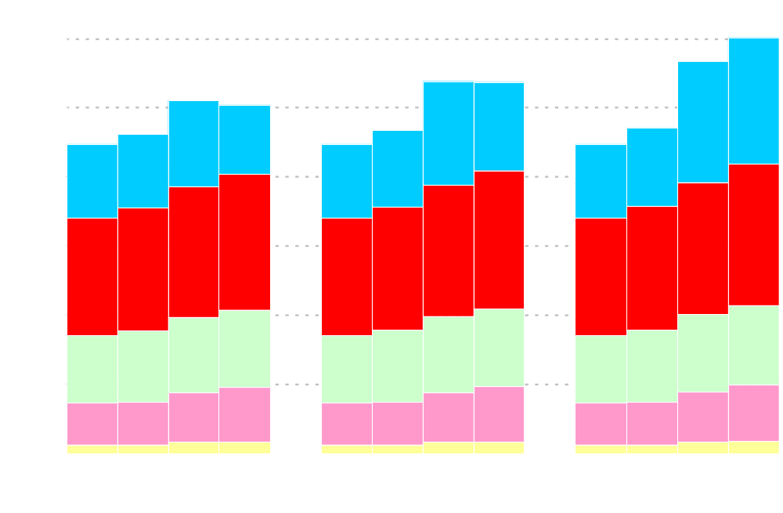
Natural Gas Consumption by Sector
(trillion cubic feet)
30.1
28.4
26.9
26.9
25.6
25.3
23.1
23.4
23.6
22.4
22.4
22.4
Electric Power
Industrial
Residential
Commercial
Transportation
Low LNG
Reference
High LNG
Notes:
Total consumption of natural gas in the AEO2006 reference case is projected to increase from 22.4 trillion cubic feet in 2004 to 26.9 tcf in 2020 (1.2 percent annually) and then level off, mostly due to higher natural gas prices and their competition with other fuels in the electric power sector. (0.7% over the whole period).
Use of natural gas increases in all sectors between 2004 and 2030. It increases 33% in the electric power sector, 24% in the industrial sector, 22% in the commercial sector, 17% in the residential sector, 4 percent in the transportation sector.
Across the LNG scenarios, natural gas consumption varies by almost 5 tcf. More than 85 percent of the swing in consumption between the low and high LNG import scenarios is attributable to natural gas use in the electric power sector.

Slide 15
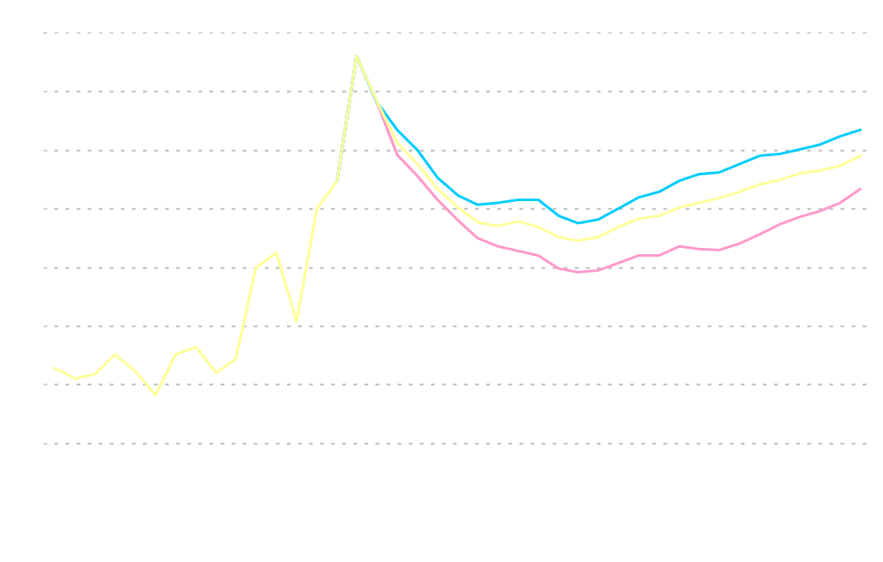
Lower 48 Natural Gas Wellhead Prices
(2004 dollars per thousand cubic feet)
History
Projections
Low LNG
Reference
High LNG
Notes:
In the AEO2006 reference case, the average U.S. wellhead price for natural gas declines gradually from current levels as increased drilling brings forth new domestic supplies and new import sources become available. However, in the long term, growth in supplies are not expected to increase sufficiently to offset the impacts of resource depletion and increased demand.
The average wellhead price falls from current levels to $4.50 per thousand cubic feet (2004 dollars) in 2016, then rises gradually to about $6.00 per thousand cubic feet in 2030.
As mentioned previously, the LNG import cases assume reference case oil prices and domestic resource levels, which turn out to me more important determinants of domestic natural gas prices than the availability of LNG.
In the High LNG case, U.S. wellhead natural gas prices are about 90 cents per thousand cubic feet lower than in the reference case.
In the Low LNG case, U.S. wellhead natural gas prices are 50 cents per thousand cubic feet higher than in the reference case.
Increases in LNG imports displace more expensive sources, decrease natural gas prices, and increase gas consumption.

Slide 16
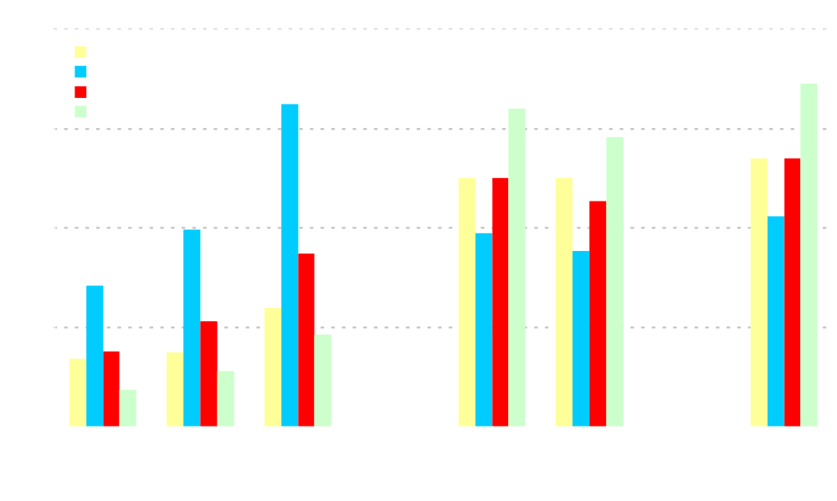
Labor Productivity, Cost Indices, and Miner Wages
Average Coal
Miner Wage
(2004 $/hr)
Equipment Cost Indices
(constant dollar index, 2004=1.000)
Labor Productivity
1.6
32
1.2
24
0.8
16
0.4
8
0.0
0
Notes:
Moving onto coal, we look at the reference case and the high and low coal cost cases.
The high and low coal cost cases were created by varying assumptions of labor productivity, equipment cost, and wages.
In the reference case, coal mining labor productivity (short tons per miner per hour), is assumed to increase on average by 0.4 percent per year through 2030, while miner wage rates and mine equipment costs remain constant in 2004 dollars. Coal mining productivity is assumed to remain near current levels in most coal supply regions. Factors that are expected to limit future productivity growth include a trend toward higher stripping ratios at western surface mines, and fragmentation of underground reserves in the east.
On the coal transport side, eastern and western railroad productivity (billion freight ton-miles per employee per year) is assumed to grow at an average rate of 1.4 and 1.5, respectively. Railroad equipment costs are assumed to decline on average by 0.4 percent per year.
In the low coal cost case, productivity improves faster, equipment costs decrease more, and wages decline compared to the Reference case.
In the high coal cost case, productivity declines, equipment costs increase, and wages increase compared to the Reference case.

Slide 17

Coal Production by Region
(billion short tons)
1.88
1.70
1.43
1.36
1.42
1.28
1.26
1.25
1.26
1.12
1.12
1.12
West of the Mississippi
East of the Mississippi
Low Coal Cost
Reference
High Coal Cost
Notes:
In 1999, coal production West of the Mississippi surpassed coal production East of the Mississippi.
In the AEO2006 reference case, U.S. coal production is projected to increase at an average rate of 1.6 percent per year, from 1.1 billion short tons in 2004 to 1.7 billion short tons in 2030.
Production from mines West of the Mississippi River is expected to provide the largest share of the incremental coal production. In 2030, nearly two-thirds of coal production is projected to originate from the Western States.
Coal production grows much slower in the high cost case than in the low cost case.
By 2030, coal production in the low coal cost case is 0.5 billion short tons greater than coal production in the high cost case. Three-quarters of the difference is produced West of the Mississippi River.

Slide 18

Coal Consumption by Sector
(billion short tons)
1.94
1.78
Coal to Liquids
1.46
1.50
1.39
1.25
1.31
1.23
1.23
1.10
1.10
1.10
Electric Power
Industrial
Low Coal Cost
Reference
High Coal Cost
Notes:
In the AEO2006 reference case, total coal consumption is projected to increase from 1.1 billion short tons in 2004 to 1.8 billion short tons by 2030. Almost three-quarters of the increase is attributable to use in the electric power sector and the remainder is attributable use in the coal-to-liquids process.
Coal consumption is projected to grow at a faster rate toward the end of the projection, particularly after 2020, as coal captures market share from natural gas in the electric power sector and as coal use for coal-to-liquids production grows.
Coal use is sensitive to coal prices and how it competes for market share in the electric power sector and it’s use as a feedstock in coal to liquids production. Between the low and high coal cost cases, coal use varies by about 440 million short tons.
More than half of the variation is attributable the use of coal in the production of liquids.
The remainder is attributable the use of coal in the electric power sector.

Slide 19

Cumulative New Generating Capacity in Three Coal Cost
Cases, 2004-2030 (gigawatts)
Natural Gas
Coal Steam
Renewables
Nuclear
Notes:
In the AEO2006 reference case, almost 350 gigawatts of electric generating capacity is added between 2004 and 2030. About half of the additions are coal fired, about 40 percent are natural gas fired, 8 percent are renewables, and 2 percent are nuclear.
Most coal-fired additions occur after 2020 when natural gas prices are projected to rise more significantly, while coal prices remain fairly stable. Between 2004 and 2020, coal-fired generation grows by 1.3 percent annually. Between 2020 and 2030, coal-fired generation grows by 3.0 percent annually.
Across the coal cost scenarios, approximately 14 gigawatts more total capacity is added by 2030 in the low coal cost case and 14 gigawatts less total capacity is added by 2030 in the high coal cost case than in the reference case. More total capacity is needed in the low cost case than the reference case because electricity sales are greater due to lower electricity prices and because natural gas capacity is used less intensively. The opposite is true for the high coal cost case.
In the low coal cost case, almost 90 gigawatts more coal-fired capacity is added by 2030 than in the high coal cost case. Conversely, in the high coal cost case 36 gigawatts more natural gas fired capacity is added, 13 gigawatts more nuclear capacity is added, and 12 gigawatts more renewables capacity is added.

Slide 20
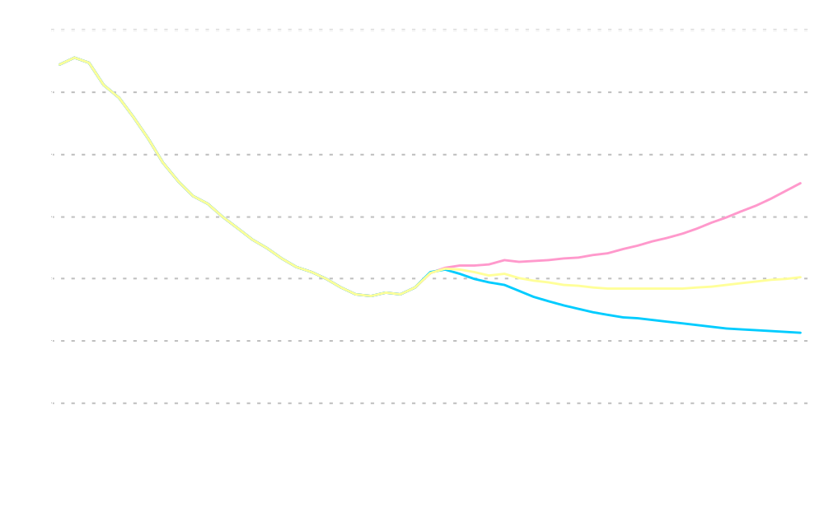
Average Delivered Coal Price
(2004 dollars per ton)
High Coal Cost
Reference
Low Coal Cost
History
Projections
Notes:
After rising in the near term from increased demand for electricity generation due to the high oil and natural gas prices, a combination of slow, but continued improvements in expected productivity, and a continuing shift to low-cost coal from the Powder River Basin in Wyoming leads to a gradual decline in the projected average delivered coal price to approximately $28.50 per ton in 2019 in the AEO2006 reference case.
Prices then increase slowly as rising natural gas prices and the need for baseload generating capacity lead to the construction of many new coal-fired generating plants. By 2030, the average delivered price in the AEO2006 reference case is projected to over $30 per ton.
[Trends in coal prices differ slightly when measured in terms of tonnage or energy (Btu) content, since the average energy content per ton of coal consumed falls over time due to increasing reliance on Western subbituminous coal that has a lower Btu content.]
Assumptions for labor productivity, equipment costs, and wages significantly effect coal prices. In the high coal cost case, delivered coal prices are almost 50 percent higher than in the reference case by 2030. Conversely, in the low coal cost case, delivered coal prices are almost 30 percent lower than in the reference case by 2030.

Slide 21
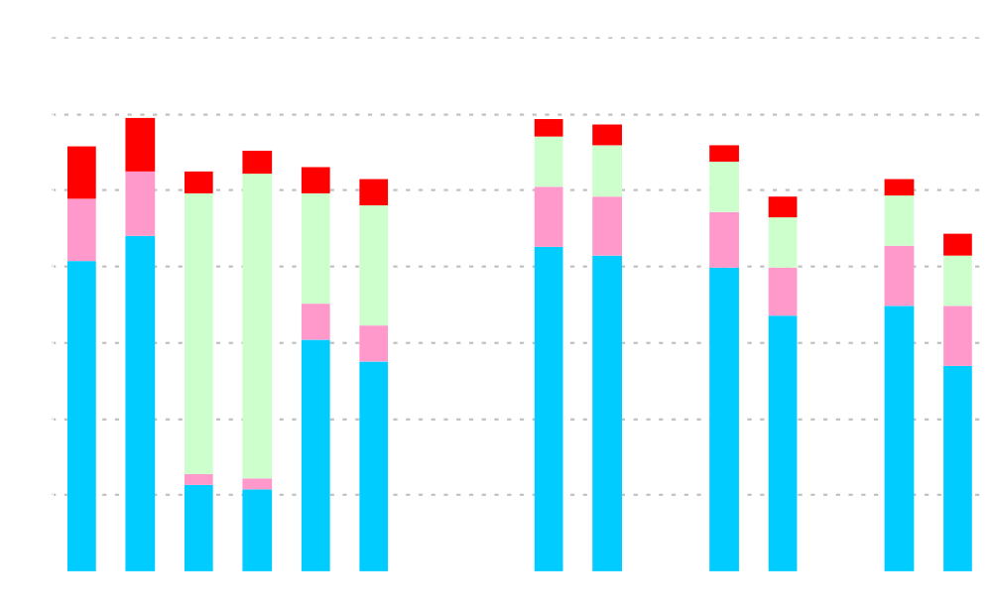
Levelized Electricity Costs for Capacity Additions in Three Cases,
2015 and 2030 (2004 cents per kilowatthour)
2015
2030
Incremental Transmission Costs
2015
2030
Variable
Costs,
Including
Fuel
Fixed
Costs
Capital
Costs
Wind
Gas
Combined
Cycle
Nuclear
Reference
Nuclear
Advanced
Cost
Nuclear
Vendor
Estimate
Coal
Notes:
We will now talk about results for the electric power sector. In the AEO, the electric power sector capacity expansion decisions are made to minimize levelized costs, while meeting Federal and local emissions regulations.
This chart illustrates the levelized costs for various technologies in 2015 and 2030 in the AEO2006 reference and the two alternative nuclear scenarios.
In 2015, in the AEO2006 reference case, natural gas-fired combined cycle capacity is cheaper than coal, wind, or nuclear capacity. As a result, combined cycle capacity is chosen over the types of capacity to meet energy requirements.
By 2030, in the AEO2006 reference case, the situation is reversed. Advanced coal technologies are cheaper than advanced combined-cycle technologies. This is mostly due to an increase in natural gas fuel cost for the combined-cycle technology and a decrease in the capital component for the coal technology.
The reference case assumptions for the cost and performance characteristics of new nuclear technologies are based on cost estimates by government and industry analysts, allowing for uncertainties about new designs. In recent years, various nuclear vendors have argued that their new plants will be simpler and less costly. However, no new nuclear plants have been ordered or constructed in the U.S. for many years, adding to the uncertainty of the estimates.
The advanced nuclear cost case assumes capital and operating costs 20 percent below those in the reference case in 2030, reflecting a 31-percent reduction in overnight capital costs from 2006 to 2030
The vendor estimate case assumes reductions relative to the reference case of 18 percent initially and growing to 44 percent by 2030, consistent with vendor estimates for the manufacture of the AP1000 advanced pressurized-water reactor.
As a result of these assumptions, nuclear generating costs in the alternative nuclear construction cost cases are cheaper than the generating costs for new coal- and natural-gas-fired units toward the end of the projection period.

Slide 22

U.S. Electricity Generation Capacity Additions in Three Cases,
2004-2030 (gigawatts)
Natural Gas
Coal Steam
Renewables
Nuclear
Notes:
This chart illustrates electricity capacity additions for the Reference case and the impact of lower nuclear capital cost estimates found in the Advanced Nuclear and Vendor Estimate cases.
Earlier, we talked about the reference case results in the coal section, but summarizing, we expect to add a significant amount of generating capacity by 2030, about one-third of the total electricity generating capacity that currently exists today. Most of the additions will be coal-fired, followed closely by natural gas-fired capacity. Most of the natural gas-fired additions will occur in the earlier forecast years, while natural gas prices are projected to be relatively lower than the later years. Conversely, most of the coal-fired additions will occur in the later years.
By 2030, in the advanced nuclear cost case, 34 GW of new nuclear capacity are added. In the vendor estimate case 77 GW are added.
Nuclear capacity additions in the advanced nuclear case and the vendor estimate case almost directly replace coal-fired capacity. There is little impact on other types of capacity.
These projections do not directly address: NIMBY, nuclear waste issues, or non-proliferation issues.

Slide 23
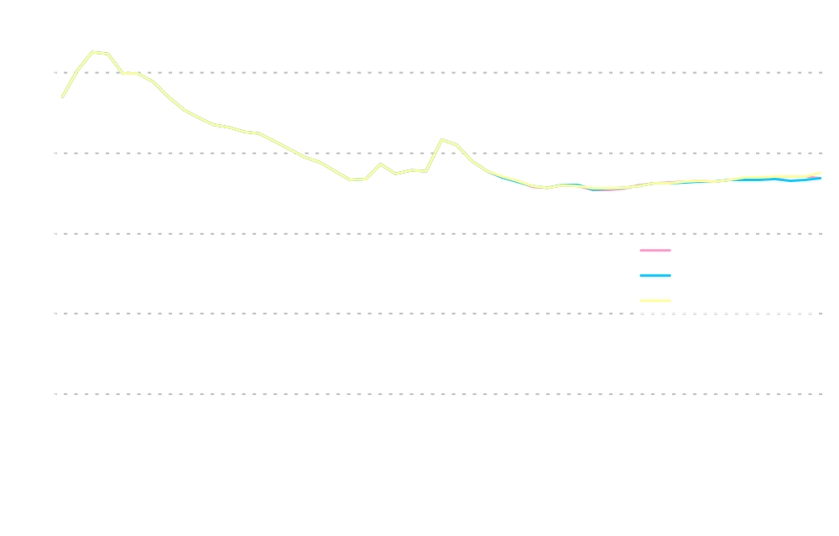
Average Delivered Electricity Price
(2004 cents per kilowatthour)
History
Projections
Notes:
In the AEO2006 reference case, average delivered electricity prices are projected to decline from 7.6 cents per kilowatthour (2004 dollars) in 2004 to a low of 7.1 cents per kilowatthour in 2015 as a result of falling natural gas prices and, to a lesser extent, coal prices. After 2015, average real electricity prices are projected to increase to 7.5 cents per kilowatthour in 2030.
Electricity prices in the nuclear plant cost sensitivity cases are lower than in the reference case, but the differences are very small – less than 2 percent in 2030.
The price impacts are limited because the first new nuclear plants are not expected for 9 to 10 years and, even by 2030 in the Vendor Estimate case, new nuclear plants account for only 22 percent of the new capacity added and 6 percent of total generating capacity.
Over a longer time period the price impacts could be more significant.
Although prices are not significantly different, carbon dioxide emissions are significantly less in the alternative nuclear cases. In the Vendor Estimate case, carbon dioxide emissions are 9.8 percent lower for the electric power sector by 2030.

Slide 24

Real Gross Domestic Product and Population
Real GDP in trillion chained 2000 dollars
Population in millions
Reference
(0.8%)
High Growth
(1.2%)
Low Growth
(0.5%)
Population
High Growth
(3.5%)
Low Growth
(2.4%)
Reference
(3.0%)
Gross Domestic Product
History
Projections
Notes:
Economic growth and population drive energy demand in the AEO2006 projections.
This chart summarizes the macroeconomic assumptions used in the AEO2006 Low, Reference, and high growth scenarios.
In the Low Growth case, the labor force (0.6%) and productivity (1.2%) grow slower than the Reference case (0.8% and 2.3%).
In the High Growth case, the labor force (1.0%) and production (2.7%) grow faster than the Reference case.

Slide 25
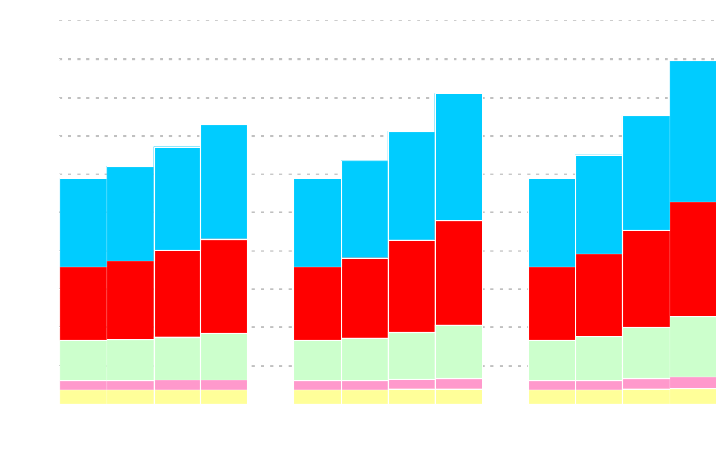
Carbon Dioxide Emissions in Three Economic Growth Cases
(billion metric tons)
9.0
8.1
7.3
7.5
7.1
6.7
6.2
6.4
6.5
5.9
5.9
5.9
Electric Power
Transportation
Industrial
Commercial
Residential
Low Growth
Reference
High Growth
Notes:
In the AEO2006 reference case, energy-related CO2 emissions increase from 5.9 billion metric tons CO2 equivalent in 2004 to 8.1 billion metric tons CO2 equivalent in 2030, roughly 1.2% per year.
The projected increases in carbon dioxide emissions primarily results from continued reliance on coal for electricity generation and petroleum fuels in the transportation sector.
In the AEO2006 reference case, electric power sector is responsible for almost one half of the increase, the transportation sector is responsible for about another one-third of the increase. The bulk of the rest is attributable to the industrial sector. Because a significant amount of the growth in the buildings sector is attributable to electricity and electricity is accounted for in the electric power sector in this chart, the buildings sector shows little growth in CO2 emissions.
Energy-related CO2 emission increase from 7.3 billion metric tons carbon equivalent in the low growth case to 9.0 billion metric tons carbon equivalent in the high growth case, an increase of about 1.7 billion metric tons.
Like growth in CO2 emissions in the reference case over time, growth in CO2 emissions across cases is mostly attributable to growth in CO2 emissions in the electric power sector, followed by growth in CO2 emissions in the transportation sector and the industrial sectors.

Slide 26
Annual Energy Outlook 2006 indicates that…
U.S. energy demand is projected to grow at an average annual rate of 1.1 percent.
The energy efficiency of the economy is projected to increase at an average annual rate of 1.8 percent as economic growth outpaces growth in energy demand.
U.S. oil import reliance is projected to grow from 58 percent to 62 percent. Import reliance shrinks to 53 percent in the high price case and grows to 68 percent in the low price case.
Future growth in U.S. natural gas supplies depend on unconventional domestic production, natural gas from Alaska, and liquefied natural gas imports.
U.S. natural gas use is projected to peak soon after 2020 before leveling off.
Wellhead gas prices are projected to decline from current levels through 2016 before beginning to increase again. Over the longer term, changes in the LNG import levels only moderately impact natural gas wellhead prices.
Coal use is projected to grow faster than other fuels; however, higher coal prices could induce switching to other fuels in the electric power sector and curtail its use as a feedstock in synthetic fuels production.
Nuclear power is projected to grow relatively slowly in the AEO2006 reference case; however, if nuclear power plants costs decrease, significant quantities of capacity additions could result.
Carbon dioxide emissions are projected to grow at an average annual rate of 1.2 percent
Notes:
U.S. energy demand is projected to grow at an average annual rate of 1.1 percent.
The energy efficiency of the economy is projected to increase at an average annual rate of 1.8 percent as economic growth outpaces growth in energy demand.
U.S. oil import reliance is projected to grow from 58 percent to 62 percent in the reference case. U.S. oil import reliance shrinks to 53 percent in the high price case and grows to 68 percent in the low price case.
Future growth in U.S. natural gas supplies depend on unconventional domestic production, natural gas from Alaska, and liquefied natural gas imports.
U.S. natural gas use is projected to peak soon after 2020 before leveling off.
Wellhead gas prices are projected to decline from current levels through 2016 before beginning to increase again. Over the longer term, changes in the LNG import levels only moderately impact natural gas wellhead prices.
Coal use is projected to grow faster than other fuels; however, higher coal prices could induce switching to other fuels in the electric power sector and curtail its use as a feedstock in synthetic fuels production.
Nuclear power is projected to grow relatively slowly in the AEO2006 reference case; however, if power plants costs decrease significantly from those used in the reference case, significant quantities of capacity additions could result.
Carbon dioxide emissions are projected to grow at an average annual rate of 1.2 percent

