Slide 1
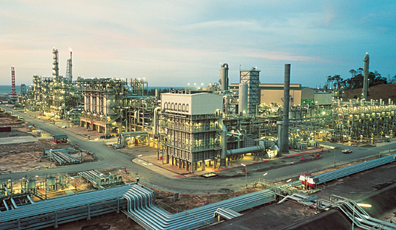
The Impacts of Synfuels
(GTL, CTL, BTL, OTL)
On World Petroleum Supply
Courtesy: Royal Dutch Shell’s Bintulu SMDS facility

Slide 2
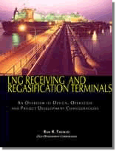
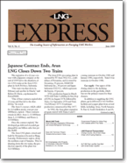

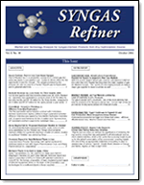
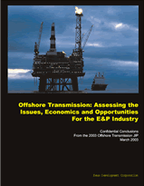
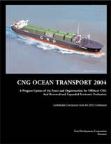
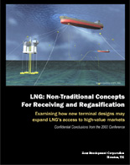
Zeus Expertise in LNG
A 15-year-old energy consultancy that assists product/ service suppliers devise strategies and forecasts of world gas-development markets
Core: proprietary databanks of world projects, markets, pricing, spending commitments, technologies, customers
Executives/analysts experienced in many elements of world gas development

Slide 3
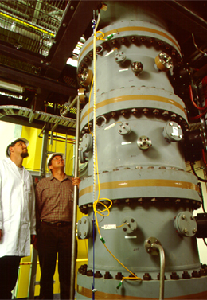
Today’s Discussion
Drivers/challenges to synfuels development
A review of synfuel conversion routes
  Gas-to-liquids (GTL)
  Coal-to-liquids (CTL)
  Biomass-to-liquids (BTL)
  Oil-Sands-to-liquids (OTL)
Conclusions
Daniel Henderson and David Harris with coal-gasification reactor. Courtesy: Csiro Energy Technology

Slide 4
Drivers to synfuels development
$12
High sustainable oil/gas prices and need for clean diesel
Strong global demand for liquid fuel supply
Large reserves of non-petroleum hydrocarbons for syngas conversion
Geopolitical uncertainty of oil supply
Expanding government initiatives
  EPACT 2005 incentives ($5.4B for cost sharing; grants; Investment tax credits (ITC); loan guarantees
Many proposed projects
Will this be enough to tip synfuel technology into commercialization?
$10
$8
EIA/DOE Forecast
$MMBtu
$6
West-Texas
Intermediate
$4
$2
Jan 1986
2030
Notes:
Crude prices likely to trade $50/bbl for foreseeable future
Major OPEC exporters willing to sustain and support crude prices certainly in the $40/bbl to $50/bbl range
Synfuels can meet concerns about security and supply diversity; can deliver real emissions reductions today
Synfuels derived from derived from natural gas, coal and biomass can also reduce petroleum dependency, ensure security of energy supply and improve air quality
Potential US CTL producers wait for budget to see if EPACT2005 incentives are funded to get first plants built

Slide 5
Drivers to synfuels development
Europe:
  Key driver: environmental regulations for diesel
  Significant demand in UK, Germany and Scandinavian countries
  Diesel supply cannot meet demand
  Refineries are long gasoline, short diesel
Asia:
  Key driver: environmental regulations in Japan, China and Australia
  New and ongoing refinery upgrades will increase diesel supply but will not meet increasing demand
US:
  Key driver: environmental regulations for diesel
  Diesel demand will likely be met by US production
  Some GTL imports may supplement supply particularly on the West Coast
Source: John J. Waycuilis, Marathon Oil Company

Slide 6
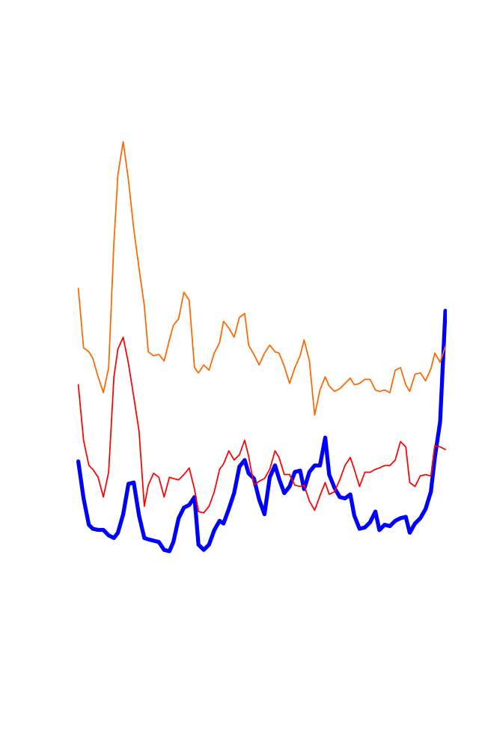
Challenges to synfuels development
Skepticism
Economics
  EPC crisis escalating capex costs for plant construction
Vacillating public/govt support:
  lower gasoline prices; mild winter, crisis averted
LS No.2
$MMBtu
LS No. 6
Déjà vu?
From mid-‘90 to mid-‘93 and again in ‘94 and ‘95, NG traded well below LS No.6, prompting major legislation and investment in NGVs. These initiatives faded in the late ‘90s as NG climbed above LS No. 2 prices.
Henry Hub
Notes:
A global shortage of raw materials, contractors, labor and other items has pushed up the capex cost of synfuels plants
GTL most commercially advanced, but plant capex up to $40K/b/d to $60K/b/d of product produced after almost hitting the $20K/b/d goal; Shell Pearl GTL: $7B
Sasol building FT design reactor to achieve significantly higher productivity in terms of gas throughput and product conversion rates over current generation designs
Goal is next-generation reactor to lower capital cost of GTL process and improve operational efficiency

Slide 7
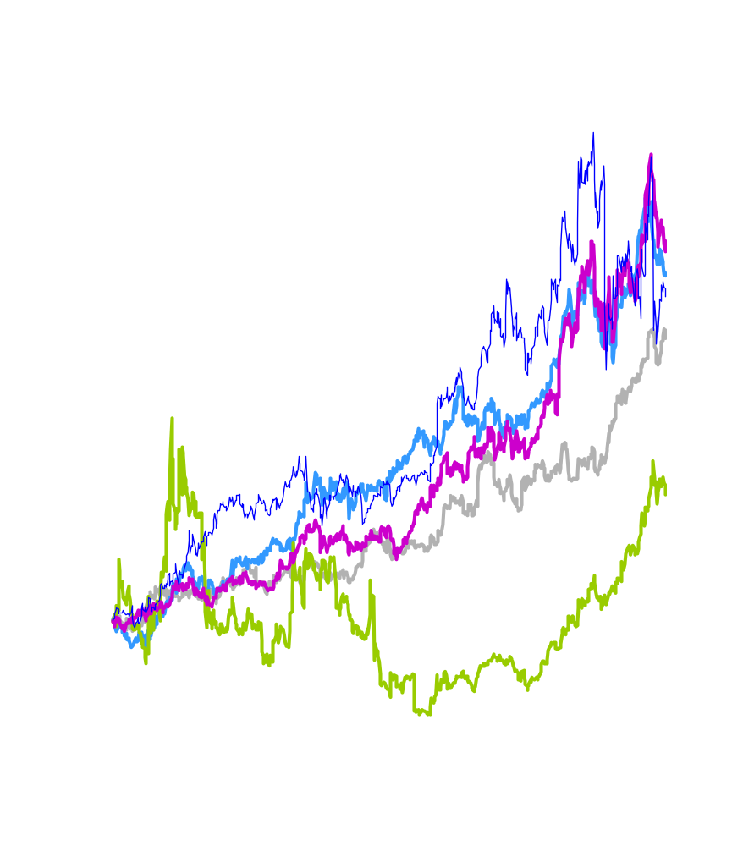
Construction Capacity Challenge
Off the charts:
Chiyoda
In the past three years, EPC order books have filled with LNG projects
Construction costs have escalated considerably
Many GTL projects, which are even more capital intensive than LNG, have been delayed until next decade
Halliburton
CB&I
Technip
Equity Value Appreciation
Fluor
$50
GTL Construction Costs
$40
$000/bbl/d of cap’y
$30
Foster Wheeler
$20
$10
Source: GAS Leads (www.gasleads.com)
1990
2000
2010
Notes:
Capital investment to install new GTL plants comparable to large S. African operations ranged from $27Kb/d to $50K/b/d of liquid fuel produced
34,000-b/d Sasol/QP plant at Qatar was estimated to cost between $20K/b/d and $25K/b/d
BP’s compact reformer was hoped to reduce costs to $20K/b/d, and with further improvements, to $17K/b/d – or low enough to compete with LNG projects
At around $11K/b/d, GTL projects could compete with new crude-oil refineries; that cost up to near $15K/b/d.

Slide 8
Gas to Liquids
Oil & Gas companies view synfuel economics favorably
  ConocoPhillips sees GTL competitive with North Sea oil
World proved gas reserves:
6,400 Tcf and growing 0.2%/yr
  R/P ratio: 67
45% of world gas reserves located in nations with R/P ratios >200 yrs
Ample gas reserves for GTL
GTL
Refinery
Natural Gas (@ $1.00/MMBtu)
$10.00
Crude Oil (@ $20/Bbl)
$20.00
Operating Costs
4.00
2.50
Cash Costs
14.00
22.50
Capital Recovery, Taxes
14.00
6.50
Total Cost to Produce
$28.00
$29.00
Source: ConocoPhillips

Slide 9
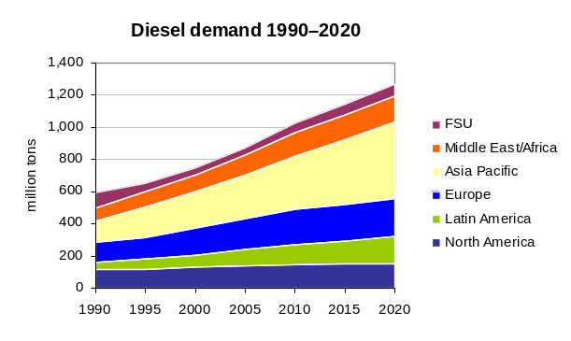
Gas to Liquids
Until Oryx, GTL projects were primarily demonstration oriented
  Mossel Bay & Bintulu were the largest
At 34,000 BPD, Oryx purported to be first commercial-scale plant
Pearl GTL (Shell) & ExxonMobil to add ~300,000 BPD of capacity next decade
More to follow
By 2020, still less than 3% world diesel production
500+
500
GTL Capacity
450
400
350
300
000 bbl/d of cap’y
250
200
150
100
50
1990
2000
2010
2020
~7 barrels/ton of oil

Slide 10
Coal to Liquids
China CTL plants move ahead
  Cheap feedstock: ~$5/bbl
  Labor and other direct cost: ~$15/bbl
US CTL plant activity somewhat stalled
  Developers seeking financing
  Reduce capex/opex
  Optimum logistics between cheap low-rank feedstocks and markets
Sasol estimates CTL plant ranges from $60Kb/d to $80K/b/d for 50K-b/d and 80K-b/d plant, respectively
China’s Shenhua and Ningxia CTL plants could cost between $5B to $7B, up from $6B, and consume 15MM to 19MM tpy of coal.
Sasol in talks with two US firms and is busy improving its processes to offset rising costs
DKRW is seeking financing for its $2.75B Medicine Bow, WY plant using GE gasifier and Rentech FT reactor
US CTL plant costs from $1.2 billion to $3 billion with MT small plant at $1.5B up to $8B for larger plants.
Notes:
China CTL plants move ahead with cheap feedstock most materials; feedstock costs would be about $5/bbl and other at $10/ton, labor and country has contracted direct operating costs would be about $15/bbl
US CTL plant activity somewhat stalled from enthusiasm last fall over EPACT2005 as developers seek financing, try to lower capex/opex and get close proximity to cheap low-rank feedstocks and markets
Sasol estimates CTL plant ranges from $60Kb/d to $80K/b/d for 50K-b/d and 80K-b/d plant, respectively
China’s Shenhua and Ningxia CTL plants could cost between $5B to $7B, up from $6B, and consume 15MM to 19MM tpy of coal. Sasol in talks with two US firms and is busy improving its processes to offset rising costs
DKRW is seeking financing for its $2.75B Medicine Bow, WY plant using GE gasifier and Rentech FT reactor
GE gasifier used on ERORA Group’s Taylorville Energy Center, IL; received $5MM in public-private financing
US CTL plant costs from $1.2 billion to $3 billion with MT small plant at $1.5B up to $8B for larger plants.

Slide 11
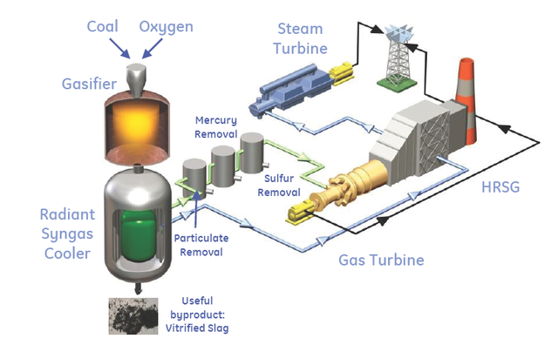
Coal to Liquids
Planned U.S. Gasification
AEP, OH
Baard Generation, OH
Cash Creek, KY
Clean Coal Power, IL
DKRW, WY
Duke/Cinergy, IN
Energy Northwest, WA
Erora Group, IL
Excelsior Energy, MN
First Energy/Consol, OH
FPL, FL
Leucadia National, LA
Madison Power, IL
Mohave Station, CA
Mountain Energy, ID
Orlando Util/Southern, FL
Otter Creek, MT
Power Holdings, IL
Rentech, WY
Royster Clark/Rentech, IL
Southeast Idaho Energy, ID
Steelhead Energy, IL
Synfuel, OK
XCEL Energy, CO
GE gasifier used on ERORA Group’s Taylorville Energy Center, IL received $5MM in public-private financing.
Diagram courtesy of GE
Notes:
US CTL plant cost depends on location, coal type, CO2 capture, CO2 pipelines to oilfields, coalmine supply
UCG in non-mined seams uses injection/production wells to convert coal in situ into product gas for chemical processes and power gen; UCG-IGCC plant generates at lower cost with CO2 emissions reduced to level 55% less than supercritical coal plant and 25% less than NGCC
Chinchilla project is targeting a 24,000-b/d diesel plant based on UCG syngas supply
UCG technology demonstrated exceptional environmental performance.
Compared to GTL: UCG-CTL is cheaper by eliminating steam reforming step that is 50% of GTL cost; but there is gasification cost and gas cleanup.
No coal handling, no reactor, no ash handling, no CO2 issues, it is at least 60% cheaper than CTL.
Capex cost of $40K b/d maybe fair estimate for UCG-based CTL.
Opex be much less than GTL or conventional CTL with no fuel purchase; use coal in ground vs. $1.50/MMbtu for coal for CTL and $6/MMbtu for gas for GTL.

Slide 12
Biomass to Liquids: Slow Advancements
BTL needs R&D
European governments view favorably.
BTL offers 90% reduction in greenhouse emissions
Five tons biomass = one ton BTL. In ideal location, one hectare generates four tons BTL
Small plant needs 12,000 acres.
European BTL production costs
2007: ~$3.35/gal
2020: ~$2.43/gal ($80/bbl COE price)
Capital cost of a commercial-size BTL plant ~$140,000/bbl in 2004 dollars
Uncertain whether gasification, other processing steps can achieve cost reductions to become competitive
BTL catalyst costs are high like other FT processes
BTL could be used only as fuel extender
Adding coal to biomass feedstock overcomes some challenges
European gasifiers operate with mixed coal/biomass feeds
Global Energy’s German gasifier has co-produced power and methanol using a mixture of coal and a range of different biomass feedstocks since 2001.

Slide 13
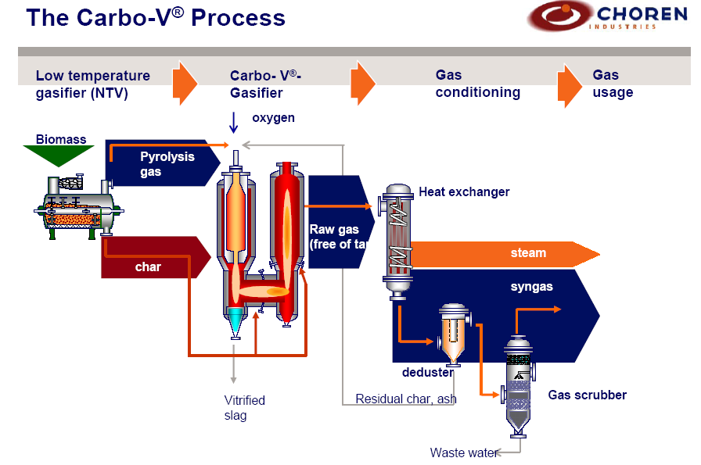
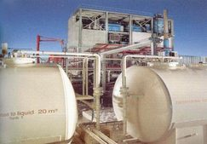
Biomass to Liquids
First commercial-scale 4,000-b/d BTL plant is planned by CHOREN Industries in Freiberg, Germany and will begin operation after 2008 followed by four additional facilities
About 2/3 of a BTL plant’s capital cost is related to biomass handling and gasification
BTL front-end technology is new and evolving and has parallels with cellulose ethanol technology
Torrefaction will greatly help the need for eliminate huge staging areas and reduce transportation costs to move feedstocks to a central point.
Main challenge is the high cost of removing oxygen
Diagram & photo courtesy of CHOREN
Notes:
BTL or CTL plant ha 60% higher capex than GTL plant. ECN directs BTL development towards use of existing large-scale coal entrained flow gasifiers as only way to benefit from economy of scale/use existing technologies.
In initial phase, coal/biomass co-gasification is best option and is possible up to at least 10% w/o plant modifications. For higher biomass shares, biomass pre-treatment required
ECN aims at using torrefaction as a process to convert all kinds of biomass into a product that has properties similar to coal

Slide 14
Oil Sands to Liquids
Gasification technology is being used commercially to gasify either petroleum coke or heavy oils at numerous petrochemical and refining sites worldwide
Gasification is being applied to oilsands industry providing environmentally sound way of using bitumen-derived petcoke or bottoms to displace natural gas-based hydrogen, heat or power production
GE is providing gasifiers for US CTL projects but Shell gasifier being used on OPTI Canada/Nexen Long Lake project in northeastern Alberta
OPTI Canada/Nexen Long Lake Economics
  Many companies in the Canadian oilsands industry are talking about installing gasifiers in the future but this joint venture is building the first gasification facility that is planned to be operational next year
  The need to economically extract synthetic crude oil (SCO) from Canadian tar sands has never been greater as private and state-owned producers such as China and India scramble to increase crude supply
  The Long Lake project using a proprietary process will provide high quality SCO from the oilsands with a major operating cost advantage

Slide 15
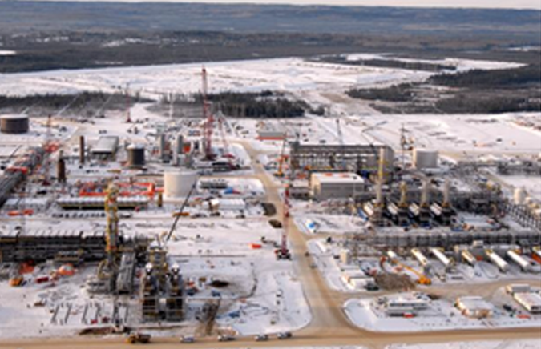
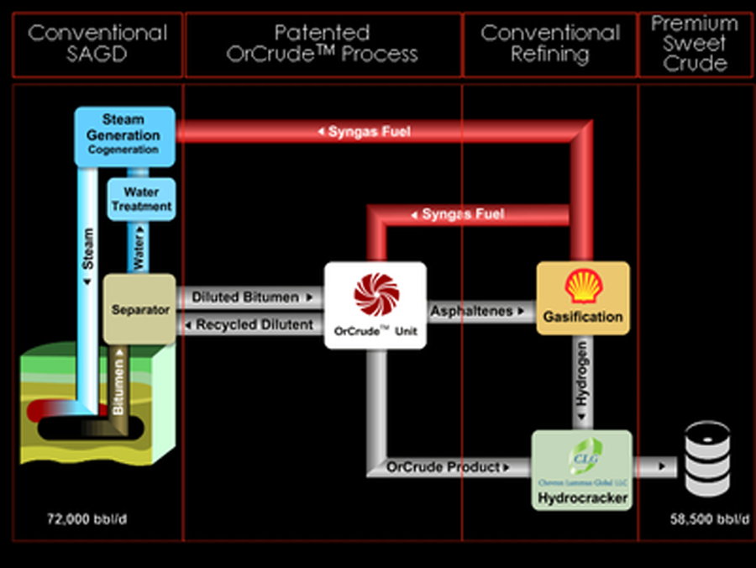
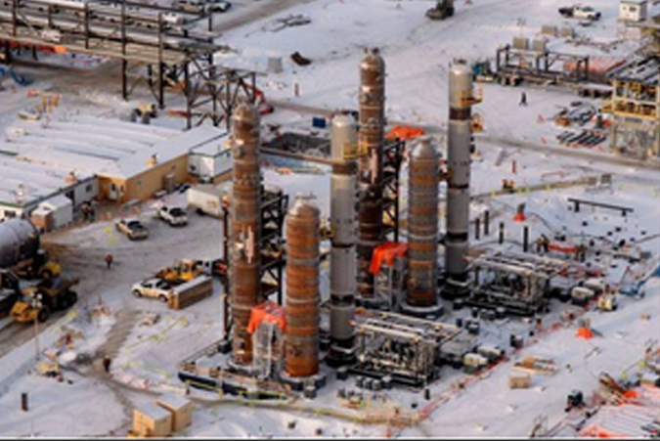
Oil Sands to Liquids: OPTI Canada/Nexen Long Lake
Phase 1 under construction, Jan 2006,
Source: OPTI Canada Inc.
Source: OPTI Canada Inc.
Gasifier Unit, Jan 2006, Source: OPTI Canada Inc.
Notes:
OPTI/Canada plans 120,000 b/d of SCO capacity by 2015; first phase under construction on $3.8B project with first steam late 2006 and the upgrader starting in mid-2007
About 1 mcf of natural gas is needed to produce bbl of bitumen using SAGD and 0.5 mcf needed for upgrading; average of 3kg of H2 required to produce one bbl of SCO at an estimated cost of $7/kg
Dependency on natural gas is a critical issue for in-situ oilsands producers and this project is designed to supply most of the fuel to dramatically reduce input costs.
Oilsands processing results in heavy sour crude subject to wide heavy-light differentials and diluent required to move the product to market if heavy crude not upgraded
The OPTI Canada process cycles bottom part of bbl to extinction rather than turning 15% of bbl into petcoke that has to be buried and uses that bbl as fuel
Liquid asphaltenes are fed into gasifier and converted to syngas with remaining fuel stream coming off gasifier after taking out H2 is equal to 100 MMcfd of gas; this stream used to fuel SAGD boiliers and cogeneration facility.
Heavy ends or bottoms sent from distillation columns to the gasifiers; reactor towers for two of the four trains being constructed.
Gasifier is specifically designed to have four trains with each one 33% of total capacity so one train down for regular maintenance to ensure higher reliability and high run time for plant.
An ASU will provide oxygen to gasifiers and hydrogen plant removes hydrogen from syngas; soot off back-end gasifier treated in wet-oxidation plant to reduce volume and waste and concentrate metals into filter cake.

Slide 16
Conclusions
Economics have never been better for conversion of non-petroleum feedstocks to liquid fuels
Principle challenge is building facilities in a construction-constrained market
Between 5.0 and 8.0 mil BPD will come from synfuels by 2020
  Oil sands is currently moving faster than any other of the synfuel technologies
    4.0 mil. BPD (17% of diesel cap’y) by 2020
  OTL will improve economics of GTL, CTL and BTL
  GTL will supply between 0.5 & 1.0 mil. BPD
  CTL will supply between 0.5 & 2.0 mil. BPD
  BTL is too hard to predict.
Notes:
Chevron acquires leases for 75,000 acres developing Ells River project that could potentially produce 100,000 bbl
EOM, CoP and Devon are also planning projects
Total acquired oilsands firm Deer Creek Energy
China’s Sinopec Group bought 40% stake in Synenco Energy’s Northern Lights project; CNOOC invested in Calgary-based MEG Energy in April 2005
India’s ONGC has been discussing possibilities of investing in oilsands projects but hat not identified technology but is continuing search
Syngas International’s gasification technology and another company’s oilsands extraction technology played an integral part in “revolutionary” new extraction method; lab test showed an increased yield of up to 15%

