Slide 1

Today’s U.S. Ethanol Industry
Helping Break America’s Addiction to Oil

Slide 2
U.S. Ethanol Industry Today
Annual production record in 2005 of 4 bgy
96 plants in 19 states with over 4.4 bgy capacity today (March, 2006)
33 Plants under construction, combined w/ 8 expansions, will increase industry capacity an additional 2 bgy (March, 2006)
Dozens of additional plants in various stages of development

Slide 3
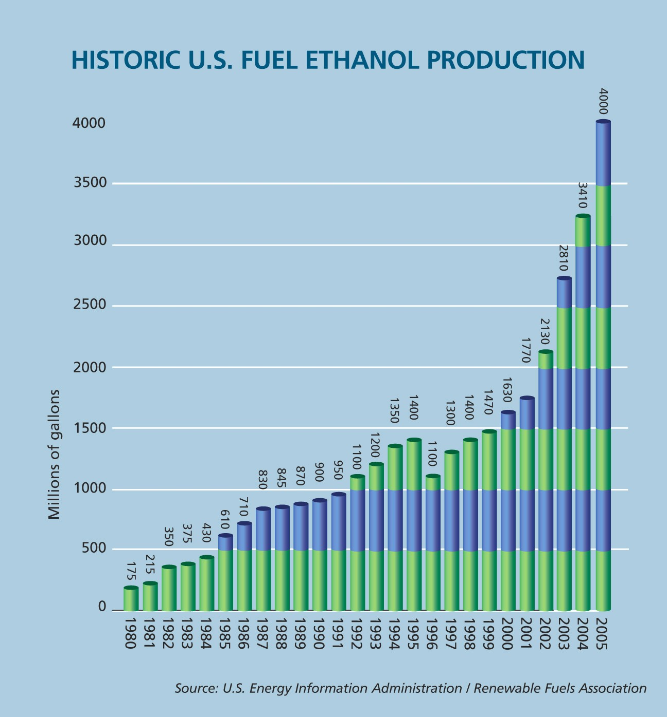

Slide 4
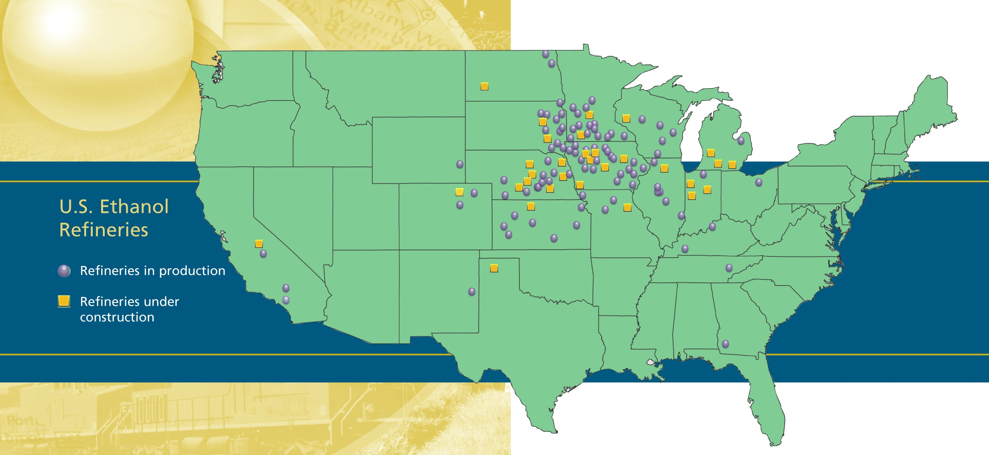
Source: RFA, January, 2006

Slide 5
Farmers Leading the Fight for
Energy Independence
Rural Revitalization!
50% of the 97 current ethanol plants are owned by farmers
Majority of ethanol plants under development are farmer-driven projects

Slide 6
Agriculture as Energy Producers
In 2005, 1.43 billion bushels of corn (13% U.S. crop) and 15% of nation’s grain sorghum crop used for ethanol
Ethanol is the 3rd largest market for corn
Ethanol dry mills produced record 9 million metric tons of distillers grain livestock feed in 2005

Slide 7
What’s Leading Industry Growth?
Renewable Fuels Standard
Rising gas and oil prices
State ethanol programs
E85 growth
Concerns about MTBE contamination resulting in new East Coast markets
Need to expand U.S. fuel supply
Environmentally-friendly profile

Slide 8
Nationwide Economic Benefits of Ethanol Demand in 2005
Added $32.2 billion to gross output
Created 153,725 jobs in all sectors of the economy
Increased economic activity and new jobs from ethanol increased household income by $5.7 billion, money that flows directly into American consumers’ pockets
Contributed $1.9 billion of tax revenue for the Federal government and $1.6 billion for State and Local governments.
Reduced imports by 170 million barrels of oil, valued at $8.7 billion

Slide 9
Annual Local Economic Impact of a
100 mgy facility
Spend an estimated $88.2 million for goods and services
Use 36.4 million bushels of corn
Operational spending will generate $406 million for the local economy
Increase the size of the state economy by $223 million
Generate nearly 1,600 new jobs
Increase household income by more than $50 million
Source: “Contribution of the Ethanol Industry to the Economy of the United States,” LECG, LLC, February 2006

Slide 10
Technology Moving Industry Forward
New technologies reducing energy consumption, improving refinery efficiency, developing new co-products, using new feedstocks
  Corn fractionation
  Cold starch hydrolysis
  Corn oil extraction
  Reduced natural gas usage: biomass gasification, fluidized bed reactor, turbines

Slide 11
Contact Information:
Renewable Fuels Association
(202) 289-3835
Web site: www.ethanolRFA.org

