Slide 1

EPAct 2005 Nuclear Power Provisions
Standby support to mitigate regulatory risk
Production tax credits
Loan guarantees
Accident liability indemnification
Notes:
Standby Support:
Covers failure of NRC to respond with scheduled reviews & approvals
Covers litigation that delays startup
100% of costs for 1st 2 plants not to exceed $500 million each
50 % for 3rd thru 6th plant not to exceed $250 million each.
Production Tax Credit:
For reactors brought into service before 2021 it provides 1.8 cents/ kWh tax credit (up to 125 million per gigawatt) per year for 8 years limited to 6 GW.
Loan guarantees:
Covers up to 80% of new plant costs (principal and interest)
Accident liability:
Extends Price Anderson -$10 billion liability limit

Slide 2

Nuclear Cost Assumptions
Reference Case- over night cost is $2014 (2004 dollars)
Advanced Technology- capital and operating costs are 20 % lower in 2030
Vendors Case- capital cost is 18% lower initially and 34% lower by 2030.
Notes:
Note that reference case price declines by 14 % in 2030.

Slide 3
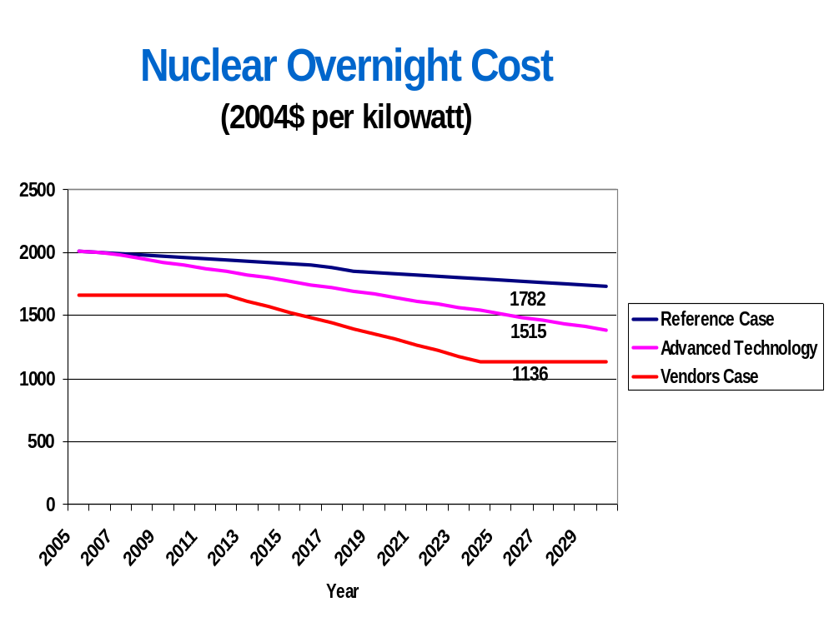

2025
Notes:
2005 2014 2013 1659
2006 2004 2003 1659
2007 1994 1979 1659
2008 1984 1953 1659
2009 1974 1926 1659
2010 1964 1902 1659
2011 1954 1876 1659
2012 1944 1849 1659
2013 1933 1823 1615
2014 1923 1798 1572
2015 1913 1772 1528
2016 1903 1746 1484
2017 1883 1721 1441
2018 1857 1695 1397
2019 1842 1669 1354
2020 1832 1644 1310
2021 1822 1618 1267
2022 1812 1592 1223
2023 1802 1567 1179
2024 1792 1541 1136
2025 1782 1515 1136
2026 1773 1489 1136
2027 1763 1464 1136
2028 1753 1438 1136
2029 1743 1412 1136
2030 1733 1387 1136

Slide 4
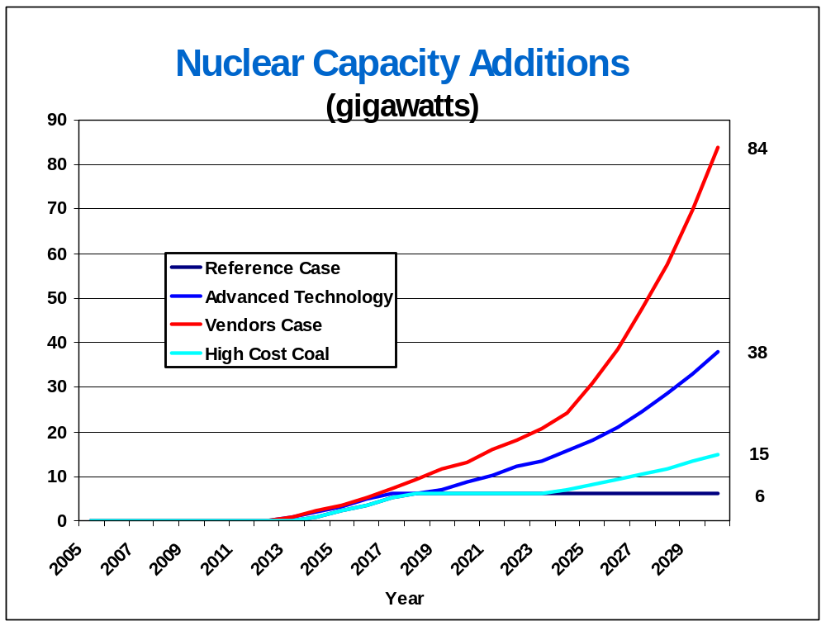
Notes:
In AEO 2005 was 7..4 and 25.1 in 2025 compared with 18.2 and 31.2 in advanced technology and vendors case, respectively. Higher levels this year due to higher fossil fuel price projections.

Slide 5
What are the prospects for new nuclear plants by 2030?
6000 megawatts?
More than 6000 megawatts?

