Slide 1
The Future of Coal: Addressing Carbon and Other Environmental Concerns
2006 EIA Energy Outlook and Modeling Conference
Howard Herzog
MIT
March 27, 2006

Slide 2
MIT Coal Study
Interdisciplinary study
Led by John Deutsch and Ernie Moniz
Follow-on from the 2003 study “The Future of Nuclear Power”
Looks out through 2050
Expected to be completed this spring and released this summer

Slide 3
Framing the Issue
Coal is relatively cheap and abundant
Criteria pollutant targets (SO_{x}, NO_{x}, particulates, Hg) can be met at reasonable costs through at least 2020 and probably well beyond
Every silver lining has a touch of gray – for coal it is climate change concerns
CO₂ capture and storage (CCS) is the technology that could allow coal use to expand even in a greenhouse gas constrained world

Slide 4
Overview
What is Carbon Dioxide Capture and Storage (CCS)?
How does capture work?
Geological storage – is it safe and effective?
How much does CCS cost?

Slide 5
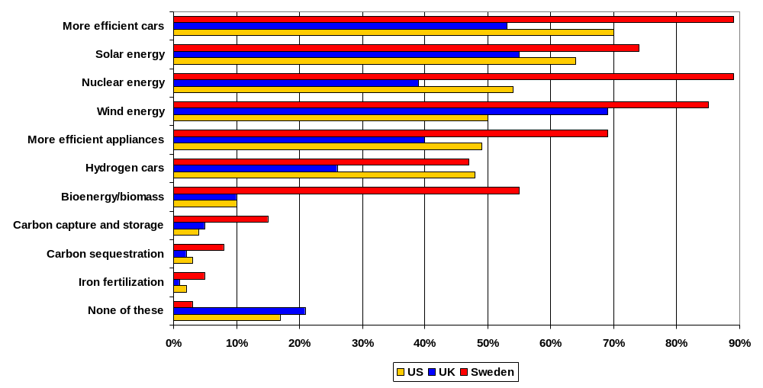
Have you heard of or read about any of the following in the past year?

Slide 6

Intergovernmental Panel on Climate Change (IPCC)
Special Report on Carbon Dioxide Capture and Storage
Accepted September 26, 2005 -- www.ipcc.ch

Slide 7
What is Carbon Dioxide Capture and Storage (CCS)?
Carbon dioxide (CO₂) capture and storage (CCS) is a process consisting of separation of CO₂ from industrial and energy-related sources, transport to a storage location, and long-term isolation from the atmosphere.

Slide 8
CCS - Sources
Hydrocarbons
Industrial Processes
Products
Power Production
Electricity
Fuels Decarbonization
Hydrogen
CO₂
CO₂
CO₂
Sequestration

Slide 9
How does capture work?
There are different types of CO₂ capture systems: post-combustion, pre-combustion and oxyfuel combustion.

Slide 10
Approaches to CO₂ Separation
Pilot/Commercial Activities
Approach | Coal | Gas
Post-combustion | Exists for Slip Streams CO₂ for Commercial Markets | Exists for Slip Streams CO₂ for Commercial Markets
Oxygen | Vattenfall’s 30 MW_{th} pilot near Berlin (approved) | Total’s retrofit of existing boiler in southwest France (approved)
Pre-combustion | FutureGen (275 MWe) in US (under study) | BP’s DF1 in Scotland (under study)

Slide 11
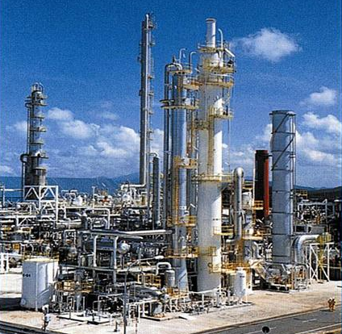
CO₂ Capture at an Industrial Process
Source: Mitsubishi

Slide 12
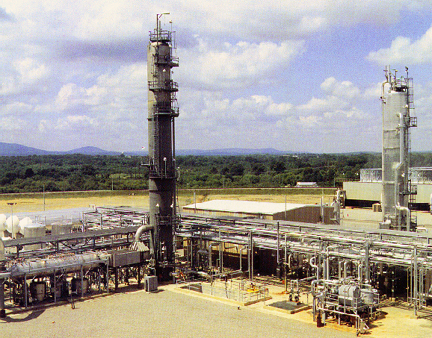
CO₂ Capture at a Coal-Fired Power Plant
Source: ABB Lummus

Slide 13
Geological storage – is it safe and effective?
Storage of CO₂ in deep, onshore or offshore, geological formations uses many of the same technologies that have been developed by the oil and gas industry and has been proven to be economically feasible under specific conditions for oil and gas fields and saline formations, but not yet for storage in unminable coal beds.

Slide 14
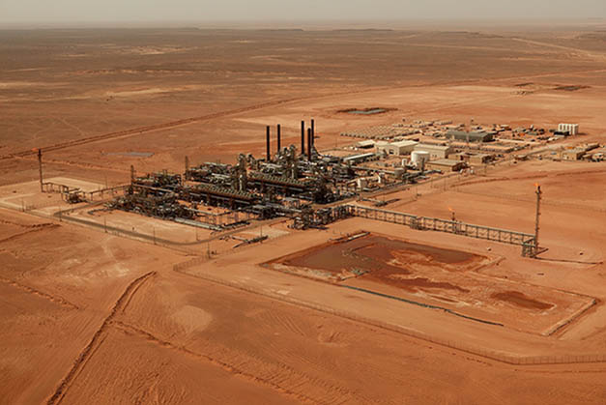
In Salah Gas Processing Plant
CO2 Storage Pipeline to Krechba
Export Gas Pipeline to Hassi R’Mel & Europe (1 BCF/d)
Import Gas Pipeline from Teguentour and Reg

Slide 15
Geological storage – is it safe and effective?
Observations from engineered and natural analogues as well as models suggest that the fraction retained in appropriately selected and managed geological reservoirs is very likely to exceed 99% over 100 years, and is likely to exceed 99% over 1,000 years.
For well-selected, designed and managed geological storage sites, the vast majority of the CO2 will gradually be immobilized by various trapping mechanisms and, in that case, could be retained for up to millions of years. Because of these mechanisms, storage could become more secure over longer timeframes.

Slide 16
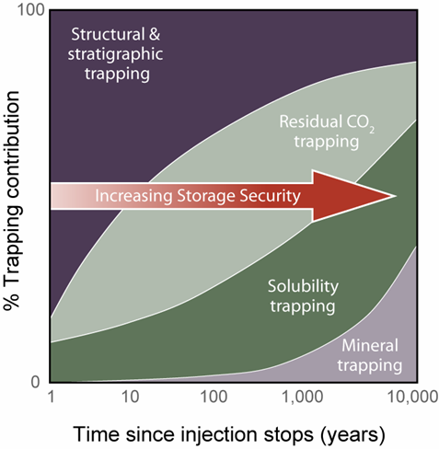
Trapping Mechanisms and Increasing Storage Security with Time
Storage security depends on a combination of physical and geochemical trapping
Over time, residual CO₂ trapping, solubility trapping and mineral trapping increase
Courtesy Sally Benson, LBNL
Notes:
Within these formations there are a number of trapping mechanisms that have been proposed – and it is concluded that in general storage security depends on a combination of physical and geochemical trapping.
Initially, the most important mechanism is physical trapping below the caprock.
Over time, other mechanisms begin to trap CO2.
Dissolution into the formations fluids
Residual trapping of CO2 in the pore spaces
And conversion of CO2 to carbonate minerals
Two important conclusions
The contribution of the secondary trapping mechanisms can be large
The consequence of this is that storage security will increase over time

Slide 17
How much does CCS cost?
Carbon capture and storage technologies exhibit significant penetration in the electric power sector at carbon prices above $30/tCO₂ (>$100/tC).
  80% associated with capture/compression
  20% associated with transport/injection
Targets of opportunity exist today at lower costs
  Low/no capture costs (industrial by-product)
  Commercial value for CO₂ (e.g., EOR)

Slide 18
How much does CCS cost?
Type of Capture Plant | Cost ($/tCO₂avoided)
Post-combustion Supercritical PC | 45
Oxyfuel Supercritical PC | 35
Pre-Combustion IGCC | 29
Assumptions:
- Uses technology available today
- Assumes an n^{th} plant (versus 1st of a kind)
- Transport/storage cost is $5/tCO₂
PC = Pulverized Coal; IGCC = Integrated Coal Gasification Combined Cycle

Slide 19
Moving Forward
Two biggest challenges for CCS:
  Reducing capture costs
  Addressing the regulatory and associated issues of storage
CCS is not a silver bullet, but should be thought of as part of a portfolio of climate change mitigation options

Slide 20
Contact Information
Howard Herzog
Massachusetts Institute of Technology (MIT)
Laboratory for Energy and the Environment (LFEE)
Room E40-447
Cambridge, MA 02139
Phone: 617-253-0688
E-mail: hjherzog@mit.edu
Web Site: sequestration.mit.edu

