Slide 1
Unconventional Natural Gas:
Industry Savior or Bridge?
Renaissance Ballroom West
3:25 p.m. - 4:55 p.m.

Slide 2
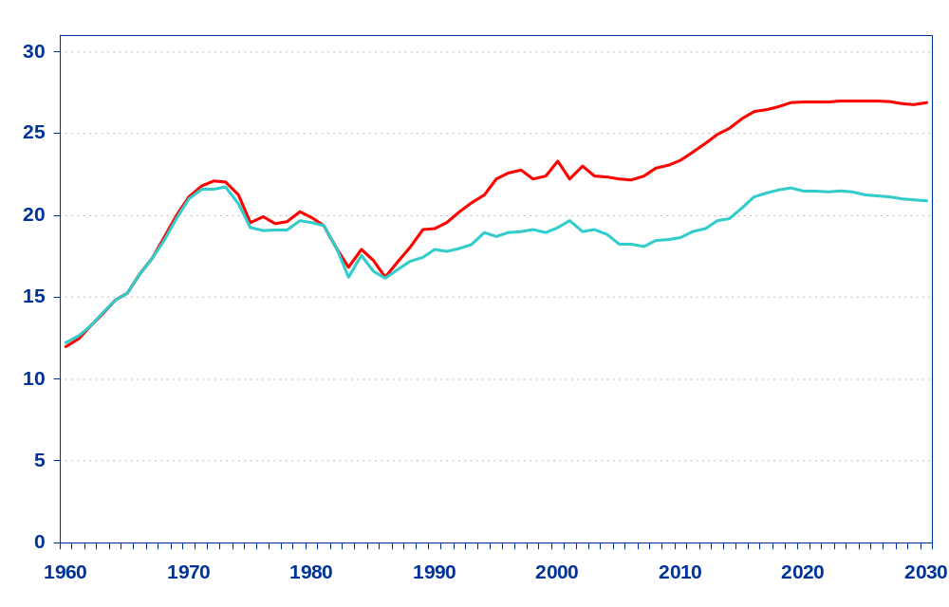
Natural Gas Production, Consumption, and Imports,
1960-2030 (trillion cubic feet)
Consumption
Net imports
21%
15%
Production

Slide 3
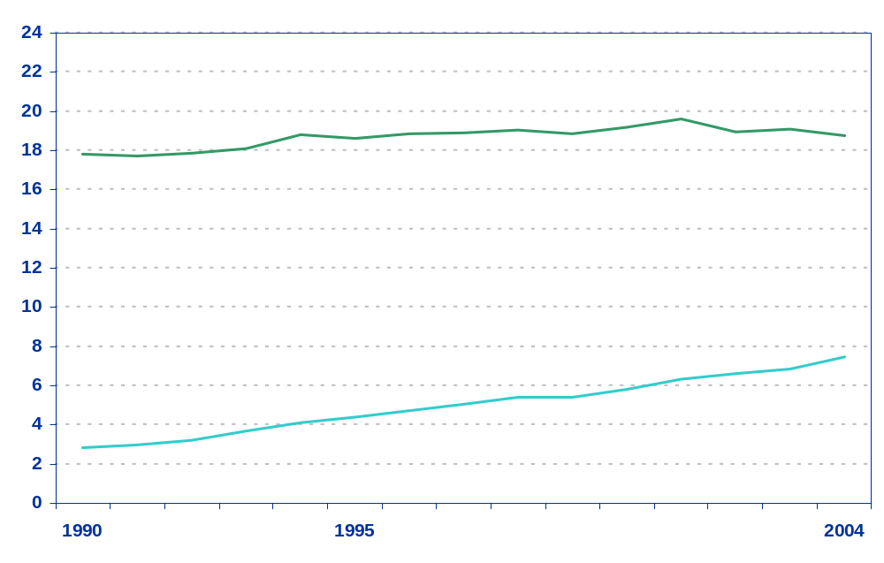
Unconventional Natural Gas Production
Rapidly Growing Share of Total U.S. Production
(trillion cubic feet)
Total
60 percent
84 percent
Unconventional
40 percent
16 percent

Slide 4
Issues
How big is the unconventional natural gas resource?
What are the technology issues that need to be surmounted to develop that resource?
From an operational perspective, what are the impediments to the development of the unconventional natural gas resource?

Slide 5
Speakers
Ted E. McCallister - Economist, Energy Information Administration
“The Outlook for Unconventional Natural Gas in AEO2006”
Vello A. Kuuskraa - President, Advanced Resources International
“Is the Unconventional Gas Resource Base Sufficiently
Large and High Quality?”
Kent F. Perry - Director, E&P Research, Gas Technology Institute
“Unconventional Gas Technology Issues”
Robert S. Boswell - CEO, Laramie Energy
“Impediments to the Development of Unconventional Natural
Gas Resources in the United States”

