Slide 1
LNG Imports and the Development of the
North American Pipeline Grid
2006 EIA Energy Outlook and Modeling Conference
Washington, D.C.
Greg Hopper
Vice President
Lukens Energy Group, a Black & Veatch company

Slide 2
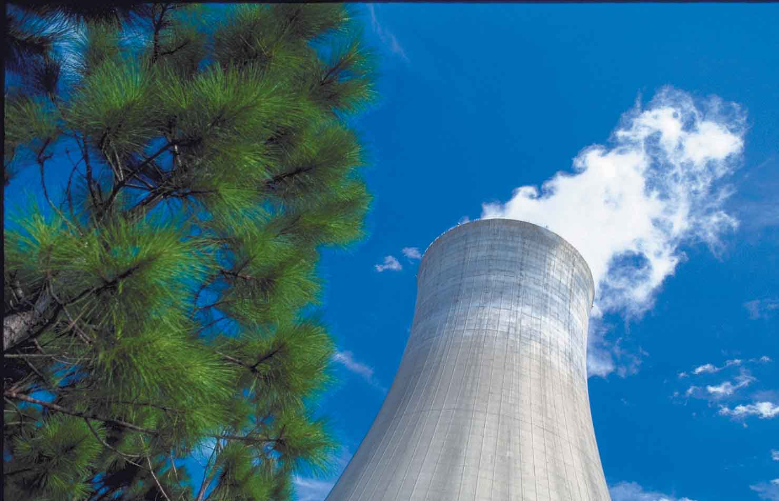
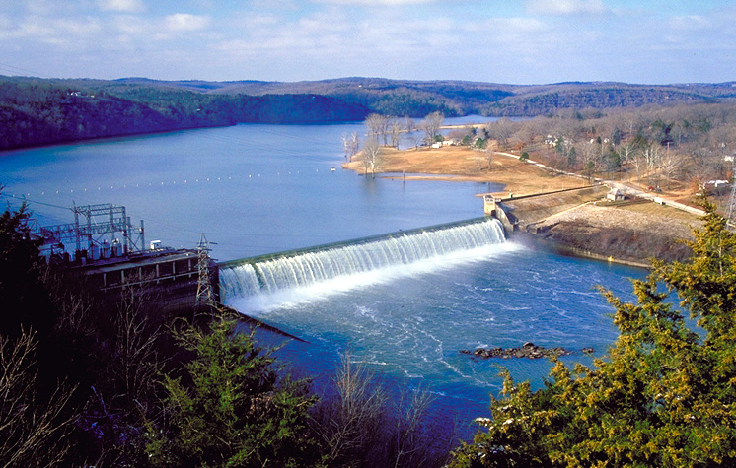



Black & Veatch builds critical infrastructure and advises clients in the global energy markets
Energy
Water
Information
Government
Lukens Energy Group is part of B&V Enterprise Management Solutions
We advise provide commercial, regulatory and strategic advisory services to clients in the natural gas and electric industries
Notes:
We currently provide consulting, construction and engineering services to four primary market sectors:
Energy
Water
Information
Government

Slide 3

Today’s Discussion
Pipeline development trends driven by LNG imports
Producer integration to trading hubs
Netback enhancement investments
Less likely infrastructure projects
Renewed impetus for storage

Slide 4
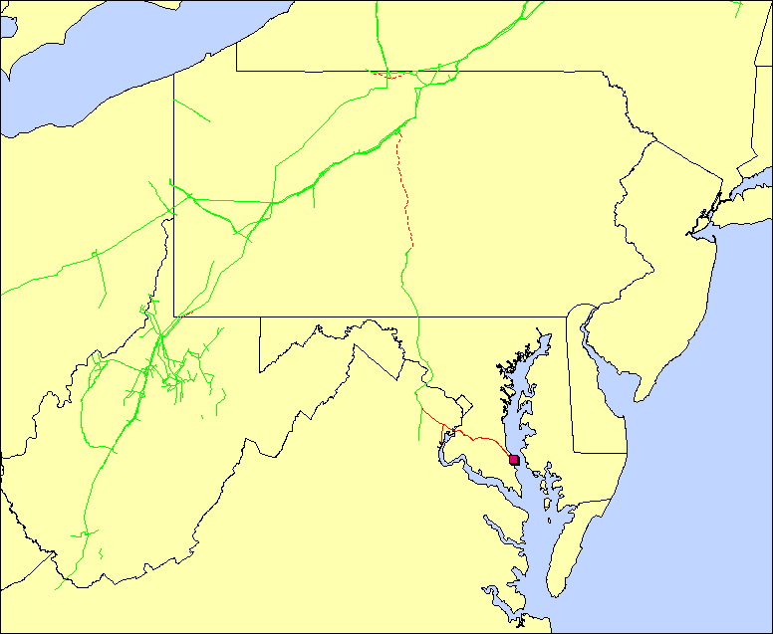
Producer Integration to Trading Hubs – Cove Point
Dominion Transmission
Cove Point Pipeline
DTI/Cove Point Pipeline Expansion Project
- 47 miles 36” loop (MD), 81 miles 24” pipe and 33 miles 24” loop (PA, WV,NY)
- Capacity: 800 MMcf/d (MD0, 700,000 Mmcf/d (PA,WV,NY)
- Capex:: $402 MM
- FERC Status: Filed on 2Q 2005
- In-service: 3Q 2008
Cove Point LNG

Slide 5
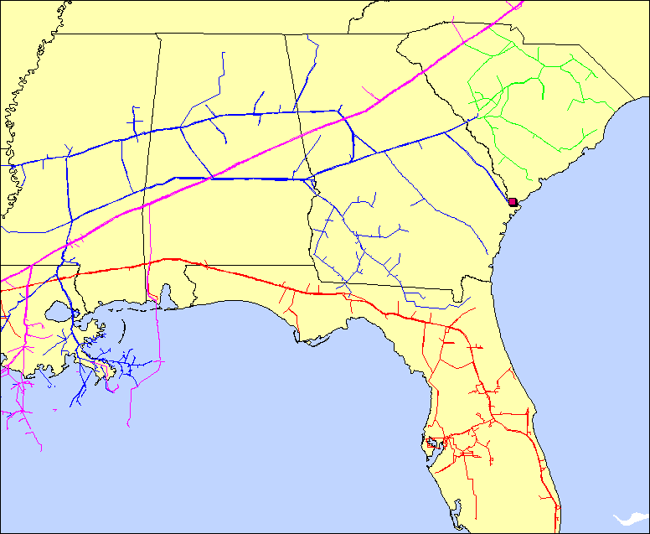
Producer Integration to Trading Hubs – Elba Island
Elba Express
- 105 miles 42” pipe, 86 mile of 36” pipe
- Capacity: 1.1 Bcf/d
- FERC Status: Prefiling
- In-service date: Mid 2010
Elba Island LNG
Cypress Project
- Project Scope (Ph 1)
- 165 miles 24” pipe
- Capacity: 220 MMcf/d
- Capex: $240 MM
- FERC Status: Filed on 2Q 2005
- In-service May 2007
FGT
SNG
SCANA Pipeline
Transco
Cypress Pipeline
Elba Express

Slide 6
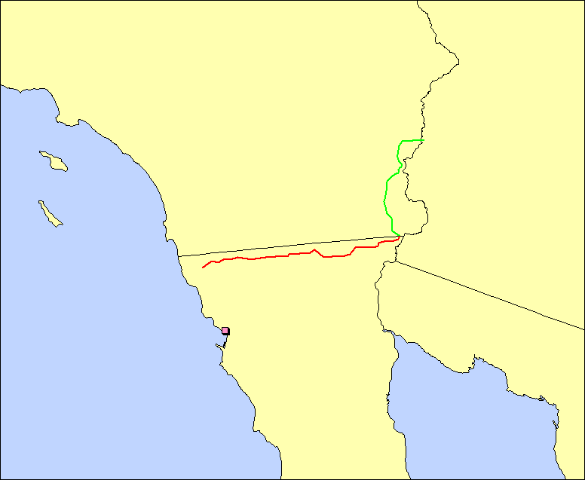
Producer Integration to Trading Hubs – Energia Costa Azul
North Baja Pipeline / Gasoducto Baja Norte Expansions
- 80 miles of 42”, 48” pipe (Phase I), and 46 miles of 16” lateral (Phase II)
- Capacity: Together the expansions will allow to import up to 2.7 Bcf/d of gas into the U.S.
- Capex: $291 MM
- In-service Date: Phase I – Late 2007; Phase II – Mid 2009
Energia Costa Azul LNG
North Baja Pipeline
Gasoducto Baja Norte

Slide 7
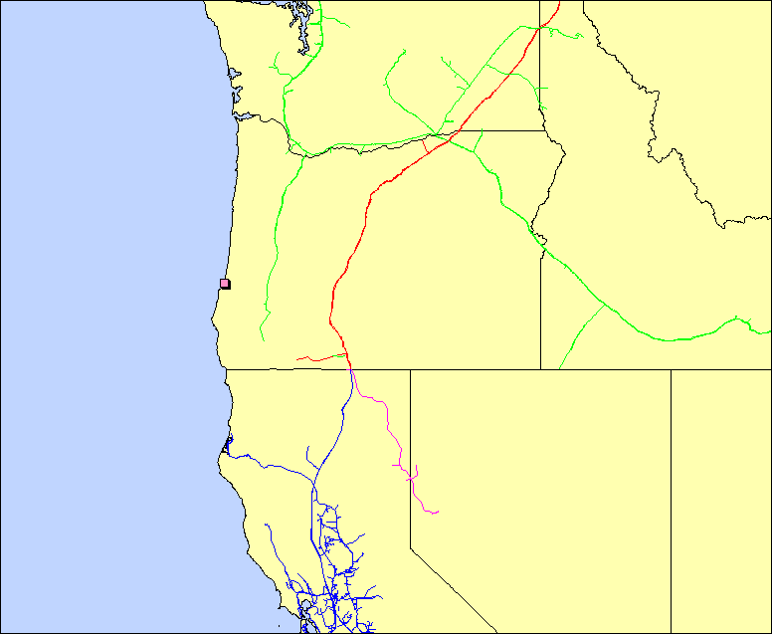
Producer Integration to Trading Hubs – Jordan Cove LNG
Northwest Pipeline
Gas Transmission NW
Tuscarora Pipeline
PG&E
Pacific Connector Gas Pipeline
Pacific Connector Gas Pipeline Project
- 250 mile pipe
- Capacity: 1 Bcf/d
- FERC Status: Filing in
1Q 2007
- In-service: 2010
Jordan Cove LNG

Slide 8
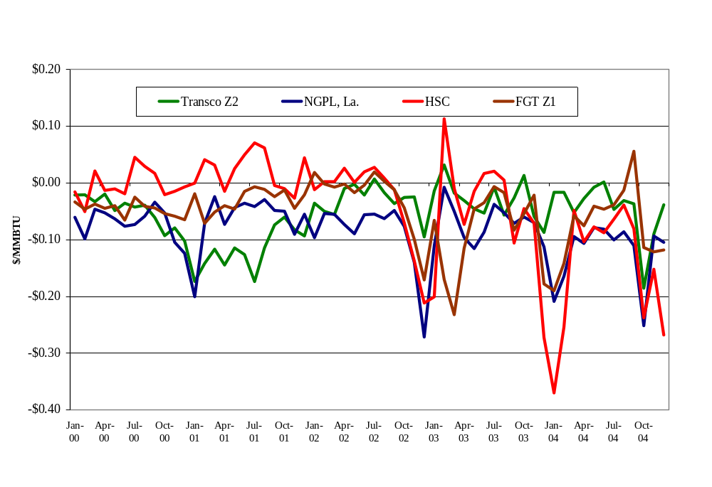
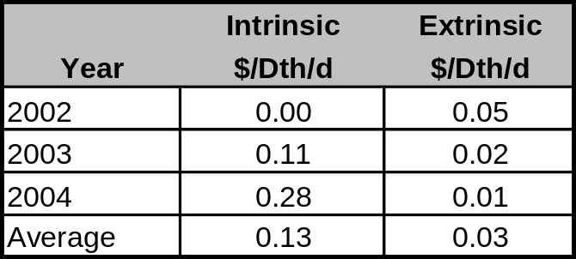

Header strategies to enhance netbacks
The total arbitrage value depends on operational characteristics – such as capacity and cost, as well as the price correlation between pricing points.
The intrinsic value is captured by choosing the highest-valued delivery point at the beginning of each month.
The realization of the extrinsic value depends on the market liquidity and portfolio management practice.
Historical Basis to Henry Hub
Potential Header Value

Slide 9
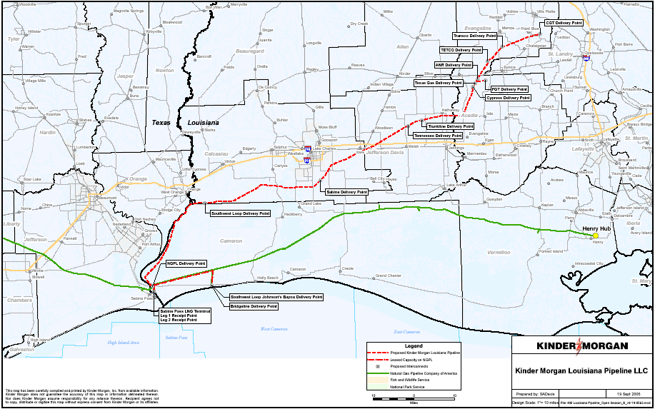
Header System - Kinder Morgan Louisiana Pipeline

Slide 10
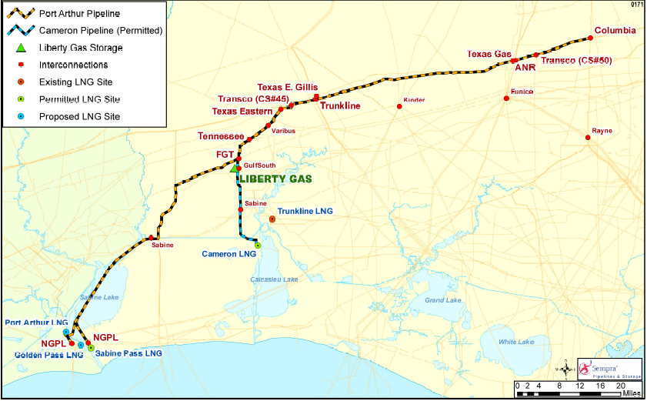
Header System – Sempra Port Arthur Pipeline

Slide 11
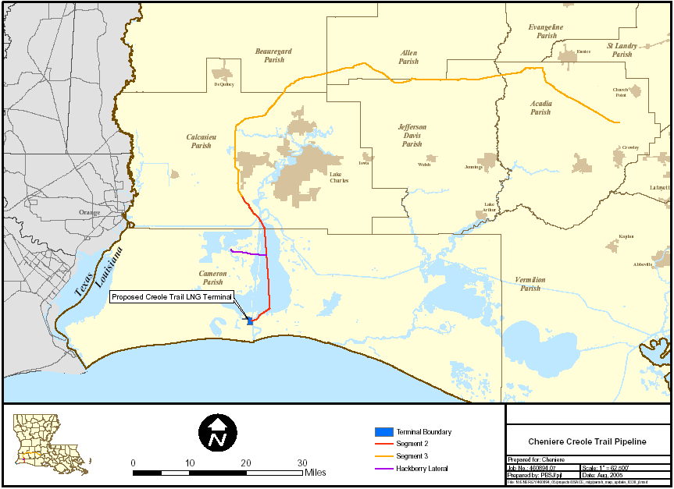
Header System – Cheniere Creole Trail Pipeline

Slide 12
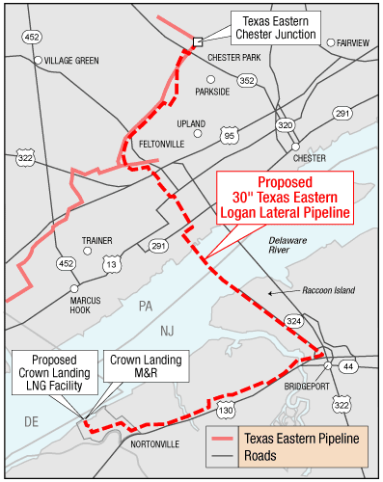
Header System – Texas Eastern Logan Lateral, BP Crown Landing

Slide 13
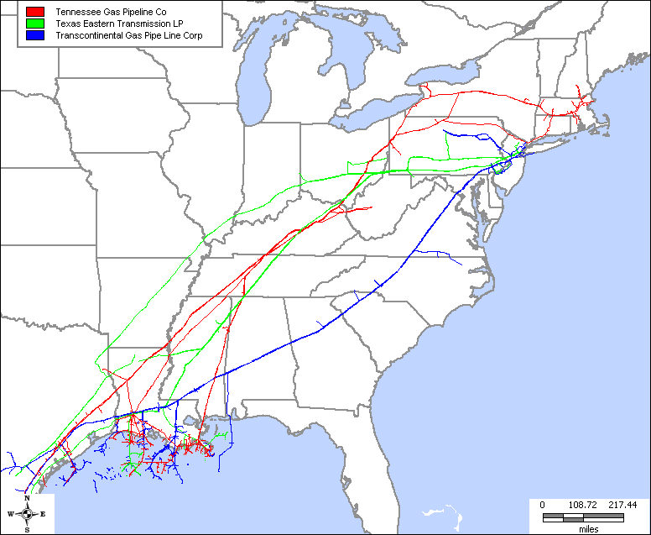
Gulf Coast-to-Northeast long haul expansions are less likely
Current Rates ~ $.55/dt, plus fuel
Incremental Rates ~ $1.40/dt, plus fuel

Slide 14
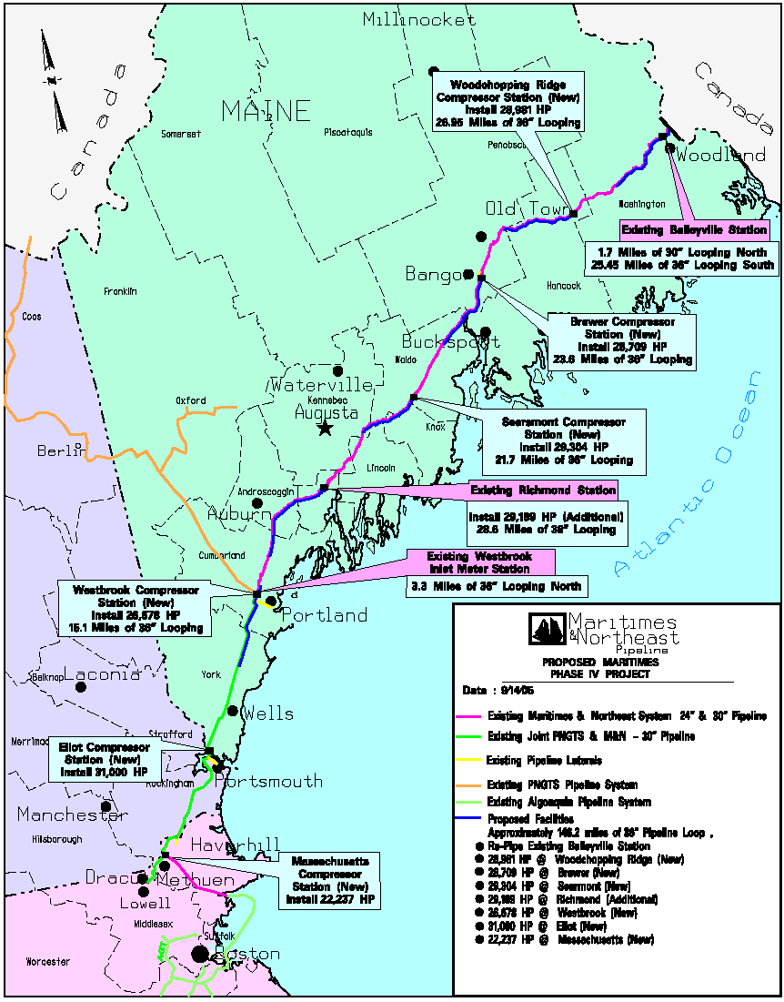
Maritimes & Northeast – Phase IV expansion uncertainty
Maritimes & Northeast Pipeline
Phase IV – Open Season Results
Shipper | Volume (MMBtu/d)
Anadarko LNG Marketing (Bear Head LNG) | 813,000
Repsol Energy NA (Canaport LNG) | 750,000
Total | 1,563,000

Slide 15
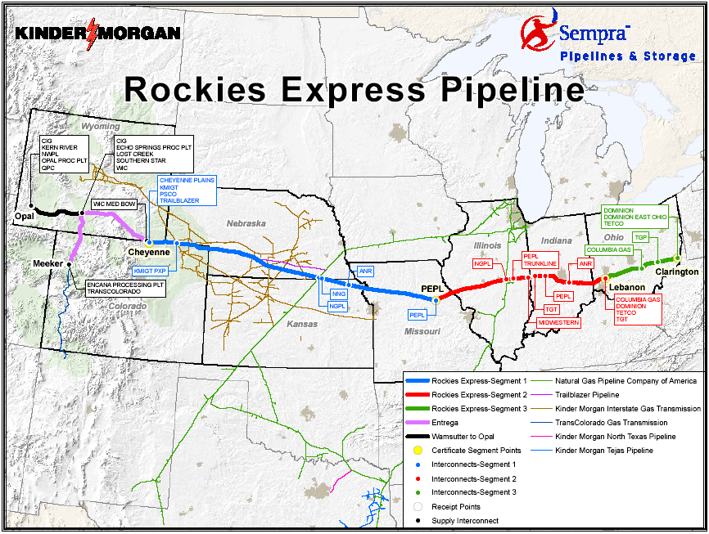
Interregional projects influence and are influenced by LNG

Slide 16
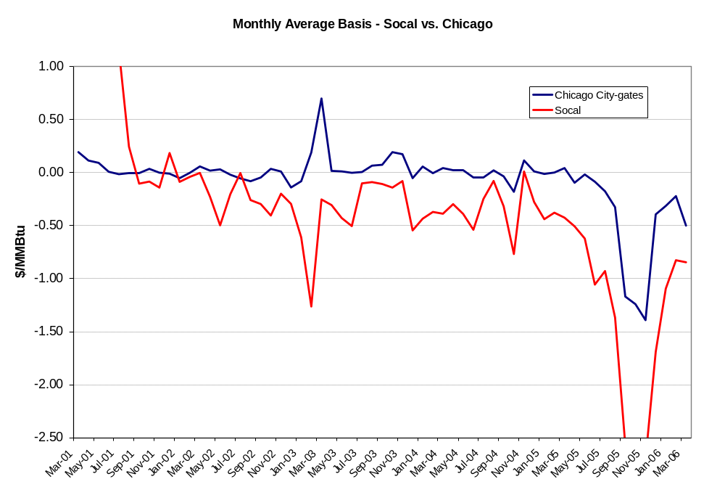
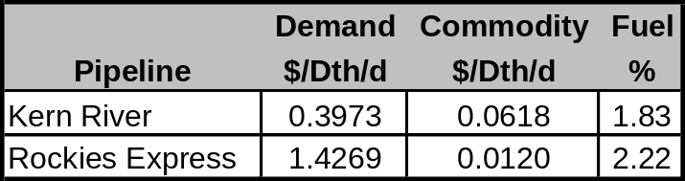
West Coast LNG may be influencing Rocky Mountain producer pipeline decisions
Comparison of Rates
Kern River vs. Rockies Express

Slide 17
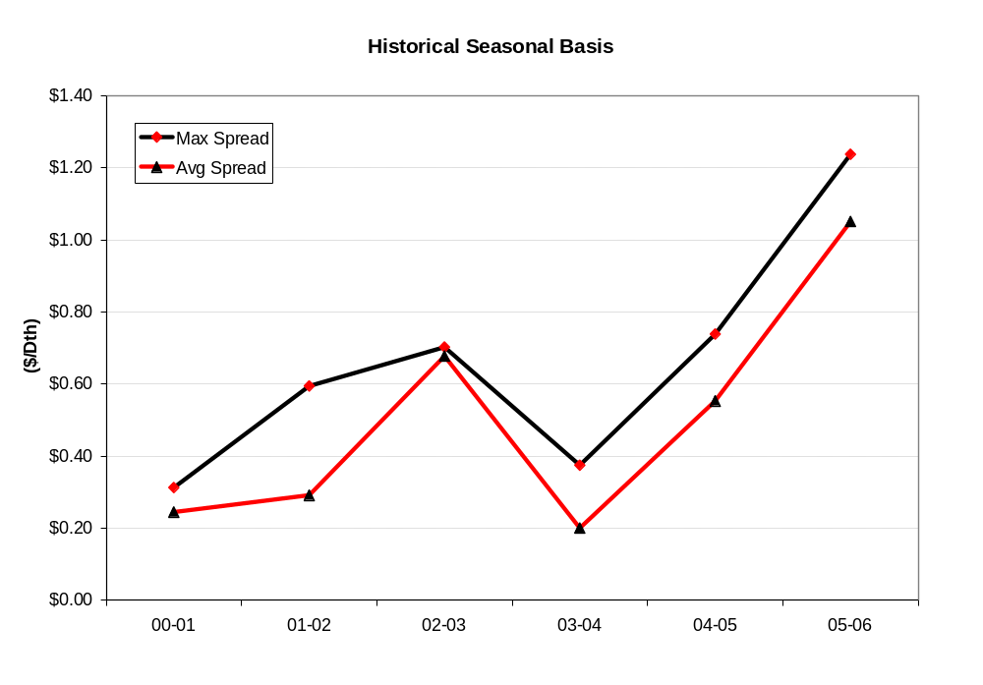
Baseloaded LNG may drive summer/winter prices wider and promote more storage development

Slide 18
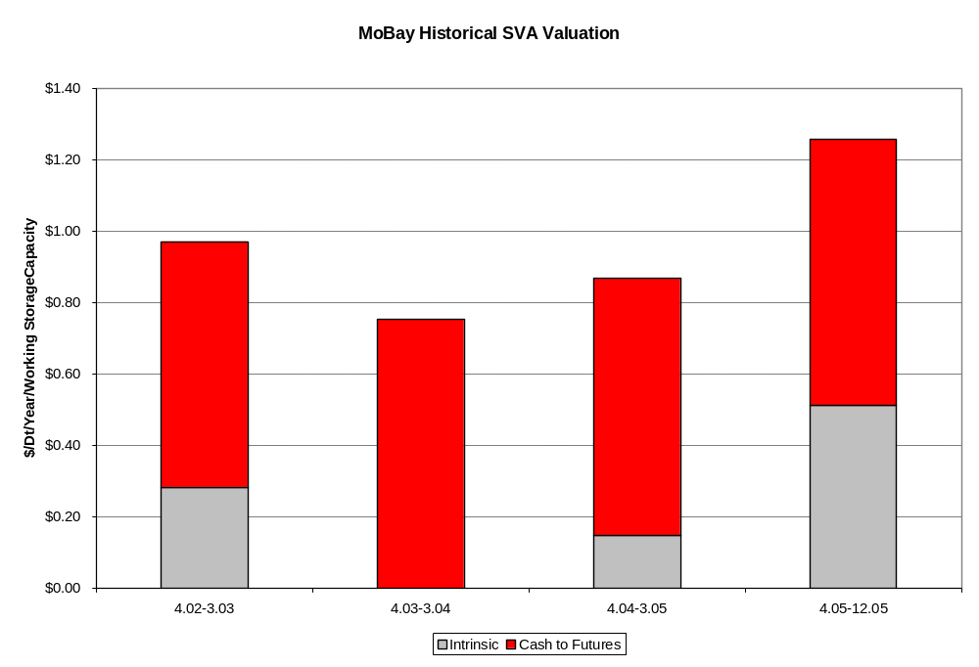
Historical values of a Gulf Coast storage facility

Slide 19
Thank You.
Greg Hopper
Vice President
713-590-2280
hoppergw@bv.com

