Slide 1

Depending on Coal
Diane Kearney
Operations Research Analyst
Energy Information Administration
March 27, 2006

Slide 2
Some factors affecting continued dependence on coal
Where will the coal come from? At what price?
Transportation challenges. What price will the railroads charge?
Environmental regulation uncertainty
Over 30 alternative cases in the AEO2006
including coal cost side cases

Slide 3
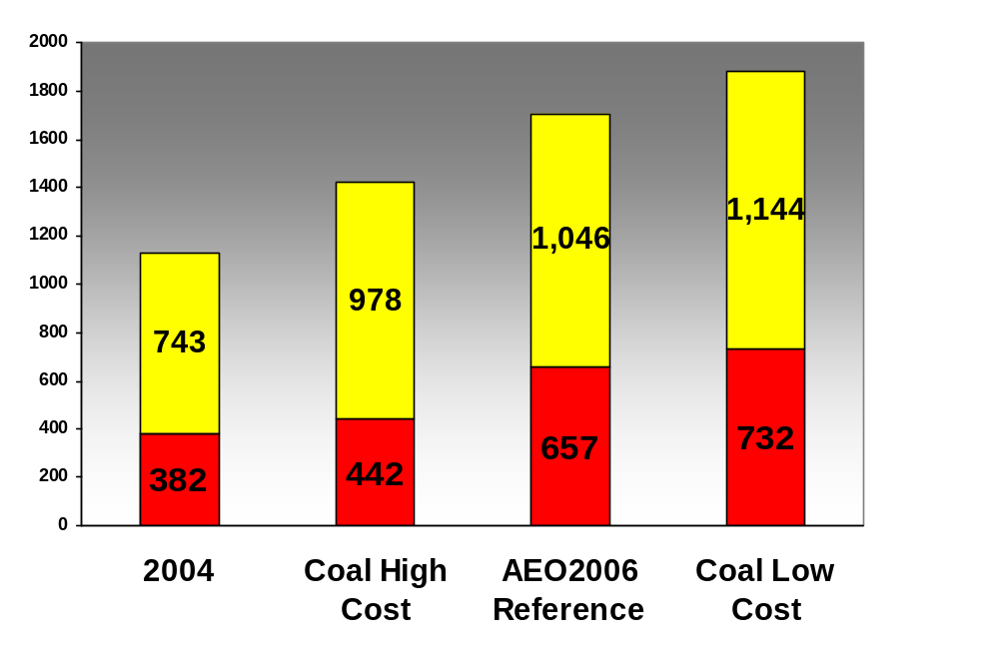

Coal Production, 2030
(million short tons)
All other basins
Wyoming Powder River Basin
Source: Annual Energy Outlook 2006

Slide 4
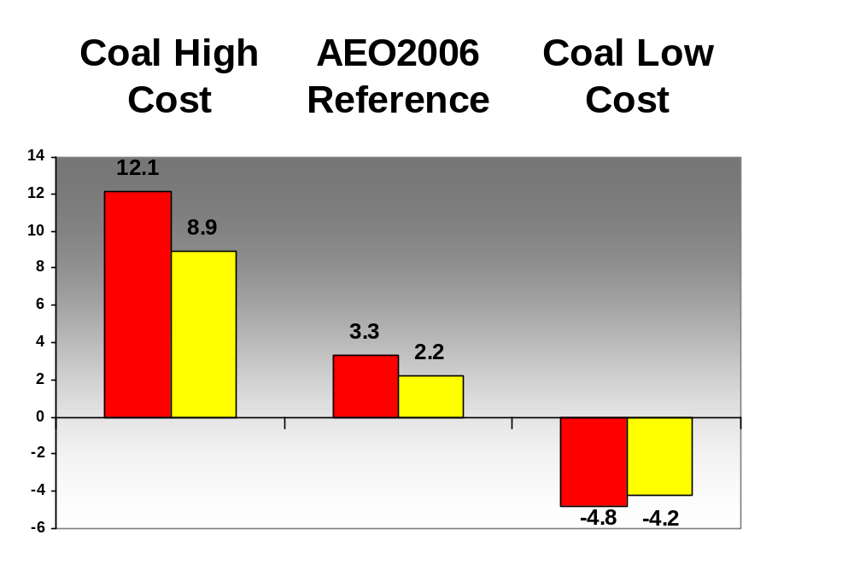
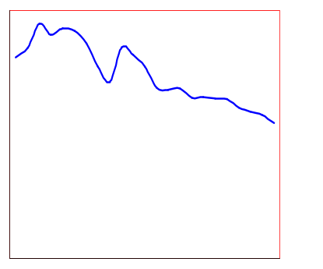
Change in coal transportation rates between 2004 and 2030 (percentage)
Eastern coal
$9.83
$14.58
Western coal
Average Coal Transportation Rates, 1979-2001 (2004 dollars per short ton)
*Percent change calculated on a constant dollar basis.
Source: Annual Energy Outlook 2006

Slide 5
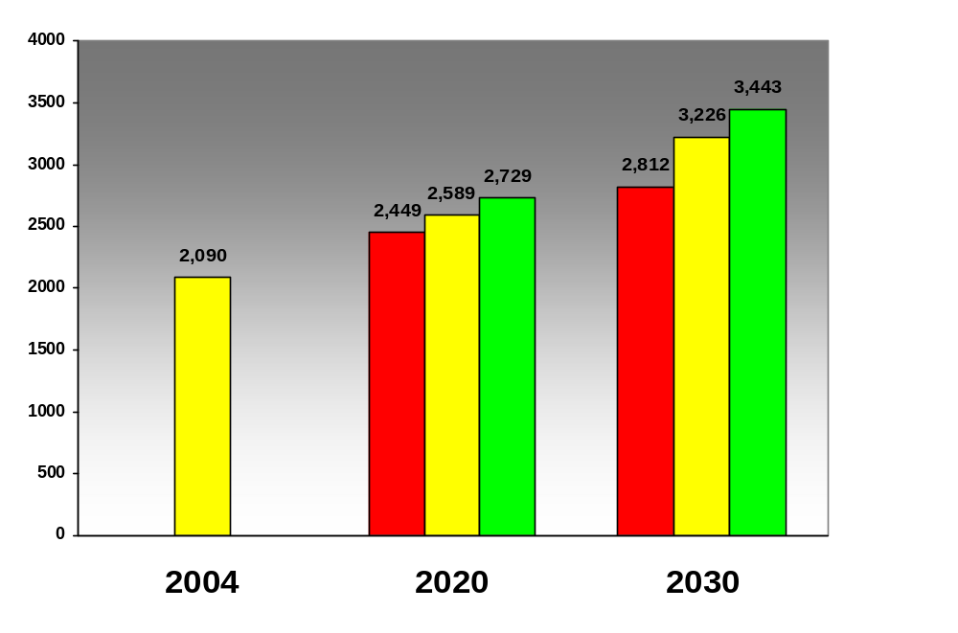
Projected Carbon Dioxide Emissions from Coal, 2020 and 2030
(million metric tons)
Coal High Cost
AEO2006 Reference
Coal Low Cost
Source: Annual Energy Outlook 2006

