Slide 1
World Oil Demand:
Outlook for 2006 and 2007
2006 EIA Energy Outlook and Modeling Conference
Global Oil Market Outlook: Short-Term Issues
Erik Kreil
Energy Markets & Contingency Information Division

Slide 2
World Oil Demand Growth is Driving a Tight Oil Market.
Oil demand growth in recent years has exceeded the growth in non-OPEC supplies.
As the call on OPEC production has increased, spare world oil production capacity has remained at low levels.
The strong demand growth has kept OECD oil inventories, on a days of supply basis, in the lower half of historically observed ranges.
However, projected high world oil prices and slower economic growth are expected to slow oil demand growth in 2005-2007 from 2004 levels.

Slide 3
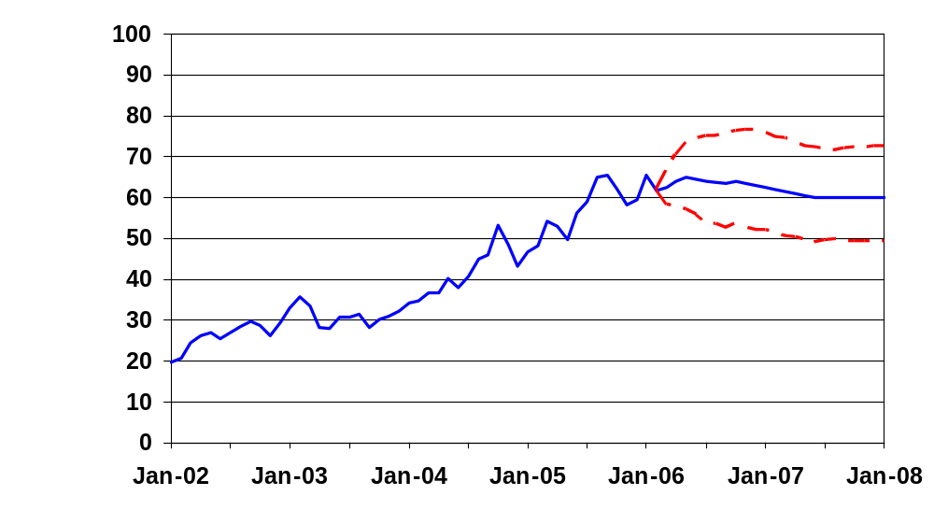
Crude Oil Prices are Expected to Remain High
(West Texas Intermediate with 95% Confidence Interval*)
*The confidence intervals show +/- 2 standard errors based on the properties of the model.
Notes:
- Continued steady world oil demand growth, combined with only modest increases in world spare oil production capacity, and the continuing risks of geopolitical instability, are expected to keep crude oil prices high through 2006-2007.
-The price of West Texas Intermediate (WTI) crude oil is projected to average $64 per barrel in 2006 and $61 in 2007. The range is +/- $12 around the base case on average.

Slide 4
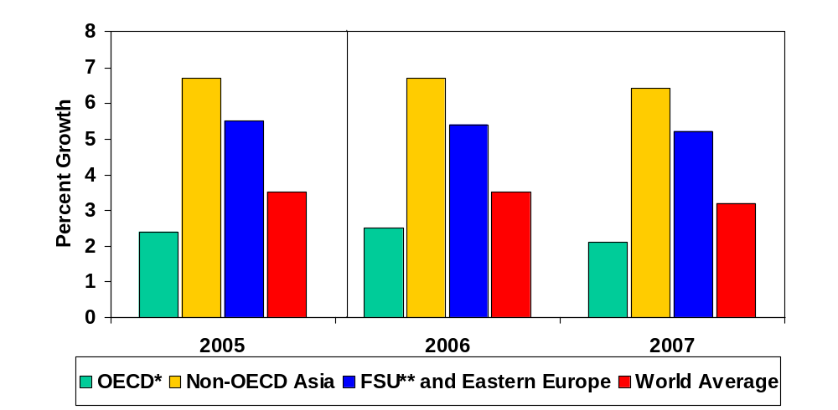
World Economic Growth Remains Strong
(Change in Real GDP from Previous Year)
* Countries belonging to Organization for Economic Cooperation and Development
** Former Soviet Union
Notes:
- Real world economic growth is projected to be 3.5% in 2005- 2006, before slowing to 3.2% in 2007.
The OECD as a whole is projected to show slow economic growth (2.4% in 2005, 2.5% in 2006, and 2.1% in 2007) because of slow growth in Europe (1.6% in 2005, 2.1% in 2006, 1.9% in 2007), and Japan (2.5% in 2005, 2.2% in 2006, 2.0% in 2007). Growth in North America is projected to be much higher (3.4% in 2005, 3.3% in 2006, 2.8% in 2007.)
Non-OECD Asia is projected to grow at 6.7% in 2005-2006, before slowing to 6.4% in 2007. Chinese economic growth (9.9% in 2005, 9.4% in 2006, 8.8% in 2007) is projected to drive Asian economies. Other fast-growing Asian countries are India, Pakistan, and Vietnam.
High oil/gas revenues are driving economic growth in the Former Soviet Union (5.5% in 2005, 5.4% in 2006, 5.2% in 2007), particularly in Russia (6.4% in 2005, 5.5% in 2006, 4.7% in 2007), Kazakhstan (9.0% in 2005, 8.9% in 2006, 8.8% in 2007), Turkmenistan (20.2% in 2005, 17.3% in 2006, 13.6% in 2007), and Azerbaijan (26.4% in 2005, 21.2% in 2006, 14.2% in 2007).

Slide 5
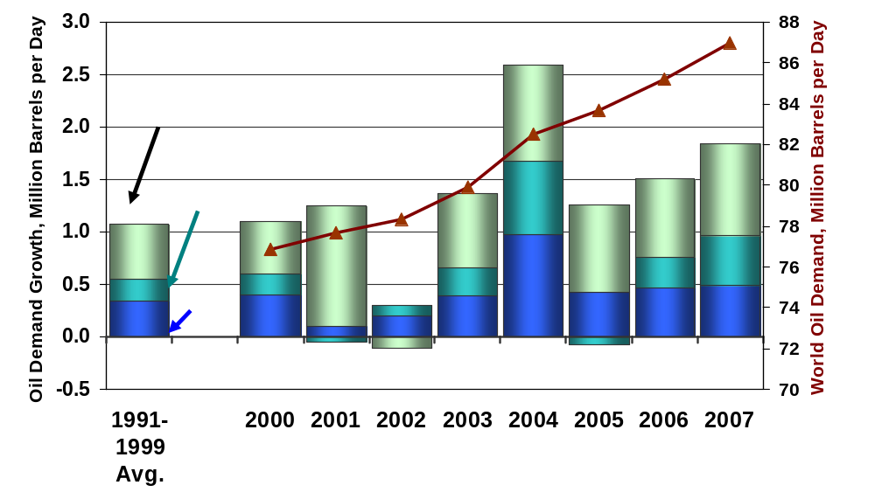
World Oil Demand Growth Slowed in 2005, but Will Increase in 2006-2007
Notes:
Annual world oil demand growth averaged just over 1 million barrels per day in the 1990’s, but fell sharply in 2002 before rising by over 2.6 million barrels per day in 2004. Demand growth slowed down in 2005 to 1.2 million barrels per day in the aftermath of hurricanes Katrina and Rita, and because of cuts in Asian fuel subsidies
World oil demand growth is projected to grow from 1.2 million barrels per day in 2005 to 1.5 million barrels per day in 2006, largely because U.S. demand is projected to recover from a net decline in 2005 to show growth of almost 300,000 bbl/d in 2006.
OECD demand growth outside of the United States is expected to remain low.
World demand growth is projected to increase further to 1.8 million bbl/d in 2007 because of economic growth in developing Asian countries (excluding China).
Chinese demand growth has shown remarkable strength. Demand grew by almost 1 million barrels per day in 2004, but slowed to an average of about 0.4 million barrels per day in 2005. It is projected to 0.5 million barrels per day in 2006-2007.

Slide 6
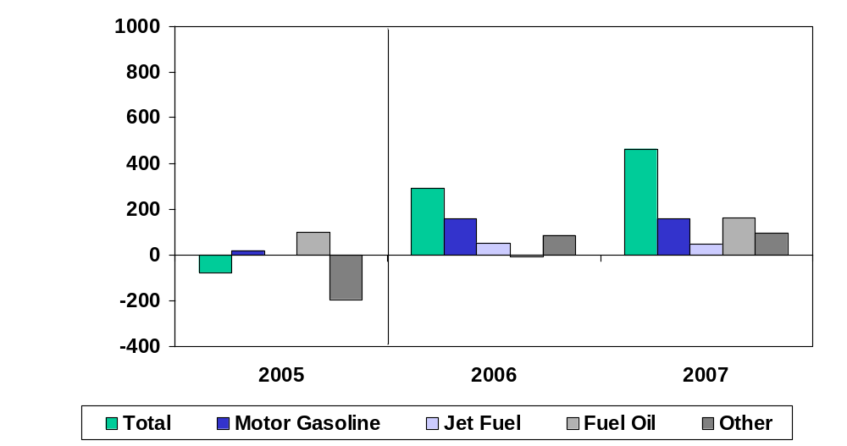
U.S. Oil Demand Growth led by Gasoline in 2006-2007
(Change from Previous Year)
0
Notes:
US oil demand growth is important, as it is the world’s largest oil consumer.
US oil demand is closely followed as the data is transparent and available worldwide on a timely basis.
In 2006 and 2007, petroleum consumption is projected to register increases of 1.4 percent and 2.2 percent, respectively.
Motor gasoline demand, which exhibited almost no growth in 2005, is set to grow 1.7 percent in both 2006 and 2007. This pattern reflects continued, but slowing, economic growth and an eventual decline in motor gasoline prices.
Distillate (diesel fuel and heating oil) demand, having increased 1.3 percent in 2005, is projected to increase 1.5 percent in the current year and 4.0 percent in 2007. However, this year’s unusually warm first quarter is expected to result in a substantial decline in heating oil demand for the year as a whole, limiting total distillate growth for 2006.
Transportation diesel demand is projected to show solid growth in 2006 and 2007 of almost 4 percent per year as the economy continues to expand and as fuel prices eventually ease slightly.

Slide 7
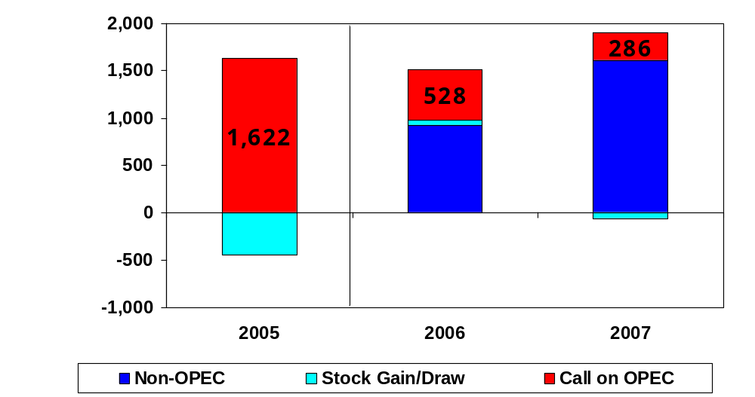
World Oil Demand Growth Will Exceed Non-OPEC Supply Growth and Require Increased OPEC Oil Supplies
Notes:
Non-OPEC conventional supply growth of 2.5 million bbl/d between 2005 and 2007.
Demand will rise over 3.5 million bbl/d between 2005 and 2007.
1 million bbl/d growth in “Call on OPEC”.

Slide 8
Conclusions
Although high world oil prices are expected to moderate oil demand somewhat, global oil demand will continue to grow because of continued economic growth in Asia and the US.
World oil demand will rise by 3.5 million bbl/d between 2005-2007, led by growth in the US, China, and other developing Asian countries.
This strong demand growth will, in turn, help keep world oil prices at relatively high levels over 2006-2007 by outpacing non-OPEC supply growth and keeping spare world oil production capacity at low levels.

