Slide 1
How Far Ethanol?
Presentation to EIA Energy Outlook and Modeling Conference
Kevin Lindemer
March, 27 2006

Slide 2
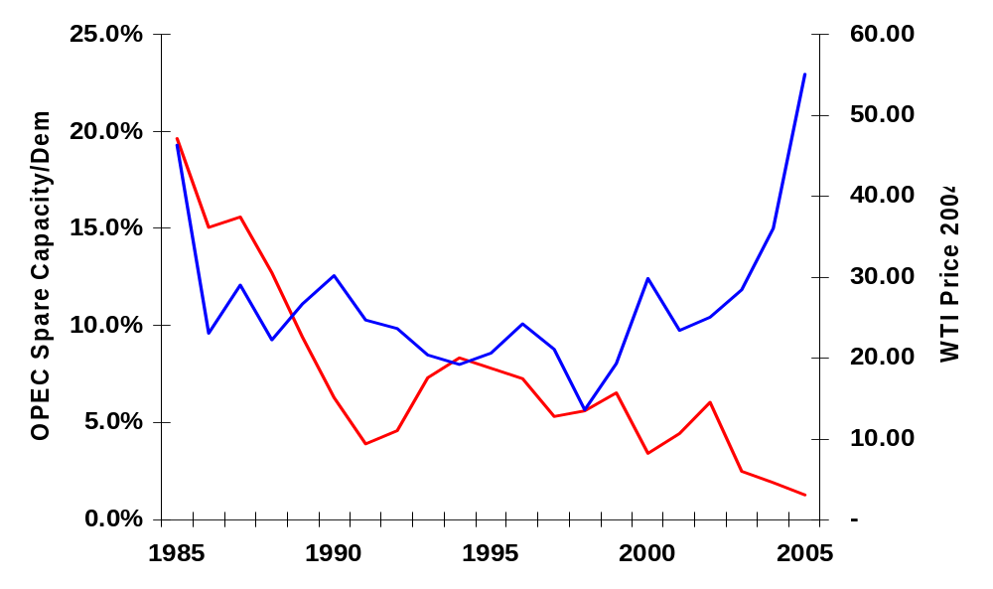
OPEC Spare Capacity and Price

Slide 3

Ethanol: The Stability of Three Policies
Ethanol
Agriculture
Energy
Environment

Slide 4
Three Major Policy Drivers
Energy Policies
  Energy Security
  Reduce dependency on petroleum-based energy sources
  Diversify energy sources
Environmental Policies
  Reduce criteria emissions at local, urban, metropolitan, and national levels
  Reduce greenhouse gas emissions
Agricultural Policies
  Create new markets for agricultural crops
  Reduce subsidies

Slide 5
Are the Ingredients for Critical Mass Coming Together?
High Risk/High Anxieties
  Climate Change, Peak Oil, Politics of Oil
Vehicle technology compatibility – current and future
  HEV, PHEV, FFV
Fuel Transparency for the Customer
  Ethanol, biodiesel
Will the cost of addressing these policies negatively impact the economy?

Slide 6
Demand Impact from High Oil/Energy Prices: What are the Implications for the Policy Drivers and Ethanol?
Price effect is smaller due to significant decline in fuel substitution capability
Income effect is smaller due to continued decline in oil/gdp in nearly all countries.
  Incremental oil demand/gdp nearly half the level of 10 years ago
For many OECD consumers, the price of crude oil is a small fraction of their fuels costs
In some major emerging markets, energy prices are subsidized and consumers do not ‘see’ higher prices
Current high prices are – still – largely demand driven
Petro dollars are being recycled more quickly through investments and financial flows
There is an absence of inflationary pressures thanks to increased global and domestic competition

Slide 7
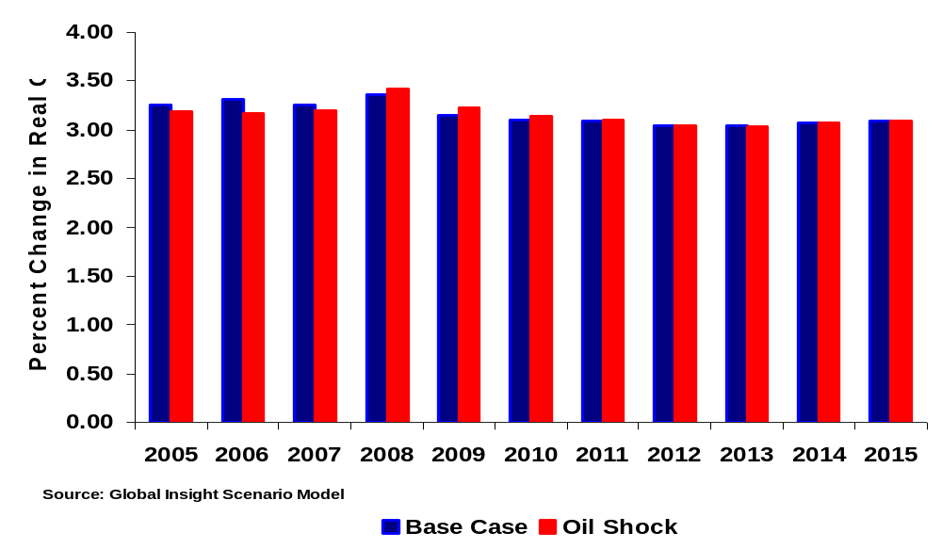
Impact of $100 Oil Shock on World Growth

Slide 8
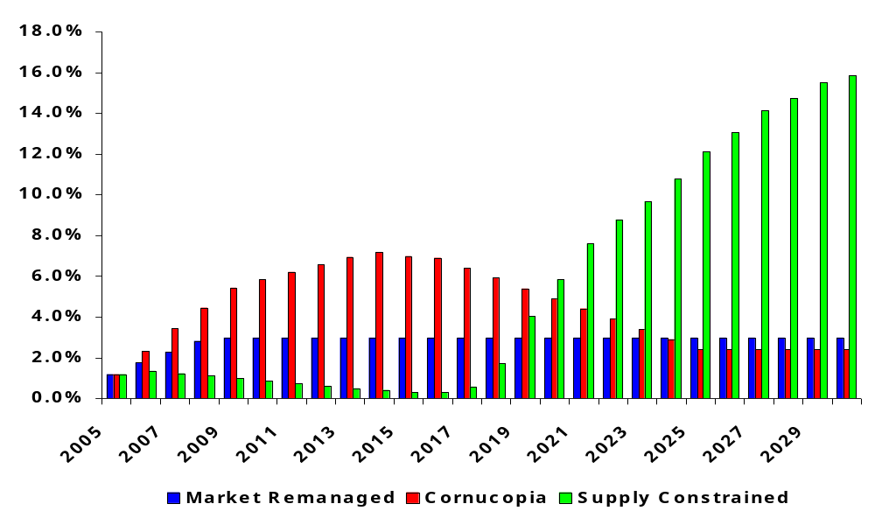
OPEC Spare Capacity Share of Global Demand

Slide 9
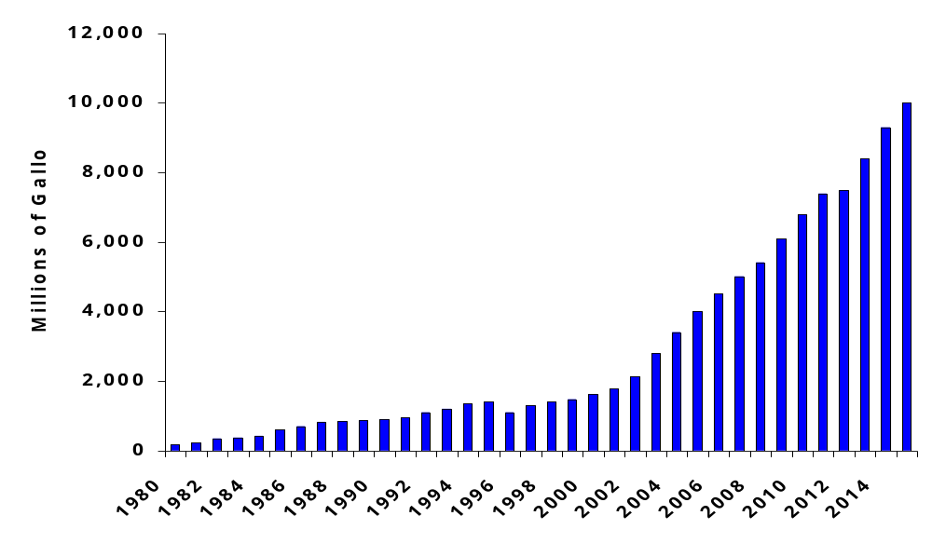
US Ethanol Production and Outlook

Slide 10
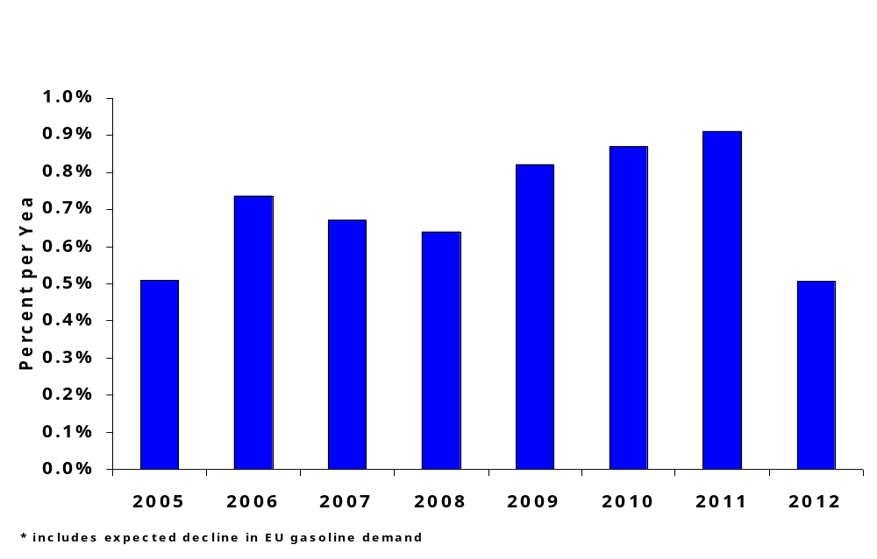
US Demand Growth Supported by EU and US Ethanol *

Slide 11
Risks and Uncertainties
How likely is it that all current risks dissipate?
  And, if they do, does it make a difference to ethanol?
Are the three policy drivers compatible?
When will oil prices come back down?
  And, what will drive them down?
What happens to crop prices?
Are assumptions about technology being applied equally?
Will ethanol capacity overshoot RFS?
What comes after RFS?

Slide 12
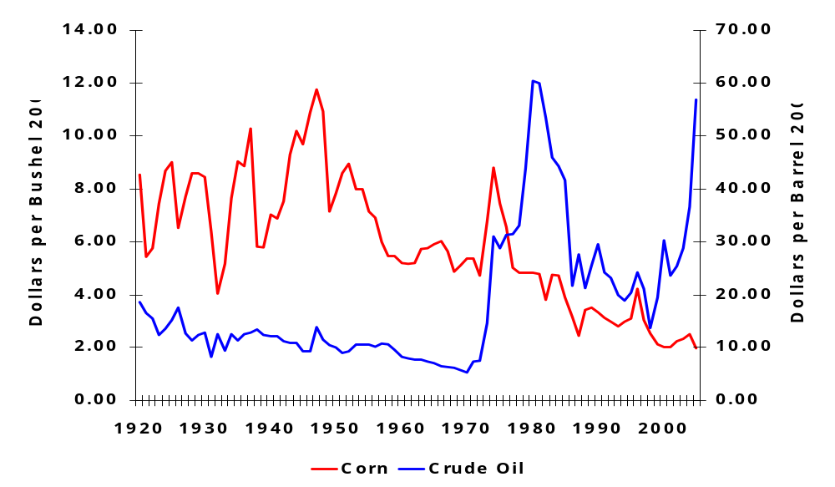
Crude Oil and Corn Prices: Can Commodities Increase in Price Over the Long-term?

Slide 13
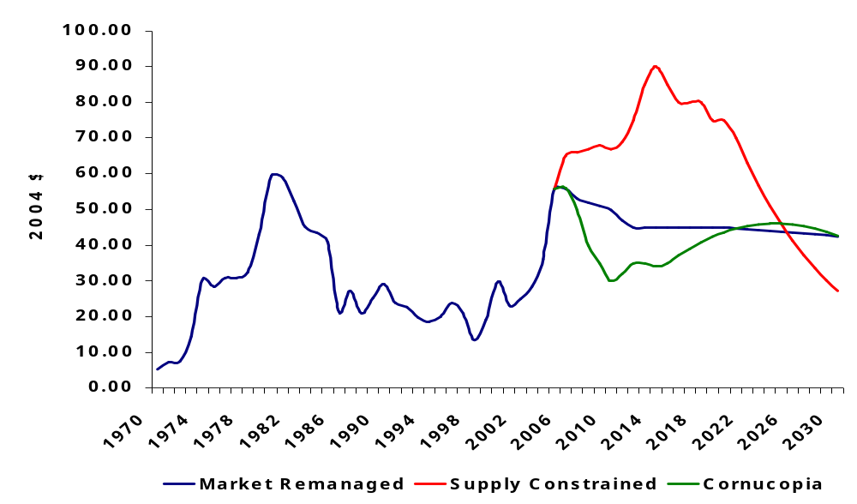
Global Insight Oil Price Scenarios

Slide 14


Thank you!
Thank you
Name
Title
E-mail: first.last@globalinsight.com
For additional information, please contact:
Kevin Lindemer
781 301 9059
Kevin.lindemer@globalinsight.com

