Slide 1

EIA’s Current View on LNG
Imports into the United States
Phyllis Martin
Senior Energy Analyst
U.S. Energy Information Administration
2006 EIA Energy Outlook and Modeling Conference
March 27, 2006
Washington, DC

Slide 2
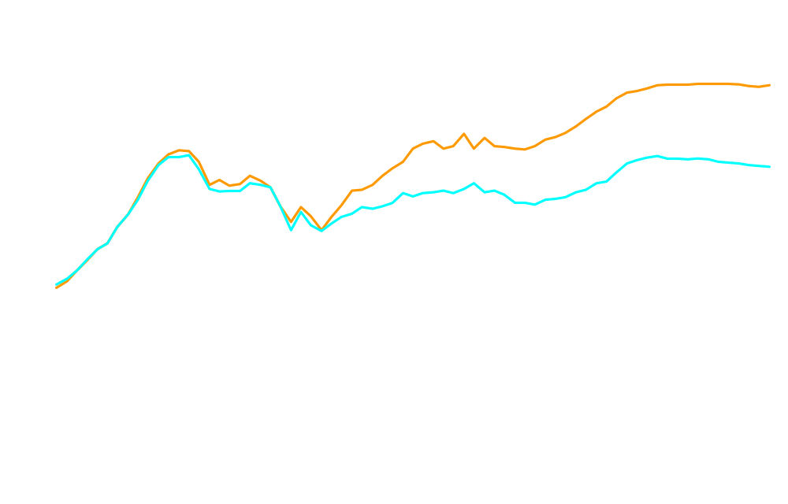
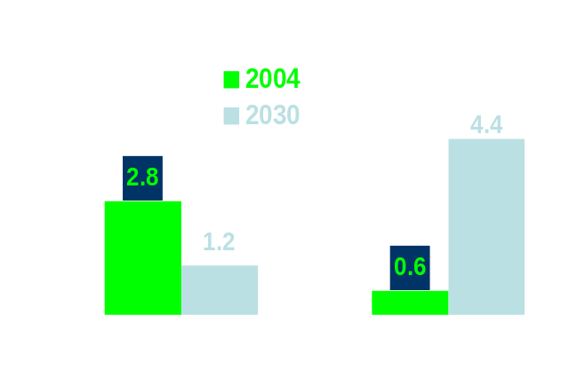
U.S. Natural Gas Production, Consumption, and Net Imports,
1960-2030 (trillion cubic feet)
History
Projections
26.9
22.4
Net Imports
21%
Consumption
15%
20.8
18.5
Production
Natural Gas Net Imports, 2004, 2025,
and 2030 (trillion cubic feet)
Average Wellhead Price
(dollars per thousand cubic feet)
2004 2030
2004 Dollars $5.49 $5.92
Nominal Dollars $5.49 $11.20
Annual Energy Outlook 2006

Slide 3
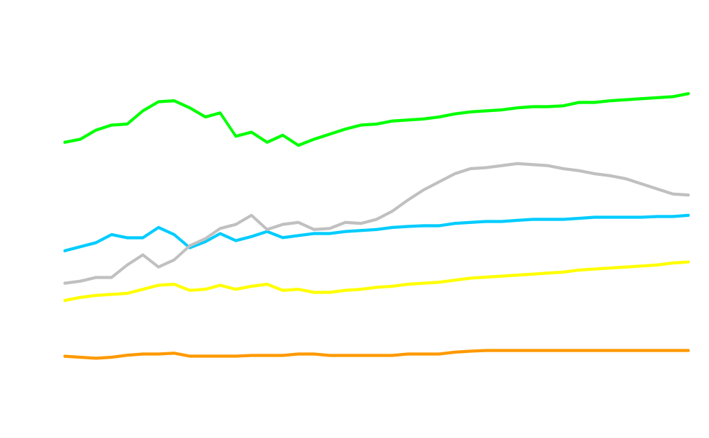
U.S. Natural Gas Consumption by Sector, 1990-2030
(trillion cubic feet)
History
Projections
Industrial*
10.0
8.5
Electric Generators
5.3
Residential
6.4
5.6
4.9
Commercial
4.0
3.0
Transportation**
0.7
0.9
* Includes lease and plant fuel
** Includes pipeline fuel
Annual Energy Outlook 2006

Slide 4
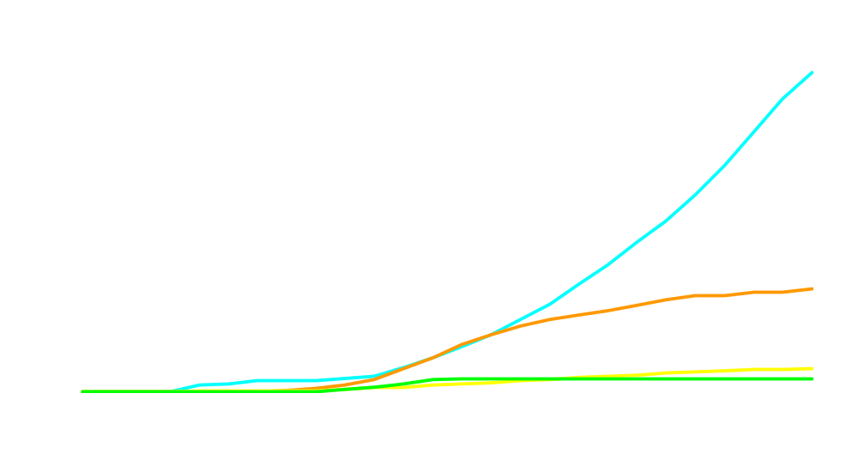
Unplanned Capacity Additions (Gigawatts)
145
Coal
NGCC
47
Nuclear
Renewables
10
6
Annual Energy Outlook 2006

Slide 5
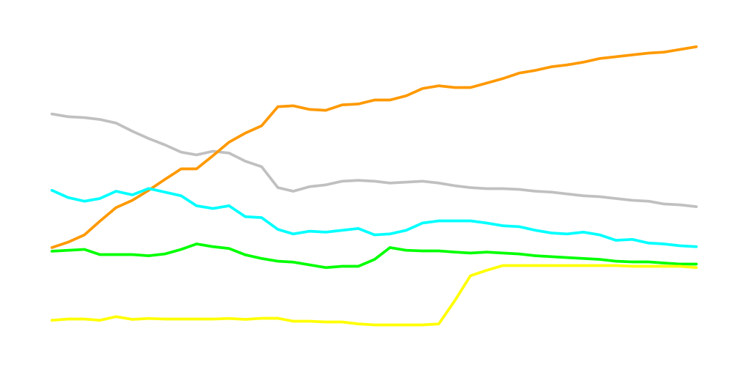
U.S. Dry Natural Gas Production,
1990 - 2030 (trillion cubic feet)
History
Projections
Onshore Unconventional
9.5
7.5
4.8
Nonassociated
Onshore Conventional
3.4
4.2
Non-associated Offshore
2.4
2.8
2.3
Associated/Dissolved
Alaska
2.1
0.4
Annual Energy Outlook 2006

Slide 6
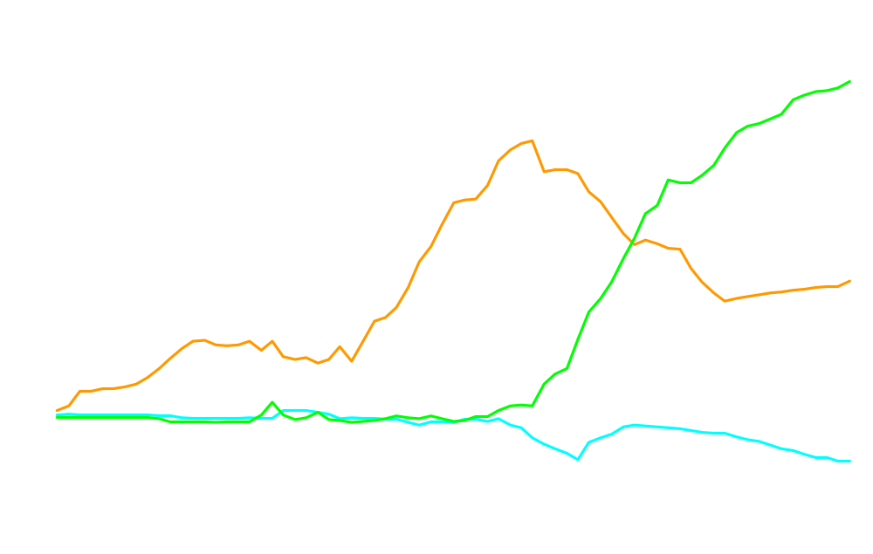
U.S. Net Imports of Natural Gas, 1960-2030
(trillion cubic feet)
History
Projections
4.4
Liquefied Natural Gas
3.2
Canada
1.8
0.6
Mexico
-0.4
-0.6
Annual Energy Outlook 2006

Slide 7

Major Sources of Incremental U.S. Natural Gas Supply,
2004-2030 (trillion cubic feet)
Growth in Alaskan Production
Growth in LNG Imports
Growth in
Non-Associated Unconventional
Base Production (all sources)
Annual Energy Outlook 2006

Slide 8
Current U.S. LNG Import Terminals
Everett, Massachusetts
Regasification Capacity:
Peak: 1.0 Bcf /day
Cove Point, Maryland
Regasification Capacity:
Peak: 1.0 Bcf /day
Lake Charles, Louisiana
Regasification Capacity:
Peak: 1.5 Bcf /day
Elba Island, Georgia
Regasification Capacity:
Peak: 1.2 Bcf/day
Gulf of Mexico, Offshore
Gulf Gateway Energy Bridge Regasification Capacity:
Peak: 500 MMcf /day
Source: Energy Information Administration

Slide 9

Natural Gas Imports, 1997-2007
(billion cubic feet)
LNG Imports:
2004: 650 Bcf
2005: 630 Bcf
2006: 830 Bcf
2007: 1,030 Bcf
History
Projections
Pipeline
LNG
__
___
Sources: History: EIA; Projections: Short-Term Energy Outlook March, 2006.

Slide 10
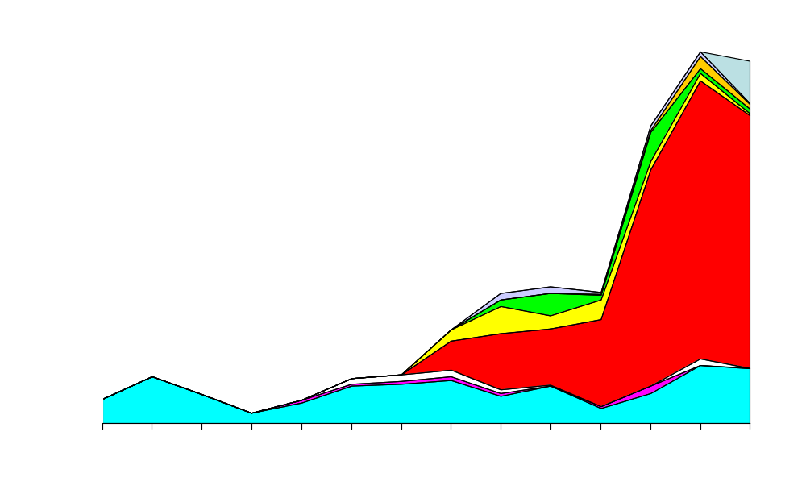
U.S. LNG Imports by Country, 1992-2005 (billion cubic feet)
Egypt
Malaysia
Trinidad and Tobago
Nigeria
Oman
Qatar
Australia
Other
Algeria
Source: EIA

Slide 11

U.S. LNG Imports, 1990-2025
(trillion cubic feet)
History
Projections
New terminals
Existing terminals
Annual Energy Outlook 2006

Slide 12
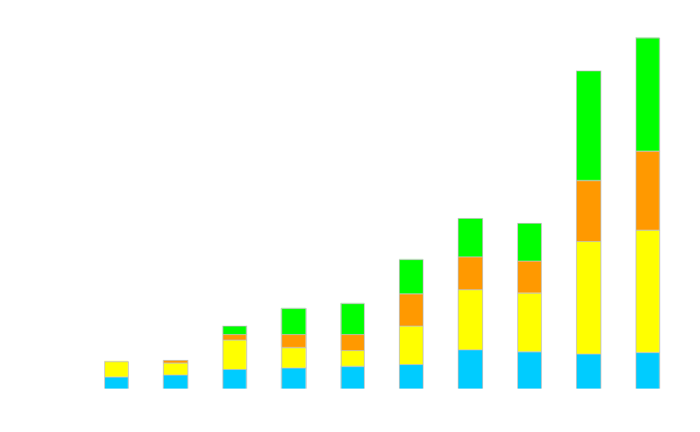
LNG Imports at Existing Onshore Terminals, 2000-2030
(billion cubic feet)
History
Projections
Cove Point, MD
Elba Island, GA
Lake Charles, LA
Everett, MA
Annual Energy Outlook 2006

Slide 13
FERC
Existing and Proposed
North American LNG Terminals
CONSTRUCTED
A. Everett, MA : 1.035 Bcfd (SUEZ/Tractebel - DOMAC)
B. Cove Point, MD : 1.0 Bcfd (Dominion - Cove Point LNG)
C. Elba Island, GA : 1.2 Bcfd (El Paso - Southern LNG)
D. Lake Charles, LA : 1.5 Bcfd (Southern Union - Trunkline LNG)
E. Gulf of Mexico: 0.5 Bcfd (Gulf Gateway Energy Bridge - Excelerate Energy)
APPROVED BY FERC
1. Lake Charles, LA: 0.6 Bcfd (Southern Union - Trunkline LNG)
2. Hackberry, LA : 1.5 Bcfd (Cameron LNG - Sempra Energy)
3. Bahamas : 0.84 Bcfd (AES Ocean Express)*
4. Bahamas : 0.83 Bcfd (Calypso Tractebel)*
5. Freeport, TX : 1.5 Bcfd (Cheniere/Freeport LNG Dev.)
6. Sabine, LA : 2.6 Bcfd (Cheniere LNG)
7. Corpus Christi, TX: 2.6 Bcfd (Cheniere LNG)
8. Corpus Christi, TX : 1.0 Bcfd (Vista Del Sol - ExxonMobil)
9. Fall River, MA : 0.8 Bcfd (Weaver's Cove Energy/Hess LNG)
10. Sabine, TX : 1.0 Bcfd (Golden Pass - ExxonMobil)
11. Corpus Christi, TX: 1.0 Bcfd (Ingleside Energy - Occidental Energy Ventures)
APPROVED BY MARAD/COAST GUARD
12. Port Pelican: 1.6 Bcfd (Chevron Texaco)
13. Louisiana Offshore : 1.0 Bcfd (Gulf Landing - Shell)
CANADIAN APPROVED TERMINALS
14. St. John, NB : 1.0 Bcfd (Canaport - Irving Oil)
15. Point Tupper, NS 1.0 Bcf/d (Bear Head LNG - Anadarko)
MEXICAN APPROVED TERMINALS
16. Altamira, Tamulipas : 0.7 Bcfd, (Shell/Total/Mitsui)
17. Baja California, MX : 1.0 Bcfd, (Energy Costa Azul - Sempra)
18. Baja California - Offshore : 1.4 Bcfd, (Chevron Texaco)
PROPOSED TO FERC
19. Long Beach, CA : 0.7 Bcfd, (Mitsubishi/ConocoPhillips - Sound Energy Solutions)
20. Logan Township, NJ : 1.2 Bcfd (Crown Landing LNG - BP)
21. Bahamas : 0.5 Bcfd, (Seafarer - El Paso/FPL )
22. Port Arthur, TX: 1.5 Bcfd (Sempra)
23. Cove Point, MD : 0.8 Bcfd (Dominion)
24. LI Sound, NY: 1.0 Bcfd (Broadwater Energy - TransCanada/Shell)
25. Pascagoula, MS: 1.0 Bcfd (Gulf LNG Energy LLC)
26. Bradwood, OR: 1.0 Bcfd (Northern Star LNG - Northern Star Natural Gas LLC)
27. Pascagoula, MS: 1.3 Bcfd (Casotte Landing - ChevronTexaco)
28. Cameron, LA: 3.3 Bcfd (Creole Trail LNG - Cheniere LNG)
29. Port Lavaca, TX: 1.0 Bcfd (Calhoun LNG - Gulf Coast LNG Partners)
30. Freeport, TX: 2.5 Bcfd (Cheniere/Freeport LNG Dev. - Expansion)
31. Sabine, LA: 1.4 Bcfd (Cheniere LNG - Expansion)
32. Hackberry, LA : 1.15 Bcfd (Cameron LNG - Sempra Energy - Expansion)
33. Pleasant Point, ME : 0.5 Bcfd (Quoddy Bay, LLC)
34. Robbinston, ME: 0.5 Bcfd (Downeast LNG - Kestrel Energy)
35. Elba Island, GA: 0.9 Bcfd (El Paso - Southern LNG)
PROPOSED TO MARAD/COAST GUARD
36. California Offshore: 1.5 Bcfd (Cabrillo Port - BHP Billiton)
37. So. California Offshore : 0.5 Bcfd, (Crystal Energy)
38. Louisiana Offshore : 1.0 Bcfd (Main Pass McMoRan Exp.)
39. Gulf of Mexico: 1.0 Bcfd (Compass Port - ConocoPhillips)
40. Gulf of Mexico: 1.5 Bcfd (Beacon Port Clean Energy Terminal - ConocoPhillips)
41. Offshore Boston, MA: 0.4 Bcfd (Neptune LNG - Tractebel)
42. Offshore Boston, MA: 0.8 Bcfd (Northeast Gateway - Excelerate Energy)
43. Gulf of Mexico: 1.4 Bcfd (Bienville Offshore Energy Terminal - TORP Technology)
15
14
34
33
26
A
41
9
42
24
20
B,23
36
19
37
18
C,35
17
6,31
28
2,32
25
21
5,30
22
D,1
27
43
3
4
7
8
10
38
39
11
40
E
29
13
16
12
US Jurisdiction
FERC
MARAD/USCG
As of March 8, 2006
* US pipeline approved;
LNG terminal pending in Bahamas
Office of Energy Projects

Slide 14
FERC
Potential North American
LNG Terminals
60
59
POTENTIAL U.S. SITES IDENTIFIED BY PROJECT SPONSORS
44. Coos Bay, OR: 0.13 Bcfd, (Energy Projects Development)
45. Offshore California: 0.75 Bcfd, (Chevron Texaco)
46. Offshore California: 0.75 Bcfd (OceanWay - Woodside Natural Gas)
47. St. Helens, OR: 0.7 Bcfd (Port Westward LNG LLC)
48. Galveston, TX: 1.2 Bcfd (Pelican Island - BP)
49. Philadelphia, PA: 0.6 Bcfd (Freedom Energy Center - PGW)
50. Astoria, OR: 1.0 Bcfd (Skipanon LNG - Calpine)
51. Boston, MA: 0.8 Bcfd (AES Battery Rock LLC - AES Corp.)
52. Calais, ME: ? Bcfd (BP Consulting LLC)
53. Baltimore, MD: 1.5 Bcfd (AES Sparrows Point – AES Corp.)
54. Offshore New York: 2.0 Bcfd (Safe Harbor Energy - ASIC, LLC)
55. Offshore Florida: ? Bcfd (Calypso SUEZ)
56. Offshore California: 0.6 Bcfd (Pacific Gateway - Excelerate Energy)
POTENTIAL CANADIAN SITES IDENTIFIED BY PROJECT SPONSORS
57. Quebec City, QC : 0.5 Bcfd (Project Rabaska - Enbridge/Gaz Met/Gaz de France)
58. Rivière-du- Loup, QC: 0.5 Bcfd (Cacouna Energy - TransCanada/PetroCanada)
59. Kitimat, BC: 0.61 Bcfd (Galveston LNG)
60. Prince Rupert, BC: 0.30 Bcfd (WestPac Terminals)
61. Goldboro, NS 1.0 Bcfd (Keltic Petrochemicals)
62. Énergie Grande-Anse QC: 1.0 Bcfd
POTENTIAL MEXICAN SITES IDENTIFIED BY PROJECT SPONSORS
63. Lázaro Cárdenas, MX : 0.5 Bcfd (Tractebel/Repsol)
64. Puerto Libertad, MX: 1.3 Bcfd (Sonora Pacific LNG)
65. Offshore Gulf, MX: 1.0 Bcfd (Dorado - Tidelands)
66. Manzanillo, MX: 0.5 Bcfd
67. Topolobampo, MX: 0.5 Bcfd
62
58
57
61
52
50
47
51
44
54
49
53
56
46
45
55
64
48
67
65
US Jurisdiction
FERC
MARAD/USCG
66
63
As of March 8, 2006
Office of Energy Projects

Slide 15
North American LNG Terminals
Existing, Under Construction, and Approved as of March 3, 2006
Existing: 5.235 Bcfd
A. Everett, MA : 1.035 Bcfd
B. Cove Point, MD : 1.0 Bcfd
C. Elba Island, GA : 1.2 Bcfd
D. Lake Charles, LA : 1.5 Bcfd
E. Gulf Gateway Energy Bridge: 0.5 Bcfd
Total: 5.235 Bcfd
Tcf/yr: US: 1.9 Tot: 1.9
New Terminals Under Construction: 9.3 Bcfd
1. Freeport, TX, U.S. : 1.5 Bcfd
2. Sabine, LA, U.S. : 2.6 Bcfd
3. Hackberry, LA, U.S. : 1.5 Bcfd
4. St. John, NB, Canada : 1.0 Bcfd
5. Point Tupper, NS, Canada 1.0 Bcfd
6. Altamira, Tamulipas, Mexico: 0.7 Bcfd
7. Baja California, Mexico : 1.0 Bcfd
Total: 9.3 Bcfd
Tcf/yr: US: 2.0, Can: 0.7, Mex: 0.6, Tot: 3.4
Approved Projects: 11.0 Bcfd
D. Lake Charles Expansion: 0.6 Bcfd
8. Corpus Christi, TX, U.S.: 2.6 Bcfd
9. Corpus Christi, TX, U.S. : 1.0 Bcfd
10. Fall River, MA, U.S. : 0.8 Bcfd
11. Sabine, TX, U.S. : 1.0 Bcfd
12. Corpus Christi, TX, U.S.: 1.0 Bcfd
13. Port Pelican: 1.6 Bcfd
14. Louisiana Offshore : 1.0 Bcfd
15. Baja California - Offshore : 1.4 Bcfd
Total: 11.0 Bcfd
Tcf/yr: US: 3.5, Mex: 0.5, Tot: 4.0
5
4
A
10
B
15
C
7
3
1
2
D
8
9
11
12
E
14
13
Existing
Under Construction
Approved
6
Source: FERC Office of Energy Projects, EIA

Slide 16
LNG Cases

Slide 17
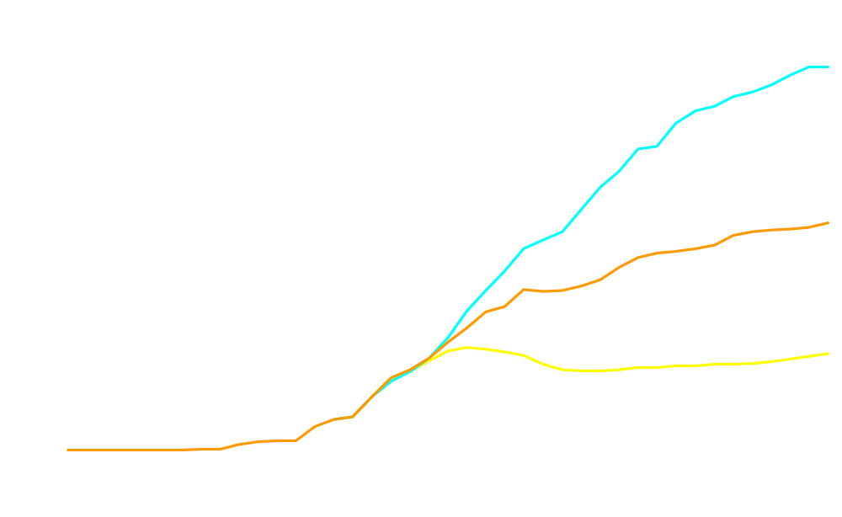
Net Imports of Liquefied Natural Gas,
1990-2030 (trillion cubic feet)
History
Projections
7.37
Low World Oil
Price ($33.73)*
4.36
Reference World
Oil Price ($56.97)*
1.85
High World Oil
Price ($95.71)*
2030 price for foreign low-sulfur
crude oil in 2004 dollars per barrel
Annual Energy Outlook 2006

Slide 18
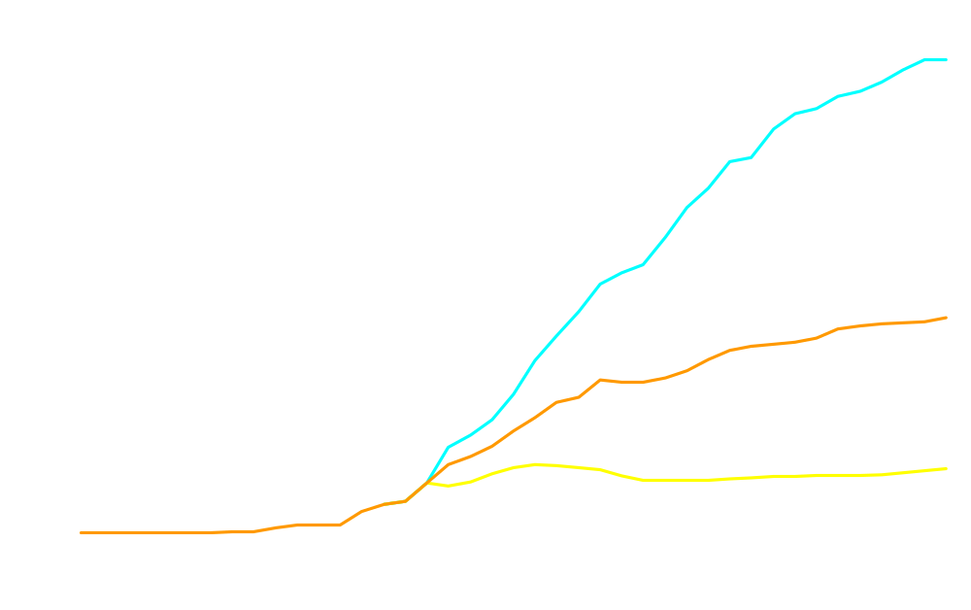
Net Imports of Liquefied Natural Gas,
1990-2030 (trillion cubic feet)
History
Projections
9.58
High LNG
4.36
Reference
1.30
Low LNG
Annual Energy Outlook 2006

Slide 19
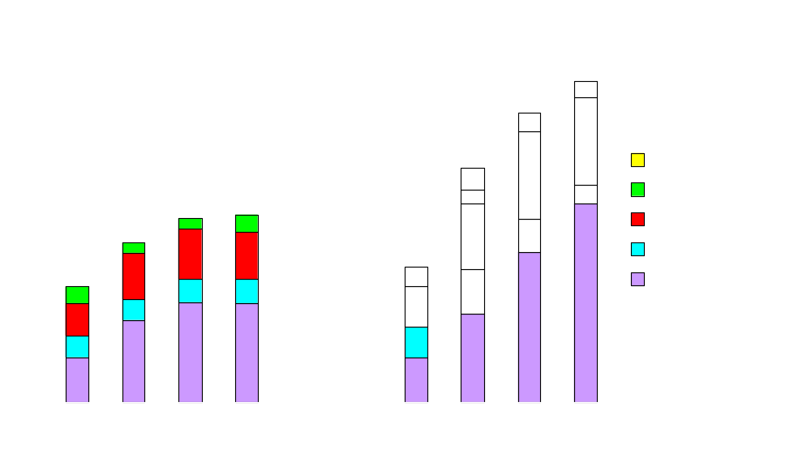
Change in Consumption and Supply in Response to Change in LNG Imports from Reference Case Levels (trillion cubic feet)
decrease in LNG imports
increase in LNG imports
solid bar – increase relative
to reference
stripped bar – decrease relative
to reference
Low LNG Case
High LNG Case
Annual Energy Outlook 2006

Slide 20
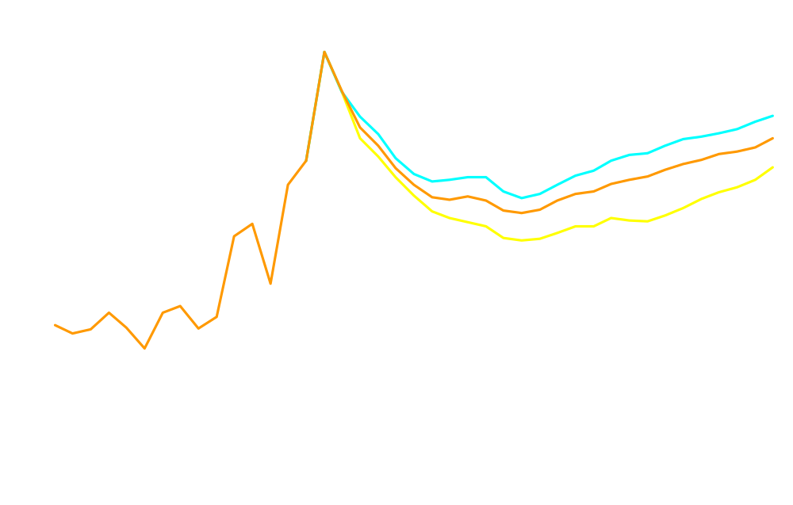
Lower 48 Natural Gas Wellhead Prices,
1990-2030 (2004 dollars per Mcf)
History
Projections
6.36
5.92
Low LNG
Reference
5.35
High LNG
Annual Energy Outlook 2006

Slide 21
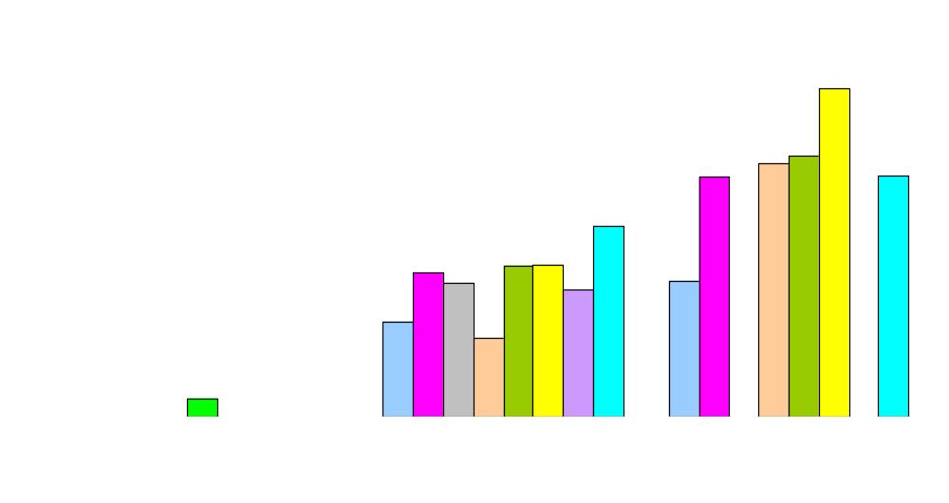
Comparison of Net LNG Import Forecasts
(trillion cubic feet)
History
Projections
PIRA
EEA
EVA
Altos
GII
EIA
SEER
DB
Annual Energy Outlook 2006

Slide 22
Annual Energy Outlook 2006 indicates that through 2030....
Imports are expected to play an important role in U.S. natural gas markets, accounting for 21 percent of total U.S. natural gas consumption in 2030, compared with 15 percent in 2004
LNG imports are projected to grow from 650 billion cubic feet in 2004 to 4.4 trillion cubic feet in 2030, with net LNG imports rising from 17 percent of net imports in 2004 to 78 percent in 2030
The most rapid growth in LNG import capacity will occur over the next decade, with peak annual capacity increasing from 1.4 trillion cubic feet in 2004 to 4.9 trillion cubic feet in 2015
Construction of new terminals is expected to slow after 2015 as rising natural gas prices limit consumption, especially in the electric generators sector, with peak annual import capacity reaching 5.8 trillion cubic feet in 2030
World oil markets have a strong influence on the U.S. LNG market
Wide variations in the amount of LNG imported have only moderate impacts on domestic natural gas prices

Slide 23

Periodic Reports
Short-Term Energy Outlook, monthly
Annual Energy Outlook 2006, February 2006
International Energy Outlook 2005, July 2005
Phyllis.Martin
Phyllis.Martin@eia.doe.gov
202-586-9592
www.eia.doe.gov

