Slide 1
Unconventional Natural Gas:
Industry Savior or Bridge
Unconventional Gas Production Projections in
the Annual Energy Outlook 2006: An Overview
Ted McCallister
Energy Information Administration
ted.mccallister@eia.doe.gov
202-586-4820
EIA Midterm Energy Outlook
and Modeling Conference
Washington, DC
March 27, 2006

Slide 2
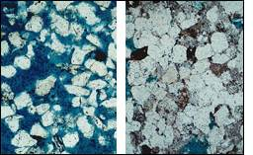
High Permeability
Sandstone
Low Permeability
Sandstone

Slide 3
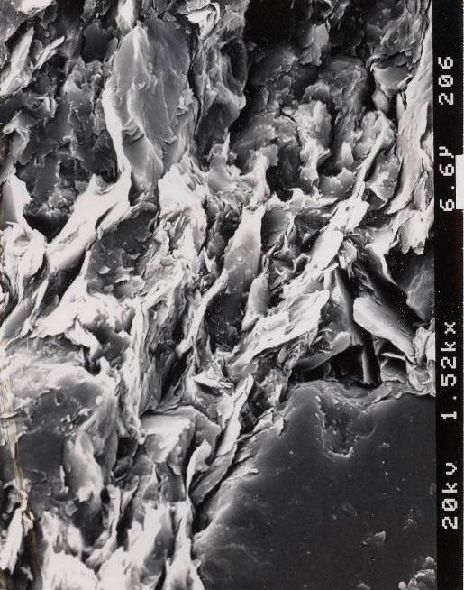
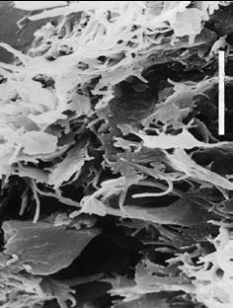

Fractured Shale
Unfractured Shale

Slide 4

Coalbed Methane Well
Water to Treatment Disposal Facility
Methane to Compression Pipeline
Pipe is Cemented in Place
To Protect Groundwater
Methane
Methane
Water
Coal
Coal
Coal
Coal
Collection Point for Water
Surface Pump Takes Water Out of Well

Slide 5
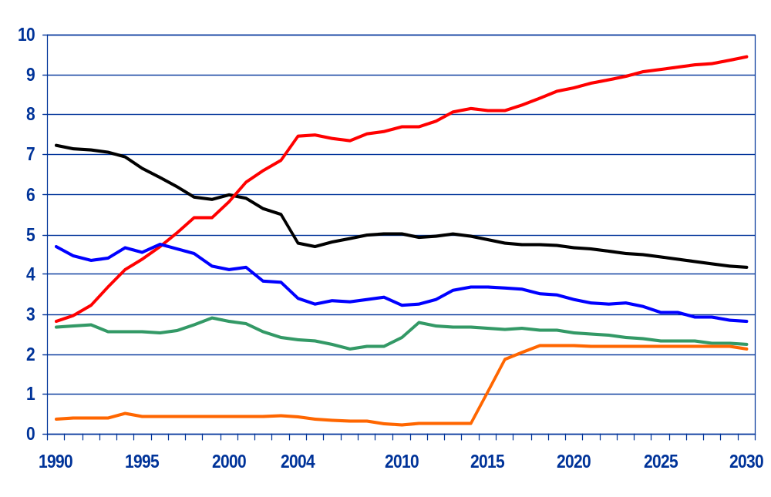
Natural Gas Production by Source 1990-2030
(Trillion Cubic Feet)
History
Projections
Lower 48 Non-Associated Unconventional
Lower 48 Non-Associated Conventional Onshore
Lower 48 Non-Associated Offshore
Lower 48 Associated-Dissolved
Alaska

Slide 6
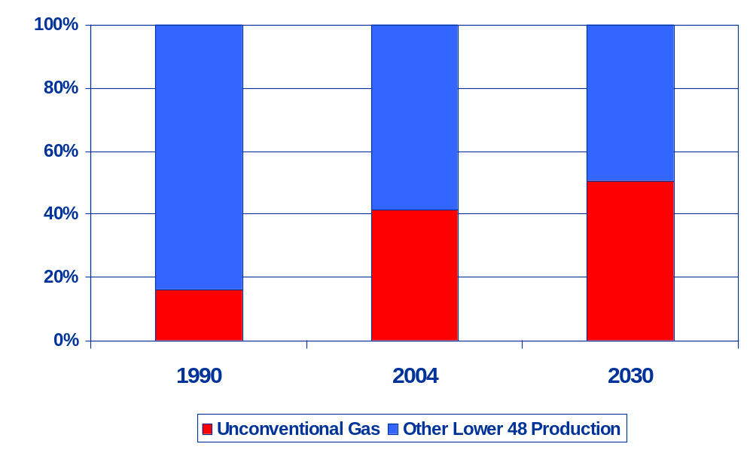
Unconventional Gas Share of Lower 48 Production
51%
41%
16%

Slide 7
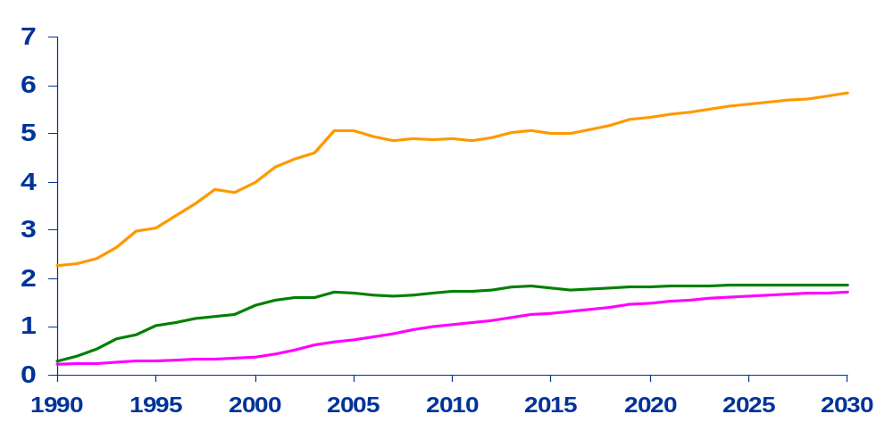
U.S. Unconventional Natural Gas Production,
1990-2030 (trillion cubic feet)
History
Projections
Tight sands
Coalbed methane
Gas shales

Slide 8
Cumulative Unconventional Gas Production by Region, 2003-2030 (Trillion Cubic Feet)
Rocky Mountain
West Coast
64
39
3
Midcontinent
Northeast
11
DC
9
4
2
14
Southwest
21
43
Gulf Coast
7
2
Coalbed Methane
Gas Shales
Tight Sands

Slide 9
Coalbed Methane Resources by Region as of January 1, 2004
Rocky Mountain
West Coast
59
Midcontinent
Northeast
DC
14.87
6
8
.68
1.53
Southwest
Gulf Coast
2
1.66
Proved Reserves
[Trillion Cubic Feet]
Undeveloped Technically Recoverable
Resources [Trillion Cubic Feet]

Slide 10
Gas Shales Resources by Region as of January 1, 2004
Rocky Mountain
West Coast
Midcontinent
Northeast
14
DC
.25
29
5.21
Southwest
Gulf Coast
40
3.07
Proven Reserves
[Trillion Cubic Feet]
Undeveloped Technically Recoverable
Resources [Trillion Cubic Feet]

Slide 11
Tight Gas Resources by Region as of January 1, 2004
<1
0.00
Rocky Mountain
West Coast
164
Midcontinent
Northeast
DC
12
56
30.00
5.09
5.44
Southwest
9
Gulf Coast
2.97
59
16.58
Proven Reserves
[Trillion Cubic Feet]
Undeveloped Technically Recoverable
Resources [Trillion Cubic Feet]

Slide 12
