Slide 1
“If Not Gas, Then ...”
The Role of Nuclear Power in a Diversified Electricity Supply Portfolio
27 MARCH 2006

Slide 2
Outline
From EPAct 1992 to EPAct 2005: Lessons learned
Nuclear power and the Energy Policy Act of 2005
New nuclear plant construction: Current status and prospects

Slide 3
The Bottom Line
The lesson of the last 15 years in U.S. electricity policy:
  Diversified fuel and technology portfolio is highly desirable, if not essential
  All fuels and technologies (nuclear, coal, natural gas, renewables, efficiency) have a legitimate role
The challenge for the next 15 years and beyond:
  Preserving/restoring diversified portfolio
  Defining appropriate roles for the various fuels and technologies

Slide 4
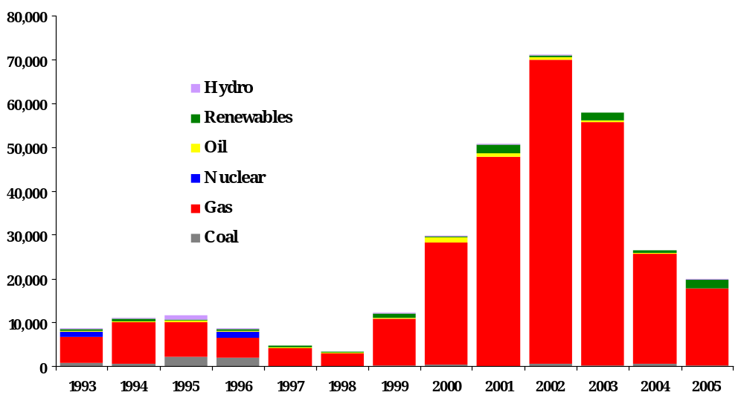
From EPAct 1992 to EPAct 2005: Generating Capacity Online (1993-2005)
Megawatts
Source: Global Energy Decisions

Slide 5
The “Dash to Gas” Since ’92: Why?
U.S. entered the 1990s heavy on baseload
  Needed mid-merit, peaking capacity
At $2-2.50/million Btu, natural gas was inexpensive
No recognition of supply constraints
But mostly, gas-fired generating capacity represented lowest investment risk at a time of punishing business uncertainty
  Industry structure
  Market design

Slide 6
The Last 15 Years: Investment in Electric Infrastructure Collapsed
With industry restructuring, significant investment, but only “churning” existing assets
Investment in new coal and nuclear generating capacity all but disappeared, even though they represent ...
New Generating Capacity: 1992-2005
Coal | 8,044 MW
Gas | 288,576 MW
Nuclear | 2,485 MW
Oil | 4,933 MW
Renewables | 9,983 MW
Hydro | 2,629 MW
Other | 223 MW
  70 percent of U.S. electricity supply
  Greatest forward price stability
Something wrong with this picture

Slide 7
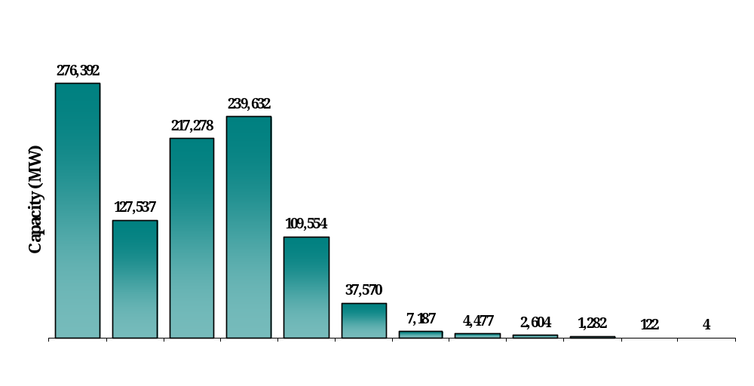
The “Graying” of the Infrastructure:
Age of Generating Capacity
Approx. 240 GW (∼25% of installed capacity) 30-40 years old
Approx. 110 GW (∼10% of installed capacity) 40-50 years old
< 10
10-20
20-30
30-40
40-50
50-60
60-70
Plant Age

Slide 8
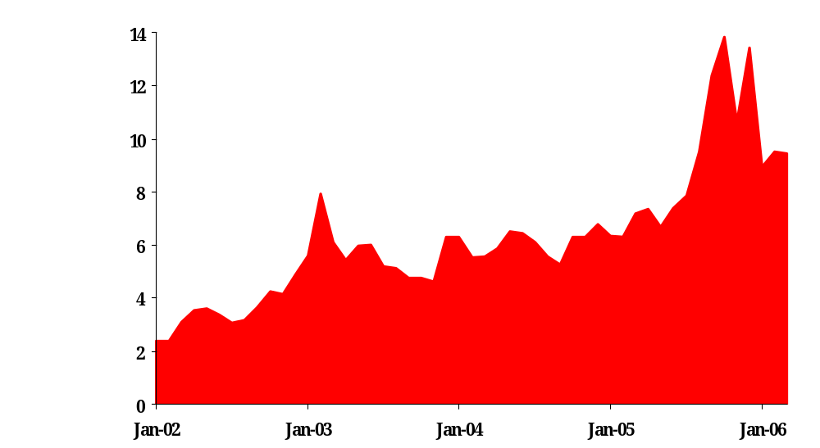
The Gas-Fired Boom and Bust
Massive build of gas-fired capacity: Unsustainable pressure on gas supply and price
  Periods of punishing volatility
U.S. Natural Gas Spot Prices
(dollars per thousand cubic feet)
  Damage to other industries (chemicals, steel, plastics, etc.)
New gas-fired combined cycle capacity running today at ∼35% capacity factor

Slide 9
The Challenge Today: Addressing the Energy Investment Crisis
Resurrecting coal and nuclear investment
  Coal: 4 GW under construction, 70 GW in development
  Nuclear: 20 GW in development
Resurrecting investment in electric and gas transmission:
  Electric: Steady decline since late-1970s ($4.0-4.5 billion/year); bottomed out through 1990s (∼$2.5 billion/year); now turning around
  Gas: Averaged $2.8 billion/year 2000-2002; should increase to $8 billion/year (NPC study)
Developing workable approaches to ensure resource adequacy

Slide 10
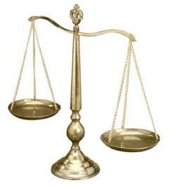
What Is Driving the Interest
In New Nuclear Construction?
Growing need for baseload generation
  Reserve margins down in 2005 for first time in a decade
Increasing environmental constraints and compliance costs, potential controls on carbon emissions
Chronic volatility in natural gas prices
U.S. Electricity Supply: 2004 - 2005
New Supply: 15 GW
Peak Demand Growth: 33.5 GW
Retirements: 10.1 GW
Mothballed: 1.8 GW

Slide 11
Near-Term Need for New Capacity
Projected Excess Capacity by NERC Region, 2005–12, Including Power Plants Under Construction (megawatts)
Region | 2007 | 2008 | 2009 | 2010 | 2011 | 2012
New England | 1,933 | 1,241 | 535 | 0 | 0 | 0
New York | 1,099 | 0 | 0 | 0 | 0 | 0
MAAC | 0 | 0 | 0 | 0 | 0 | 0
ECAR | 10,876 | 8,759 | 6,998 | 4,827 | 2,251 | 0
MAIN | 5,809 | 5,715 | 5,061 | 4,431 | 3,660 | 2,246
MAPP-US | 2,267 | 1,319 | 906 | 205 | 0 | 0
VACAR | 0 | 0 | 0 | 0 | 0 | 0
Southern | 3,079 | 1,762 | 1,173 | 0 | 0 | 0
TVA | 2,190 | 1,318 | 427 | 0 | 0 | 0
Entergy | 16,134 | 15,111 | 14,500 | 14,458 | 13,788 | 13,105
FRCC | 2,086 | 862 | 0 | 0 | 0 | 0
SPP | 5,681 | 4,759 | 3,825 | 2,879 | 1,836 | 792
ERCOT | 6,665 | 5,242 | 3,783 | 1,995 | 468 | 0
WECC-US | 14,191 | 9,808 | 7,521 | 4,469 | 1,238 | 0
US Total | 72,010 | 55,897 | 44,729 | 33,265 | 23,241 | 16,143
Source: Cambridge Energy Research Associates and EV Power ®, Global Energy Decisions, Inc.
Notes: (1) Required reserve margin assumed to be 18 percent in New England, New York, PJM, WECC, and FRCC; otherwise it is 15 percent; (2) Includes only known scheduled retirements.

Slide 12
Energy Legislation Provides
Investment Stimulus for New Plants
Federal loan guarantees
  Covers up to 80% of project cost
  Allows more highly leveraged capital structure
  Reduces project cost
Production tax credits
  $18/MWh for up to 6,000 MW
  Worth up to $125 million in tax credits per year for
  8 years for 1,000 MW of capacity

Slide 13
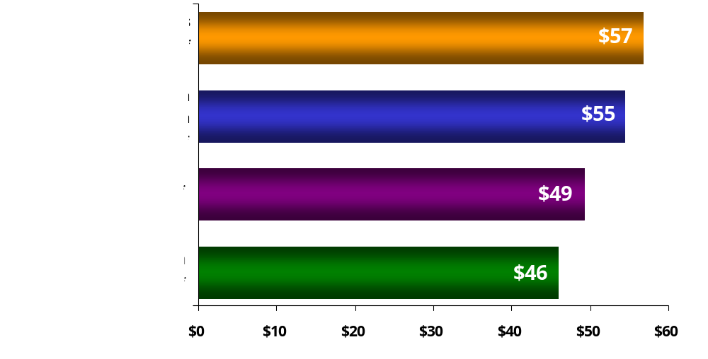
Investment Stimulus Offsets
Higher Cost of First New Plants
Estimated Electricity Costs for New Generating Capacity
*Assumes 15% cost of equity, 8% cost of debt and a 50/50 debt/equity structure.
**Assumes 15% cost of equity, 6% cost of debt and an 80/20 debt/equity structure.
Source: NEI analysis of first-year operating costs using EIA data

Slide 14
Containing the Perceived Risk
Of First New Nuclear Plants
New licensing process reduces risk of delay
  Project developers will have regulatory approvals before significant capital spent
Federal standby support
  Provides $2 billion of risk coverage for first six plants
  Covers delays resulting from licensing or litigation

Slide 15
Substantial Flexibility in Structuring, Financing New Nuclear Projects
Regulated companies:
  in cost-of-service states, companies will build new nuclear plants as rate-base projects
  conservative capital structure (50/50 debt/equity)
  Substantial investment protection: Reasonable assurance that all costs prudently incurred recovered through electric rates
Unregulated generating companies:
  merchant projects, highly leveraged (80/20 debt/equity)
  financing supported by long-term power purchase agreements and federal loan guarantees

Slide 16
Status of New Plant Licensing
Company | Design | Units | Date for Filing COL Application
Dominion | ESBWR | 1 | 2007
NuStart Energy (TVA) | AP1000 | 2 | 2007
NuStart Energy (Entergy) | ESBWR | 1 | 2007/2008
Entergy | ESBWR | 1 | 2008
Southern Co. | AP1000 | 1-2 | 2008
Progress Energy | AP1000 | 2-4 | 2007
South Carolina Electric & Gas | AP1000 | 1-2 | 2007
Duke Energy | AP1000 | 2 | 2008
UniStar Nuclear | U.S. EPR | 1-4 | 2008

Slide 17
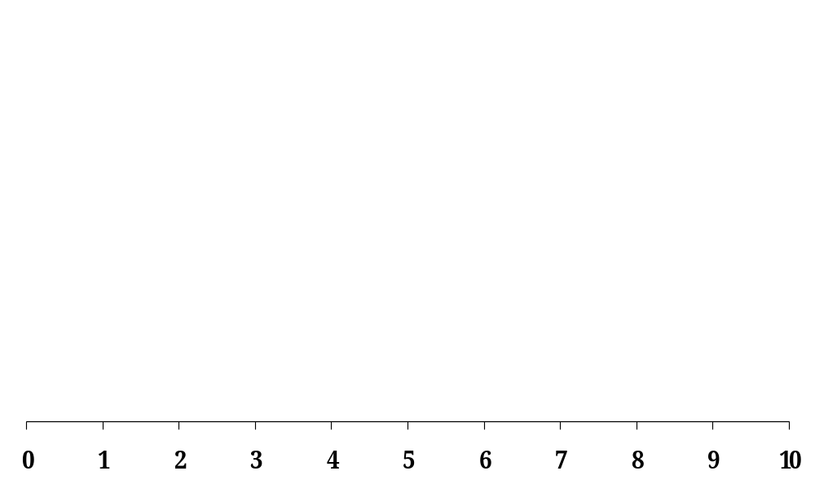
Roadmap to Commercial Operation
Building a new nuclear plant is not a one-step process or decision: It is a sequence of 3 successive decisions
1
First Decision: To file an application for a COL
Second Decision: Long-lead procurement
of major components and commodities
2
3
Third Decision: Proceed
with construction
Years (estimates)

Slide 18
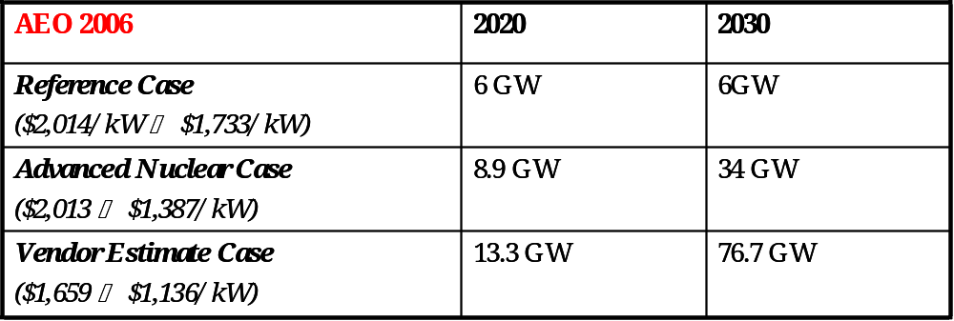
Nuclear Plant Build Rates
CERA ($2,000 - $2,350/kW) | 2020
Shades of Green | 9GW
World in Turmoil | 0
Technology Enhanced | 18 GW
Rearview Mirror | 7 GW

Slide 19
How Much Nuclear Power Do We Need?
Electricity demand in 2030 will be 45% greater
than today
To maintain current electric fuel supply mix would mean building:
50
Nuclear reactors (1,000 MW)
261
Coal-fired plants (600 MW)
279
Natural gas plants (400 MW)
93
Renewables (100 MW)
Source: 2006 Annual Energy Outlook, Energy Information Administration

Slide 20
Looking Ahead: What’s the Next Big Thing?
On the verge of a major build cycle in the U.S.:
  ∼75 GW of new coal-fired capacity
  ∼20 GW of new nuclear capacity
  ∼10-15 new LNG regasification terminals
  Gas pipeline from Alaska, plus significant expansion of lower-48 pipeline network
  And other critical infrastructure (roads, bridges, cities)
  And around the world (China, India, etc.)

Slide 21
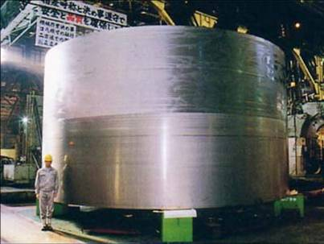
Materials, Manufacturing: The Next Big Thing?
To support a major build cycle takes:
  Commodities (structural and specialty steels, concrete, etc.)
  Pipe, compressors, valves, tubing, vessels, steam generators, pumps, steam turbines, reactor vessels, forgings, etc.
24’ Diameter x 13’ High: 127 Tons
Has anyone done a global inventory of capacity available to support new build cycle across entire energy sector?
Example: Only one supplier (Japan Steel Works) worldwide for ultra-large ring forgings used to fabricate reactor pressure vessels

