Slide 1
2006 EIA Energy Outlook & Modeling Conference
March 27, 2006
Panel: The Future Relationship of Oil & Natural Gas Prices in the US
John B. Parry (VP/Senior Analyst)
Dr. John T. Malone (VP/Senior Analyst)
John S. Herold, Inc

Slide 2
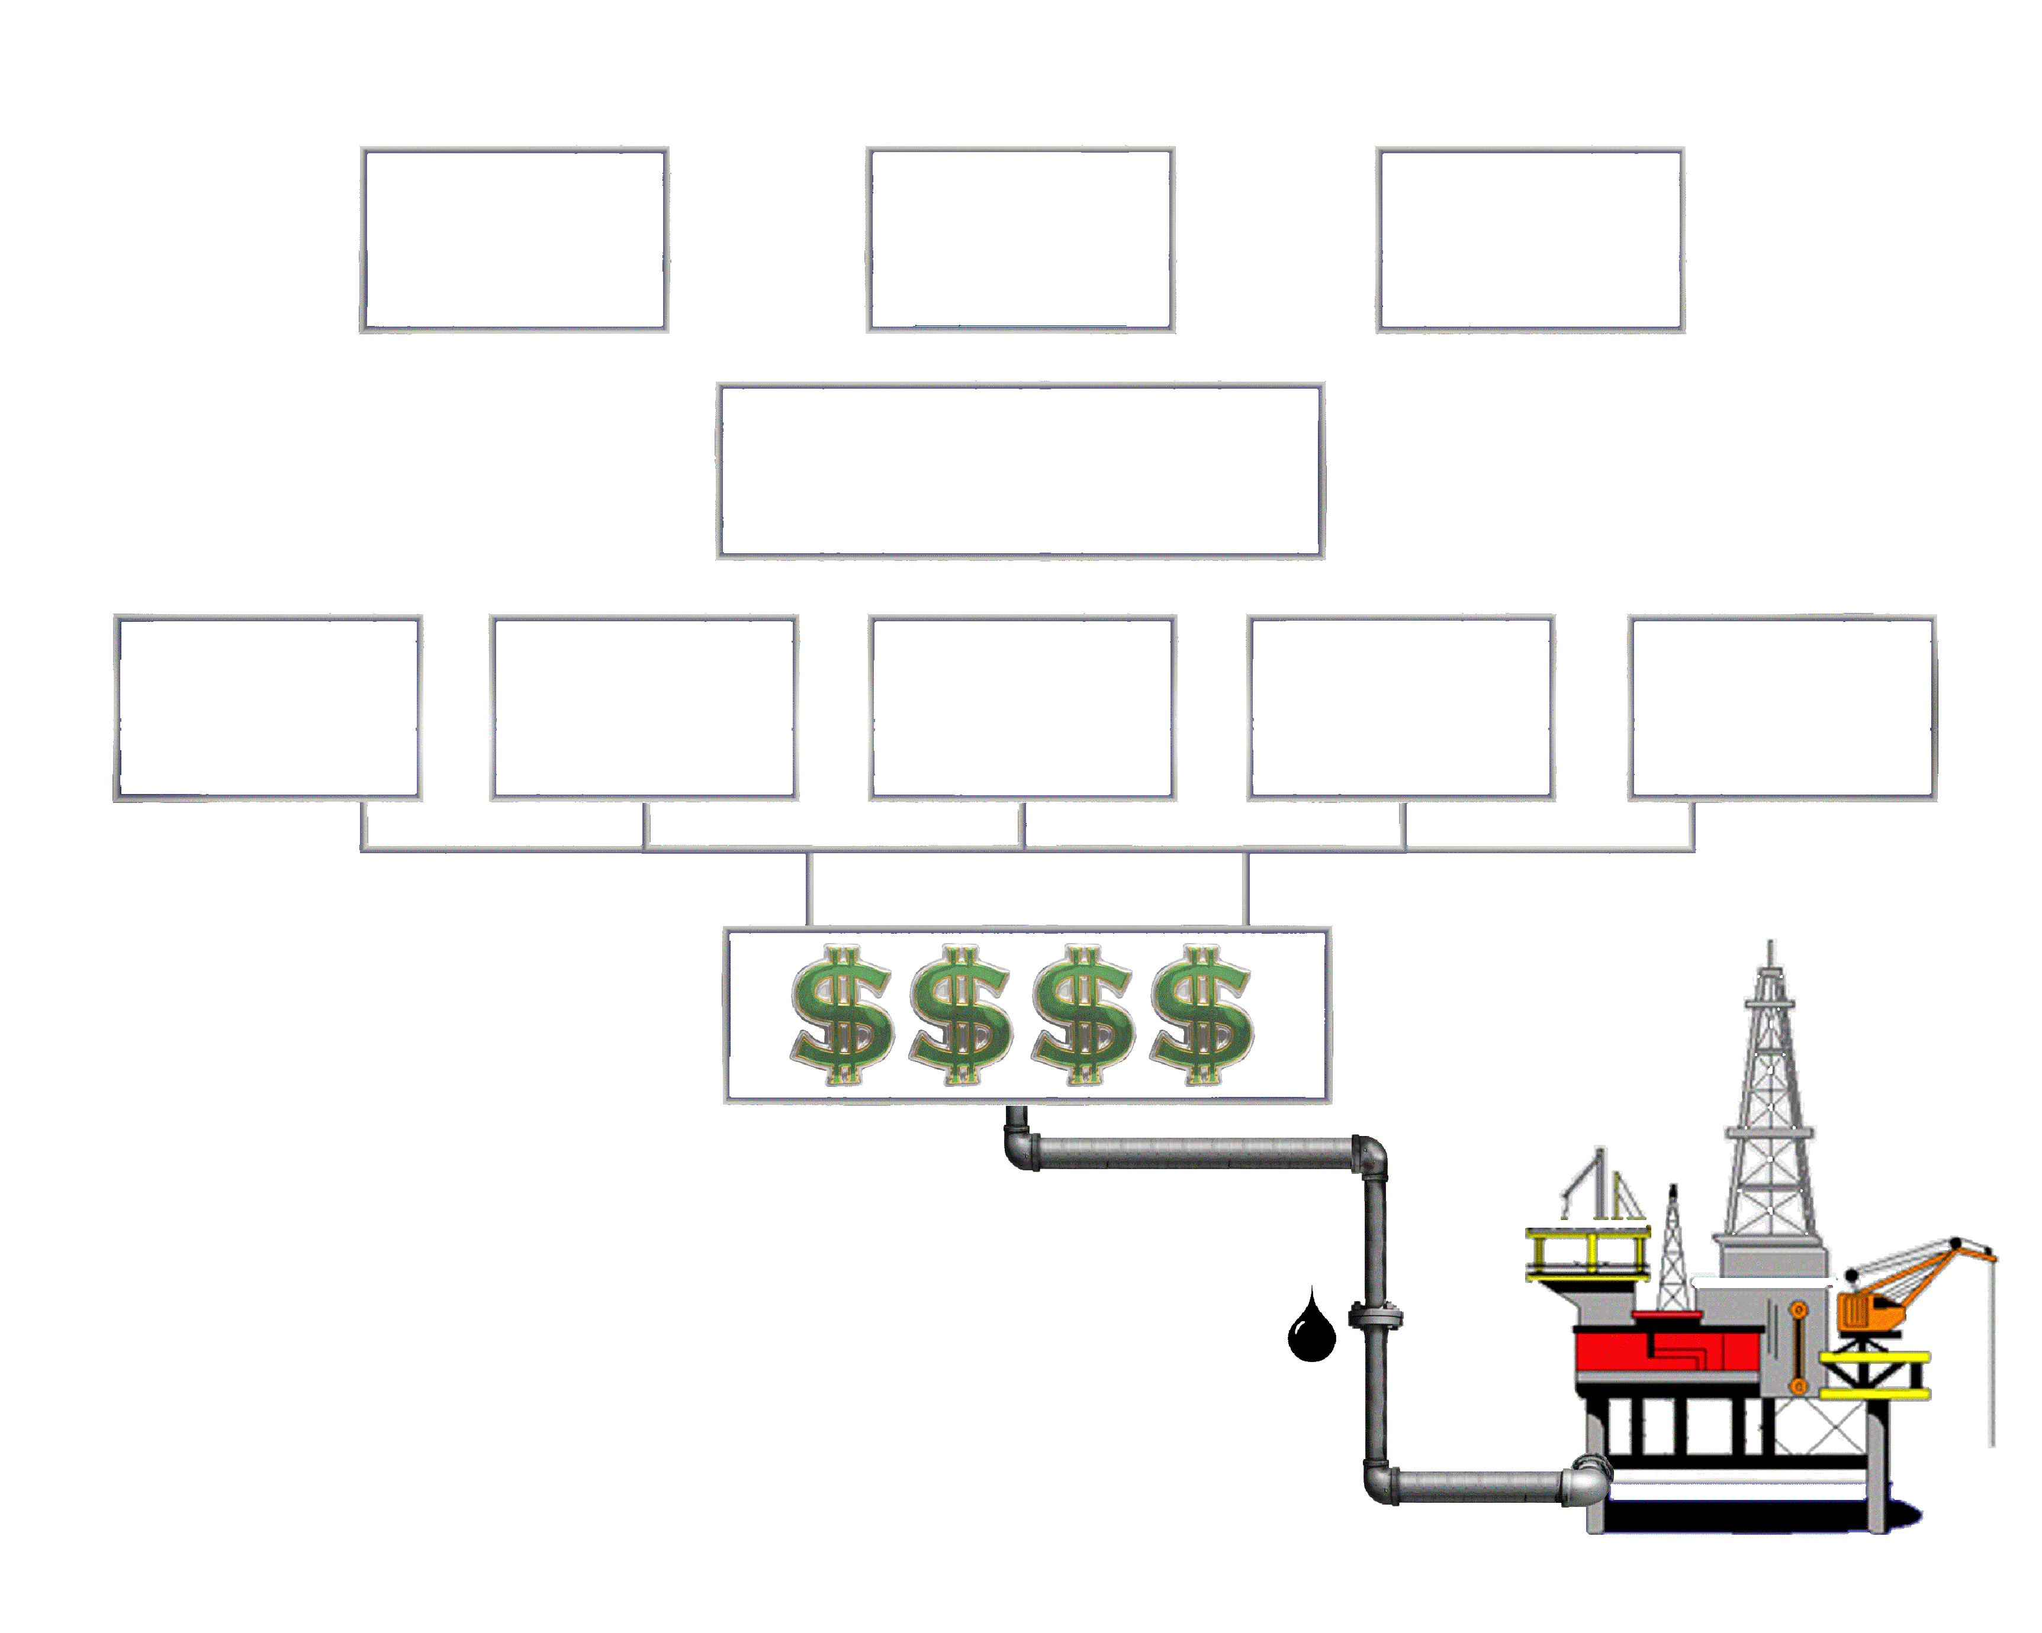
What does John S. Herold Do?
OUR CLIENTS
Dividends
Interest Payments
Capital Providers
Equity Investors
Debt Investors
Credit Providers
Equity
Debt
Financial Intermediaries
Credit
Investment Banks
Capital
Oil Companies
BP plc
TOTAL
ExxonMobil
Shell
Lukoil
Where is Capital Flowing?
What Have the Returns Been?
What Will the Returns Be?

Slide 3
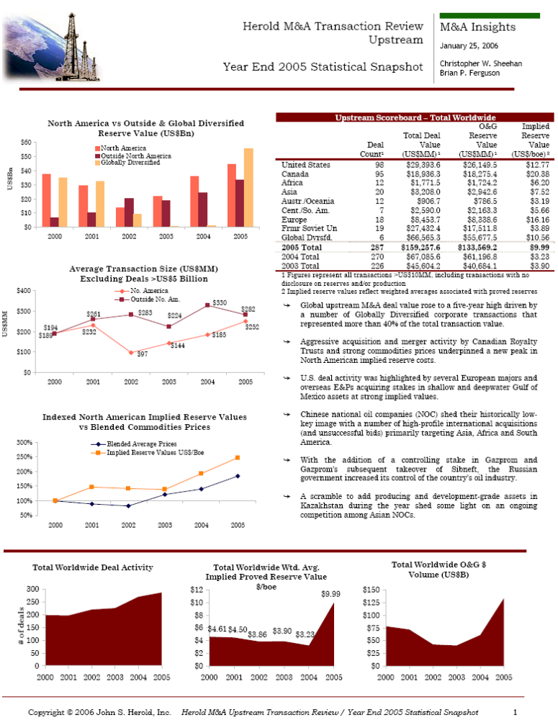

Slide 4
Summary
Tightened spare world crude oil & refining capacity expected to maintain ALL energy price levels near 2004/05 levels in near to medium term
Short-term US oil/gas price ratio likely to average in upper range of past ten years; longer term ratio expected to trend upwards if LNG successfully bridges widening US supply/demand gap at competitive prices
Above ground inventories will continue to influence shorter-term price swings for US oil & gas; post-hurricane(s) price spike driven by future inventory concerns
Oil-indexed pricing for European gas means strong competition for LNG supply to the US for the foreseeable future – Atlantic Basin/Middle East LNG economics expected to be increased factor in future US oil/gas price ratio

Slide 5
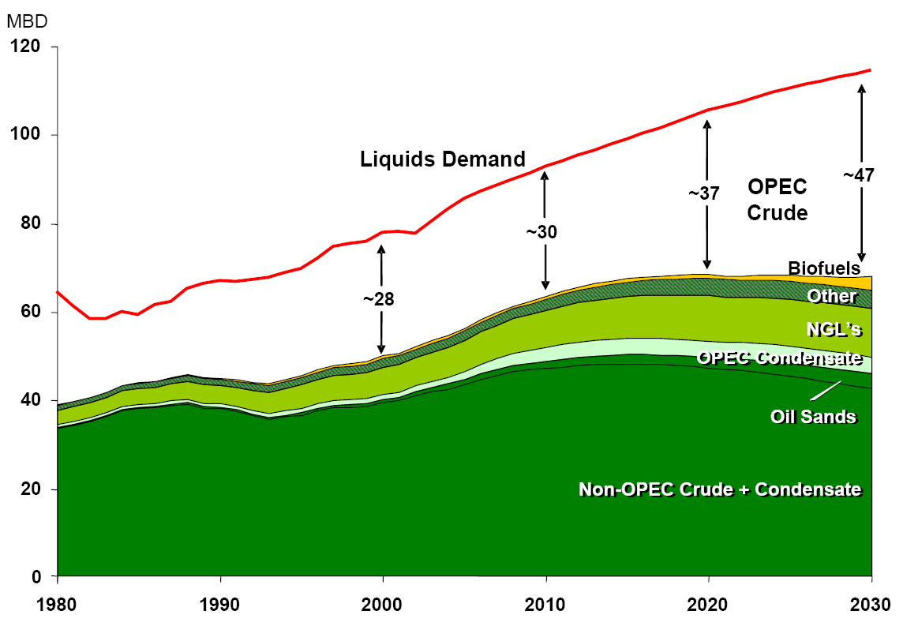
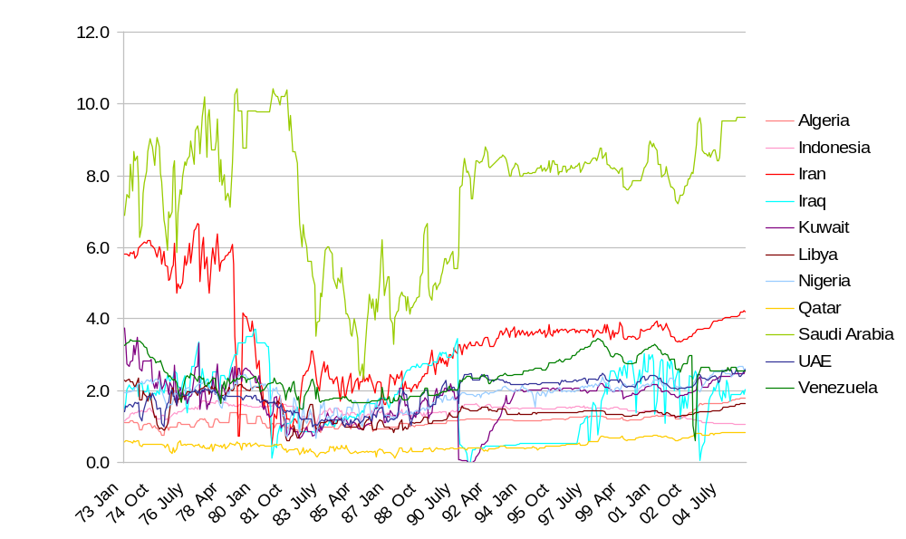
Call on OPEC
OPEC Production
(1973-current)
Liquids Demand vs. Supply
*MMBoe
Source: ExxonMobil Energy Outlook Dec. 2005
Source: EIA

Slide 6
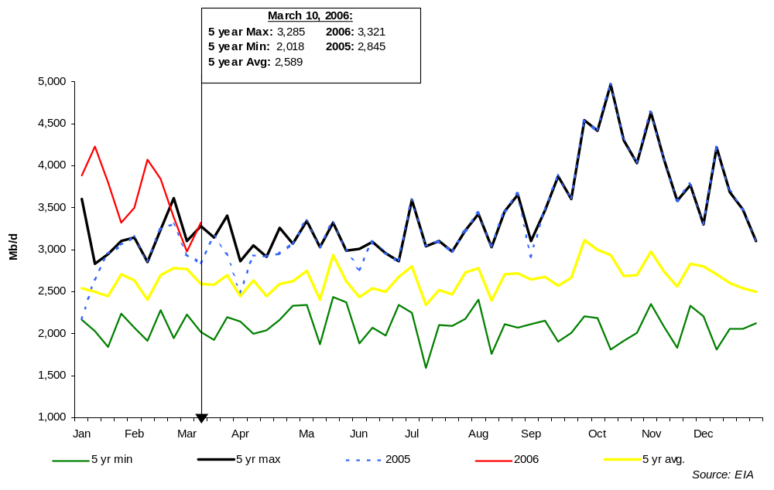
US Refined Product Imports

Slide 7
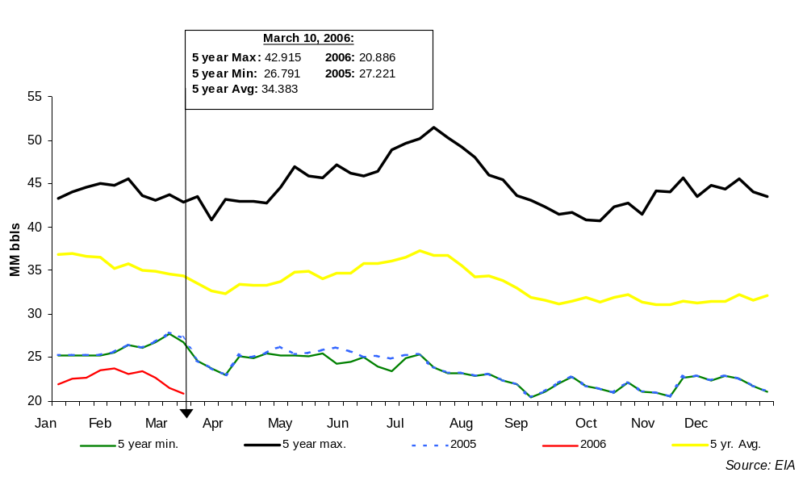
US Reformulated Gasoline Inventories

Slide 8
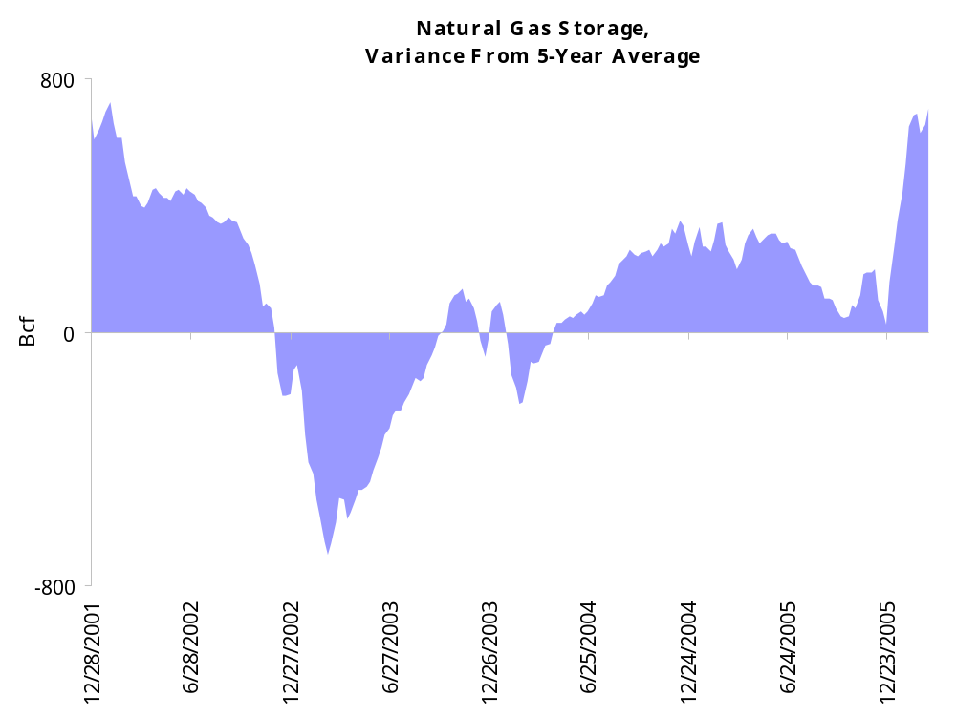
Storage at Seasonal Highs

Slide 9
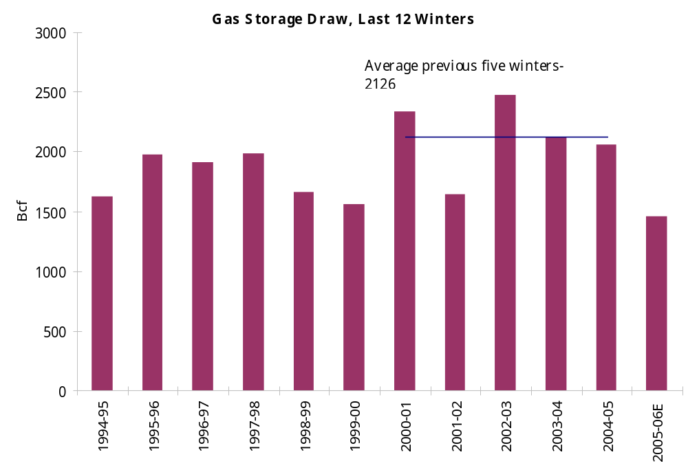
Storage Drawdown

Slide 10
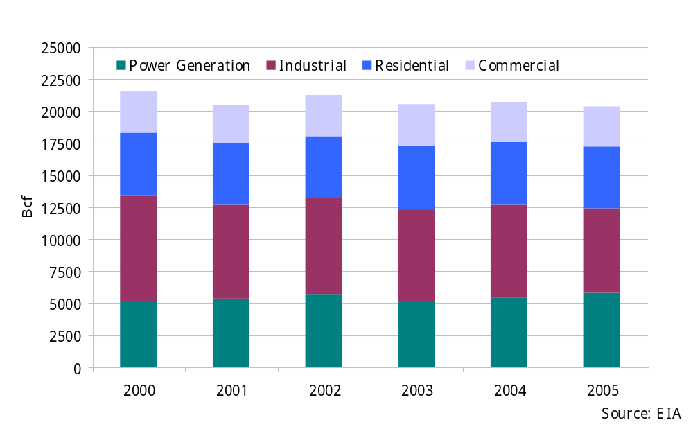
US Natural Gas Consumption by Sector

Slide 11
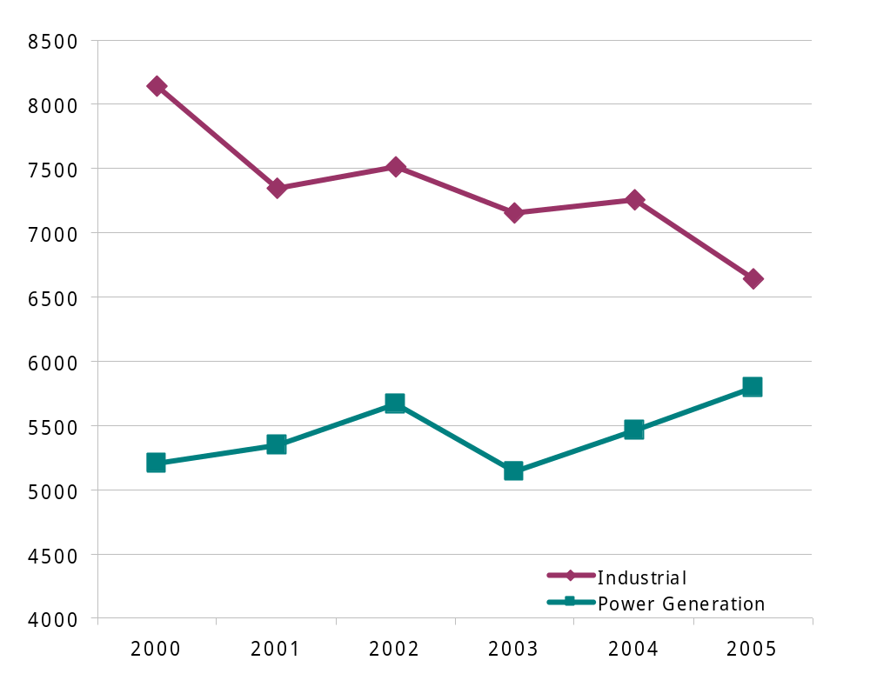
Industrial vs. Power Gas Consumption

Slide 12
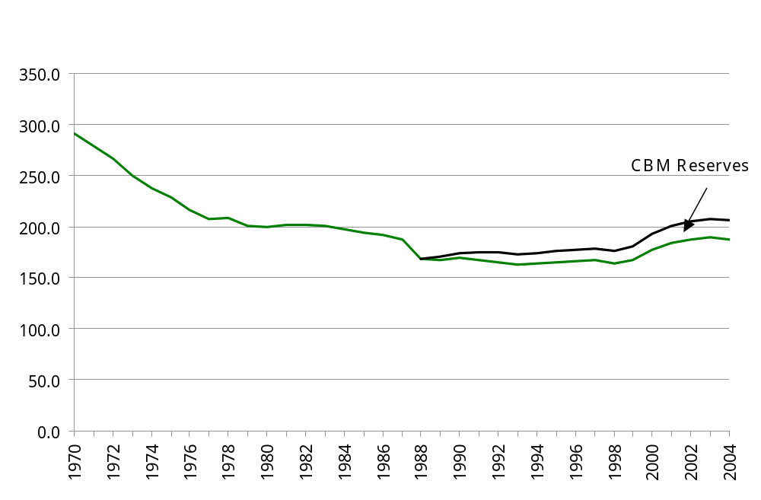
US Proved Natural Gas Reserves

Slide 13
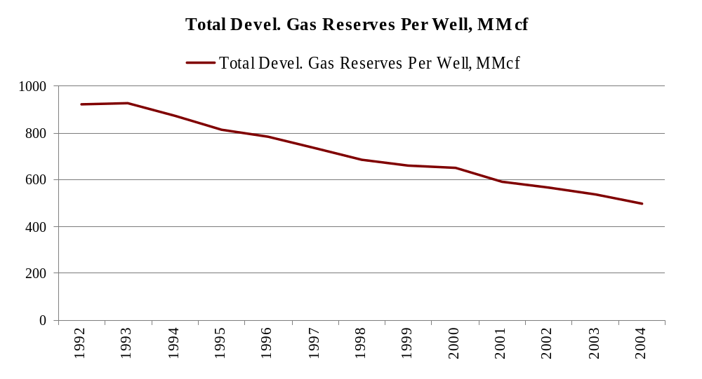
Declining Natural Gas Well Productivity in NA
Natural Gas Well productivity has fallen 30% since 1990
Source John S Herold

Slide 14
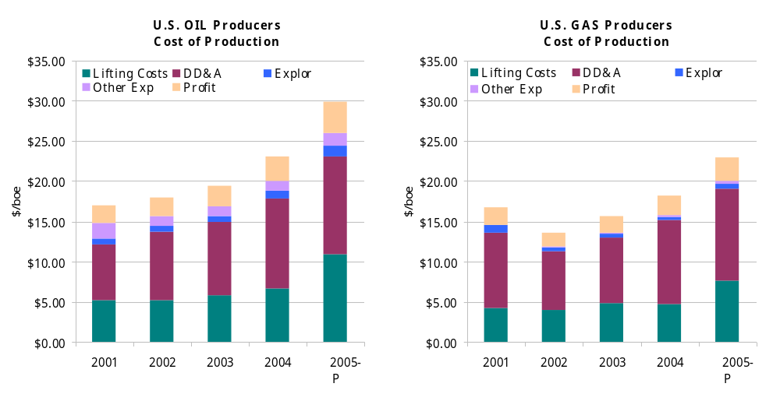
Fully Allocated Unit Costs

Slide 15
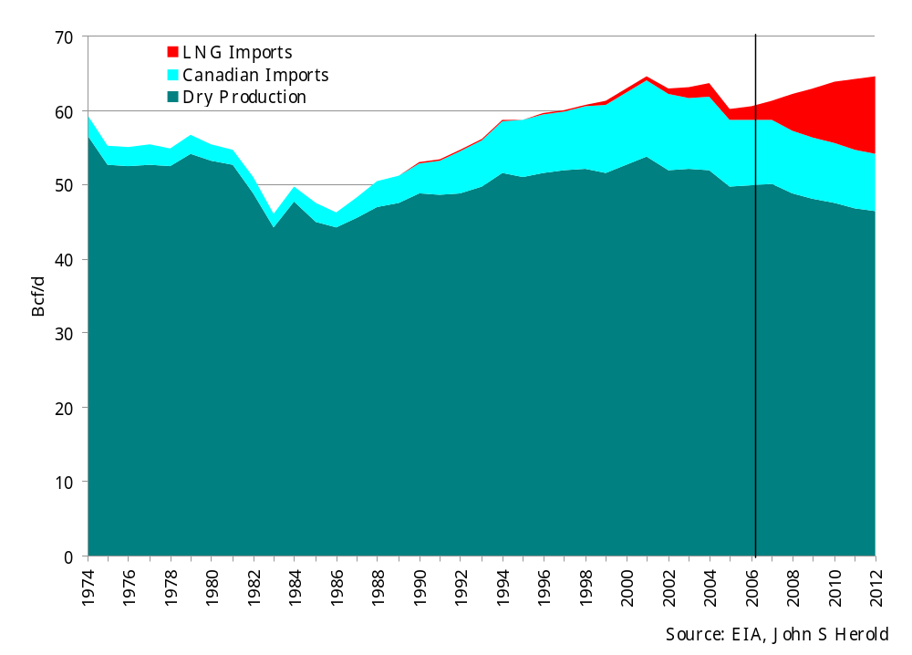
US Natural Gas Supply

Slide 16
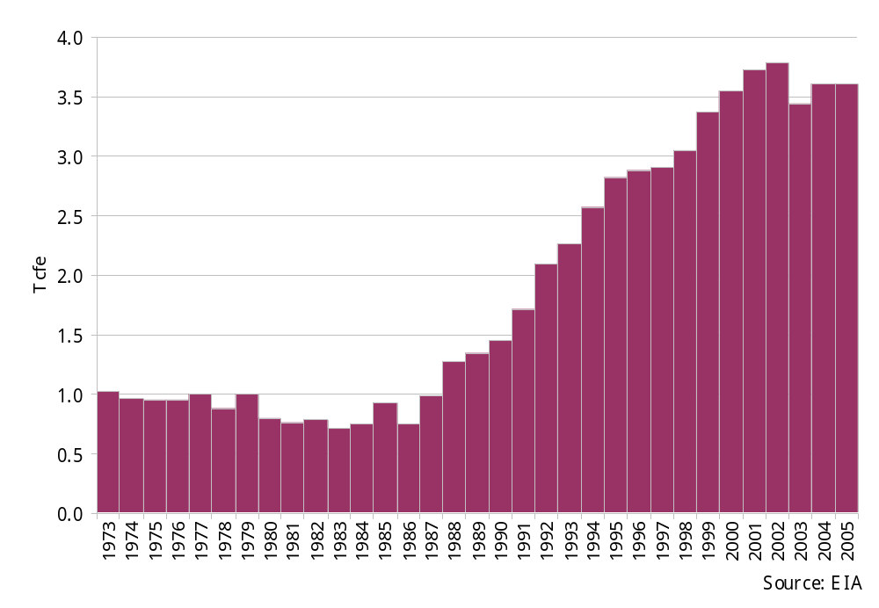
US Gas Pipeline Imports From Canada

Slide 17
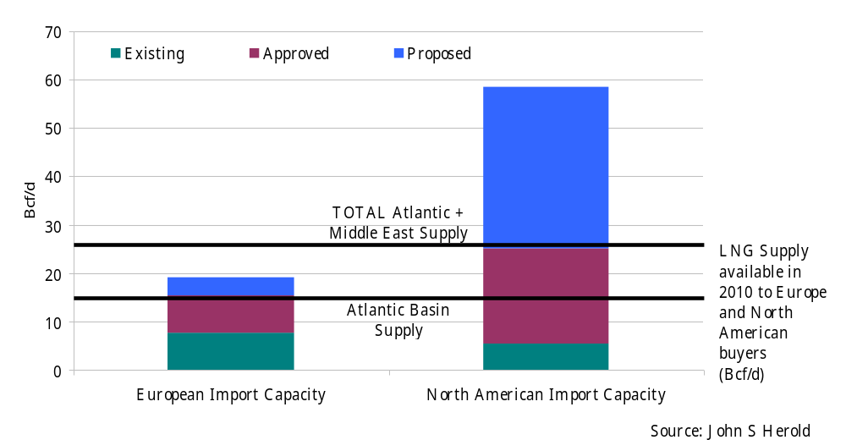
Atlantic Basin LNG
Regas Capacity 2010

Slide 18
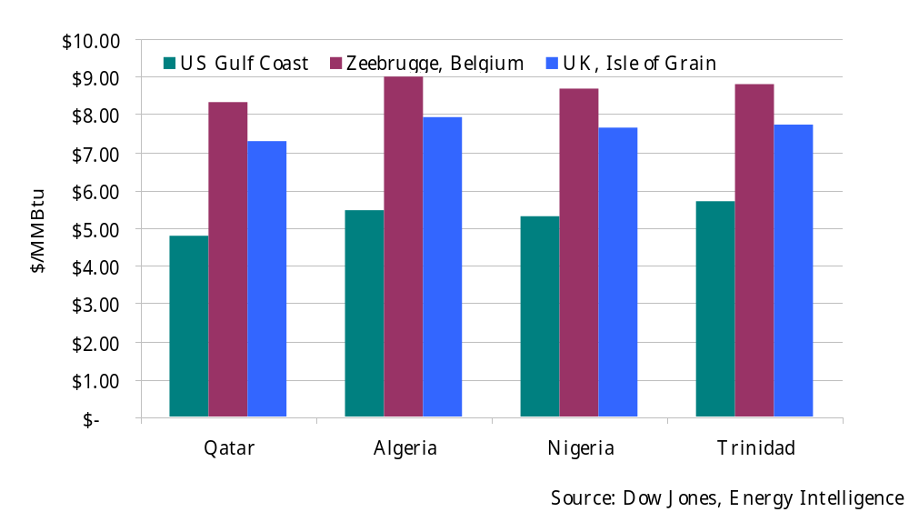
Indicative Spot Netbacks to
Select LNG Suppliers 3.22.06

Slide 19

Marathon Oil
Equatorial Guinea LNG Project
Project Type: Utility
Ownership: Marathon 60%, GEP Petroleum 25%, Mitsui 8.5%, Marubeni 6.5%
Operating Parameters:
Capital Cost: 1.4 billion
Capacity: 3.4 MT/yr.
Contract: 17 years (Bg)
Start-up: Late 2007
Pricing: Henry Hub Index
Op. Cost: $1.00/Mcf
Economic Returns:
Gas Price Scenario Internal Rate of Return:
Base Case 15%
$3.50 12%
$4.25 16%
$5.00 17%
$6.00 19%

Slide 20
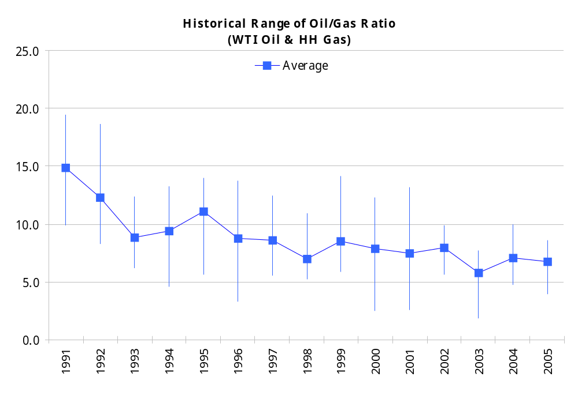
Ratio trending downwards
Oil - $21.22/bbl
Gas - $1.45/Mcf
Oil - $31.10/bbl
Gas - $5.89/Mcf
Oil - $56.56/bbl
Gas - $8.91/Mcf
Oil - $14.38/bbl
Gas - $2.08/Mcf
1996-2005 average = 7.6

Slide 21
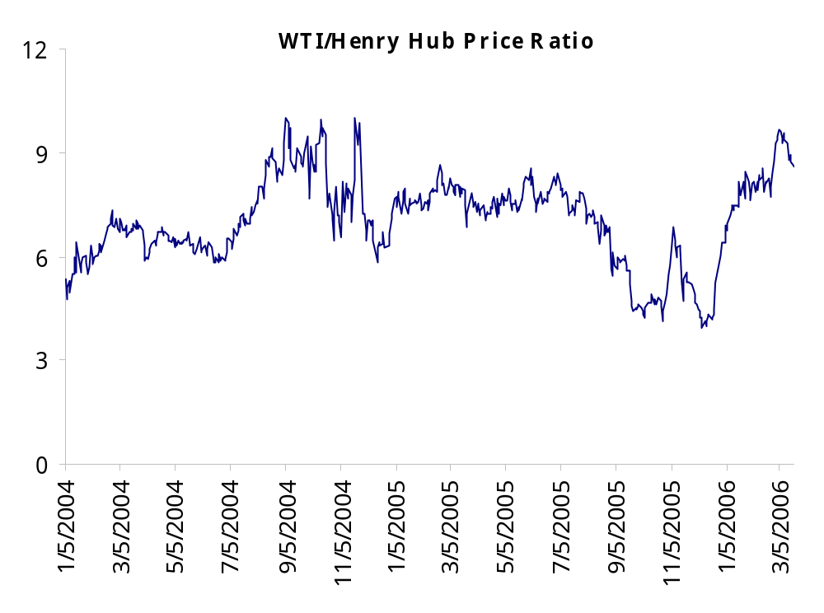
Ratio highly volatile in short term
9.6
4.0

Slide 22
Summary
Tightened spare world crude oil & refining capacity expected to maintain ALL energy price levels near 2004/05 levels in near to medium term
Short-term US oil/gas price ratio likely to average in upper range of past ten years; longer term ratio expected to trend upwards if LNG successfully bridges widening US supply/demand gap at competitive prices
Above ground inventories will continue to influence shorter-term price swings for US oil & gas; post-hurricane(s) price spike driven by future inventory concerns
Oil-indexed pricing for European gas means strong competition for LNG supply to the US for the foreseeable future – Atlantic Basin/Middle East LNG economics expected to be increased factor in future US oil/gas price ratio

