Slide 1
Presented at:
2006 EIA Energy Outlook and Modeling Conference
Washington, DC
March 27, 2006
Oil and Gas Prices
Will They Stay Linked?
Energy and
Environmental
Analysis, Inc.
1655 N. Fort Myer Drive
Suite 600
Arlington, Virginia 22209
Kevin R. Petak
(703) 528-1900
kpetak@eea-inc.com

Slide 2
Contents
Recent Trends in Oil and Gas Markets
Projected Trends
Future Linkage Between Oil and Gas Prices

Slide 3
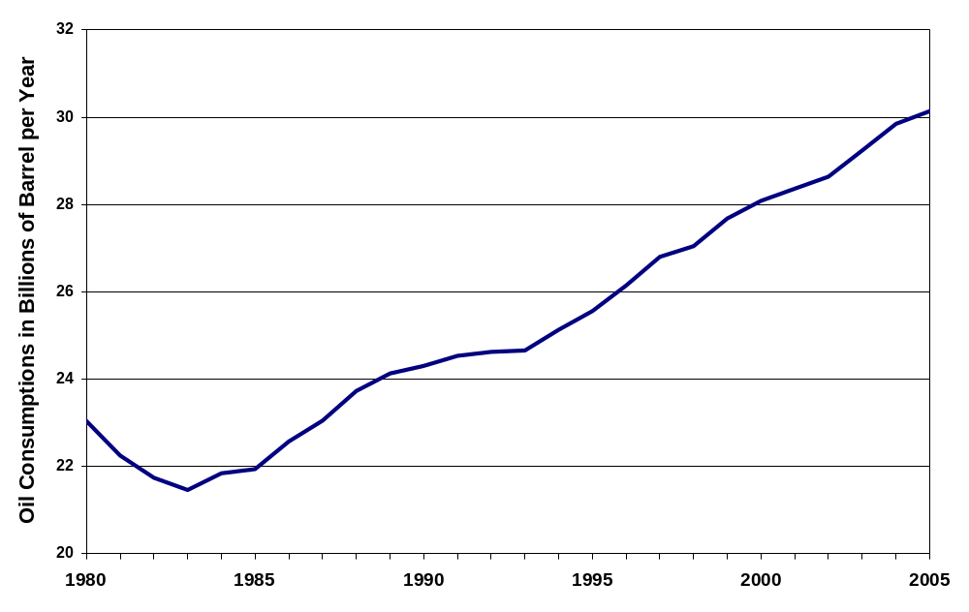
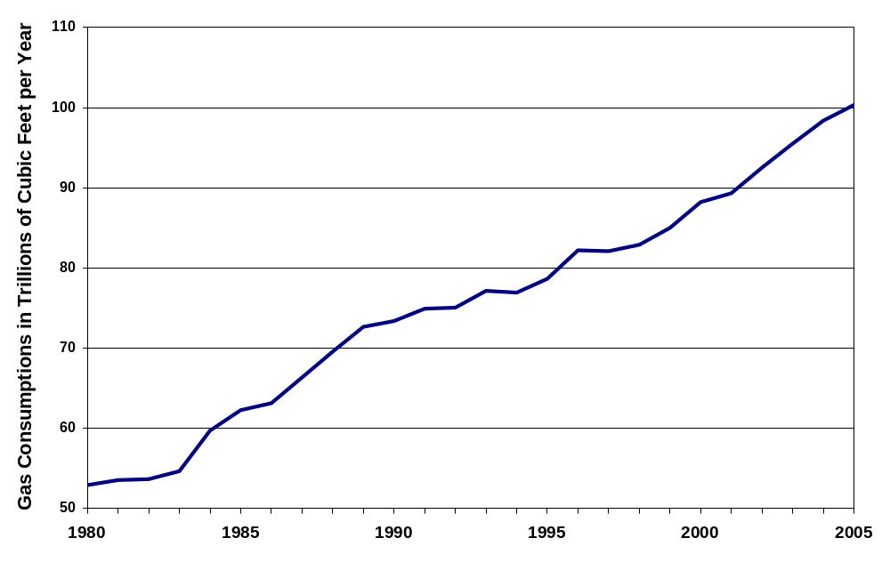
Growth in World Oil and Gas Use
World Oil Use
Bottom Line: Robust growth in both fuels.
World Gas Use
Global oil use rising at 1.6 percent per year.
  Tiger economies dominate growth.
Global gas use rising at 2.6 percent per year.
  Growth evenly spread geographically.
Source: International Energy Agency

Slide 4
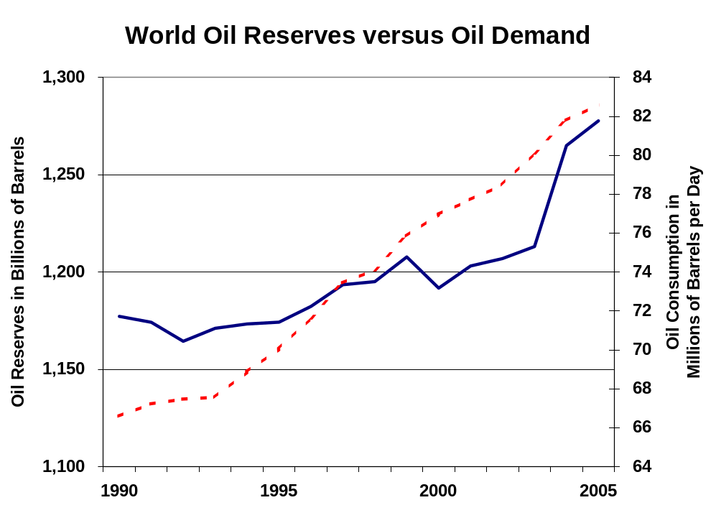
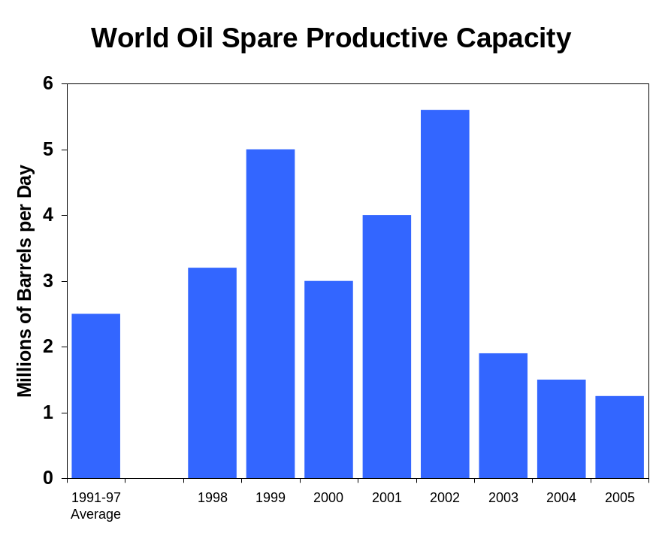
Oil Supply
The Tightening Oil Balance
Demand
Reserves
Source: Energy Information Administration
World oil use has grown at 1.6 percent per year, however, proven reserves have grown by only 0.5 percent per year.
While oil demand has grown, spare productive capacity has declined.
Even though reserve growth has kept pace with demand growth during the past 6 or 7 years, spare productive capacity has declined, indicating a reduced productivity for developed reserves.

Slide 5

World Oil Reserves
1,277 Billion Barrels
of Proven Oil Reserves /1
Market subject to monopolistic or oligopolistic behavior.
Eastern Europe &
Former U.S.S.R.
North
America /2
Western
Europe
79
16
729
215
Middle
East
Caribbean
1
Africa
Asia &
Oceania
Oil reserves and production concentrated in the Middle East. The calculated “HHI value for reserves” is about 0.37, indicating highly concentrated supply.
100
36
99
Central & South
America
42 years of supply at current consumption levels
1. Source: Oil and Gas Journal.
2. North American reserves includes 175 billion barrels of oil sands reserves in western Canada.

Slide 6
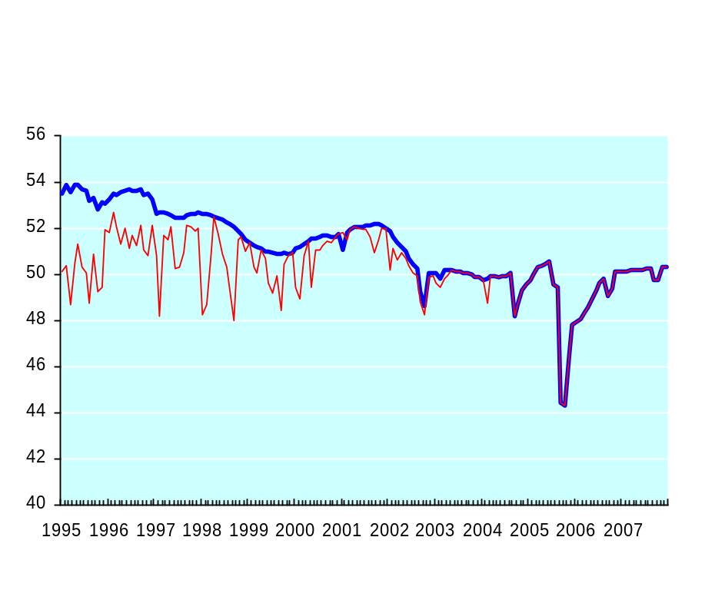
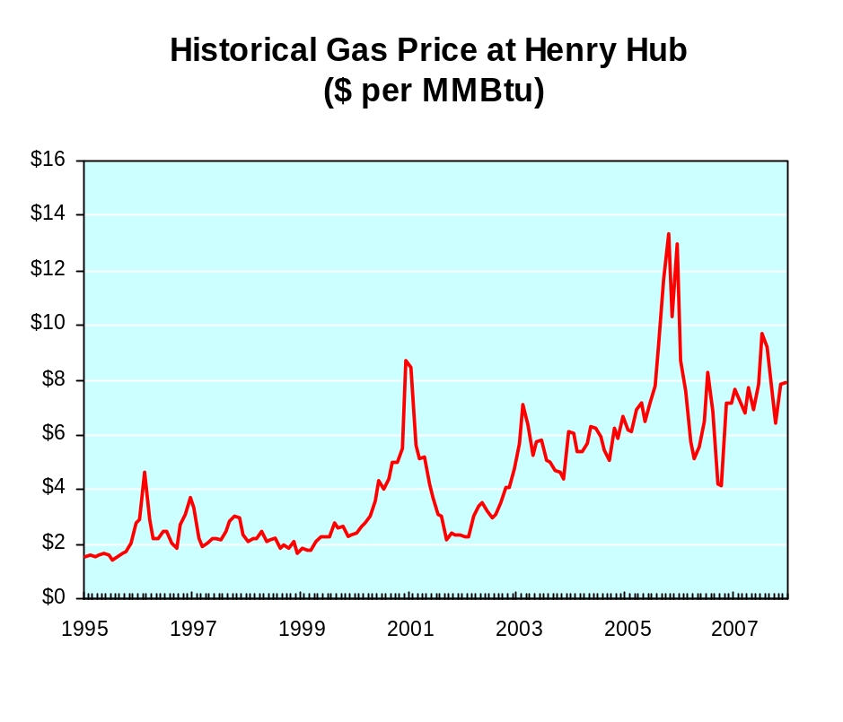
The Changing Gas Balance
Lower-48 Dry Gas Production Vs. Dry Gas Capacity (BCFD)
Hurricane Ivan
Hurricane Katrina & Rita
Price Spike Winter 2000-01
Rising Prices Winter 2002-03
Prices Relatively
Low & Stable
The “Gas Bubble”
Excess Productive Capacity
Source: Energy and Environmental Analysis, Inc.
Source: Platts Gas Daily & Energy and Environmental Analysis, Inc.
Divergent trends in gas supply and demand have led to a tight balance between supply and demand, higher gas prices, and increased price volatility.
TIGHT BALANCE EXPECTED TO CONTINUE

Slide 7
World Gas Reserves
6,044 Trillion Cubic Feet
of Proven Gas Reserves /1
Global gas market likely to develop.
Eastern Europe &
Former U.S.S.R.
1,964
North
America
Western
Europe
182
Middle
East
264
2,522
Caribbean
19
Africa
Asia &
Oceania
477
384
Gas reserves and production less concentrated in the Middle East. However, the calculated “HHI value for reserves” of 0.30 indicates the market could become concentrated.
232
Central & South
America
60 years of supply at current consumption levels
1. Source: Oil and Gas Journal.

Slide 8
Summary of Global Oil and Gas Production
Oil reserves not increasing as quickly as oil use.
  Productivity of recently developed reserves declining.
Oil reserves and production concentrated.
Gas markets tightening around the world.
  Production waning in a number of areas (most notably the U.S. and Western Europe).
Global LNG trade immature compared to oil trade.
Bottom Line: Supplies under pressure to keep up with demand, leading to higher prices for both fuels ...

Slide 9
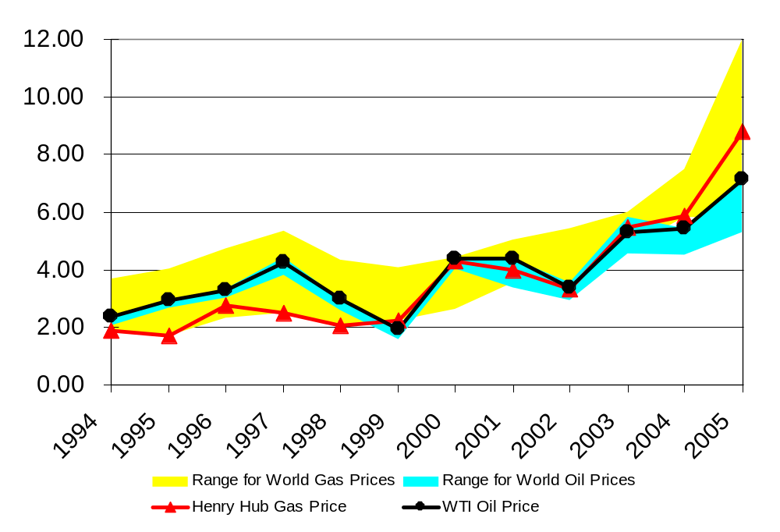
Oil and Gas Prices
Annual Average Values in U.S. Nominal Dollars per MMBtu
Sources: Energy Information Administration and Platts Gas Daily

Slide 10
Summary of Oil and Gas Prices
Upward price trends indicative of tightening supply/demand balances globally.
Wider range for gas prices indicates relatively weak correlation among regional markets.
Global oil and gas prices historically linked by market competition and contract pricing.
U.S. oil and gas prices more recently linked (weak correlation in 1990s).
  Correlation likely to be strengthened as a global LNG market evolves....

Slide 11
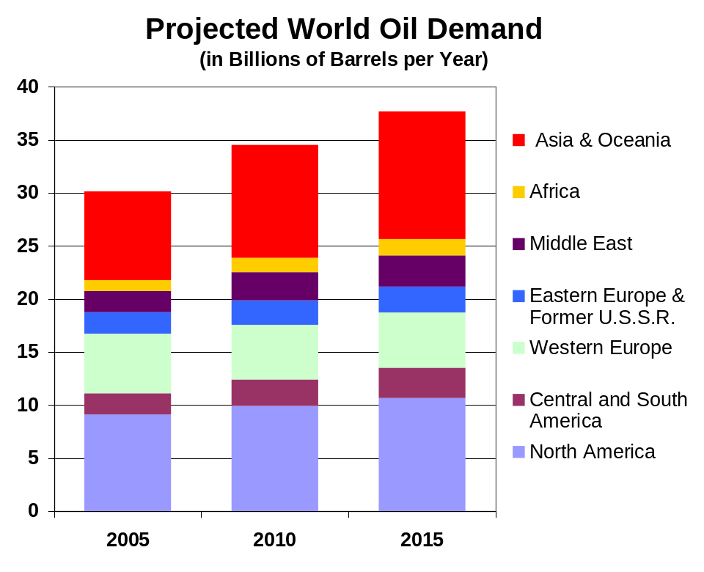
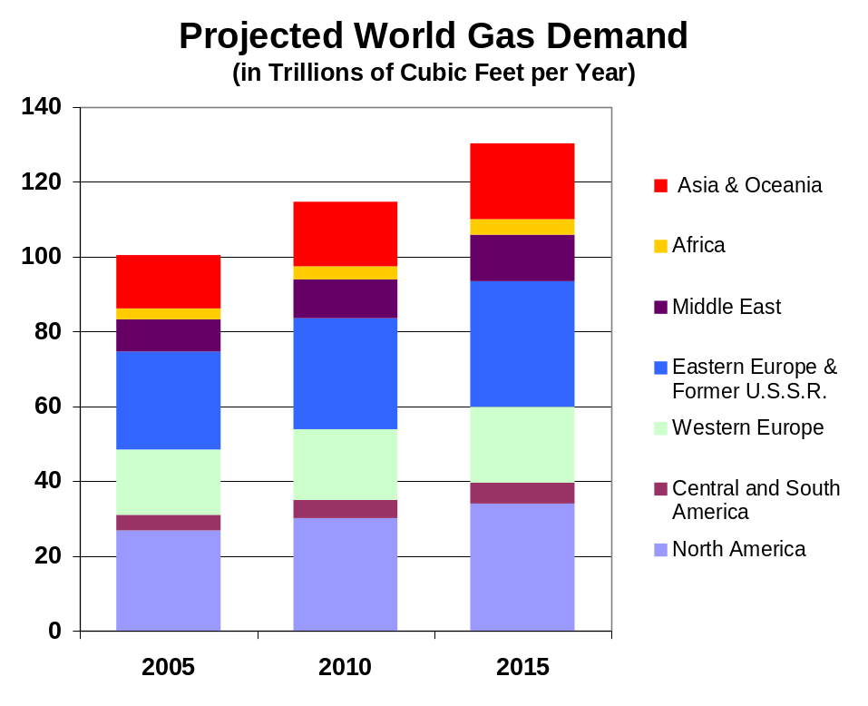
Projected Consumption for Oil and Gas
Source: Energy Information Administration
Source: Energy and Environmental Analysis, Inc.
According to the U.S. Energy Information Administration, over the next ten years, world demand for oil will grow at 2.3 percent per year to nearly 38 billion barrels in 2015.
Demand is driven by economic growth, particularly in developing countries like China.
We expect gas demand to grow even more quickly, at 2.6 percent per year to 130 trillion cubic feet in 2015.
Development of new liquefaction facilities uses “stranded gas” and fosters development of a true world market for natural gas.

Slide 12
Bottom Line
Oil and gas supplies will have difficulty keeping pace with demand for the foreseeable future, continuing to place upward pressure on oil and gas prices.
… gas and oil prices likely to stay coupled in this environment.

Slide 13
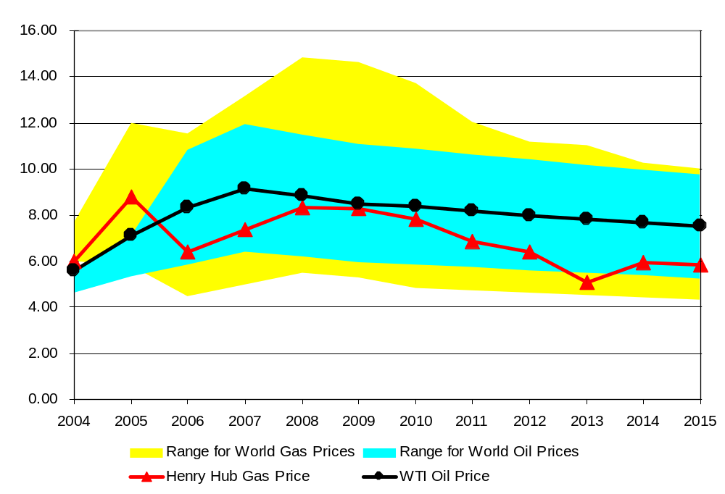
Projected Oil and Gas Prices
Annual Average Values in U.S. Dollars per MMBtu (2005$)

Slide 14
Summary of Oil and Gas Prices
Supply/demand balances expected to remain tight, keeping prices relatively high and volatile.
Wider range for gas prices indicates relatively weak correlation between regional markets.
  However, regional prices should converge over time as the global LNG market evolves.
Oil and gas prices are likely to trend in the same direction, but may disconnect over periods of time within any market.
Current linkage between oil and gas prices is mostly a result of demand-side competition, such as fuel switching. Future linkage will be driven increasingly by supply-side activity (i.e., LNG versus oil resource development, gas-to-liquid conversion).

Slide 15
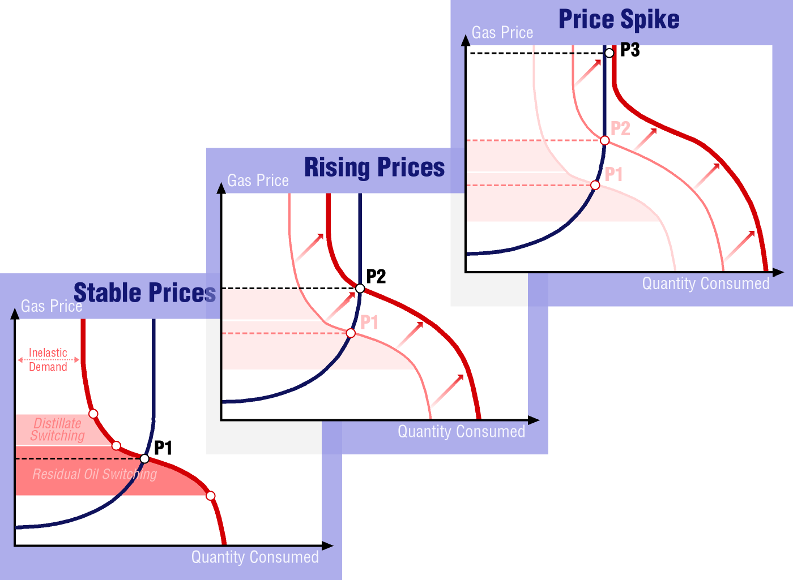
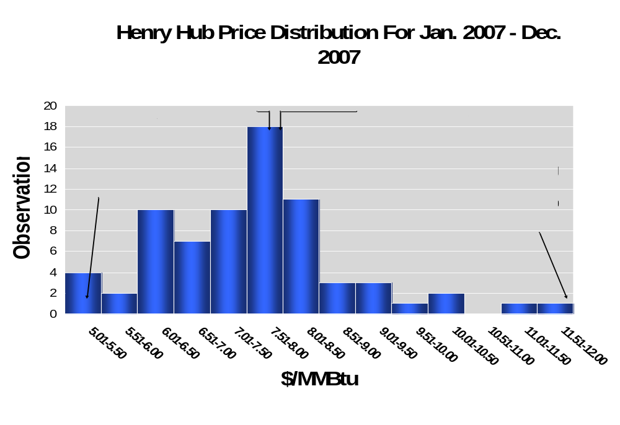
Gas Prices
Impact of Weather
Changes in weather shift daily demand, causing wide swings in gas prices.
Significant price volatility suggests need of additional gas storage, peakshaving capability, or fuel switching capability.

Slide 16
Some Signposts to Watch to Determine Whether Oil and Gas Prices Will Remain Coupled (A U.S. Perspective)
Signpost | Example Market Event | Likely Outcome
Gas-to-oil switching capacity | Retirement of capacity | Gas prices up relative to oil prices
Globalization of LNG | Political turmoil delays liquefaction development | Gas prices up
Globalization of LNG | Aggressive development of LNG liquefaction capability | Gas prices fall relative to oil prices
Environmental policies favoring gas | Carbon control leading to retirement of coal capacity | Gas prices up
Environmental policies favoring other fuels | Nuclear or IGCC subsidy | Gas prices down
Weather | Significant hurricane disruptions along the Gulf Coast | Gas prices up
Weather | Mild temperatures with wetter than normal conditions in the western U.S. | Gas prices down
Underground Gas Storage | Aggressive development of storage facilities | Reduces the impact of adverse weather conditions, increasing the correlation between gas and oil prices

Slide 17
Conclusions
Demand growth in the face of waning oil and gas supplies is driving upward price pressure for both fuels.
  Oil and gas prices have both been on an upward trend over the past five years. Prices have been highly correlated.
Oil and gas prices are likely to stay coupled as supply/demand balances remain tight for both fuels, however, significant price volatility is likely.
  Weather alone can swing average annual prices by $3 to $4 up or down from a baseline trend.
Development of the global LNG market is a critical signpost.
  Slower than expected development of liquefaction capability would maintain upward pressure on gas prices and weaken correlation between regional gas prices and oil prices.
  However, rapid deployment of liquefaction capacity may create temporary surpluses in regional gas markets, causing short episodes of gas price depression.

Slide 18
Presented at:
2006 EIA Energy Outlook and Modeling Conference
Washington, DC
March 27, 2006
Oil and Gas Prices
Will They Stay Linked?
Energy and
Environmental
Analysis, Inc.
1655 N. Fort Myer Drive
Suite 600
Arlington, Virginia 22209
Kevin R. Petak
(703) 528-1900
kpetak@eea-inc.com

