Slide 1
2006 EIA Energy Outlook and Modeling Conference
Return to Coal, from Where and at What Price?
Commercial and Regulatory Issues and Trends Impacting the Coal Transportation and Supply Markets
March 27, 2006
By:
Peter A. Pfohl
Slover & Loftus
(202)347-7170
pap@sloverandloftus.com

Slide 2
INTRODUCTION AND OVERVIEW
Coal Has and Remains the Electric Generation Dominant Fuel
Coal Transportation Costs are a Significant Component of Generating Electricity
History and Recent Trends in Western Coal Transportation Pricing
Western Coal Supply Market Issues

Slide 3
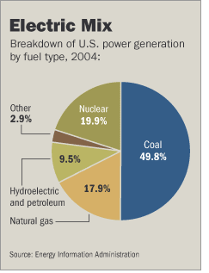
KING COAL
Coal is a primary contributor to the production of electricity
Coal remains the baseload dominant fuel for electric generation
        (Wall Street Journal (March 15, 2006))

Slide 4
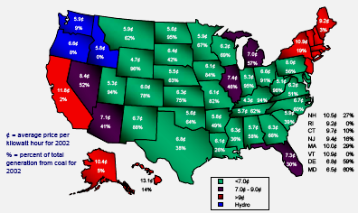
KING COAL (con’t)
Factors favoring coal
  Abundant supply
  A secure and stable U.S. domestic source
  Low cost (especially for surface mined western coal)
  Price differential with other fuels
(American Coal Council: Opportunities to Expedite
the Construction of New Coal-Based Power Plants (Nov. 2004))

Slide 5
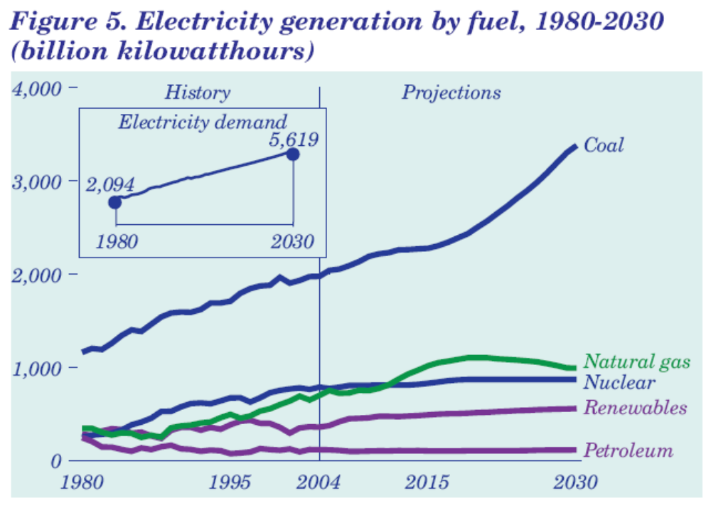
KING COAL (con’t)
EIA’s Energy Annual Outlook 2006

Slide 6
WESTERN COAL TRANSPORTATION ISSUES
Historical Issues/Trends
  Staggers Rail Act of 1980: a watershed event
  ICC takes proactive stance to open up Southern PRB coal reserves to 2-carrier competition
    “The public interest requires that these coal resources be made available to consumers under the most favorable terms possible. Ensuring competition for the transportation of coal is the best means to guarantee that result”
    (Finance Docket No. 28934, et al., Chicago and North Western Transp. Co. -- Construction and Operation of a Line of Railroad, 363 I.C.C. 906, 927 (1981))
  1984 – early 2000s
    Increased rail-to-rail competition through private, confidential contracts
    Rate reductions through pass-through of some productivity gains (see EIA, Energy Policy Act Transportation Rate Study: Final Report on Coal Transportation)
    Railroads become more profitable due to productivity gains and cost savings
      BNSF’s CEO Matt Rose testified that, during this period: “railroad expenses were reduced even more deeply than rates,” and he concluded that these results “allowed the industry to gradually shore-up its finances.” (Statement of Matthew K. Rose Before the Senate Subcomm. on Surface Transportation (May 9, 2001))

Slide 7
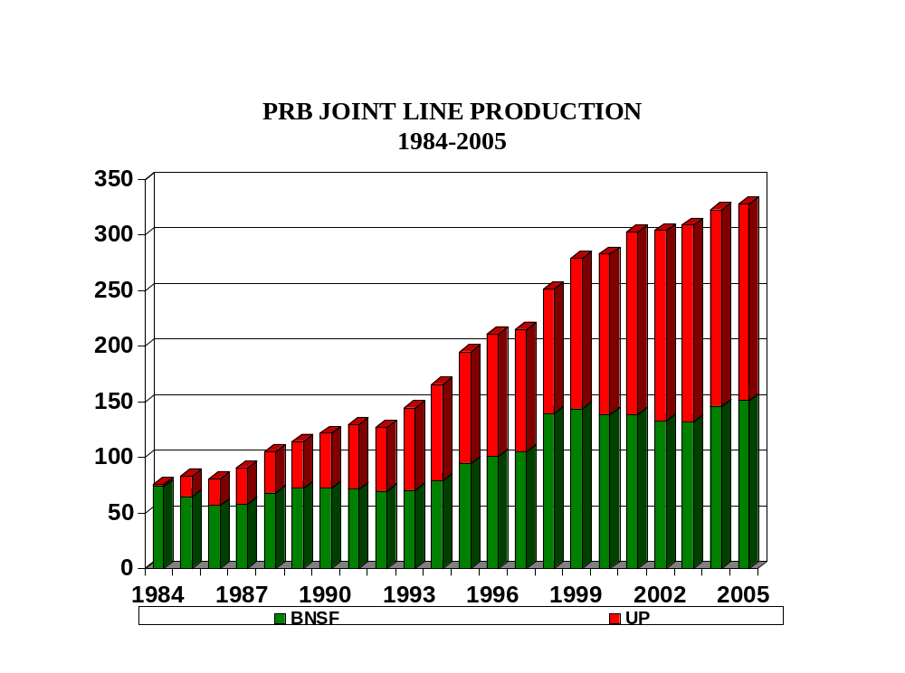
WESTERN COAL TRANSPORTATION ISSUES (con’t)
• Southern PRB
– Significant (but generally consistent) PRB market growth
– UP and BNSF Reach Market Equilibrium

Slide 8
WESTERN COAL TRANSPORTATION ISSUES (con’t)
Dark Clouds?
  Industry Consolidation
    Since 1980, the number of major “Class I” railroads in the U.S. has shrunk from 42 to 4
      “Big Four” now control 90%+ of annual ton-miles
    Two lead carriers remain in both the West (UP and BNSF) and the East (CSXT and NS)
      Any “next round” of mergers would produce a national rail duopoly -- putting control of most American rail freight in the hands of two mega-carriers
  Southern PRB: UP and BNSF reach market equilibrium (see previous slide)
  Regulatory Results

Slide 9
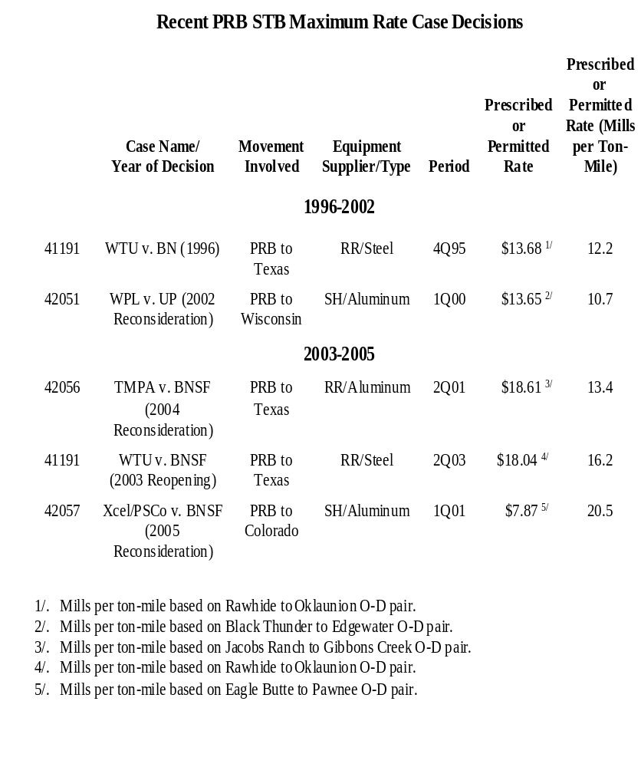
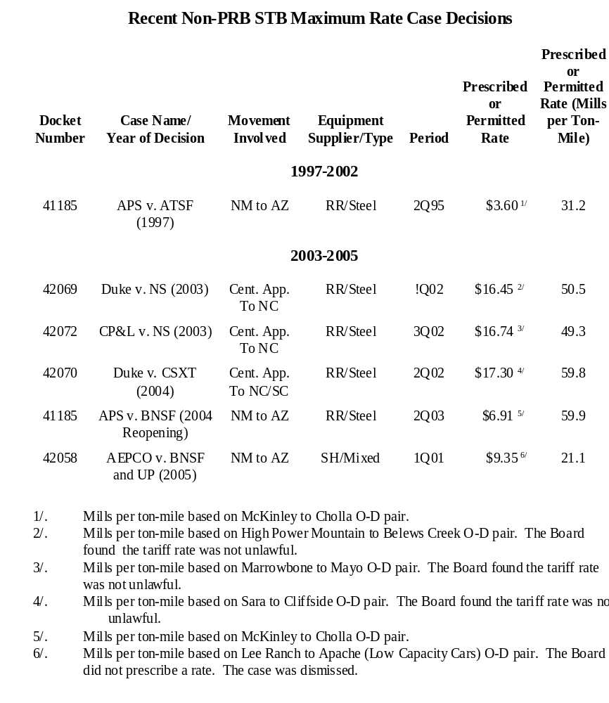
WESTERN COAL TRANSPORTATION ISSUES (con’t)
• Trends in STB coal maximum rate case decisions

Slide 10
WESTERN COAL TRANSPORTATION ISSUES (con’t)
  Railroad Commercial Issues
    Public Pricing of Western Coal Services
      Fall, 2004: UP and BNSF each institute new “public pricing” programs to apply on western coal movements
      Railroad Public pricing characteristics:
        Higher rates
        Shorter terms (1-3 years)
        Unilaterally decreed service terms
        Imposition of fuel surcharges
        A reluctance to compete for traffic that enjoys access to both systems
      DOJ Investigation (Feb. 2005: DOJ “is looking into the possibility of anticompetitive practices involving the transport of coal”)

Slide 11
WESTERN COAL TRANSPORTATION ISSUES (con’t)
• Railroads Recent Message: “Get used to” rate
increase “pain”:
Pricing Environment . . . Pricing remains strong. After 25 years since the Staggers Act deregulated the industry, demand finally outstrips capacity. BN believes that 2-3% pricing growth is sustainable with 3-5% volume increases, which will more than offset 2.5%-3% cost inflation, resulting in double-digit EPS growth over the foreseeable future.
Rapid price increases have been painful for BN’s customers, although the railroad has provided transportation managers with data to help explain the increases to their bosses. The goal is obviously to obtain greater acceptance of price increases and manage expectations for the future, i.e. get used to price increases.
(UBS Investment Research, BNSF, Highlights from Meeting with Management (Aug. 29, 2005) at 4)

Slide 12
WESTERN COAL TRANSPORTATION ISSUES (con’t)
Changing Business Environment
Unprecedented levels of demand have created a very strong pricing environment . . . . Across all business groups, we are obtaining solid price increases in the marketplace. At the same time, we are working to reduce the complexity and inflexibility of long-term contracts so that we can respond more quickly to changing market conditions. One clear example is in our coal business where we have instituted new coal pricing mechanisms for all shipments from the Southern Powder River Basin (SPRB) in Wyoming, as well as spot movements out of Colorado and Utah. We have simplified the way we do business with our customers by clearly communicating the revenue we need in order to reinvest in our coal business, while sharply reducing the administrative burden of dozens of separate contracts. In total, 322 million tons of coal moved out of the SPRB in 2004, and that is expected to grow to over 500 million tons by 2013. Our goal is to participate in meeting that growing demand, but only if the financial returns are sufficient to justify the necessary investment.
Dick Davidson, UP Chairman and CEO, UP 2005 Annual Report

Slide 13
WESTERN COAL TRANSPORTATION ISSUES (con’t)
• Wall Street’s Message: A “secular” pricing story:
We continue to recommend overweighting the North American
railroads as we believe the stocks will have 10%-20% annual
EPS growth between now and 2010, due primarily to their secular
pricing story (our contention for the past year has been that it’s
secular, not cyclical). . . . [W]e believe the secular pricing story will
lead to EPS growth rates over the next 5 years that is almost 3x the
historical EPS growth rate of the industry. Given this accelerated
EPS growth rate and the likelihood that the North American railroad
industry will earn its cost of capital on a sustainable basis for the first
time in at least 50 years, we contend that the industry will be revalued
higher . . . . We’re not concerned about regulatory risk as the current
environment in Washington is understanding of the railroad industry’s
plight to earn its cost of capital. . . .
(Morgan Stanley, Air Freight and Surface Transportation, Secular Pricing Leaves
50%-100% More Upside Potential in Railroad Stocks (Jan. 23, 2006))

Slide 14
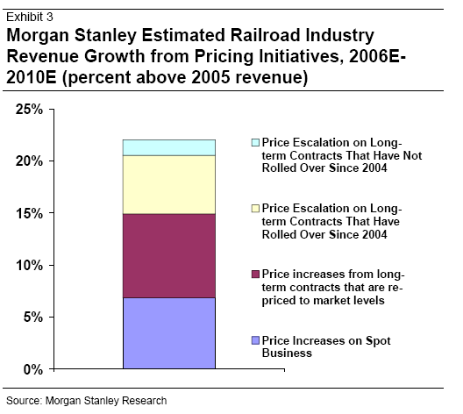
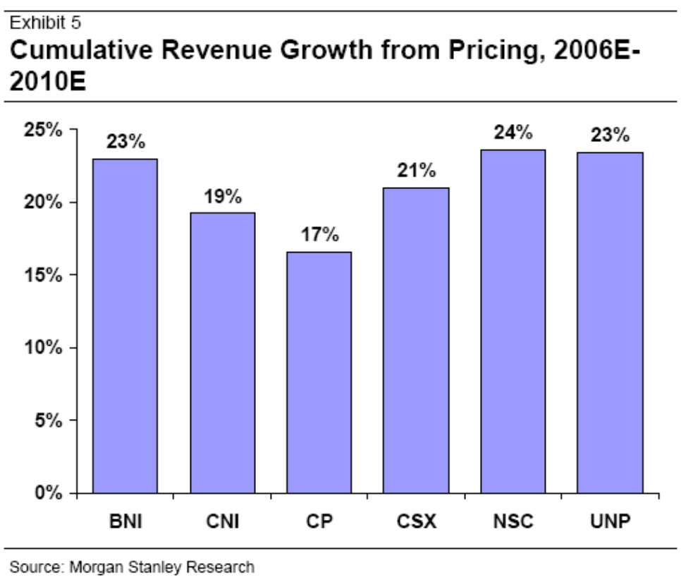
WESTERN COAL TRANSPORTATION ISSUES (con’t)
• Railroad Revenue Growth Driven by Pricing
(Morgan Stanley, Air Freight and Surface Transportation, Secular Pricing Leaves 50%-100% More Upside Potential in Railroad Stocks (Jan. 23, 2006))

Slide 15
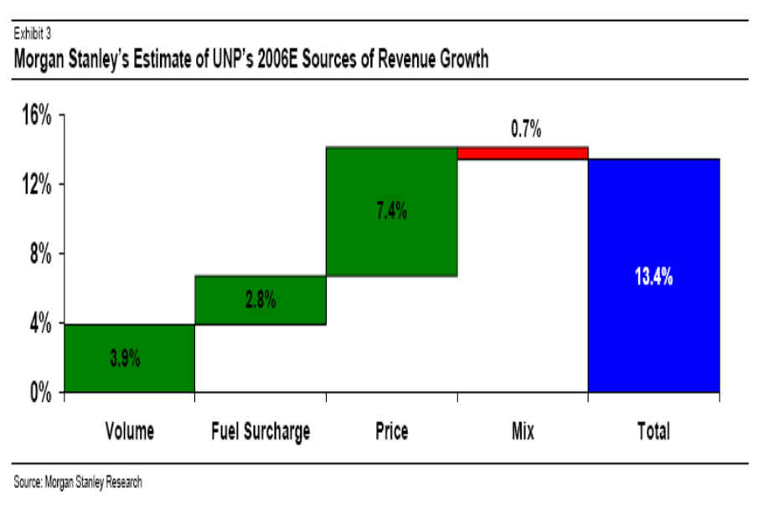
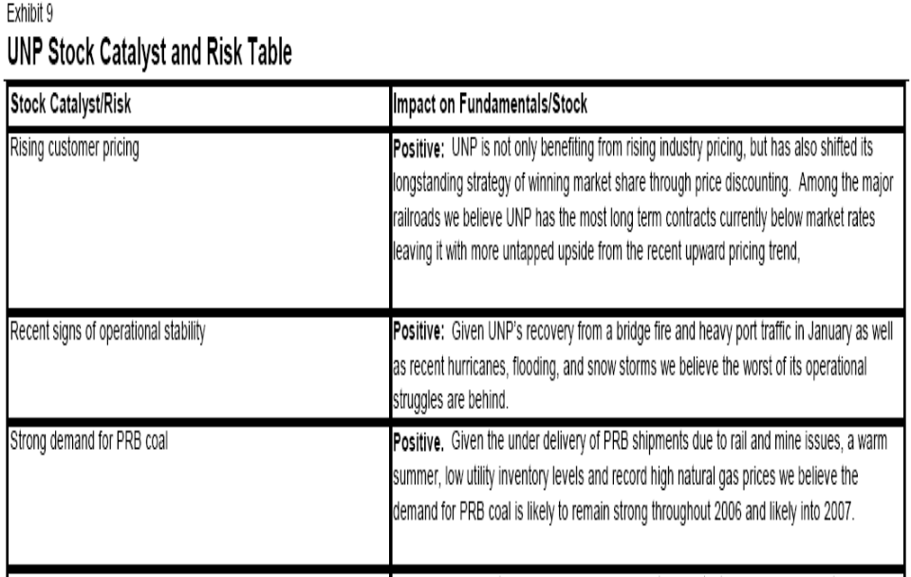
WESTERN COAL TRANSPORTATION ISSUES (con’t)
Morgan Stanley, Union Pacific, Raising Price Target as Our Thesis is Unfolding Earlier than Expected (March 15, 2006))

Slide 16
WESTERN COAL TRANSPORTATION ISSUES (con’t)
– Service Problems
• Deliveries not meeting demand – dwindling stockpiles
• Insufficient capacity/slack capacity?
Source: EIA Coal News and Markets, Week of February 19, 2006

Slide 17
WESTERN COAL TRANSPORTATION ISSUES (con’t)
Coal Customers’ have concerns about supply/demand factors in the current market environment
  BNSF’s Chairman, President, and CEO Matt Rose:
    “we don’t bring capacity on sooner than we need it, so we always have a natural tightness”
    (William C. Vantuono, “Fluidity, velocity, capacity, consistency,”
    Railway Age, (Dec. 2004) at 15-19)
  UP Vice President of Marketing, Jack Koraleski:
  “[i]n some ways, we are where we always wanted to be,
  with demand for our services outstripping the supply”
  (Joe Ruff, “UP to charge more, turn away some cargo,” Associated Press
  (Jan. 28, 2005))

Slide 18
WESTERN COAL TRANSPORTATION ISSUES (con’t)
Fuel Surcharges
  Issue: The railroads continue to apply fuel surcharges on traffic that are not directly tied to carrier fuel costs of the involved service
  The Problem: Coal customers subject to railroad fuel surcharges are seeing fuel surcharges that have exceeded 20% of the carrier’s rates
  Addressing the Problem:
    Similar fuel surcharges being applied across all transportation industries
    There has been some political pressure applied on this issue
    STB public hearing on railroad fuel surcharges scheduled for May 11, 2006
      -- The STB’s notice seeks comments regarding “concerns that recent fuel surcharges collected by railroads are designed to recover amounts over and above increased fuel costs”
      -- The STB notes the limits on its jurisdiction over rates and states that “this hearing is not intended to address the level of surcharges”
    Possible unreasonable practice claim?

Slide 19
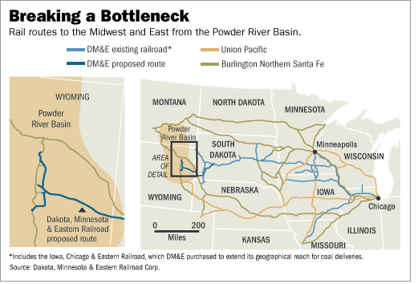
WESTERN COAL TRANSPORTATION ISSUES (con’t)
• NEW RAILROAD COMPETITION?
(DM&E Railroad)
(Wall Street Journal (March 15, 2006))

Slide 20
WESTERN COAL TRANSPORTATION ISSUES (con’t)
• Incumbent Carriers’ Response to DM&E’s $2.5 Billion
public financing plan:
  “[DM&E’s] now turning to look for government money.
  You know, we continue to believe this would be very, very
  bad public policy especially now that the industry is really
  improving its returns and allowing more expansion capital
  to be put in.”
  (BNSF CEO Matt Rose,
  BNSF 4Q05 Investors Conference)

Slide 21
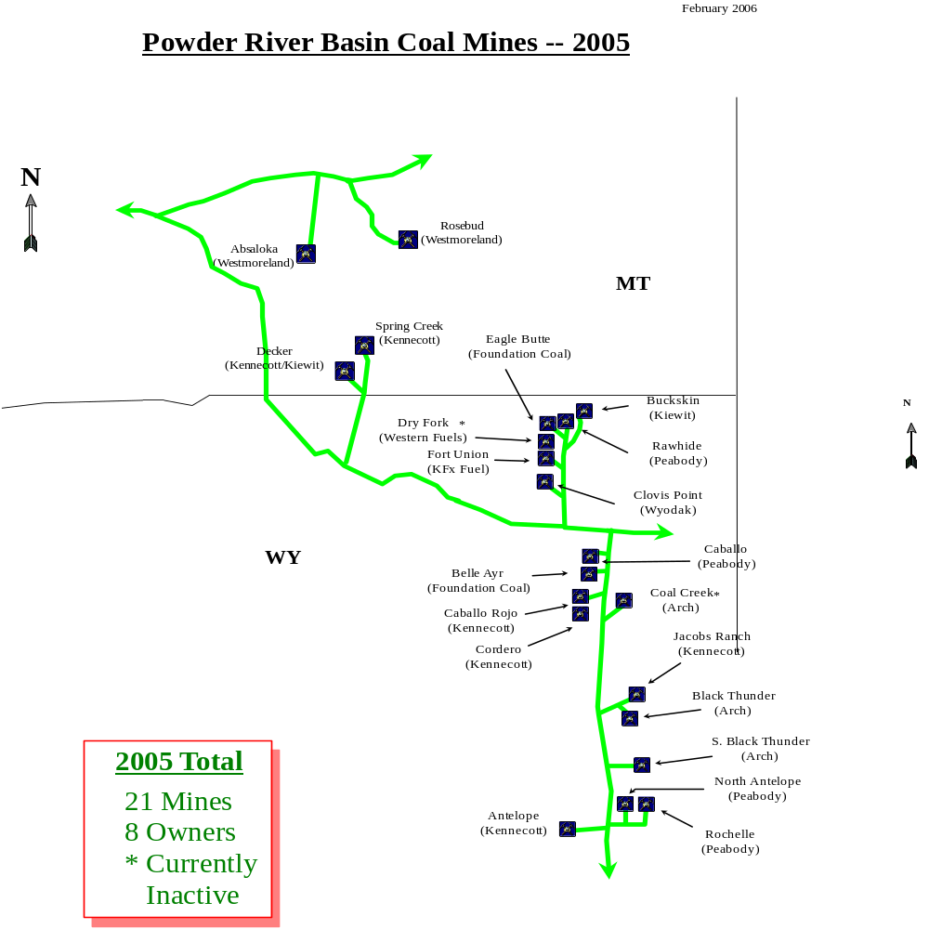
WESTERN COAL SUPPLY ISSUES
● PRB Overview

Slide 22
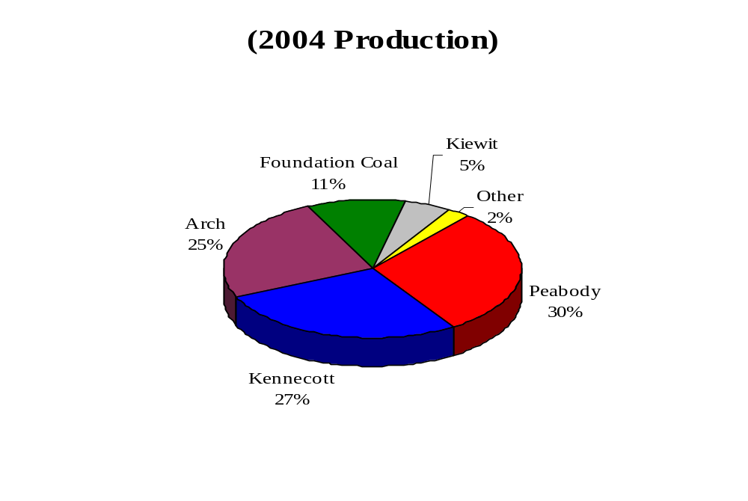
WESTERN COAL SUPPLY ISSUES (con’t)
● Southern PRB Market Shares and the PRB “Big Three”
Powder River Basin (WY)
Production Market Shares (2004)
● Coal customers’ market concerns
– Tripling of PRB spot coal prices in 2005
– Several Governmental Investigations in Recent Years
-- DOJ 2001 Price Spike Investigation
-- FTC 2004 Challenge to Arch/Triton Merger (concerns
of market consolidation and producer market “discipline”)

Slide 23
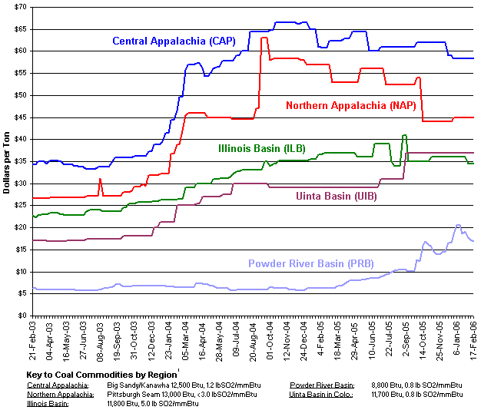
WESTERN COAL SUPPLY ISSUES (con’t)
● 2005 run-up in Western coal prices (anomoly or trend)?
(EIA: Average Weekly Coal Commodity Spot Prices Business Week Ended February 17, 2006)

Slide 24
CONCLUSION
Coal Remains the Electric Generation Dominant Fuel
Recently, Significant Market Price Pressures on the Delivered Cost of Coal have Arisen
Even with Price Increases, Price Differentials Between Coal and other Substitute Fuel Choices (e.g., Natural Gas) May Continue to Keep Coal Demand Strong (as Recognized in EIA’s 2006 Annual Energy Outlook)
Who Pays?

