Slide 1
Global Supply Through 2010: Complacency Before The Storm?
Presentation to EIA Energy Outlook And Modeling Conference
By Jamal Qureshi, Lead Analyst
Oil Markets Group
March 27, 2006

Slide 2
Supply Through 2010
The deepwater and Central Asian “bulge” is upon us
  2004-2005 was inflection point heading into better quality slate
Danger these trends induce policy complacency
  More countries maturing, declining
  Exploration trends not encouraging
Company strategies unlikely to change macro picture much
  At $30+ WTI, IOCs going all out but are opportunity-constrained
  NOCs face varied constraints; little production upside, some downside

Slide 3
PFC Energy’s Supply Methodology
For each country reserve additions (field by field) have been documented along with production history
A decline is modeled for the producing base using current withdrawal rates and remaining reserve estimates for fields in the existing production base (an additional 15-20% volume has been added to the current estimates of P1+P2 to account for possible higher recoveries).
All new discoveries with a development plan are documented and probabilistically modeled to add to the producing base (P90, P50, and P10 reserves are used).
All undeveloped discoveries without a development plan are modeled using country average peak rates, decline rates, development concepts, etc. and added to the producing base (The range of recoverable reserves modeled is +/- 20% of reported P1 and P2.
Probabilistic expected value exploration models are built which assume that average field size discoveries, success rates, etc. (documented since 1990) continue over the next two decades; volumes from these EVA model resource discoveries (with appropriate development delays and production profiles) are added to base production.

Slide 4
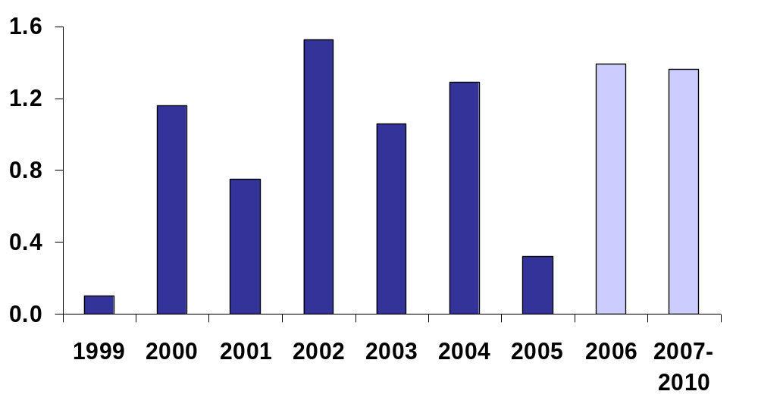
2006 Marks Start Of Supply Surge
Annual Supply Growth, Non-OPEC Liquids & OPEC NGLs
mmb/d
Growth this year good at 1.4 million b/d (including OPEC NGLs)
Follows very weak 2005 of 320,000 b/d
Rest of decade expected to see growth average 1.4 mmb/d as well – 60% higher than the growth of the previous 10 years!

Slide 5
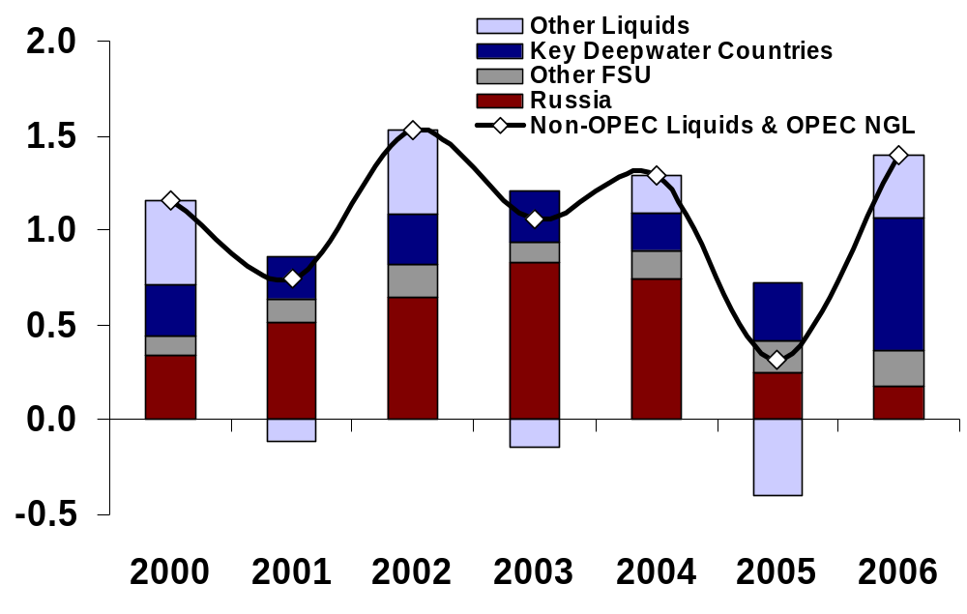
Components Of Growth Changing
Annual Supply Growth, Non-OPEC Liquids & OPEC NGLs
mmb/d
Russia no longer the driver
Deepwater has displaced Russia as key growth driver
Central Asia poised to become key driver as well

Slide 6
2005-2010 Growth Versus Decline Regions
FSU
+2.2 mmb/d
Western Europe
-1 mmb/d
Western Hemisphere
Deepwater & Unconventionals:
+2.1 mmb/d
Rest Of Region Conventionals:
-0.7 kb/d
Non-OPEC Mideast/North Africa
-0.4 mmb/d
Asia-Pacific
+0.1 mmb/d
Sub-Saharan Africa (incl. Nigeria)
+2 mmb/d
GLOBAL NON-OPEC CRUDE
+3.6 mmb/d
GLOBAL NGL & OTHER LIQUIDS
+2.7 mmb/d

Slide 7
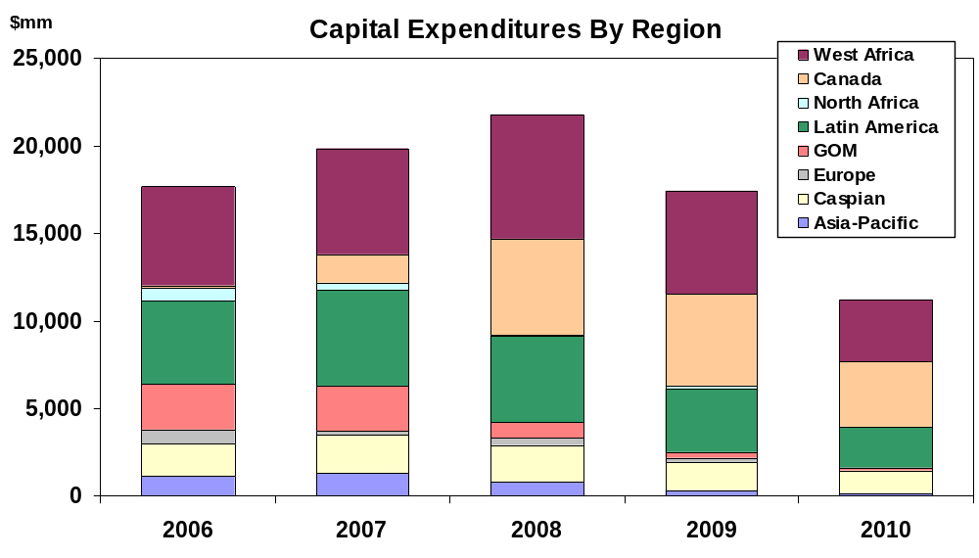
Capex Matches Production Growth Regions
Capital Expenditures By Region: 2006-2010

Slide 8
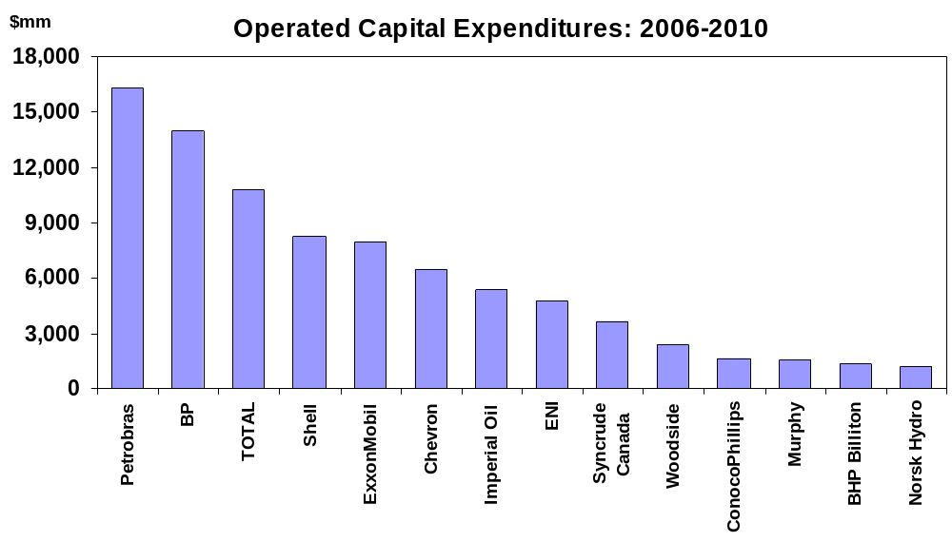
Big Players All Involved
Gross Operated Capital Expenditures: 2006-2010
Note: Minimum $1 Billion in total operated capex

Slide 9
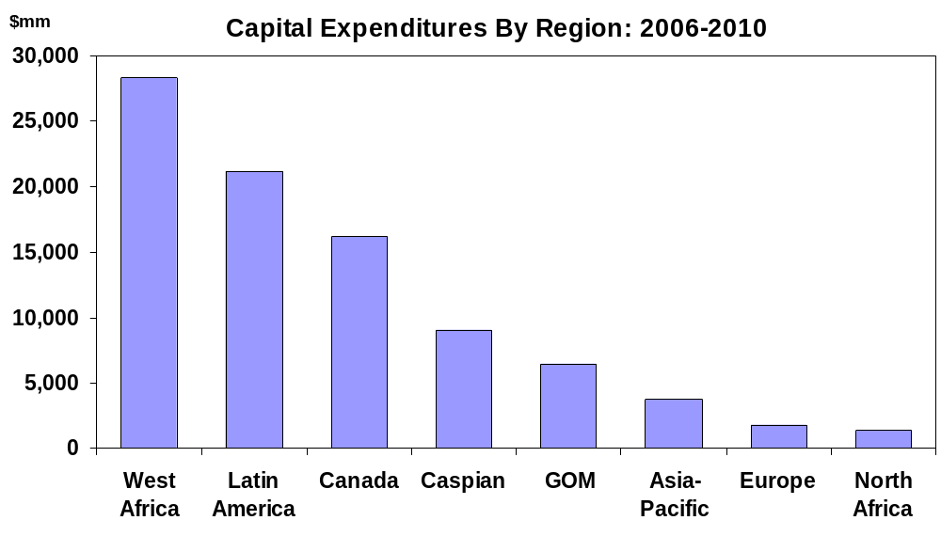
Capex Matches Production Growth Types
Capital Expenditures By Region: 2006-2010
Deepwater
Unconventionals
Central Asia

Slide 10
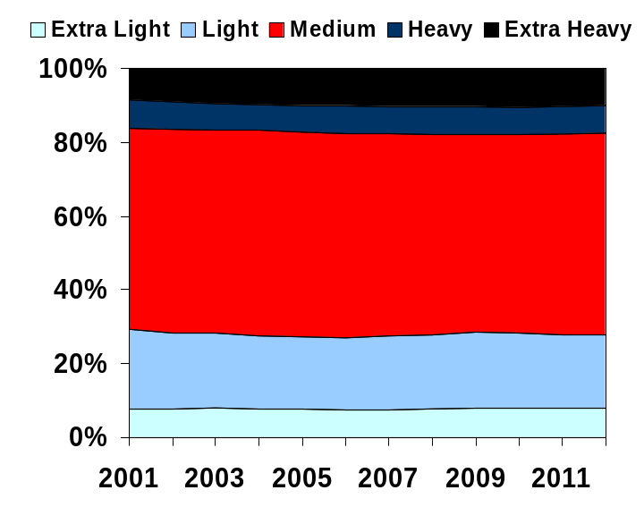
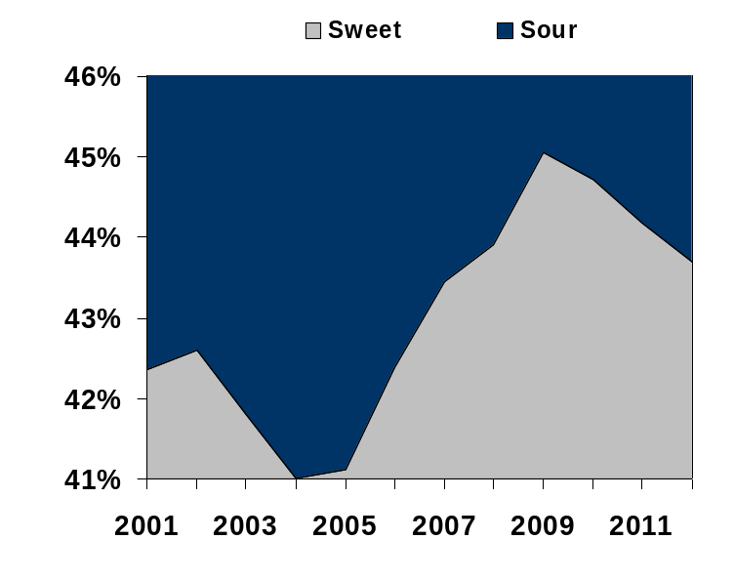
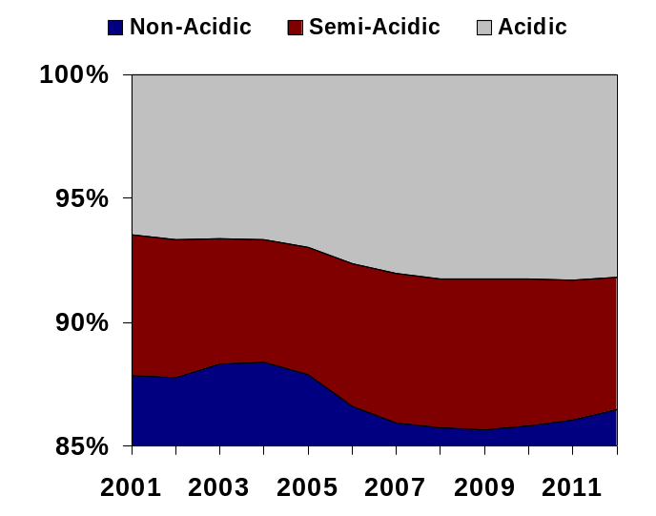
Quality Improvement Has Begun
Global Crude Slate By Gravity, Sulfur, Acidity
In the next five years the global crude slate is going to grow:
  Lighter
  Sweeter
  More acidic (one worse trend)
After 2010, trends expected to begin reversing

Slide 11
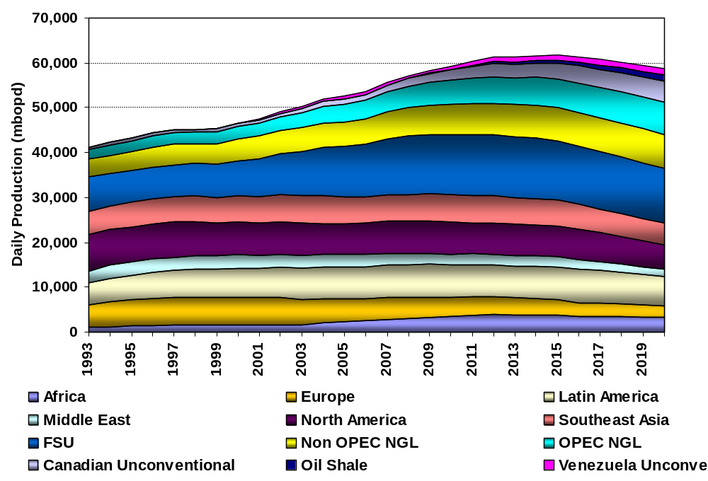
The Long-Term Context
NGL and Unconventional Heavy Supply
Conventional Supply
Conventionals: Deepwater and Central Asia are coming into their own now, temporarily overwhelming the impact of declining mature basins.
Unconventionals: Development speeding up, will keep Non-OPEC supply growth going beyond likely conventional peak early next decade.

Slide 12
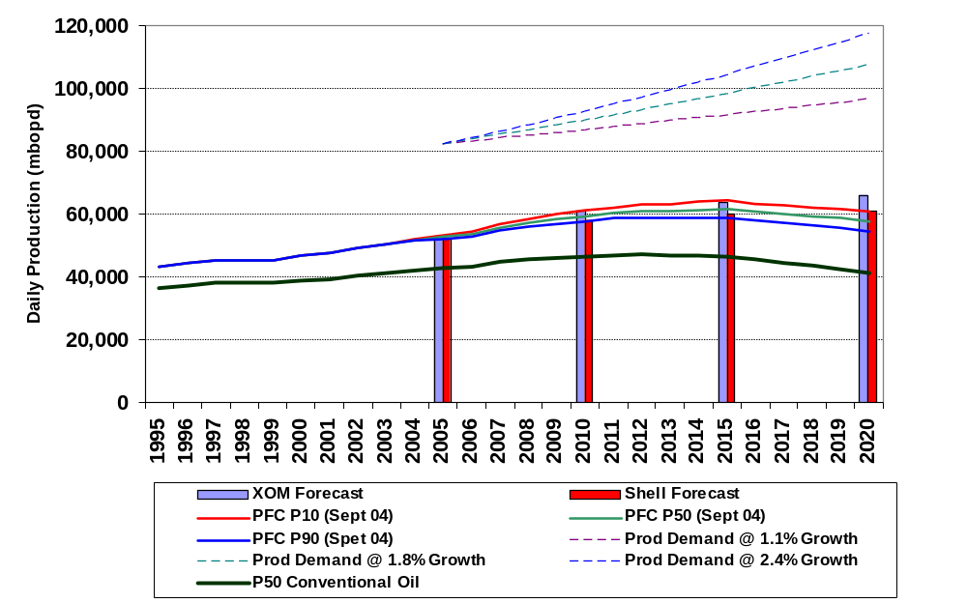
The Problem - The Expected Growing Gap Between Global Demand and Global Non-OPEC Supply in the Next Decade
Call on OPEC Crude
40 – 52 mmb/d
35 – 38 mmb/d
OPEC Crude
29 – 31 mmb/d
Forecast of Non-OPEC crude and all global NGL, Condensate, and Oil Sands

Slide 13
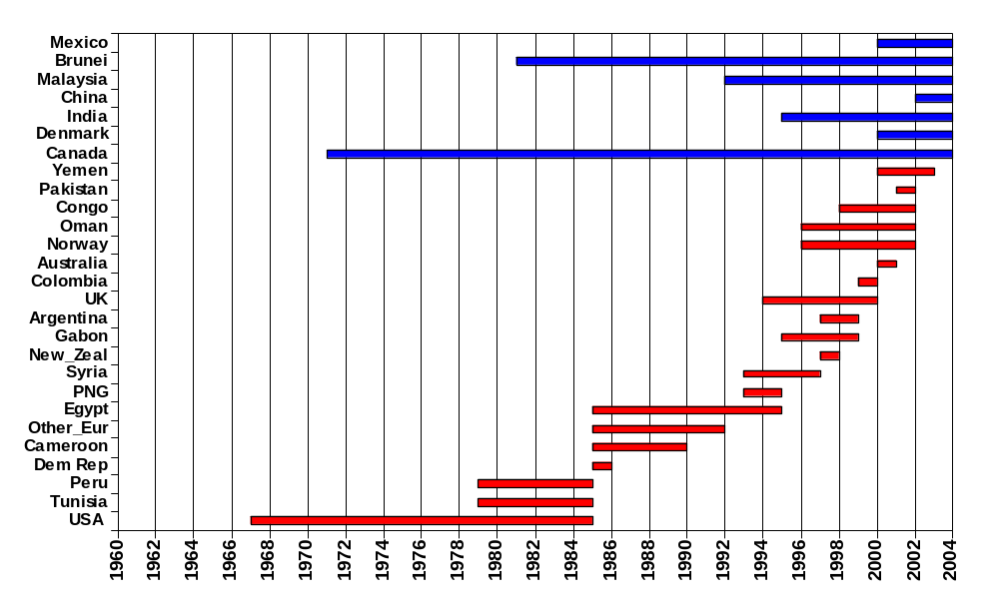
Many Non-OPEC Producers have Either Gone into Decline or Reached Plateau Since the Mid - 1990s
Countries in the plateau phase
Countries in the decline phase
Duration of Plateau
Onset of Plateau
Onset of Decline
The above bars show the onset and duration of documented production peaks or plateaus – tracking country life cycle shows an acceleration of the number of countries passing from peak to decline

Slide 14
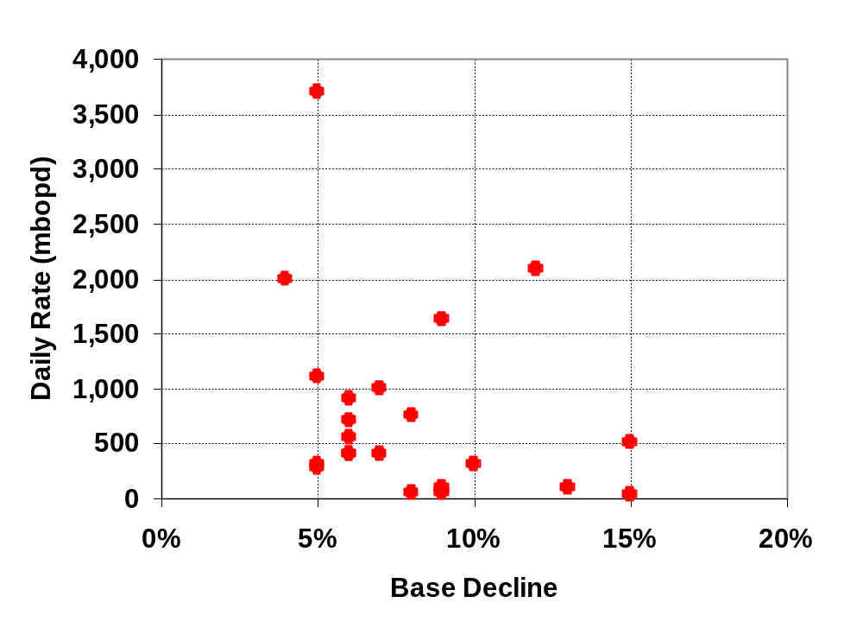
The Base Decline Underlying New Production is Higher than Generally Assumed
Weighted Average Base Production Decline Rate estimated at ~7%
The above points show the decline rate in base production (defined as fields onstream before 2000), calculated by netting “new field” production from the gross production profile

Slide 15
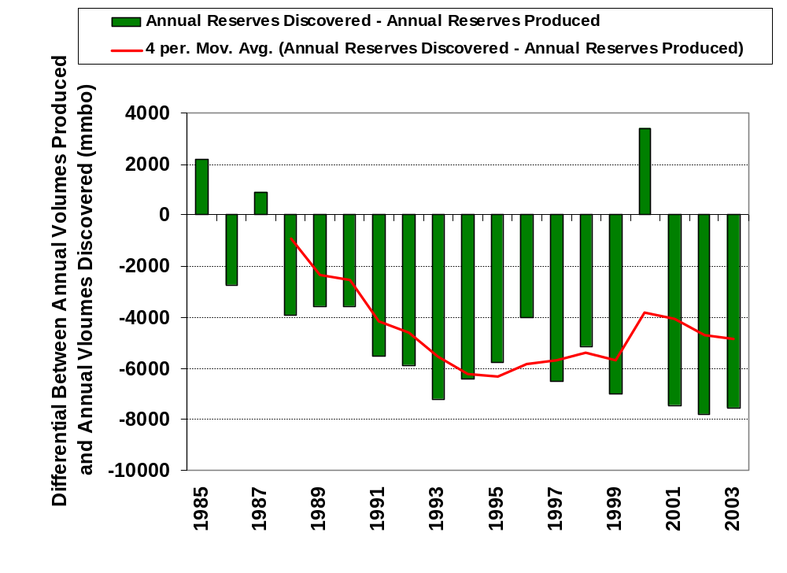
Non OPEC Annual Crude Oil Production Balance
Impact of Kashagan discovery in Kazakhstan
Global Non-OPEC crude production is currently exceeding reserves additions by as much as 8 billion barrels per year – this continuing depletion of the reserve base will ultimately lead to the inability to continue growing production rate
Note: Excludes North America and Canadian Oil Sands

Slide 16
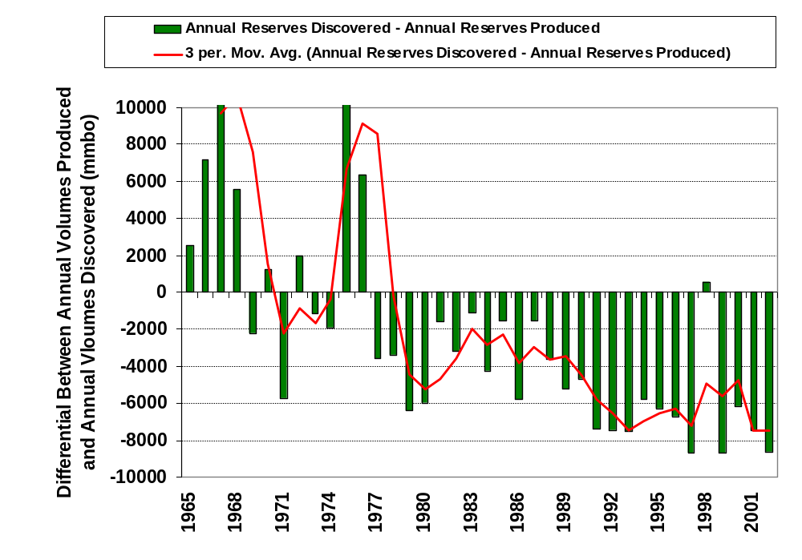
OPEC Historical Annual Crude Production Balance
Impact of Asdagan discovery in Iran
Global OPEC crude production is also exceeding reserves additions by ~8 billion barrels per year; here, the challenge lies in accelerated expansion of production capacity.

Slide 17
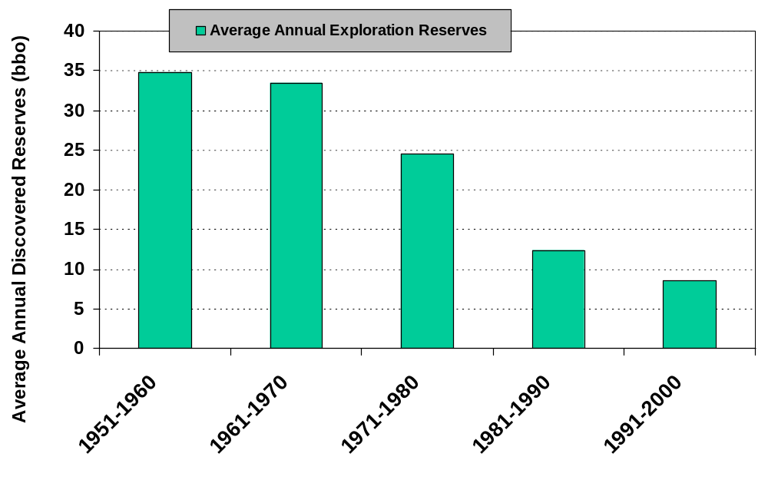
Decline in Reserves Additions + Growth in Demand => Consuming Global Liquids Inventory
1.7% Growth - Annual Volumes Required 2005-2020
Reserves Discovered Outside of North America
To stabilize depletion of Non – OPEC reserves => offset every barrel produced with a new barrel found (either through discovery or enhanced recovery); based on current and projected levels of consumption => need to return to success levels typical of the period prior to 1980

Slide 18
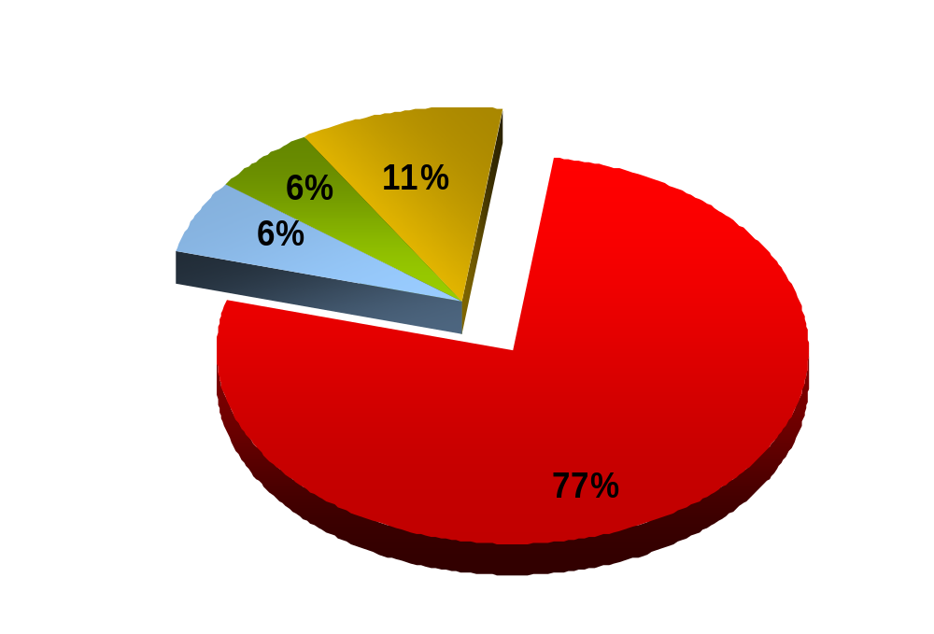
IOCs Don’t Have Access To The Big Reserves
NOC Oil Reserves
(Equity Access)
Oil Reserves Held by New Russian Companies
<25% of Oil Accessible
WW Proven Oil Reserves:
1,148 bill. bbl
Full IOC
Access
NOC Oil Reserves
(No Equity Access)
NOCs control the big reserves…
As a result IOCs are rule takers and price takers
Source: PFC Energy

Slide 19
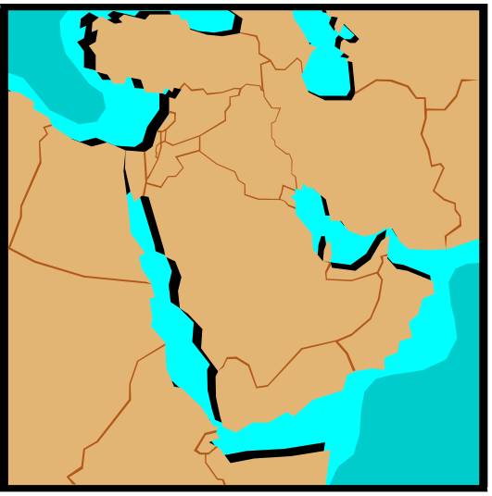
IOC Attention Will Expand to Unconventionals
Plenty Of IOC
Capital To Spend
OPEC Reserve Access Constrained
Non-OPEC
Conventional
Opportunities
Shortage of conventional opportunities in Non-OPEC for IOCs
Most projects at $60 WTI are viable at $30 as well, so supply outlook varies little
With OPEC reserves largely unavailable, capital beyond conventional opportunities flows in greater amounts to gas and unconventionals
These are “thin margin” barrels relative to conventional oil and gas; renewed “resource nationalism” will further erode the returns to the contractor (oil company)
Unconventional
Opportunities
Gas
& Related
Liquids

Slide 20
NOCs Not Financially Constrained, But Technical Resource Constrained
More adept
Statoil
Petrobras
National Asset Holders
Entrepreneurial NOCs
Petronas
S. Aramco
PEMEX
Gazprom/Rosneft
Sonatrach
Technology
CNOOC
CNPC
QP
Market Seekers
LNOC
NIOC
Sinopec
ONGC
KPC
Strategic Resource Seekers
Technology Seekers
PTT
Pertamina
EGPC
PDVSA
Ecopetrol
Sonangol
Less adept
Finance and Security
Seekers
Declining NOCs
NNPC
Resources
(domestic)
Diminishing Production
Expanding Production

Slide 21
Important Messages – 1
Non-OPEC countries are not running out of oil or other liquids.
But there are going to be significant challenges to growing conventional Non-OPEC liquids production beyond 55 mmb/d and total Non-OPEC production beyond 62 mmb/d in the early part of the next decade, without a dramatic improvement in reserve additions through exploration.
  NOTE: “Re-discovery” of the entire global deepwater resource play (some 52 billion barrels to date) would offset only 3 years of current deficit between global liquids consumption and global reserves additions
Under average/moderate demand growth projections, OPEC will be challenged to expand production capacity fast enough to address the gap between demand growth and Non-OPEC supply.

Slide 22
Important Messages – 2
If new supply sources are not found => demand will have to adjust, either abruptly/painfully, or pre-emptively/more smoothly
Medium-term supply outlook presents a serious energy policy challenge:
  Supply growth will be robust
  If demand is moderate => see spare capacity build-ups throughout the industry
  Combination results in (temporary) downward pressure on crude and product prices but with little in the “development hopper” once the deepwater production peak has been worked through
  Result: Policymakers grow more complacent about the problems emerging next decade, rather than taking advantage of this “window” to accelerate initiatives (demand-side management, alternative fuels, bio-fuels, renewables, etc.)

Slide 23
Corporate Offices
1300 Connecticut Avenue, N.W.
Suite 800
Washington, DC 20036 USA
Tel: (1 202) 872 1199
Fax: (1 202) 872 1219
Paris, France
Tel: (33 1) 47 70 29 00
Fax: (33 1) 47 70 27 37
Houston, Texas
Tel: (1 713) 622 4447
Fax: (1 713) 622 4448
London, United Kingdom
Tel: 44 (0) 1256 760678
Fax: 44 (0) 1256 760678
info@pfcenergy.com www.pfcenergy.com

