Slide 1
Outlook for U.S. Petroleum and Biofuels
Tony Radich
Energy Information Administration
Office of Integrated Analysis and Forecasting
anthony.radich@eia.doe.gov
March 27, 2006

Slide 2
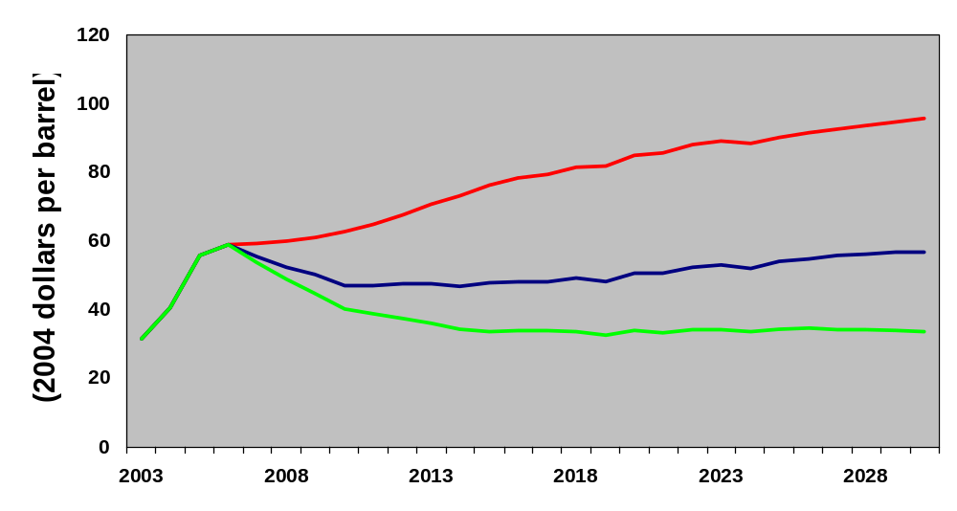
Foreign Low-Sulfur Light Crude Price Cases
High Price
Reference
Low Price

Slide 3
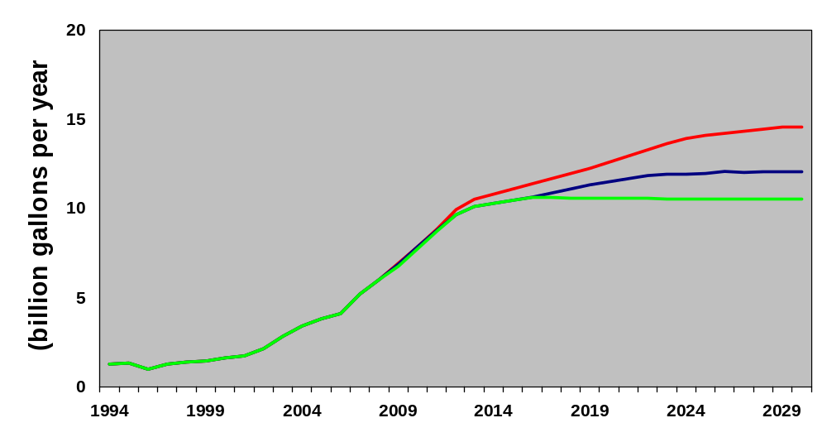
U.S. Ethanol Use By Crude Oil Price Case
(billion gallons per year)
High Price
Reference
Low Price

Slide 4
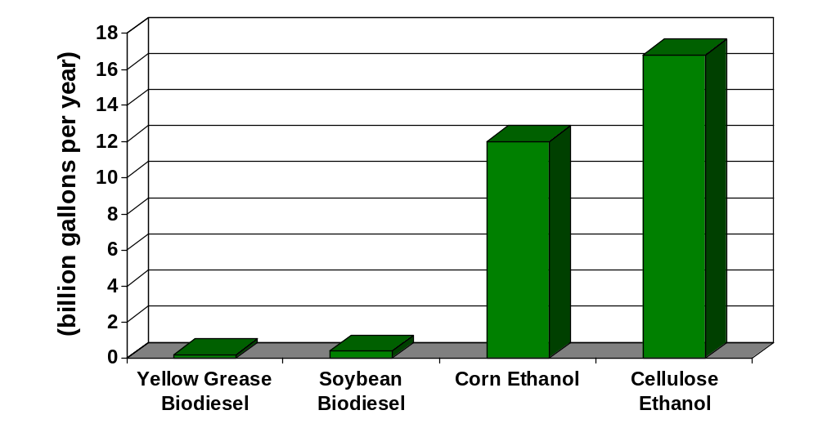
Economic Potentials for Biofuels Production in AEO2006

Slide 5
Ethanol Cost by Technology, 2012
(2004 dollars)
 | Corn Dry Mill | Cellulose
Raw Material | Corn | Crop Residue, Switchgrass
Co-product | Distillers’ Dried Grains with Solubles | Electricity to Grid
Plant Size | 50 million gallons per year | 50 million gallons per year
Capital Cost | $65 million | $369 million
Raw Material Cost | $0.90 per gallon | $0.49 per gallon
Non-energy Operating Cost | $0.25 per gallon | $0.63 per gallon
Cost of Delivered Energy | $0.21 per gallon | $0
Co-product Value | -$0.16 per gallon | -$0.12 per gallon
Variable Cost | $1.20 per gallon | $1.00 per gallon

Slide 6
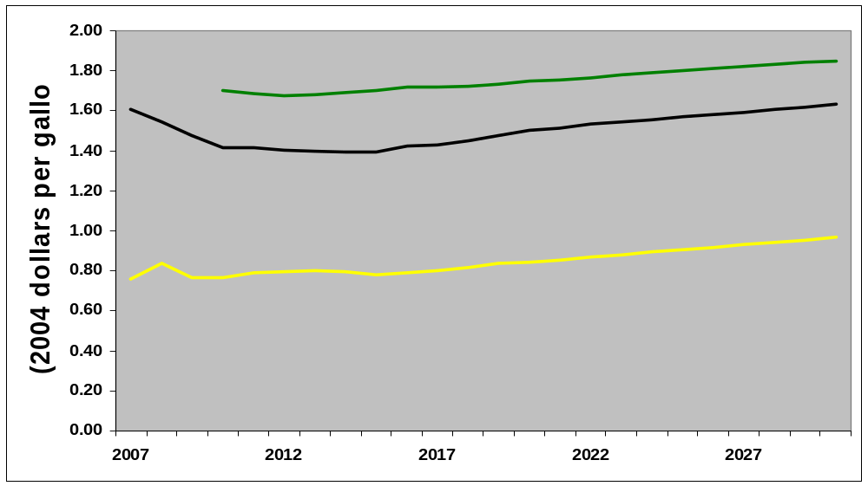
Comparison: West North Central Division Ethanol Costs Including Tax Credit Versus Gasoline
Cellulose, maximum of 0.17 BGal/yr
Conventional Gasoline
Dry Mill, maximum of 9.1 BGal/yr

