Slide 1

U.S. GRAIN ETHANOL INDUSTRY OUTLOOK
Hosein Shapouri
USDA/Office of Energy Policy & New Uses
EIA Energy Forecasting Conference
Washington, DC, March 27, 2006

Slide 2
OVERVIEW
Current agriculture system
Resource base
Major use of cropland
Major crops-coarse grains, wheat, soybeans, and all hay
World’s current agricultural problems
Conclusions

Slide 3
Current Agriculture System
Large farm size
Highly capital intensive
High tech, hybrid and genetically modified seeds, precision farming and variable rate technology, yield mapping, center pivot irrigation systems, etc.
High yield
Provide food, fiber, and nonfood for domestic and export markets
Creates excess production and declining prices

Slide 4
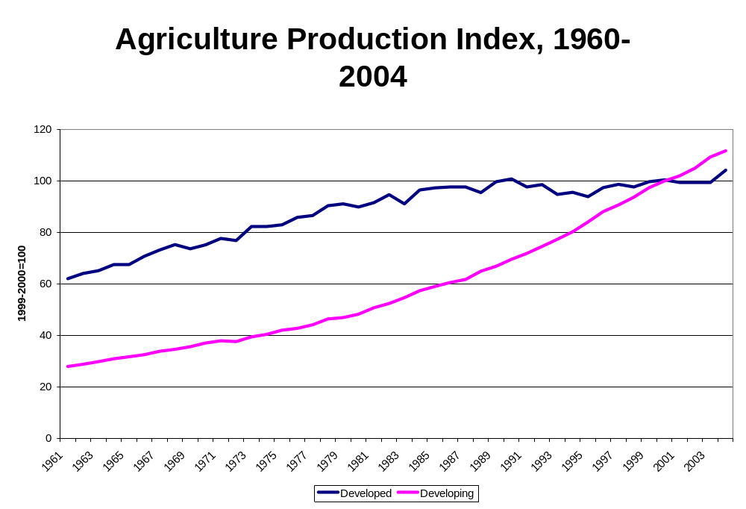
Source: FAO/UN

Slide 5
Biomass Feedstocks
Crops containing:
Starch--grains, roots, etc.
Sugar--sugar beets, sugar cane, sweet sorghum, etc.
Oil--soybeans, rapeseed, peanuts oil, etc.
Energy crops
Byproducts--molasses, cheese whey, etc.
Animal fats--tallow, lard, etc.
Agriculture and forestry residues
Organic wastes--waste sugar and starch, sorted municipal solid waste, etc.

Slide 6
Resource Base
Total land:
  Forest
  Pasture and range
  Cropland
  Others

Slide 7
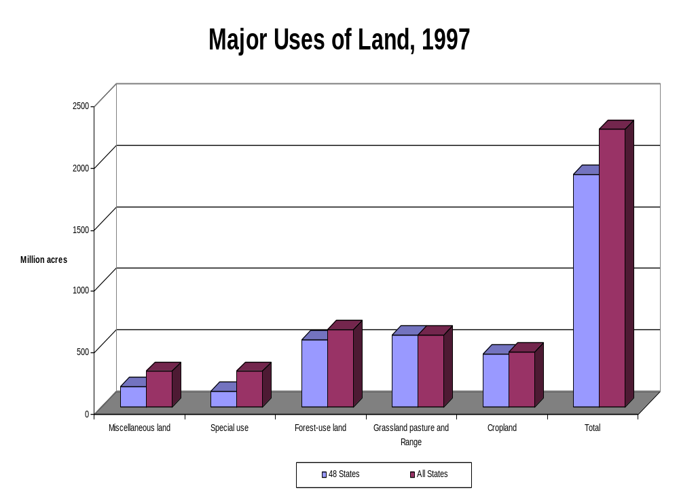

Slide 8
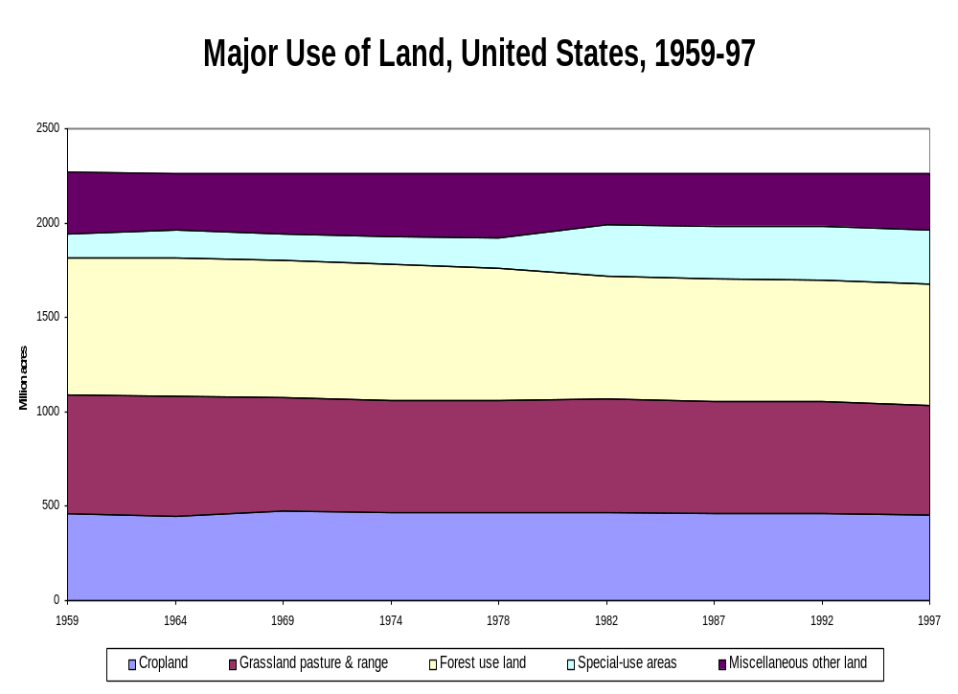

Slide 9
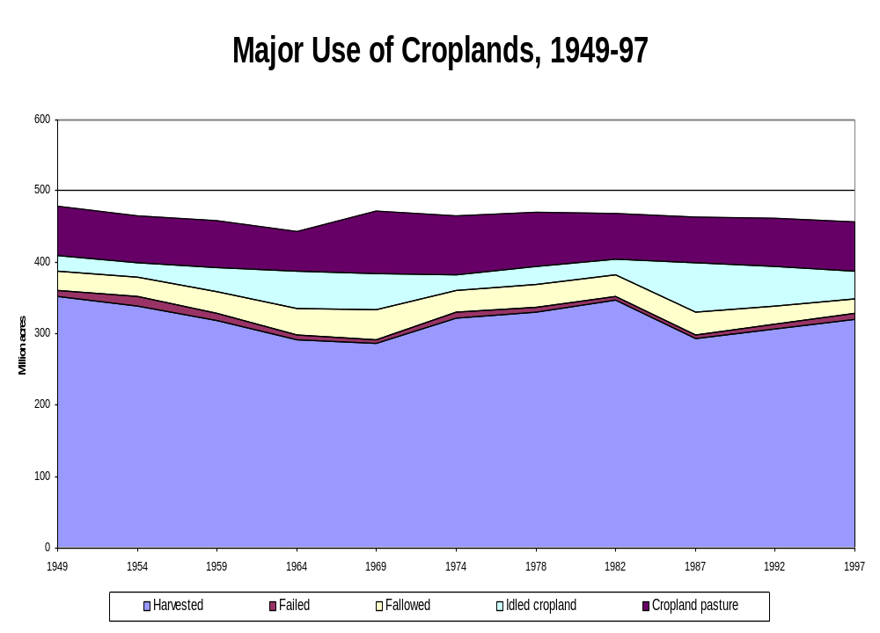

Slide 10
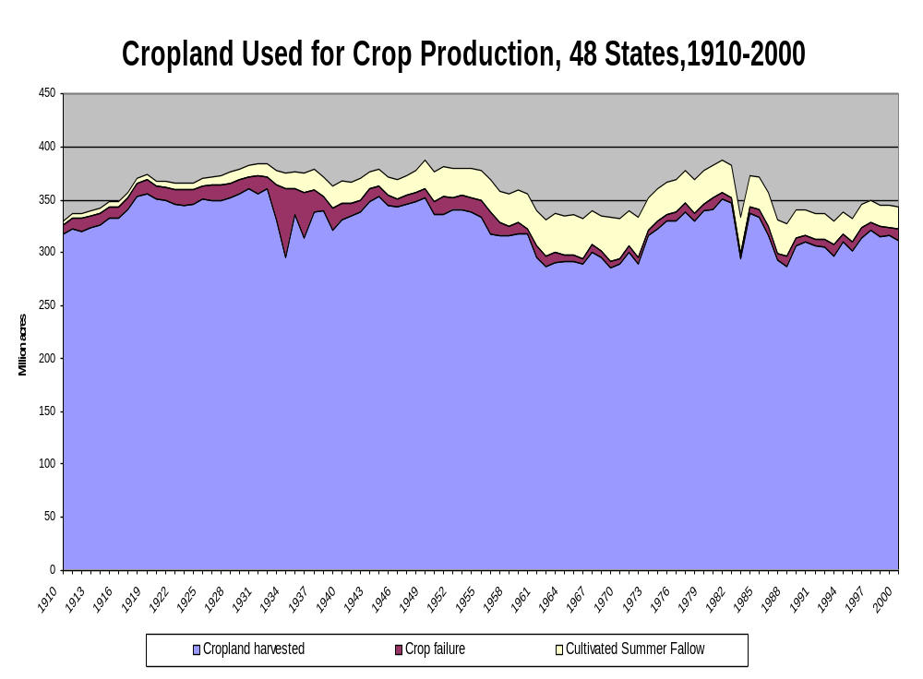

Slide 11
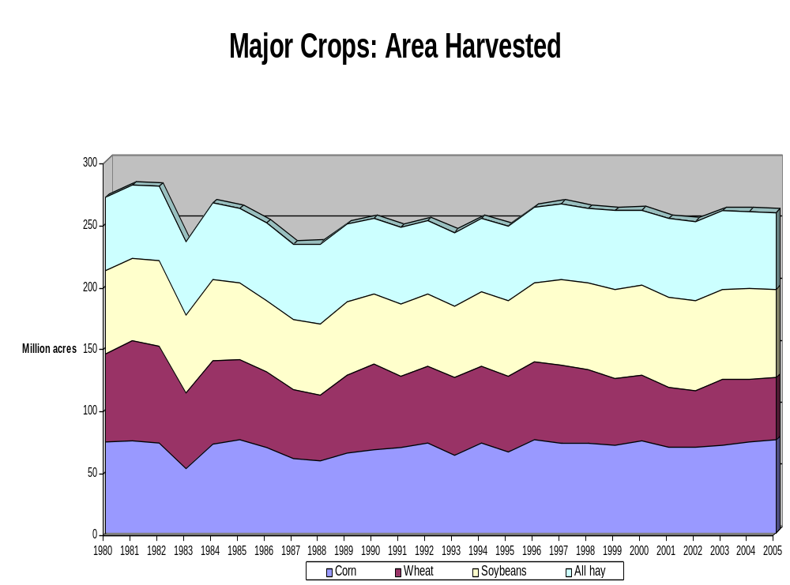

Slide 12
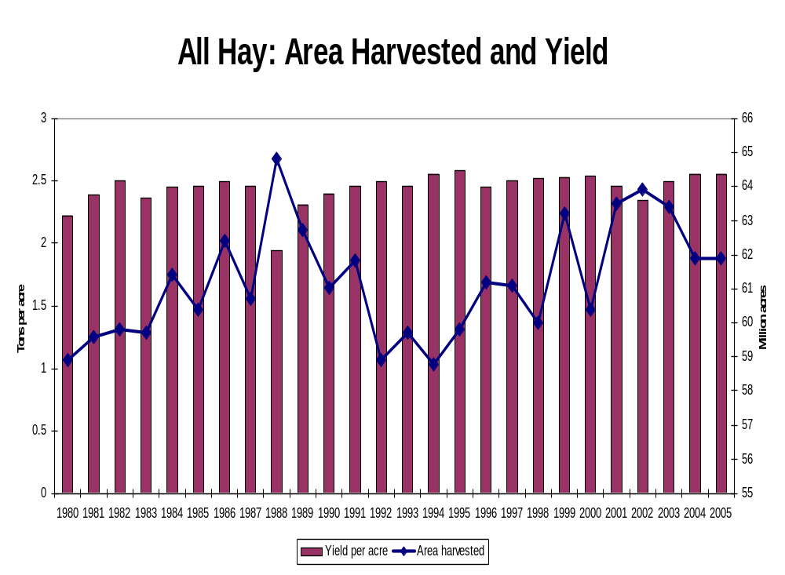

Slide 13
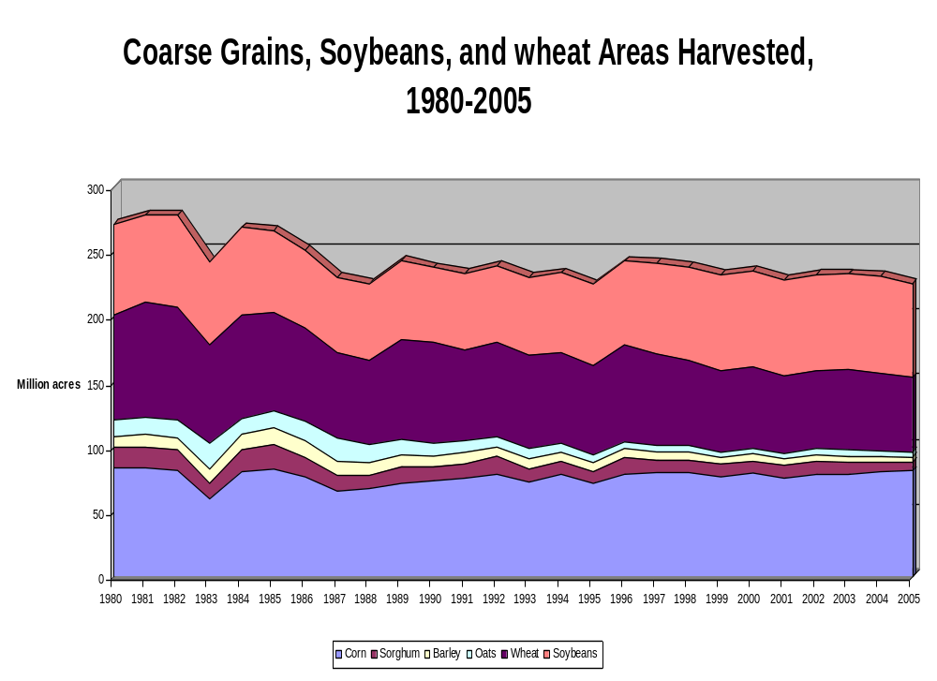

Slide 14
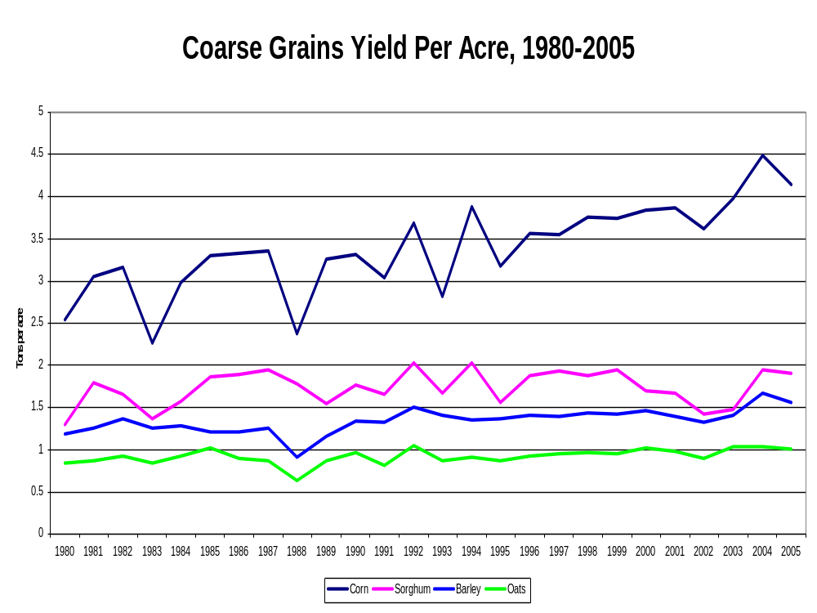

Slide 15
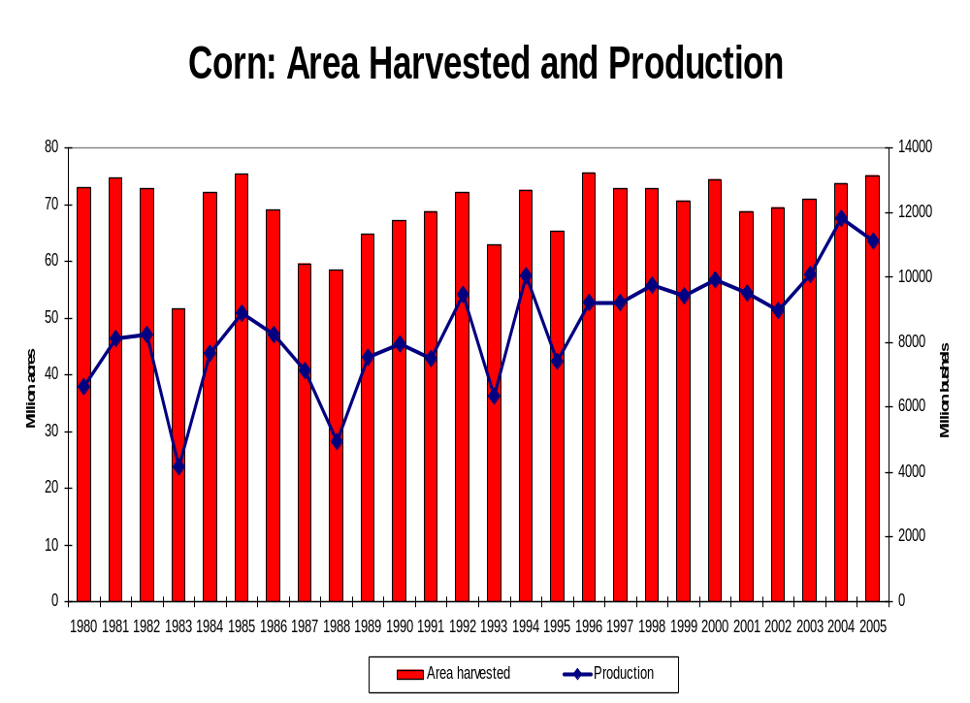

Slide 16
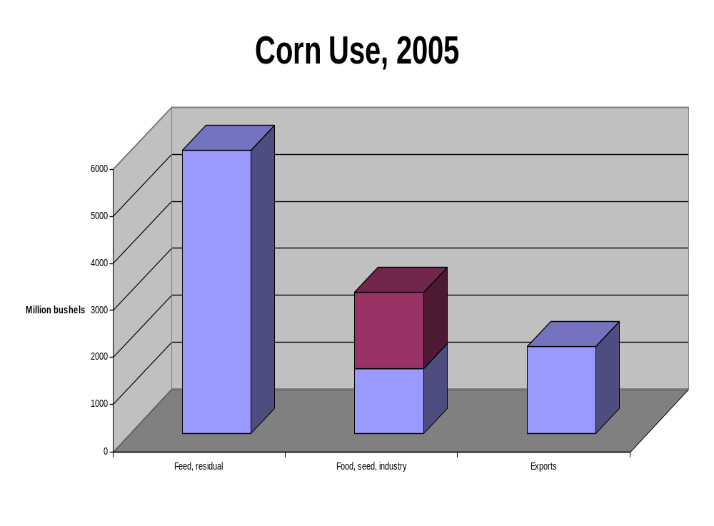
52%
14%
18%
13%

Slide 17
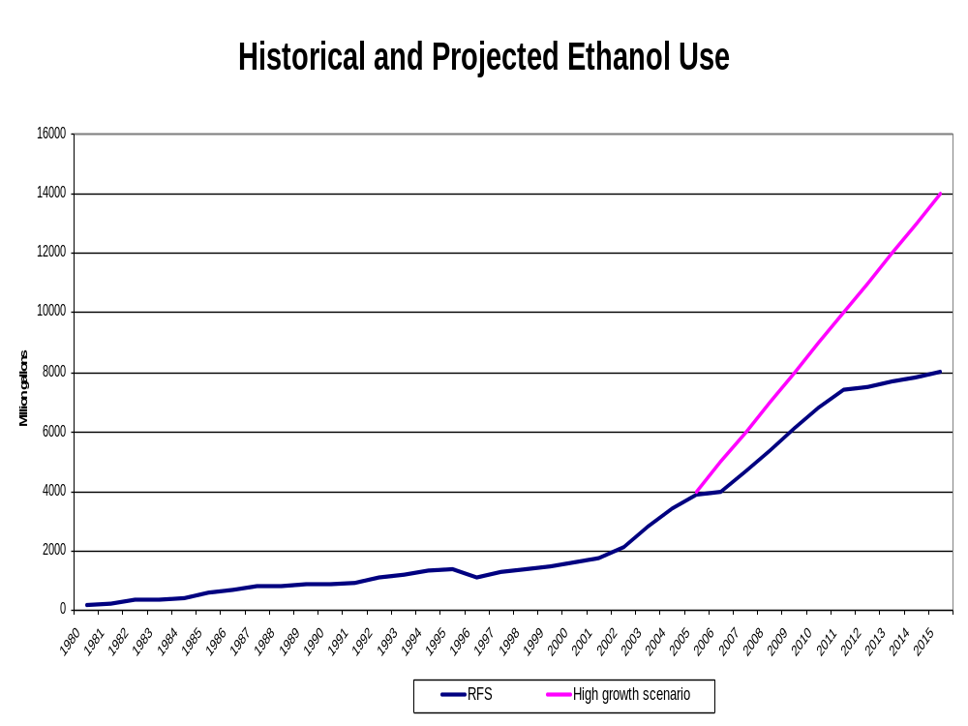

Slide 18
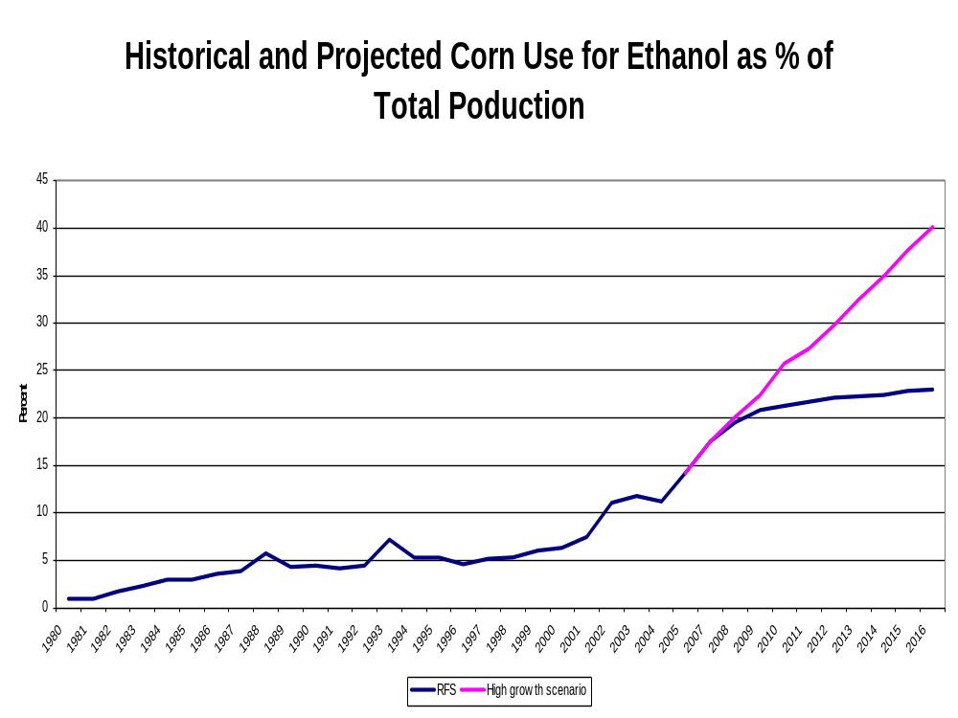

Slide 19
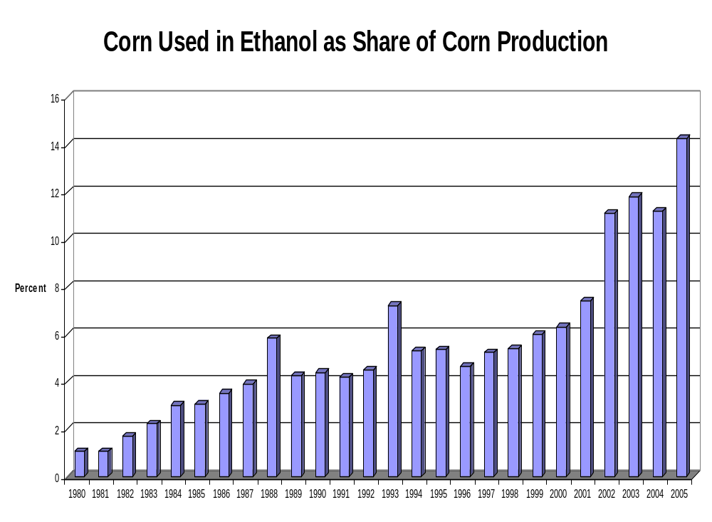

Slide 20
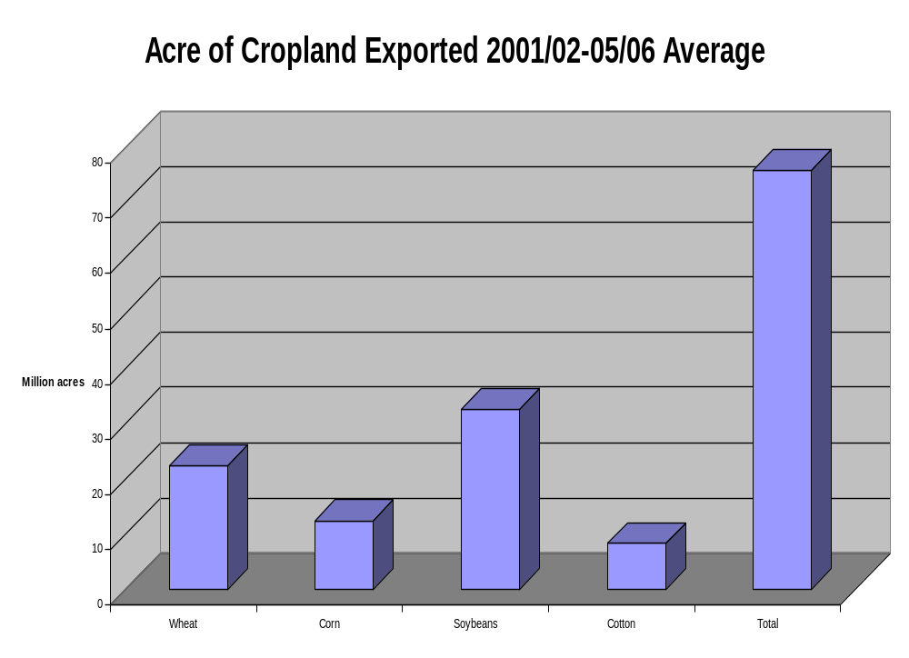

Slide 21
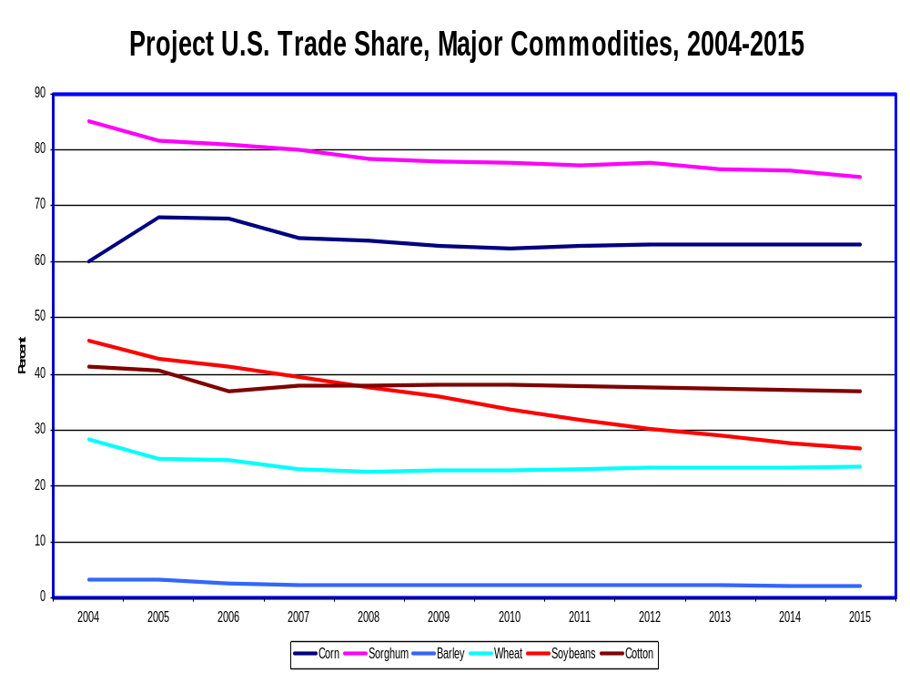

Slide 22
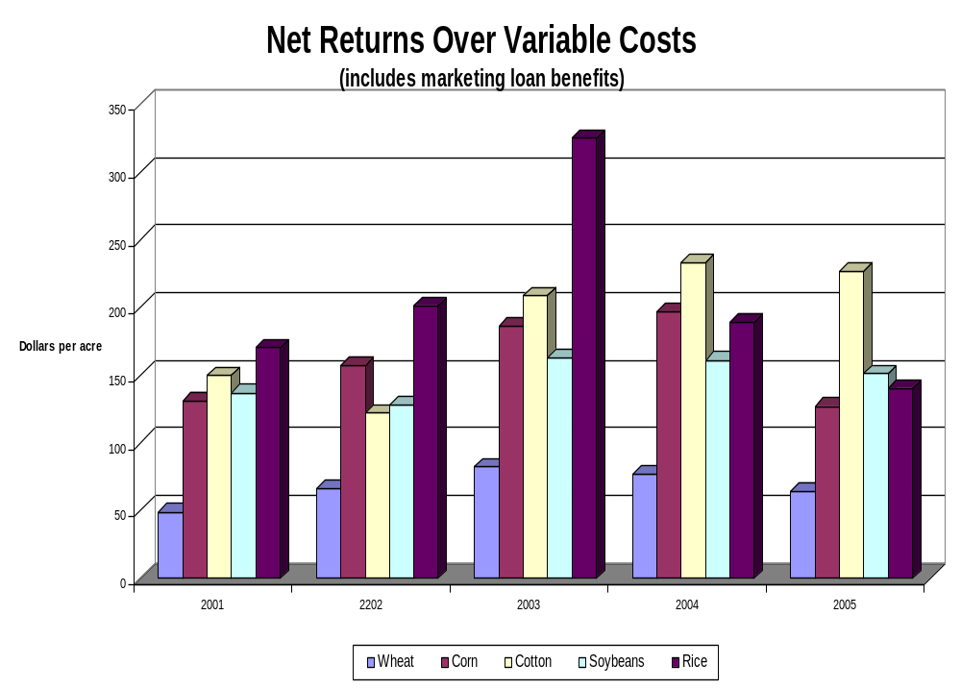

Slide 23
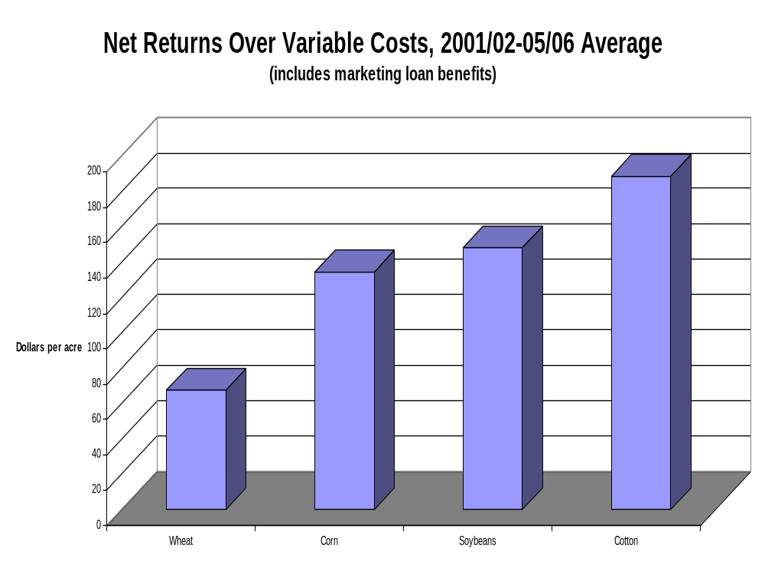

Slide 24
World’s Current Agricultural Problems
Growing subsidy, increasing production incentives, and trade barriers
Major R&DD breakthrough leading to excess production
Exceptional production growth in developing countries adds pressure on production incentives
Stagnated food demand in mature markets
Aggressive competition in exports market

Slide 25
Agriculture Beyond Food
Food:
  Products differentiation
  Boutique commodities
  High-value products, organic food, and GM free food products
Nonfood:
  Biobased products, biofuels, solvents, adhesives, plastics, hydraulic fluid, pharmacutical, panels, foam, light weight cement, nutraceutical, etc.

Slide 26
Conclusions
Currently, corn is the lowest feedstock for production of ethanol in the U.S.
Corn use for production of ethanol will continue to increase
Existing cropland and cropland idled by Government programs (CRP) could be used to grow corn and other feedstock for production of biofuels, biopwer and biobased products

