Slide 1
EMERGING UNCONVENTIONAL
LIQUID PETROLEUM OPTIONS
Presented at the annual
EIA Energy Outlook and Modeling Conference
March 27, 2006
Washington, D.C.
by
Dale Simbeck
SFA Pacific, Inc.
444 Castro Street, Suite 720 phone: 1-650-969-8876
Mountain View, California 94041 fax: 1-650-969-1317
web home page: www.sfapacific.com e-mail: info@sfapacific.com

Slide 2
Presentation Overview
Background
  SFA Pacific
  When will the oil age peak
  Impacts of higher oil prices
  What happens if we really move into a carbon constrained world
Unconventional oil supply options
  CO₂ enhanced oil recovery (EOR)
  Oil sands & ultra heavy oil
  Oil shale
  Oil substitution - clean alternative liquid fuels via syngas-to-liquids (STL) from natural gas, coal & biomass plus ethanol & biodiesel
Outlook and Summary

Slide 3
SFA Pacific Background
Founded in 1980
Performs technical, economic & market assessments for the major international energy & engineering companies
  Over 40% of our work is consistently outside the United States
Principal work involves heavy oil upgrading, syngas (H₂ & CO), electric power generation & emissions control
Niche is objective outside opinion & comparative analysis before companies make major decisions or investments
Unique perspective with no vested interest in engineering, resources, technologies, R&D or project development

Slide 4
Famous Hubbert Curve Peak Oil Analysis
In 1956 M. King Hubbert, a Shell Oil geologist, predicted USA domestic oil production would peak in the early 1970s
  In spite of much ridicule from his peers, he was correct for the USA
  This famous paper was focused on promoting nuclear energy and also predicted that USA NG would peak in 1973 & world oil would peak in 2000 at 33 million bbl/d, both quite wrong
  Hubbert curve analysis continues today by mostly oil peak “doomsayers” who are usually predicting the oil peak is only few (2-5) years away for the last 26 years (since the 1980 oil price price run-up)
Hubbert peak curve analysis is based on a bell curve analysis with the key input being a fixed recoverable resource
  Fixing the recoverable resource is questionable due to our poor ability to predict future technology improvements & impact of oil prices

Slide 5
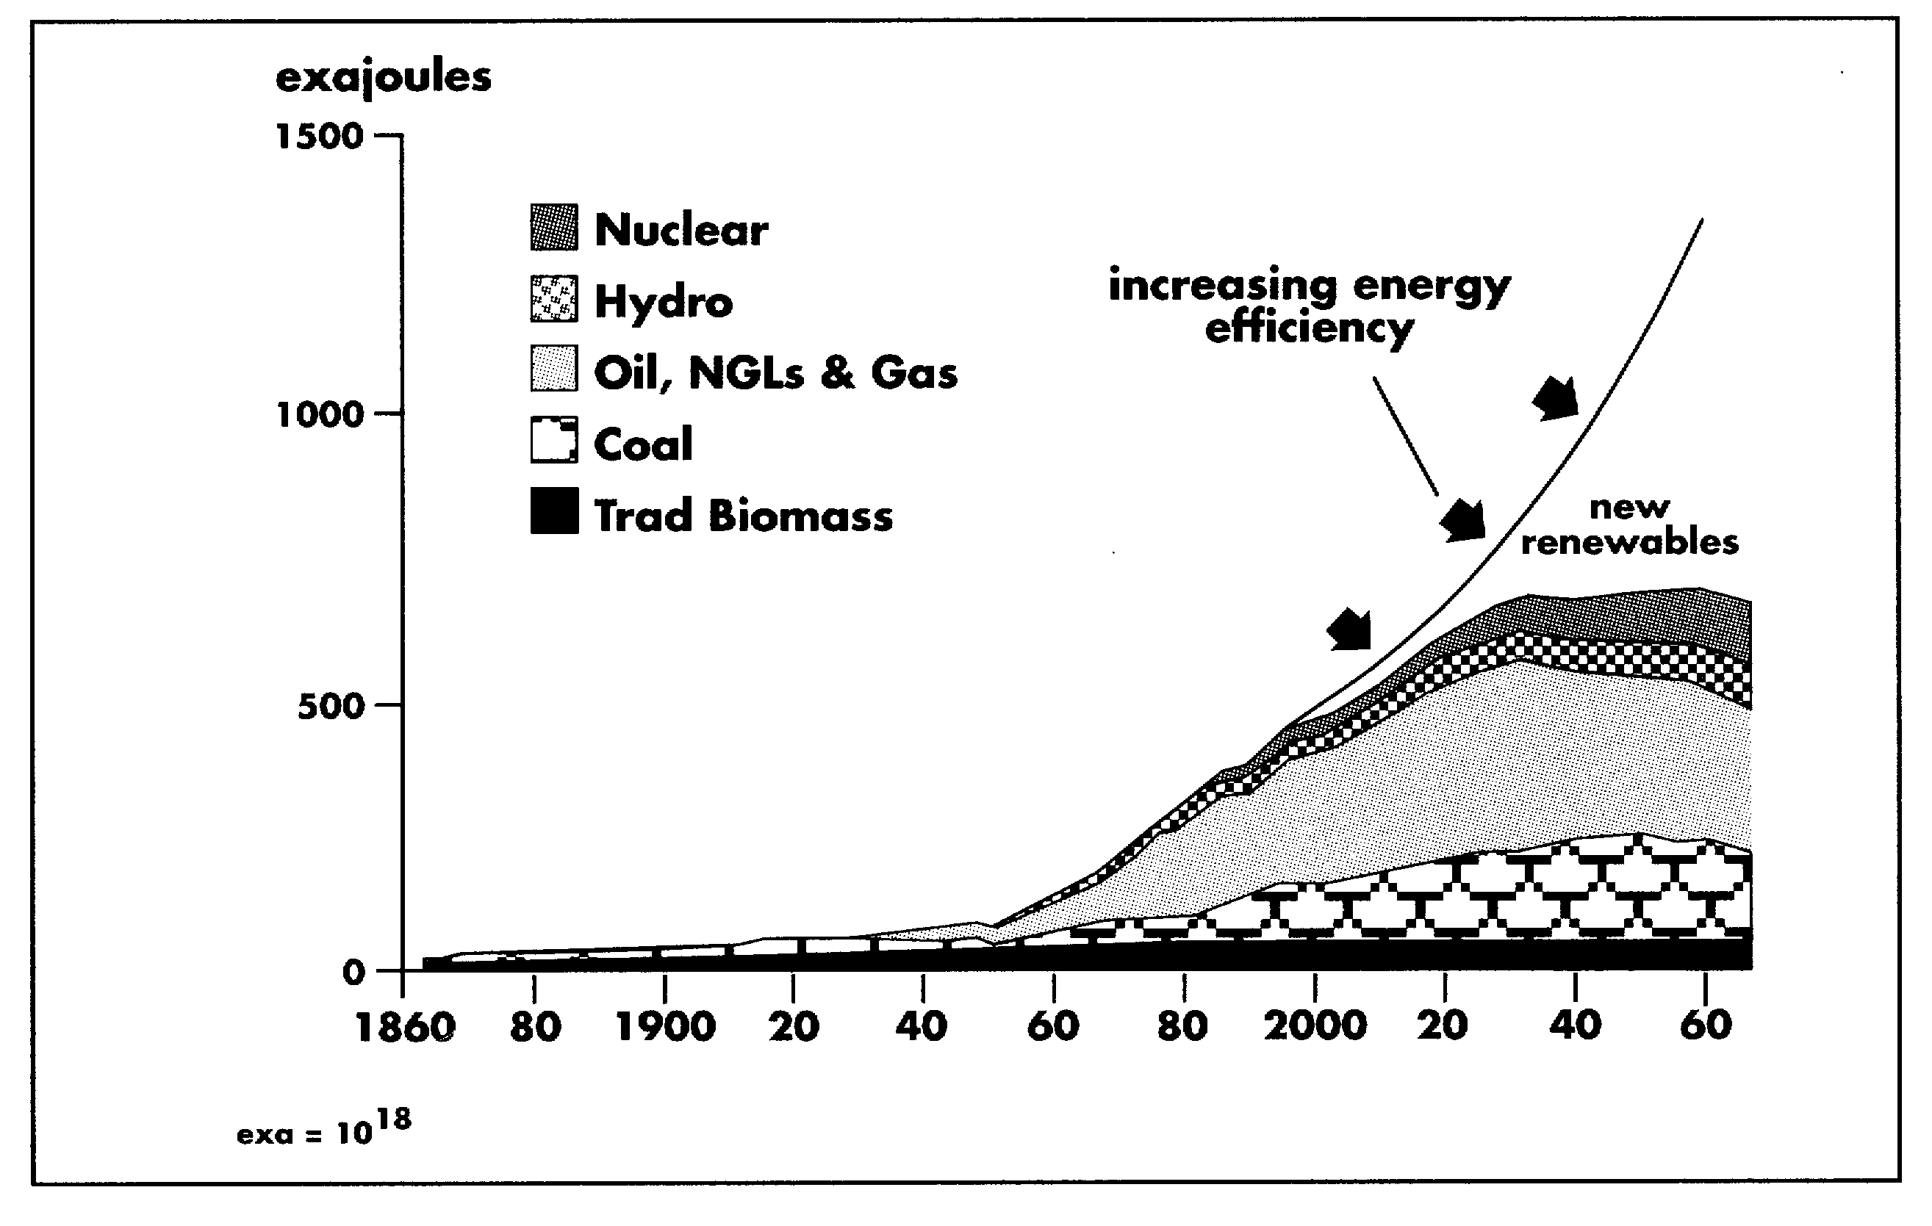
Shell’s Famous 1996 World Energy Supply/Demand Projection
Shows the long-term importance of increasing efficiency & new renewables
Projected oil & NG peak in about 2030
Source: Paper by C.A. Herkstroter (managing director of Royal Dutch Shell), “A Continuing Contribution--Oil and Gas in the 21st Century”, presented at Nymphenburg Talk, Munich, June 19, 1996

Slide 6
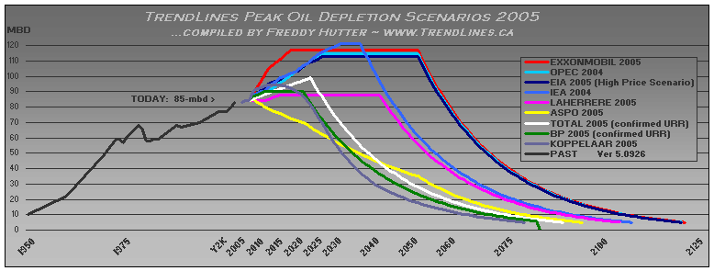
Big Range In Current Oil Peak Projections
The realization of this inevitable oil peak might keep oil prices high

Slide 7
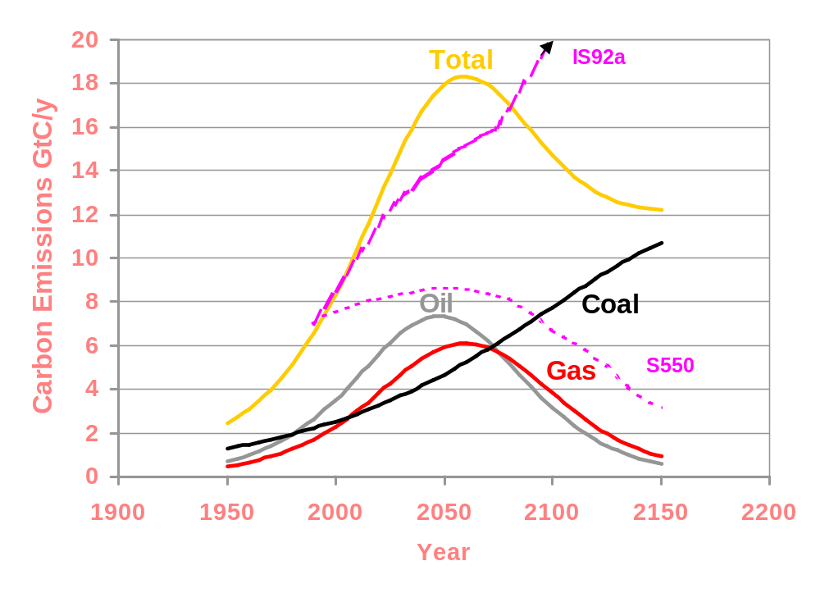
SFA Pacific’s Worst (Latest) Case Projection of the Fossil Age Peak
Note:
CO₂ emissions as carbon not units of energy
Also the IPCC IS92a beyond 2050 Gt/y carbon projection is highly questionable
Source: SFA Pacific, Inc.

Slide 8
Hubbert Curve Oil Peak Doomsayers Commonly Ignore Several Basic Issues:
How consistently wrong everyone’s past projections have been, being too negative or conservative on future oil supplies
Typical remaining oil in place (ROIP) is still 60-70% of the original oil in place (OOIP) when defined as unrecoverable
  Long-term it is likely reasonable to expect doubling of total production to ROIP down to only 30-35% of OOIP
  Increasing oil recovery via improving technologies & higher oil prices
Unconventional oil options, the focus of this presentation
The inevitable oil peak will be when oil supplies vs. demand makes oil prices high enough that other options become more economical - we are only running out of cheap oil

Slide 9
High Oil Prices Generates More Conservation Plus Increased Oil Supplies & Oil Substitution
Oil conservation driven by higher fuel prices (oil price & taxes)
  Large potential in just replacing current 15 mpg SUVs with 30 mpg clean diesels & hybrid SUVs
  Large potential by also reducing vehicle weight - smaller & lighter SUVs & autos, regardless of power source - 15 mpg SUV vs. 60 mpg compact
Increased oil supplies from unconventional oil such as: CO₂ EOR, heavy oil, oil sands & shale oil - driven by high oil prices
Oil substitution via syngas-to-liquids (STL) from remote natural gas (GTL) & coal (CTL) - become economical at high oil prices
However, 5-10 years lag time due to the long life of energy use equipment & high capital cost of energy investments

Slide 10
What If We “Really” Moved Into a “Carbon Constrained World”
  Conservation & energy efficiency significantly increase as energy prices rise to reflect increasing realization that oil & NG could peak in 10-40 yr.
  Natural gas demand/prices go up while coal & oil residue demand/prices go down as CO₂ avoidance & emission cost gains “real” market values
  Nuclear will eventually make a big comeback, however, not for 20-30 years, until life-extensions & upgrades + eventual decommissioning of current fleet + we honestly assess why nuclear power failed the 1st time
  Renewables become increasingly important but have limitations
    Intermittent solar PV & wind turbines cannot replace baseload coal power
    Beyond waste biomass, bioenergy requires cheap land & ultra-cheap labor
  CO₂ capture & storage (CCS) of fossil fuels becomes strategic for technical, economic, energy resource & overall reduction perspectives
    Once big coal CCS units can co-process biomass for “double reductions”

Slide 11
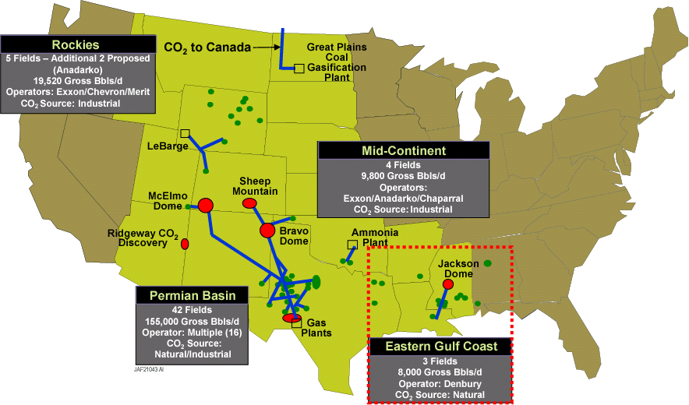
Over 25 Years of Experience - Currently 35 Million t/y CO₂ Storage (with 30% from Anthropogenic CO₂ Sources) producing 250,000 bbl/d of Enhanced Oil Recovery (EOR)

Slide 12
CO₂ EOR CCS Using Anthropogenic CO₂
State/
Province
Plant
Type
CO₂
EOR
Fields
Million t/yr
Operator
Texas Gas Processing 1.6 Sharon, Ridge, etc. ExxonMobil
Colorado Gas Processing 1.3 Rangely ChevronTexaco
Oklahoma Fertilizer 0.7 Purdy, Sho-Ven-Tum Anadarko/ Chaparell
Wyoming Gas Processing 3.6 Lost Soldier, Salt Creek ExxonMobil
Alberta Ethylene Plant 0.5 Joffre Viking Numac Energy
Saskatchewan Coal Gasification 2.0 Weyburn EnCana
& North Dakota
------
North American Total 9.7 million tons per year CO₂
This is almost 30% of the total North American EOR of about 35 million t/y
For comparison North Sea Sleipner Aquifer CO₂ injects only 1.0 million t/y

Slide 13
Large CO₂ EOR Opportunity While Also Reducing CO₂
Currently 0.25 million bbl/d EOR while storing 35 million t/y CO₂ with total USA domestic oil production at only 5 million bbl/d and total USA proven reserves of only 21.9 billion bbl
Feb. 2006 DOE Report by ARI estimate of USA EOR potential:
  582 billion barrels OOIP & 389 billion barrels ROIP (67% of original IP)
  47 billion barrels (economic potential, current technology)
  89 billion barrels (technical potential, current technology)
  129 billion barrels (technical potential, advanced technology)
  Exploitable U.S. CO₂-EOR potential up to 3 million bbl/d by 2020
    CO₂ requirements - about 0.5 billion t/yr CO₂ or 9% of U.S. total
EOR is currently limited by CO₂ supplies - must develop cost effective man-made CO₂ supplies as this is a big “win-win”

Slide 14
Large CO₂ EOR Potential Gaining Support
North Sea: BP announced NG to H₂ for power with CO₂ capture for EOR Statoil & Shell - NG to power & MeOH with CO₂ capture for EOR
California: BP announced refinery coke gasification for H₂ to power with CO₂ for local EOR
East Texas: Strong Texas State government supporting refinery coke or coal gasification to refineries H₂ & power with CO₂ capture for EOR
Western Canada: Considering CO₂ pipeline for Fort McMurray oil sands upgrading sources of CO₂ for EOR amenable oil fields near Edmonton
Alaska North Slope: Considering CO₂ from clean-up of NG for the planned North Slope NG pipeline with CO₂ capture for EOR
Expanding existing CO₂ EOR systems + additional potential in other North American oil fields (including Midwest & Mexico)

Slide 15
Oil Sands and Ultra-Heavy Oil
Alberta, Canada - Heavy oil and mostly “oil sands”
  Recoverable resource estimated at >180 billion bbl - big increase due to the development of Steam Assisted Gravity Drainage - SAGD
  Oil sands production already 1 million bbl/d & conservatively estimated to grow to 3 million bbl/d by 2020 - $70 billion being invested
  Total resource about 1,600 billion bbl
Venezuela - mostly Orinoco “extra heavy crude”
  Recoverable resource estimated at 272 billion bbl
  Current production total approaching 3.5 million bbl/d with 0.5 million bbl/d from Orinoco but political instability hurting growth
  Total resource about 1,900 billion bbl
Other steam stimulated heavy oil EORs in USA & Mexico

Slide 16
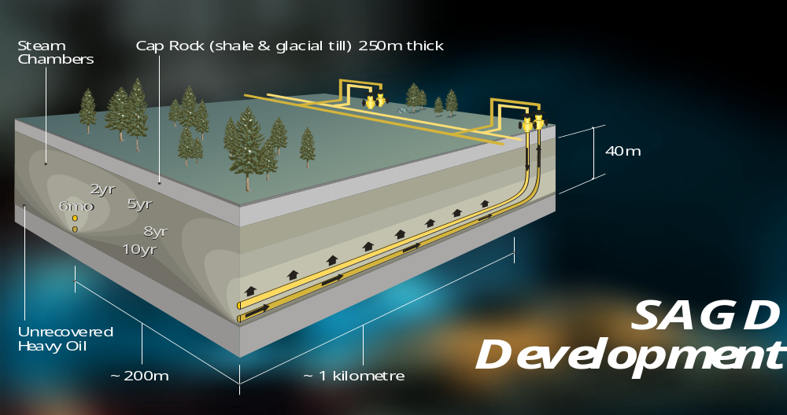
Steam Assisted Gravity Drainage
Source: Suncor

Slide 17
Oil Shale
Perhaps the most technically & economically challenging unconventional oil resource
  Due to the low energy (oil) content per ton of oil shale “rock”
  However, massive resource (over 1,500 billion bbl in just the USA) thus the size of the recoverable “reward” warrants high risk R&D efforts
  Innovative R&D efforts underway by several major energy companies
Will likely require innovative new in-situ process to:
  Reduce massive solids handling, thermal processing & water use
  Avoid massive CO₂ emissions of carbonate rock calcinatiion
Oil shale is an important domestic oil resource, however impacts likely minor for the next 25 years
  Nevertheless, expect some innovative demonstrations in the future

Slide 18
Oil Substitution at High Oil Prices via
Syngas (H₂ & CO)-to-liquids (STL)
Growing F-T diesel + some methanol, ethanol, mixed alcohol, dimethyleither & even H₂ (for FCV) as transportation fuels
  Syngas-to-liquids via remote natural gas GTL: already 50,000 b/d with >1 million b/d F-T & MeOH under development in Qatar, Nigeria & Iran
    Higher capital & lower efficiency than LNG but GTL gives better net-back value & market flexibility to the remote NG resource owner
  Syngas-to-liquids via coal CTL: already 150,000 b/d F-T operating in South Africa with >400,00 b/d being proposed in Australia, China & U.S.
    Very high capital & low efficiency requires cheap coal & high oil prices
  Coal gasification for syngas-to-liquids or H₂ has nice co-benefits
    Can easily co-feed what ever waste fuels are available, like waste biomass
    Large pure CO₂ vent - thus cost effective large source of CO₂ for EOR

Slide 19
National Academies Recent 2003 Hydrogen Economy Report - Major Finding
  Could have a major impact in the next 50 years - conducting RD&D to determine whether a hydrogen economy might be realized is important
  H₂ must be economic, safe & appealing, & offer energy security & environmental advantages - four fundamental RD&D challenges
    Economic, durable, safe & environmentally acceptable FC & H₂ storage
    Infrastructure to provide H₂ for FCV
    Sharply reduce costs of H₂ production from renewables
    If policies for CO₂ reduction develop, capture & storage of CO₂ from coal gasification H₂ production may become an important technology
  Transition period is likely to be lengthy
  H₂ FCV can reduce imported energy via use of domestic coal, nuclear & renewables - however impacts likely minor for the next 25 years

Slide 20
Oil Substitution at High Oil Prices via Renewable Energy Alternative
Ethanol & biodiesel - discussed by others at this conference
  Key issues: size of required subsidies, unsustainable use of aquifer water & low liquid fuel yield per year per acre (or hectare) of land use
  Most of subsidies paid to the big distillers with few benefit to farmers
Waste biomass for substitute liquid fuels is likely better
  Could be cellulosic ethanol, aggressively promoted in North America
  Europe appears to favor waste biomass to syngas-to-liquids due to twice the liquid fuel yield year per unit of land use vs. ethanol
  However more likely co-processing any waste biomass in large coal based syngas-to-liquids units is more cost effective, even with CCS
    Essential economy-of-scale for gasification to make the syngas & avoids massive seasonal biomass storage or low annual load factors

Slide 21
Outlook
Potential for worldwide unconventional oil by 2025 in millions of bbl/d crude oil equivalents if oil prices stay above $45/bbl
  Options MM bbl//d COE Key location
  CO₂ EOR 3-6 USA
  Oil sands 4-5 Canada
  Ultra heavy oils 4-5 Venezuela
  Syngas-to-liquids from remote NG 2-3 Middle East
  Syngas-to-liquids from coal/biomass 1-2 China & USA
  Ethanol without subsidies <0.5 Brazil
  Ethanol & biodiesel via big subsidies <0.5 USA
  Oil shale only demos USA
  Total 15-22 million bbl/d

Slide 22
Summary
We are only running out of cheap oil
  Nevertheless, the Hubbert curve “doomsayers” will likely keep public attention on the peak in the oil age, which helps keep oil prices high
High oil prices generates more conservation plus increased oil supplies (like unconventional oil) & oil substitution (like STL)
  However, 5-10 years lag time due to equipment life & big investments
Large potential for unconventional oil in just North American
  Impressive Canadian oil sands growth shows what can be done
  CO₂ EOR is the biggest “win-win” for the USA - limited by CO₂ supplies
    Potentially 3-5 million bbl/d EOR production while storing 0.5-1.0 billion t/yr CO₂ if we can develop cost effective big man-made CO₂ supplies
  Syngas-to-liquids via coal + waste fuel gasification is an effective USA source of clean alternative liquid fuels plus big CO₂ supplies for EOR

