Slide 1


If Not Gas Then…
The Renewable Solution

Slide 2
LNG vs. Renewables
LNG
  5 tcf shortfall met with LNG imports.
  Annual cost of $50 billion.
  Twenty year NPV of $425 billion.
  Major security concerns.
Renewables
  150,000 to 200,000 MW of renewables.
  Total investment of $200 to $300 billion.
  SOx, NOx, particulates, mercury and CO2 benefits.

Slide 3
Policy Goals
Economics
Security
Environment

Slide 4
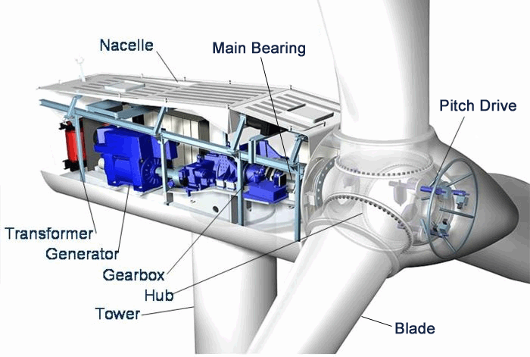
Wind

Slide 5


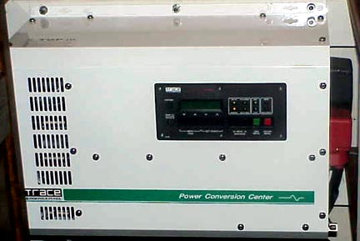
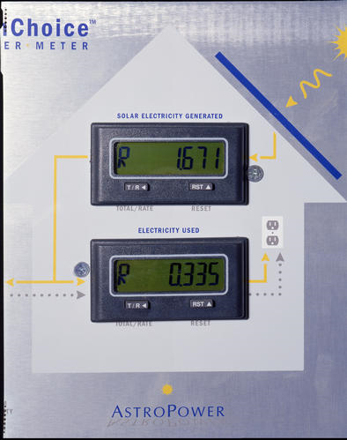
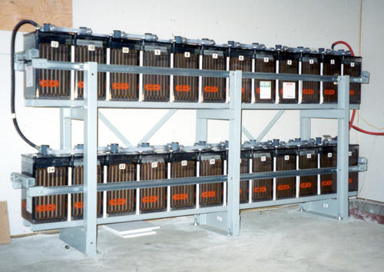

Photovoltaics
Module
Switchgear
Inverter
Meter
Battery
Charge
Controller
Electric Grid

Slide 6
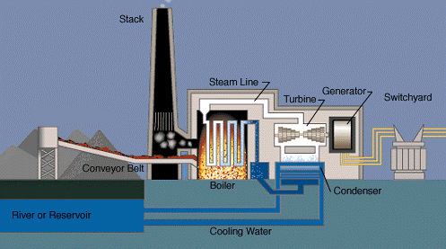
Biomass

Slide 7
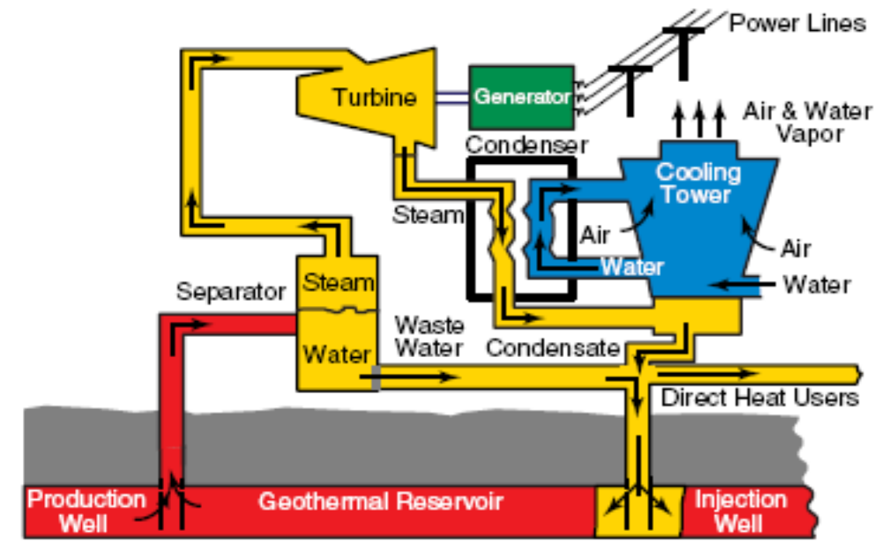
Geothermal

Slide 8
Security Exposure
Catastrophic, e.g. explosions at nuclear or LNG plants.
Fragility, e.g. allowing the electric grid to depend on long, vulnerable transmission lines.
Dependency, e.g. relying on oil and natural gas imports from OPEC.

Slide 9
Security Evaluation
Create an authority similar to the Council on Environmental Quality that applies the National Environmental Policy Act.
NEPA asks: is this action necessary and is it done so as to minimize the damage to the environment.

Slide 10
Environmental Prudence
Climate change concerns require policy to stabilize CO2 emissions from electricity generation and transportation.

Slide 11
Stabilization Wedges
Annual world wide carbon emissions are 7 billion tons, growing at 1.5% or 105 million tons.
A “wedge” is 1/7ths of the annual increase or 15 million tons.
US responsibility is for two wedges, one for electricity one for transportation.

Slide 12
Electric Sector Wedge
18,000 MW of new renewable projects each year will stabilize the emissions from the US electric sector if the renewable energy backs-out coal generation.

Slide 13
Basic Roles and Policy Principles: Public Values
Security and environmental prudence are public values.
The Public role is to provide incentives to engage the best possible private initiative to achieve these goals.

Slide 14
Basic Roles and Policy Principles: Private Initiative
Private effort is needed at every stage, from basic science, to research and development, to R,D&D, to efficient commercial operation.

Slide 15
Basic Roles and Policy Principles: Organizing
Set a public return of $50 for every ton of carbon avoided provided that:
  all actions to pass the economic, security, and environmental standards simultaneously.
  Use creative measures to deliver this benefit, such as “full faith and credit” backing of Treasury for projects.

Slide 16
What Would This Look Like
Every kWh of carbon free, secure, economic generation would receive a return of $.013 per kWh.
This would add 18,500 MW per year and would provide $17 billion in new investment.
Jobs in installation and O&M would increase 54,000 and over 70,000 existing manufacturing firms could make component parts,

