Slide 1


The Relationship Between Henry Hub and WTI Crude Oil Prices: Are Oil and Natural Gas Prices Related?
2006 EIA Energy Outlook and Modeling Conference
March 27, 2006
Jose Villar
jvillar@eia.doe.gov
Natural Gas Division
Energy Information Administration (EIA)
www.eia.doe.gov

Slide 2
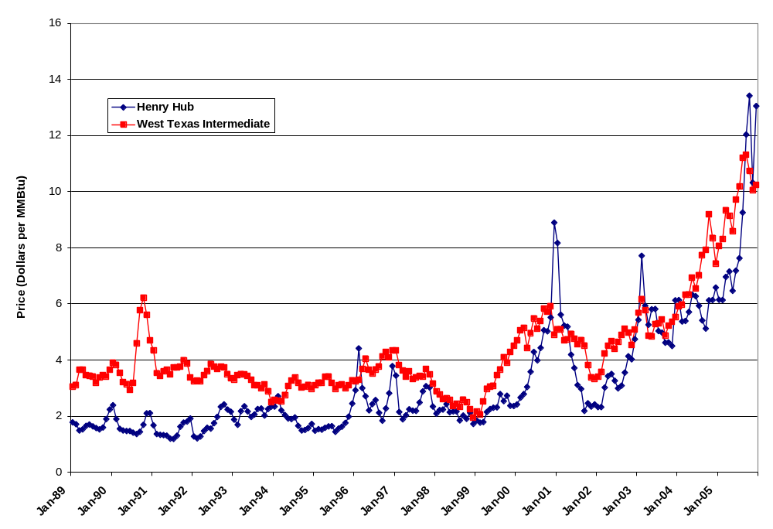
Natural Gas and Crude Oil Prices Have Appeared to Decouple at Times
www.eia.doe.gov
Notes:
Over the years, natural gas and refined petroleum products have been used as closed substitutes in US industry and electric power generation. Consequently, movements of natural gas prices have generally tracked crude oil prices.
This can be seen In the graph where Henry Hub natural gas and West Texas Intermediate crude oil spot pot prices are presented in terms of their equivalent thermal content.
However, in the past 5 years or so, natural gas prices have seemed to move somewhat independently of crude oil prices.
Indeed, natural gas prices rose above what was seen as their historical relationship with crude oil prices in 2000, 2002, 2003, and again late in 2005.
This has led some to question whether natural gas and crude oil prices are still related.
This presentation seeks to develop an understanding of the salient characteristics of the economic and statistical relationship between crude oil and natural gas prices.

Slide 3
Objectives
Identify the Economic Factors Linking Crude Oil and Natural Gas Markets
Statistically Test for the Possibility of a Long-Run Relationship Between Natural Gas and Crude Oil Prices
www.eia.doe.gov
Notes:
First, I will review the demand-side and supply-side factors, which suggest that changes in crude oil prices may influence natural gas prices.
The remainder of the presentation will focus on the time series econometric analysis of the relationship between crude oil prices and natural gas prices.
Using 16 years of data drawn from January 1989 through December 2005, time series of WTI crude oil prices and Henry Hub natural gas prices will be analyzed, focusing on decomposing the short-run and long-run effects of changes in crude oil and natural gas prices.
A stable, statistically robust relationship over time between crude oil prices and natural gas prices will be identified, and the implications of this relationship for understanding short-run changes in prices will be discussed.
Let’s begin by looking at some demand-side factors that relate crude oil and natural gas prices.

Slide 4
Demand Factors Linking Crude Oil and Natural Gas Markets
  Natural gas and petroleum products are substitutes in consumption. An increase in the price of crude oil will increase the demand for natural gas, increasing its price.
  Competition between natural gas and petroleum products occurs principally in the industrial and electric generation sectors.
www.eia.doe.gov
Notes:
Natural gas and petroleum products are substitutes in consumption. An increase in the price of crude oil will increase the demand for natural gas, increasing its price.
Competition between natural gas and petroleum products occurs principally in the industrial and electric generation sectors.
The National Petroleum Council (NPC) in its 2003 report provided an estimate that approximately 5 percent of industrial boilers can switch between natural gas and petroleum fuels.
Other analysts estimate that up to 20 percent of power generation capacity is dual-fired, although in practice it is expected that the relevant percentage is considerably less.
The fuel-switching capacity between oil and gas likely constitutes a minimal threshold of switching capacity as some anecdotal evidence suggests that switching may occur in the dispatching decision.
There are also supply-side factors that may suggest an economic relationship between crude oil and natural gas prices.

Slide 5
Supply Factors Linking Crude Oil and Natural Gas Markets
  Increases in crude oil prices may increase natural gas produced as a co-product of oil, tending to decrease natural gas prices.
  Increased crude oil prices may spur more exploration and development as cash flow expands, which could put downward pressure on natural gas prices.
  An increase in crude oil prices may lead to increased costs of natural gas production as natural gas and crude oil operators compete for similar economic resources.
www.eia.doe.gov
Notes:
On the supply-side, the effects of increases in crude oil prices may conflict. Insofar as the production and the exploration of crude oil and natural gas occurs together, increasing oil prices, tend to decrease natural gas prices.
This occurs because natural gas is found in two basic forms—associated gas and non-associated gas. Associated gas is natural gas that occurs in crude oil reservoirs.
Thus, increases in crude oil prices which lead to increased oil production may increase natural gas produced as a co-product of oil. This tends to decrease natural gas prices.
In 2004, associated-dissolved gas comprised approximately 2.7 trillion cubic feet (Tcf) or 14 percent of marketed natural gas production in the United States.
Next, an increase in crude oil prices may lead to more drilling and development of natural gas projects as increased cash flow becomes available to finance new drilling and project development. While it is generally expected that increased cash flow would expand supply activities for both gas and oil, changes in the relative price structure could lead to increases in drilling for one fuel at the expense of the other.
In contrast, crude oil and natural gas can also be rivals in production. Natural gas and crude oil operators compete for similar economic resources such as labor and drilling rigs. The increased oil-drilling activity resulting from increased oil prices would bid up the cost of the relevant factors of production, which will increase the cost of finding and developing natural gas prospects. In this way, an increase in crude oil prices may lead to increased costs of natural gas production and development, putting upward pressure on gas prices.
These economic factors suggest that oil and gas prices should be related. The analysis of crude oil and natural gas prices that follows empirically tests this hypothesis, and finds significant statistical evidence supporting the hypothesis that crude oil and natural gas prices are indeed related.

Slide 6
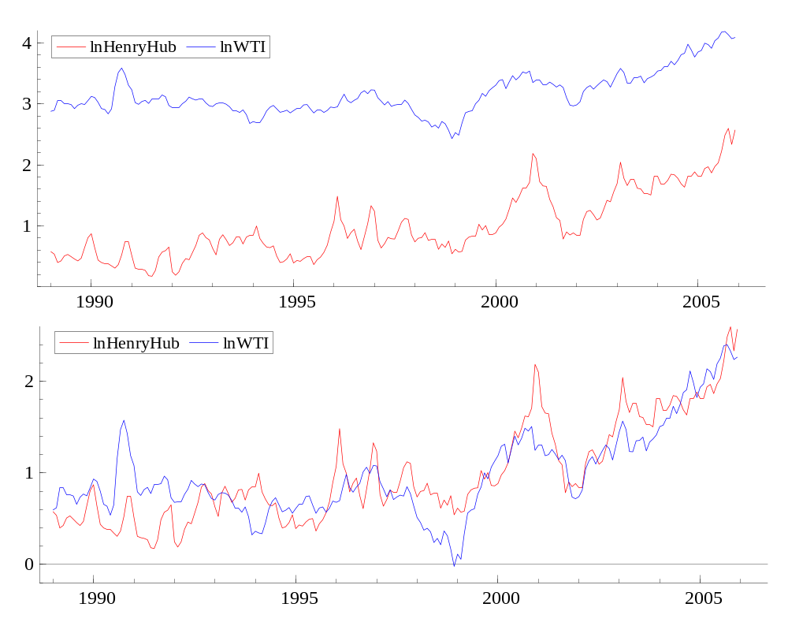
Natural Gas and Crude Oil Prices Appear to Follow Similar Trends
Logarithms of Natural Gas and Crude Oil Prices
Crude Oil Prices Mean-Shifted and Rescaled
www.eia.doe.gov
Notes:
These graphs are logarithmic transformations of the prices shown earlier. Prices are expressed in logs to compress scale effects without imposing unnecessary assumptions such as burner tip parity. Later in the analysis, they also will allow the interpretation of estimated parameters as elasticities. Throughout the remainder of the presentation the analysis is conducted in terms of logarithms of prices.
Looking at the graph in the upper panel, the prices exhibit wandering behavior: periods where prices move up for successive periods, followed by successive periods of downward movement. This suggests that natural gas and crude oil prices may be non-stationary time series. A non-stationary series is defined as time series in which past random shocks do not dissipate with the passage of time. In other words, the price at any given point in time is equal to the sum of all past random shocks and its initial starting point. These summations of past random disturbances are called stochastic trends.
This is contrasted with stationary series in which past shocks dissipate with time. Non-stationary series can be restored to stationarity by simply subtracting the preceding period from the current period—in effect, canceling out the sums of past shocks.
In the lower panel, the WTI series has been rescaled and shifted down to allow for easier comparison with the Henry Hub series. This graph suggests that natural gas and crude oil prices share a common trend, fluctuating around a fixed level. The fact that natural gas and crude oil prices seem to cling to each other with the passage of time in this fashion suggest that they may be cointegrated.
Typically it is not possible to take two non-stationary series and create a weighted average of them that is stationary. However, when it does occur the two variables are said to be cointegrated

Slide 7
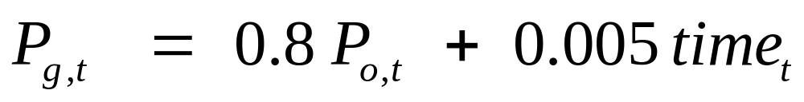
Cointegration Analysis of Natural Gas and Crude Oil Prices
Two variables are cointegrated if
  They are unit root processes
  A stationary linear combination of them can be found
If the price of natural gas, p_{g} , and the price of crude oil, p_{o} are cointegrated, then
www.eia.doe.gov
Notes:
When two variables are cointegrated it implies that the stochastic trends underlying the data generation process may be cancelled out. This suggests that there is an intrinsic, structural relationship between cointegrated variables.
While the econometrics of cointegration may seem somewhat esoteric, the idea behind it is fairly simple. Imagine a man walking a dog on a leash: The dog may wander this way or that, and the man may wander this way or other, but because the leash tethers them together, they tend to move along together. Whenever they stray too far apart, the leash acts to bring them back together.
This is the object of the cointegration analysis of natural gas and crude oil prices: to find out if a tether linking crude oil and natural gas prices exists, and if so, how stable it is.
Establishing that a cointegrating relation exists between natural gas and crude oil prices is sufficient to establish that natural gas and crude oil prices are indeed related.
The time series econometric analysis established that the cointegrating relation between natural gas and crude does exist and is statistically robust.

Slide 8
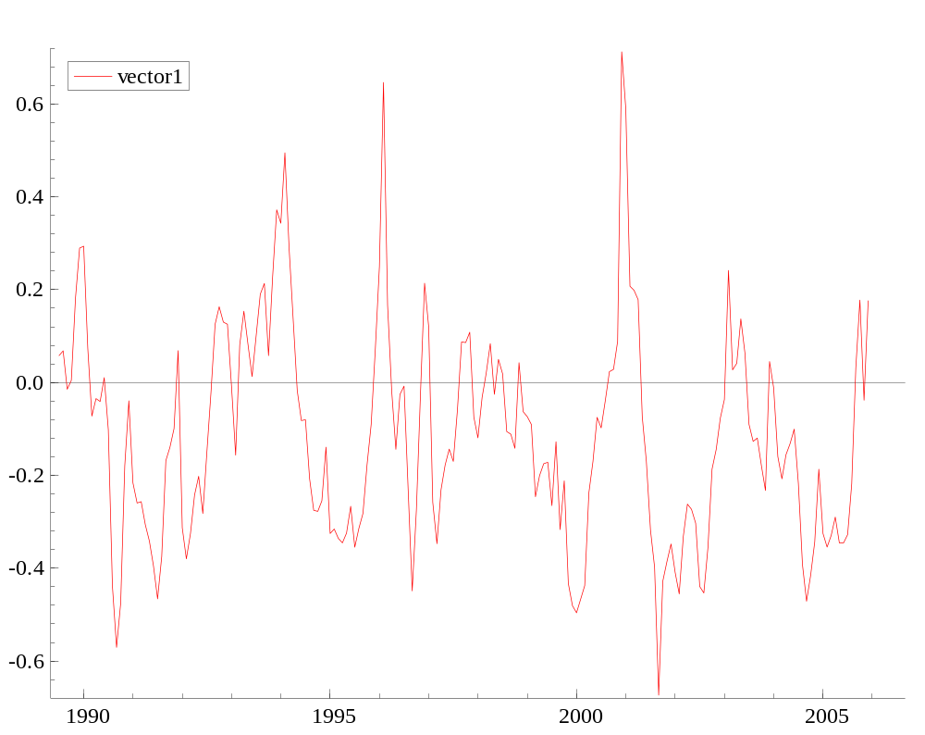
The Cointegrating Relation Depicts the Deviation of the Price of Natural Gas from the Price of Crude Oil
www.eia.doe.gov
Notes:
The cointegrating relation may be interpreted depicting departures from a long-run equilibrium. In the graph the long-run equilibrium that is expected to prevail is given by the zero-line where there was an equiibrium in a long-run sense between natural gas prices and oil prices.
In this way, natural gas and crude oil prices vary together around the fixed long-run equilibrium at the zero-line. When a disequilibrium results from a shock to crude oil or natural gas prices, it is followed by a return to the long-run equilibrium.
For example, the peak in February 1996 shows the impact of the severe freezing weather nation-wide on Natural Gas Prices as the Henry Hub price climbed to $4.42 per MMBtu compared with the preceding month’s price of $2.92 per MMBtu.
And the peak in December 2000 also shows the impact of severe freezing weather as Henry Hub prices rose from $5.52 MMTU in November to $8.90 MMBTU in December.
In each case these departures from the long-run equiloibrium were eventually followed by return to the long-run equilibrium.
The cointegration relation may be interpreted as an “equilibrium” correction mechanism for modeling purposes.

Slide 9
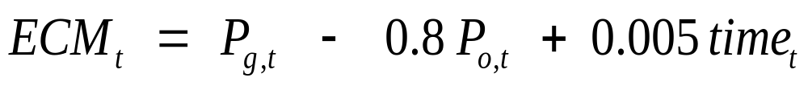
“Equilibrium” Correction Mechanism
The cointegration relation is interpreted as a long-run relation or an “equilibrium” correction mechanism for modeling purposes.
Notes:
This is the cointegration relation presented earlier. However, it is here explicitly presented as an equilibrium corection mechanism.
As noted earlier, in the long-run equilibrium, it will equal 0.
Considered in this way, the equilibrium correction mechanism can be used in a short-run, or vector equilibrium correction, model of natural gas prices.

Slide 10
The Vector Equilibrium Correction Model and Cointegration
The Vector Equilibrium Model (VECM) uses the cointegration relation to help explain short-run movements in natural gas prices.
The VECM expresses changes in prices as a function of short-run and long-run effects, as well as the speed of adjustment from disruptions to the long-run equilibrium.
Δ P_{g,t} = 0.3ΔP_{o,t} + 0.10ΔP_{g,t-1} - .2 ECM_{t-1} + v_{t}
Short-run effect
Long-run equilibrium
www.eia.doe.gov
Notes:
The Vector Equilibrium Model (VECM) uses the cointegration relation, or equilibrium correction mechanism to help explain short-run movements in natural gas prices. The estimated model results are presented here.
Here the change in the natural gas price in the current period is expressed as the result of short-run and long-run effects.
When the ECM in the preceding period is in long-run equilibrium and equal to 0, the model reduces to its short-run effects--contemporaneous changes in the crude oil price and the past change in natural gas price in the preceding period. It should be noted that the actual estimation of the model included other short-run factos such as heating degree days, seasonal variation, and natural gas inventory levels. While these effects are important and significant, they are not explicitly presented here owing to limited space and the desire to focus on the crux of the VECM analysis
When the ECM does not equal zero because there has been a disruption from the long-run equilibrium it will augment the short-run adjustment of the natural gas price. In this way the parameter, -0.2, represents the speed of adjustment to disruptions from the long-run equilibrium. In other words, about 20 percent of the disruption from the equilibrium in the preceding period.
Having estimated the VECM and the cointegrating relation, it is natural to ask how well does the model fit the data and how stable are the results?

Slide 11
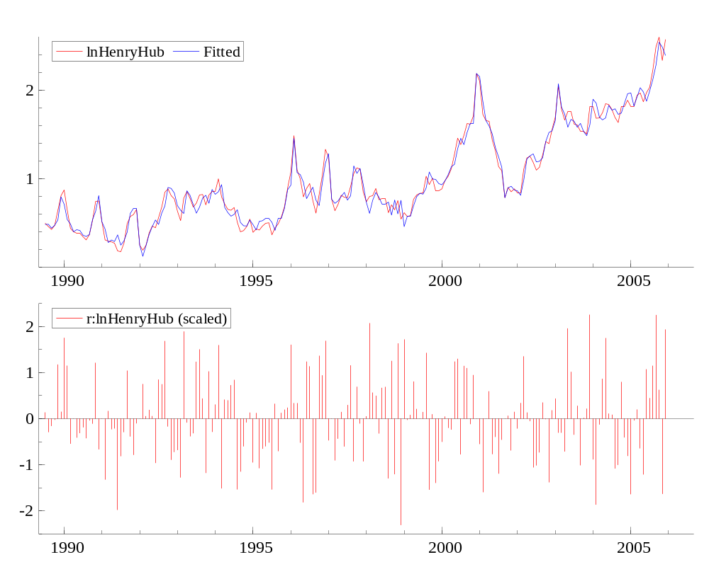
The Estimated VECM Provides a Good Fit of Natural Gas Prices (1989-2005)
Fitted Model and Actual Values
Scaled Residuals of Fitted Model
www.eia.doe.gov
Notes:
The model estimates of natural gas prices fit the actual natural gas price quite well.
Two graphs are presented in the slide.
In the panel, estimates resulting from the fitted model are plotted the actual Henry Hub prices. Presented in this fashion, the fitted and actual series are virtually indistinguishable.
In the lower panel, the residuals between the model estimates and actual values are scaled by the standard error of the estimates. The vast majority of the scaled residuals lie within 2 standard deviations of the actual values. In other words, in most cases, the residuals are not significantly different from zero.
These results underscore the stability of the model.
And not to belabor the point, recursive testing of the model provided further statistical support of the stability and robustness of these results.

Slide 12
Implications of the VECM for the Analysis of Crude Oil and Natural Gas Prices
Crude oil and natural gas prices have a stable long-run relationship.
Crude oil prices influence but are not influenced by natural gas prices.
Natural gas prices have been growing at a slightly faster rate than crude oil prices.
About 20 percent of a disruption from the long-run equilibrium will be recovered in the following period.
www.eia.doe.gov
Notes:
So what does all this mean?
Statistical testing of the cointegration relation and the derivation of an equilibrium correction mechanism found significant statistical evidence supporting the hypothesis that crude oil and natural gas prices have a stable relationship.
The statistical evidence also supported the hypothesis that natural gas prices adjust to oil prices, but do not influence oil prices.
Natural gas prices have been growing at a slightly faster rate than crude oil prices.
The estimation of the equilibrium correction mechanism, or the long-run equilibrium relation, can be used to explain short-run movements in natural gas prices. And that about 20 percent of a disruption from the long-run equilibrium will be recovered in the following period.
In other words, changes in natural gas prices result from short-run effects and disruptions to the long-run equilibrium between natural gas and crude oil prices.

Slide 13

Implications of the VECM:
Model Dynamics
www.eia.doe.gov
Notes:
So what are the practical implications of the VECM?
To answer this question, it may helpful to look at how natural gas prices respond to changes in the crude oil price, holding all else constant. Two cases are considered: a permanent increase in the crude oil price, and second, a transitory increase in the crude oil price.
The first case is presented in the upper panel: Crude oil prices rise by 20 percent, and remain unchanged thereafter. The immediate response of natural gas prices is to climb about 5 percent in the same period as the oil price shock occurs. In each successive period following the initial shock, gas prices continue to climb, but at decreasing rate as gas prices adjust to the disruption in the long-run equilibrium. And so gas prices climb about 10 percent within the first two periods following shock, and about 15 percent within 12 months. The oil price shock is not passed through on a one-to-one basis to natural gas prices.
The second case is presented in lower panel: A transitory spike in crude oil prices such that the crude oil price increases 20 percent in the initial period, followed by an offsetting decrease in the following period. As in the preceding case natural gas prices respond to the contemporaneous increase in crude oil prices by climbing about 5 percent. In the first period following the initial price spike, the natural gas price continues to climb to restore the long-run equilibrium. However, it is hit with a second contemporaneous oil price shock—this time a downward movement of about 17 percent in oil prices– offsetting the previous increase. This leads the natural gas price to decline. 2 months following the initial oil price shock, natural gas prices are about 1 percent above its price level in the initial period. In the ensuing months, the natural gas price continues to decline until it falls a about 1 percent below its initial level.
These examples serve to illustrate that short-run changes in the natural gas price result from changing short-run market conditions and adjustments to long-run equilibrium in the preceding period. These effects can reinforce, or offset each other, which could make it appear that natural gas prices have decoupled from crude oil prices, when in fact they are related.

Slide 14
www.eia.doe.gov
www.eia.doe.gov

