Slide 1

EEI Views on the EIA Electric Survey Forms
Presentation by Henri Bartholomot, EEI Director, Regulatory Legal Issues
at the EIA Energy Outlook, Modeling, and Data Conference in Washington DC
on March 28, 2007

Slide 2
Edison Electric Institute (EEI) is the association of U.S. shareholder-owned electric utilities
Our members serve about 67 percent of end-use electricity customers nationwide and generate almost 60 percent of the electricity generated in the U.S.

Slide 3
Several other types of entities also provide electricity in the U.S.
  Municipally owned electric utilities
  Rural electric cooperatives
  Co-generation industrial facilities
  Federal power marketing administrations

Slide 4
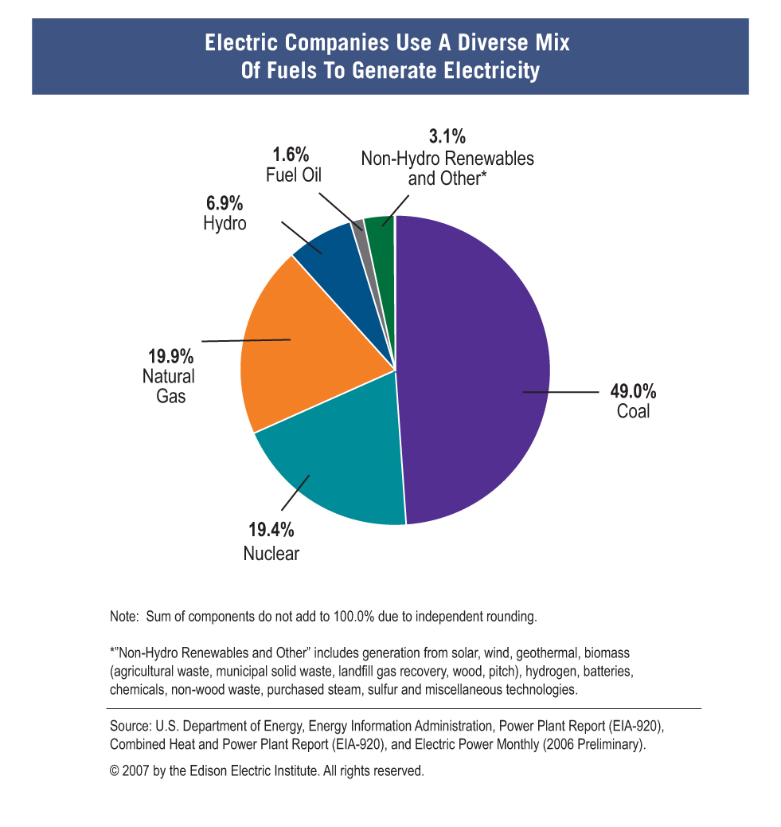
4

Slide 5
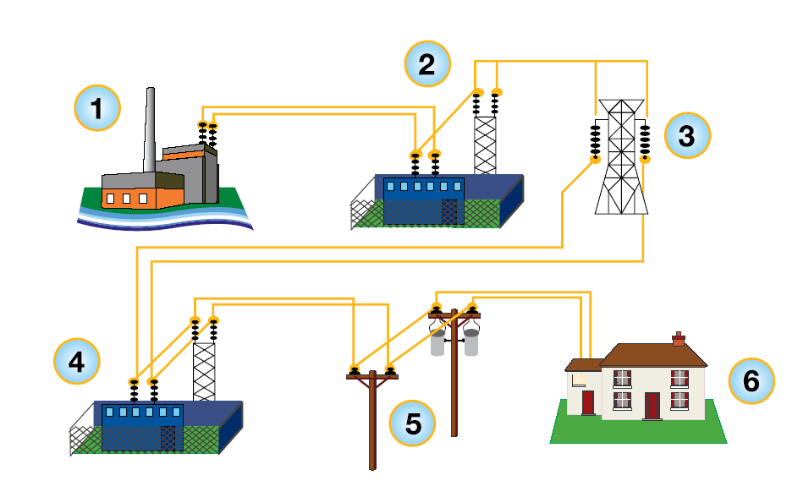
Electric Companies Rely on a Complex Array of Generation, Transmission, and Distribution Facilities to Serve Their Customers
5

Slide 6
EEI members operate in competitive energy and financial markets
  Wholesale electricity markets
    RTOs and ISOs
    Bilateral contracts
    Hedging
  Retail markets competitive in some areas
  Stock and bond markets

Slide 7
EEI members are subject to extensive federal and state regulation
  Siting and operating facilities
    Clean air, water, and solid waste permits
    Land use authorizations, wetlands permits
    Endangered species, historic preservation
  Energy and financial markets
    Competitive bids for generation
    Wholesale and retail rate approval
    Financial disclosures to investors

Slide 8
Furthermore, EEI members collect and report large volumes of information to a variety of federal and state agencies
    Energy Information Administration (EIA)
    Federal Energy Regulatory Commission (FERC)
    Environmental Protection Agency (EPA)
    Securities and Exchange Commission (SEC)
    State utility commissions

Slide 9
EIA Electric Power Survey Forms Filed by EEI Members
Form | Description | Estimated Reporting Burden | Confidential Data Elements
EIA-411 [Annual] Coordinated Bulk Power Supply Program Report | Peak demand and energy for the preceding year and 5 future years Existing and planned generating capacity Scheduled capacity purchases and sales Bulk electric transmission system maps and power flow cases Proposed transmission lines | 1,527 hours per regional response | Bulk electric transmission maps Bulk transmission facility power flow cases
OE-417 [Per Incident] Electric Emergency Incident and Disturbance Report | Electric emergency incidents and disturbances For DOE’s use in fulfilling its overall national security responsibilities | 5 minutes per initial response, 2 hours per explanation | Utility contact information Narrative description of incident
9

Slide 10
EIA Electric Power Survey Forms Filed by EEI Members
Form | Description | Estimated Reporting Burden | Confidential Data Elements
EIA-423 Monthly Cost and Quality of Fuels for Electric Plants Report | Fuel quantity Fuel quality – Btu, sulfur, ash content Fuel purchase type, cost, contract expiration date, tolling agreements Fossil fuel supplier | 1.3 hours per response | Delivered fuel cost – plant purchase price
EIA-767 [Annual] Steam Electric Plant Operation and Design Report | Plant design parameters and annual operations data for boilers generators cooling systems stacks flues flue gas particulate collectors flue gas desulfurization units | 66.3 hours for plants > 100 MW, 3.4 hours for plants > 10 MW < 100 MW | Plant latitude and longitude
10

Slide 11
EIA Electric Power Survey Forms Filed by EEI Members
Form | Description | Estimated Reporting Burden | Confidential Data Elements
EIA-826 Monthly Electric Sales and Revenue with State Distributions Report | Revenue associated with the sale of electricity Sales (MWh delivered) Number of customers by end-use sector and state Sample survey of 450 utilities and non-utilities selling to end use customers | 1.2 hours per response | Energy only sales without delivery service Bundled service by retail energy providers Power marketers that provide bundled service
EIA-860 Annual Electric Generator Report | Ownership and NAICS designation Energy sources and prime mover Nameplate capacity Fuel switching capability Operational and regulatory status On-line dates and actual or planned retirement dates | 10.2 hours per electric utility, 5.1 hours per non-utility | Plant latitude and longitude Tested heat rate
11

Slide 12
EIA Electric Power Survey Forms Filed by EEI Members
Form | Description | Estimated Reporting Burden | Confidential Data Elements
EIA-861 Annual Electric Power Industry Report | Revenues associated with the sale of electricity MWh sales delivered Number of customers Energy sources and disposition Customer service programs Electric operating revenue DSM information Distribution system information | 8.1 hours per response | None
EIA-906 [Monthly for Large Plants/ Annual for Others] Power Plant Report | Electric power generation Fuel consumption and heat content Fossil fuel stocks | 1.3 hours monthly, 1.9 hours annually | Stocks at end of reporting period
12

Slide 13
EEI encourages all agencies to
  Minimize the reporting burden
  Apply reporting provisions equitably across ownership type and energy sector
  Treat key commercial and security related information as confidential

Slide 14
Burden issues
  Reporting involves significant costs
    Collecting, verifying, and analyzing data take substantial staff time, funds, and other resources
    Multiple reports are often due at the same time
  Paperwork Reduction Act aims to reduce these costs
    Requires agencies to minimize the reporting burden and to avoid duplication
    Requires triennial review by each agency and the Office of Management and Budget (OMB)

Slide 15
Burden recommendations
  Collect only information each agency truly needs
  Collect the information only in the detail needed
  Avoid duplication
  Allow information to be filed in original or .pdf formats without re-entry of data
  Provide reasonable reporting deadlines

Slide 16
Equitability issues
  Requiring only shareholder-owned electric companies and not others to report information can harm companies and undermine fair competition by
    imposing higher costs on those companies
    giving their competitors strategic advantage

Slide 17
Equitability recommendations
  Treat shareholder- and non-shareholder owned entities comparably
  Treat energy sectors comparably
  Collect less rather than more data when possible in search for common ground

Slide 18
Confidentiality issues
  Disclosing commercially sensitive information such as cost and operating data can harm companies
    FOIA “b(4)” exemption applies
    CIPSEA can apply
  Disclosing information such as facility location, design, importance, and safeguards can increase security risks
    Department of Homeland Security umbrella
    DOE confidentiality efforts
    FERC confidentiality efforts

Slide 19
Confidentiality recommendations
  Aggregate commercially sensitive information; do not disclose it at a plant or company level
  Avoid disclosing security-related information such as facility location, design, importance, and safeguards
  Ensure that information remains confidential when shared with others
    Maintain protection across agencies
    Disclose only to those who need the information
    Use non-disclosure agreements

Slide 20
Initial suggestions for EIA Electricity 2008 triennial review
  Streamline the electric survey forms
    Eliminate unnecessary detail
    Consolidate EIA forms if that makes sense
  Provide reasonable reporting deadlines
  Protect sensitive information
    Do not release latitude and longitude or other security sensitive information
    Consolidate information about competitive operations and costs to avoid disclosing at a plant or company level

