Slide 1

Greenhouse Gas Emissions in the Annual Energy Outlook
EIA Energy Outlook, Modeling and Data Conference
March 28, 2007
Washington, DC
J. Alan Beamon, Director
Coal and Electric Power Division
Energy Information Administration
Official Energy Statistics from the U.S. Government

Slide 2
Energy Information Administration
Independent statistical agency within the Department of Energy
  www.eia.doe.gov
Produce monthly short-term and annual long-term forecasts of U.S. and world energy markets
Short Term Energy Outlook
  http://www.eia.doe.gov/emeu/steo/pub/contents.html
Annual Energy Outlook, 2007
  http://www.eia.doe.gov/oiaf/aeo/index.html
International Energy Outlook, 2006
  http://www.eia.doe.gov/oiaf/ieo/index.html
Produce special analyses of emerging issues and the impacts of regulatory/legislative changes
  http://www.eia.doe.gov/oiaf/service_rpts.htm
  http://www.eia.doe.gov/oiaf/analysis.htm
EIA’s analyses and projections should not be seen as advocating or reflecting any position of the Department of Energy, the Administration, or any other organization.
EIA Energy Outlook, Modeling and Data Conference, March 28, 2007
Notes:
Many of you are probably fairly familiar with the Energy Information administration, but for those of you who are not:
EIA is an independent statistical agency within the Department of Energy and we take that independence very seriously. Our goal is to
“Provide policy-independent data, forecasts, and analyses to promote sound policy making, efficient markets, and public understanding regarding energy and its interaction with the economy and the environment.”
We collect a lot of data and in the forecasting area we put out three major products, the:
Short Term Energy Outlook
Annual Energy Outlook
International Energy Outlook
As the names suggest these products differ in their analysis timeframes and geographic coverage. Both the AEO and IEO now project through 2030, while the STEO looks out 2 years.
We also prepare a large number of analysis products at the request of the Department of Energy, the Administration and the Congress.
I have included link to all these products on our web page.

Slide 3
About the Annual Energy Outlook 2007
Energy markets are uncertain!
AEO2007 reference case based on current rules and regulations as of October 2006
AEO2007 includes over 30 cases, including:
  Three alternative economic growth cases
  Three alternative oil/gas price cases
  Three coal price cases
  Dozens of alternative technology cases
    Lower and higher renewable technology cost and performance cases
    Lower and higher nuclear technology cost and performance cases
    Lower and higher fossil technology cost and performance cases
    Lower and higher end use technology cost and performance cases
  Several regulatory sensitivity cases
  All cases should be considered
All projections are wrong!
Greenhouse gas regulations would change the outlook!
EIA Energy Outlook, Modeling and Data Conference, March 28, 2007
Notes:
I’m going to say this over and over again – ENERGY MARKETS ARE UNCERTAIN!
I suspect that people know this, but they never call and ask us for the range of natural gas prices we project in 2030, they just want THE PRICE! Similarly, they want the number and types of plants to be built, in what States and Counties!
Recognizing the uncertainty in long-term forecasting we prepare over 35 cases each year in the Annual Energy Outlook. We look at the potential impacts of:
- slower/faster economic growth
- higher/lower world oil and natural gas prices
- higher/lower coal prices
- alternative technology assumptions in the residential,
commercial, industrial, transportation, power, and oil and gas
supply sectors.
- regulatory changes.
While I will discuss some of the results from other cases, most of my talk today will focus on the reference case from our report. However, I encourage you to look at the full array of cases, especially if you are evaluating investment choices that might involve ¼ billion to more than a billion dollars – the size of many typical power plant investments.

Slide 4
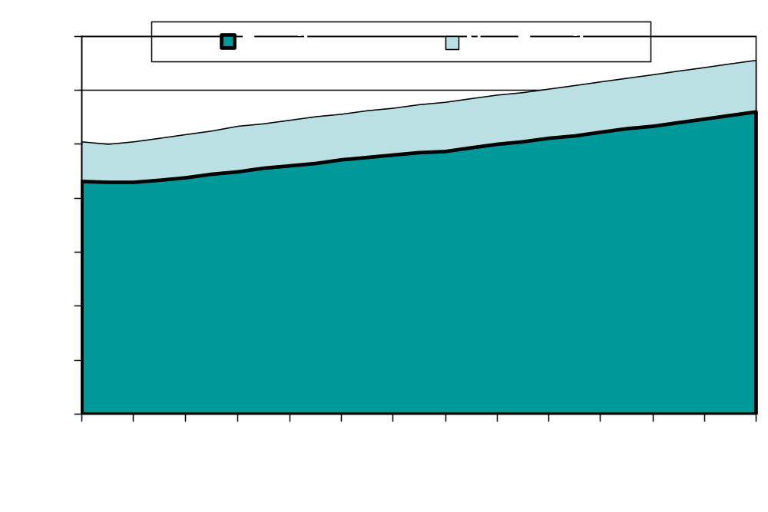
Total Energy Consumption
(Quadrillion Btu)
EIA Energy Outlook, Modeling and Data Conference, March 28, 2007

Slide 5
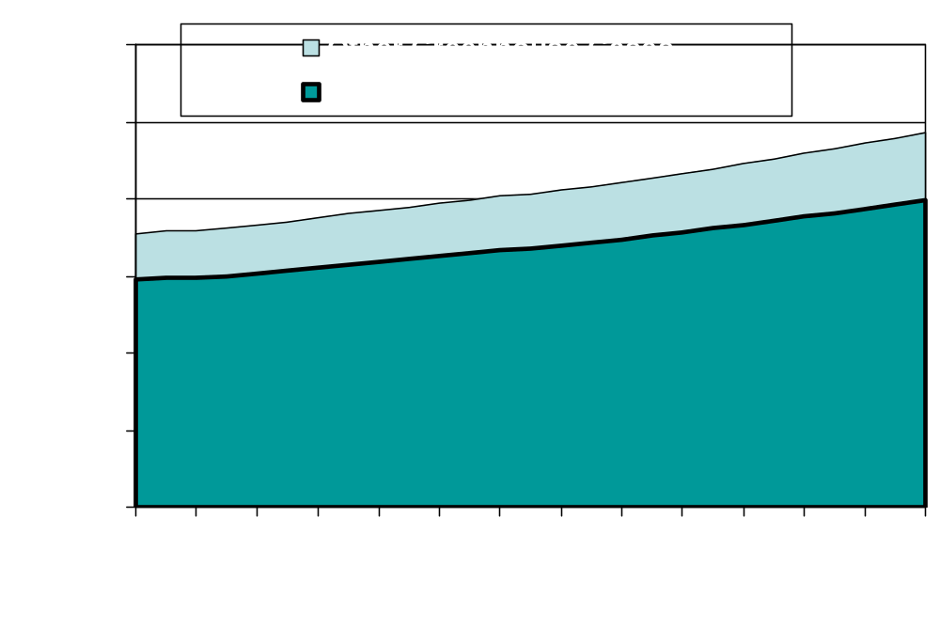
Total Greenhouse Gas Emissions
(Million Metric Tons Carbon Dioxide Equivalent)
EIA Energy Outlook, Modeling and Data Conference, March 28, 2007

Slide 6
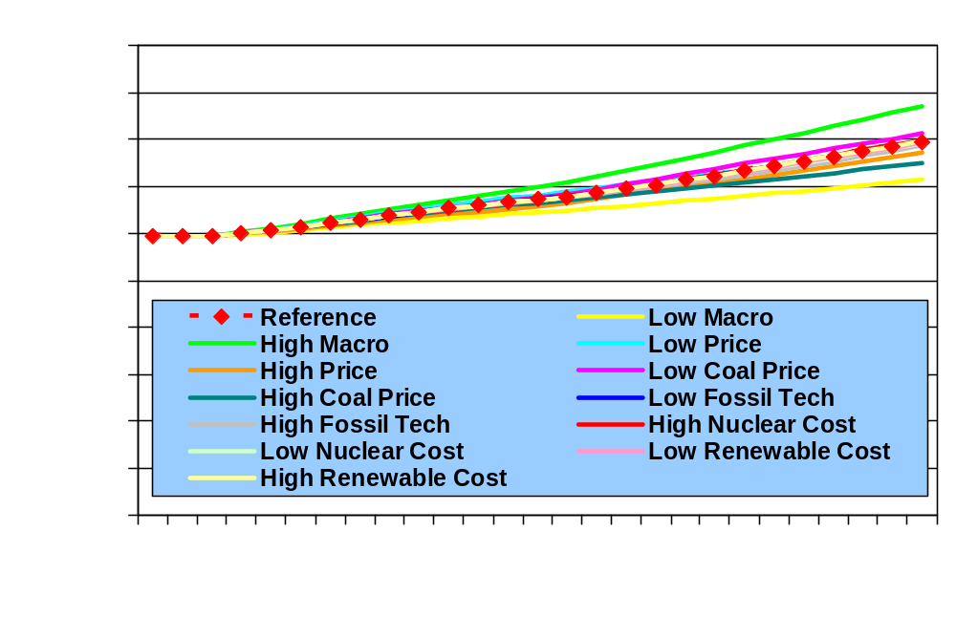
Energy Related Carbon Dioxide Emissions in Alternative Cases
(Million Metric Tons)
EIA Energy Outlook, Modeling and Data Conference, March 28, 2007

Slide 7
EIA Analyses Impacting Greenhouse Gas Emissions
Energy Market Impacts of a Clean Energy Portfolio Standard – Follow-up, February 2007
Energy Market and Economic Impacts of a Proposal to Reduce Greenhouse Gas Intensity with a Cap and Trade System, January 2007
Energy and Economic Impacts of H.R. 5049, the Keep America Competitive Global Warming Policy Act, September 2006
Energy Market Impacts of a Clean Energy Portfolio Standard, June 2006
Energy Market Impacts of Alternative Greenhouse Gas Intensity Reduction Goals, March 2006
EIA Energy Outlook, Modeling and Data Conference, March 28, 2007

Slide 8
EIA Analyses Impacting Greenhouse Gas Emissions, continued
Impacts of the Modeled Recommendations of the National Commission on Energy Policy, April 2005
Analysis of Senate Amendment 2028, the Climate Stewardship Act of 2003, May 2004
Analysis of S. 1844, the Clear Skies Act of 2003; S. 843, the Clear Air Planning Act of 2003; and S. 366, the Clean Power Act of 2003, May 2004
Analysis of S. 485, the Clear Skies Act of 2003, and S. 843, the Clean Air Planning Act of 2003, September 2003
Analysis of S.139, the Climate Stewardship Act of 2003, June 2003
EIA Energy Outlook, Modeling and Data Conference, March 28, 2007

Slide 9
EIA Analyses Impacting Greenhouse Gas Emissions, continued
Impacts of the Kyoto Protocol on U.S. Energy Markets and Economic Activity, October 1998
Ongoing studies
  Analysis of S. 280, the Climate Stewardship and Innovation Act of 2007
  Proposal requiring 25 percent renewable fuels in the motor vehicle transportation and electricity markets by 2025
EIA Energy Outlook, Modeling and Data Conference, March 28, 2007

Slide 10
Thank you
Energy Information Administration
www.eia.doe.gov
J. Alan Beamon
Joseph.Beamon@eia.doe.gov
202-586-2025
EIA Energy Outlook, Modeling and Data Conference, March 28, 2007

