Slide 1
Natural Gas Projections from EIA and Six Others
EIA Energy Outlook, Modeling and Data Conference
March 28, 2007
Washington, DC
Joe Benneche, Natural Gas Analyst
Notes:
This morning’s session is titled “Varying Views on the Future of the Natural Gas Market”. Many of you have already heard some of the basic elements of EIA’s natural gas projection earlier this morning, I will expand on that a bit. Then I’ll show you how EIA’s projections compare with six others
This can be interesting in and of itself, but a more important issue is to try to understand a little more about why we are different. Do some of us place a greater weight on one driver than others? Do we see markets evolving in a different way, particularly internationally? It is really a matter of just starting with some different assumptions?
While we can only begin to make a stab at this in this session. We hope to gain a few insights through our discussion today. While we published six other projections in EIA’s natural gas forecast comparison, we unfortunately only have time for three speakers today, who I’ll introduce in turn.

Slide 2
Overview
EIA’s Natural Gas Projections
  Primary Assumptions
  Consumption
  Production/Imports
  Wellhead Price
EIA and Other Projections Compared
  Consumption
  Production/Imports
  Production versus Price
Notes:
For my talk, I’ll first give a quick overview of some of the primary assumptions in the NEMS oil and gas representation and then present the projections for natural gas consumption, production, imports, and wellhead prices.
Second, I’ll show how six other forecasters line up with the EIA projections.

Slide 3
EIA’s Natural Gas Projections
Notes:
In order to give more time to the invited speakers, I will go through this rather quickly. There is very little information that I am adding that is not already available on EIA’s web site.

Slide 4
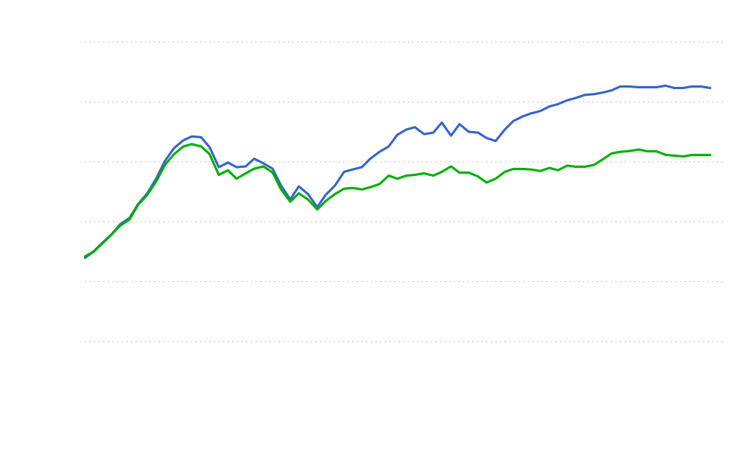
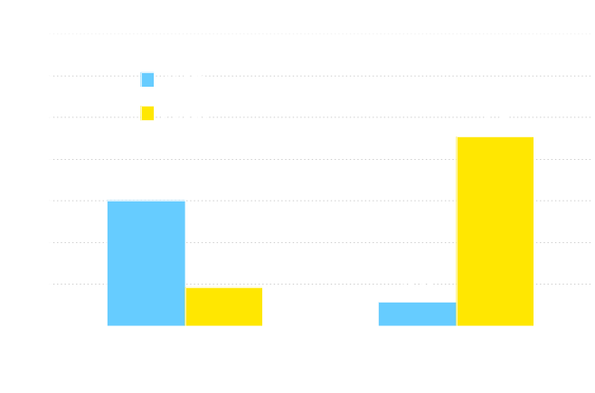
Natural Gas Production, Consumption, and Imports
History
Projections
26.1 Tcf
Consumption
Net Imports
21%
16%
20.5 Tcf
Production
Natural Gas Net Imports, 2005 and 2030
(trillion cubic feet)
Source: Annual Energy Outlook 2007
Notes:
Domestic gas production is projected to increase more slowly than consumption over the forecast, rising from 18.2 trillion cubic feet (Tcf) in 2005 to 20.5 Tcf in 2030. Growing production is supported by rising wellhead gas prices, relatively abundant gas resources, and improvements in technologies, particularly for unconventional gas. Economic conditions allow an Alaskan pipeline to begin moving gas to the lower 48 States in 2018.
Consumption is projected to climb from 22.0 Tcf in 2005 to 26.1 Tcf by 2030, yielding a gap of close to 4.1 Tcf. The increase is primarily due to the rapid growth in demand for industrial and commercial applications, which account for 77 percent of the growth.
The difference between consumption and production is made up by increasing use of imports, specifically LNG. In AEO2007, net imports grow from 3.6 Tcf in 2005 to 5.4 Tcf in 2030.
The national average wellhead price is projected to decline from $7.51 per thousand cubic feet (mcf) in 2005 dollars in 2005, reaching an average price of $5.01 per thousand cubic feet in 2013, and then rising to $5.98 per thousand cubic feet in 2030.

Slide 5
Primary Assumptions/Drivers
Demand
  Macroeconomic (GDP, population, personal disposable income, industrial output)
  Levelized costs for new electric plants and other costs
  Natural gas and competitive fuel prices
Supply
  Consumption and supply prices
  Resources
  Technology
  World market (oil prices, LNG competition)
Notes:
While the natural gas and other fuel prices impact natural gas consumption levels, macroeconomic factors are typically the primary driver in the model. A primary assumption is the GDP growth rate, averaging 2.9% per year for the AEO2007 reference case. Other factors contribute directly or indirectly, such as: housing starts and commercial floorspace. Industrial output is a major driver in fuel consumption in the sector. In the electric sector, the levelized costs for new electric plants (which includes fuel costs) are a primary driver over the longer-term. Of course we also assume current laws and regs.
Since we assume the markets will balance total supply will always equal total consumption. The more important question is the mix. Domestic production depends to a great degree on the assumes resource levels, as well as the assumption that technological improvements in the future will continue at a pace similar to the past. While there are some cost assumptions directly built into the model, we are also projecting how costs will change over time.
Oil prices are an important driver in the gas market in setting alternate fuel prices on the consumption side. On the supply side they influence associated production, drilling costs, and cashflow in the oil and gas industry.
Finally, our assumptions about how the LNG market will develop worldwide influence our projections for LNG imports.

Slide 6
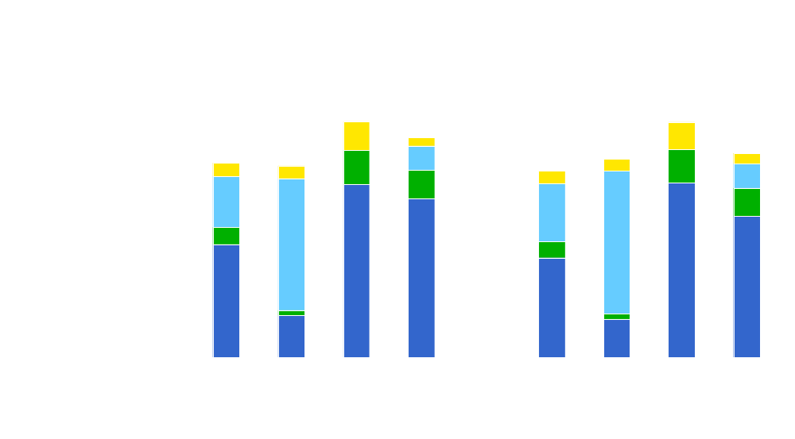
Levelized Electricity Costs for New Plants
Incremental Transmission Costs
Variable Costs, Including Fuel
Fixed Costs
  Capital Costs
2015
2030
Source: Annual Energy Outlook 2007
Notes:
Following through with one example on the consumption side, is the levelized costs for new electric plants.
You can see that even with relatively high fuel costs, gas combined cycle plants just beat out new coal plants on an average basis in 2015. Whereas, by 2030, coal is generally more competitive.
As a result in part,

Slide 7
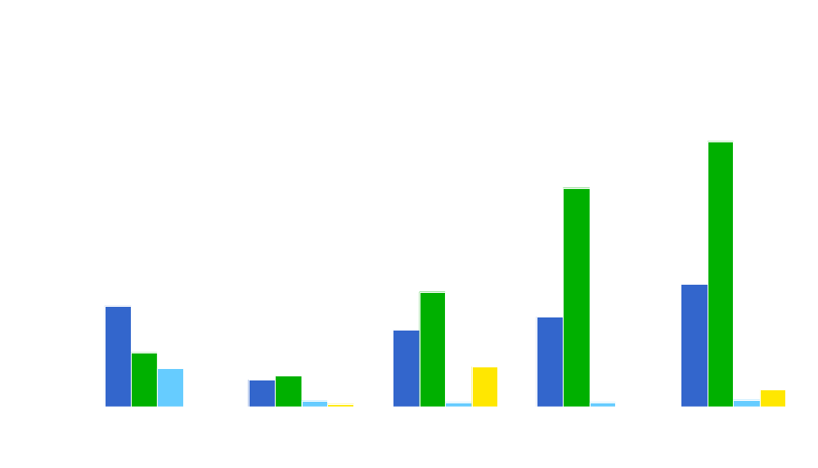
Electricity Generation Capacity Additions by Fuel Type
Natural gas
Coal
Renewables
Nuclear
Source: Annual Energy Outlook 2007
Notes:
...capacity additions for coal plants are projected to dominate in the future.
Some new gas plants are still projected, particularly in areas were greater restrictions are in place, for instance, but the levels are less than they would be otherwise.

Slide 8
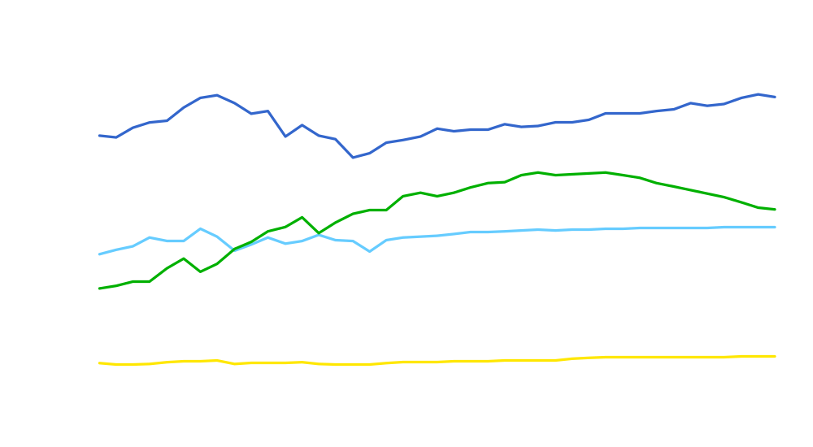
Natural Gas Consumption by Sector
History
Projections
Industrial*
Electric Generators
Residential
Commercial
Transportation**
* Includes lease and plant fuel
** Includes pipeline fuel
Source: Annual Energy Outlook 2007
Notes:
The impact can be seen more clearly in the national consumption figures, as gas consumption by electric generators is projected to peak in 2020 and decline thereafter.

Slide 9

Technically Recoverable U.S. Natural Gas Resources as of January 1, 2005
Proved
193
Total: 1,341 tcf
Inferred nonassociated
176
50
226
Offshore
Undiscovered nonassociated
Onshore
119
164
283
Offshore
Onshore
Unconventional
Coalbed methane
278
126
74
478
Other unproved
Shale gas
Tight gas
131
31
162
Alaska
Lower 48 associated-dissolved
Source: Energy Information Administration
Notes:
This figure shows the technically recoverable natural gas resources, as of January 1, 2005, that are assumed in NEMS. These resource assessments come primarily from the U.S. Geological Survey for onshore regions and from the Mineral Management Service for the offshore. Via contract, Advanced Resources Incorporated provides estimates for unconventional sources. The key observation here is that unconventional gas resources dominate the gas resource base. Not surprisingly, this is forecast to be the largest source of domestic incremental production in the future.
We had 193 Tcf of proved reserves (both conventional and unconventional) in the beginning of 2005. That is, gas from known reservoirs, where wells have been drilled and production rates have been demonstrated.
Inferred reserves (at 226 Tcf) are also in known reservoirs, but data are insufficient as to the certainty of recovery. Almost 80 % of these are onshore.
Undiscovered nonassociated conventional resources (283 tcf), based on regional geologic formations and their propensity to hold producible natural gas, are the least certain. More than half of these are in the offshore.
The largest category by far is unproved unconventional resources with 478 Tcf, 58 percent of which is from tight sandstone. Other unconventional natural gas resources include gas shales and coalbed methane.
Other unproved natural gas resources include 31 tcf of Alaskan gas and 131 tcf of associated-dissolved natural gas in lower 48 crude oil reservoirs.
Next, lets look at the production that we expect to flow from these resources.

Slide 10
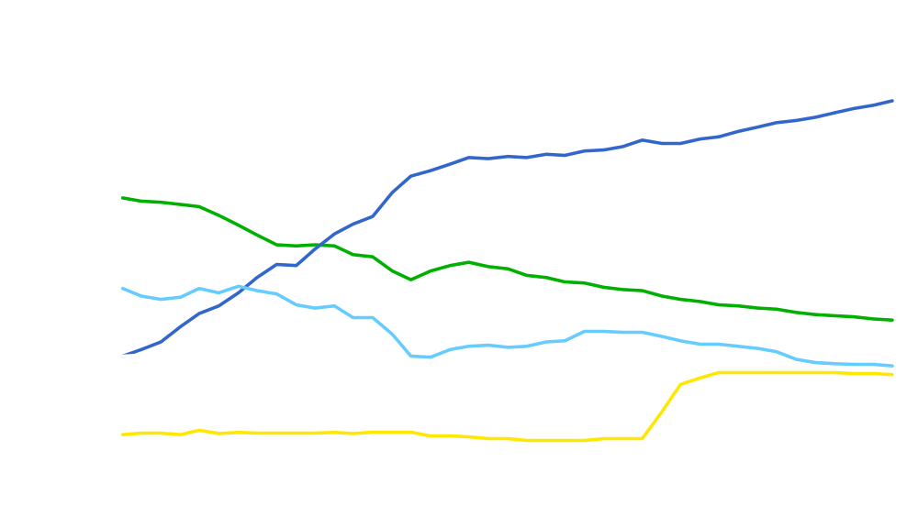
Dry Natural Gas Production
History
Projections
Onshore Unconventional
Nonassociated
Onshore Conventional
Nonassociated Offshore
Associated/Dissolved
Alaska
Source: Annual Energy Outlook 2007
Notes:
Domestic gas production is expected to increase from 18.2 Tcf in 2005 to 20.5 Tcf in 2030. Increased U.S. natural gas production comes primarily from unconventional sources and from Alaska.
Unconventional gas production increases by 2.2 Tcf over the forecast period, mainly because of technological improvements, rising prices, and relatively abundant unconventional sources (tight sands, shale, and coalbed methane). Annual production from unconventional sources is expected to account for 55 percent of Lower-48production in 2030, compared to 45 percent today.
Over the forecast, Alaska gas production accounts for three quarters the growth in domestic natural gas production, growing by 1.7 tcf over the forecast period. Alaska gas is projected to begin flowing to the Lower-48 States in 2018. With subsequent expansion of this pipeline, Alaskan gas production reaches 2.2 Tcf in 2030, compared with .4 tcf in 2005.
Total lower-48 non-associated gas production is expected to increase by about 700 Bcf over the forecast period, as resource depletion causes exploration and development costs to increase.
Production of associated-dissolved natural gas from Lower-48 crude oil reserves is projected to grow from 2.1 tcf in 2005 to 2.5 tcf in 2015. After 2015, both onshore & offshore AD gas production are expected to decline, with total AD gas production falling to 2.0 tcf in 2030.
Since the largest growth is in unconventional gas, let’s look at that in more detail.

Slide 11
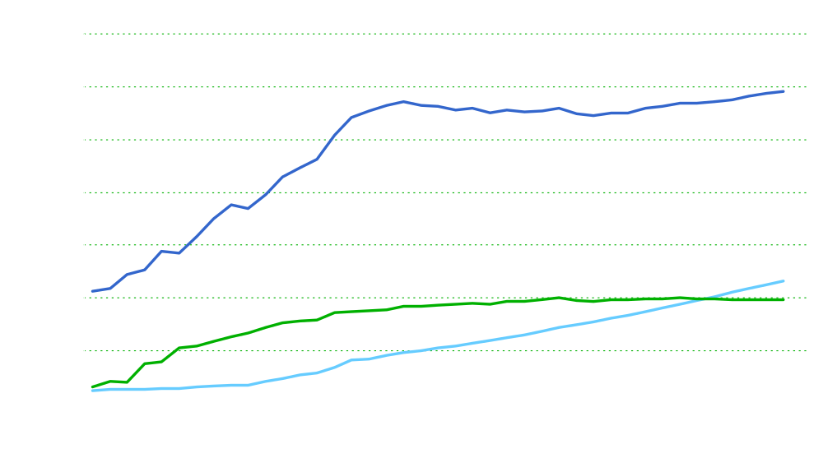
Unconventional Natural Gas Production
History
Projections
Tight Sands
Coalbed Methane
Gas Shales
Source: Annual Energy Outlook 2007
Notes:
All types of unconventional natural gas production are projected to increase in the Annual Energy Outlook 2007, though at varying rate.
Production of tight sands, the most expensive type of unconventional gas, is expected to initially level off as it competes with other sources of supply to meet rather stable demand requirements, but it increases later in the forecast as technological gains increase productivity and market forces drive up demand for natural gas.
Coalbed methane production is projected to rise slightly in the forecast period, but not to experience the sharp gains seen in the past decade, as the more prolific basins reach and/or pass maturity.
Gas shales production is projected to experience the most noticeable growth, driven by relatively low costs, favorable access to resources, and proximity to existing infrastructure.

Slide 12
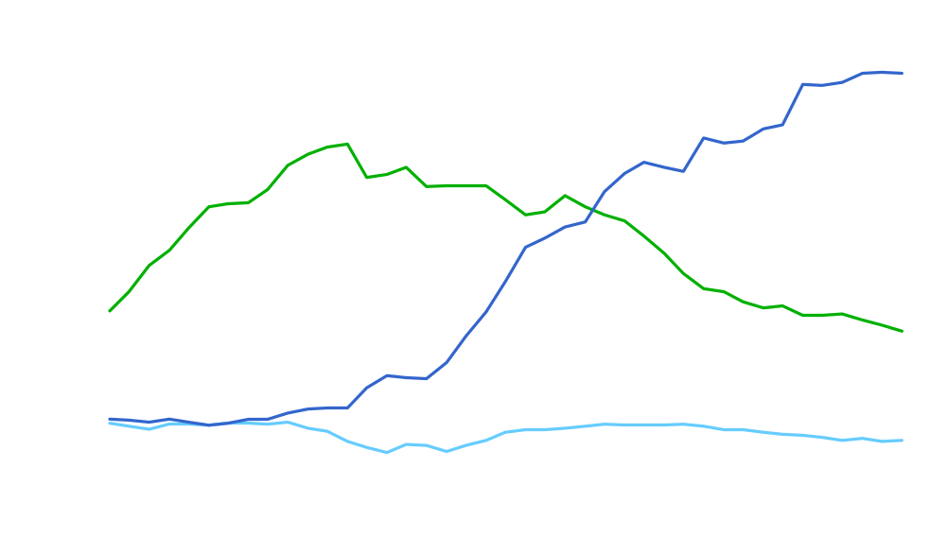
Net Imports of Natural Gas
History
Projections
Overseas LNG
Canada
Mexico
Source: Annual Energy Outlook 2007
Notes:
With U.S. natural gas production declining, imports of natural gas rise to meet increasing domestic consumption.
A projected decline in Canada’s non-Arctic conventional gas production is only partly offset by Canada’s Arctic and unconventional gas production. Even though a MacKenzie Delta natural gas pipeline is expected to begin transporting natural gas in 2012 in the reference case, projected net gas imports from Canada diminish over time, as conventional gas resources decline and internal consumption increases. Canadian gas imports decline from 3.3 trillion cubic feet in 2005 to 1.2 trillion cubic feet in 2030 in the reference case.
Most of the projected growth in U.S. natural gas imports is in the form of liquefied natural gas (LNG). Total projected U.S. LNG terminal capacity increases rapidly from 1.4 trillion cubic feet in 2005 to 4.9 trillion cubic feet in 2012. After 2012, U.S. LNG terminal capacity grows more slowly reaching 6.5 trillion cubic feet in 2030. Net LNG imports are projected to grow from 0.6 trillion cubic feet in 2005 to 4.5 trillion cubic feet in 2030. World-wide competition for LNG supply is expected to constrain U.S. LNG imports below U.S. terminal capacity throughout the forecast.
Projected net exports of U.S. natural gas to Mexico are projected to decline from current levels. In 2005, net exports to Mexico were 300 billion cubic feet. Net gas exports to Mexico are projected to decline through 2019 due to Mexico’s LNG imports. After 2019, projected net exports of U.S. natural gas to Mexico are projected to increase slightly; reaching 250 billion cubic feet in 2030.

Slide 13
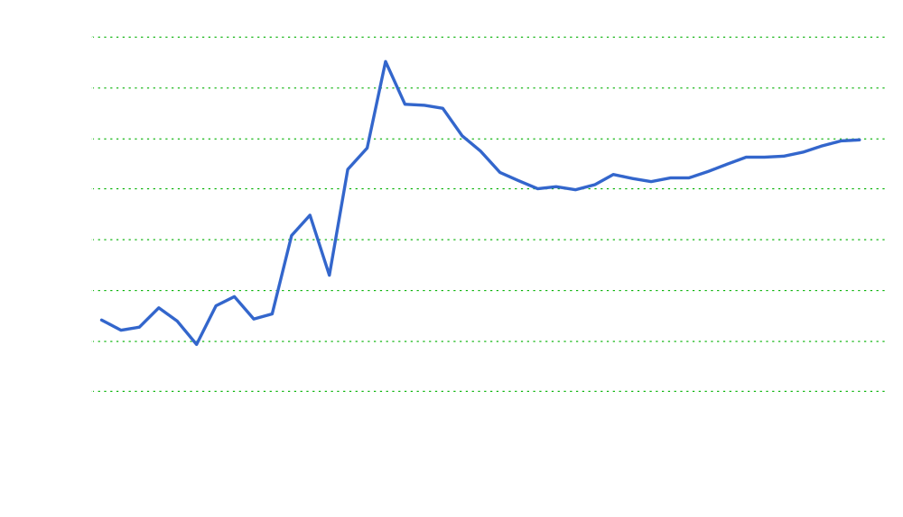

Average Lower 48 Natural Gas Wellhead Price
History
Projections
$5.98
$9.62
Source: Annual Energy Outlook 2007
Notes:
In the reference case, projected wellhead natural gas prices decline from current levels, reaching an average price of $5.01 per thousand cubic feet (2005 dollars) in 2013, and then rising to $5.98 per thousand cubic feet in 2030. Henry Hub spot natural gas prices are projected to bottom out in 2013 at $5.49 per million Btu (2005 dollars) and subsequently rise to $6.52 per million Btu in 2030.
Currently high gas prices stimulate the construction of new liquefied natural gas (LNG) terminal capacity, which results in a significant increase in projected LNG terminal capacity by 2015. High natural gas prices also stimulate the construction of an Alaska natural gas pipeline, which begins operations in 2018, and stimulate unconventional gas production. On the demand side, currently high gas prices reduce the projected growth in natural gas consumption. So current high gas prices both stimulate the development of new gas supplies and constrain gas consumption growth. Collectively, the interaction of greater gas supply and slower gas demand growth leads to the projected decline in gas prices through 2013.
After 2013, the projected increase in the wellhead natural gas price largely results from the increasing cost of developing the remaining U.S. natural gas resource base.Growth in nonconventional sources, Alaska production, and LNG imports are not expected to increase sufficiently to offset the impacts of resource depletion and increased demand.
Prices are projected to increase in an uneven fashion as new, large-volume supply projects temporarily depress prices when initially brought online. In nominal dollars, the 2030 price is the equivalent of $9.62 per thousand cubic feet.
The Reference case forecast assumes known technology and technological trends. Wellhead natural gas price projections are more sensitive to variations in technological change than to the levels of natural gas production and consumption. In February, we will be releasing the full AEO2007 report which will include a number of side cases, including high and low technology cases which show the impact of varying technological assumptions on natural gas prices and a restricted supply case which shows the impact of restrictions on supply that include limited LNG capacity expansion and no Alaska pipeline.

Slide 14
EIA and Other Projections

Slide 15
Other Forecastors
EVA – Energy Ventures Analysis, Inc. (2006)
EEA/ICF – Energy and Environmental Analysis, Inc., an ICF International Company (10/06)
GII – Global Insight, (2006, preliminary)
DB – Deutsche Bank AG, (11/06)
SEER – Strategic Energy and Economic Research, Inc. (4/06)
Altos – Altos Partners (11/06)
Notes:
First of all, I want to point out that comparing projections can be a bit tricky without a bit of digging into the details. Even then it is hardly straightforward.
At EIA we are not specifically trying to predict the future, but project a likely future given a set of assumptions. Given this, we are also trying to build models to reflect how the real market and market players react, within our real limitations. We also hope to establish plausible assumptions. It is within this context that we hope to be judged. Of course, in the end, many people are just looking for an accurate prediction.
The specific objective of other modelers is not clear, but I suspect they are more under the gun to generate an accurate prediction and are more likely to assume anticipated changes in laws and regulations, for instance.

Slide 16

Total Natural Gas Consumption Comparison
* Excludes pipeline fuel and CNG vehicles
Notes:
I’m going to primarily concentrate on 2025 in my discussion. Here we see that Global Insight is projecting a notably lower level of total consumption. In fact, GII is lower in all but the electric generator sector, and there they are higher by only a small margin.
EIA and DB are somewhat similar, with EIA growing a little faster earlier and a little slower later, this largely reflects the differences seen in the electric sector. Otherwise, DB is a bit higher in the R/C side and a bit lower for industrial.
The other 4 are clearly projecting greater total consumption levels than EIA, ranging from 2.2 to 2.7 Tcf more.
The next three graphs present consumption by sector, which I’ve placed on similarly scaled graphs for comparative purposes.

Slide 17

Residential/Commercial Natural Gas Consumption Comparison
Notes:
For residential and commercial consumption, EIA is pretty much right in the middle of the pack, which makes us comfortable.

Slide 18

Industrial Natural Gas Consumption Comparison
* Includes lease and plant fuel

Slide 19

Electric Generator Natural Gas Consumption Comparison

Slide 20

Net LNG Imports Comparison

Slide 21

Net Natural Gas Pipeline Imports Comparison

Slide 22

Domestic Natural Gas Production Comparison

Slide 23

Sources of Supplied Natural Gas Comparison
2015
2025
2030

Slide 24



Natural Gas Production/Price Comparison
(2015)
EIA
EEA/ICF
Altos
DB
SEER
GII
EVA
Domestic Production (Tcf)
(2025)
EEA/ICF
EIA
SEER
EVA
GII
DB
Altos
(2030)
EIA
SEER
GII
DB
Altos
Wellhead Price (2005 dollars per Mcf)

Slide 25
Thank you
Energy Information Administration
www.eia.doe.gov
Joe Benneche
Joseph.Benneche@eia.doe.gov
202-586-6132

