Slide 1
INTEK
Potential Development of United States Oil Shale Resources
March 28, 2007
Khosrow Biglarbigi
INTEK, INC.
Presented at the 2007 EIA Energy Outlook Conference, Washington, D.C.

Slide 2



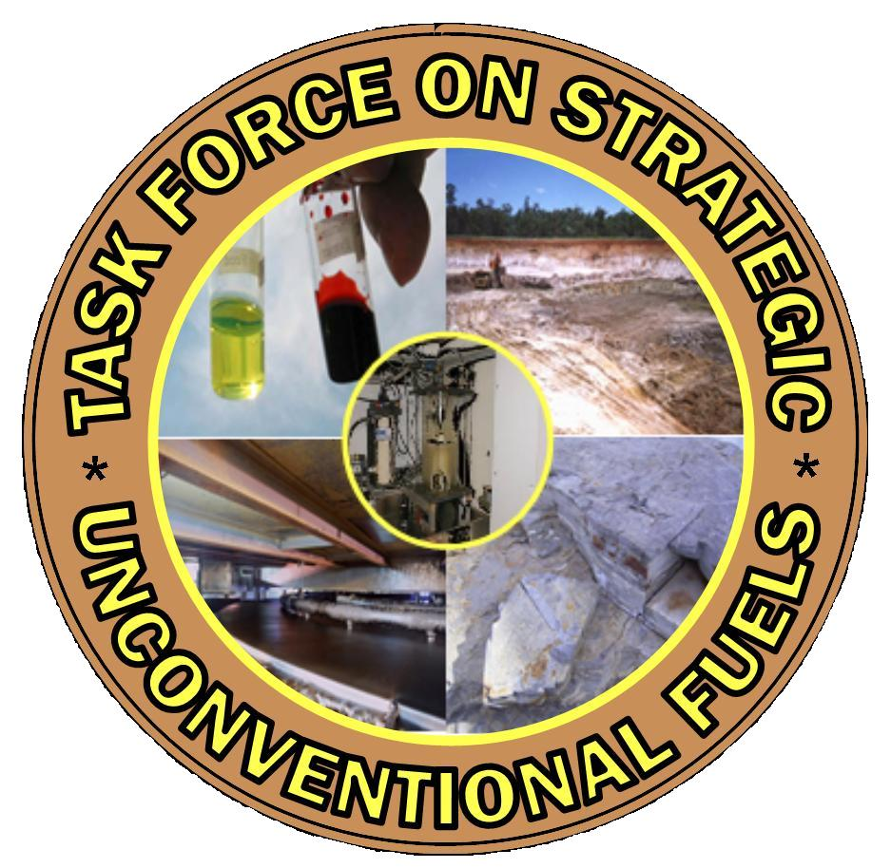







Acknowledgements
U.S. Department of Energy
  Office of Naval Petroleum & Oil Shale Reserves
  Office of Petroleum Reserves
Task Force for Unconventional Fuels
  Department of Energy
  Department of Defense
  Department of the Interior
  Colorado
  Kentucky
  Mississippi
  Utah
  Wyoming

Slide 3
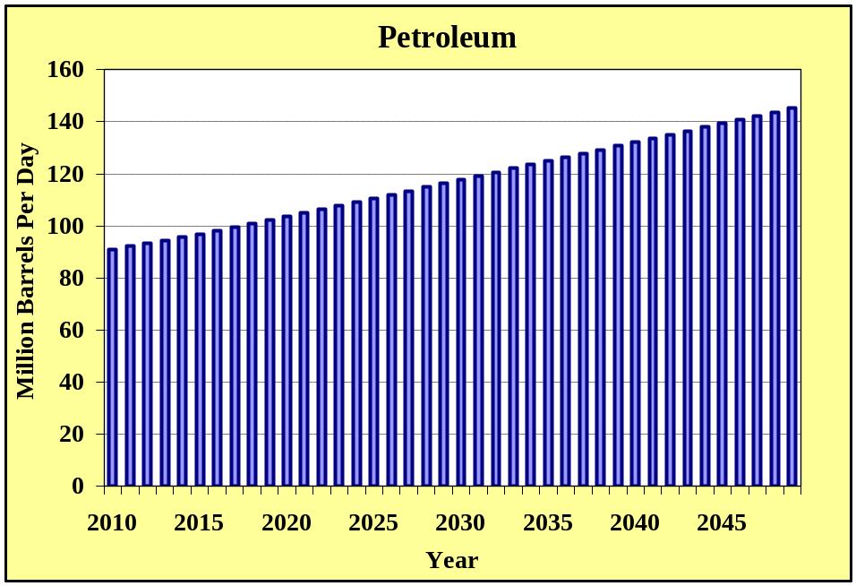
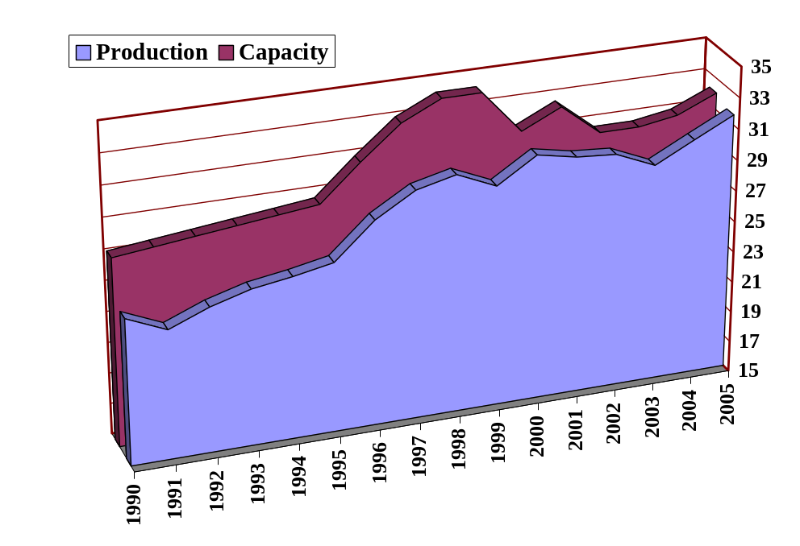
World Oil Supply and Demand
Growing World Demand
Demand Growth of 15MMBbl/D (by 2025)
OPEC Excess Capacity of 1 MMBbl/D (in 2005)
Where Would the Balance Come From?
Diminishing OPEC Excess Capacity
Source: Energy Information Administration (AEO 2006)
Million Bbl/D

Slide 4
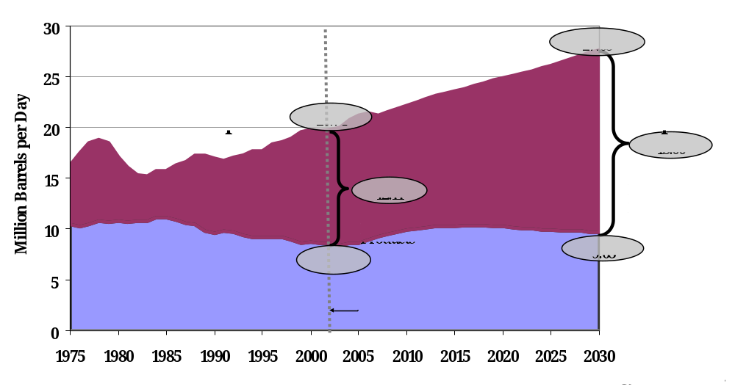
Reason for Concern at Home:
Ever Rising Oil & Refined Products Imports

Slide 5
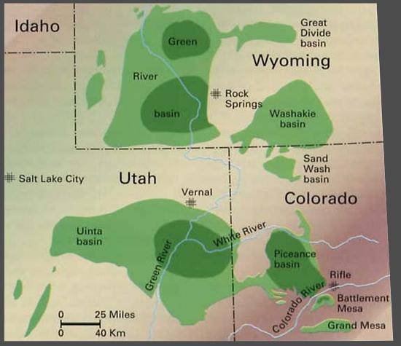
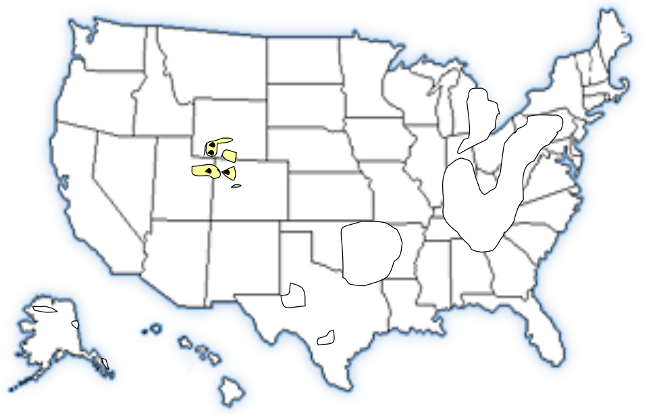
The Opportunity:
Most Concentrated Hydrocarbon Deposits on Earth
Over 6 trillion barrels of resource nationwide
Nearly 2 trillion barrels in rich deposits in Western states
Colorado, Utah, and Wyoming

Slide 6
Western Oil Shale Ownership
(80% on Federal Lands)
1400
1200
Federal
Non
Federal
-
210
1000
800
Resource (Billion Barrels)
600
990
400
60
90
200
220
170
0
CO
UT
WY

Slide 7
Oil Shale Conversion Technology
Surface Process
Premium Refinery Feed
Resource
Ore Mining
Retorting
Oil Upgrading
In-Situ Process
Premium Refinery Feed
Resource
In-Situ Conversion
Oil Upgrading

Slide 8
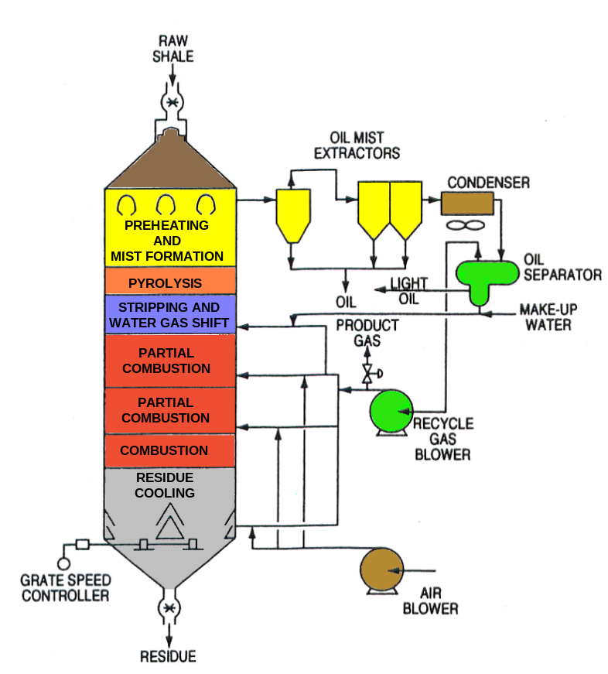
Example Surface Retort Technology
Gas Combustion Retort
Originally developed by
  Cameron Engineering
  Bureau of Mines
Most successful
  High thermal efficiency
  High retort efficiency
Variations of GCR
  Petro-six operating in Brazil
  Paraho Process being tested for a major project abroad

Slide 9
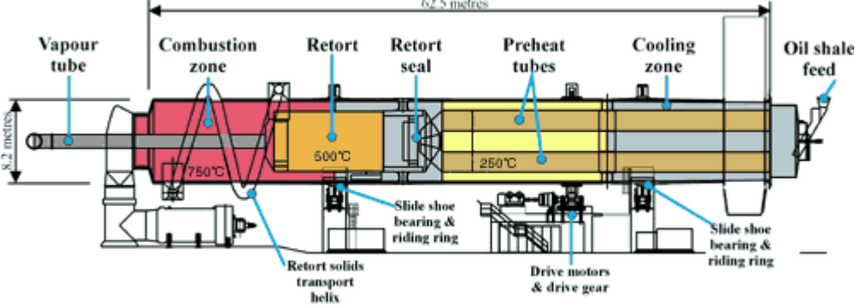
Example Surface Retort Technology
Initially designed for extracting bitumen from tar sands
Selected for oil shale conversion in Australia (SPP)
OSEC to apply ATP for its RD&D efforts in Utah
Alberta Taciuk Processor (ATP)

Slide 10
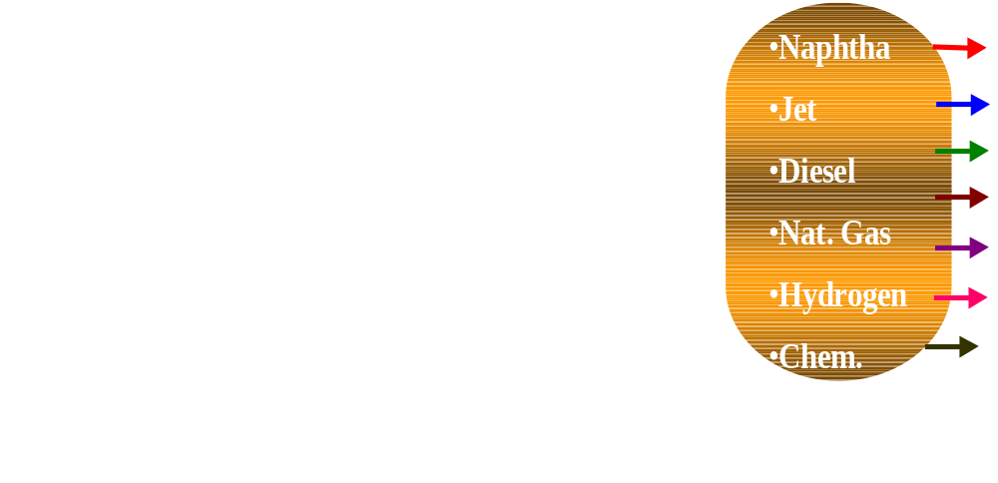
Example In-Situ Conversion Technology
Developed by Shell Petroleum
Currently in “pilot” phase in north-western Colorado
Shell to apply technology at three other sites in Colorado
Shell’s ICP Process

Slide 11
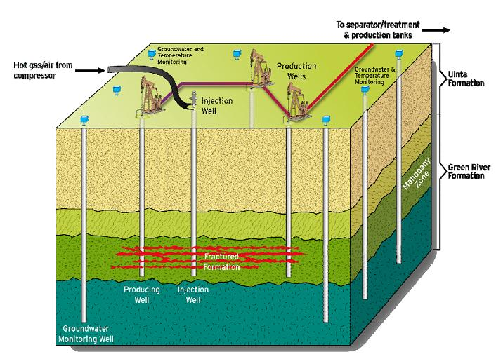
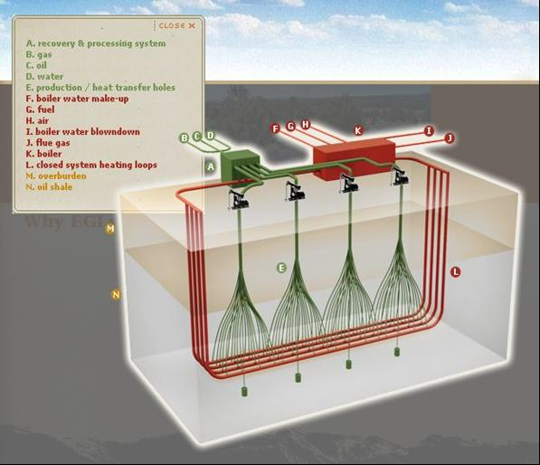
Other Examples of In-Situ Conversion Technology
Pilot tests under development in Colorado
Chevron Process
EGL Resources Process

Slide 12
R&D Leasing Program
DOI awarded five (5) RD&D leases in 2006
  Shell Frontier
  Chevron U.S.A.
  EGL Resources
A sixth lease is being finalized for award (OSEC LLC)
Lease size and duration:
  Initially, 160 acres (per)
  Option to expand to 5,120 acres (if technology is successful)
  The RD&D phase is for ten (10) years
Companies have started process for operations

Slide 13
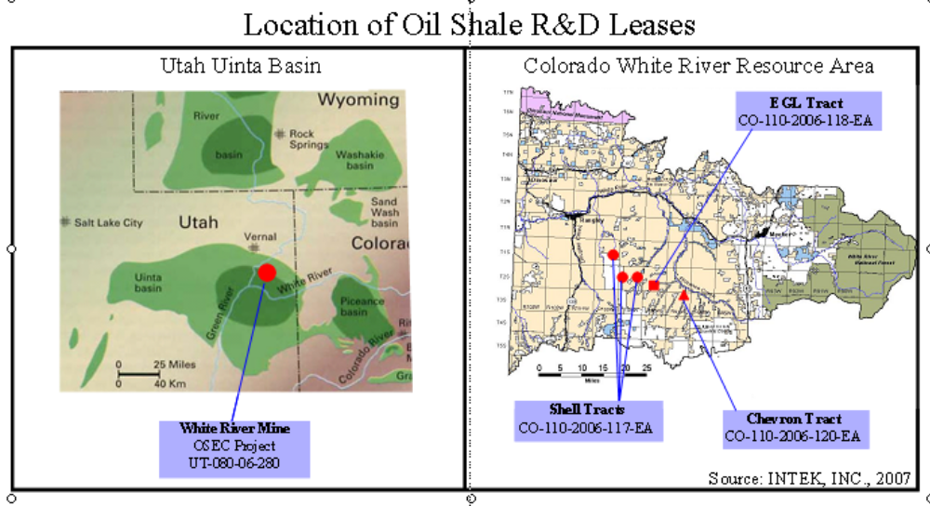
Location of Oil Shale R&D Leases

Slide 14
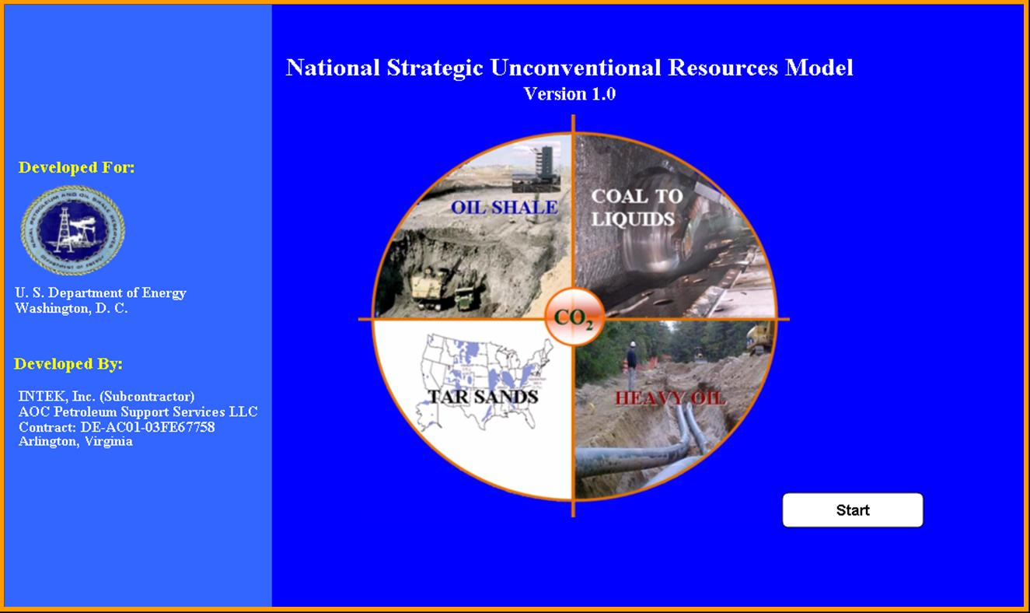
A New Model Developed by NPOSR

Slide 15
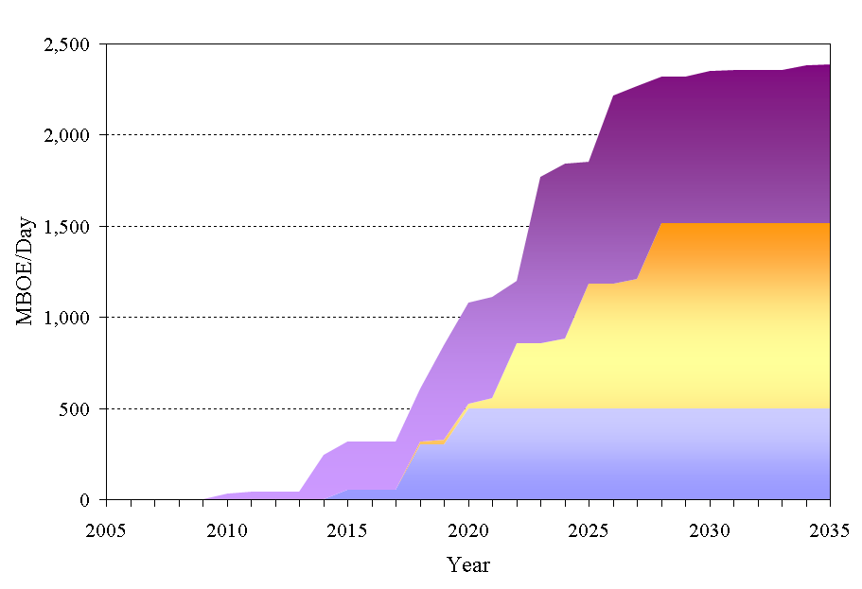
Projected Production Potential (BOE)
(Shale Oil in the U.S.)
RD&D
Tax Incentives
Base

Slide 16
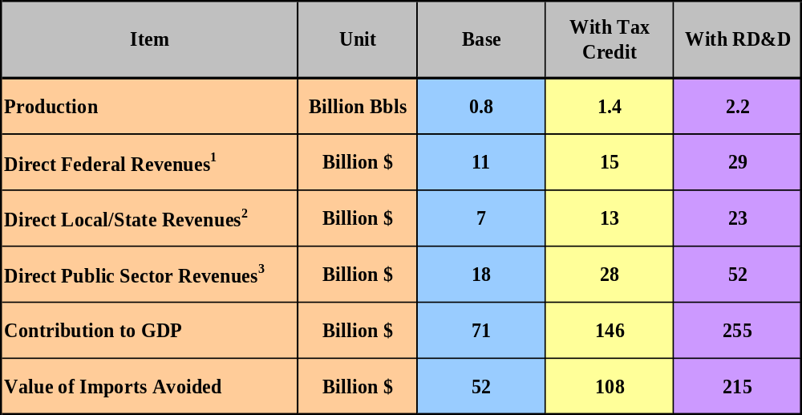
Example Benefits of Oil Shale Development
Cumulative (Over 25 Years)
1 – Federal Revenues are the sum of Federal Business Taxes plus Royalty payments
2 – State Revenues are the sum of State Business Taxes, production taxes, plus the state portion of Federal Royalty payments
3 – Public Sector Revenues are the sum of Direct Federal and Direct State Revenues

Slide 17
Oil Shale Environmental Challenges
Emissions
  Heating shale can generate gases including SO₂, NOx, CO₂, particulates, and water vapor
  Technology exists to control / reduce emissions
  And to sequester
Land Impacts
  Disturbance depends on processes
  31 square miles per 1 MM Bbl/d capacity
  Land can be reclaimed
  For in-situ, similar impact as conventional oil and gas operations

Slide 18
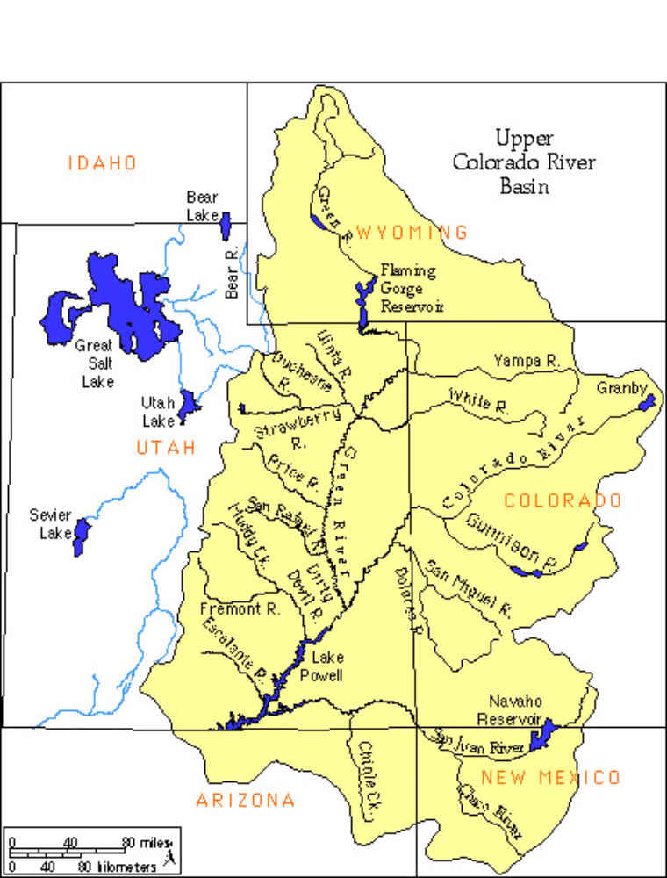
Environmental Challenges
Water Impacts
  Estimates range from 1-3 barrels of water per barrel of shale oil
  Demonstration needed to attain reliable data
  In-situ processes are challenged to protect groundwater
  In the West, water will be drawn from local and regional sources

Slide 19
Summary
Over 2 trillion barrels of in place resource
The most concentrated hydrocarbon deposits on Earth
Conversion technologies are advancing rapidly
A unique opportunity to provide long term sustained production
Production potential of up to 2.5 MMBbl/Day
Substantial economic benefits to the Nation
Requires concerted effort by the private sector, Federal & State governments, and local communities

