Slide 1
The New World of Biofuels: Implications for Agriculture and Energy
Keith Collins, Chief Economist, USDA
EIA Energy Outlook, Modeling, and Data Conference
March 28, 2007

Slide 2
Overview
Ag 101
Status of Biofuels & Market Implications
Public Policy and Biofuels
Role of Research
USDA Energy Policy & 2007 Farm Bill

Slide 3
Ag at a Glance
Item | 2006 | 2007F
 | Billion $
Farm cash receipts | 243 | 259
Crop receipts | 122 | 134
Corn receipts | 23 | 31
Livestock receipts | 121 | 125
Livestock feed costs | 31 | 35
Value of exports (FY) | 69 | 78

Slide 4
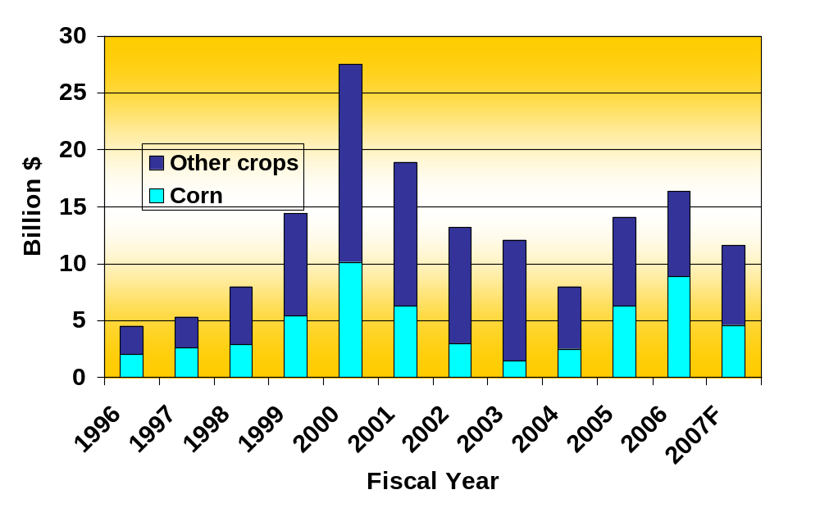
Farm Program Payments . . . corn accounts for a large share

Slide 5
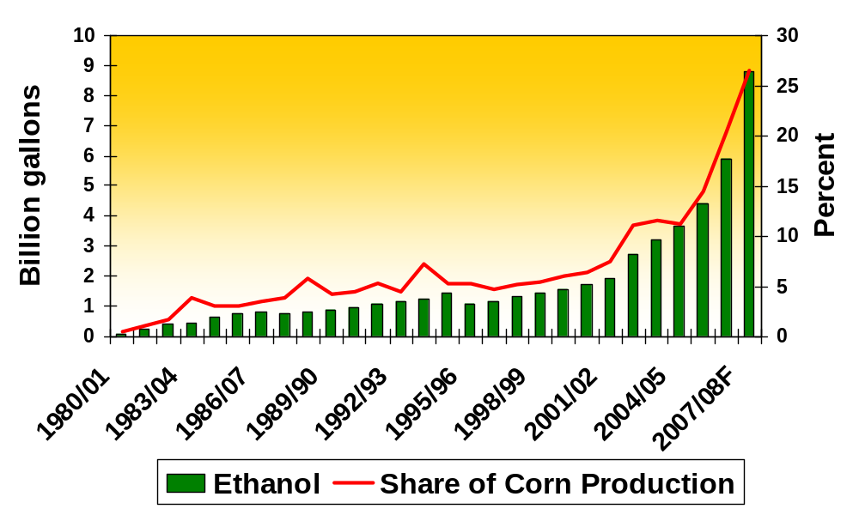
Corn Ethanol Production . . . expect to use 27% of ’07 corn crop for nearly 9 bil. gal.

Slide 6
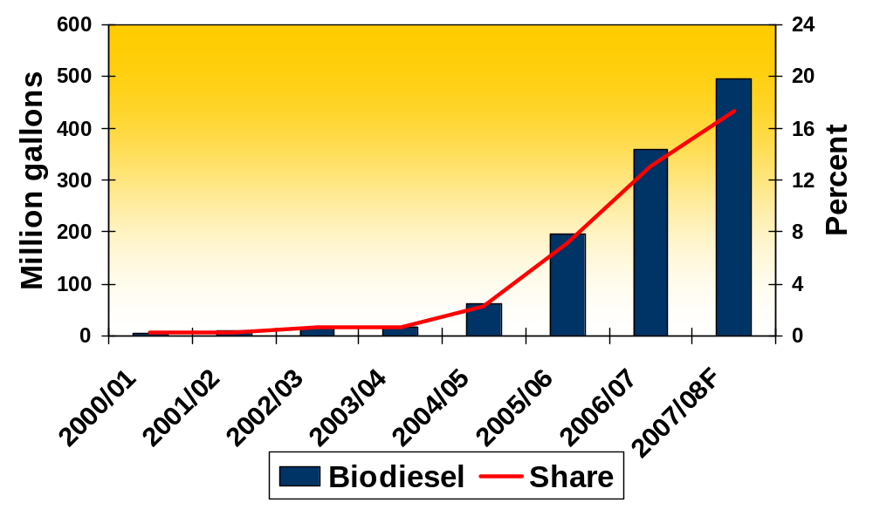
Biodiesel Production . . . expect to use 17% of ’07 soyoil crop for 500 mil. gal.

Slide 7
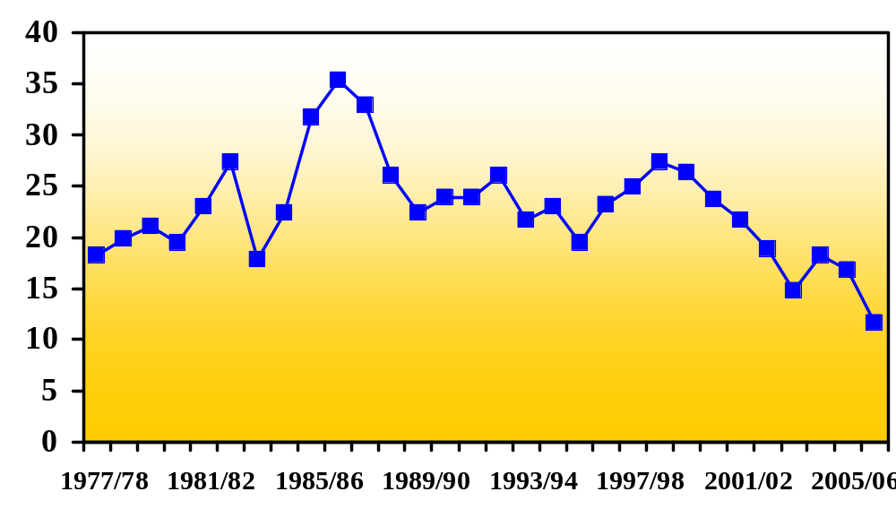
Global Coarse Grain Stocks . . . getting uncomfortably tight
% of total use
19% & Record corn prices
2006/07F: 12%
Crop Year

Slide 8
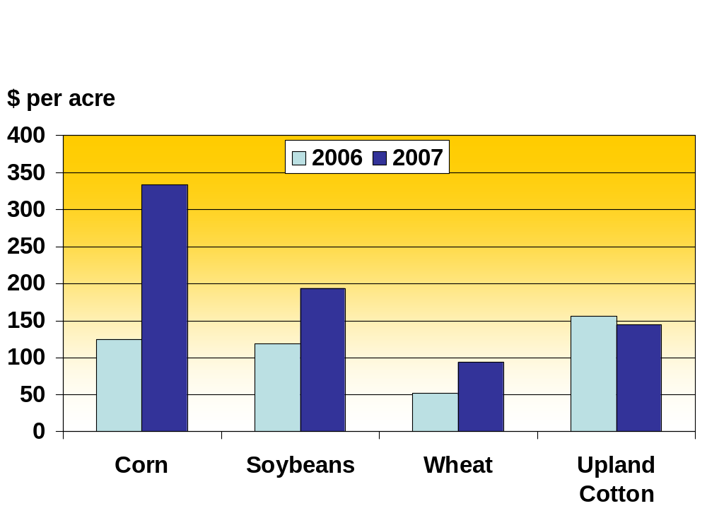
Expected Net Returns . . .
favor corn

Slide 9
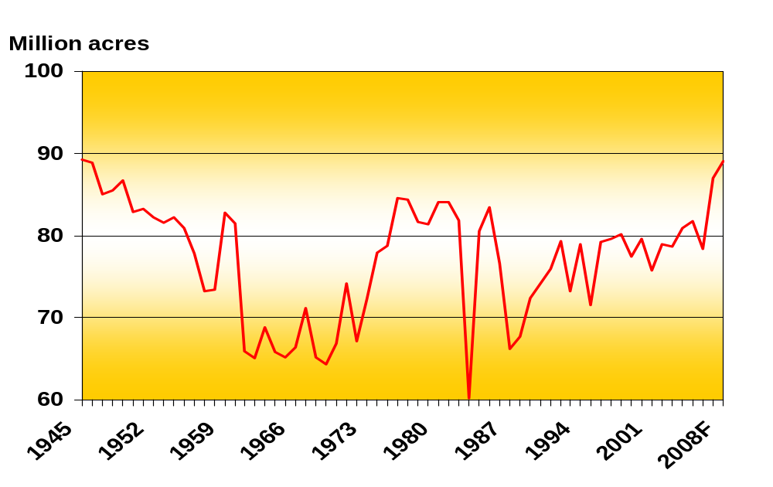
Corn Acres Planted . . .
highest Since 1945 expected

Slide 10
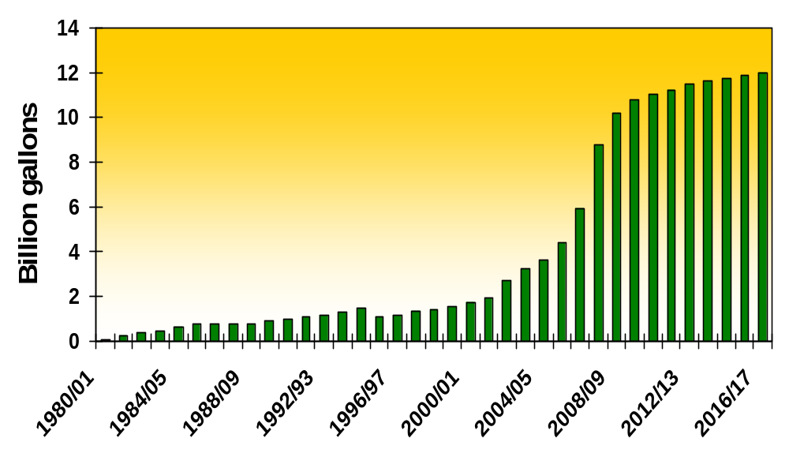
Projected Corn Ethanol Production… expect 12 bil. gal. in 2016/17– 30% of corn crop

Slide 11
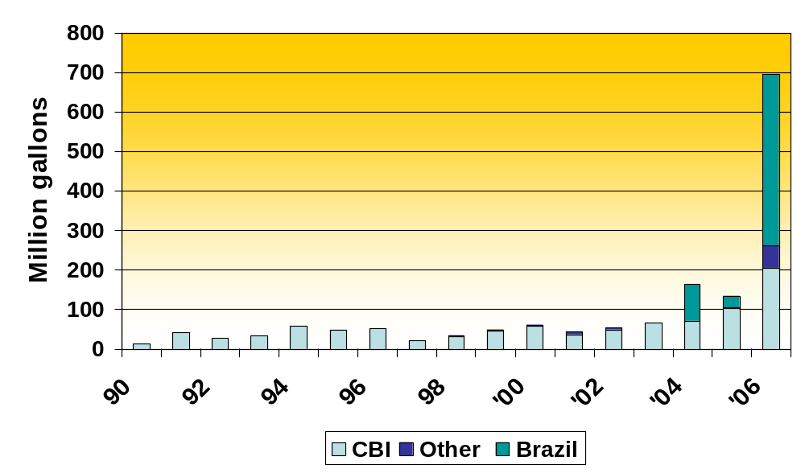
Ethanol Imports Augment Demand… imports soaring, led by Brazil
Source: Census and Customs CBI TRQ data

Slide 12
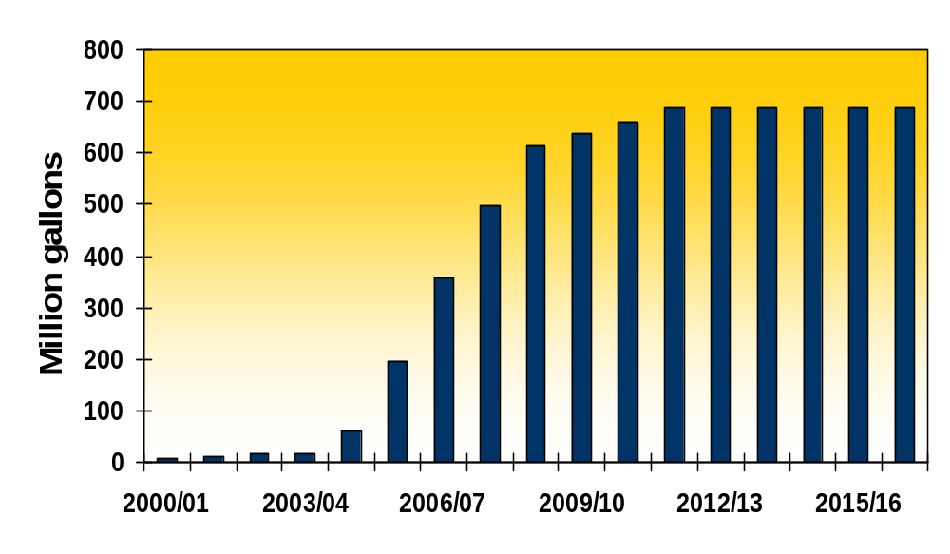
Projected Soy Biodiesel Production… expect 700 mil. gal. in 2016/17 – 23% of soyoil production

Slide 13
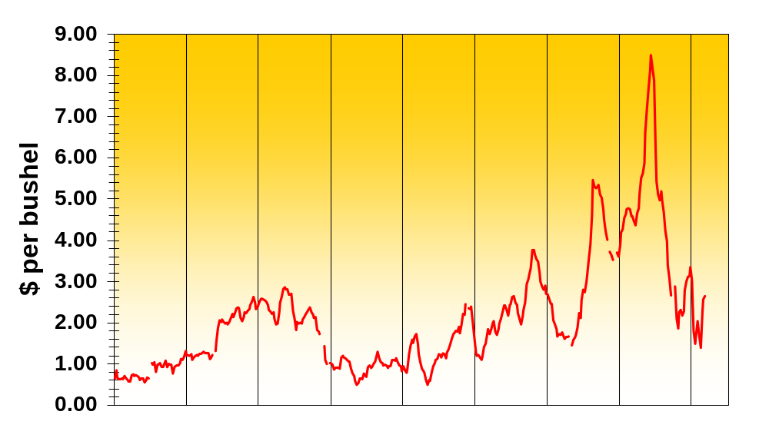
Ethanol-Corn Price Spread . . . weekly data (2.75xPeth-Pcrn)
1999
2000
2001
2002
2003
2004
2005
2006
2007

Slide 14
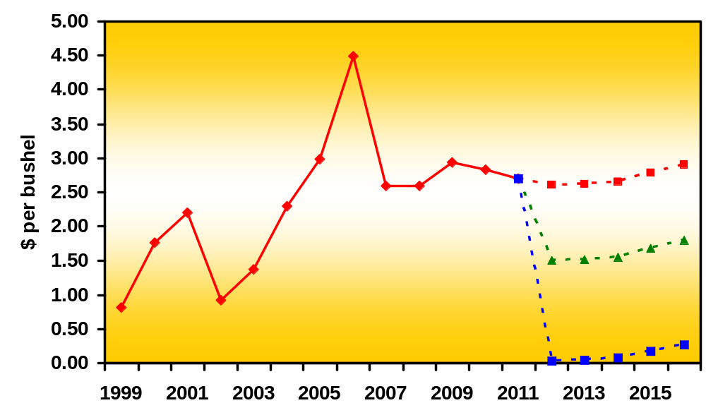
Ethanol-Corn Price Spread . . . annual data with alternative Peth scenarios
Ethanol priced =
historical premium
Priced = gasoline
Priced = 70% gasoline

Slide 15
Challenges Facing Ethanol
Corn trend acreage & yields
Global weather
Demand growth for blends/E85
Ethanol distribution system
Tax credit, tariff, RFS/AFS issues
Livestock feed costs & adjustments
DDG quality
Meat and consumer food prices
Environmental issues: nitrogen, water quantity & quality, CRP

Slide 16
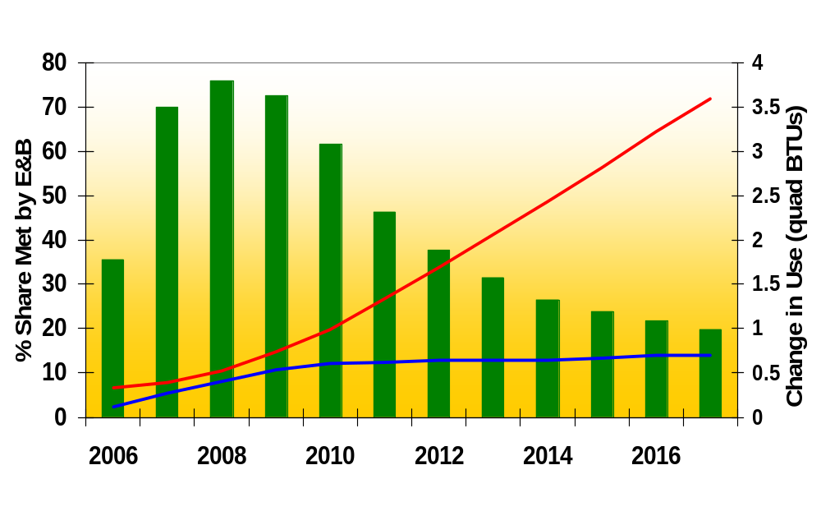
Change in Fuel Use Since 2005 Met by Ethanol/Biodiesel
∆ Total Gas/Distillate Use
E/B share of
∆ total fuel use
∆ E/B use
Source: 2007 EIA Annual Energy Outlook

Slide 17
Options to Maintain Biofuel Growth
Do nothing
Minimum prices (price controls)
Maintain or amend subsidies/tax
preferences
Increase renewable fuel standards

Slide 18
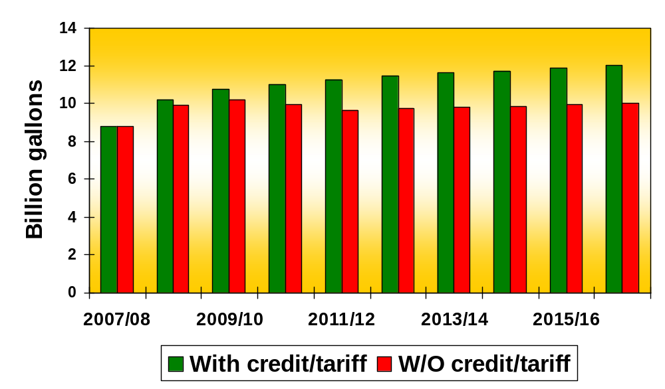
Projected Corn Ethanol Production. . . w/o tax credit and import tariff (USDA analysis)

Slide 19
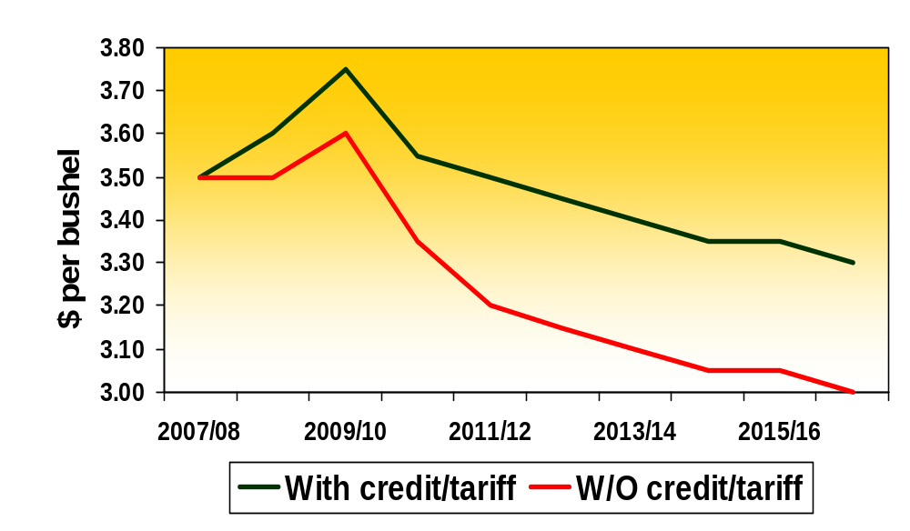
Projected Corn Prices… w/o tax credit and import tariff (USDA analysis)

Slide 20
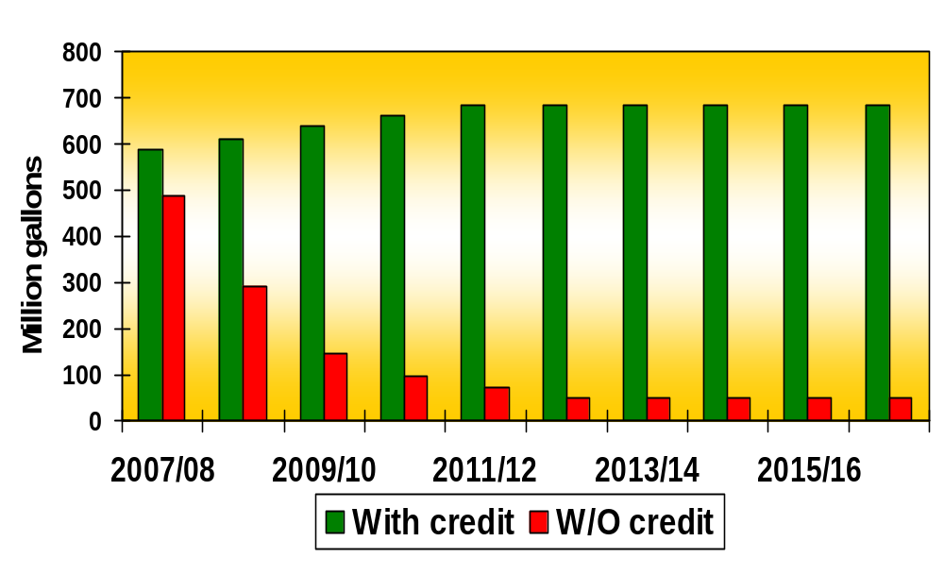
Projected Soy Biodiesel Production. . . w/o tax credit (USDA analysis)

Slide 21
President’s “20 in 10” Proposal
Reduce U.S. gasoline use by 20% in the next 10 years
Path:
  Modify CAFÉ
  Require 35 billion gallons of renewable and alternative fuels by 2017
Easy to achieve?
Role of Ethanol and Biodiesel ?

Slide 22
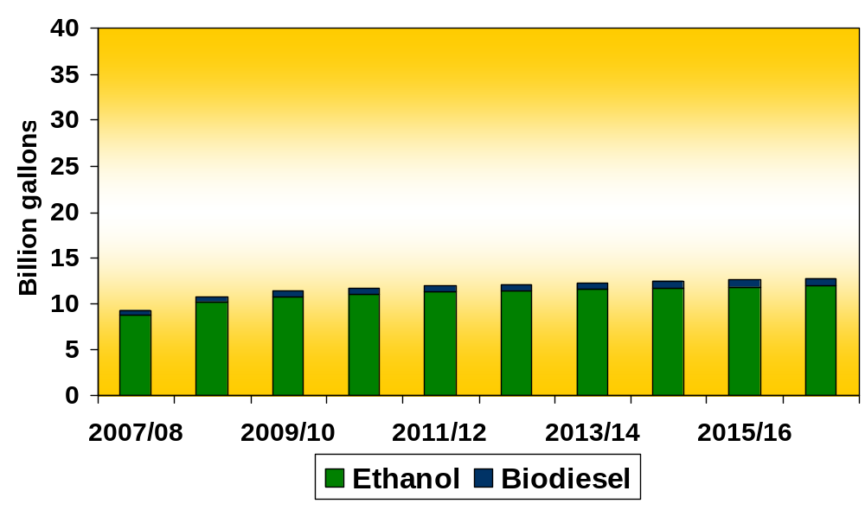
USDA Baseline Biofuel Production
“20 in 10”
22 billion

Slide 23
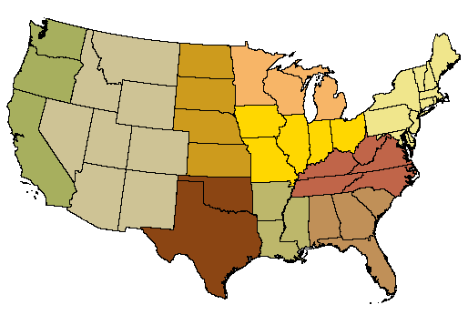
Biomass Potential by 2017
(excluding corn based ethanol)
(310 million tons of biomass = 28 billion gallons of ethanol)
10
1
5
2
1
3
19
33
17
1
9
5
19
12
6
22
80
4
2
7
7
8
Forest Residues (130)
17
1
14
Crop Residues (152)
2
Perennial Crops (26)
Source: “Billion-Ton” Study

Slide 24
Cost Competitiveness of Cellulosic Ethanol
 | Corn Based | Cellulosic Today?--Illustrative | Cellulosic 2010-12— DOE target
Feedstock | $1.17 @$3.22/bu 2.75g/bu | $1.00 @$60/dt 60g/dt | $0.33 @$30/dt 90g/dt
By-Product | -$0.38 | -$0.10 | -$0.09
Enzymes | $0.04 | $0.40 | $0.10
Other Costs** | $0.62 | $0.80 | $0.22
Capital Cost | $0.20 | $0.55 | $0.54
Total | $1.65 | $2.65 | $1.10
** (includes preprocessing, fermentation, labor)

Slide 25
Role for Research
Reduce Production Costs
  - Land Costs
    -- Cropland
    -- Grassland/Pasture
  - Establishment and Reseeding
  - Bailing and Staging
Transportation Costs

Slide 26
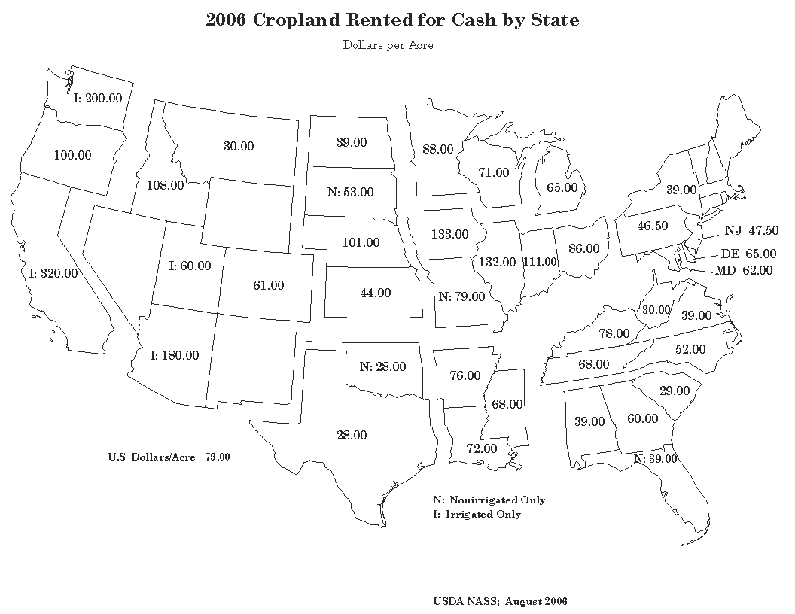
Cropland Rents . . . hard for dedicated crops to compete for land
Cropland rents over $100/acre need over 3 dt/acre just to cover land costs

Slide 27
Production Costs . . .
(actual economic data are limited)
University of Nebraska/ARS
  --Switchgrass, 173 acres, 5 years, 10 farmers
  --Average yield = 3.4 tons/acre
  --Land cost = $17/ton
  --Production cost = $27/ton
  Total cost = $44/ton
Iowa State University
  --Switchgrass from Pasture
  --Average yield = 4 tons/acre
  --Land cost = $13/ton
  --Establishment + reseeding cost = $7/ton
  --Production cost = $40/ton
  Total cost = $60/ton

Slide 28
2007 Farm Bill Proposal
$500 million-- Ag Bioenergy and Biobased Products Research Initiative
$150 million--Biomass Research and Development Act
$100 million--Cellulosic Bioenergy Program
$150 million--Forest Wood-to-Energy Program
Biomass Reserve Program (BRP)

Slide 29
Conclusions
Tight agricultural markets raising risks
Corn ethanol:
  --Approaching limits
  --Making minor inroads in crude oil market
  --Can do a little more with better yields
Cellulosic technology:
  --Great prospects
  --Large potential biomass feedstock base (technical)
  --Must focus on economic potential
  --Need to improve yields to reduce feedstock costs
  --Public policy goal to get over initial adjustment costs

