Slide 1
Annual Energy Outlook 2007
EIA Energy Outlook, Modeling and Data Conference
March 28, 2007
Washington, DC
John J. Conti
Director
Office of Integrated Analysis and Forecasting
Energy Information Administration
Notes:
Good morning and thank you for attending this year’s conference. We appreciate the technical feedback we get during the conference as well as some insight into what you would like to see in future AEO’s I would like to take this opportunity to thank all the EIA staff that helped to make this conference possible.
We have broadened the scope of this year’s conference, again. Besides the long-term projection issues and the short-term projection issues that were introduced last year, this year’s conference includes a session on future electric power data collections at EIA.
I will discuss energy projections contained in the Annual Energy Outlook 2007. The AEO contains 33 scenarios, in addition to the Reference Case, which address a number of possible future outcomes for U.S. energy markets. Like last year, I hope to give a greater flavor for some of the other scenarios that are contained in the AEO; however, based on some of the comments we received, I will present a reduced litany of mind numbing numbers.
The projections in the AEO2007 are not statements of what will happen, but what might happen given the specific assumptions and methodologies used. These projections are based generally on current laws and regulations and do not include the potential impacts of pending or proposed legislation, regulations, or standards. However, these projections do provide an objective, policy-neutral basis that can be used to analyze energy markets under alternative assumptions.
The AEO results are based on the National Energy Modeling System, which is an abstraction of energy markets, including the representation of regulations and producer and consumer behavior.

Slide 2
Overview
Legislation and Regulation
Issues in Focus
AEO2007 reference case
Oil market results in the context of the low, reference, and high price cases
Natural gas market results in the context of the low, reference, and high LNG cases
Coal market results in the context of the low, reference, and high coal cost cases
Energy production and consumption in the context of the frozen, reference, and advanced technology cases
Carbon dioxide emissions in the context of the low, reference and high growth cases
Notes:
I will first present some information about chapters 2 and 3 of the AEO.
Next, I will present some general information about the AEO2007 reference case to provide some context for the comparisons that follow.
The following sections will contrast the reference case with two alternative sets of scenario projections found for each fuel.
I will present results for the oil markets in the context of the low, reference and high price cases.
Then, I will present information about the natural gas markets in the context of the low, reference, and high LNG import cases.
That will be followed with information about the coal markets in the context of the low, reference, and high coal cost cases.
This will followed with information about overall energy production and consumption in the context of the frozen, reference, advanced, technology cases.
Finally, I will present information about carbon dioxide emissions in the context of the low, reference, and high growth cases.

Slide 3
Legislation and Regulation Section
Discusses selected evolving legislative and regulatory issues affecting the AEO.
It provides an update on the handling of key provisions in the Energy Policy Act of 2005 (EPACT2005).
It discuses other recently enacted legislation and regulation:
  the new Corporate Average Fuel Economy (CAFE) standards for light-duty trucks,
  the regulation of emissions from stationary diesel engines, and
  Federal and State Ethanol and Biodiesel Requirements
It provides a summary of how sunset provisions in selected Federal fuel taxes and tax credits are handled.
  Excise taxes on Highway Fuels
  Biofuels tax credits
  Production tax credit for electricity generation
Recaps recent changes in electricity markets
Recaps state renewable energy requirements and goals
It discuses the Clean Air Interstate Rule, Clean Air Mercury Rule, and the proposed regulation of greenhouse gases in California.
Notes:
The Legs and Regs sections discusses selected evolving legislative and regulatory issue and how they are represented in the AEO.
Legislation and Regulation that is discussed includes:
Energy Policy Act of 2005
CAFE
Regulation of emission from stationary diesel engines
Federal and State ethanol and biodiesel requirements
Summary of selected Federal fuel taxes and tax credits.
Excise taxes on Highway Fuels
Biofuels tax credits
Production tax credit for electricity generation
Recaps recent changes in electricity markets
Recaps state renewable energy requirements and goals
It discuses the Clean Air Interstate Rule, Clean Air Mercury Rule, and the proposed regulation of greenhouse gases in California.

Slide 4
Issues in Focus
The “Issues in Focus” section includes discussions of:
  World Oil Prices in the AEO2007
  The impact of rising construction costs on energy markets
  The demand response to higher energy prices in end-use sectors
  Miscellaneous electricity services in the building sector
  Improved representation of non-energy-intensive manufacturing
  Impact of loan guarantees on selected electric generating technologies
  Oil and Gas resources in the lower 48 Federal outer continental shelf
  The proposed Alaska natural gas pipeline
  Coal transportation issues
  Biofuels penetration in U.S. transportation markets
Notes:
This Issues and Focus section provides in-depth discussion of topics of special interest that may affect the AEO projections.
This list get updated every year and you can probably gain some insight into why results have changed in the AEO2007 by a quick review of this section.

Slide 5
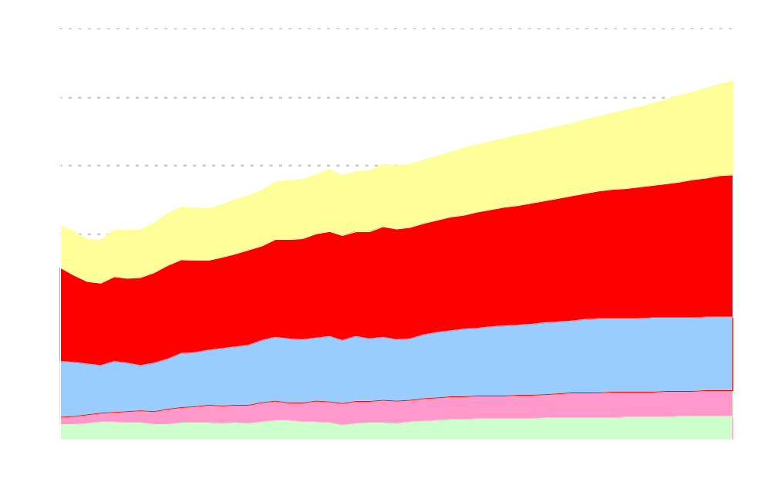
Primary Energy Consumption by Fuel
(Reference Case)
quadrillion Btu
Coal
Liquid Fuels
Natural Gas
Nuclear
Renewables
Notes:
Total primary energy consumption in the AEO2007 reference case is projected to increase by about 30 percent, from about 100 quadrillion Btu in 2005 to 131 quadrillion Btu in 2030.
Coal is the fastest growing fuel followed in decreasing order by renewables, liquid fuels, natural gas, and nuclear.
For all fuels, the projected rate of growth in primary fuel consumption for the 1980 through 2005 period is about the same as 2005 through 2030 period; however, for some individual fuels it can be more or less.
The rates of growth in primary energy consumption for coal and natural gas are similar to history; whereas, they are different for renewables, petroleum and nuclear.
Renewables are projected to grow at 1.5 percent per year in the AEO2007 reference case, faster than the 0.3 percent rate of growth in history.
Liquid fuels is also projected to grow faster at 1.0 percent per year compared to 0.7 percent per year experienced in the historical period.
Nuclear power is projected to grow at 0.6 percent per year between 2005 and 2030, much slower than the 4.4 percent per year historical growth rate.

Slide 6
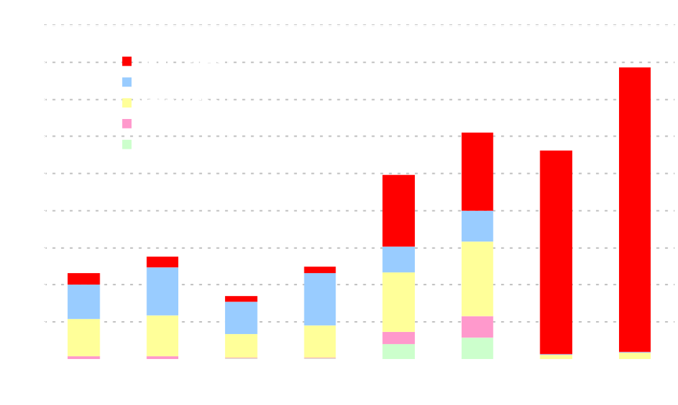
Delivered Energy Consumption by Sector and Fuel
(Reference Case)
quadrillion Btu
39.3
30.5
28.1
24.9
13.8
11.6
12.4
8.5
Residential
Commercial
Industrial
Transportation
Notes:
Total delivered energy consumption in the reference case grows at 1.1% per year. The commercial and transportation sectors grow faster than the average, while the industrial and residential sectors grow slower than the average.
Commercial energy use grows almost 50 percent due to increases in commercial floor space as it expands to serve greater population and higher incomes.
Transportation energy use increases about 40 percent. Most of that growth occurs in light-duty vehicles, followed by heavy truck travel and air travel.
Industrial energy use increases almost 25 percent as a result of 65 percent increase in industrial output. Efficiency improvements and structural shifts in the economy away from energy-intensive manufacturing moderate energy growth.
Residential energy use grow by almost 20 percent as total households increase by about 30 percent. Average house hold square footage increase by about 13 percent.

Slide 7
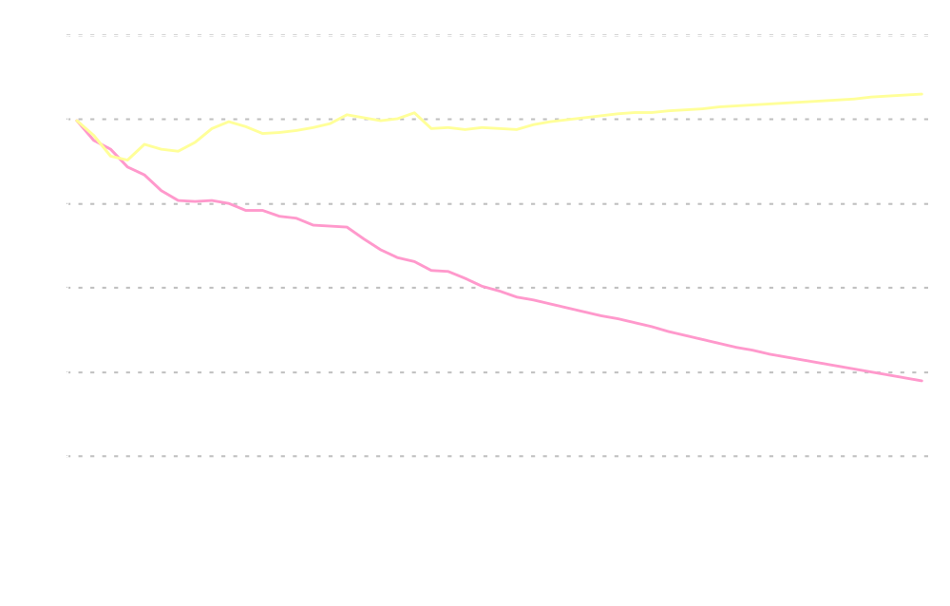
Energy Use per Capita and per Dollar of Real GDP
(Reference Case)
index, 1980=1
Energy use per capita
Energy use per dollar GDP
History
Projections
Notes:
Energy efficiency can be measured in many different ways. The chart illustrates two different measures of energy efficiency: Energy Intensity and Per Capita Energy Use.
In the Reference case, the economy is expected to continue to become less energy-intensive as GDP grows at 2.9% annually, while energy use grows by 1.1%. Energy intensity (primary energy use per dollar of GDP) is projected to decline at an average rate of 1.8 percent per year between 2005 and 2030.
The energy intensity decline in the projections approximately matches the decline rate between 1990 and 2005.
Efficiency gains and structural shifts in the economy offset some of the growth in demand for energy services. Energy-intensive industries’ share in overall industrial output is projected to fall by an average rate of 0.6%/yr, which is slower then the decline rate of 1.2%/yr experienced from 1992 to 2005.
Starting in the late 1980s and lasting through the mid-1990s, energy consumption per capita increased with declining energy prices and strong economic growth.
Per capita energy use is projected to increase by an average of 0.3%/yr in the projections, despite relatively high energy prices and efficiency improvements in all sectors.

Slide 8

World Oil Prices
(Reference Case)
2005 dollars per barrel
High Price
Reference
Low Price
History
Projections
Notes:
In AEO2007, world crude oil prices are projected to fall from current levels to about $50 per barrel in (2005 dollars) in 2015, then rise to $59 per barrel in 2030. World oil production reaches 117 million barrels per day by 2030 and OPEC’s market share is expected to remain at about 40 percent throughout the reference case projections.
The AEO2007 also includes alternative price cases designed to address the uncertainty about OPEC market behavior and the world conventional crude oil resource base.
In the low price case, the conventional world resource base is 15% larger than the USGS mean estimate. World crude oil prices decline gradually from today’s level to $34/bbl in 2015 and remain at that level through 2030. In this case world oil production reaches 127 million barrels per day in 2030, with OPEC’s share rising to 42 percent.
In the high price case, the conventional world resource base is 15% smaller than the USGS mean estimate. In this case, world crude oil prices grow throughout the projection horizon, reaching more than $100/bbl in 2030. World oil production reaches 102 million barrels per day in 2030, with OPEC’s share falling to 33 percent.

Slide 9
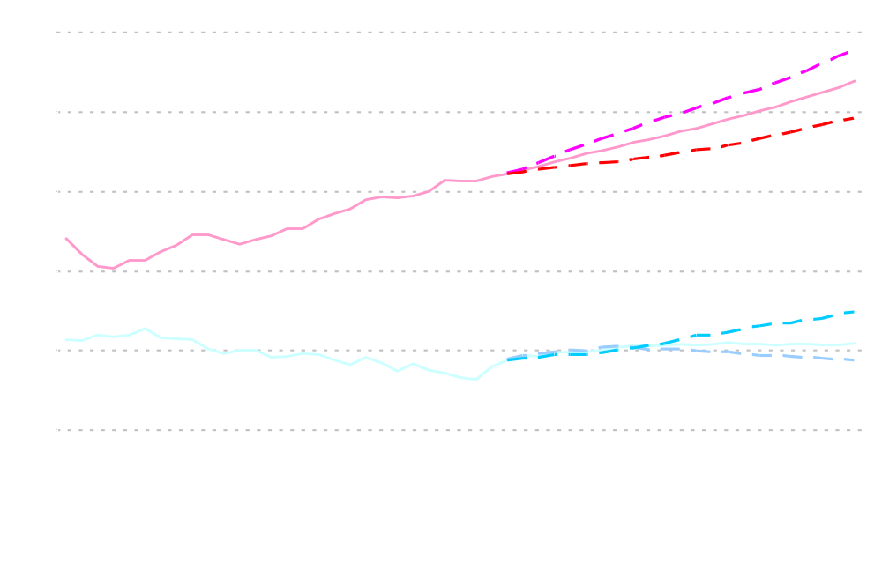
Liquid Fuels Supply, Consumption, and Imports
(Price Scenarios)
million barrels per day
Low Price
High Price
67%
49%
61%
Consumption
Net imports
60%
High Price
Production
Low Price
History
Projections
Notes:
In the reference case in 2030, net imports of crude oil and refined products are 16.4 mbd. Import dependency decrease from 60% in 2005 to a low of about 55% in 2010, before rising again to 61% in 2030. Under alternative oil price projections, import fraction ranges from 67% in the low price case to 49% in the high price case.
In the High Price case, higher crude oil prices spur greater exploration and development of domestic oil supplies, reduce demand for petroleum, and slow the growth of oil imports compared to the reference case.
Total domestic petroleum supply in 2030 is 2.2 mbd (19%) higher than in the reference.
Total net imports in 2030, including crude oil and refined products, are reduced to 12.0 mbd, 4.3 mbd less than in the reference case.
The converse is true for the low price case.
Total domestic petroleum supply in 2030 is 1.1 mbd (10%) lower than in the reference.
Total net imports in 2030, including crude oil and refined products, are increased to 19.3 mbd in the low price case, 3 mbd more than in the reference case.

Slide 10
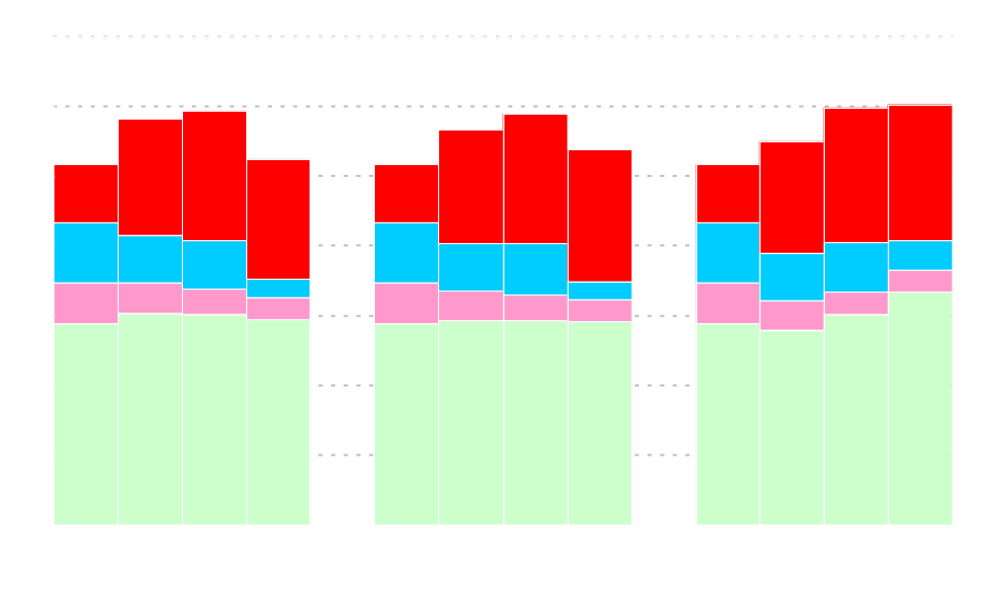
Domestic Crude Oil Production by Source
(Price Scenarios)
million barrels per day
5.8
5.9
5.9
6.0
6.0
5.7
5.5
5.2
5.2
5.2
5.4
5.2
Lower 48 Offshore Deep
Alaska
Lower 48 Offshore Shallow
Lower 48 Onshore
Low Price
Reference
High Price
Notes:
In the reference case, total domestic crude oil production is projected to increase from 5.2 mbd in 2005 to 5.9 mbd in 2016, before declining to 5.4 mbd in 2030.
New onshore L48 conventional oil reservoir discoveries are likely to be smaller, more remote, and increasingly costly to exploit; however, higher oil prices offset these disadvantages, resulting in L48 onshore oil production remaining relatively constant in the reference case. (2.9 mbd)
L48 Shallow Offshore declines by about half throughout the forecast.
EIA assumes that drilling in ANWR continues to be prohibited. Alaskan oil production is expected to decline across all scenarios.
Considerable oil resources remain in the offshore, especially in the deep waters of the Gulf of Mexico, where production is expected to roughly double and reach a peak of 2.0mbd in 2017 before declining. World oil prices are especially important to development of the deepwater gulf.
In the low price case, the larger resource base assumptions cause relatively higher production in the near term, but the lower crude world oil prices depress production by the end of the forecast. The converse is true in the high price case.

Slide 11

Petroleum Liquids from Coal, Natural Gas, and Shale
(Price Scenarios)
million barrels per day
2020
2030
Notes:
This chart illustrates domestic unconventional petroleum liquids production in the reference and high price cases. By 2030, unconventional petroleum liquids production accounts for 2 percent of total liquids production in the reference case and 7 percent of total liquids production in the high price case. There are no domestic unconventional liquids production in the low price case.
In the reference case, world oil prices are high enough to promote the development of Coal-to-liquids. CTL production increases from about 100,000 barrels per day in 2020 to 440,000 barrels per day in 2030.
There are no projected production of gas-to-liquids or oil shales in the reference case.
In the high price case, U.S. coal-to-liquids production grows from 600,000 bbl/dy in 2020 to 1.7 mbd in 2030.
Gas-to-liquids production is about 100, 000 barrels per day beginning in 2020.
The U.S. has vast resources of oil shales; however, based on currently documented technologies, production only occurs in the High Price Case where it reaches about 400,000 b/d by 2030.

Slide 12
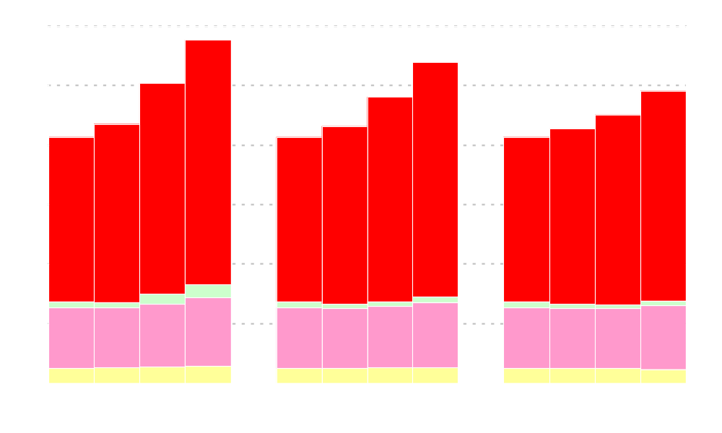
Liquid Fuels Consumption by Sector
(Price Scenarios)
million barrels per day
28.8
Electric Power
26.9
Residential and Commercial
25.2
24.6
24.0
21.8
22.6
20.8
20.8
21.6
20.8
21.4
Transportation
Industrial
Low Price
Reference
High Price
Notes:
Despite the continuation of relatively high petroleum product prices, total liquid fuels consumption is projected to grow from 21 million barrels per day in 2005 to 27 million barrels per day in 2030 in the reference case.
The transportation sector consumes almost three-quarters of all liquid fuels and the industrial sector about 20 percent. The remaining 6% is divided among the residential, commercial, and electric power sectors.
Light duty vehicles are responsible for more than half of all energy use in the transportation sector. Despite the significant increase in petroleum consumption in the transportation sector in the projections, light duty vehicles efficiency increases 13 percent.
Much of the increase in new light-duty vehicle fuel economy reflects greater penetration of hybrid and diesel vehicles. Hybrids (10%) and diesel vehicles (6%) are together expected to account for about 16 percent of new vehicle sales in 2030.
Across the price cases, liquid fuels consumption varies by about 4 mbd.
The transportation sector is responsible for almost 70 percent of the change.
The electric power sector is responsible for almost 20 percent of the change
The remainder is spread among the Industrial and buildings sectors.
The penetration of advanced technology and alternatively fueled vehicles across scenarios is a key factor in the change in transportation sector petroleum consumption.

Slide 13

Net Imports of Liquefied Natural Gas
(LNG Scenarios)
trillion cubic feet
History
Projections
High LNG
Reference
Low LNG
Notes:
Moving to natural gas, in the reference case, LNG grows from 0.6 trillion cubic feet in 2005 to 4.5 tcf in 2030.
In order to evaluate the potential impact of higher or lower LNG imports, two additional cases were constructed to investigate the impact on domestic production, consumption, and prices. The range of values found in these scenarios were based upon the LNG imports found in the high and low price cases.
In the High LNG case, LNG imports are assumed to be 30 percent higher than in the Low Price case. LNG imports grow faster to 9.8 tcf by 2030
In the Low LNG case, LNG imports are assumed to be 30 percent lower than in the High Price case. LNG imports grow slower to 1.6 tcf by 2030.
The LNG import cases assume reference case oil prices and domestic resource levels.

Slide 14
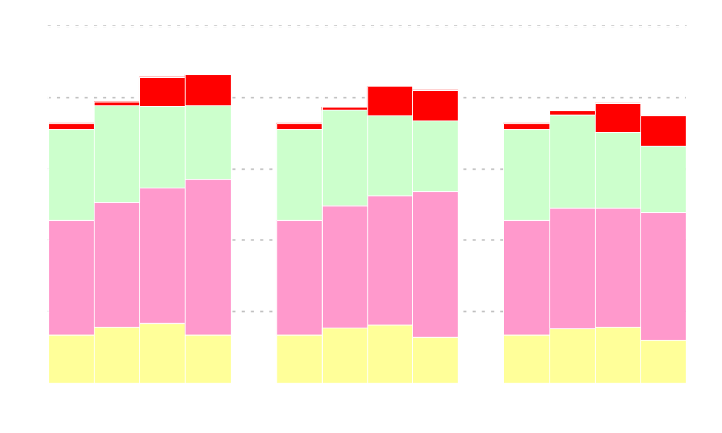
Natural Gas Production by Source
(LNG Scenarios)
trillion cubic feet
Alaska
21.5
21.6
20.8
20.5
19.7
19.3
19.1
19.6
18.2
18.2
18.2
18.7
Lower 48 Conventional
Onshore
Lower 48
Unconventional
Lower 48 Offshore
Low LNG
Reference
High LNG
Notes:
In the reference case, domestic dry natural gas production is projected to increase from 18.2 tcf in 2005 to 21.0 tcf in 2022, before declining to 20.5 tcf in 2030.
Unconventional natural gas production (i.e., Coal bed methane, tight sands, and gas shale) is projected to grow throughout the period from 8.0 tcf in 2005 to 10.2 tcf in 2030 and account for 50% of domestic U.S. gas production in 2030.
Lower-48 offshore production is projected to increase from the 2005 level of 3.4 tcf to 4.6 tcf in 2015 as new resources come on line in the Gulf of Mexico. After 2015, lower-48 offshore production declines to 3.3 tcf in 2030.
With the projected completion of an Alaskan natural gas pipeline in 2018, total Alaskan production increases from slightly less than ½ tcf in 2005 to 2.2 tcf in 2021 and remains at about that level through 2030.
Lower-48 onshore conventional production (inc. assoc. dis) decreases throughout the forecast, although still supplying 24 percent of all supplies in 2030.
Domestic dry natural gas production only moderately compensates for the variance in LNG imports across scenarios. By 2030, domestic dry natural gas production is about 3 tcf higher in the low LNG import case than in the high LNG import case
About three-fourths of the difference in supply is due to increased unconventional natural gas production. The remainder is split evenly between offshore and conventional production.

Slide 15
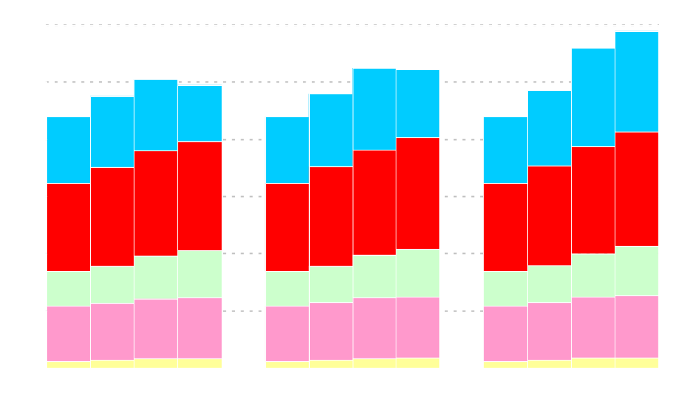
Natural Gas Consumption by Sector
(LNG Scenarios)
trillion cubic feet
29.5
28.0
26.3
26.1
25.3
24.8
24.3
23.8
24.0
22.0
22.0
22.0
Electric Power
Industrial
Commercial
Residential
Transportation
Low LNG
Reference
High LNG
Notes:
Total consumption of natural gas in the AEO2007 reference case is projected to increase from 22 trillion cubic feet in 2005 to 26 tcf in 2020 (1.2 percent annually) and then level off, mostly due to higher natural gas prices and their competition with other fuels, especially in the electric power sector. (0.7% over the whole period).
Use of natural gas increases in all sectors between 2005 and 2030, except the electric power sector.
It increases 45% in the industrial sector, 39% in the commercial sector, 10% in the residential sector, 58% in the transportation sector (due to its use in natural gas transportation).
In the electric power sector, natural gas consumption increases from 5.1 tcf today to about 7.2 tcf in 2020. After 2020, as natural gas prices are projected to increase more steeply, consumption falls to 5.9 tcf.
Across the LNG scenarios, natural gas consumption varies by almost 5 tcf. Almost 85 percent of the swing in consumption between the low and high LNG import scenarios is attributable to natural gas use in the electric power sector.

Slide 16

Lower 48 Natural Gas Wellhead Prices
(LNG Scenarios)
2005 dollars per thousand cubic feet
History
Projections
Low LNG
Reference
High LNG
Notes:
In the AEO2007 reference case, the average U.S. wellhead price for natural gas declines gradually from current levels as increased drilling brings forth new domestic supplies and new import sources become available. However, in the long term, growth in supplies are not expected to increase sufficiently to offset the impacts of resource depletion and increased demand.
The average wellhead price falls from current levels to $5.00 per thousand cubic feet (2005 dollars) in 2015, then rises gradually to about $6.00 per thousand cubic feet in 2030.
As mentioned previously, the LNG import cases assume reference case oil prices and domestic resource levels, which turn out to me more important determinants of domestic natural gas prices than the availability of LNG.
In the High LNG case, U.S. wellhead natural gas prices are about 70 cents per thousand cubic feet lower than in the reference case.
In the Low LNG case, U.S. wellhead natural gas prices are 60 cents per thousand cubic feet higher than in the reference case.
Increases in LNG imports displace more expensive sources, decrease natural gas prices, and increase gas consumption.

Slide 17

Labor Productivity, Cost Indices, and Miner Wages
(Coal Cost Scenarios)
Average Coal
Miner Wage
(2005 $/hr)
Labor Productivity
Equipment Cost Indices
(constant dollar index, 2005=1.000)
1.5
30
2005
Low Coal Cost
Reference Case
High Coal Cost
1.0
20
0.5
10
0.0
0
Notes:
In the reference case, coal mining labor productivity (short tons per miner per hour), is assumed to increase on average only by 0.8% per year through 2030. Factors that are expected to limit future productivity growth include a trend toward higher stripping ratios at western surface mines and fragmentation of underground reserves in the east.
Miner wage rates and mine equipment costs are assumed to remain relatively constant throughout the projections.
On the coal transport side, railroad productivity (billion freight ton-miles per employee per year) is assumed to grow at an average rate of 1.4%. Railroad equipment costs are assumed to decline on average by 0.2% per year.
The high and low coal cost cases were created by varying assumptions of labor productivity, equipment cost, and wages.
In the low coal cost case, productivity improves faster, equipment costs decrease more, and wages decline compared to the Reference case.
In the high coal cost case, productivity declines, equipment costs increase, and wages increase compared to the Reference case.

Slide 18

Coal Production by Region
(Coal Cost Scenarios)
billion short tons
1.82
1.69
1.42
1.32
1.33
1.20
1.19
1.17
1.23
1.13
1.13
1.13
West of the Mississippi
East of the Mississippi
Low Coal Cost
Reference
High Coal Cost
Notes:
In 1999, coal production West of the Mississippi surpassed coal production East of the Mississippi.
In the AEO2007 reference case, U.S. coal production is projected to increase at an average rate of 1.6 percent per year, from 1.1 billion short tons in 2004 to 1.7 billion short tons in 2030.
Production from mines West of the Mississippi River is expected to provide the largest share of the incremental coal production. In 2030, more than two-thirds of coal production is projected to originate from the Western States.
Coal production grows much slower in the high cost case than in the low cost case.
By 2030, coal production in the low coal cost case is almost ½ billion short tons greater than coal production in the high cost case. Three-quarters of the difference in coal production occurs West of the Mississippi River.

Slide 19

Coal Consumption by Sector
(Coal Cost Scenarios)
billion short tons
1.88
1.77
Coal to Liquids
1.45
1.43
1.38
1.30
1.20
1.19
1.18
1.13
1.13
1.13
Electric Power
Industrial
Low Coal Cost
Reference
High Coal Cost
Notes:
In the AEO2007 reference case, total coal consumption is projected to increase from 1.1 billion short tons in 2005 to 1.8 billion short tons by 2030. Eighty percent of the increase is attributable to use in the electric power sector and the remainder is attributable use in the coal-to-liquids process.
Coal consumption is projected to grow at a faster rate toward the end of the projection, particularly after 2020, as coal captures market share from natural gas in the electric power sector and as coal use for coal-to-liquids production grows.
Coal use is sensitive to coal prices and how it competes for market share in the electric power sector and it’s use as a feedstock in coal to liquids production. Between the low and high coal cost cases, coal use varies by about 440 million short tons.
About 80 percent of the difference in coal use is attributable to use in the electric power sector.
The remainder (20%) is attributable the use of coal in the production of liquids.

Slide 20

Cumulative New Generating Capacity, 2006-2030
(Coal Cost Scenarios)
gigawatts
Coal Steam
Natural Gas
Renewables
Nuclear
Notes:
In the AEO2007 reference case, almost 300 gigawatts of electric generating capacity is added between 2005 and 2030. More than half of the additions are coal fired, about 35 percent are natural-gas fired, 6 percent are renewables, and 4 percent are nuclear.
Most coal-fired additions occur after 2020 when natural gas prices are projected to rise more significantly, while coal prices remain fairly stable. Between 2005 and 2020, coal-fired generation grows by 1.4 percent annually; however, between 2020 and 2030, coal-fired generation grows more rapidly, by 3.0 percent annually.
Across the coal cost scenarios, approximately 12 gigawatts more total capacity is added by 2030 in the low coal cost case and 18 gigawatts less total capacity is added by 2030 in the high coal cost case than in the reference case. More total capacity is needed in the low cost case than the reference case because electricity sales are greater due to lower electricity prices and because natural gas capacity is used less intensively. The opposite is true for the high coal cost case.
In the low coal cost case, more than 100 gigawatts coal-fired capacity is added by 2030 than in the high coal cost case. Conversely, in the high coal cost case, 36 gigawatts more nuclear capacity is added, 28 gigawatts more natural gas fired capacity is added, and 5 gigawatts more renewables capacity is added.

Slide 21

Average Delivered Coal Price
(Coal Cost Scenarios)
2005 dollars per million Btu
High Coal Cost
Reference
Low Coal Cost
History
Projections
Notes:
After rising through 2008 from increased demand for electricity generation due to the high oil and natural gas prices, a combination of slow, but continued improvements in expected productivity, and a continuing shift to low-cost coal from the Powder River Basin in Wyoming leads to a gradual decline in the projected average delivered coal price through 2018 in the reference case.
Prices then increase slowly, as rising natural gas prices and the need for baseload generating capacity lead to the construction of many new coal-fired generating plants. By 2030, the average delivered price in the AEO2007 reference case is projected to be over $33 per ton.
Trends in coal prices differ slightly when measured in terms of tonnage or energy (Btu) content, since the average energy content per ton of coal consumed falls over time, due to increasing reliance on Western subbituminous coal that has a lower Btu content.
Assumptions for labor productivity, equipment costs, and wages significantly effect coal prices. In the high coal cost case, delivered coal prices are almost 50 percent higher than in the reference case by 2030. Conversely, in the low coal cost case, delivered coal prices are about 25 percent lower than in the reference case by 2030.

Slide 22
Integrated Technology Cases
For many years, the AEO has included two cases that have attempted to quantify the impact of more optimistic and pessimistic assumptions regarding technology characteristics
These two technology cases combine the assumptions from other technology cases to analyze the impacts of more rapid and slower technology improvement rates.
  The integrated 2006 technology case combines the assumptions from the residential, commercial, industrial, and transportation 2006 technology cases, the electricity low fossil technology case, the low renewables case, and the high nuclear cost case.
  The integrated high technology case combines the assumptions from the residential, commercial, industrial, and transportation high technology cases, the electricity high fossil technology case, the high renewables case, and the low nuclear cost case.
Consumer behavior is assumed to remain unchanged.
Notes:
The integrated 2006 technology case combines the assumptions from the
residential, commercial, industrial, and transportation 2006 technology cases,
the electricity low fossil technology case, the low renewables case, and
the high nuclear cost case.
The integrated high technology case combines the assumptions from the
residential, commercial, industrial, and transportation high technology cases (earlier availability and higher efficiency of technologies),
the electricity high fossil technology case, the high renewables case, and
the low nuclear cost case.

Slide 23
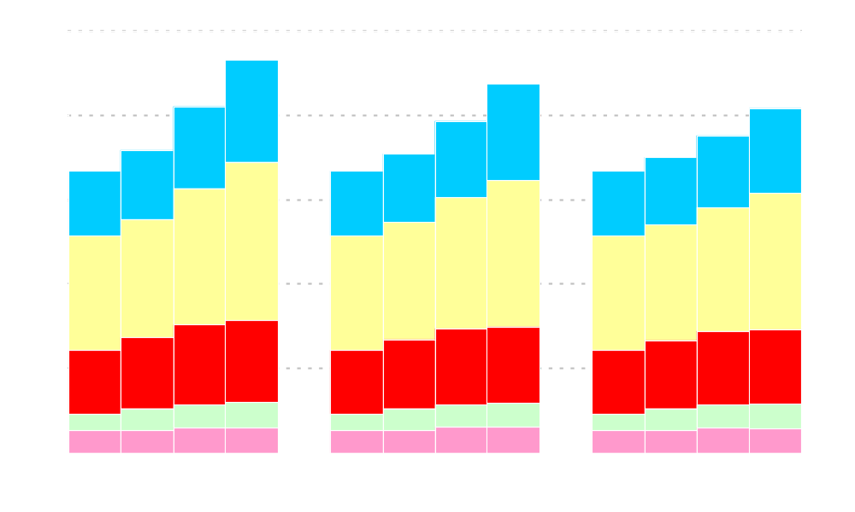
Primary Energy Consumption by Fuel
(Technology Scenarios)
quadrillion Btu
140
131
123
118
122
113
108
106
105
100
100
100
Coal
Liquid Fuels
Natural Gas
Renewable
Nuclear
Low Technology
Reference
High Technology
Notes:
We have already discussed primary energy consumption by fuel in the reference case earlier in the presentation.
In the low technology case total primary energy consumption is 6% higher than the reference case and in the high technology case primary energy consumption is about 7% lower than in the reference case.
In the low technology case, the largest increase in consumption amongst fuels occurs in natural gas, mostly to increased consumption in the electric power sector due to increased electricity sales and in industrial sector due to reduced efficiency.
Consumption of all other fuels in the low technology case is also greater than in the reference case, except nuclear because fewer nuclear plants are built as a result of more pessimistic assumption.
In the high technology case, the largest decrease in consumption amongst fuels occurs in coal, mostly due to decreased consumption in the electric power sector due to decreased electricity sales.
Consumption of all other fuels in the low technology case is less than in the reference case, except for renewables because more plants are built as a result of assumptions for more optimistic technical characteristics.

Slide 24
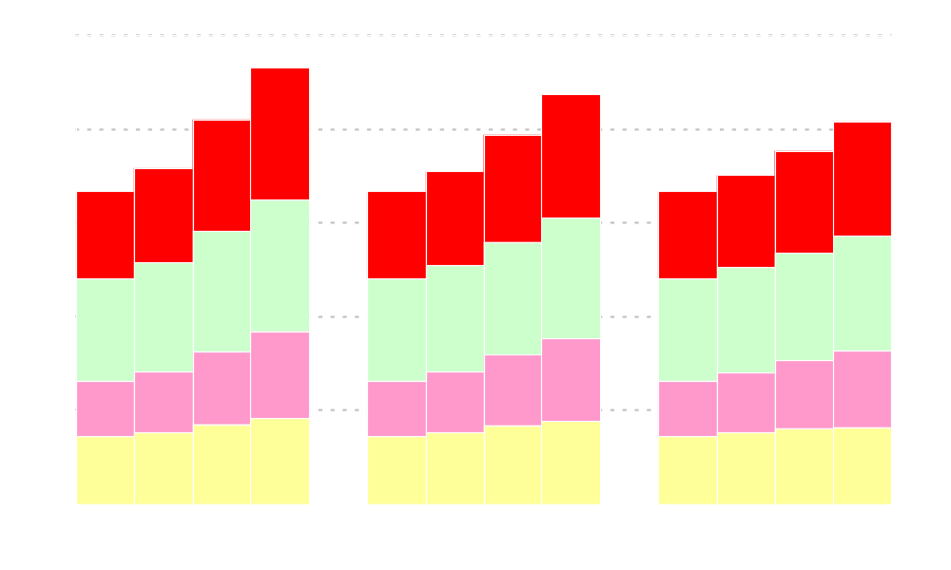
Primary Energy Consumption by Sector
(Technology Scenarios)
quadrillion Btu
140
131
123
118
122
113
108
106
105
100
100
100
Transportation
Industrial
Commercial
Residential
Low Technology
Reference
High Technology
Notes:
Once again we have already discussed the reference case.
In the 2006 technology case, energy consumption in all sectors is greater than in the reference case, varying from a low of about 3 percent for the residential sector to a high of 10 percent in the industrial sector due to reduced efficiency improvement opportunities.
In the high technology case, the largest decrease in consumption amongst sectors occurs in the residential sector (8%) due to reduced lighting, space heating, and miscellaneous end use services demands.
Consumption in other sectors in the high technology case is less than in the reference case by about 6 to 7 percent.

Slide 25

Cumulative New Generating Capacity, 2006-2030
(Technology Scenarios)
gigawatts
Coal Steam
Natural Gas
Renewables
Nuclear
Notes:
One of the most dramatic differences between the low and high technology cases occurs in electric power sectors capacity additions.
Electricity sales in the high technology case is almost 700 bkWh less in the high tech than in the low tech (about 13% of reference case sales).
The electricity sales growth rate in the low tech case is 1.6 percent annual and 1.1 percent in the high tech case.
As a result of the reduced electricity sales, much less new generating capacity is needed, more than 100 gW.
If I can draw your attention to the purple bar, almost all of the reduction occurs in coal-fired power plants, about 80 gigawatts.
Of the remainder almost all is gas-fired.

Slide 26

Real Gross Domestic Product and Population
(Macro Scenarios)
Real GDP in trillion chained 2000 dollars
Population in millions
Reference
(0.8%)
High Growth
(1.2%)
Low Growth
(0.5%)
Population
High Growth
(3.4%)
Low Growth
(2.2%)
Reference
(2.9%)
Gross Domestic Product
History
Projections
Notes:
Economic growth and population drive energy demand in the AEO2007 projections.
These macro scenarios show the greatest change in energy consumption and hence CO2 emissions, amongst scenarios.
This chart summarizes the macroeconomic assumptions used in the AEO2007 Low, Reference, and high growth scenarios.
In the reference case, between 2005 and 2030, population grows by 0.8% annually and GDP grows 2.9% annually.
GDP growth is driven by labor force growth of 0.5% annually and productivity growth of 2.3%
In the Low Growth case, both the labor force (0.5%) and productivity (1.9%) grow slower than the Reference case
In the High Growth case, the labor force (1.0%) and production (2.8%) grow faster than the Reference case.

Slide 27
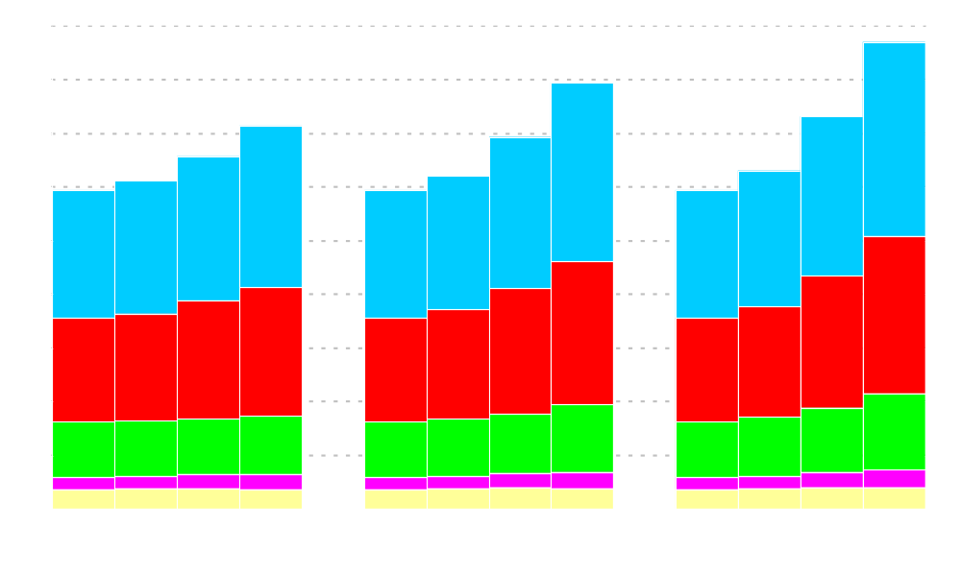
Carbon Dioxide Emissions
(Technology Scenarios)
billion metric tons
8.0
8.7
7.1
7.3
6.9
6.6
6.3
5.9
6.1
5.9
6.2
5.9
Electric Power
Transportation
Industrial
Commercial
Residential
Low Growth
Reference
High Growth
Notes:
In the AEO2007 reference case, energy-related CO2 emissions increase from about 6 billion metric tons CO2 equivalent in 2005 to 8 bmt CO2 equivalent in 2030, roughly by one third.
In the reference case, electric power sector is responsible for almost half of the increase, mostly due to the increased reliance on coal for electricity generation.
The transportation sector is responsible for about another one-third of the increase due to increase reliance on petroleum fuels.
The bulk of the remainder is attributable to the industrial sector.
Because a significant amount of the growth in the buildings sector is attributable to electricity, which is accounted for in the electric power sector, the buildings sector shows little growth in CO2 emissions.
In 2030, energy-related CO2 emission are 7.1 bmt CO2 equivalent in the low growth case and 8.7 bmt CO2 equivalent in the high growth case, a difference of about 1.6 bmt.
The difference in CO2 emissions across cases is mostly attributable to differences in CO2 emissions in the electric power sector, followed by the transportation and industrial sectors.

Slide 28
Annual Energy Outlook 2007 indicates that…
U.S. primary energy consumption is projected to grow by about 30 percent by 2030.
U.S. energy intensity is projected to improve at an average annual rate of 1.8 percent as economic growth outpaces growth in energy consumption.
U.S. oil import reliance is projected to remain relatively flat at 60 percent in the reference case, although it shrinks to 49 percent in the high price case and grows to 67 percent in the low price case.
Future growth in U.S. natural gas supplies depends on unconventional domestic production, natural gas from Alaska, and liquefied natural gas imports.
U.S. natural gas use is projected to peak soon after 2020, due to reduced use in the electric power, which can exploit other more cost-effective options.
Wellhead gas prices are projected to decline from current levels through 2016 before beginning to increase again. Over the longer term, changes in the LNG import levels only moderately impact natural gas wellhead prices.
Coal use is projected to grow faster than other fuels; however, higher coal prices could induce switching to other fuels in the electric power sector and curtail its use as a feedstock in synthetic fuels production.
Nuclear power is projected to grow relatively slowly in the AEO2007 reference case; however, if nuclear power plant costs decrease or coal costs increase, significant quantities of capacity additions could result.
Carbon dioxide emissions are projected to grow at an average annual rate of 1.2 percent, but emission vary significantly with economic growth.
Notes:
U.S. primary energy consumption is projected to grow by about 30 percent by 2030.
U.S. energy intensity is projected to improve at an average annual rate of 1.8 percent as economic growth outpaces growth in energy consumption.
U.S. oil import reliance is projected to remain relatively flat at 60 percent in the reference case, although it shrinks to 49 percent in the high price case and grows to 67 percent in the low price case.
Future growth in U.S. natural gas supplies depends on unconventional domestic production, natural gas from Alaska, and liquefied natural gas imports.
U.S. natural gas use is projected to peak soon after 2020 due to reduced use in the electric power, which can exploit other more cost effective options.
Wellhead gas prices are projected to decline from current levels through 2016 before beginning to increase again. Over the longer term, changes in the LNG import levels only moderately impact natural gas wellhead prices.
Coal use is projected to grow faster than other fuels; however, higher coal prices could induce switching to other fuels in the electric power sector and curtail its use as a feedstock in synthetic fuels production.
Nuclear power is projected to grow relatively slowly in the AEO2007 reference case; however, if nuclear power plant costs decrease or coal costs increase, significant quantities of capacity additions could result.
Carbon dioxide emissions are projected to grow at an average annual rate of 1.2 percent, but emission vary significantly with economic growth.

Slide 29
Thank you
Energy Information Administration
www.eia.doe.gov
John Conti
John.Conti@eia.doe.gov
202-586-2222

