Slide 1





Gasoline Demand Elasticities
2007 EIA Energy Outlook, Modeling and Data Conference
Carol Dahl, Professor and Director

Slide 2
Coming Attractions-
Gasoline Demand Survey Update
"Find a relationship that survives long enough to be useful." Hendry and Juselius (2001)
1. Study in Context
2. What are Elasticities?
3. Why are They Important?
4. Demand Methodologies
5. Summary of Survey Work to Date
6. Demand for Transportation Fuels
Nasser Al Dossary

Slide 3
Scope of Study - Critical Review
All Econometric Demand Elasticities
All countries - all products
>1500 studies
Levels of aggregation
E, C, El, O, Ng, Biomass
O – tr & ntr
O – G, K, D, Fo-lt, Fo-hv
Sector r, c, i, e, tr, ii
On line data base

Slide 4
Demand Elasticities
P
D
Q

Slide 5
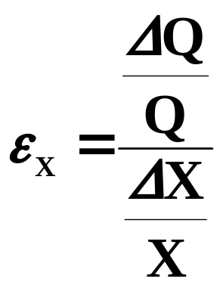
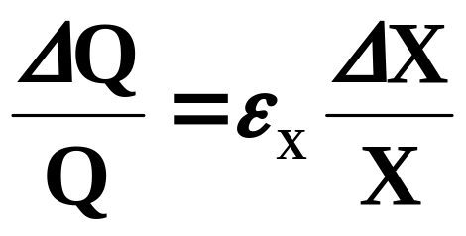
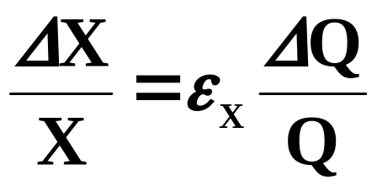
Demand Elasticities – What Are They?
How consumption responds to a variety of variables?
e.g. price elasticity
Consumption response to prices?

Slide 6
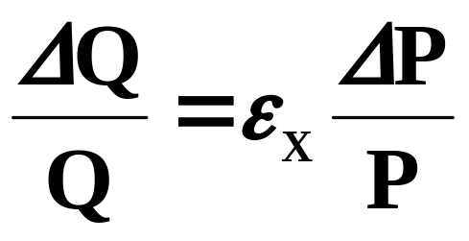
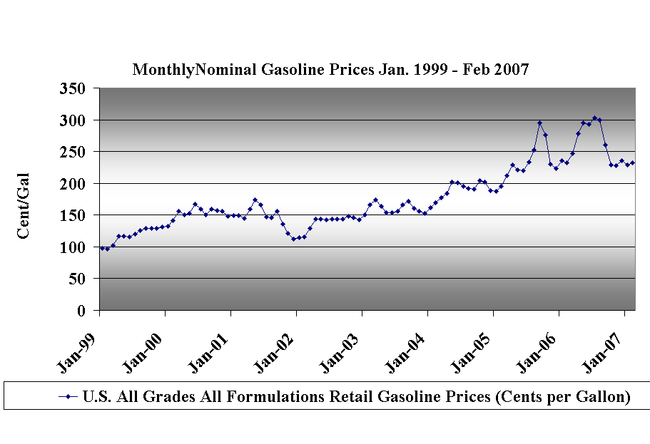
Elasticities –Why Important?

Slide 7
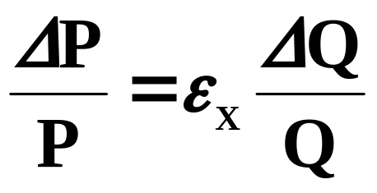
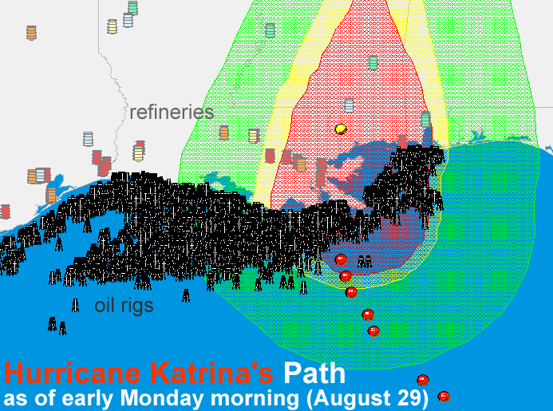
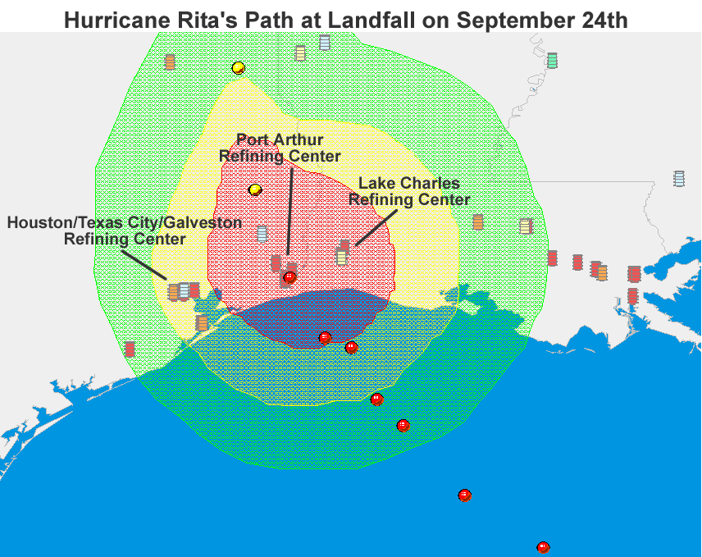
How Easily a Market Can Respond to Disruption,

Slide 8
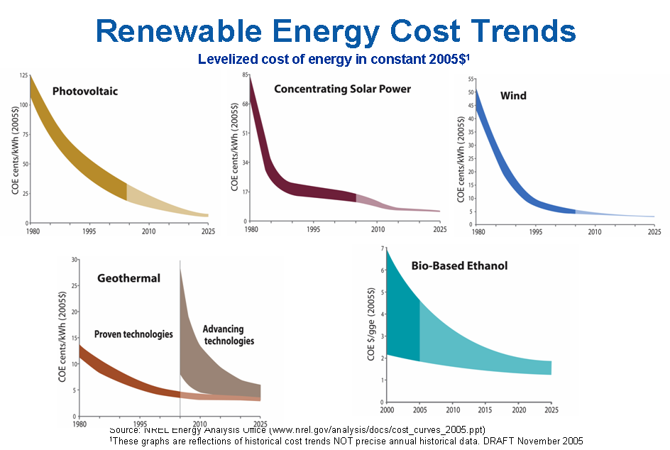
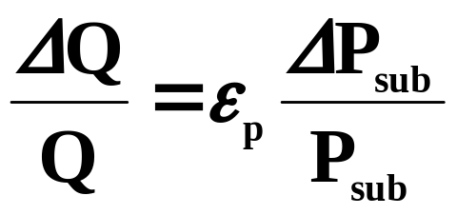
Renewable phase in

Slide 9
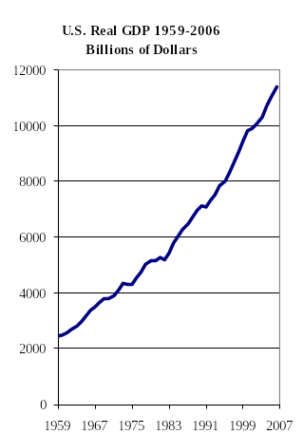
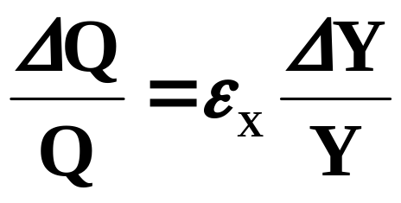
Responses to the Business Cycle

Slide 10
Estimation Issues: Q_{i} = β_{o} + β_{P}P_{i} + β_{Y}Y_{i}
Is P exogenous?
Is equation identified?
Is equation correctly specified?
correct variables, correct functional form
statistical tests
recent – cubic splines, nonparametric
Is relationship stable and symmetric?
statistical tests
Aggregation Issues
Notes:
Conventional Wisdom – betaP = 0

Slide 11
Measuring Short Run and Long Run
1. Lags
2. Vehicle Stock and Use Choice
3. Data: Cross Sections versus Time Series

Slide 12
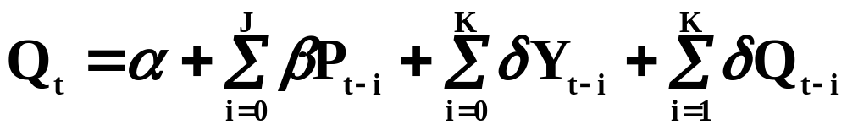
Short Run and Long Run Using Lags
Time Series Issues
Variables are non-stationary
spurious regression
lose consistency
lagged endogenous

Slide 13
Non-stationarity
Three causes of non-stationarity
y_{t} = μ + y_{t-1} + βt + ε_{t}
drift random time
walk trend
First difference – make stationary I(1)
run
may lose variation – lower efficiency

Slide 14
Non-stationarity
All integrated of order 1 or same order
linear combination I(0) stationary
cointegrated
OLS consistent (super)
measure long run relationship
error correction model
short run deviations

Slide 15
Endogenous RHS
biased and inconsistent
time series – all could be endogenous
system approach – vector autoregression
cointegration may save the day
may be > 1 cointegrating relationships

Slide 16
Stock Changes (LR) Utilization (SR)
Gallons = Miles/(Miles/Gallon)
log (Gallons) = log(Miles) – log(Miles/Gallon)
∂log (Gallons) = ∂ log(Miles) – ∂log(Miles/Gallon)
∂log (Price) ∂log (Price) ∂log (Price)
Rebound effect (Cafe standards)
MPG ↑ Cost per mile↓ Miles ↑
cancelling some of efficiency gains
Greening, Greene, and Difiglio (2000) – 10% sr and up to 30% long run

Slide 17
Cross Section (LR) - Time Series (SR)
Cross section
adjusted to large differences
price and income
Time series
how much adjustment in periodicity of data

Slide 18
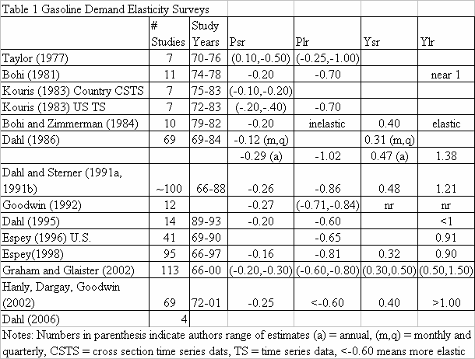

Slide 19
Espy 96’ Meta-analysis on Gasoline Elasticities
Determine effects on gasoline demand elasticities by
Functional form
Lag structure
Estimation technique
Other study differences
Analysis on US studies without household panel data

Slide 20
Price Elasticity Results of Espy 96’
Explains 1/3 to 1/2 variation in long run elasticities
No significant from non-price & income variables
Static & dynamic no significanty difference long run estimates
Per capita or per household demand less elastic than total demand or demand per vehicle

Slide 21
Price Elasticity Results of Espy 96’
No difference in LR estimates for monthly, quarterly, or annual data
No difference in linear or log linear models
No difference national or state cross section time series
Cross section time series of non-US find 50% more elastic price response

Slide 22
Price Elasticity Results of Espy 96’
Random coefficient techniques < elastic price response
Demand was more price elastic prior to 1974
Other
Hughes, Knittel, and Sperling (2006
– monthly, static
Price Income
1/75-1/80 -0.30 0.47
3/01-3/06 -0.04 0.53

Slide 23
Income Elasticity Results Espy 96
Vehicle ownership lowers the elasticity
Non-price and income variables do not lower elasticity
Linear models are not different than non-linear
Monthly and quarterly data find a smaller long run income response

Slide 24
Income Elasticity Results Espy 96
Higher income elasticity (10% significance level)
Per capita
Per household
Per vehicle
Income elasticity less elastic before 1974 (10%)
No difference national and cross section time series of states
Random coefficient find more elastic income response

Slide 25
Global Demand for Transportation Fuels
Nasser Aldossary (PhD Candidate)
Scope: Estimate elasticities (price, income) 45 countries.
Methodology: Building an econometrics model for each country.
Fuels of focus: Gasoline and Diesel.
Sample years: 1978-2004
Total consumption of selected countries:
Gasoline 88% and 85% Diesel of world’s consumption

Slide 26
Sum Up
Numerous Surveys
conventional wisdom
little or no price response
all surveys conclude there is
most come to numerical conclusion
income near 1
not so inconsistent with surveys
my best guesses
ε_{p}(annual -0.2) ε_{p}(lr -0.6 to -0.8)
ε_{p}(annual 0.3 to 0.5) ε_{p}(lr <1)

Slide 27


